Slide 1


Prepared by Dr. Wesam Ahmed
IT402
Internet of Things
Lecture 7

Slide 2



IoT Security and Privacy
Lecture 7
IT402‎
Internet of Things
Prepared by
Dr. Wesam Ahmed

Slide 3

07
Learning Objectives:
1.1 Describe the different IoT security challenges
1.2 Describe the different IoT security requirements
1.3 Describe the different IoT Domain Attacks

Slide 4
07
IoT Security Challenges
Multiple Technologies :Each IoT technology (e.g. wireless sensor, RFID, cloud, virtualization) has its own vulnerabilities (insecure communication channels, data leakage, weak authentication).
Since IoT systems depend on a chain of interconnected technologies, the overall security is only as strong as the weakest link in that chain.
Multiple Verticals: The IoT paradigm will have numerous verticals such as healthcare, smart cities, industrial automation, agriculture, and transportation.
Each vertical has unique security requirements (e.g., patient data privacy in healthcare vs. device reliability in industrial IoT).
The security requirements of each vertical are quite different from the remaining verticals.
Understand the Importance of Business Intelligence

Slide 5
07
IoT Security Challenges
Understand the Importance of Business Intelligence
Scalability: 30 billion smart devices will be connected to the Internet by 2022.
Managing authentication, data protection, and secure communication for billions of devices is a massive challenge.
High Availability (HA): HA refers to characteristic of a system that is continuously operational for a desirably long period of time.
It is often measured against the ideal of being “100% operational” or “never failing.”
Security Impact: Security and HA are closely linked. Network administrators sometimes avoid using security tools (like network discovery or active threat response functions) because they may disrupt critical systems.

Slide 6
07
IoT Security Challenges
Understand the Importance of Business Intelligence
Big Data: Each smart object is expected to be supplied by numerous sensors, where each sensor generates huge streams of data over time.
Protecting these large data streams requires efficient, scalable, and real-time security mechanisms that ensure data integrity, confidentiality, and privacy.
Traditional data security tools often struggle to keep up with the volume, velocity, and variety of IoT-generated data.
Resource Limitations: The majority of IoT end devices have limited resource capabilities such as CPU, memory, storage, battery and transmission range.
These limitations make them highly vulnerable to attacks, especially Denial of Service (DoS), where attackers can easily overload the system and cause service disruptions. Flooding Attacks: Sending massive amounts of data packets to exhaust device or network bandwidth. Designing lightweight and energy-efficient security solutions is essential.

Slide 7
07
IoT Security Challenges
Understand the Importance of Business Intelligence
Remote Locations: In many IoT verticals (e.g. Smart Grid, Railways, Roadsides), IoT devices, epically sensors, will be installed in unmanned locations that are difficult to reach.
Attackers can interfere with these devices without being seen.
To counter this, IoT systems must include:
Cyber and physical security monitoring
Devices capable of remote operation and maintenance
Durability to operate under extreme environmental conditions
Compact designs suitable for limited space installations

Slide 8

07
IoT Security Challenges
Understand the Importance of Business Intelligence
Mobility: Smart objects are expected to change their location often in the IoT paradigm.
Examples: (wearable devices, connected vehicles).
Constant movement creates security and connectivity challenges,
such as maintaining secure authentication, data integrity, and trust across changing networks.
Traditional static security measures are not sufficient; therefore, defensive mechanisms must be adaptive, context-aware, and capable of real-time response to protect devices in these dynamic and mobile environments.

Slide 9
07
IoT Security Challenges
Understand the Importance of Business Intelligence
Delay-Sensitive Services
Many IoT applications (e.g., health monitoring, autonomous vehicles, industrial automation) are delay-sensitive.
Even minor delays caused by security processing or attacks can disrupt operations or endanger safety.
Systems must be protected from any attack that increases latency or causes service interruptions.

Slide 10
07
IoT Security Requirements
Understand the Importance of Business Intelligence
To ensure secure and trustworthy IoT operations, several fundamental security requirements must be met:
Confidentiality: ensures that the exchanged messages can be understood only by the intended entities.
Achieved through encryption and secure communication protocols (e.g., TLS, SSL).
Integrity: ensures that the exchanged messages were not altered/tampered by a third party.
Protects against tampering, modification, or injection attacks by malicious entities.
Authentication: ensures that the entities involved in any operation are who they claim to be.
Prevents impersonation attacks, where an attacker pretends to be another device or user.
Implemented using passwords.

Slide 11
07
IoT Security Requirements
Understand the Importance of Business Intelligence
To ensure secure and trustworthy IoT operations, several fundamental security requirements must be met:
Availability: Ensures that IoT services and devices remain accessible and operational at all times.
Denial of Service (DoS) and Distributed DoS (DDoS) attacks directly threaten this requirement by causing service disruptions.
Achieved through redundancy, load balancing, failover mechanisms, and robust network management.
Authorization: Ensures that entities (devices or users) have the appropriate permissions to perform specific actions.
Prevents unauthorized operations or access to restricted data.
Managed through access control lists (ACLs), role-based access control (RBAC), or policy-based authorization systems.

Slide 12

07
IoT Security Requirements
Freshness: Ensures that data is current and not reused from an earlier session.
Protects against replay attacks, where an attacker resends old messages to trick a device or system into reverting to a previous state
Typically enforced using timestamps.
Non-Repudiation: Ensures that an entity cannot deny having performed a specific action, such as sending a message or initiating a transaction.
Provides accountability in IoT communications, ensuring that every action or message can be verified, logged, and attributed to the responsible entity.
Understand the Importance of Business Intelligence

Slide 13
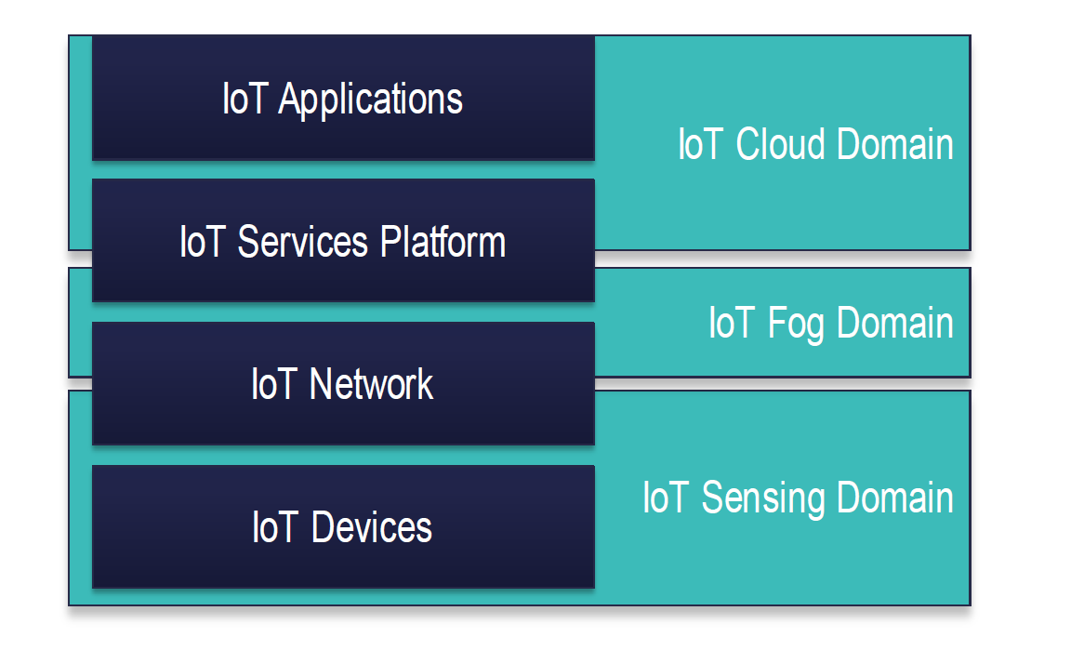
Mapping of IoT Domains
07
Understand the Importance of Business Intelligence
IoT Devices (IoT Sensing Domain)
This is the foundation layer of the IoT architecture.
It includes sensors, actuators, RFID tags, and embedded systems that collect data from the environment.
Functions:
  Sense and gather physical data (e.g., temperature, motion, pressure).
  Send this data to the network layer for processing.

Slide 14
Mapping of IoT Domains
07
Understand the Importance of Business Intelligence
IoT Network (IoT Sensing Domain → Fog Domain)
Responsible for transmitting data between IoT devices, fog nodes, and the cloud.
Uses multiple communication technologies such as Wi-Fi, Bluetooth, ZigBee, 5G, and LPWAN.
Functions:
  Enable data routing and connectivity.
  Ensure secure, reliable, and low-latency communication.

Slide 15
Mapping of IoT Domains
07
Understand the Importance of Business Intelligence
IoT Services Platform (IoT Fog Domain)
Acts as an intermediate processing layer between IoT devices and the cloud.
Includes edge or fog computing nodes that perform local data processing, filtering, and analytics close to the source.
Functions:
  Reduce latency and network congestion.
  Improve responsiveness for time-sensitive applications.
  Support real-time decision-making without full dependence on the cloud.

Slide 16
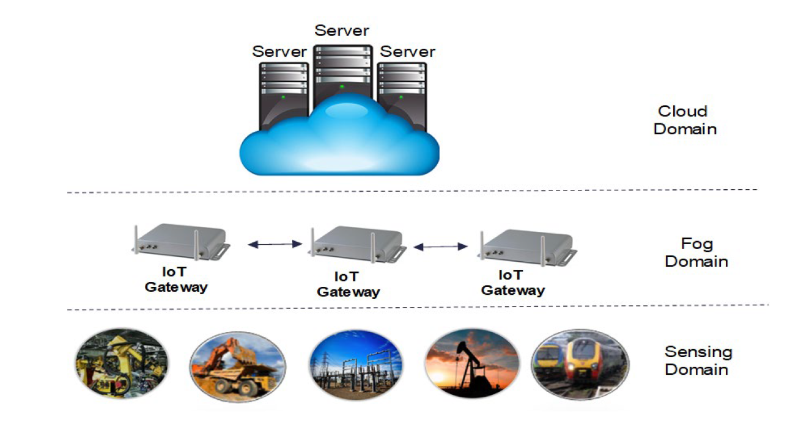
Mapping of IoT Domains
07
Understand the Importance of Business Intelligence

Slide 17
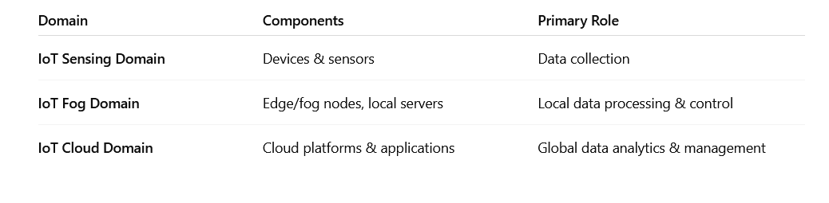
Mapping of IoT Domains
07
Understand the Importance of Business Intelligence
Summary of Domains

Slide 18
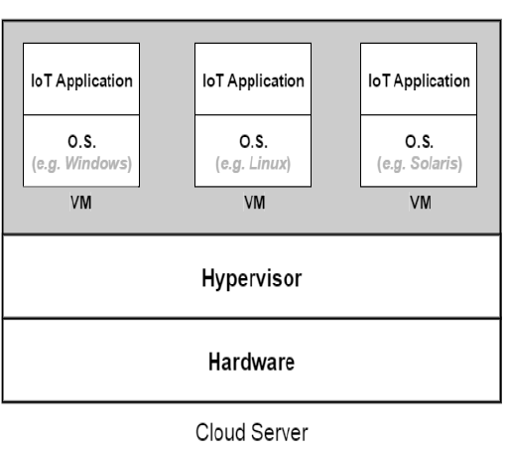
Cloud Domain Attacks
07
Understand the Importance of Business Intelligence
Cloud platforms run many IoT applications, each performing specific operations (data processing, analytics, storage.
Each IoT application is deployed on one or more Virtual Machines (VMs).
A VM operates like a separate computer, with its own operating system (OS).

Slide 19
Cloud Domain Attacks
07
Understand the Importance of Business Intelligence
Allocation of VMs to Physical Machines (PMs):
VMs run on Physical Machines (servers).
Each VM is allocated specific resources:
  CPU
  Memory
  Storage
Attackers may attempt to overwhelm or exploit these resources.

Slide 20
Cloud Domain Attacks
07
Understand the Importance of Business Intelligence
Role of the Hypervisor (Virtual Machine Manager):
Monitoring Running VMs
Tracks VM performance and resource usage.
Ensures the server is running efficiently.
Separating VMs from Hardware
VMs do not interact directly with physical hardware.
Hypervisor acts as a layer in between.

Slide 21

Cloud Domain Attacks
07
Hidden Channel Attacks:
Even though virtual machines (VMs) running on the same physical server are logically isolated by the hypervisor, they still share some physical hardware components, such as:
CPU cache
Memory buses
Network interfaces (virtualized but still connected to the same hardware)
Because these components are physically shared, complete isolation is not always guaranteed.
Understand the Importance of Business Intelligence

Slide 22
Cloud Domain Attacks
07
Hidden Channel Attacks:
Shared hardware introduces opportunities for side-channel attacks, where an attacker VM can observe patterns in shared hardware to infer sensitive information from another VM.
Example: Cache-based Side-Channel Attack
Two VMs share the same CPU cache.
The attacker VM measures cache access times to detect which memory areas were recently used by the victim VM.
From these timing differences, the attacker can extract information such as:
  cryptographic keys , sensitive data operations
Understand the Importance of Business Intelligence

Slide 23
Cloud Domain Attacks
07
Hidden Channel Attacks:
To mitigate hidden-channel or side-channel attacks between VMs, several countermeasures can be applied. These techniques attempt to strengthen isolation and reduce the chances of information leakage through shared hardware:
Hard Isolation Solutions:
Separate the cache dedicated for each VM through hardware or software: The idea is to partition the CPU cache, ensuring each VM gets its own cache portion. This prevents attackers from observing cache usage patterns of other VMs.
Another way to achieve hard isolation is by assigning only one VM to each server. This prevents data leakages across VMs because no other VM shares hardware..
Understand the Importance of Business Intelligence

Slide 24
Cloud Domain Attacks
07
Understand the Importance of Business Intelligence
Noisy Data Access Time: This technique aims to prevent attackers from using timing side-channel attacks to infer data access patterns of other VMs.
Adding Random Noise to Data Fetch Time
Adds random noise to the amount of time needed to fetch data, which makes it hard to tell whether or not the data was fetched from the cache or from the memory.
By doing this, it becomes harder for a malicious VM to identify what segments of the cache were populated by another VM that shares the same server.
The attacker VM cannot accurately detect which cache lines were accessed by the victim VM. This prevents the attacker from reconstructing: Memory access patterns , Sensitive computations , What the victim VM is doing, What data or code it is accessing

Slide 25
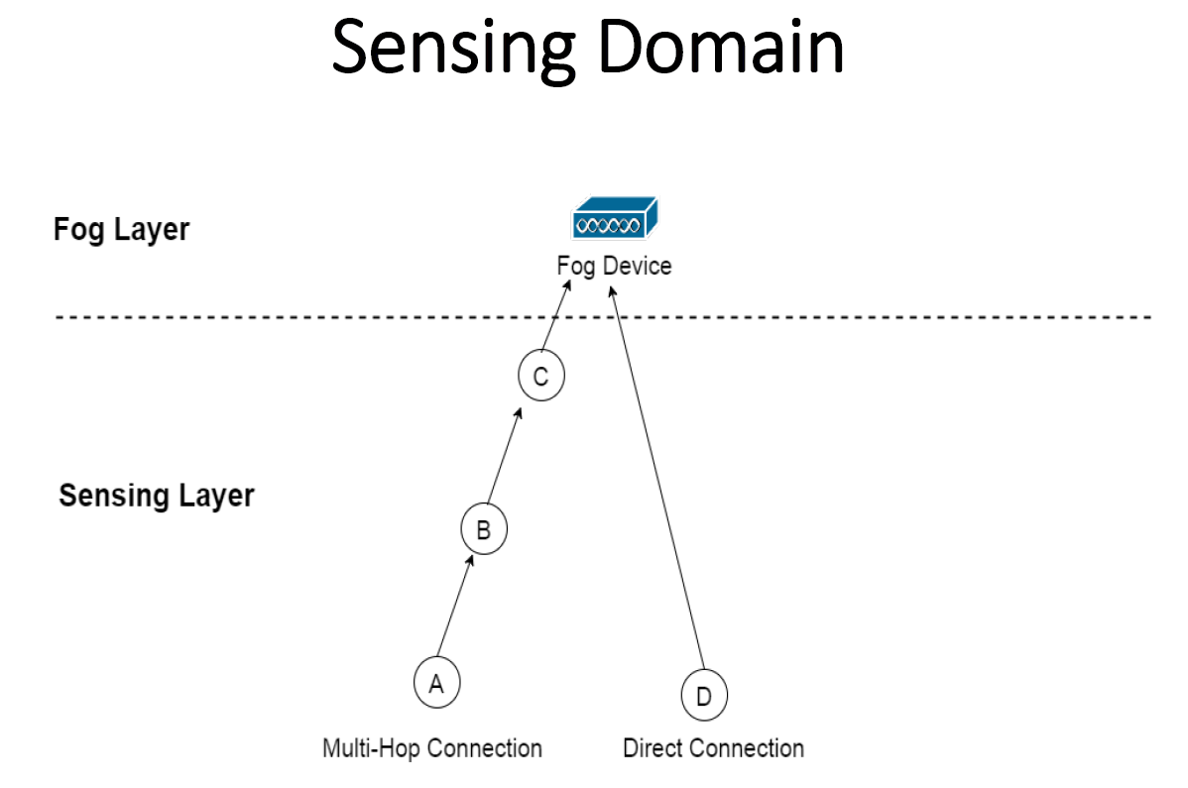
Sensing Domain Attacks
07
Understand the Importance of Business Intelligence
The diagram shows how sensor nodes communicate with a fog device in a layered IoT architecture.

Slide 26
Sensing Domain Attacks
07
Understand the Importance of Business Intelligence
Types of Connections
a. Multi-Hop Connection
Data travels through intermediate sensor nodes before reaching the fog device.
In the diagram:
  A → B → C → Fog Device
Used when nodes are far from the fog device or have limited transmission power.
b. Direct Connection
Sensor nodes send data directly to the fog device without passing through other nodes.
In the diagram:
  D → Fog Device
Requires sufficient communication range or power.

Slide 27

Sensing Domain Attacks
07
Understand the Importance of Business Intelligence
Jamming Attacks:
A malicious attacker transmits unwanted radio signals on the same frequency used by legitimate devices.
This disrupts communication and prevents devices from sending or receiving data properly.
Other Types of Jamming Attacks: Constant Jamming, Deceptive Jamming, Reactive Jamming, Random Jamming.

Slide 28

Sensing Domain Attacks
07
Jamming Attacks Preventive Techniques:
Machine Learning Techniques
Advanced ML algorithms (e.g., decision trees, SVMs, neural networks) can classify signals as:
  Legitimate communication
  Jamming interference
ML can detect subtle patterns that are hard to identify using simple thresholds.
Signal Analysis
The collected data is analyzed to determine if the patterns match normal network behavior or a jamming scenario.
Understand the Importance of Business Intelligence

Slide 29
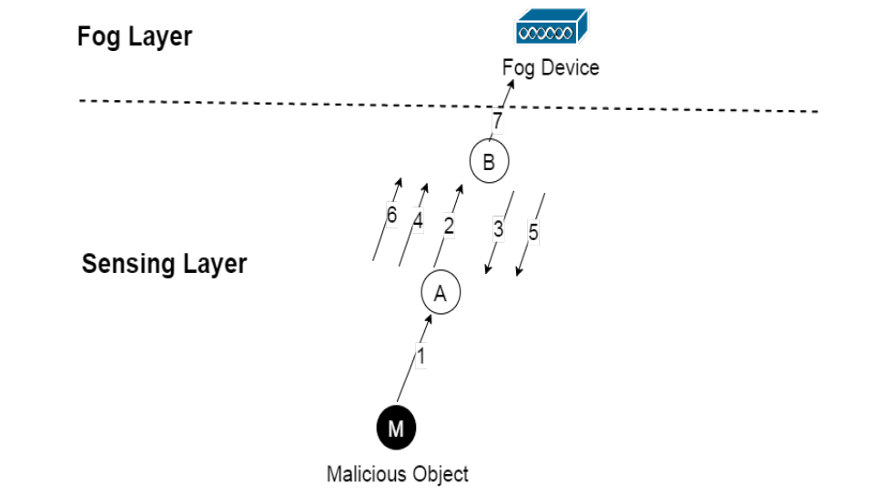
Sensing Domain Attacks
07
Understand the Importance of Business Intelligence
Carousel Attack:
Attacker specifies routing paths that include loops where same packet gets routed back and fourth among the other objects wasting their power (A sends to B and B sends to A).
It is designed to waste the energy of network nodes by creating unnecessary routing loops.
How the Carousel Attack Works
The attacker creates a fake routing path that includes loops. Attacker sends a malicious packet with the route field
A packet is intentionally routed in a cycle — for example:
A → B → A → B → A → …
Instead of reaching its destination, the packet keeps traveling back and forth.

Slide 30
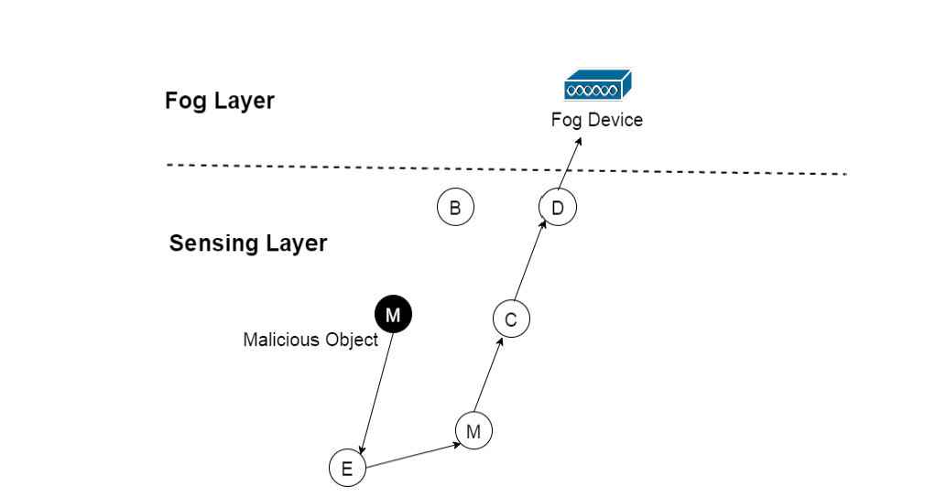
Sensing Domain Attacks
07
Stretch Attack
If the routing protocol supports source routing, then an attacker can send the packets that it is supposed to report to the fog device through very long paths rather than the direct and short ones (M selects longest path)
Understand the Importance of Business Intelligence

Slide 31
Sensing Domain Attacks
07
How the Stretch Attack Works
If the routing protocol allows the sender to specify the exact path (source routing), then:
A malicious node M creates a fake, very long route for the packets.
Instead of going through the shortest path to the fog device or base station,
the packet is sent through many extra nodes. The attacker intentionally inserts many intermediate nodes to make the path as long as possible
Example:
Normal shortest path:
A → Fog Device
Malicious stretched path chosen by attacker M:
A → X → Y → Z → W → … → Fog Device
Understand the Importance of Business Intelligence

Slide 32
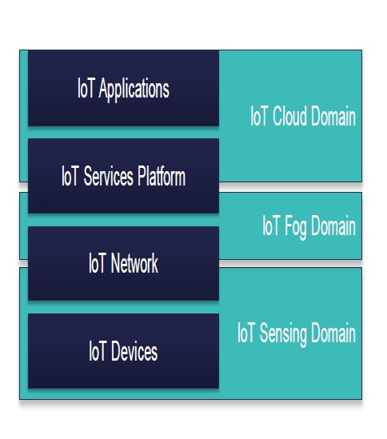
07
Fog Domain Devices and Challenges
Understand the Importance of Business Intelligence
Fog Layer in IoT
The Fog Layer sits between the edge (sensors/devices) and the cloud in an IoT architecture.
It is designed to process data closer to where it is generated, reducing latency and network load.

Slide 33
07
Fog Domain Devices and Challenges
Understand the Importance of Business Intelligence
Fog Layer in IoT:
Functions of Fog Layer Devices
Fog devices are intermediate computing nodes that handle local processing before sending data to the cloud.
Data Collection
  Collect sensing data from sensors or smart objects.
Local Processing
  Data aggregation: Combine data from multiple sources to reduce redundancy.
  Data preprocessing: Clean, filter, or normalize data.
  Data storage: Temporarily store data for analysis or caching.
Data Forwarding
  Send processed or summarized results to the cloud layer for further storage, analytics, or decision-making.

Slide 34
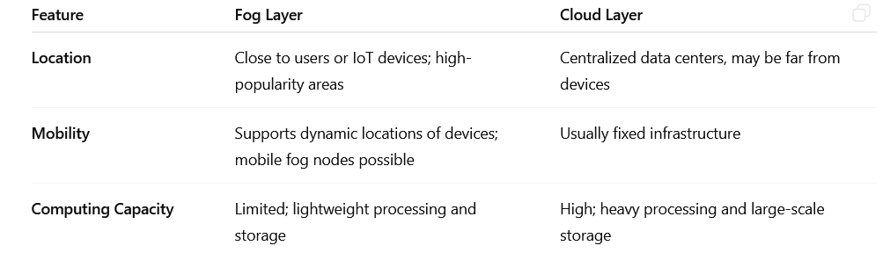
07
Fog Domain Devices and Challenges
Fog Layer is similar to cloud layer with key differences:
Fog Layer is similar to cloud layer with key differences:

Slide 35
Fog Domain Attacks and Countermeasures
07
Fog Layer is similar to cloud layer with key differences:
Fog Domain Attacks and Countermeasures:
Authentication and Trust Issues:
Unlike cloud data centers which are offered by well-known companies, fog devices will be owned by multiple and less-known entities.
Countermeasures:
Mutual authentication protocols: Ensure both fog device and smart object verify each other’s identity.

Slide 36
Fog Domain Attacks and Countermeasures
07
Fog Layer is similar to cloud layer with key differences:
Fog Domain Attacks and Countermeasures:
Higher vulnerability to DoS Attacks:
Fog devices have lower computing capacity compared to cloud servers.
Attackers can easily overload them with traffic (DoS attacks), disrupting service for connected smart objects.
Countermeasures
Traffic monitoring and rate limiting to prevent resource exhaustion.
Lightweight intrusion detection systems (IDS) tailored for fog environments.

Slide 37
Fog Domain Attacks and Countermeasures
07
Fog Layer is similar to cloud layer with key differences:
Fog Domain Attacks and Countermeasures:
Container-Related Security Threats
Many fog devices run multiple containers on the same OS and hardware.
In computing, a container is a lightweight, standalone, and executable software package that includes everything needed to run a piece of software: the code, runtime, system tools, libraries, and settings.
Compromise of one container can affect other containers sharing the same environment.
Countermeasures
Strong container isolation using sandboxing (Each container runs in a “sandbox,” a protected environment that limits what it can access outside itself.).

Slide 38
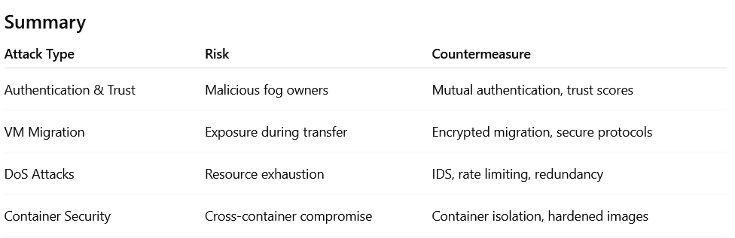
Fog Domain Attacks and Countermeasures
07
Fog Layer is similar to cloud layer with key differences:
Fog Domain Attacks and Countermeasures:

Slide 39
Summary
07
Gorry and Scott-Morton (1971) proposed a framework that is a 3-by-3 matrix
IoT security
Domain Attacks

Slide 40


Thank You

