Slide 1



Module 2: Basic Switch &
End Device Configuration
Lecture 1
CCNA – Introduction to Networks V7.0 (ITN)
Prepared by
Dr. Abdelrhman Ahmed

Slide 2
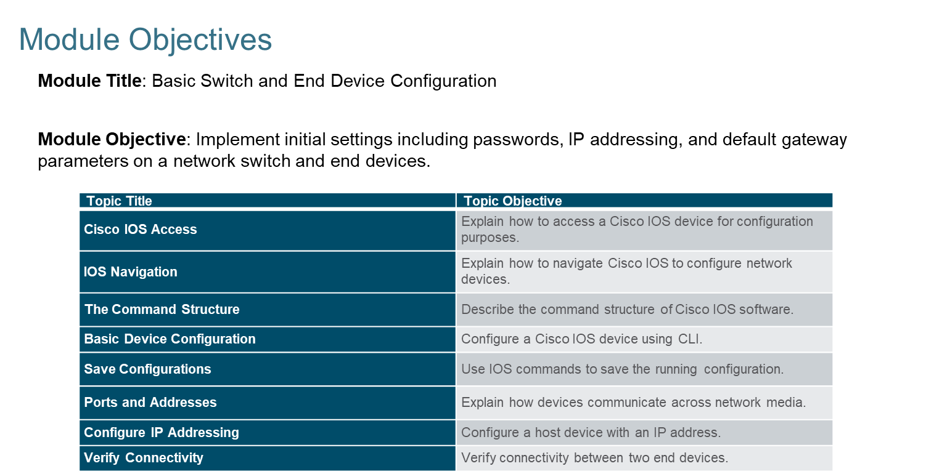
Chapter
Basic Switch and End Device Configuration
01

Slide 3
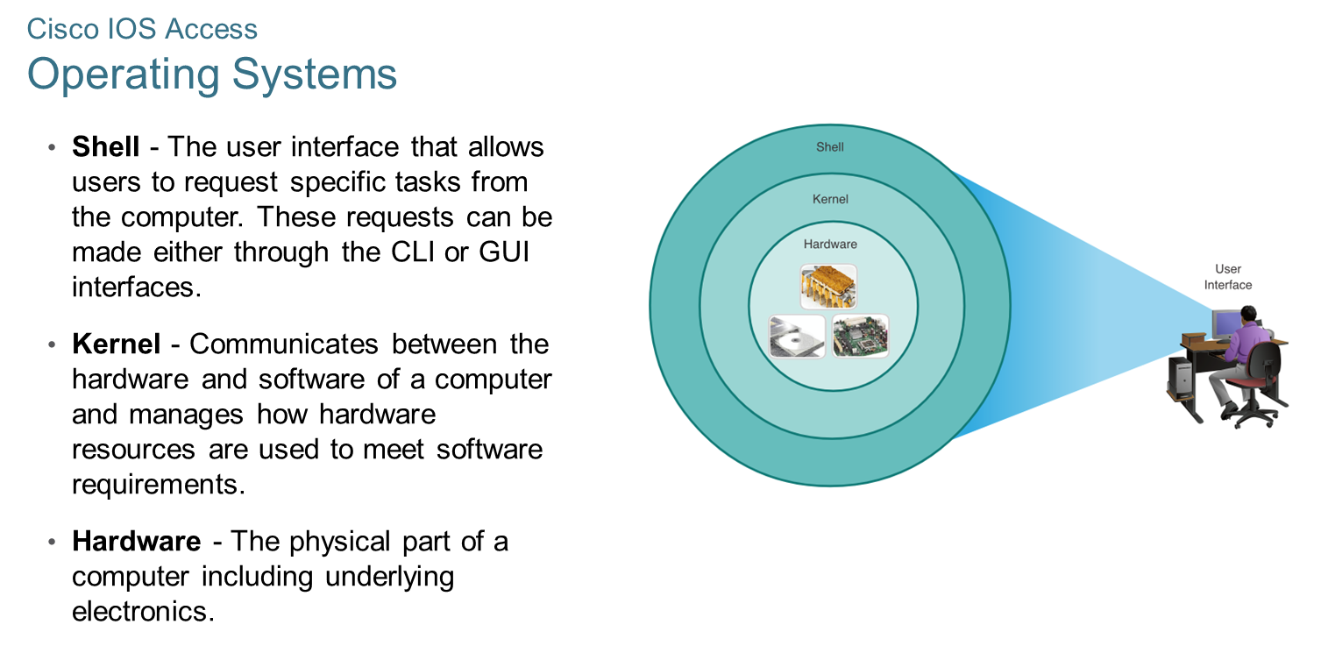
Chapter
Cisco IOS Access
01

Slide 4
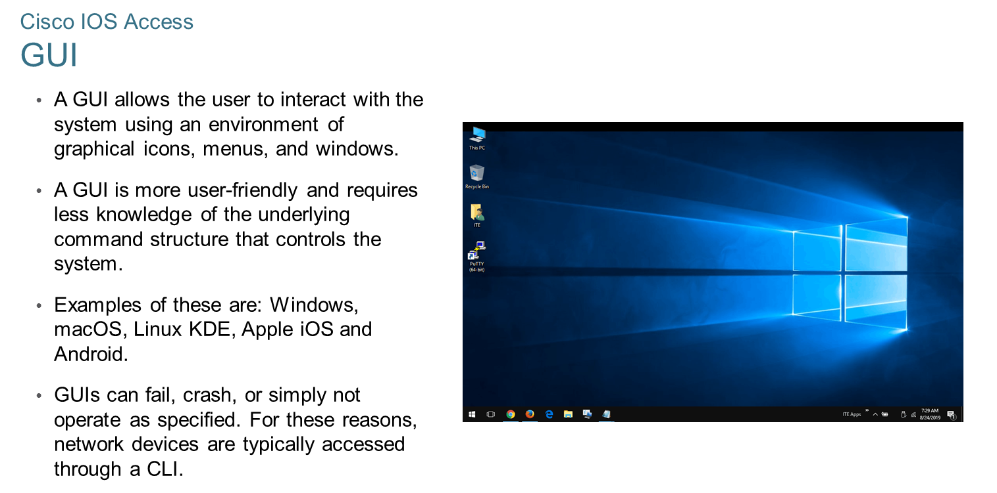
Chapter
Cisco IOS Access
01

Slide 5
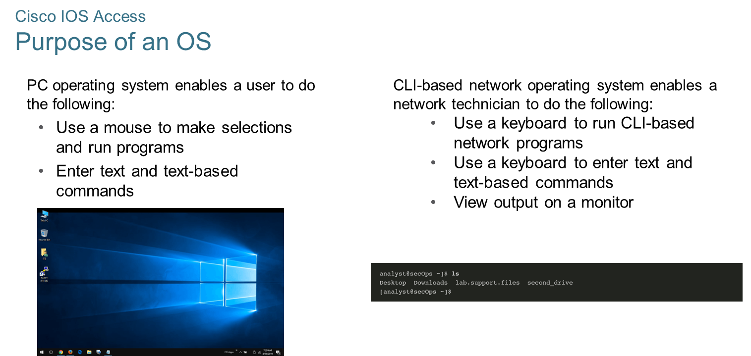
Chapter
01
Cisco IOS Access

Slide 6
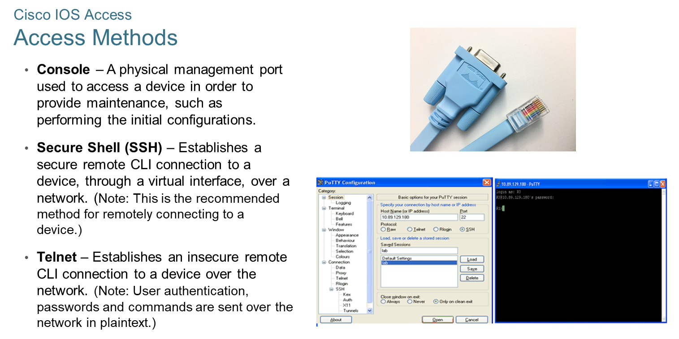
Chapter
Cisco IOS Access
01

Slide 7
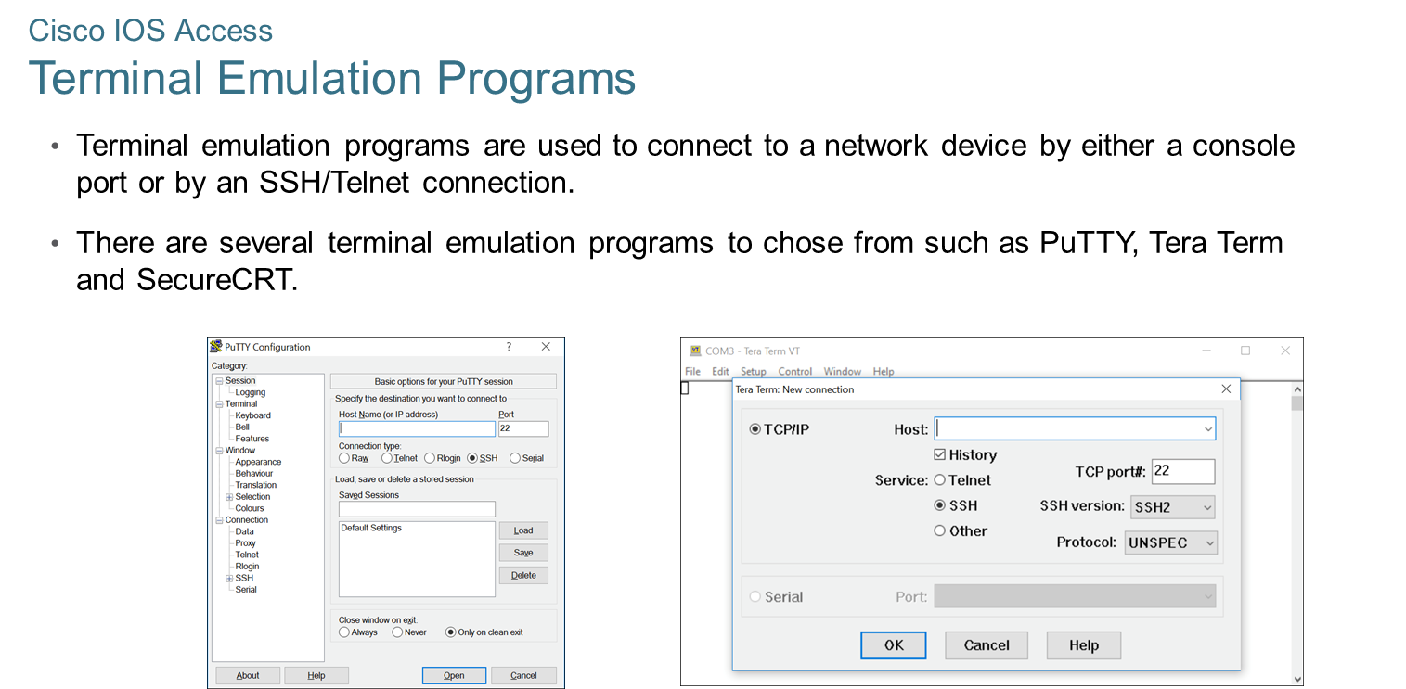
Chapter
Cisco IOS Access
01

Slide 8
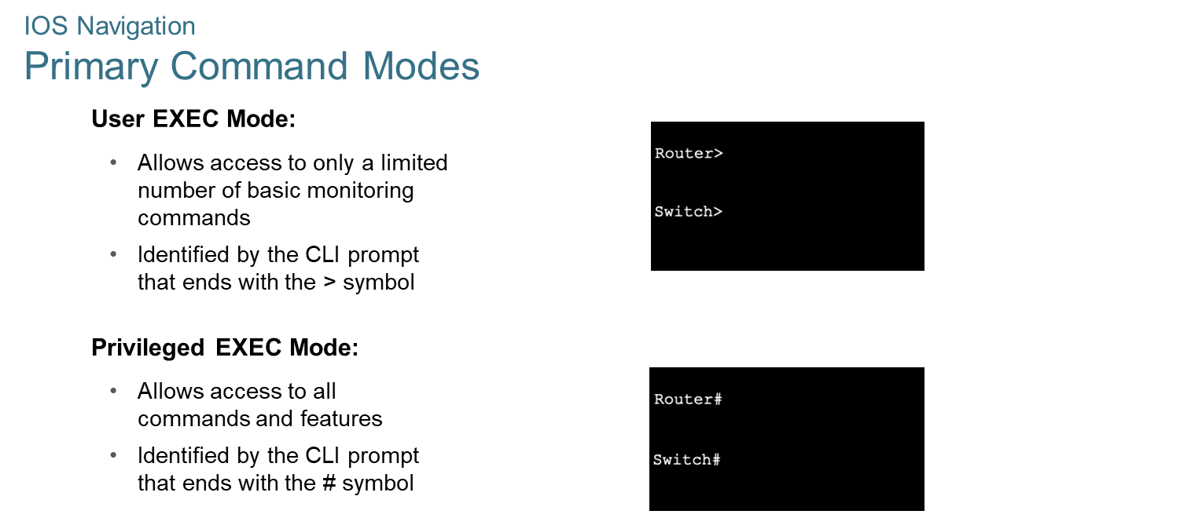
Chapter
IOS Navigation
01

Slide 9
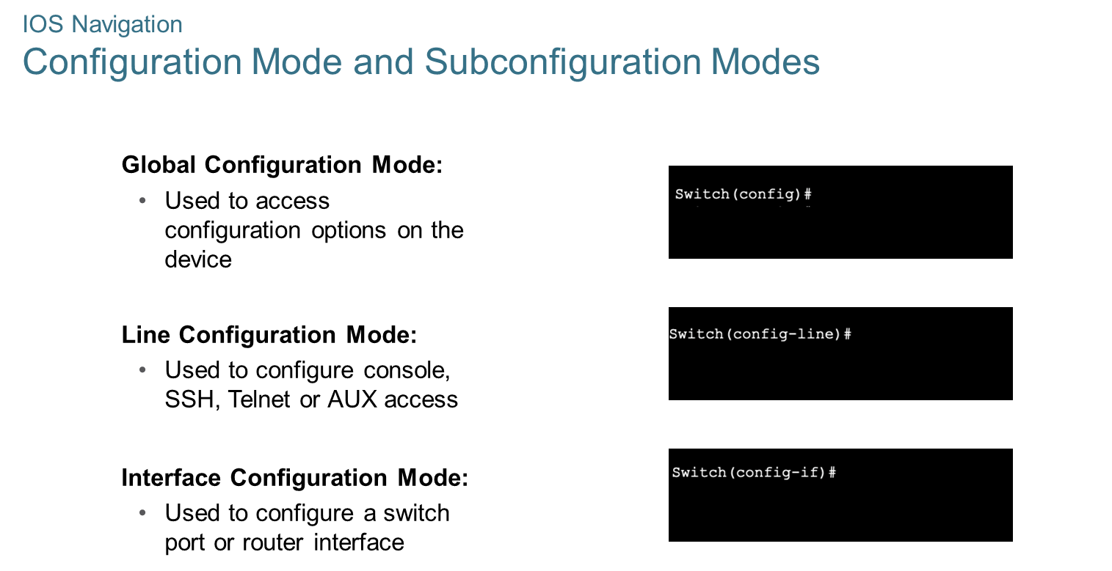
Chapter
IOS Navigation
01

Slide 10
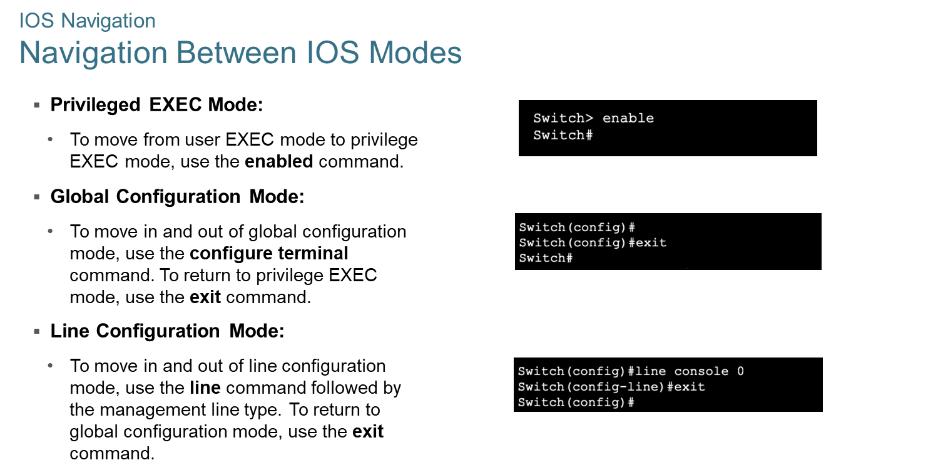
Chapter
IOS Navigation
01

Slide 11
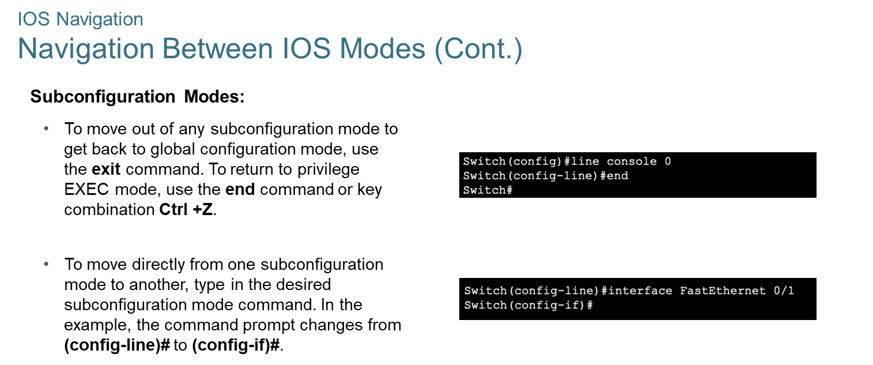
Chapter
01
IOS Navigation

Slide 12
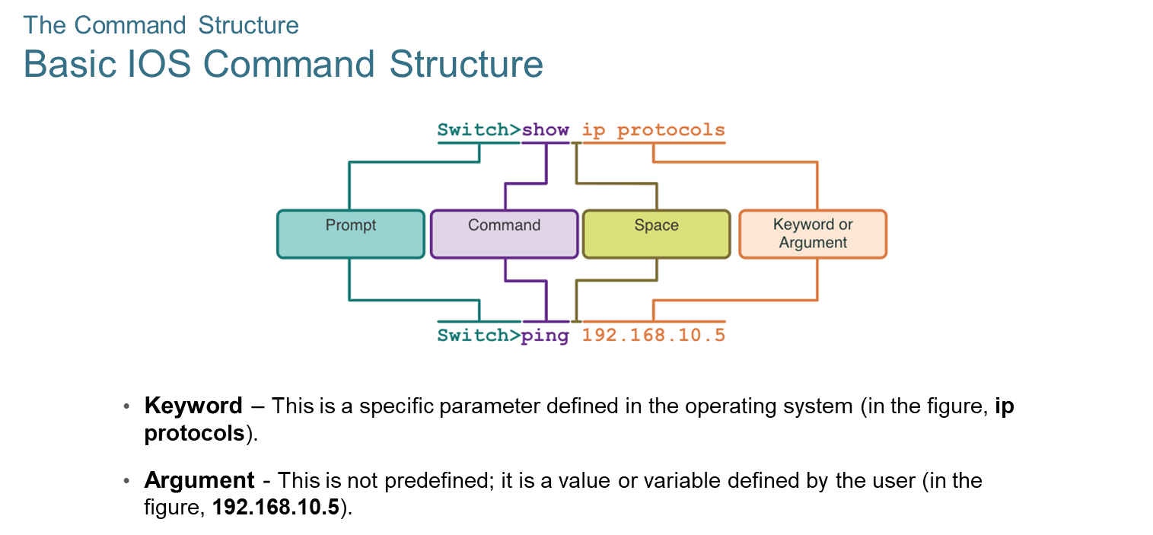
Chapter
The Command Structure
01

Slide 13
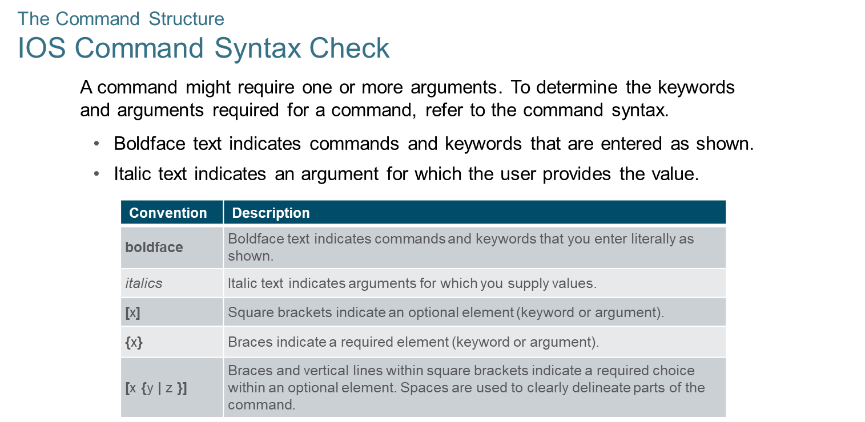
Chapter
The Command Structure
01

Slide 14
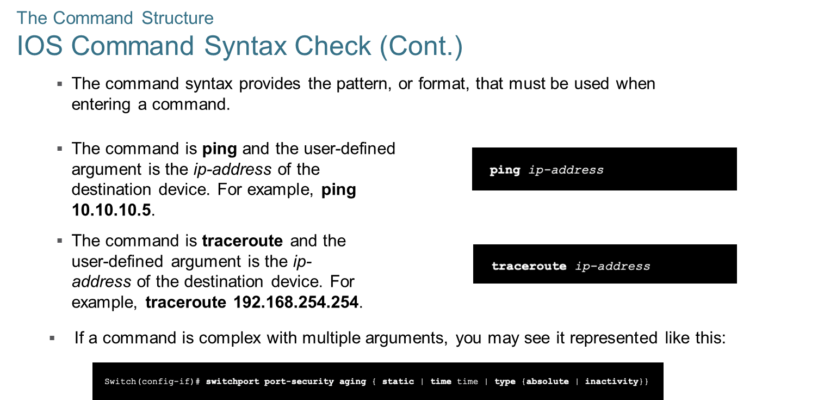
Chapter
The Command Structure
01

Slide 15
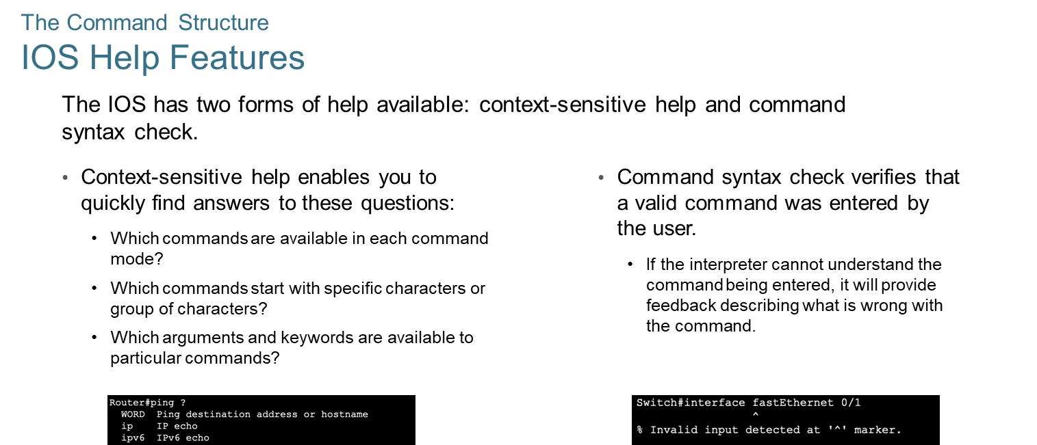
Chapter
The Command Structure
01

Slide 16
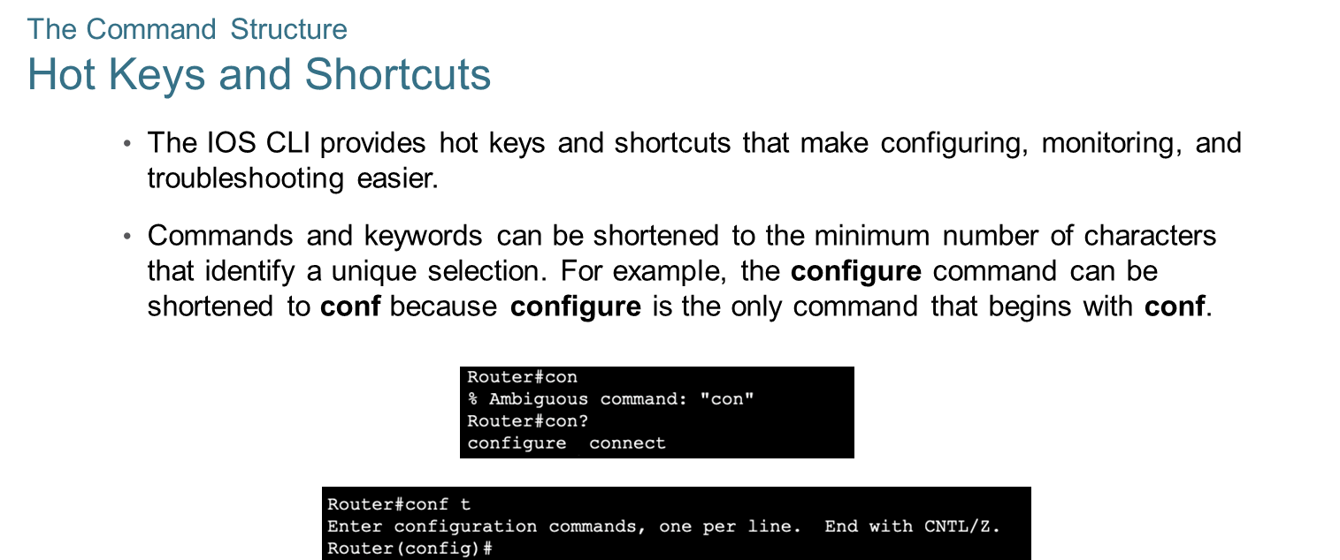
Chapter
The Command Structure
01

Slide 17
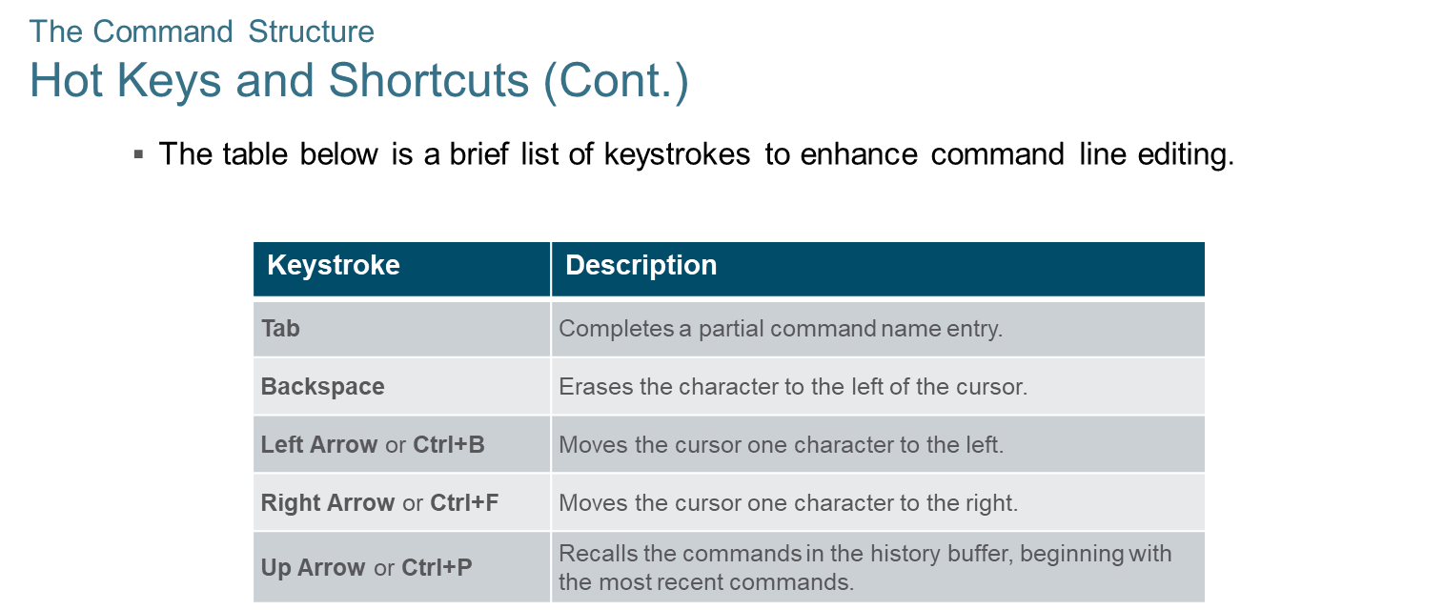
Chapter
The Command Structure
01

Slide 18
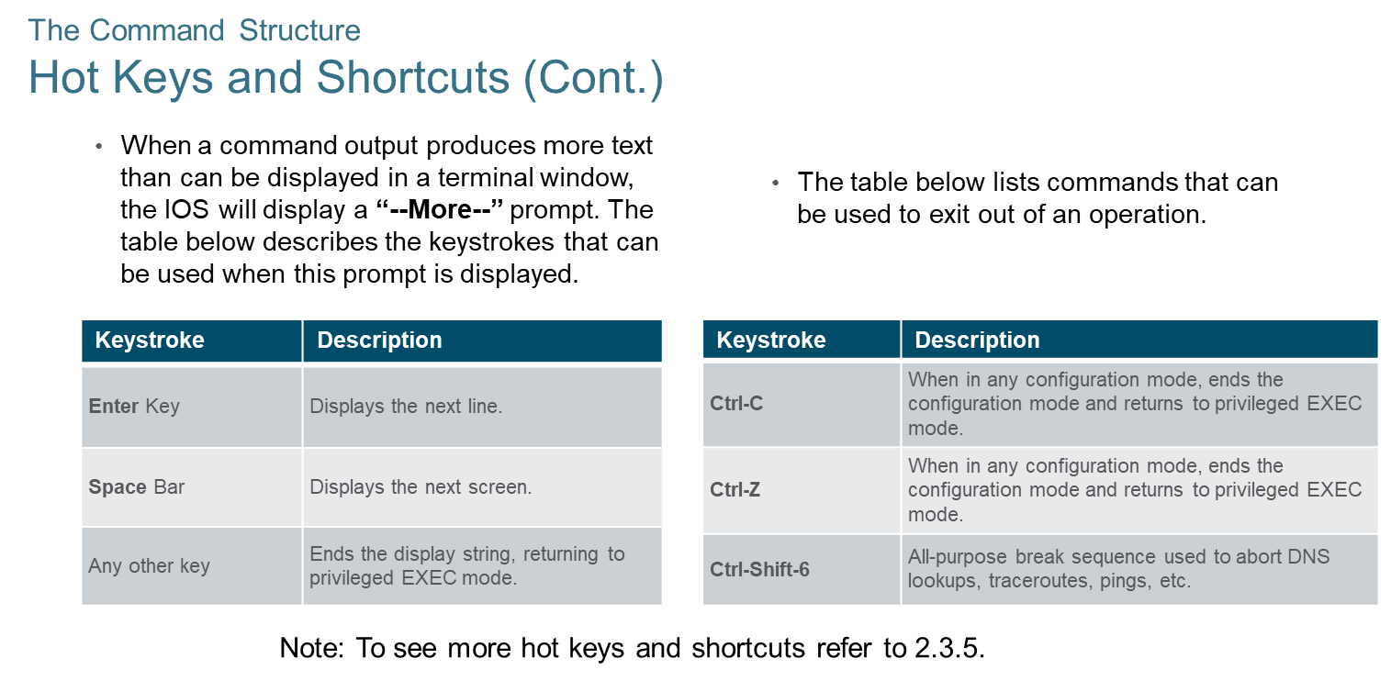
Chapter
The Command Structure
01

Slide 19
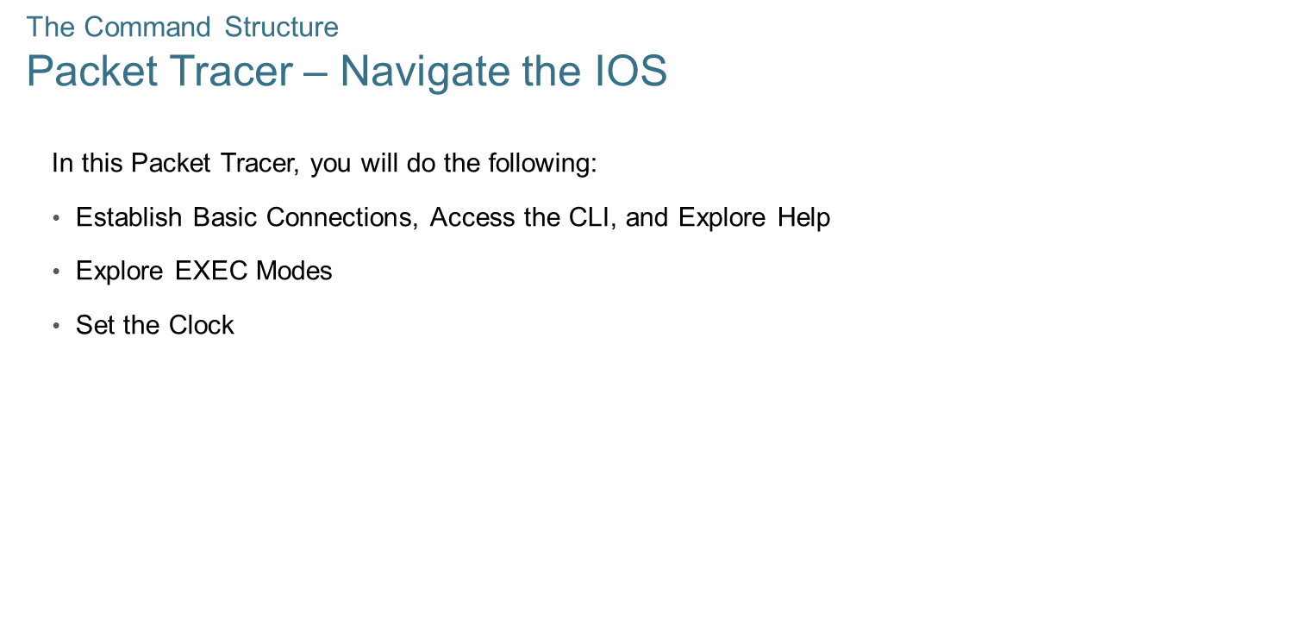
Chapter
The Command Structure
01

Slide 20
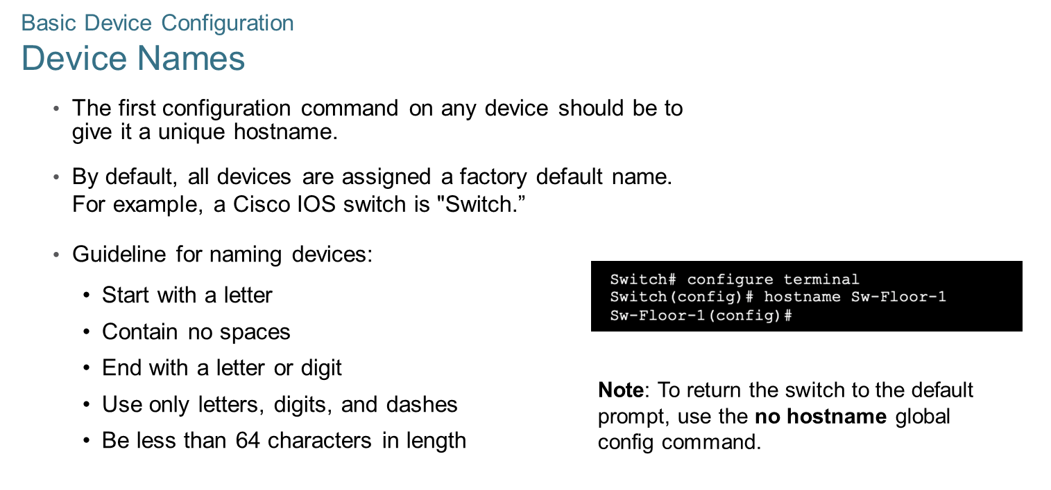
Chapter
01
Basic Device Configuration

Slide 21
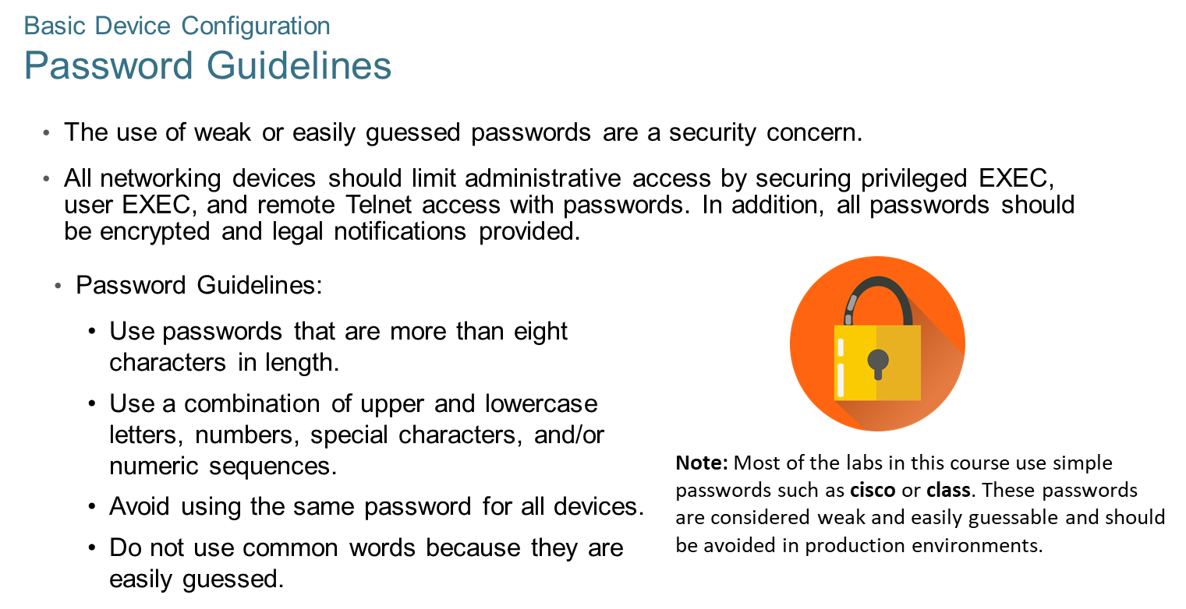
Chapter
Basic Device Configuration
01

Slide 22
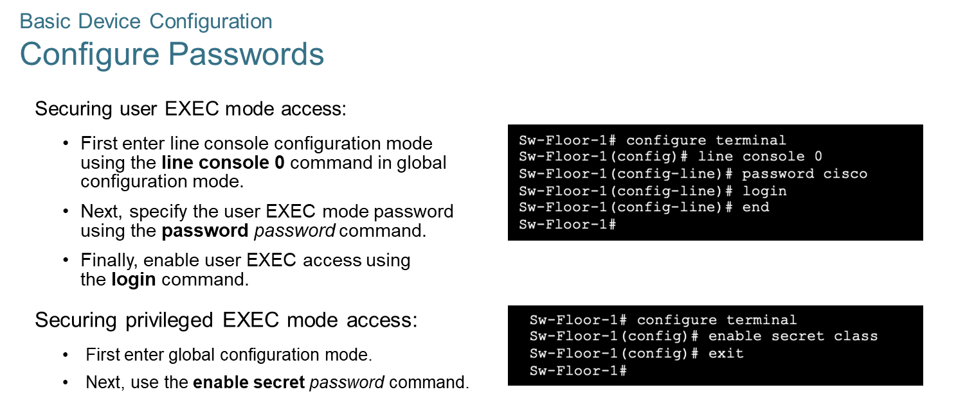
Chapter
Basic Device Configuration
01

Slide 23
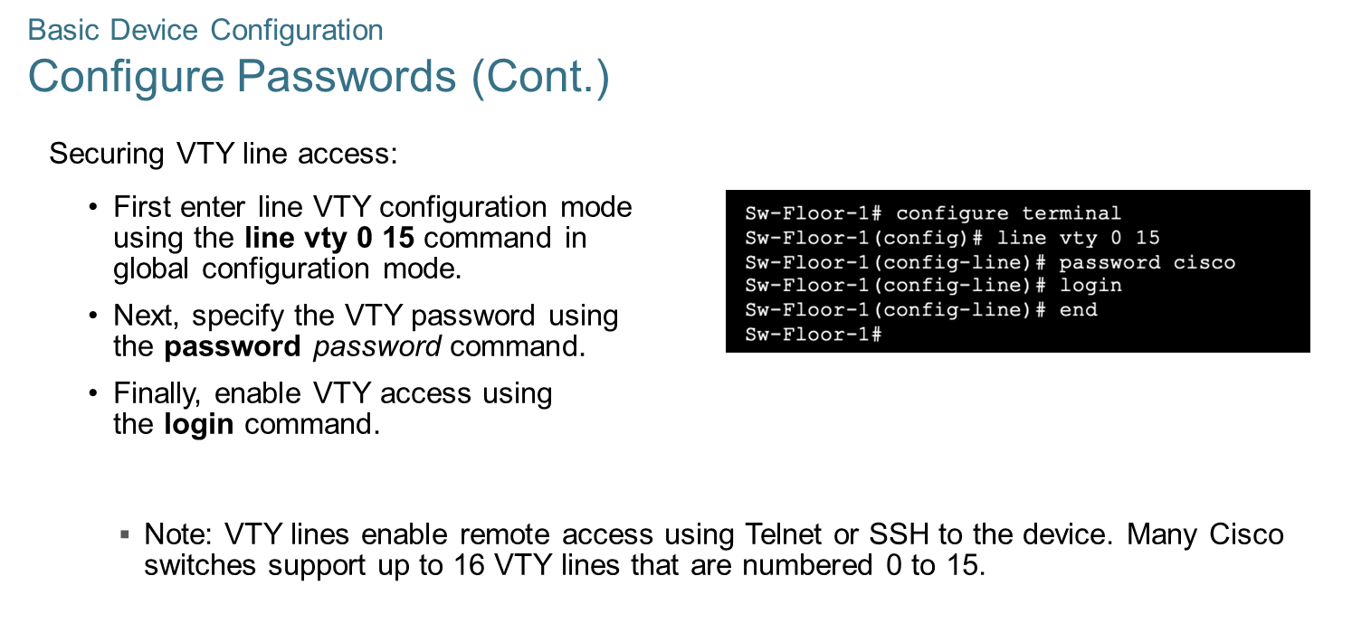
Chapter
01
Basic Device Configuration

Slide 24
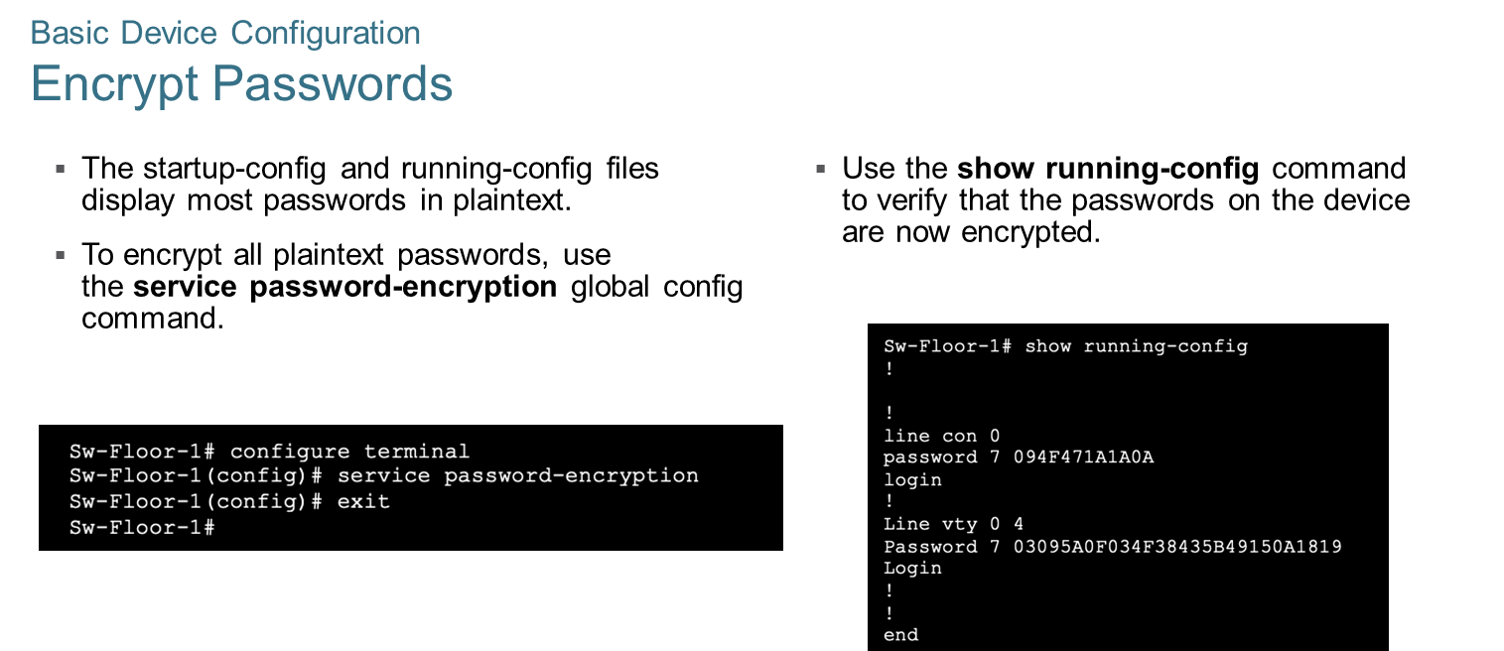
Chapter
01
Basic Device Configuration

Slide 25
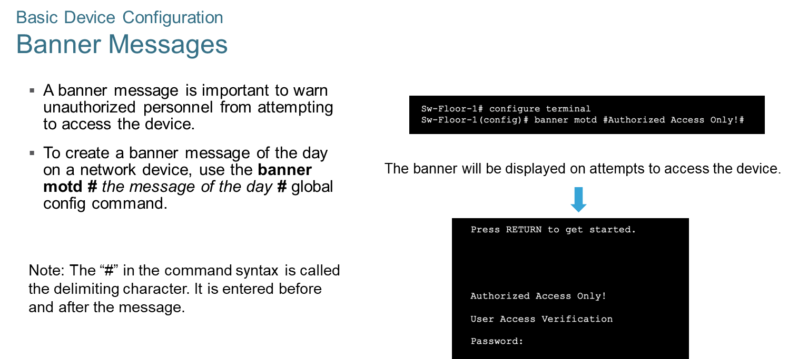
Chapter
Basic Device Configuration
01

Slide 26
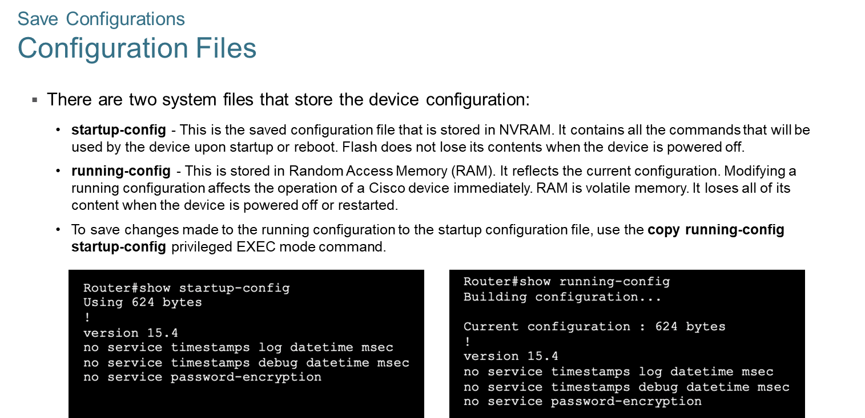
Chapter
Save Configurations
01

Slide 27
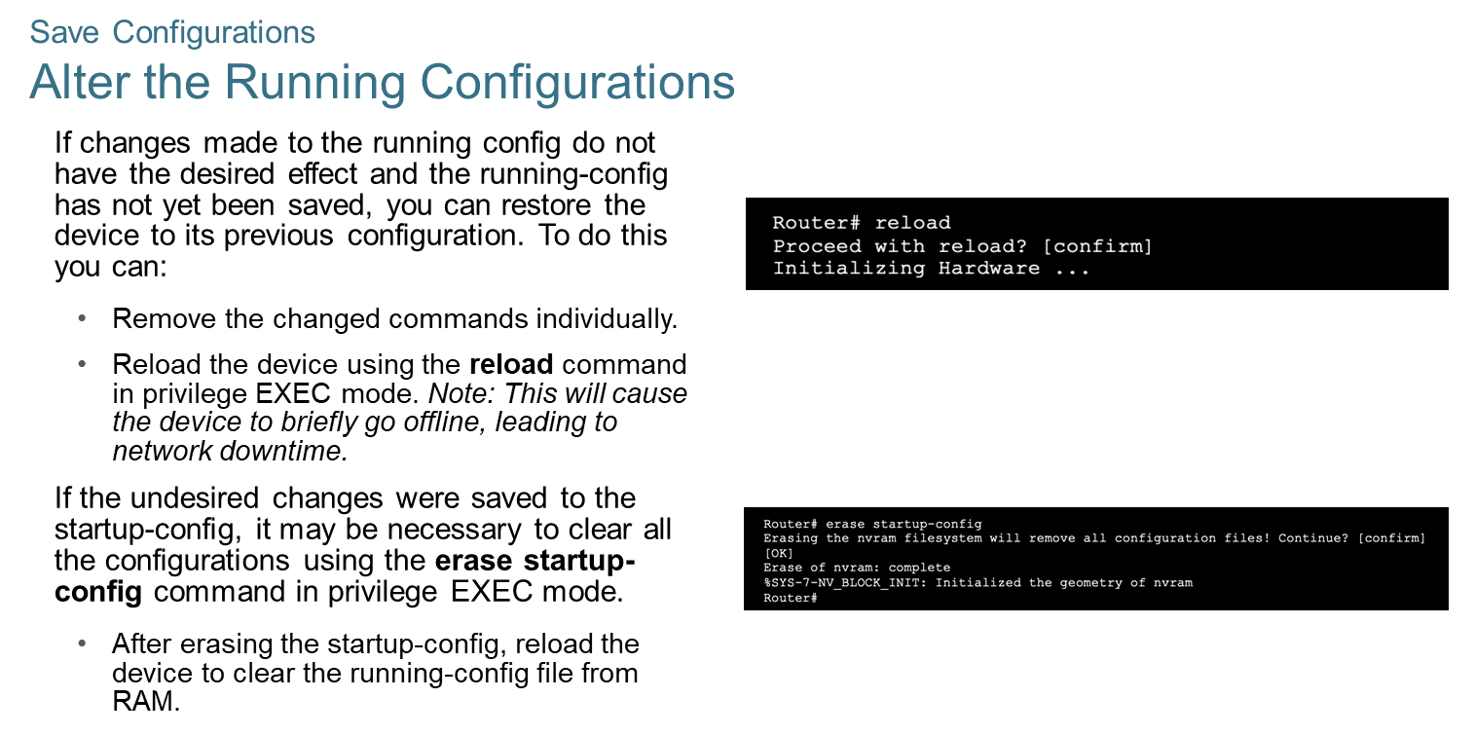
Chapter
Save Configurations
01

Slide 28
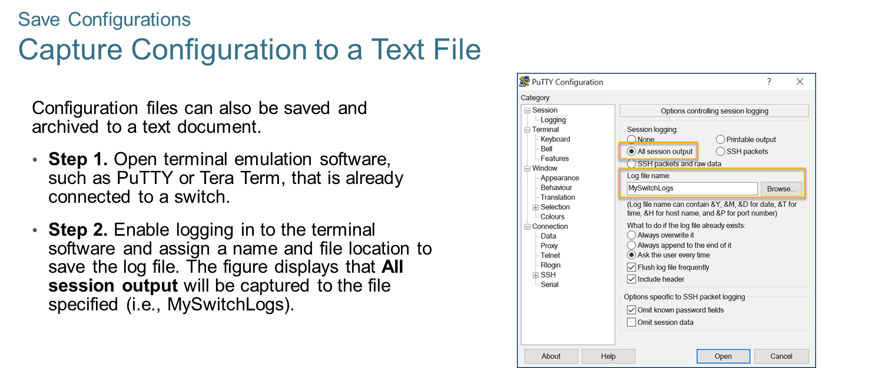
Chapter
Save Configurations
01

Slide 29
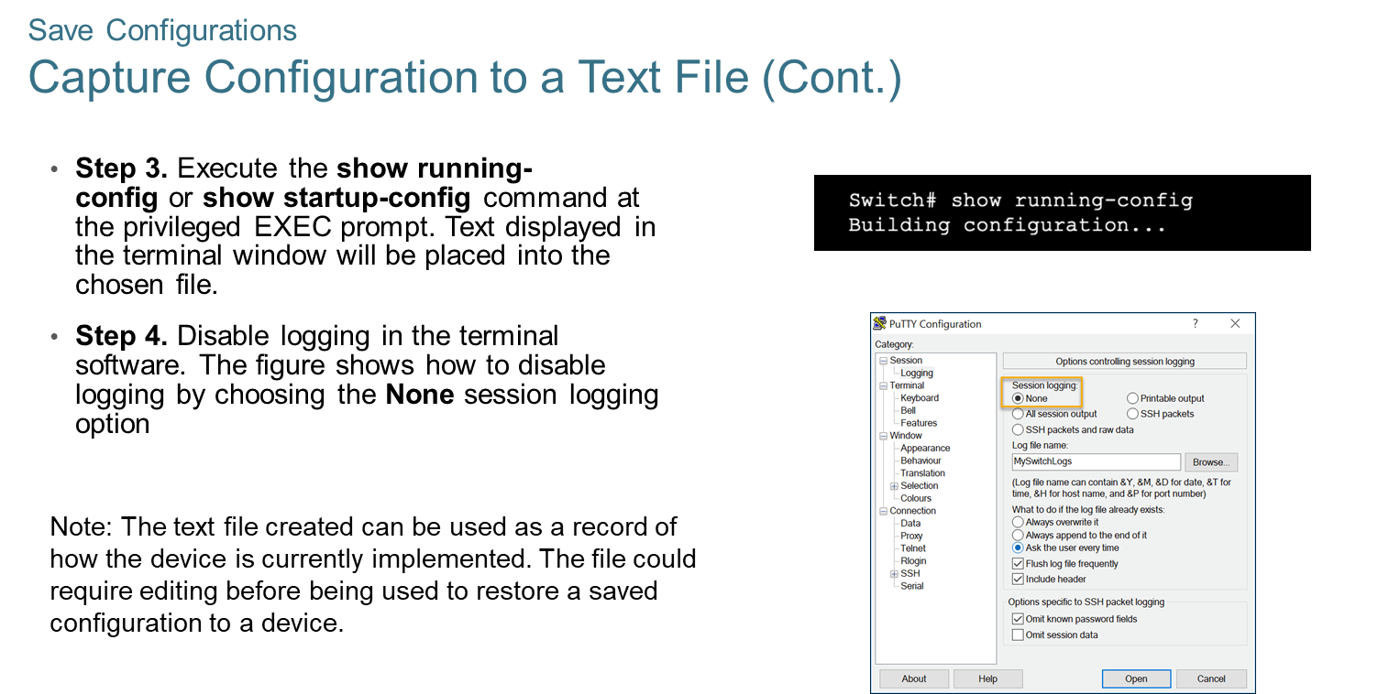
Chapter
Save Configurations
01

Slide 30
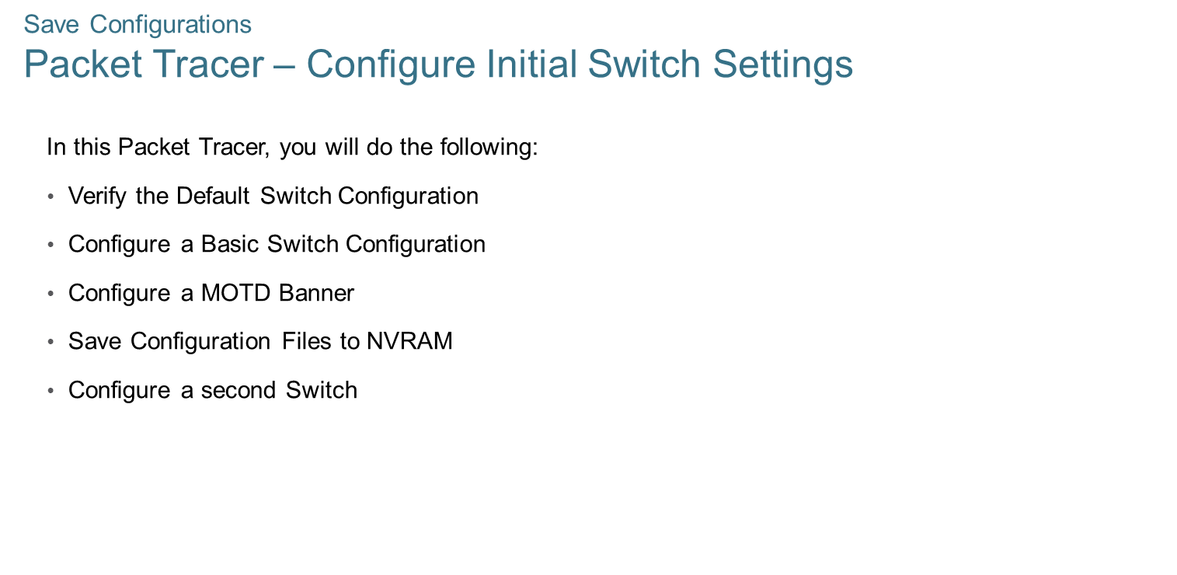
Chapter
Save Configurations
01

Slide 31
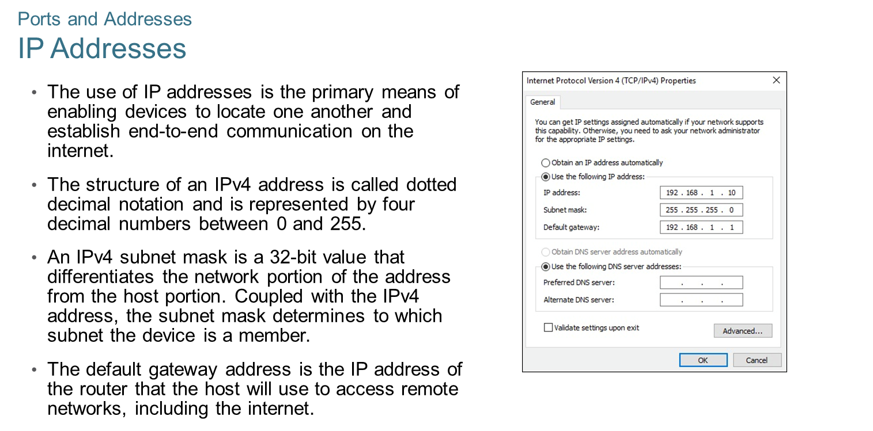
Chapter
Ports and Addresses
01

Slide 32
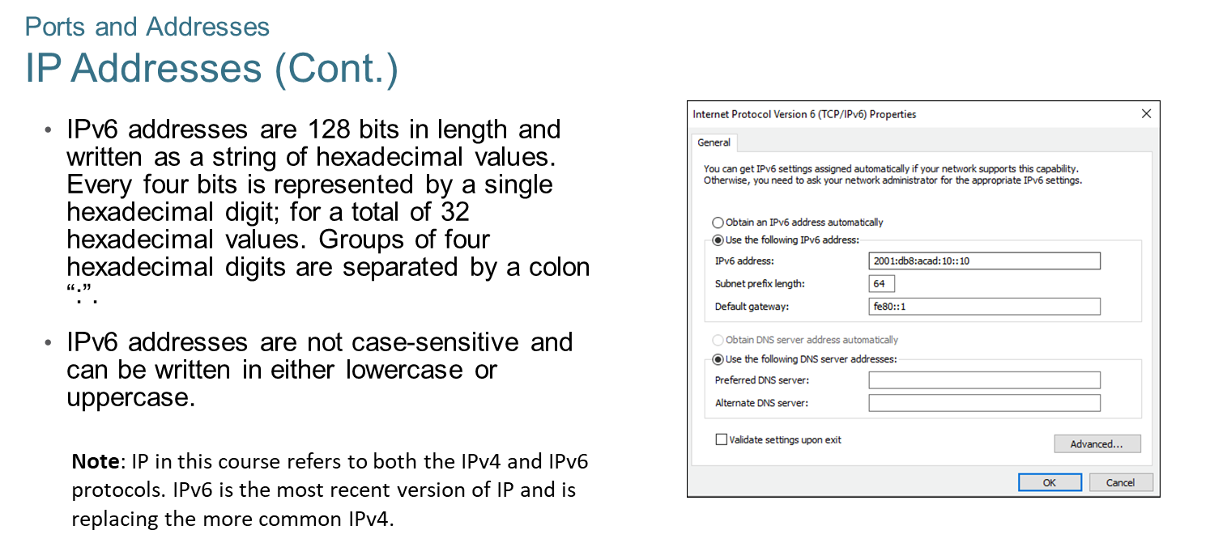
Chapter
Ports and Addresses
01

Slide 33
Chapter
Ports and Addresses
01

Slide 34
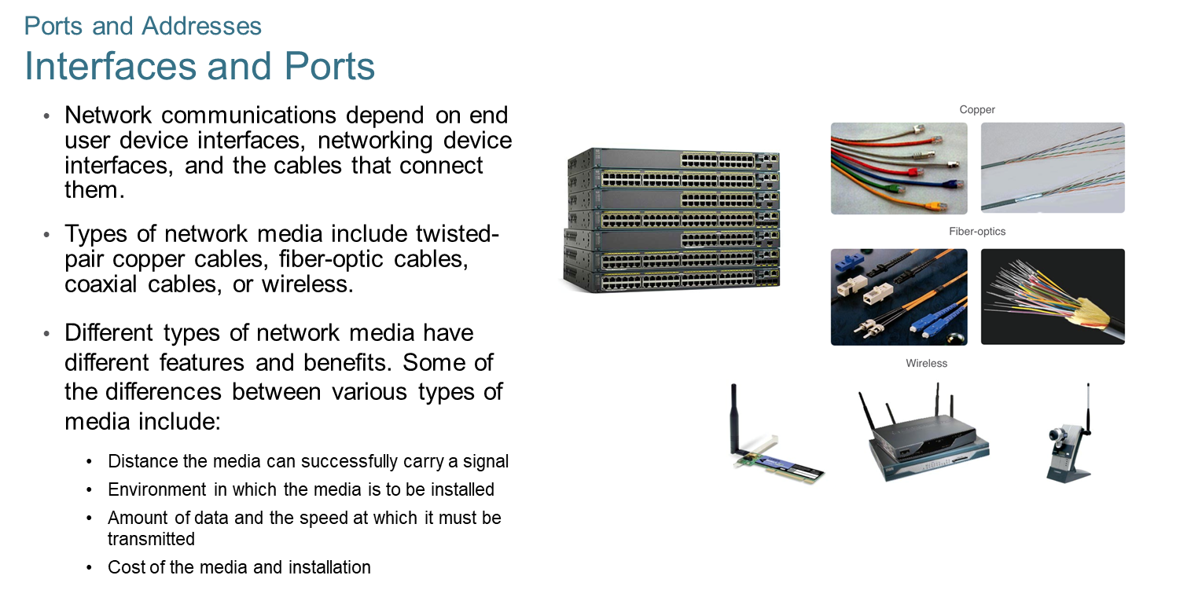
Chapter
01
Ports and Addresses

Slide 35
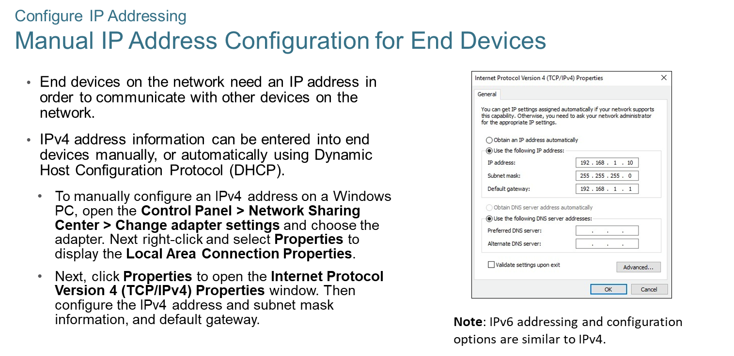
Chapter
Configure IP Addressing
01

Slide 36
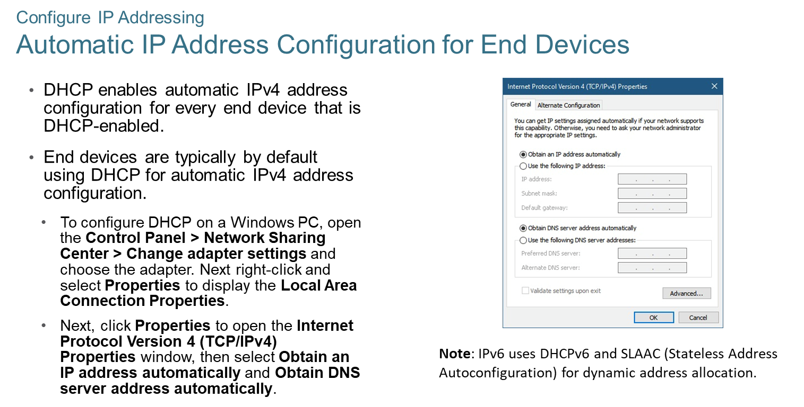
Chapter
01
Configure IP Addressing

Slide 37
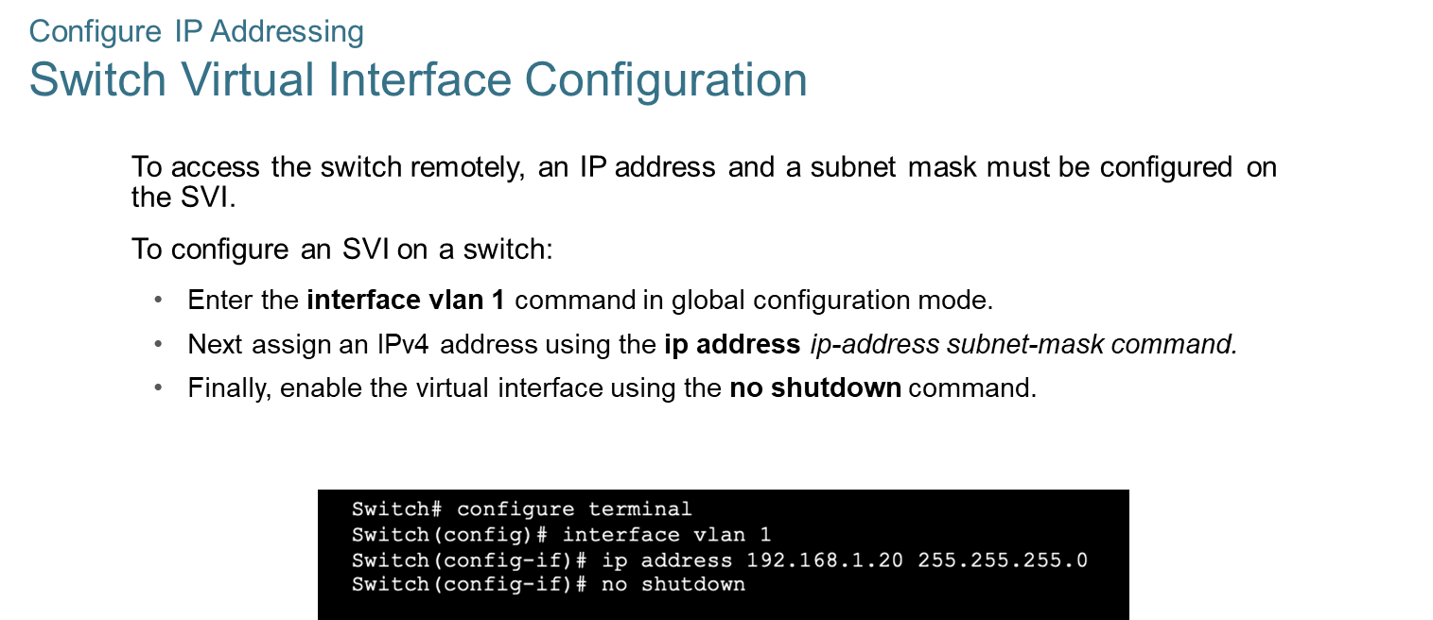
Chapter
Configure IP Addressing
01

Slide 38



Thank You

