Slide 1


Managing People and Organizations
Prepared by Dr. Usama Al-Fendi
MGM603
Managing People and Organizations
Lecture 9

Slide 2

Lecture
Learning Outcomes
9
Define groups and teams and identify and describe several types of each.
Identify the five core group performance factors and relate them to groups and teams in organizations.
Discuss the stages of group and team development, other team performance factors, and the implementation process in the context of creating new teams.
Identify the primary benefits and costs of teams, how managers can promote effective team performance, and important team competencies.
Describe emerging team opportunities and challenges related to virtual teams and diversity and multicultural teams.

Slide 3
Lecture
Groups and Teams
9
Types of Groups and Teams:
 | A group is Two or more people who interact with one another such that each person influences and is influenced by each other person. Two people who are physically near each other are not a group unless they interact and have some influence on each other. Coworkers may work side by side on related tasks—but if they do not interact, they are not a group. A team is An interdependent collection of at least two individuals who share a common goal and share accountability for the team’s as well as their own outcomes. A key part of this definition is that team members are interdependent with respect to information, resources, and skills. As tasks become more complex, they require greater coordination among team members.

Slide 4
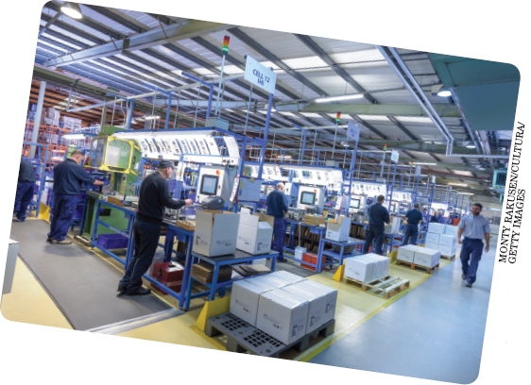
Lecture
Groups and Teams
9
Types of Groups and Teams:
Groups are prevalent throughout most organizations. A variety of different kinds of workgroups and teams like this one perform many different kinds of functions and play a number of different roles.

Slide 5
Lecture
Groups and Teams
9
Workgroups
Workgroups | Workgroups are formal groups established by the organization to do its work Workgroups include command (or functional) groups and affinity groups (as well as teams). A command group is relatively permanent and is characterized by functional reporting relationships such as having both a group manager and those who report to the manager. Affinity groups are relatively permanent collections of employees from the same level in the organization who meet on a regular basis to share information, capture emerging opportunities, and solve problems

Slide 6
Lecture
Groups and Teams
9
Workgroups
command groups | In business organizations, most employees work in command groups, as typically specified on an official organization chart. The size, shape, and organization of a company’s command group can vary considerably. Typical command groups in organizations include the quality-assurance department, the customer service department, the cost-accounting department, and the human resource department. Other types of command groups include work teams organized as in the Japanese style of management, in which subsections of manufacturing and assembly processes are each assigned to a team of workers. The team members decide among themselves who will perform each task.

Slide 7

Lecture
Groups and Teams
9
Teams
Groups composition plays a big role in how a group functions and performs. For example, the group on the left includes people who, on the surface at least, seem very different from one another along several obvious dimensions. The group on the right, though, is comprised of people who appear to be very similar to one another. These differences and similarities will affect how the groups members interact and the outcomes they are able to achieve.

Slide 8
Lecture
Groups and Teams
9
Teams
Teams | Organizations also use a wide variety of different types of teams Each type of team is composed of different members and responsible for different types of tasks. The functional teams come from the same department or functional area. A team of marketing employees and a team of finance employees are examples of functional teams. Cross-functional teams have members from different departments or functional areas. This is one of the most common types of work teams. An example of a cross-functional team is a top-management team with members representing different functions or units of the organization.

Slide 9
Lecture
Groups and Teams
9
Teams
Teams | 3. Problem-solving teams are teams established to solve problems and make improvements at work. The core strength of problem-solving teams is that because employees are the ones actually doing the work, they usually know the job best. For example, Colgate and JM Huber, a raw material supplier, jointly assembled a multidisciplinary team to identify ways to reduce costs. The team ultimately realized savings of hundreds of thousands of dollars

Slide 10
Lecture
Groups and Teams
9
Teams
Teams | 4. Self-directed teams set their own goals and pursue them in ways decided by the team. Team members are responsible for tasks typically reserved for team leaders or managers, including scheduling work and vacations, ordering supplies, and evaluating their performance. for example, At 3M (makers of Post-It Notes, Scotch Tape, and myriad other products), self-directed work teams have made improvements in products, services, and processes while increasing customer responsiveness, lowering operating costs, increasing productivity, and decreasing cycle times.

Slide 11
Lecture
Groups and Teams
9
Teams
Teams | 5- Venture teams are teams that operate semi-autonomously to create and develop new products (product development teams), processes (process design teams), or businesses (venture teams). 6- Virtual teams are teams of geographically and/or organizationally dispersed coworkers who communicate using the Internet and other information technologies For example, PricewaterhouseCoopers, one of the world’s largest accounting firms, with more than 236,000 employees in 158 countries, uses virtual teams to bring employees from around the globe “together” for a week or two to prepare work for a particular client. The Whirlpool Corporation used a virtual team composed of experts from the United States, Brazil, and Italy during a two-year project to develop a chlorofluorocarbon-free refrigerator

Slide 12
Lecture
Groups and Teams
9
Teams
Teams | 7- Global teams have members from different countries. Global teams can be virtual or meet face-to-face. Procter & Gamble, a multinational manufacturer of family, personal, and household care products, uses global teams to allow employees at its Cincinnati headquarters to collaborate with employees and suppliers all over the world.

Slide 13
Lecture
Groups and Teams
9
Teams
Functional teams | members come from the same department or functional area
Cross-functional teams | members come from different departments or functional areas
Problem-solving teams | teams created to solve problems and make improvements
Self-directed teams | set their own goals and pursue them in ways defined by the team
Venture teams | teams that operate semi-autonomously to create and develop new products, processes, or businesses
Virtual teams | teams of geographically and/or organizationally dispersed coworkers who communicate using telecommunications and information technologies
Global teams | face-to-face or virtual teams whose members are from different countries

Slide 14

Lecture
Groups and Teams
9
Teams
Virtual teams are becoming increasingly common in organizations. New forms of technology, coupled with pressures to reduce travel costs, make it easy for colleagues who are geographically dispersed to interact in ways that mirror face-to-face interactions. Of course, they may also have a reduced personal connection with their colleagues when meeting this way.

Slide 15
Lecture
Groups and Teams
9
Informal Groups
Informal Groups | informal groups are formed by their members and consist of friendship groups, which are relatively permanent, and interest groups, which may be shorter-lived. Friendship groups arise out of cordial personal relationships among members and the enjoyment they get from being together. Interest groups are organized around a common activity or interest, although friendships may also develop among members.

Slide 16
Lecture
Groups and Teams
9
Informal Groups
Informal Groups | Good examples: of interest groups are the networks of working women that have developed over the last several years. Many of these groups began as informal social gatherings of women who wanted to meet with other women working in male-dominated organizations, but they soon developed into interest groups whose benefits went far beyond their initial social purposes.

Slide 17
Lecture
Groups and Teams
9
Group Performance Factors
Group Performance Factors | The performance of any group is affected by several factors (in addition to its reasons for forming and the stages of its development, discussed later). In a high-performing group, a group synergy often develops in which the group’s performance is more than the sum of the individual contributions of its members. Several additional factors may account for this accelerated performance. The five basic group performance factors are composition, size, norms, cohesiveness, and informal leadership. If you are part of a group or team that is not performing effectively, the Improve Your Skills feature might be a useful diagnostic tool.

Slide 18
Lecture
Groups and Teams
9
Group Performance Factors
 | Diagnosing Team Problems Here are some questions you can ask in diagnosing team issues. 1. Clear direction Can each of the team members articulate the purpose that the team exists to achieve? 2. A real team task Is the team assigned collective responsibility for all of its customers and major outputs? Does the team make collective decisions about work strategies (rather than leaving it to individuals)? Are team members willing and able to help one another? Does the team get team-level feedback about its performance?

Slide 19
Lecture
Groups and Teams
9
Group Performance Factors
Group Performance Factors | 3. Team rewards Are more than 80 percent of all rewards available to teams only, and not to individuals?

Slide 20
Lecture
Groups and Teams
9
Group Performance Factors
Group Performance Factors | 4. Basic material resources Does the team have its own meeting space? Can the team easily get the basic materials it needs to do its work? 5. Authority to manage the work How to meet client demands Which actions to take, and when Whether to change their work strategies when they deem necessary Do team members have the authority to decide the following without first receiving special authorization?

Slide 21
Lecture
Groups and Teams
9
Group Performance Factors
Group Performance Factors | 6. Team goals Can team members articulate specific and shared team goals? 7. Improvement norms Do team members encourage one another to detect and solve problems? Do members openly discuss differences in what members have to contribute to the team? Do members encourage experimentation with new ways of operating? Does the team actively seek to learn from other teams?

Slide 22
Lecture
Groups and Teams
9
Group Composition
Group Composition | Group Composition: The degree of similarity or difference among group members on factors important to the group’s work Group composition is most often described in terms of the homogeneity or heterogeneity of the members A group is homogeneous if the members are similar in one or several ways that are critical to the work of the group, such as in age, work experience, education, technical specialty, or cultural background.

Slide 23
Lecture
Groups and Teams
9
Group Composition
Group Composition | In heterogeneous groups, the members differ in one or more ways that are critical to the work of the group. A substantial amount of research has explored the relationship between a group’s composition and its productivity.

Slide 24
Lecture
Groups and Teams
9
Group Composition
 | A homogeneous group is likely to be more productive when the group task is simple, cooperation is necessary, the group tasks are sequential, or quick action is required. A heterogeneous group is more likely to be productive when the task is complex, requires a collective effort (that is, each member does a different task, and the sum of these efforts constitutes the group output), and demands creativity, and when speed is less important than thorough deliberations. For example, a group asked to generate ideas for marketing a new product probably needs to be heterogeneous to develop as many different ideas as possible. A homogeneous group tends to have less conflict, fewer differences of opinion, smoother communication, and more interactions.

Slide 25
Lecture
Groups and Teams
9
Group Composition
 | When a task requires cooperation and speed, a homogeneous group is therefore more desirable. If, however, the task requires complex analysis of information and creativity to arrive at the best possible solution, a heterogeneous group may be more appropriate because it generates a wide range of viewpoints. More discussion and more conflict are likely, both of which can enhance the group’s decision making. Group composition becomes especially important as organizations become increasingly more culturally diverse. Cultures differ in the importance they place on group membership and in how they view authority, uncertainty, and other important factors.

Slide 26
Lecture
Groups and Teams
9
Group Composition
 | Increasing attention is being focused on how to deal with groups made up of people from different cultures. In general, a manager in charge of a culturally diverse group can expect several things. First, members will probably distrust one another. Stereotyping will present a problem, and communication problems will almost certainly arise. Thus, managers need to recognize that such groups will seldom function smoothly, at least at first. Managers may therefore need to spend more time helping a culturally diverse group through the rough spots as it matures, and they should allow a longer-than-normal time before expecting it to carry out its assigned task.

Slide 27

Lecture
Groups and Teams
9
Group Composition
Groups composition plays a big role in how a group functions and performs. For example, the group on the left includes people who, on the surface at least, seem very different from one another along several obvious dimensions. The group on the right, though, is comprised of people who appear to be very similar to one another. These differences and similarities will affect how the groups members interact and the outcomes they are able to achieve.

Slide 28
Lecture
Groups and Teams
9
Group Size
 | A group—the number of people in the group—can have as few as two members or as many members as can interact and influence one another. Group size can have an important effect on performance. A group with many members has more resources available and may be able to complete a large number of relatively independent tasks. In groups established to generate ideas, those with more members tend to produce more ideas, although the rate of increase in the number of ideas diminishes rapidly as the group grows. Beyond a certain point, the greater complexity of interactions and communication may make it more difficult for a large group to achieve agreement.

Slide 29
Lecture
Groups and Teams
9
Group Size
Group Size | Social loafing is the tendency of some members of groups not to put forth as much effort in a group situation as they would working alone. Social loafing often results from the assumption by some members that if they do not work hard, other members will pick up the slack. How much of a problem this becomes depends on the nature of the task, the characteristics of the people involved, and the ability of the group leadership to be aware of the potential problem and do something about it.

Slide 30
Lecture
Groups and Teams
9
Group Size
Group Size | The most effective size of a group, therefore, is determined by the group members’ ability to interact and influence one another effectively. The need for interaction is affected by the maturity of the group, the tasks of the group, the maturity of individual members, and the ability of the group leader or manager to manage the communication, potential conflicts, and task activities.

Slide 31

Lecture
Groups and Teams
9
Group Size
Social loafing occurs when one or more members of a group put forth less effort than others and let other members of the group pick up the slack. This man, for example, is distracted and not paying attention to what his team members are doing. But he may end up getting just as much credit as they do when their project is completed.

Slide 32
Lecture
Groups and Teams
9
Group Norms
 | A norm is a standard against which the appropriateness of a behavior is judged. Thus, norms determine the behavior expected in a certain situation. Group norms usually are established during the second stage of group development (communication and decision making) and are carried forward into the maturity stage. By providing a basis for predicting others’ behaviors, norms enable people to behave in a manner consistent with and acceptable to the group. Without norms, the activities in a group would be chaotic. Norms result from the combination of members’ personality characteristics, the situation, the task, and the historical traditions of the group.

Slide 33
Lecture
Groups and Teams
9
Group Norms
 | Norms can be positive or negative for individual and organizational outcomes because group members tend to follow them even if the consequences are negative. Lack of conformity to group norms may result in attempts to correct the deviant behavior, verbal abuse, physical threats, ostracism, or even ejection from the group. Group norms are enforced, however, only for actions that are important to group members. For example, if the office norm is for employees to wear suits to convey a professional image to clients, a staff member who wears jeans and a sweatshirt violates the group norm and will hear about it quickly. But if the norm is that dress is unimportant because little contact with clients occurs in the office, the fact that someone wears blue jeans may not even be noticed.

Slide 34
Lecture
Groups and Teams
9
Group Cohesiveness
Group cohesiveness | Group cohesiveness is the extent to which a group is committed to remaining together; it results from forces acting on the members to remain in the group. The forces that create cohesiveness are attraction to the group, resistance to leaving the group, and motivation to remain a member of the group. group cohesiveness is related to many aspects of group dynamics: maturity, homogeneity, manageable size, and frequency of interactions.

Slide 35
Lecture
Groups and Teams
9
Group Cohesiveness
Group cohesiveness | The following figure shows that group cohesiveness can be increased by competition or by the presence of an external threat. Finally, successfully reaching goals often increases the cohesiveness of a group because people are proud to be identified with a winner and to be thought of as competent and successful.

Slide 36
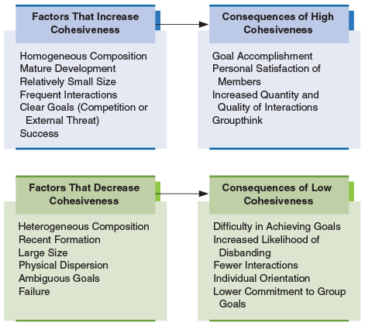
Lecture
Groups and Teams
9
Group Cohesiveness
Figure 7.1. Factors That Affect Group Cohesiveness and Consequences of Group Cohesiveness
The factors that increase and decrease cohesiveness and the consequences of high and low cohesiveness indicate that although it is often preferable to have a highly cohesive group, in some situations the effects of a highly cohesive group can be negative for the organization.

Slide 37
Lecture
Groups and Teams
9
Group Cohesiveness
Group cohesiveness | Research on group performance factors has focused on the relationship between cohesiveness and group productivity. Highly cohesive groups appear to be more effective at achieving their goals than groups that are low in cohesiveness, especially in research and development groups in U.S. companies. However, highly cohesive groups will not necessarily be more productive in an organizational sense than groups with low cohesiveness. If such a group decides on a goal that has little to do with the business of the organization, it will probably work to achieve its own goal even at the expense of any organizational goals that might be compromised by the group’s efforts.

Slide 38
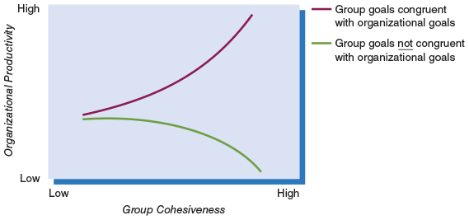
Lecture
Groups and Teams
9
Group Cohesiveness
Figure7.2. Group Cohesiveness, Goals, and Productivity
This figure shows that the best combination is for the group to be cohesive and for the group’s goals to be congruent with the organization’s goals. The lowest potential group performance also occurs with highly cohesive groups when the group’s goals are not consistent with the organization’s goals.

Slide 39
Lecture
Groups and Teams
9
Group Cohesiveness
 | Cohesiveness may also be a primary factor in the development of certain problems for some decision-making groups. An example is groupthink, which occurs when a group’s overriding concern is a unanimous decision rather than critical analysis of alternatives. These problems, together with the evidence regarding group cohesiveness and productivity, mean that a manager must carefully weigh the pros and cons of fostering highly cohesive groups. Finally, there is emerging evidence that the emotional intelligence of group members can promote cohesiveness. In this context, emotional intelligence refers to interpersonal capability that includes the ability to perceive and express emotions, to understand and use them, and to manage emotions in oneself and other people.

Slide 40
Lecture
Groups and Teams
9
Informal Leadership
 | informal leader is a person who engages in leadership activities but whose right to do so has not been formally recognized. The formal and the informal leader in any group or team may be the same person, or they may be different people. For example, most groups and teams need people to play both task and socioemotional roles. An informal leader is likely to be a person capable of carrying out both roles effectively. If the formal leader can fulfill one role but not the other, an informal leader often emerges to supplement the formal leader’s functions. If the formal leader can fill neither role, one or more informal leaders may emerge to carry out both sets of functions.

Slide 41

Lecture
Groups and Teams
9
Informal Leadership
An informal leader is someone who engages in leadership activities without the formal authority to do so. Take these construction supervisors, for instance. The project manager may be away handling other responsibilities and one of the two supervisors in the center is taking charge during the manager’s absence. This supervisor, then, is emerging as an informal leader by taking on a larger role than has been actually granted to them by the company.

Slide 42
Lecture
Groups and Teams
9
Creating New Groups and Teams
 | Managers frequently have the opportunity to create new groups and teams. Given the significant roles that groups and teams can play in organizational effectiveness, it is clearly important that this process be approached logically and rationally. In general, if a new group or team is being created, managers should be aware of the stages that groups and teams go through, understand how various performance factors should be considered, and be aware of the formal process experts suggest for implementing teams.

Slide 43
Lecture
Groups and Teams
9
Stages of Group and Team Development
 | Groups are not static, and when a new group or team is created it generally goes through some “growing pains” before it becomes fully functional. Traditional research on small groups per se (as opposed to teams) has focused on a four-stage development process: mutual acceptance, communication and decision making, motivation and productivity, and control and organization. The stages and the activities that typify them are shown in Figure 7.3. We will discuss the stages as separate and distinct. It is difficult to pinpoint exactly when a group moves from one stage to another, however, because the activities in the phases tend to overlap.

Slide 44
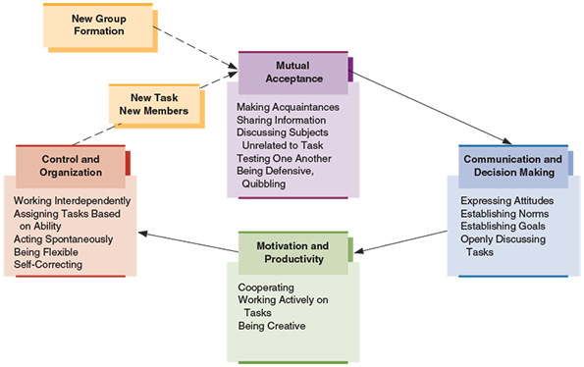
Lecture
Groups and Teams
9
Stages of Group and Team Development
This figure shows the stages of evolution from a newly formed group to a mature group. Note that as new members are added or an existing group gets a new task, the group needs to go through the stages again.

Slide 45
Lecture
Groups and Teams
9
Stages of Group and Team Development
 | Mutual Acceptance In the mutual acceptance stage of group development (also called the forming stage), the group forms, and members get to know one another by sharing information about themselves. They often test one another’s opinions by discussing subjects that have little to do with the group, such as the weather, politics, sports, or recent events within the organization. Some aspects of the group’s task, such as its formal objectives, may also be discussed at this stage. However, such discussion probably will not be very productive because the members are unfamiliar with one another and do not know how to evaluate one another’s comments.

Slide 46
Lecture
Groups and Teams
9
Stages of Group and Team Development
Communication and Decision Making | 2- Communication and Decision Making The group progresses to the communication and decision-making stage (also called storming stage) once group members have begun to accept one another. In this stage, members discuss their feelings and opinions more openly, which can increase conflict; they may show more tolerance for opposing viewpoints and explore different ideas to bring about a reasonable solution or decision. The membership usually begins to develop norms of behavior during this stage. Members discuss and eventually agree on the group’s goals. Then they are assigned roles and tasks to accomplish the goals.

Slide 47
Lecture
Groups and Teams
9
Stages of Group and Team Development
Motivation and Productivity | 3- Motivation and Productivity In the next stage, motivation and productivity stage (also called the norming stage), the emphasis shifts away from personal concerns and viewpoints to activities that will benefit the group. Members perform their assigned tasks, cooperate with one another, and help one another accomplish their goals. The members are highly motivated and may carry out their tasks creatively. In this stage, the group is accomplishing its work and moving toward the final stage of development.

Slide 48
Lecture
Groups and Teams
9
Stages of Group and Team Development
Control and Organization | 4- Control and Organization In the final stage, control and organization stage (also called the performing stage), the group works effectively toward accomplishing its goals. Tasks are assigned by mutual agreement and according to ability. In a mature group, the members’ activities are relatively spontaneous and flexible rather than subject to rigid structural restraints. Mature groups evaluate their activities and potential outcomes and take corrective actions if necessary. The characteristics of flexibility, spontaneity, and self-correction are very important if the group is to remain productive over an extended period.

Slide 49
Lecture
Groups and Teams
9
Stages of Group and Team Development
 | Finally, as working conditions and relationships change, either through a change in membership or when a task is completed and a new task is begun, groups may need to re-experience one or more of the stages of development to maintain the cohesiveness and productivity characteristic of a well-developed group. The San Francisco Forty-Niners, for example, once returned from an NFL players strike to an uncomfortable and apprehension-filled period. Their coach conducted rigorous practices but also allowed time for players to get together to air their feelings. Slowly, team unity returned, and players began joking and socializing again as they prepared for the rest of the season. Their redevelopment as a mature group resulted in two subsequent Super Bowl victories.

Slide 50


Thank You

