Slide 1

Project Management Technologies
Prepared by Lecturer Waseem Tabbaa
Section six - Chapter 22
PMG 312
S4 - Advanced tools and techniques
Ch. 22 - Risk mechanics

Slide 2

Section Six
Ch. 22
Introduction
Chapter 22 Risk mechanics........................................................................ 387
Risk management........................................................................................... 387
Risk analysis ................................................................................................... 388
Qualitative risk analysis........................................................................... 388
Quantitative risk assessment................................................................... 390
Risk response planning................................................................................. 394
Accept risk.................................................................................................. 398
Avoid risk ................................................................................................... 399
Mitigate risk ............................................................................................... 400
Transfer risk ............................................................................................... 401
Risk monitoring and control ........................................................................ 402
Summary......................................................................................................... 405
References ....................................................................................................... 407

Slide 3
Section Six
Ch. 22
Risk management
The first two processes were discussed in Chapter 11 and the remaining four processes are discussed in this chapter. Below are the six processes:
  Plan risk management: Consists of how to approach, plan, and execute the risk management activities for a project with the main output of this process being the risk management plan.
  Identify risk: Determines the risks that are likely to affect a project and documents the characteristics of each with the main output of this process being the risk register.
  Perform qualitative risk analysis: Prioritizes risks for subsequent further analysis or action by assessing and combining their probability of occurrence and impact with the main output being to update the risk register.
  Perform quantitative risk analysis: Estimates numerically the effects of risks on project objectives with the main output also involving updates to the risk register.
  Plan risk responses: Develops options and actions to enhance opportunities and to reduce threats to project objectives. Using the outputs of the above processes, various risk response strategies are made, resulting in the main output of this process being also to update the risk register as well as the project management plan and risk-related contractual agreements.
  Monitoring and controlling risks: Tracks identified risks, monitoring residual risks, identifying new risks, executing risk response plans, and evaluating their effectiveness throughout the project cycle. The main outputs of this process are recommended corrective and preventive actions, requested changes, updates to the risk register, and revised project management plan.

Slide 4
Section Six
Ch. 22
Risk analysis
Qualitative and Quantitative risk assessment and analysis:
  These analyses are simply a way to prioritize risks based on the consequences that could occur should the risk occur. Prioritization is generally based on criteria set by the team and often listed from most to least of concern. The purpose of these types of analyses is to analyze the likelihood of occurrence and impact to the project should the risk occur.

Slide 5
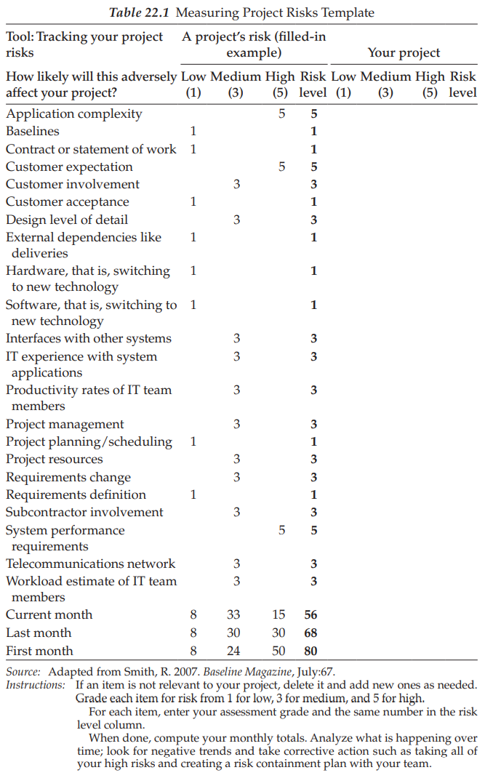
Section Six
Ch. 22
Qualitative risk analysis

Slide 6
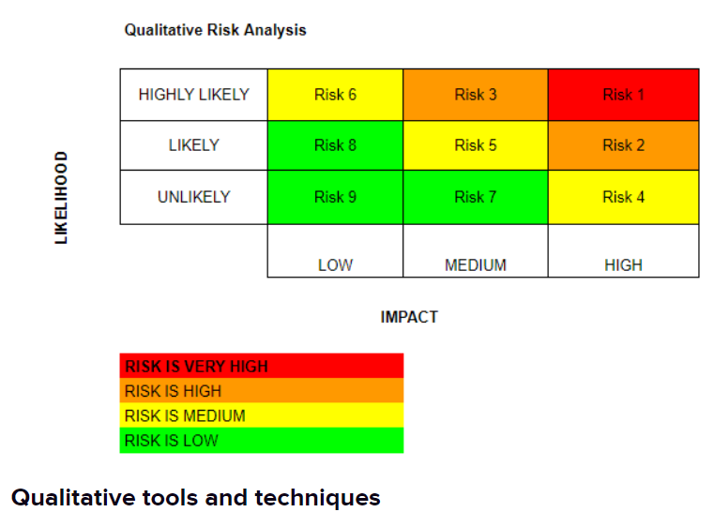
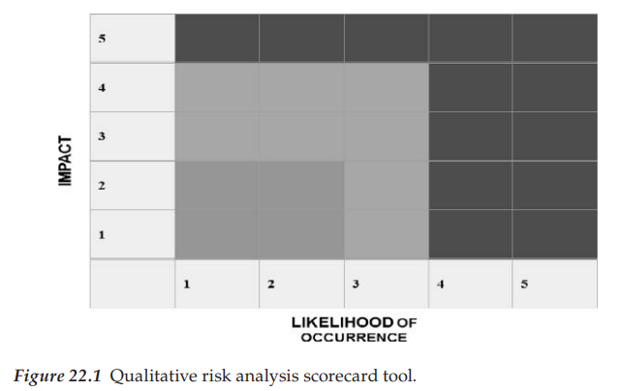
Section Six
Ch. 22
Qualitative risk analysis

Slide 7
Section Six
Ch. 22
Qualitative risk analysis
Different templates can be used to assist with this analysis.
Table 22.1 is a template to assess project risks.
Also, Figure 22.1 is an example of a qualitative risk analysis scorecard tool.
The qualitative risk analysis tool such as the risk scorecard provides a way to assess how likely it is for a risk to occur (probability of occurrence) and the impact the risk, if it occurs, will have on a project (consequence).
In this example there are different categories for probability such as very small, small, moderate, great, and very great.
For instance, a “5” is given for a probability assigned to a risk of “very great.”
Although it appears as if these categories are subjective, there is a very detailed document that accompanies different risk scorecards so that each risk will be analyzed exactly the same.
For consequences, there are also categories such as insignificant, low, moderate, serious, and very serious.
These consequence categories also have a specified description and rating affiliated with each description so that all risks will be analyzed exactly the same.
Almost every project will have risks that fall under each of these categories.
Hopefully, the risks that fall under very serious such as a loss of life or billion dollar cost have a probability that is very small.
Table 22.2 displays a platform risk calculator to be used to make decisions based on risks present, such as risks with the company’s infrastructure.
For instance, a project that has a technology component can utilize such a template in identifying the risk of the company’s current software infrastructure impacting the project.

Slide 8
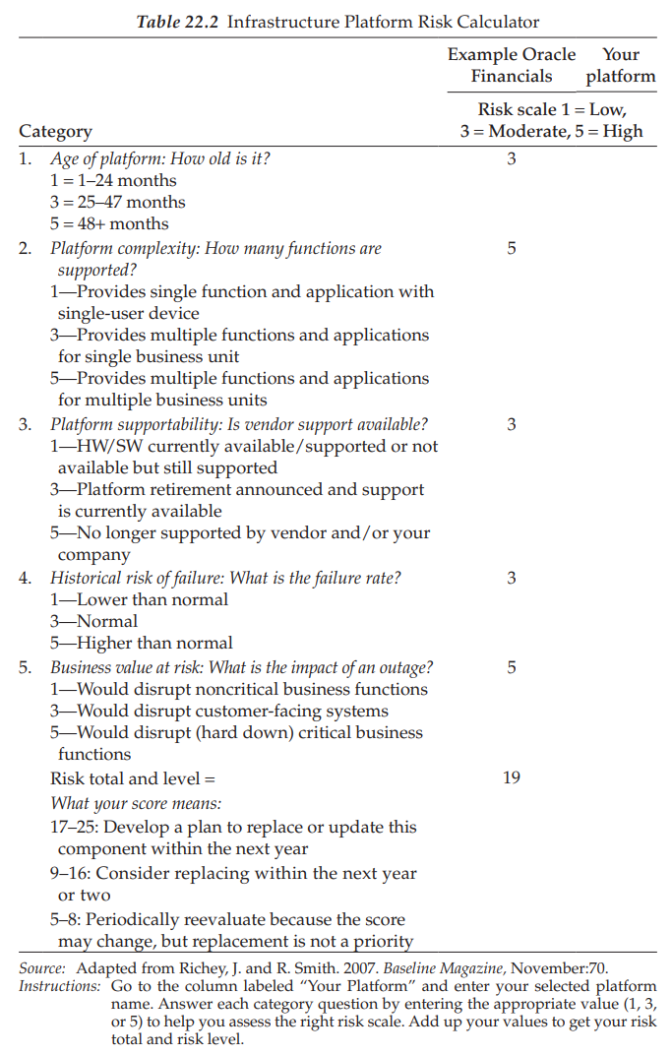
Section Six
Ch. 22
Quantitative risk assessment

Slide 9
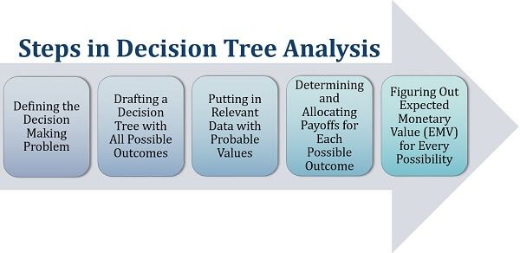
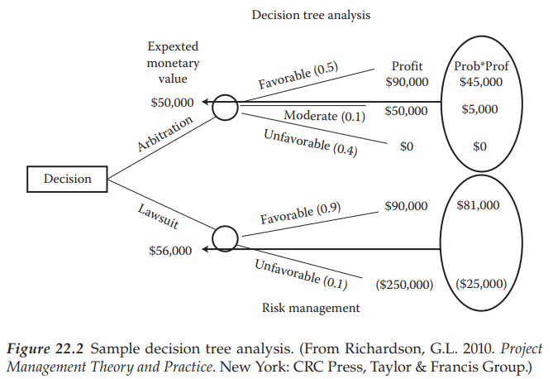
Section Six
Ch. 22
Quantitative risk assessment

Slide 10
Section Six
Ch. 22
Quantitative risk assessment
Common quantitative risk assessments often use decision tree analysis, sensitivity analysis, and simulation modeling.
Decision tree analysis is a probabilistic evaluation of an event, which can be modeled using the decision tree
diagramming technique.
The technique traces different outcomes of their projected results, and from this, one can judge the appropriate course of action.
For example, it encompasses the cost of each available choice, the probabilities of each possible scenario, and the rewards of each alternative logical path.
Solving the decision tree provides the expected monetary value for each alternative when all the rewards and subsequent decisions are quantified, such as the example decision tree in Figure 22.2.
This decision tree example compares a strategy of pursuing a lawsuit or using arbitration to settle a dispute.
Each of the branches outlines options that are considered and the corresponding probability of that individual outcome.
At the end of each branch, the monetary result is displayed.
By multiplying the probability of the event times the outcome and summing the branch, it is evident that the decision to pursue a lawsuit receives the greatest expected value.
However, it also has the highest potential for loss at $250,000.
Sometimes, the avoidance of a major loss is more desirable than achieving maximum return.
Sensitivity analysis is used in determining which risks have the most potential impact on the project.
It takes each task and sees what the effect on project completion would be if it took its optimistic or pessimistic duration, while all other tasks took the deterministic value.

Slide 11
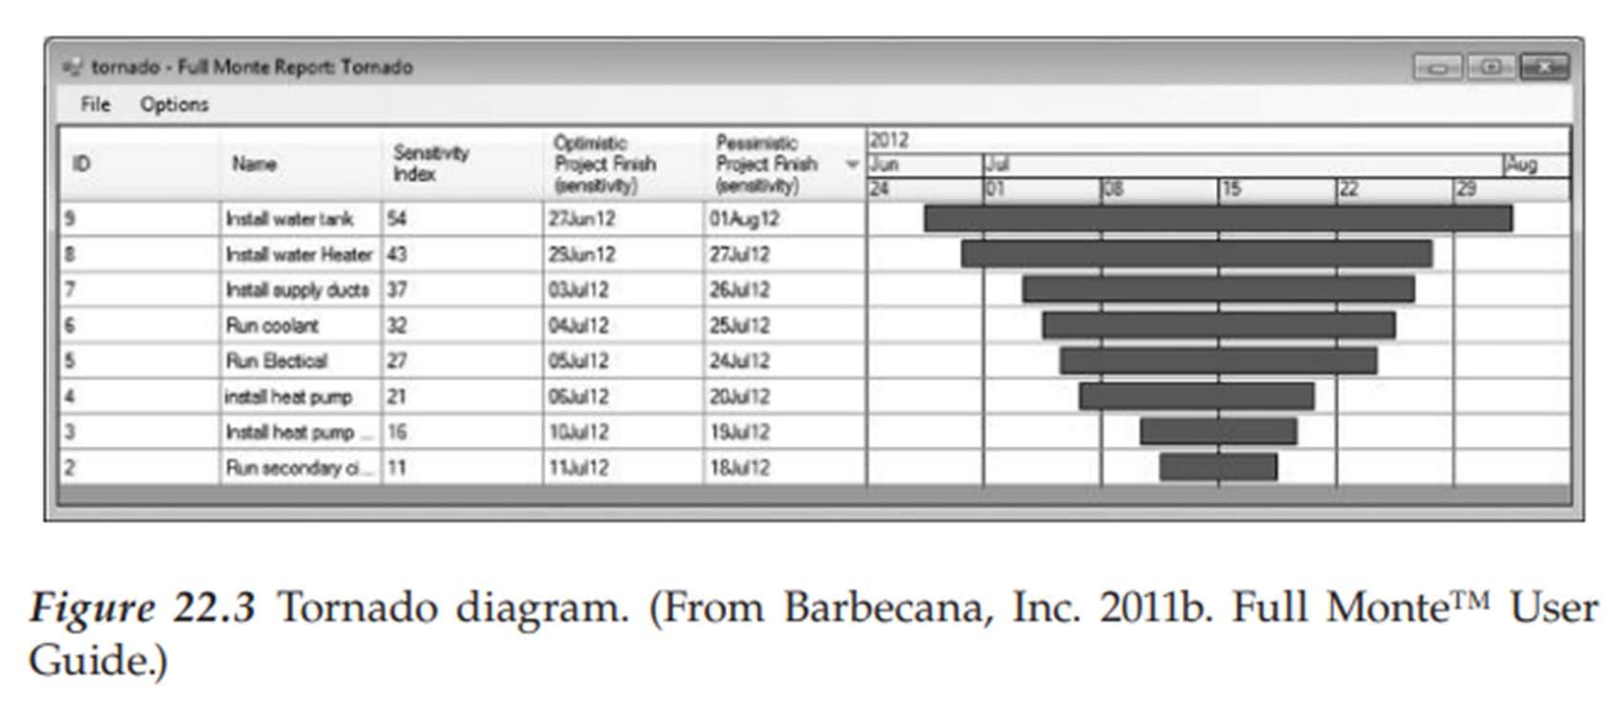
Section Six
Ch. 22
Quantitative risk assessment
Sensitivity analysis can be in the form of a tornado diagram that ranks the project activities in order of significance for, say, critical path.
The tornado diagram helps decide where to focus attention.
An example of a tornado diagram is shown in Figure 22.3.

Slide 12
Section Six
Ch. 22
Risk response planning
Defining risk responses is necessary so there is a plan in place to respond to a risk should it occur.
This plan is helpful as it is a plan written in advance of the risk occurring so that the team can easily refer to the plan should the risk occur.
Being proactive with risks is important as once a risk occurs, the team could be in a state of distress trying to identify a solution if there isn’t a plan to fall back on regarding the best risk response.
Following a plan that was written in advance helps the team be proactive with the goal of enhancing opportunities and reducing threats to the project’s objectives.
The four different risk strategies are accept risk, avoid risk, mitigate risk, and transfer risk.
Identifying the root cause of a risk or risks helps to understand the reason why the risk could occur, which brings insights into whether a risk will be accepted, avoided, mitigated, or transferred.
A risk be accepted if the likelihood of the risk occurring and the financial impact to the project are both low.
If the likelihood of the risk occurring and the financial impact to the project are both high, the risk be avoided.
Furthermore, if the likelihood of the risk occurring is high and the financial impact to the project is low, the risk mitigation strategy may be the best decision.
Finally, if the likelihood of the risk occurring is low and the financial impact to the project is high, a risk-avoidance strategy may be best.

Slide 13
Section Six
Ch. 22
Risk response planning
However, each industry, company, and even project is unique, so what works for one project in one company within one industry may not also work in a different project within a different company or industry.
Even one project within the same industry and company may have very strong views and differing views on how to handle risks.
Each of these strategies will now be addressed.
Risks can also be positive such as using a new software tool to speed up a task.
Using the tool could complete the task much earlier than estimated, which is a positive risk.
However, there may also be potential negative risks affiliated with the tool due to the amount of time it may take for the team to learn how to use the tool, which could potentially impact the project negatively if the learning time takes away from other project tasks.

Slide 14
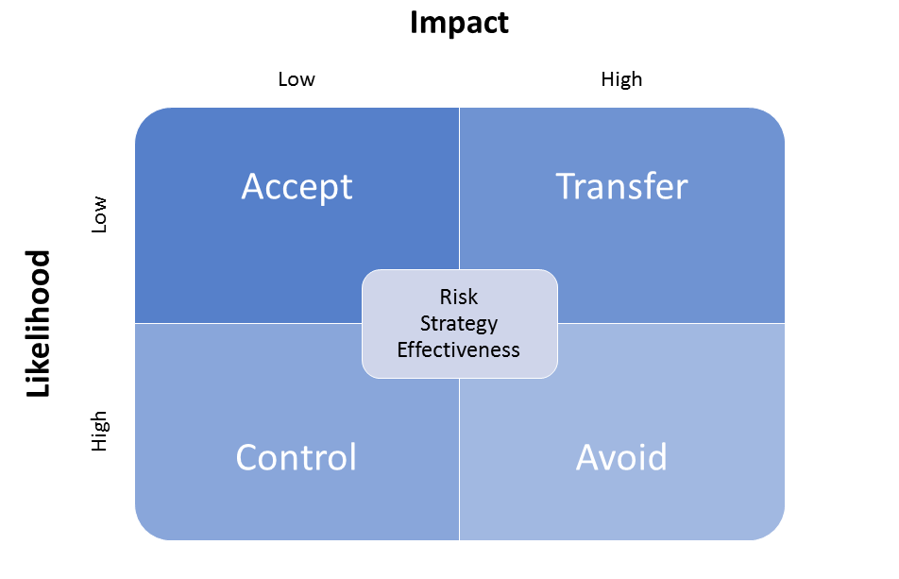
Section Six
Ch. 22
Risk response planning

Slide 15

Section Six
Ch. 22
Accept risk

Slide 16
Section Six
Ch. 22
Accept risk
Accepting a risk takes place when a project team is aware of a risk that could occur and decides not to reduce the likelihood of the risk occurring or the impact it would have if it does occur.
An example of accepting project risk is using a new technology.
For instance, new software may have potential bugs in it that could negatively impact the project in some way.
Ultimately, the Project Manager has decided that no course of action is going to be identified for dealing with this potential risk should it be realized.
Another example could be an outside community fair that carries the risk of weather impacting the success of the fair.
Since dates for the fair must be set, the project team will just accept the risk that the fair may not be successful due to weather.
In some cases, a project risk has to be accepted due to circumstances such as this example where there may not be a building large enough in a community to house an indoor fair or the cost of such a building is beyond the funds available to host the fair.
Accepting project risks is no different than the risk a person takes every day by assuming risks in traveling by car, for instance.
Sometimes, it is impossible to do anything but to accept risks to move forward within a project.

Slide 17

Section Six
Ch. 22
Avoid risk

Slide 18
Section Six
Ch. 22
Avoid risk
Avoiding a risk occurs when a project team is aware of a risk that could occur and decides to identify a plan of action to reduce the likelihood of the risk occurring.
This way the risk can be avoided and thereby it is unable to impact the project.
To avoid the risk, a plan of action could be identified.
Furthermore, sometimes a risk is decided by the Project Manager to be ignored for many reasons such as viewing new technology as an opportunity versus a risk or for many political reasons as well.
Now, an example of avoiding risk for a wedding planner is planning a wedding with a concern of an outdoor wedding being rained out to instead hold the wedding in an indoor location.
This is a way to completely avoid the risk from impacting the project, in this case, a wedding.
Another example is of a company adapting different technology and considering new technology.
The risk is that there may be problems finding skilled new hires experienced with the new technology.
A way to avoid the risk is for the company to instead adapt proven technology where there is an abundance of skilled workers to hire.

Slide 19
Section Six
Ch. 22
Mitigate risk
Mitigating a risk occurs when a project team is aware of risks and develops a plan of action to reduce the impact a risk will have on the project should the risk occur during the project.
An informal way of describing the process of mitigating risk is to develop an action plan to basically control the exposure in terms of controlling the degree to which a risk occurring can negatively impact a project.
Typically, a Project Manager will prioritize the risks based on the probability of it occurring and of impacting project objectives.
Risks, once identified, should be uniquely numbered and ranked.
This is accomplished through identifying which risks could potentially impact the project most severely and which risks have the highest probability of occurring.
Through ranking the risks, the top risks will surface to the top of the lists, which assists in monitoring and controlling project risks.
Strategies for mitigating these risks can occur in numerous ways.

Slide 20
Section Six
Ch. 22
Mitigate risk
An example of mitigating risk might be to use new technology for the entire system instead of choosing to only have a portion of the project use the new technology.
Or, the project could be turned into small phases where phase two does not begin until phase one is completed, thereby
resulting in phase two only using the same technology if it is proved successful in phase one.
This would then reduce the impact the risk has on the project if the new technology is not successful because only the first phase of the project would have used the new technology.
Another example could be for a project that involves sending project team members away on training of a highly in-demand skill.
The risk is that these team members, once trained, could leave the organization and work for a competitor instead.
One way to mitigate this risk is to have these team members sign a contract that they must fulfill 1 year of employment for the company after being trained or must reimburse the company for the cost of the training.
Yet another example could be that a project team in need of certain supplies for a project could order the supplies much earlier than needed to mitigate the risk of the supplies not arriving on time.
Another example is to perform research to read reviews and industry reports to see if a certain supplier, technology, product, and so on has a proven track record before it is adopted by the project team as this also mitigates risk.

Slide 21
Section Six
Ch. 22
Mitigate risk
It is important for a contingency fund or a risk reserve to be established, so there are funds in place to use if needed to implement mitigation plans immediately.
Organizations should have reserve pools in place so that projects can tap into these buckets of funds if necessary.
Simulations can be performed to help determine the amount of reserve funds an organization or specifically a project may need.
Simulations will help a Project Manager recognize the variability that can occur with time and cost in carrying out the project.
Having knowledge of the variability information will help in planning accordingly for risks that could occur by making sure that an adequate risk reserve is in place.
A hidden problem in organizations occurs when a Project Manager doubles the work plan schedule and costs to accommodate any risks that impact the project.
This is not an acceptable way to plan for risks because work will expand to the increased cost and schedule provided, making an organization operate in a costly manner to be inefficient.
Instead of this bad management practice, Project Managers should be direct in their interactions with the management and instead insert cost and schedule buffers for the project as a whole versus adding a cost and schedule buffer to every task.
The cost and schedule project buffer provides the Project Manager with a better understanding of how to monitor the project to assess how it is doing in terms of the true schedule and cost.

Slide 22
Section Six
Ch. 22
Mitigate risk
Any action taken to mitigate the risk thereby reducing the likelihood of the risk occurring or the impact the risk will have if it occurs falls under the strategy of mitigating risk.
Table 22.3 displays a mitigation plan template that could be filled out to develop an action plan prior to the start of the project or at the time the potential risk is identified to help the project team lessen the impact to the project.
Also important in mitigating risks is to identify risk triggers, which are those events that could alert the Project Manager or project team that a risk is close to occurring.
A risk trigger is merely identifying something that the team can measure which can then serve as a way for the team to predict that a project risk is likely to occur.
The analogy describes how a meteorologist can anticipate weather changes through a barometer.
Therefore, project risks need to have a trigger identified that can be a predictor of a risk occurring.
An identified item in the risk register is a risk event and when it triggers, it is the occurrence of the risk event.

Slide 23
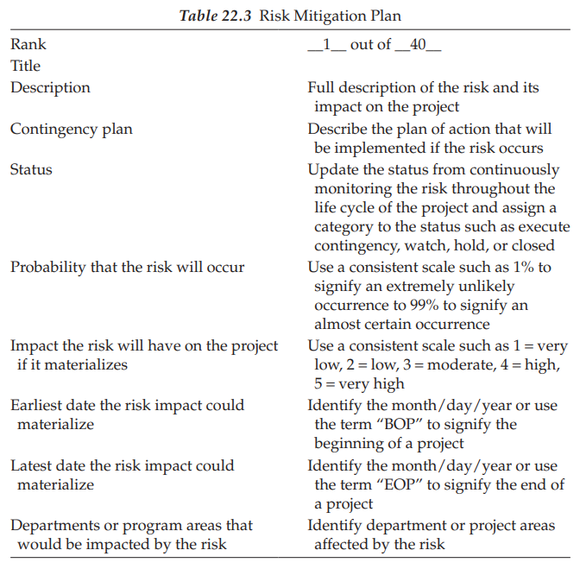
Section Six
Ch. 22
Mitigate risk

Slide 24
Section Six
Ch. 22
Transfer risk
The transfer of risk occurs when another party assumes the negative outcome should the risk occur.
Every day, people take part in activities that have affiliated risks.
For instance, driving a car has risks ranging from getting a speeding ticket to being involved in a car accident with negative consequences from a financial perspective or a health perspective.
For example, the purchasing of car insurance transfers the risk incurred to another party that would then assume the consequences should the risk event occur.
Another example that was previously discussed in this chapter involved a system that could be permanently destroyed by a hurricane.
A way to transfer the risk is to transfer the back-up system to another organization or a different location such as a different state.
The responsibility of the back-up system resides with the other organization, thereby transferring the risk to another party.
Sharing risks also is a form of transfer where a third party may be involved.
Another form of sharing risks is to transfer the risks to another project.

Slide 25
Section Six
Ch. 22
Risk monitoring and control
Finally, risk monitoring and control needs to occur.
This consists of merely tracking all the risks previously identified and implementing response strategies as necessary, so the project is not impacted by the potential risks.
The monitoring and controlling of risks is an ongoing effort throughout the life of the project.
Those risks that have been previously identified along with an identified risk strategy need to be monitored to gauge how likely it is that the risk could occur.
As a good rule of thumb, a Project Manager should not leave the risk monitoring and controlling effort open-ended and instead set certain time intervals officially established for monitoring and controlling risks.
Therefore, one should not monitor and control risks once in the life of the project as that is not enough.
Perhaps, the project plan should state that risks must be monitored and controlled when each major milestone work begins and ends.
If the monitoring of the risk results in unveiling that the risk is more likely to occur, the risk mitigation plan can be implemented, such as the template displayed previously in Figure 22.3.
The risk can be better controlled by implementing the mitigation plan.

Slide 26
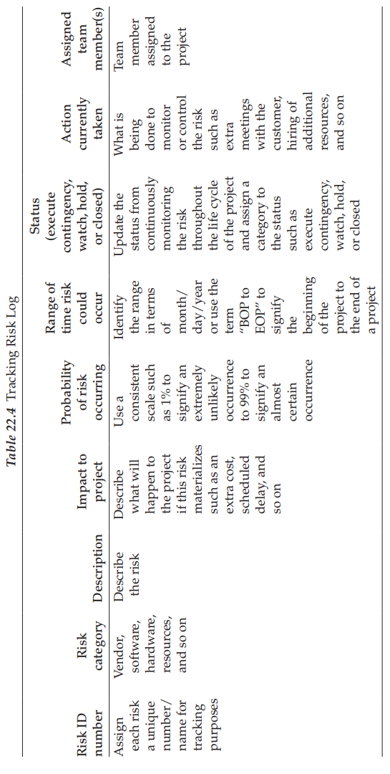
Section Six
Ch. 22
Risk monitoring and control

Slide 27
Section Six
Ch. 22
Risk monitoring and control
The team cannot decide to suddenly begin monitoring and controlling risks in the middle of a project.
For project success, a process at the onset of the project must be established for the team to follow in monitoring and controlling risks.
Therefore, it is important to develop the process for your team to carry out the task of monitoring and controlling risk so that risks can be reported, which is not limited to but should include the following tasks:
  Look at current risks in exploring how these risks could be reduced or eliminated and no longer need coverage.
  Track systematically the identified risks in a risk log displayed in Table 22.4.
  Identify new risks continuously throughout the life cycle of the project.
  Produce lessons learned for future risk assessment and allocation efforts.

Slide 28
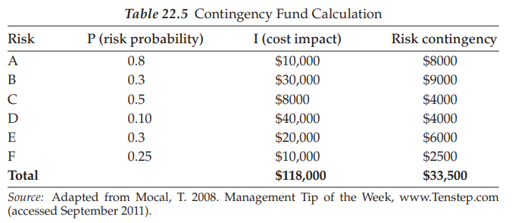
Section Six
Ch. 22
Risk monitoring and control

Slide 29
Section Six
Ch. 22
Risk monitoring and control
After all risks have been identified and analyzed, the Project Manager needs to set aside sufficient reserves to support these future events.
The simple example shown in Table 22.5 illustrates the mechanics of this process.
Mathematically, these calculations would indicate that a contingency fund of $33,500 would be sufficient to cover this probabilistic set of items.
However, note that risk D by itself would wipe out the fund, so what is wrong with this process?
First, we have to recognize that the expected value calculation requires a sufficient number of observations to function properly.
Second, this process is not a pure science and there will likely be events occurring that are not in the list, as well as probability and impact quantification errors.
Under normal situations, the number of items identified will suffice for the mathematical size requirement, leaving behind the quantification and undefined event issues.
Experience will help with the specification of a valid contingency reserve and on that basis will be somewhat stable to management.
However, it will always be an issue to show reserves in a project for items that have not yet been physically defined or happened.
Regardless of the amount set aside for this class of unknowns, it is important to recognize this time and cost aspect of the planning process.
The Project Manager has the challenge of justifying to management why these additional funds are needed.

Slide 30
Section Six
Ch. 22
Summary
Risks are analyzed with a quantitative or a qualitative assessment.
Once the risk has been thoroughly assessed, a plan as to how to respond to the risk is identified.
Therefore, a plan is put in place to respond to each risk event with the goal being to enhance opportunities and reduce threats to the project’s objectives.
The last step is the monitoring and controlling of risks throughout the life of the project.
This section has discussed many tools and techniques in risk management, which will require many resources for the Project Manager and project team to be successful.
Most importantly, although risks are identified at the beginning of the project, new risks may become identified throughout the life cycle of the project, so it is important to continuously assess potential risks throughout the project.

Slide 31
Section Six
Ch. 22
QUESTIONS
Student review questions:
  Describe and differentiate between quantitative and qualitative risk assessments.
  Describe the risk response strategies.
  Explain the importance of the risk monitoring and controlling process.
  Give three examples of risk assessment tools used by companies.
  Create a risk scorecard appropriate for use by your university or company in rolling out a new system.

Slide 32
Section Six
Ch. 22
QUESTIONS
EXERCISES:
  Check the exercise in the book page 406-407

Slide 33
Section Six
Ch. 22
References
Barbecana, Inc. 2011a. Full Monte™ Software, http://barbecana.com/full-monte/.
Barbecana, Inc. 2011b. Full Monte™ User Guide.
Benta, D., I.M. Podean and C. Mircean. 2011. On best practices for risk management in complex projects, Informatics Economica 15(2):142–152.
Liebig, H. and R. Hastings 2009. Reducing risk through mitigation strategies, Applied Clinical Trials 18(8):42–45.
Mocal, T. 2008. Management Tip of the Week, www.Tenstep.com (accessed September 2011).
Olson, D.L. and D. Wu 2011. Risk management models for supply chain: A scenario analysis of outsourcing to China, Supply Chain Management: An International Journal 16(6):401–408.
Project Management Institute (PMI). 2008. PMBOK® Guide, 4th ed. Newtown Square, PA: Project Management Institute.
Richardson, G.L. 2010. Project Management Theory and Practice, New York: CRC Press, Taylor & Francis Group.
Richey, J. and R. Smith. 2007. Making infrastructure decisions, Baseline Magazine November:70.
Sheehan, N. 2010. A risk-based approach to strategy execution, Journal of Business Strategy 31(5):25–37.
Smith, R. 2007. Don’t let risks sink your project, Baseline Magazine, July:67.
Virine, L. and M. Trumper. 2007–2008. Quantitative risk analysis with Microsoft project, http://projectdecisions.org/paper/Paper_MSProjectRiskAnalysis.pdf (accessed December 6, 2012).

Slide 34
Thank You
The End..
Thank You

