Slide 1

Hybrid Sales Forecasting Using Machine Learning and Deep Learning
Othman Omar Alamoudi
Supervisor: Dr. Wesam Ahmed

Slide 2
Agenda
Presentation Outline
Introduction and Background
Contributions
Literature Review
Methodology
Results and Analysis
Conclusion and Future Work

Slide 3
INTRODUCTION AND BACKGROUND
Sales forecasting plays a vital role in retail decision-making, inventory control, and supply chain planning
Traditional statistical forecasting models primarily capture linear trends and seasonality
Machine learning models improve accuracy by modeling nonlinear relationships but lack explicit temporal memory
Deep learning models, such as LSTM and GRU, are effective for learning sequential dependencies in time-series data
However, relying on a single modeling approach is often insufficient to fully capture the complexity of real-world sales data

Slide 4
CONTRIBUTIONS
Proposed a hybrid sales forecasting framework combining Prophet and deep learning
Applied residual learning to capture nonlinear patterns not modeled by statistical methods
Compared LSTM and GRU architectures within the hybrid framework
Validated the proposed approach using real-world retail sales data

Slide 5
LITERATURE REVIEW
Key Findings | Models Used | Dataset |  | Study
ML models outperform classical methods | Regression, SVR | Retail sales | 2020 | Zhang et al. (2020)
Captures nonlinear and temporal patterns | LSTM | Sales & demand data | 2020 | Sezer et al. (2020)
Improved multi-horizon forecasting | Deep learning | Retail time series | 2021 | Lim et al. (2021)
GRU offers comparable accuracy with fewer parameters | LSTM, GRU | Sales time series | 2022 | Karim et al. (2022)
Hybrid approaches achieve lower forecasting error | Hybrid models | Retail datasets | 2020-2025 | Recent Studies

Slide 6
Motivation
Sales forecasting is critical for inventory and planning
Traditional models fail with nonlinearity and dynamics
AI-based models offer improved accuracy

Slide 7
Problem Definition
Inaccurate forecasts cause overstocking and losses
Traditional models cannot capture complex patterns
Need for hybrid intelligent forecasting frameworks

Slide 8
Objectives
Evaluate ML and DL models for sales forecasting
Develop a hybrid Prophet + DL framework
Compare Prophet, Prophet+LSTM, Prophet+GRU

Slide 9
Dataset
Coffee Shop Sales Dataset (149,116 transactions)
Transactional data aggregated to daily sales
Real-world retail scenario

Slide 10
Proposed Framework
Baseline Prophet forecasting
Residual learning using LSTM and GRU
Final forecast = Prophet + learned residuals

Slide 11
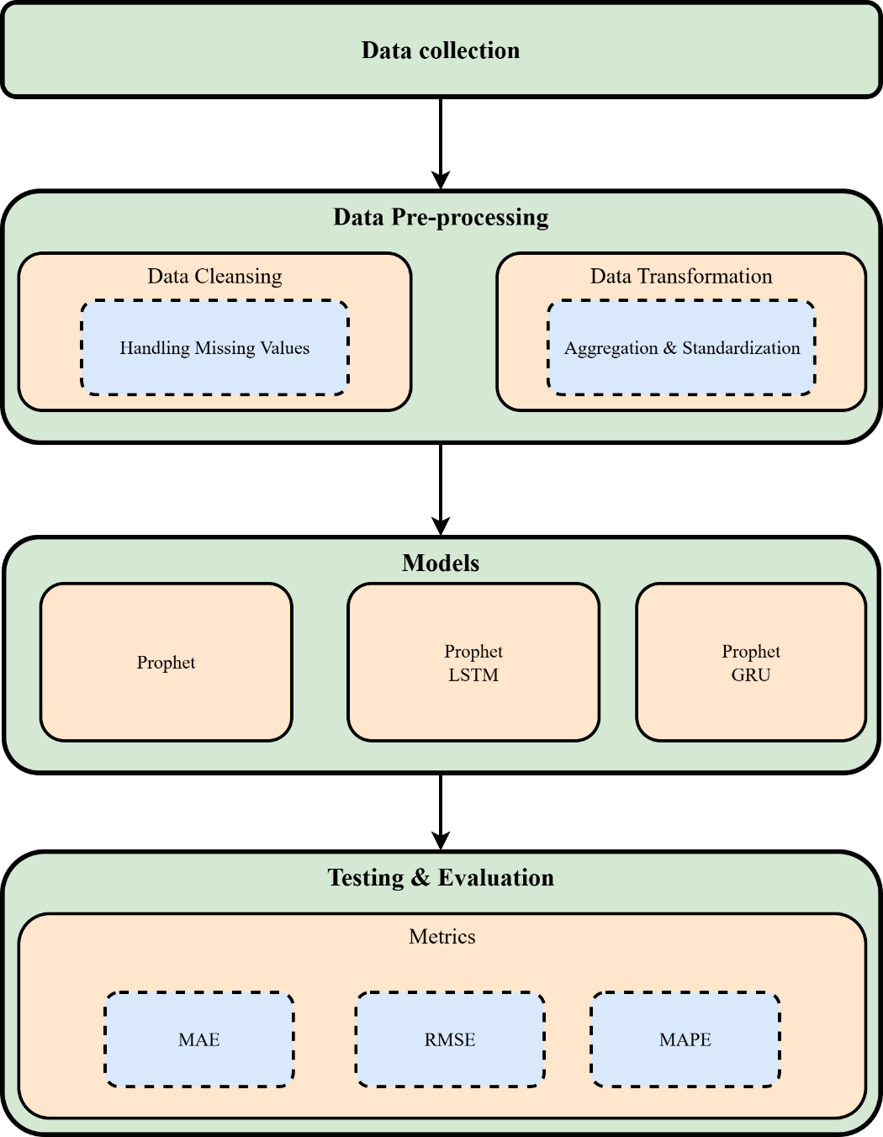
Proposed Framework

Slide 12
Models Used
Prophet (statistical baseline)
LSTM (deep learning)
GRU (efficient recurrent model)

Slide 13
Experimental Setup
Train/Validation/Test split
Sequence length: 30 days
50 epochs with early stopping

Slide 14
Evaluation Metrics
MAE – average absolute error
RMSE – penalizes large errors
MAPE – relative percentage accuracy

Slide 15
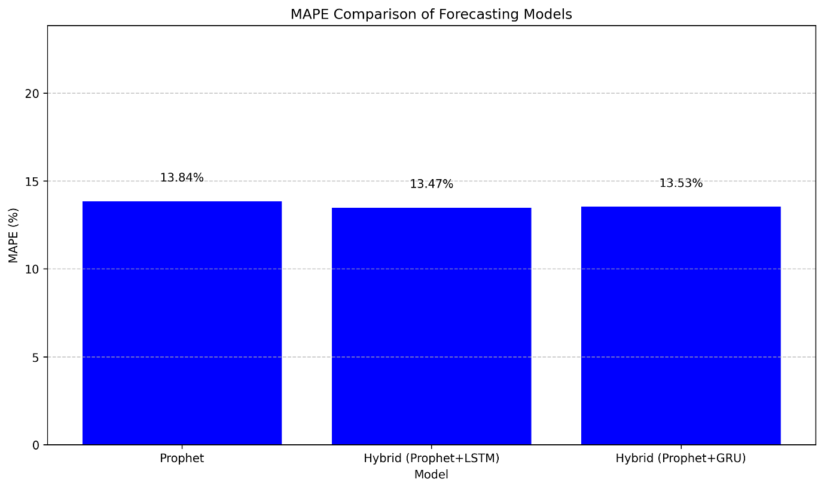
Results
Prophet MAE: 184.12, MAPE: 13.84%
Prophet+LSTM MAE: 181.12, MAPE: 13.47%
Prophet+GRU MAE: 181.75, MAPE: 13.54%

Slide 16
Discussion
Hybrid models outperform Prophet
LSTM slightly better accuracy
GRU more computationally efficient

Slide 17
Conclusion
Hybrid forecasting improves accuracy
Residual learning is effective
Applicable to real-world retail forecasting

Slide 18
Future Work
Transformers and attention mechanisms
Multivariate forecasting
Real-time deployment

Slide 19
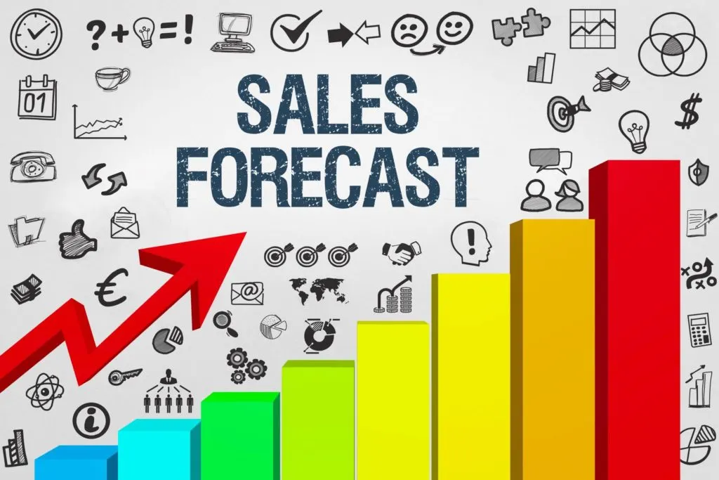
Thank You

