Slide 1

International Business Management
Prepared by Dr. Badur elgasim
Lecture 8
MGM 506
Organization of Multinational Operations

Slide 2

Learning Objectives
Definition and Functions of Organizing The Organization of Multinational
Factors Influencing the Structure of MNCs
The Development of an International Corporate Structure
Newer Forms of Organizations

Slide 3

Introduction
Collective endeavors, such as businesses, require a certain amount of order and organization, without which failure ensues. Organizational goal achievement depends on the effective combination of the contributions and work output of individual members. Because organizational activities are interdependent, complementary, and varied in type and timing, they require a certain degree of coordination and integration, which are facilitated through their operational proximity. Operational proximity means making allowances for the synchronization of activities in time and space

Slide 4
Definition and Functions of Organizing The Organization of Multinational
The organizing function involves designing a skeleton and structure that delineate the nature and extent of formal relationships among various internal components, including tasks, jobs, positions, and units of the organization. It is the physical and nonphysical form the organization assumes in response to its internal requirements and external environment. It allows for the distribution of power and authority among the members and the establishment of communication lines between them

Slide 5

The internal requirements of a firm are related to the type of technology used, the nature of tasks performed, and the type of strategy employed. The external environment is the combination of outside constituencies and forces that are influential in determining the fate of the organization. Because firms have different internal requirements and external environments, they employ various structural configurations. In other words, the structure of a firm is a tool for attainment of goals and a means to an end

Slide 6
The structure of the organization defines the boundaries of the organizational components (units); the relationships among the various parts; the extent, limits, and location of authority and power; and the formal communication patterns.
The architects of the organizational structure need to answer four basic questions about the firm

Slide 7
What should the units of organization be?
Which components should be joined, and which should be kept apart?
What size and shape pertain to the different components?
4.What is the appropriate placement of and relationship between the different units?
The basic principle for organizing is to group activities that have similar characteristics and functions from the lowest levels of the firm and proceed upward. In doing so, tasks are clustered into jobs, jobs are combined to form departments, and departments are put together to create business units.
The clustering of activities just described is commonly referred to as departmentalization

Slide 8
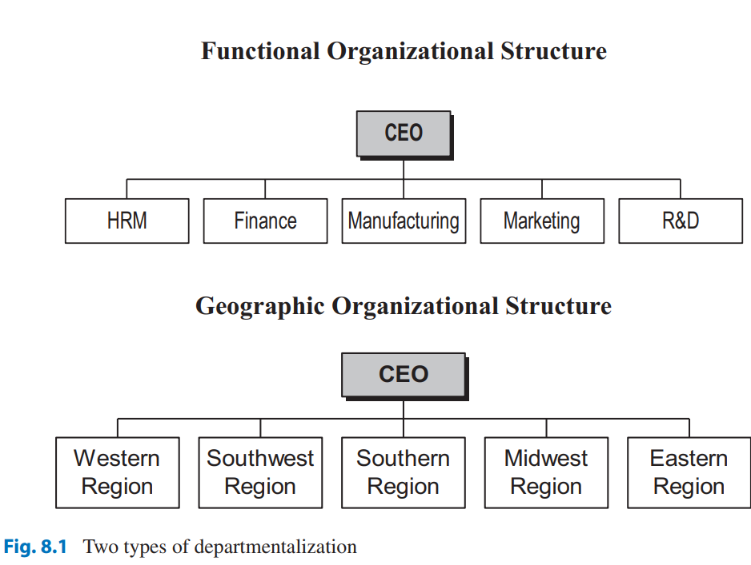
There are six common bases for departmentalization or grouping of organizational activities: knowledge and skill, work process and function, time (shifts in a factory), output (products), client, and place (geographic) .
Figure 8.1 represents organizational structures resulting from two of the most commonly used types of departmentalization: functional and geographic

Slide 9
Factors Influencing the Structure of MNCs
External Forces The major external environmental forces that influence an MNC’s structure are economic conditions, host governments, technological developments, product-market characteristics, and information technology
Economic Conditions Changes in economic conditions at home and abroad create opportunities for and threats to the operation of MNCs.

Slide 10
Unemployment and reduced purchasing power resulting from recessions and slower economic growth force adjustments in MNCs’ business operations.
Reduced market share and earnings in mature markets may prompt firms to diversify. Internationalization may partly be the consequence of home market saturation and maturity.

Slide 11
Technological Developments
In some industries, the high level of risk and huge investment required for developing new products are straining the financial capabilities of many MNCs, prompting international joint ventures between competitors.
Also, because of globalization, MNCs face the same competitors in many markets. Consequently, local advantages are quickly eroded by the immediate responses of international rivals.

Slide 12
The reality of competition between partners of international joint ventures and the need for fast response require a flexible structure and a closer integration of worldwide operations.
Technological developments are considered to be the most important factor influencing structural changes in MNCs

Slide 13
Product-Market Characteristics
Newly industrialized countries such as South Korea and Taiwan have appeared on the international scene as competitors partly because of recent shifts in regional economic growth. The emergence of this new competition has increased market uncertainty and instability.
Simultaneously, advances in manufacturing technologies, new product development, and marketing, along with the convergence of consumer tastes and preferences for certain products, have created a global market

Slide 14
Other product-market characteristics, such as diversity of product line and the nature of the competition, affect the organizing efforts of MNCs. A product division structure and a centralized decision-making process, for example, would serve well those firms that have a diverse product line and are competing with other MNCs in national markets. If competition in national markets is limited to local firms, granting more autonomy to the subsidiary would be appropriate. With competition limited to local firms, intimate knowledge of local conditions and a closer relationship with domestic businesses would be necessary.

Slide 15
Host Government Policies
are influential factors shaping the strategies and, in turn, the structure of MNCs. Investment incentives offered by host governments stimulate FDI and the expansion of MNC operations. Many forms of trade and business requirements and restrictions influence the management of MNCs. Taxes and tariffs, the need for local content, local ownership, technology transfer, local employment, and minimum exports exert pressure on foreign subsidiaries.

Slide 16
Company Factors
Major company factors include its history, top management philosophy, nationality, corporate strategy, and degree of internationalization
Company History Firms in the early stages of internationalization have a few managers with experience and expertise in coping with a complex worldwide operation. As the firms continue to operate abroad and learn how to manage their worldwide businesses, decisions regarding the organizational structure will be affected by those years of experience in foreign markets.

Slide 17
Top Management Philosophy
Top management philosophy regarding the autonomy granted to subsidiaries is reflected in various control mechanisms that the headquarters employs. The organizational structure is a means for exercising headquarters control over subsidiaries.
A loose federation of national subsidiaries under the general direction of headquarters, for example, is a sign of management belief that local executives are better qualified to run their own operations.

Slide 18
Nationality
There are differences among the organizational designs of American, Japanese, and European MNCs. European subsidiaries, for example, tend to have more autonomy than American subsidiaries. The type of control used also varies among the MNCs of different countries. US MNCs tend to exercise a higher level of output control over their subsidiaries, while Europeans usually exert a higher level of behavioral control . Corporate Culture Another factor that influences the choice of organizational structure is corporate culture

Slide 19
The Development of an International Corporate Structure
As a mechanism that facilitates progress toward goals, organizational structure evolves to accommodate the implementation of strategies. Firms follow different paths to international expansion, which assumes many different forms. The organizational structure of most international operations evolves to serve the growing needs of their diverse markets. Consequently, their choice of the structure depends on the type of strategy employed. The firm thus transforms from a domestically oriented one and passes through three phases—namely, international, multinational, and global

Slide 20
International Orientation
In the first phase, competition is limited to a small number of companies located in developed countries. These firms manufacture products with functions, features, and characteristics that are designed for the domestic market. International operation for these firms consists only of exports. Although exports may be an important source of revenue, they constitute only a small portion of the total corporate earnings, so international operations are merely an appendage to their domestic business. At this stage, firms continue using the existing domestic structures, with some minor additions to accommodate business activities across national borders

Slide 21
Multinational Orientation
In the growth stage, technology diffusion and price competition, particularly from domestic firms, force firms to establish manufacturing facilities in low-cost locations abroad. As increased foreign sales make up a larger share of corporate revenues, firms enter the second phase by changing the organizational structure to include the international division structure
Global Orientation
In Phase 3, most of the corporate revenues are generated from abroad. At this stage, MNCs organize their operations on a global basis

Slide 22
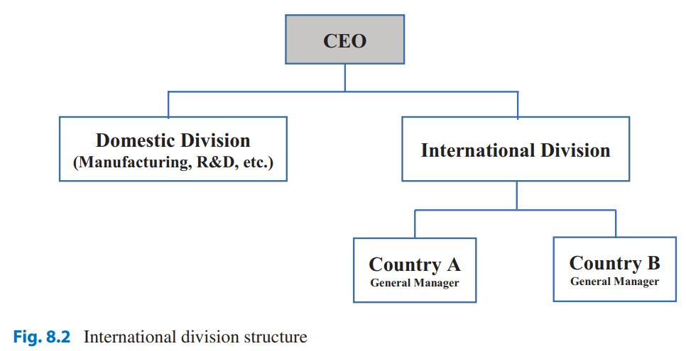
The International Division Structure
The international division corporate structure is likely to be adopted by firms with a dominant domestic business, a narrow product line, limited geographic diversity, and few managers with international business expertise and experience.

Slide 23
Advantage:
The international division structure provides a few benefits, including the adequate top management attention to foreign business, the concentration of international management expertise at the headquarters, and the acquisition of capital and resources worldwide

Slide 24
Disadvantages:
The international division structure has some drawbacks. There is an inherent conflict between the goals of the domestic and international divisions. Almost always, products that are sold abroad are those produced for the domestic market.
The international division does not have its own R&D and engineering staff. Therefore, it cannot cater to the special needs of its foreign customers

Slide 25
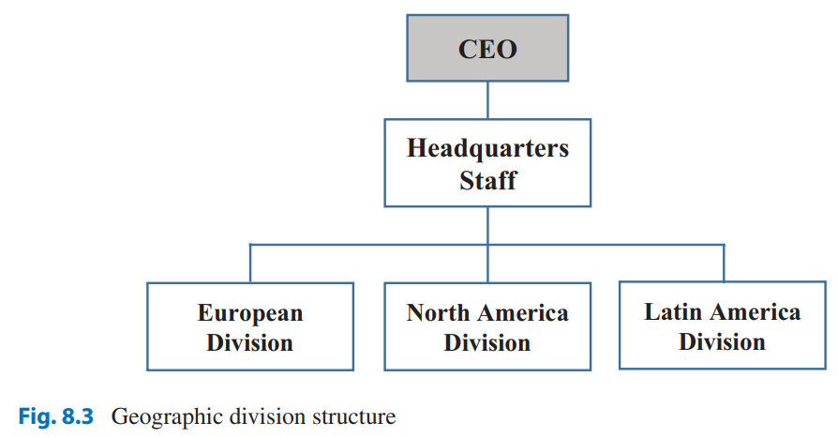
The Geographic Division Structure
The geographic or regional structure divides worldwide operations into regional divisions. The responsibility for managing each geographic area goes to a senior level executive
The advantages of: the geographic division form are the possibility of regional economies of scale and the treatment of country subsidiaries as profit centers. It is also suited to situations where whole regions can be treated as a market, with modest marketing modifications for individual countries.

Slide 26
Disadvantage
A firm with a diverse product range may find that the regional structure is inadequate to handle coordination among product lines and between the country subsidiaries.
MNCs using a geographic division structure may experience difficulties with the transfer of new production techniques and new product ideas from one country to another and the optimum flow of products and material from diverse sources to world markets

Slide 27
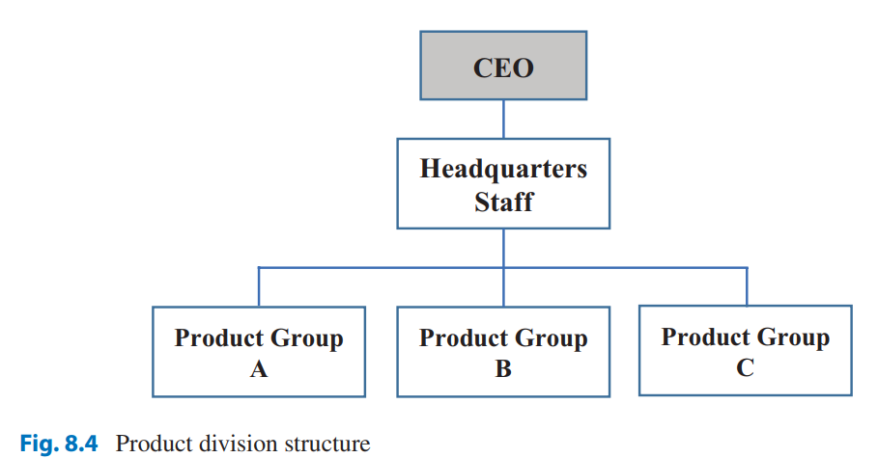
The Product Division Structure
Firms using a product division structure arrange their business into product groups and assign a senior line executive total responsibility for each product division

Slide 28
Advantages:
The benefits of product division are realized when high transportation costs, tariffs, and other considerations favor local manufacturing of the product. By emphasizing the product market and taking advantage of advanced technology and product expertise, multinational operations are better served by this type of structure.
The flexibility of division by product allows the MNCs with growth strategies to add new product divisions without disturbing the rest of the organization .facilitates fast response to the global competitive pressures against specific product lines.

Slide 29
Disadvantages
A product division structure may result in wasteful duplication of management, sales representation, and plant capacity utilization within regions.
A customer, for example, may be visited by representatives from different product divisions

Slide 30
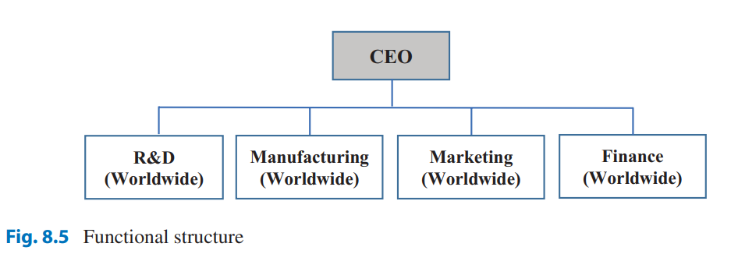
The Functional Structure
In a functional structure, the responsibilities of managing the MNC’s operations are organized by functions. Each business function, such as manufacturing, marketing, finance, R&D, and human resource management, is assigned to a top-level executive
Advantages :A functional structure seems to work well in the raw material extractive industry because raw materials are very homogeneous and processes do not differ substantially from one country to another

Slide 31
Disadvantages :
For a firm with a multiple product lines, the use of a functional structure could create problems. It puts undue demands on functional managers, which are not easily met. These managers would need expertise in multiple product lines and regions. Another problem is the inherent divergence of objectives among functional managers. The conflicts resulting from differences in objectives between functional managers

Slide 32
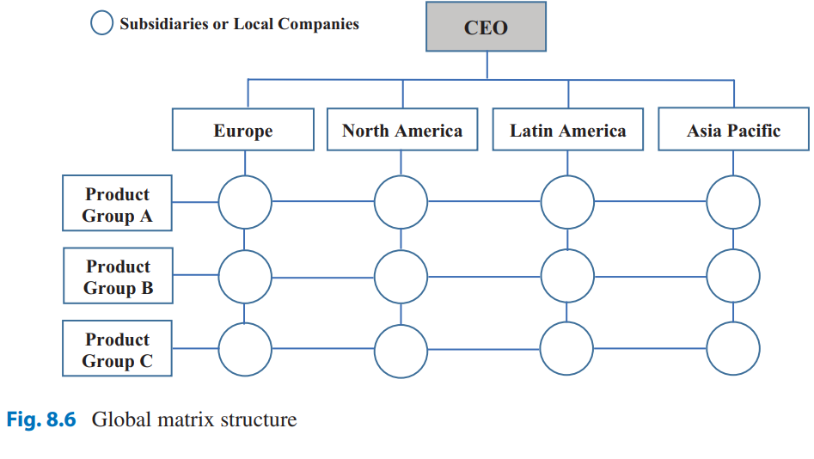
Global Matrix Structure
Matrix management is an organizational form in which normal hierarchy is overlaid by some form of lateral authority, communication, and influence. A matrix organization does not follow the traditional principle of unity of command, which prescribes that each subordinate will have only one superior. There are dual channels of authority, performance responsibility, evaluation, and control in a matrix organization.

Slide 33
Advantages : It enables the efficient use of organizational resources. Specialists, as well as equipment, can be shared across multiple projects or countries. It also provides a clear and workable mechanism for coordination work across functional lines, facilitating project integration.
Disadvantages :Proponents praise its efficiency and flexibility, while critics say the matrix is costly, cumbersome, and overburdening to manage. It has a built-in tension between country managers and product managers, who are in competition for control over the same set of resources. Such conflict is viewed as a necessary mechanism for achieving an appropriate balance between product issues and unique country requirements

Slide 34
Newer Forms of Organizations
MNCs and domestic firms alike are in constant search for the best possible organization design. Although functions, products, and geographic areas remain the three basic models of organizational structure, each has shortcomings that limit its application. The efforts to combine the benefits of all three models while keeping the drawbacks at a minimum produced the matrix structure. Although the matrix design offers the flexibility and quick response needed in a dynamic global business environment, it is not the final answer to the organizing needs of the MNCs

Slide 35
Market-Based Design
A market-based design takes into account market differences in structuring the firm. A market could be a group of countries that have a similar pattern of needs, purchasing behaviors, and product use. Based on these criteria, the world could be divided into a few markets that could be served with similar products and services. The advent of the Internet and modern communication technologies has reduced the problems associated with geographic separation between different units within each market

Slide 36
Strategic Business Unit
Based on the logic of market-based design, General Electric established its planning around “strategic business units” (SBUs)—families of businesses that encompass product and geographic dimensions.
The older structure serves as a supportive skeleton on which the newer structure of an SBU is overlaid. Xerox Corporation has done similarly by discarding its matrix structure in favor of SBUs

Slide 37
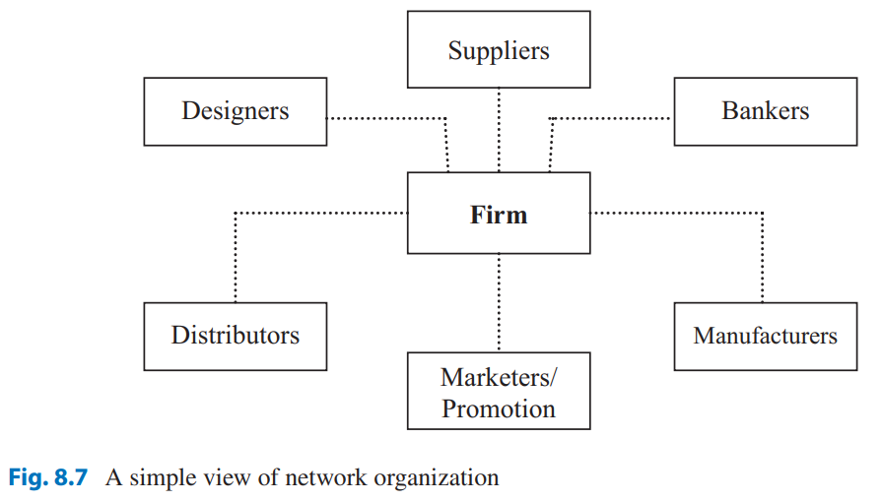
Networks
There are two paths to internationalization: the traditional path and the new path.
The new path is provided by the free trade system and the network of its participants, which act as a springboard from which firms can launch themselves directly to the global stage.

Slide 38
In doing so, they become a part of the network and acquire network structures. These firms are characterized by their connections with suppliers, marketers, and other firms and, where needed, with the local governments. We call these forms a “network” design The network, however, is neither a solid form nor a design that has a permanent skeleton on which the organizational requirements of job design, authority-responsibility designation, communication, and relationships could be fleshed out. It is more of a multidirectional organization rather than either a vertical or a horizontal organization

Slide 39
Resources:
Kamal Fatehi & Jeongho Choi
International Business Management
Succeeding in a Culturally Diverse World, Second Edition

