Slide 1


Strategic And Operational Risk Management
Prepared by Dr. Ayman Hassan
  PMG 630
  The risk management Process
Lecture 2

Slide 2



Strategic And Operational Risk Management
Lecture 2
PMG 630
The risk management Process
Prepared by
Dr. Ayman Hassan

Slide 3
Lecture No.2, Content
***Summary of the previous lecture, A-B-C***
Introduction with Important tips & approach
Operational risk management processes & Risk management techniques
Guiding questions for expanding the scope of ORM, The questions are:
What should go right?
What could go wrong?
What are the causes and consequences?
What is the probability of it happening?
What can be done to detect, control and manage it?
What are the alternatives?
What are the influences that go beyond this particular time?
4. Presenting the idea of the causal chain of events and its purpose
5. Conclusion.

Slide 4
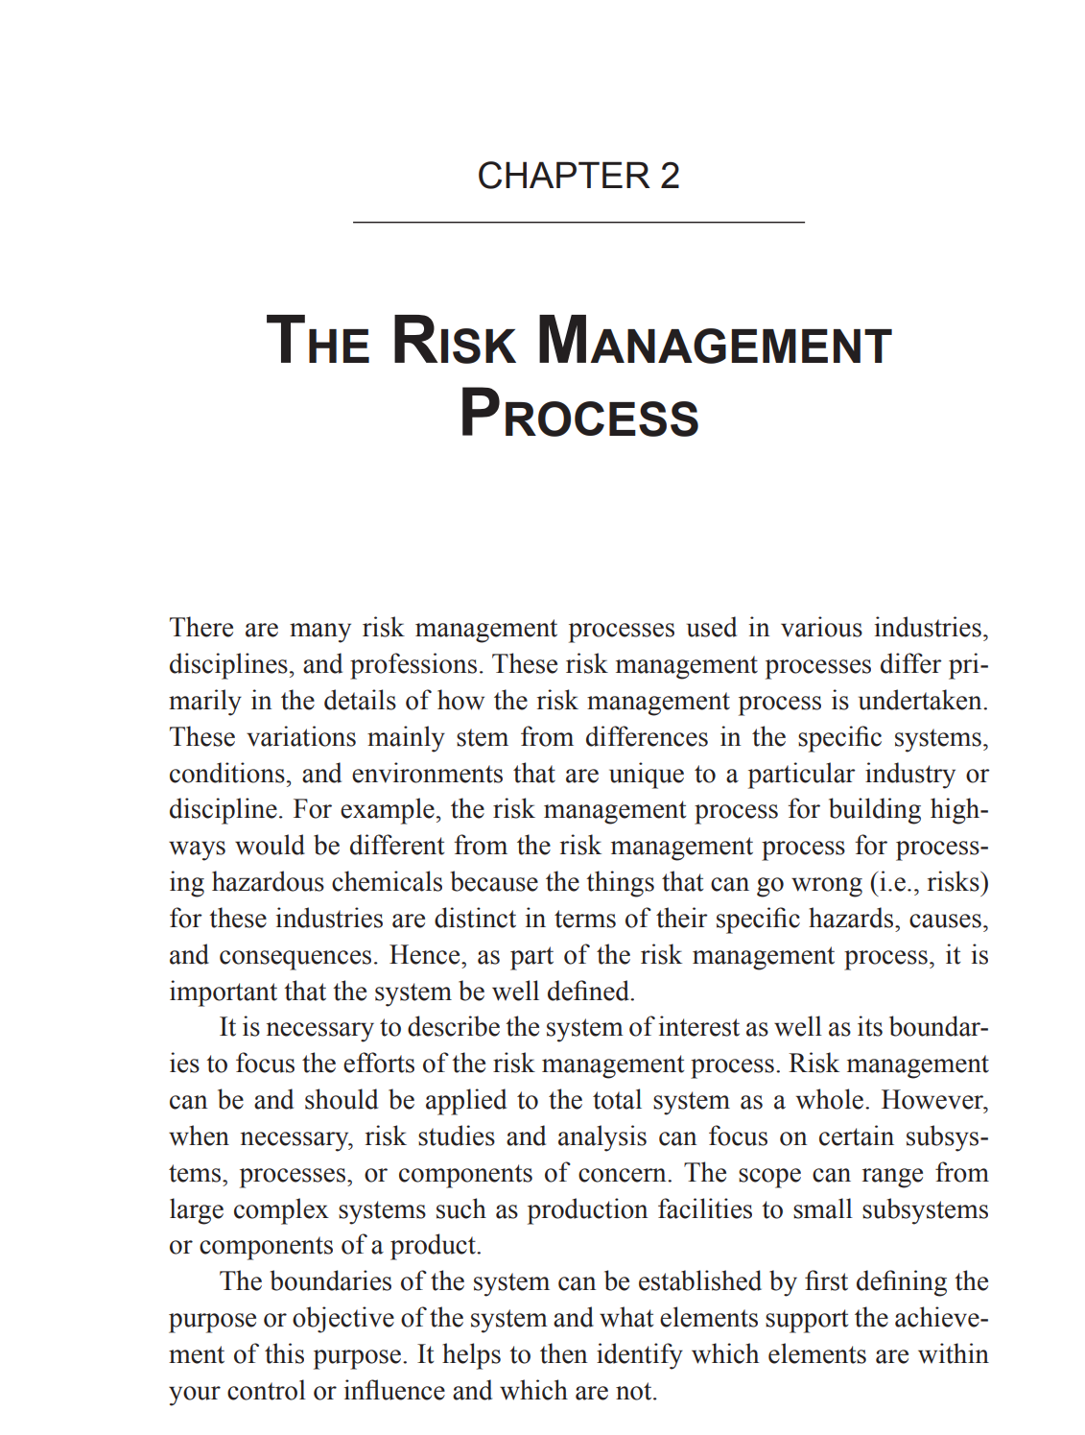

Lecture No.2,
Chapter 2

Slide 5



***In the previous lecture-A-***
Hazard + Exposure = Risk
+
=
Adapted by:
Dr. Ayman Hassan

Slide 6
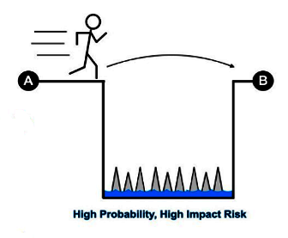
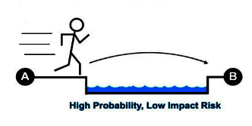
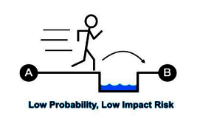
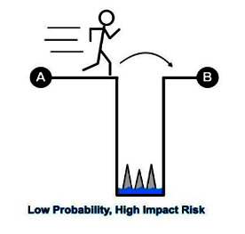
***In the previous lecture-B-***
risk = frequency (likelihood) x consequence (severity)
LIKELIHOOD
CONSEQUENCE
Adapted by:
Dr. Ayman Hassan

Slide 7
***In the previous lecture-C-***
There is no life without risks...there are never real guarantees
Probability and attempts at prediction.....are never without risks
As long as you move, you will be exposed to danger... expect it or not
Survival, continuity, and the desire to succeed...a human hope
Ayman Hassan

Slide 8
1. Introduction
There are many risk management processes used in various industries, disciplines, and professions.
These risk management processes differ primarily in the details of how the risk management process is undertaken.
These variations mainly stem from differences in the specific systems, conditions, and environments that are unique to a particular industry or discipline.

Slide 9
1-1. Introduction, Important tips
It is necessary to describe the system as well as its boundaries to focus the efforts of the risk management process.
Risk management should be applied to the total system as a whole. However, when necessary, risk studies and analysis can focus on certain subsystems, processes, or components of concern.
The scope can range from large complex systems such as production facilities to small subsystems or components of a product.

Slide 10
1-2.Introduction Important approach, Simple risk matrix
LIKELIHOOD
H
3
6
9
M
2
4
6
S
1
2
3
SS
M
H
Source:
Dr. Ayman Hassan
CONSEQUENCE

Slide 11
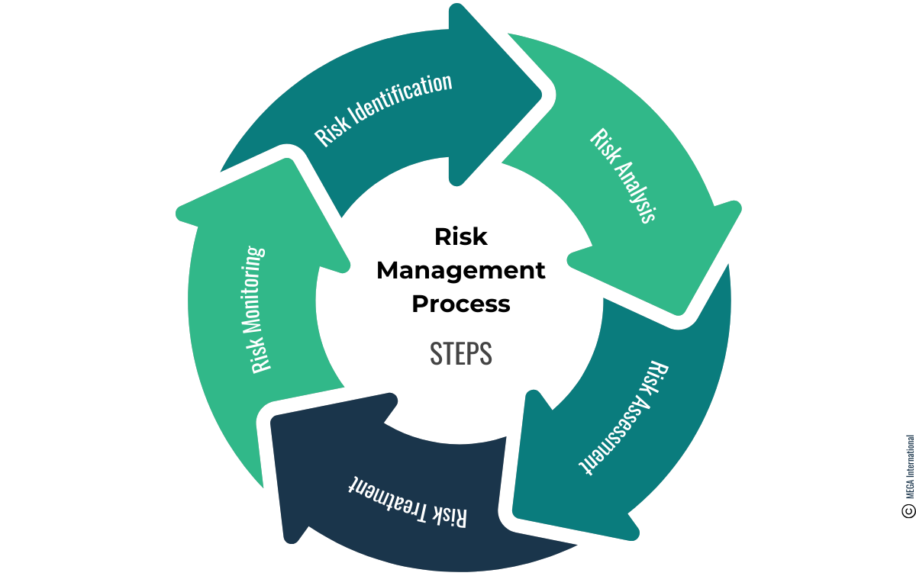
2. Operational risk management processes
Here Are The Essential Steps of A Risk Management Process
Identify the Risk
Analyze the Risk
Evaluate the Risk
Treat the Risk
Monitor and Review the Risk

Slide 12
3- Treat the Risk -Risk management techniques
LIKELIHOOD
Reduce
Avoid
Risk management techniques
Accept
Transfer
Source:
Dr. Ayman Hassan
CONSEQUENCE

Slide 13
3. Guiding questions for expanding the scope of ORM
Here we find five questions that correspond to the three steps of risk management, which are:
Identifying & Analyzing risks
Evaluation ( assessment step )
Mitigating its effects
The questions, respectively, are:
What should go right?
What could go wrong?
What are the causes and consequences?
What are the chances or chances of it occurring?
What can be done to detect, monitor and manage them?
What are the alternatives?.
What are the influences that extend beyond this particular time?

Slide 14
3-1. Why should we ask?
We ask... to define
We ask...to analyze
We ask...to evaluate
We ask...to know the impact
We ask... about alternatives: “Do we accept - do we avoid - do we participate - do we transfer the risk?”
We ask... Will the effect extend to other periods?
Ask about benefits/costs
The questions help us in the process of identifying hazards, analyzing its causes and effects, and thus dealing with it using operational risk management techniques, to make the best decision.
We ask... to define
We ask...to analyze
We ask...to evaluate
We ask...to know the impact and its probability
We ask... about alternatives: “ Accept - Avoid - Participate - Transfer the risk?”
We ask...to make the appropriate decision within the framework of benefits/costs
We ask... to take control

Slide 15
3-2. what should go right?
Once the system of interest is defined, its primary goals and related constraints need to be identified. for examples a production system.
The following are some of the possible goals:
• Produce the right quantity and quality products.
• Minimize shortages in raw materials, machine resources, and needed personnel.
• Minimize total cost of production.
• Minimize disruption in delivery of finished products.
• Minimize the number of defective products.
• Maximize return on invested resources (e.g., profit).

Slide 16
3-3. What could go wrong?
Once the system of interest is defined, identifying the hazards, risks, and accidents that may happen in the operation of a system is the next step in managing risk, to deduce some undesirable events based on the objectives, for example
• Failure to produce the right quantity and quality products.
• Excessive shortages of raw materials, machine resources, and needed personnel.
• Unacceptable total cost of production.
This question helps identify risk events

Slide 17
3-3-1. What could go wrong?
The previous question: “What could go wrong?” We can describe it as a negative scenario
identification (also known as antigoal, anti objective, or negative scenario analyses) is a common strategy that basically conceives different ways things can go wrong in a system based on what are known as desired events.
It helps to imagine departures or deviations from the ideal.
Still, identification of risk can be a daunting and difficult task.

Slide 18
3-3-2. Ways of operational risk Classifications
On the basis of its primary causes, Table 1.2
On the basis of its consequences, Table 1.4
There are also several ways to find information on a particular risk, hazard, or accident described as follows.
Using Historical Information
Using Comparative Analysis
Using Predefined List of Risk Events
Team-Based Elicitation
Modeling

Slide 19
3-3-2-1. Ways of operational risk Classifications
1. Using Historical Information
The simplest way to identify risk that may happen in the future is by looking back at the past.
This is particularly applicable for systems that are currently operating or systems that have operated in the past.
Histories of risk events that have happened are usually documented in various forms: written, electronic, or tacit.
Companies that are diligent in their risk management practices, usually keep detailed information surrounding these events in the form of a risk register, a risk log, or hazard log.

Slide 20
3-3-2-1. Ways of operational risk Classifications
1-1. Using Historical Information
As an example a power supply interruption in a chemical processing plant.
The following information is commonly found in risk registers related to this risk event:
Brief description of risk event
• Known causes
Power outage at local electrical grid supply, accidental switch off of power switch into the facility, localized natural events such as lightning strikes, localized accidents such as fire, and others;
• Known consequences
Interruption in the affected facility and all ongoing chemical processes, downtime, production delays, product defects, and others;
• Risk management strategies in place
Uninterrupted power supply by backup generator.

Slide 21
3-3-2-2. Ways of operational risk Classifications
2. Using Comparative Analysis
There are instances as a system not yet built or still being developed.
In these cases, there are no past records of risk events.
Another instance is when a system is undergoing significant change.
Observing other similar systems and risk events that have occurred in those systems it will be useful information.
Observing similar systems includes looking at historical information such as risk registries and hazard logs of those systems that are comparable.

Slide 22
3-3-2-3. Ways of operational risk Classifications
3. Using Predefined List of Risk Events
Events Data banks of risk registers or hazard logs provide a wealth of information on risk events.
This type of list is commonly published by agencies like professional and industry groups based on a compilation of risk registers from systems under their purview.
These come in the form of lists, checklists, records, databases, standards, and codes of practice. For example, the construction industry has pre-existing hazard lists compiled by the Occupational Safety and Health Administration (OSHA) ‘Occupational Safety and Health Administration

Slide 23
3-3-2-3. Ways of operational risk Classifications
3-1. Using Predefined List of Risk Events
Consider as an example a list of risk events that applies to construction workers.
A predefined hazard list includes the following:
• Falling
• Sunburn
• Exhaustion
• Unacceptable loud noise
• Physical injuries
• Dust and particulate inhalation Manuals, handbooks, and guides also often contain predetermined list of known risks.
Material safety data sheets, equipment manuals, equipment manufacturers’ technical representatives, existing health and safety plans, and handbooks can help identify common risks.

Slide 24
3-3-2-4. Ways of operational risk Classifications
4. Team-Based Elicitation
Brainstorming is useful when hazards have to be conceived (abstractly imagined) and predicted (foreseen).
Certain A multidisciplinary, cross-functional team with specific system knowledge can help identify many potential operational risks.
This method capitalizes on the wide range of knowledge and experience of team members, especially tacit knowledge.
Representatives in the organizational functions related to the system of interest should be included, starting with the operators, supervisors, design and quality engineers, maintenance personnel, and all other workers who directly interact with the system of interest.
Occupational and safety experts, health specialists, and other personnel experienced with industry-specific risks are also good candidates to be included as team members.

Slide 25

3-3-2-4. Ways of operational risk Classifications
4. Team-Based Elicitation
Characteristics of the team-based elicitation method
Collective expertise and experience is important to ensure that as many potential hazards as possible are identified.
A meeting or workshop format may be helpful in gathering data quickly.
In the end, it is important to collect as much information as possible about the system to help us identify all potential hazards to the system.

Slide 26
3-3-2-5. Ways of operational risk Classifications
5. Modeling
Models are used to identify potential risk events.
Models include analytical, mathematical, physical, mental, and other types, which may be used to represent a new system, the changes within the existing system, and the system’s external environment.
Many models of these types often include computer simulations.
Consider as an example the prototype modeling of cars and airplanes to identify which components will most likely fail after extensive use under various scenarios.

Slide 27
3-4. What are the causes and consequences?
this phase is to describe these events for the purpose of extending understanding and knowledge about the risk
This involves establishing causality, identifying root causes and their likelihood, as well as characterizing consequences and impact.
This helps in developing more appropriate and effective decisions or actions related to the management of risk.
Invoking the notion of the systems

Slide 28
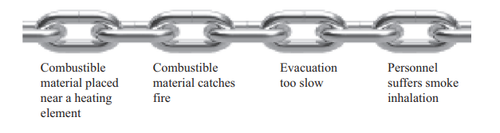
3-4-1. What are the causes and consequences?
This Figure is a causal chain of events showing interaction between elements of a system, mechanics of fire, and the risk event of a fire in an industrial facility.
Figure 2.1.
OPERATIONAL RISK MANAGEMENT

Slide 29
3-4-2. What are the causes and consequences?
Ultimately
analysis of the causal chain of events leads to the identification of root causes.
The knowledge of various elements of a system and their interactions in time may explain how a risk event can eventually occur. for example, how humans use a machine in an industrial process, may be used to establish the causal chain of events. The key is to identify root causes to be addressed. Many cause analysis tools such as root cause analysis, fish bone diagram, Pareto charts, and scatter diagrams can be useful.

Slide 30
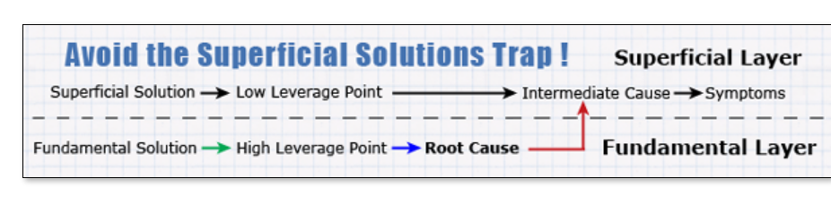
3-4-3. What are the causes and consequences?
A causal chain is the path of influence running from a root cause to problem symptoms. Each link in the chain repressents something in the real world. At one end of the chain is the root cause. At the other end is the symptoms it causes. The many links between the two ends are the intermediate causes. How this works is explained in this diagram:

Slide 31
3-5. What are the chances of occurrence?
Sequences of events that lead to a particular risk event, that is, the causal chain of events, need to be described in terms of their respective chances of occurrence.
The frequency or chance of occurrence of a risk event pertains to the quantitative or qualitative description of how often or how soon a particular risk event may occur.
This is often derived from historical information or records of the risk event.
This can also be derived from team-based elicitation.

Slide 32
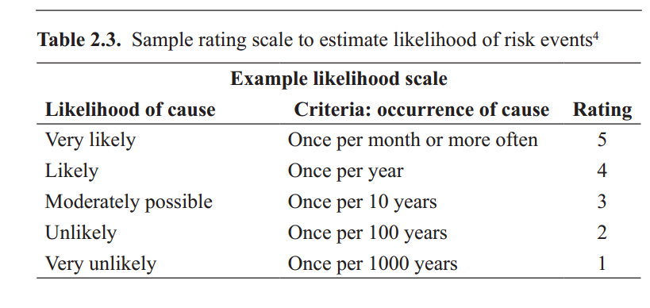
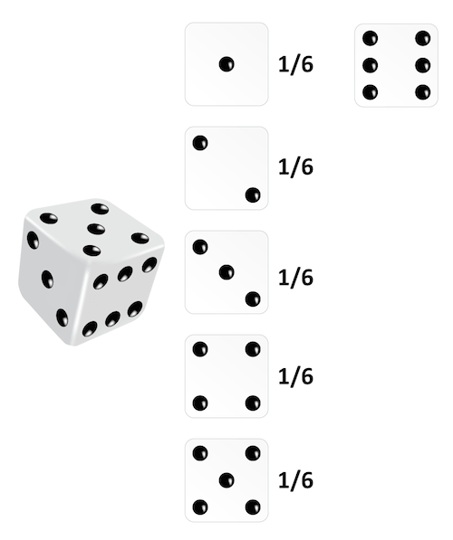
3-5-1. What are the chances of occurrence?
Likelihoods are also evaluated through a rating scale such as that shown in Table 2.3.

Slide 33
3-6. What can be done to detect, control and manage them?
Ranking and scoring is conducted to evaluate criticality and determine relative importance.
However, common critical risks are those whose consequences are related to health and safety, compliance to regulatory requirements, or those that affect core business practices.
Criticality may be assessed using a risk matrix
The risk matrix in Table 2.4 highlights risk events with high severity ratings such as those risks that fall under the catastrophic category of consequences or risks that fall under the very likely category of likelihood of occurrence.

Slide 34
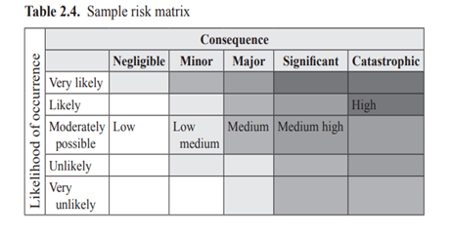
3-6-1.What can be done to detect, control and manage them?
In Table 2.4, these are the risk events that fall in the darker boxes. Risk events that fall in the darkest boxes should be addressed immediately.
Risk matrix tables are useful for categorizing and prioritizing identified risks.

Slide 35
3-7. What are the alternatives?
Which risk treatment strategies will work well together, given the causal chain of events?
Risk treatment strategies are not mutually exclusive, and effective action plans are usually made up of combination of strategies, albeit in various degrees.
Consider the causal chain of events illustrated in Figure 2.1 of a system and mechanics of fire.
Based on common experience, we can identify particular risk strategies to address the various segments in this chain

Slide 36
3-7-1. What are the alternatives?
For example, regular housekeeping to prevent the accumulation of combustible materials near a heating element, installing and maintaining smoke detectors near equipment with heating elements, having an evacuation plan and conducting regular drills, training to prevent smoke inhalation, and others.
However, all these strategies can be in various degrees and combinations; the appropriateness may depend on the particulars of the specific system.
The usual criteria in choosing alternatives are
• Early detection
• Minimize direct and indirect consequences
• Faster recovery
• Impede accrual of consequences.

Slide 37
3-8. What are the Effects beyond this particular time?
From a system’s perspective, it is important to evaluate the effects of the risk treatment alternatives to other elements of the system.
Risk treatment alternatives may be analyzed according to their effects to functionalities of elements of the system, the manner by which they alter interaction among elements, and their potential to affect future decisions.
This is also the point where the acceptable level of risk is determined by comparing the costs and benefits of each mitigation alternative.
The concept of As Low as Reasonably Practicable, a fundamental approach that sets the risk to the tolerable, reasonable, and practical level, will be further discussed in Chapter 3.

Slide 38

* In the End *
Conclusion

Slide 39
9. Conclusion
The generalized framework for operational risk management can be summarized in six steps, with one precursory step (hence, the label 1 + 6 guiding questions in Table 2.1). These questions extend the more commonly known risk analysis, assessment, and management.
The questions are as follows:
What should go right?
What can go wrong?
What are the causes and consequences?
What is the likelihood of occurrence?
What can be done to detect, control, and manage them?
What are the alternatives?
what are the effects beyond this particular time?
The notion of the causal chain of events was introduced to show interactions between elements of a system and how this can be used to assess the chances of occurrence and the consequences if the risk events occur.
The causal chain of events can also be used to generate ways of how initiating events can be detected before a risk event occurs, as well as what can be done to control their occurrence and consequences.

Slide 40
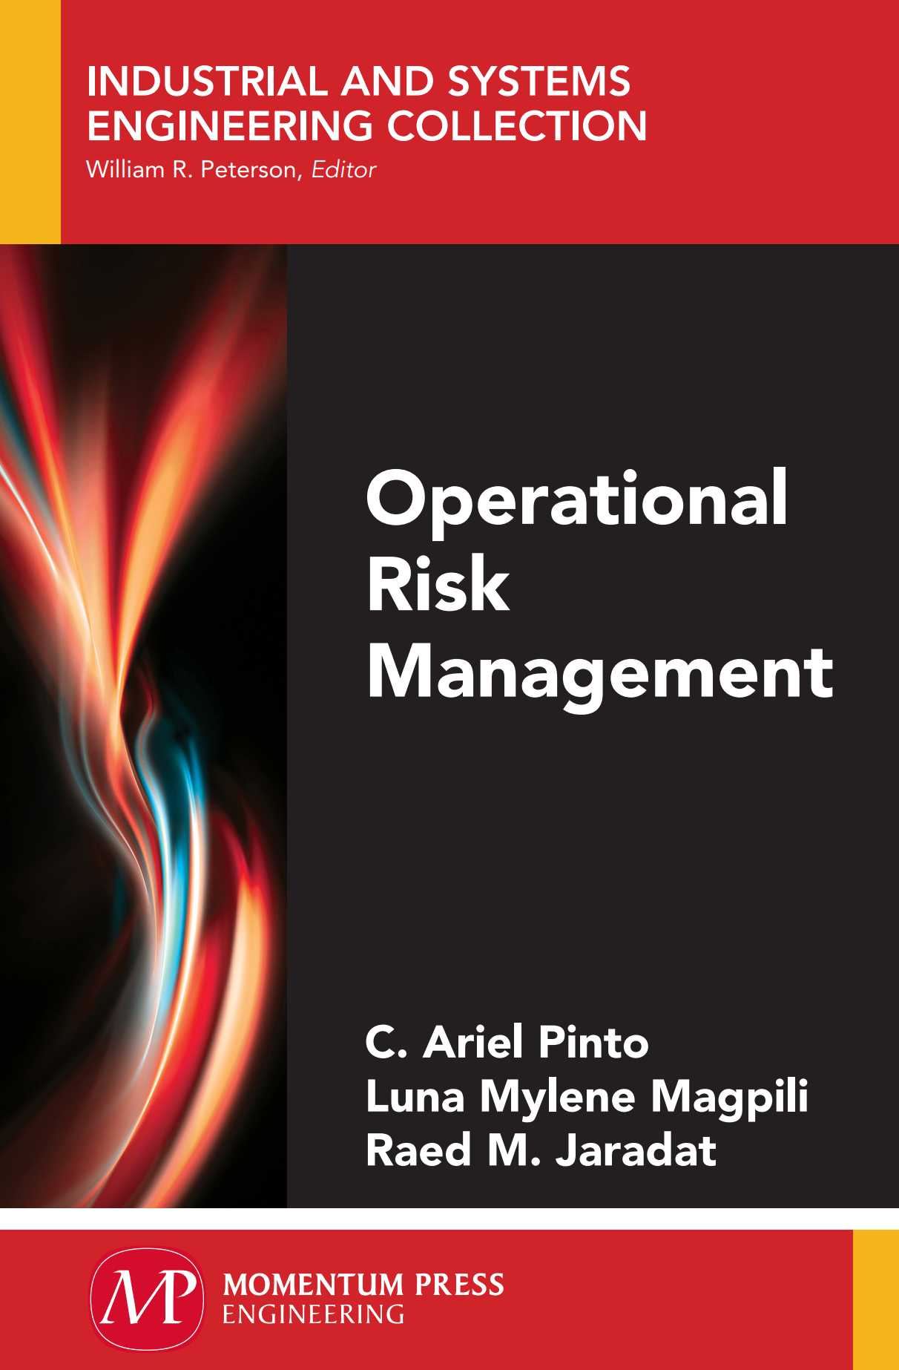
10. References & Resources
Causal Chain - Tool/Concept/Definition (thwink.org)

Slide 41



Thank You

