Slide 1



Project Time Management
PMG212
Prepared by Dr. Nael Yousry
Presented by Dr. Amira Elfekky
مقرر: إداره وقت المشروع
الفصل الدراسي الثالث 2023
Lecture 1

Slide 2

Agenda
Understanding Project Management
Meaning of “ Project “
Project Management Life Cycle
Successful project management
Benefits of project management
Obstacles of project management
Project Management
Project Manager's Role
Functional Manager’s Role
www.midocean.ae

Slide 3
Agenda
Understanding Project Management
Meaning of “ Project “
Project Management Life Cycle
Successful project management
Benefits of project management
Obstacles of project management
Project Management
Project Manager's Role
Functional Manager’s Role
www.midocean.ae

Slide 4


Chapter
1
Understanding Project Management
In order to understand project management, one must begin with the definition of a project.
A project can be any series of activities and tasks.
www.midocean.ae

Slide 5
Agenda
Understanding Project Management
Meaning of “ Project “
Project Management Life Cycle
Successful project management
Benefits of project management
Obstacles of project management
Project Management
Project Manager's Role
Functional Manager’s Role
www.midocean.ae

Slide 6

Chapter
Meaning of “ Project “
1
A project: is a temporary endeavor undertaken to create a unique product, service, or result.
Project characteristic:
  Projects are temporary.
  Has definite beginning and end, the end is reached when the project’s objective have been achieved.
  Projects are unique.
  Every project creates a unique product, service, or results.
  Progressively elaborated.
  Progressively: proceeding in steps.
  Elaborated: worked with care and detail.
www.midocean.ae

Slide 7
Chapter
Meaning of “ Project “
1
The temporary nature of projects indicates that a project has a definite beginning and end.
Temporary does not necessarily mean a project has a short duration.
The end of the project is reached when one or more of the following is true:
  The project’s objectives have been achieved;
  The objectives will not or cannot be met;
www.midocean.ae

Slide 8
Chapter
Project Ending
1
  Funding is exhausted or no longer available for allocation to the project;
  The need for the project no longer exists (e.g., the customer no longer wants the project completed, a change
  in strategy or priority ends the project, the organizational management provides direction to end the project);
  The human or physical resources are no longer available; or
  The project is terminated for legal cause or convenience.
www.midocean.ae

Slide 9
Agenda
Understanding Project Management
Meaning of “ Project “
Project Management Life Cycle
Successful project management
Benefits of project management
Obstacles of project management
Project Management
Project Manager's Role
Functional Manager’s Role
www.midocean.ae

Slide 10
Lecture 1
Project Management Life Cycle
Project Management Process Groups
Chapter
1
Initiation
Planning
Execution
Controlling
Closeout

Slide 11
1st PM Process Group
Project initiation
Chapter
1
● Selection of the best project given resource limits
● Recognizing the benefits of the project
● Preparation of the documents to sanction the project
● Assigning of the project manager
www.midocean.ae

Slide 12
2nd PM Process Group
Project planning
Chapter
1
● Definition of the work requirements
● Definition of the quality and quantity of work
● Definition of the resources needed
● Scheduling the activities
● Evaluation of the various risks
www.midocean.ae

Slide 13
3rd PM Process Group
Project execution
Chapter
1
● Negotiating for the project team members
● Directing and managing the work
● Working with the team members to help them improve
www.midocean.ae

Slide 14
4th PM Process Group
Project monitoring and control
Chapter
1
● Tracking progress
● Comparing actual outcome to predicted outcome
● Analyzing variances and impacts
● Making adjustments
www.midocean.ae

Slide 15
5th PM Process Group
Project closure
Chapter
1
● Verifying that all of the work has been accomplished
● Contractual closure of the contract
● Financial closure of the charge numbers
● Administrative closure of the papework
www.midocean.ae

Slide 16
Agenda
Understanding Project Management
Meaning of “ Project “
Project Management Life Cycle
Successful project management
Benefits of project management
Obstacles of project management
Project Management
Project Manager's Role
Functional Manager’s Role
www.midocean.ae

Slide 17
Chapter
Successful project management
1
Successful project management can then be defined as having achieved the project objectives:
● Within time
● Within cost
● At the desired performance/technology level
● While utilizing the assigned resources effectively and efficiently
● Accepted by the customer
www.midocean.ae

Slide 18
Agenda
Understanding Project Management
Meaning of “ Project “
Project Management Life Cycle
Successful project management
Benefits of project management
Obstacles of project management
Project Management
Project Manager's Role
Functional Manager’s Role
www.midocean.ae

Slide 19
Chapter
Benefits of project management
1
● Identification of functional responsibilities to ensure that all activities are accounted for, regardless of personnel turnover
● Minimizing the need for continuous reporting
● Identification of time limits for scheduling
www.midocean.ae

Slide 20
Chapter
Benefits of project management
1
● Identification of a methodology for trade-off analysis
● Measurement of accomplishment against plans
● Early identification of problems so that corrective action may follow
● Improved estimating capability for future planning
● Knowing when objectives cannot be met or will be exceeded
www.midocean.ae

Slide 21
Agenda
Understanding Project Management
Meaning of “ Project “
Project Management Life Cycle
Successful project management
Benefits of project management
Obstacles of project management
Project Management
Project Manager's Role
Functional Manager’s Role
www.midocean.ae

Slide 22
Chapter
Obstacles of project management
1
● Project complexity
● Customer’s special requirements and scope changes
● Organizational restructuring
● Project risks
● Changes in technology
● Forward planning and pricing
www.midocean.ae

Slide 23
Agenda
Understanding Project Management
Meaning of “ Project “
Project Management Life Cycle
Successful project management
Benefits of project management
Obstacles of project management
Project Management
Project Manager's Role
Functional Manager’s Role
www.midocean.ae

Slide 24
Chapter
Project Management
1
Project management can mean different things to different people.
Quite often, people misunderstand the concept because they have ongoing projects within their company and feel that they are using project management to control these activities.
www.midocean.ae

Slide 25
Chapter
Project Management
1
In such a case, the following might be considered an appropriate definition:
Project management is the art of creating the illusion that any outcome is the result of a series of predetermined, deliberate acts when, in fact, it was dumb luck.
www.midocean.ae

Slide 26
Chapter
Project Management
1
Project management is designed to make better use of existing resources by getting work to flow horizontally as well as vertically within the company.
www.midocean.ae

Slide 27
Chapter
Project Management
1
Project management is the planning, organizing, directing, and controlling of company resources for a relatively short-term objective that has been established to complete specific goals and objectives.
www.midocean.ae

Slide 28
Chapter
Project Management
1
Classical management is usually considered to have five functions or principles:
● Planning
● Organizing
● Staffing
● Controlling
● Directing
www.midocean.ae

Slide 29
Chapter
Project Management
1
Today, the definition of project success has been modified to include completion:
● Within the allocated time period
● Within the budgeted cost
● At the proper performance or specification level
● With acceptance by the customer/user
www.midocean.ae

Slide 30
Chapter
Project Management
1
Today, the definition of project success has been modified to include completion:
● With minimum or mutually agreed upon scope changes
● Without disturbing the main work flow of the organization
● Without changing the corporate culture
www.midocean.ae

Slide 31
Agenda
Understanding Project Management
Meaning of “ Project “
Project Management Life Cycle
Successful project management
Benefits of project management
Obstacles of project management
Project Management
Project Manager's Role
Functional Manager’s Role
www.midocean.ae

Slide 32
Chapter
PROJECT MANAGER’S ROLE
1
The project manager is responsible for coordinating and integrating activities across multiple, functional lines.
The integration activities performed by the project manager include:
● Integrating the activities necessary to develop a project plan
www.midocean.ae

Slide 33
Chapter
PROJECT MANAGER’S ROLE
1
The integration activities performed by the project manager include:
● Integrating the activities necessary to execute the plan
● Integrating the activities necessary to make changes to the plan
www.midocean.ae

Slide 34
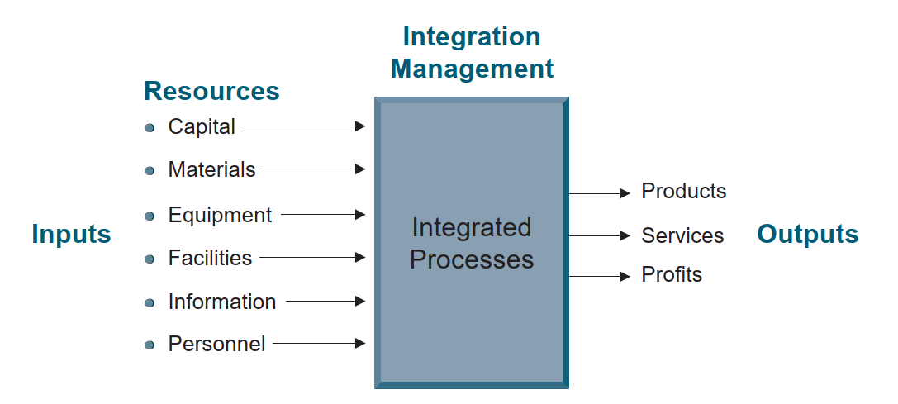
Chapter
Integration management.
1
www.midocean.ae

Slide 35
Agenda
Understanding Project Management
Meaning of “ Project “
Project Management Life Cycle
Successful project management
Benefits of project management
Obstacles of project management
Project Management
Project Manager's Role
Functional Manager’s Role
www.midocean.ae

Slide 36
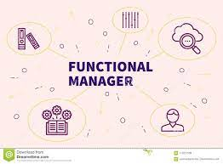
Chapter
FUNCTIONAL MANAGER’S ROLE
1
● The functional manager has the responsibility to define how the task will be done and where the task will be done (i.e., the technical criteria).
www.midocean.ae

Slide 37
Chapter
FUNCTIONAL MANAGER’S ROLE
1
● The functional manager has the responsibility to provide sufficient resources to accomplish the objective within the project’s constraints (i.e., who will get the job done).
www.midocean.ae

Slide 38


Chapter
FUNCTIONAL MANAGER’S ROLE
1
● The functional manager has the responsibility for the deliverable.
www.midocean.ae

Slide 39

www.midocean.ae

Slide 40



Thank You

