Slide 1


Master Of Real Estate
Management
Prepared by Dr. Ahmad Muhammad
MKT600
Digital Marketing Concepts
Lecture 8

Slide 2



Master Of Real Estate
Management
Lecture 8
MKT600
Digital Marketing Concepts
Prepared by
Dr. Ahmad Muhammad

Slide 3

Chapter
Mobile Marketing and Real Estate Apps
08

Slide 4

Chapter
Lecture Objectives
08
Interpret the concept of “marketing illusion” as an outcome of the interaction between digital marketing techniques and consumer behaviour, and analyse its core characteristics, namely the creation of artificial need, the exploitation of non-rational moments, and the distortion of personal priorities. Demonstrate an understanding of the concept of mobile marketing, while identifying its unique characteristics that make it an interactive, personal, and measurable tool. Apply the methodology of mobile marketing strategy by formulating the three principal questions: analysing the current situation, defining the future vision, and proposing implementation mechanisms. Classify mobile advertising content channels (responsive websites, AMP, instant articles, various forms of advertising, text messages, push notifications, in-game advertising, and QR codes) according to their characteristics, advantages, and practical limitations. Discuss the effectiveness of advertising through mobile devices, with particular emphasis on the importance of personalization, spatial integration (So-Lo-Mo), and the utilization of the device’s unique capabilities, such as geolocation (GPS) and direct connectivity. Relate the emergence of real estate applications to the mobile revolution, and identify the fundamental determinants of their function (spatial and temporal interactivity, data-driven personalization, and content enrichment). Analyse the functional classification of real estate applications (multi-source listing applications, developer applications, brokerage applications, and property management applications) and evaluate the strategic importance of each type within the institution’s integrated digital marketing mix.

Slide 5
Chapter
Introduction
08
Today, smartphones have become an indispensable part of people’s lives. In the past, house keys and wallets were considered the essential items people took with them when leaving home. Today, however, smartphones have come to precede almost everything else, to the point that many people cannot move from one place to another without them.
Naturally, this development has contributed to marketers’ growing desire to reach consumers more aggressively. Marketers are now able to communicate with consumers regardless of time or location and mobilize them around products, services, brands, content, and more. Whereas shopping once required leaving the house, it has now become a routine activity comparable to brushing one’s teeth before going to bed.
Of course, the consumer’s belief that they need a product may also be regarded as a marketing illusion. For example, when a consumer is making final preparations before going to bed and browsing social media on a smartphone one last time before sleeping, they may suddenly encounter a product and feel compelled either to purchase it or to seek more detailed information about it, even at the expense of their sleep. In this sense, confusing consumers about their priorities may be considered a form of marketing illusion.

Slide 6

“Marketing illusion” is a contemporary behavioural and psychological phenomenon in which the consumer’s desire is stimulated, or a sense of need for a given product is created (whether a good, a service, information, or other types of products), not as a result of a genuine need or an objective evaluation, but rather as a direct consequence of advanced digital marketing techniques that have become deeply embedded in daily life, most notably mobile phone applications.
Chapter
08

Slide 7
Chapter
Introduction
08
This illusion manifests itself through several fundamental characteristics, including:
The creation of artificial need: This refers to the transformation of the product from being a merely potential option into an element that appears “necessary” or “urgent” in the eyes of the consumer, through psychological mechanisms such as insistence, artificial scarcity, or emotional association with life situations (such as comfort or social distinction).
Exploiting non-rational moments: Digital marketing operates by penetrating personal spaces and quiet moments (such as browsing before sleep), when the consumer’s critical barriers are lowered. The marketing stimulus is thus presented at a time when the consumer is more likely to make impulsive or insufficiently considered purchasing decisions.
Distorting priorities: In fact, marketing illusion creates an imbalance in the consumer’s hierarchy of personal priorities. As in the example we presented, it may render the acquisition of a transient product (seen in a pop-up advertisement) more urgent than preserving time for rest or sleep. In other words, it reorders the individual’s needs according to a marketing agenda rather than in accordance with his or her values or genuine long-term benefits.

Slide 8
The nature of digital channels further contributes to reinforcing this illusion, as they enable continuous access to the consumer, present products in an attractive and direct manner, and facilitate the purchasing process through only a few steps (such as “buy now with the click of a button”), thereby eliminating the periods of deliberation and reflection that were present in traditional purchasing processes.
In summary, marketing illusion is the product of a gap created by modern marketing channels between “induced desire” (generated by intelligent and intensive marketing campaigns) and “actual need” (as determined by the consumer after rational consideration and a balancing of benefits and costs). It is a concept of great importance in contemporary marketing and consumer behaviour studies, as it highlights the immense persuasive power of digital channels and the ethical issues associated with their use.
Chapter
08

Slide 9
Chapter
Mobile marketing
08
Mobile marketing refers to those activities that use and leverage mobile devices, e.g., tablets, phones, or watches, to connect with target audiences and to promote a brand’s products or services.
With the help of mobile devices and technology, mobile marketing is a complementary digital marketing tool that provides the opportunity to reach the target audience at the right time, in the right place, and through the right medium. It enables the delivery of personalized messages to this audience, encourages immediate action at the moment the message is sent, can be measured effectively, is relatively low in cost, may be used either independently or in conjunction with other marketing tools, and adds an interactive dimension to these tools.
Mobile marketing emerged with the widespread use of devices known as cell phones or mobile phones in the 1990s. It has continued to support marketers by adapting to the new digital world order as internet access was incorporated into mobile phones and these devices evolved into smartphones. Accordingly, SMS, MMS, and Bluetooth were among the most commonly used mobile marketing techniques during the mobile phone era.

Slide 10
Before diving into a variety of mobile marketing tactics and activities, let’s first develop a mobile marketing strategy. Your mobile marketing strategy is a subset of your overarching digital marketing strategy. This means your mobile marketing strategies should support and align with both your marketing and digital marketing goals and objectives. That said, since so many people are now accessing the internet using mobile devices, i.e., smartphones and tablets, a mobile marketing strategy may represent the core digital marketing strategy for a particular organization. This strategic decision will largely be driven by the target audiences and their mobile behaviours.
Chapter
08
Mobile Marketing Strategy

Slide 11
Chapter
Mobile Marketing Strategy
08
To begin developing your mobile marketing strategy, you will want to ask the following key questions:
• Where is our mobile strategy today?
Ask yourself what mobile experiences have we already created, e.g., mobile-friendly website, mobile app, mobile marketing campaigns / outreach, email marketing campaigns, etc.? In essence, you want to take inventory of your mobile activities and then compare them to your competition. This approach is often referred to as situational analysis. Situational analysis is the process of critically evaluating the internal and external conditions that affect your organization. Some common business frameworks used for this activity are SWOT Analysis, PESTLE Analysis, Porter’s Five Forces, 5 C Analysis, and VRIO Analysis.
• Where do we want our mobile strategy to be in the future?
When answering this question, think about what the ideal mobile customer experience should be. This experience should add significant value to your mobile audiences such that they are willing to give you their time and/or money for that “wow” experience.
• How do we get there?
In this final step, explore ways to deliver those mobile experiences that provide a sustainable competitive advantage. And as part of these considerations, identify the various mobile channels you want to use, e.g., a mobile website, mobile app, social media optimized for mobile, text messaging, etc.

Slide 12
Chapter
Mobile Marketing Strategy
08
Mobile Advertising Content Channels
Like other areas of digital marketing, content is a core element of mobile marketing. To ensure that your content is viewed, you need to make sure your content is optimized for a mobile experience. When reviewing your mobile content, think about the following areas:
• Website: If your website is not mobile-friendly, not only will mobile visitors leave quickly, but your SEO will also suffer.
• Email: Many marketers use email to promote products, news, and developments with their target audiences. Many readers will open these emails on their mobile devices. So, make sure the email service you are using offers mobile-optimized versions of your email messages.
• Mobile App: Organizing, properly presenting, and prioritizing your mobile app content is crucial in fostering maximum engagement and use.
• Social Media: According to Statcounter, 78% of smartphone users access social media on their mobile devices once per day. So, mobile users are a dominant audience on social media. Since social media platforms often format and present their content differently, make sure your posts conform to the correct specifications and that they are also consistent with the way content is viewed and shared on mobile devices. This is one reason why platform-specific content is recommended, as opposed to reposting the exact same content across all your channels.

Slide 13
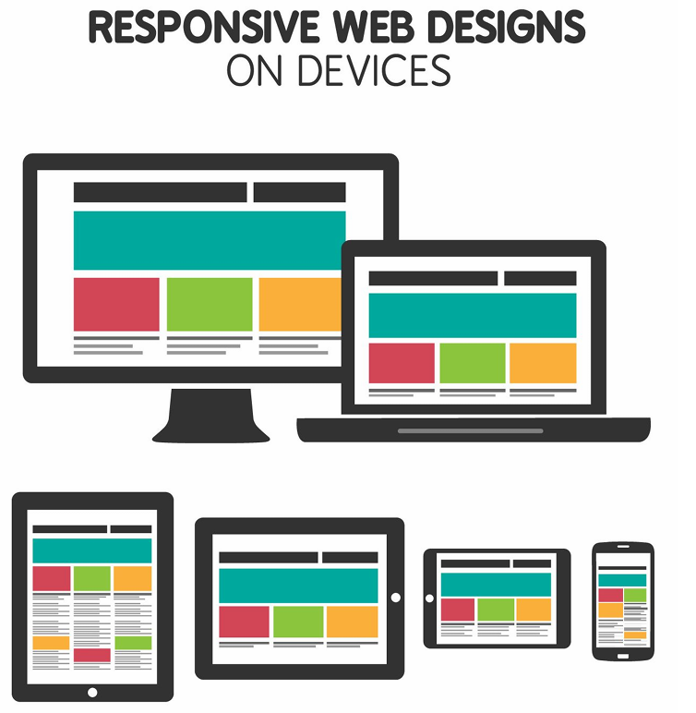
Chapter
Mobile Marketing Strategy
08
Now, let’s look at several specific, mobile-optimized content options:
Responsive Web Design
Responsive web design is about creating websites and webpages that deliver an optimal customer experience regardless of screen size. A responsive website will automatically adjust the content for different screen sizes, e.g., a large desktop monitor, laptop, tablet (vertical or horizontal orientation), and mobile phones. As the screen size increases or decreases, webpage elements will automatically reshuffle, resize, hide, shrink, or enlarge to make them look good on all devices.

Slide 14
Most web building technologies, e.g., WordPress, Wix, Weebly, Squarespace, etc., have responsive web design built right into their platforms. Or in other cases, these transformations are likely to be coded into your webpages by developers in conjunction with the design or marketing teams. As a marketer, if you are building standalone landing pages and/or other webpages, do make sure that they are responsive by testing and viewing your webpages on a variety of screens. For example, this can clarify whether your call-to-action buttons are visible or not before scrolling.
Chapter
08
Mobile Marketing Strategy

Slide 15
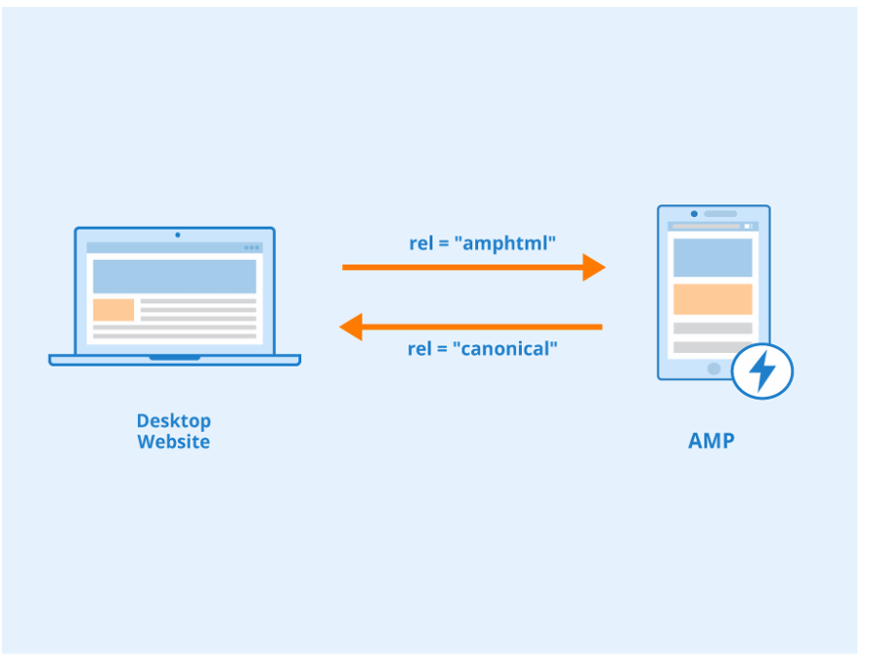
Chapter
Mobile Marketing Strategy
08
Google’s Accelerated Mobile Pages (AMPs)
In early 2016, Google launched an open-source project and released the infrastructure for accelerated mobile pages. Accelerated mobile pages (AMPs) are essentially stripped-down versions of existing webpages that load significantly faster on mobile devices. AMP-enabled pages often remove elements like videos, ads, and animations and keep the most relevant content and images. For mobile users, not only can AMPs reduce the time to load, they can also reduce the amount of bandwidth required to view content, which on mobile devices is an important consideration. All of this sounds like a promising mobile experience.

Slide 16
Chapter
Mobile Marketing Strategy
08
However, to make AMPs work, marketers must use Google’s infrastructure, which has three key components:
• AMP HTML:
AMP HTML is a subset of regular HTML with a few AMP-specific tags, called AMP HTML components. These custom components, combined with the restrictive HTML, mean that AMP pages must be coded slightly differently than standard webpages. Note: you can have both AMP and non-AMP pages, but their underlying code will differ.
• AMP JavaScript (JS):
The AMP JS library handles resources and asynchronous loading. Unfortunately, third-party JavaScript is not allowed, which for some organizations may present an issue. For example, many social media sharing buttons use third-party javascript. So, these buttons would not be available on these pages.
• AMP Cache:
To allow pages to load even faster, marketers can have their AMP-enabled pages cached (stored) and delivered from Google’s content delivery network (CDN). Since Google’s AMP CDN has cached versions of your pages, it can deliver those pages much more quickly.

Slide 17
Chapter
Mobile Marketing Strategy
08
While faster page loading times are compelling, there are several fundamental issues with AMPs
• Difficult to Implement: While there is an easy-to-use WordPress plugin to create AMP-enabled pages, if your website is using a different web platform, creating valid AMP-enabled pages can be challenging and may require working with your website developers. This may also impact your ability to update and maintain these pages.
• Lack of Analytics: Unfortunately, you cannot use standard analytics tags because the AMP pages live on Google’s servers. As a result, you may not get the analytics you need to assess your marketing activities, e.g., engagement, traffic, etc.
• Decreased Ad Revenue: While there are AMP-optimized ads, AMP-enabled pages usually reduce the number of ads shown, which can significantly impact your website’s ad revenue.
• Fewer Leads: Unfortunately, AMP strips out lead magnet forms and downloadable assets, which reduces your ability to gather leads.
• Less Social Sharing: Many social sharing buttons use JavaScript. Since AMP does not allow third-party JavaScript, these buttons may not be shown, making it more difficult for viewers to easily share your content.

Slide 18
Given the above issues, AMP-enabled pages are being used less and less. AMP-enabled pages tend to work best for large media sites that have time-sensitive news / content that is primarily being viewed on mobile devices. As mentioned in our SEO chapter, there are many other ways to optimize your webpages and improve your SEO, while maintaining control of your webpages. So, you will need to decide if AMP-enabled pages best support your specific mobile marketing strategy or not.
Chapter
08
Mobile Marketing Strategy

Slide 19
Chapter
Mobile Marketing Strategy
08
Facebook Instant Articles (IA)
Instant Articles are Facebook’s native publishing platform and are similar to Google’s AMP. IAs are optimized for fast loading speeds and allow users to stay on the platform to read them.
To address many of the issues mentioned with AMP, Facebook Instant Articles have added several features over the years:
• Circulation and Navigation Features: The features allow marketers to insert buttons into their articles that link to other content or make it easy for viewers to share content, e.g., one button click to share via Facebook Messenger.
• Subscriptions: Understanding that many marketers wanted to drive subscriptions, Facebook added the ability to insert subscription buttons directly into articles, as well.
• Call-to-Action Buttons: Facebook IA offers the ability to include call-to-action buttons directly in articles. The analytics related to these clicks can be monitored via your Facebook Insights analytics.
• Page-Like Option: This feature allows viewers to like a Facebook page, i.e., the Facebook page managed by the publisher of the article, directly from within the article.
• No Code Instant Articles Builder: Facebook offers an Instant Articles builder that does not require coding. Simply download and install the builder and follow the guide to get started.
• Third-Party Analytics Tracking: Instant Articles integratewith many popular analytics tools, like Google Analytics, etc.

Slide 20
Chapter
Mobile Marketing Strategy
08
While Facebook has done quite a bit to address many of the issues highlighted with AMP-enabled pages, there are still some drawbacks:
• Reliance on Facebook: While Facebook does have billions of active users, marketers are depending on Facebook, and their constantly changing algorithms, to reach their target audiences.
• Limited Analytics Functionality: While you can integrate third-party analytics tags, the integration method (iframes) does not capture behavioural analytics. Without these insights, you cannot track viewers’ behaviours and your understanding of your audience’s activities is not complete. Tracking viewer behaviour is a powerful way to define areas for improvement and to adjust your content strategy to achieve organizational goals and objectives.
• Brand Identity Issues: Even though your Instant Articles can be housed in your own content management system, all your content is converted to a single Facebook template / design. While there is a logo bar at the top and some colour and font choices, your articles become more “Facebook-like” and will not completely reflect your brand identity or design. From a marketing point of view, there is a risk of losing a visual connection with your target audience who will not experience the “look” and “feel” of your brand.
• Ad Restrictions: There are still some limitations when it comes to ads within Instant Articles. For example, ads cannot exceed 15% of the content and no autoplay videos.
Overall, Facebook Instant Articles can be a compelling distribution channel for your content. That said, make sure it is part of your broader mobile marketing strategy.

Slide 21

Chapter
Mobile Marketing Strategy
08
Mobile Ads
Most advertising networks like Google Ads, Facebook Ads, Twitter Ads, LinkedIn Ads, etc. allow marketers to target their ads to mobile devices. Mobile ad spending now exceeds desktop, which highlights the importance of this advertising channel.
Digital marketing agency, Marketo, also stated that Facebook mobile ads were five times (5×) more effective than their desktop versions. So, mobile advertising can clearly be an effective alternative to desktop advertising.
Given that these ads are displayed on mobile devices, it may present more convenient and direct ways for potential customers to connect with you, e.g., to call you. To do this, simply use the “call extension” option, e.g., in Google Ads, which allows the person to call your organization directly by simply clicking on your call-to-action button or link.

Slide 22
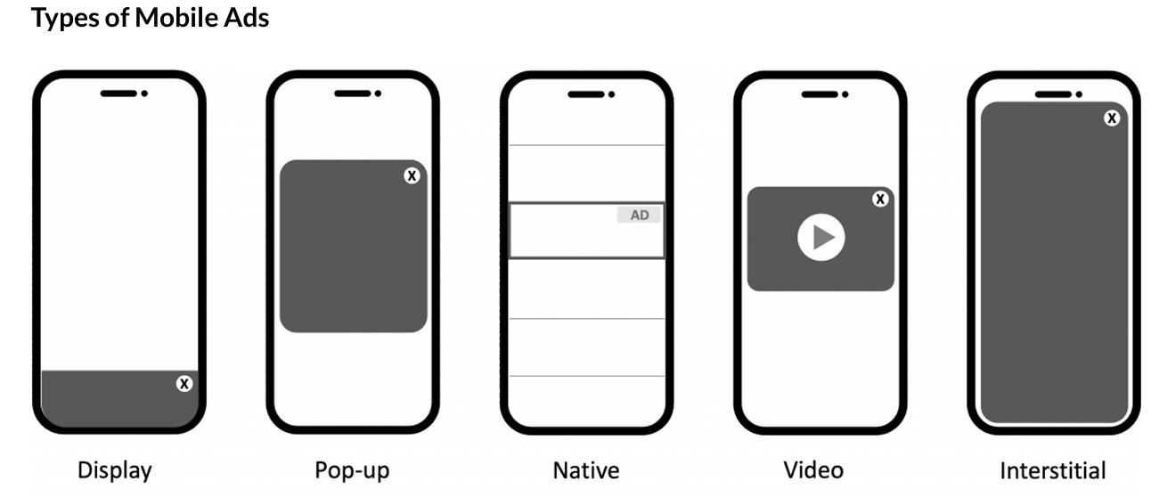
Like other digital marketing ads, there are a variety of mobile ad types. Depending on your goals, target audience, and the platform, you will need to select the appropriate type. That said, the following is a list of the most commonly used mobile advertising formats:
• Display (Banner) Ads:
Display (banner) ads are the oldest version of mobile ads. Display ads are usually embedded directly on a webpage or in an app. In most cases, they use images (or graphics with text) that are designed to grab the audience’s attention. Many of the same considerations for website display ads apply to mobile display ads. Even though display ads are cost-efficient and widely used, marketers are quickly exploring other options like interactive ads and video ads.
Mobile Marketing Strategy

Slide 23
• Video Ads:
Video advertising is a powerful way to convert your target audience. Product videos can be particularly helpful during the purchase decision-making process. Videos can effectively deliver a full visual experience, which helps prospective customers better understand the products or services. And since more people are watching videos on their phones, optimizing YouTube ads and pre-roll video ads can potentially reach a very large audience / viewership. When creating mobile video ads, here are some tips for better ROI:
◦ Keep it simple
◦ Use your creativity
◦ Keep it short and focused
◦ Make sure the audio is not too loud
◦ Display a call-to-action
Mobile Marketing Strategy

Slide 24
• Full-screen or Interstitial Mobile Advertising:
Interstitial ads are the full-screen videos or graphics that are usually placed at app transition points. To remove or close them, users can usually click the X button (often in the top right hand corner). Say, for example, you are playing a video game. You have just managed toclear Level 1 and are ready to go to the next level. But, before moving on, you see an ad or a short video ad pop up. These are interstitial mobile ads.
Interstitial ads get higher click-through rates compared to display ads. However, show these ads only at transition points, so that you do not interrupt the content flow. Ad types may include text, graphics, or rich media. Since these ads fill up the entire or majority of the screen, they are hard to ignore and tend to get noticed.
Mobile Marketing Strategy

Slide 25
• Native App-based Ads:
Native ads are similar to display ads but are created to more closely match the style, design, and tone of the content in which they are embedded. Since the ads match the content and other elements of the app, they blend in much more seamlessly and more importantly, cannot be blocked. As a result, these ads get displayed to targeted audiences without causing significant interruptions in the flow of content. A popular example of native mobile advertising is Facebook ads. Users scroll through their page/news feeds and see ads (sponsored posts) inserted between non-paid / organic posts. To create high quality native mobile ads that highlight your brand, be sure to include the following key elements:
◦ Headline
◦ Detailed description
◦ Brand logo or name
◦ URL
Mobile Marketing Strategy

Slide 26
• Interactive / Playable Mobile Ads:
Interactive ads are a type of gamified video or multimedia ad. These are preferred by savvy marketers who want to create interactive advertising experiences. Games are a natural way to generate customers’ interest. Playable mobile ads work especially well when marketing other apps. For example, if your app is about finding directions on a map, a playable mobile ad could provide a short and quick demo that lets users try a simplified version before downloading the app. These short interactive demos deliver a powerful ad experience, that ultimately gets prospective customers to spend more time interacting with the ad, engaging with the brand, and converting.
Mobile Marketing Strategy

Slide 27
SMS & MMS:
SMS stands for short message service and is often also referred to as a text message. MMS stands for multimedia message service and includes text messages with audio, video, or images. Many brands, have been using SMS successfully to advertise their products and promotions and drive real results. Specifically, X has used an SMS holiday campaign to offer holiday specials, weekly deals, and cheerful holiday messages. Many SMS campaigns have been quite successful, but if possible do consider MMS campaigns. Like other marketing activities, providing more interactive and visual content can help get your audience’s attention and be more memorable. Set aside an appropriate budget and explore both of these underutilized options because they may deliver surprising results.
Chapter
08
Mobile Marketing Strategy

Slide 28
Location-based Ads:
Location-based (also called geofencing or geo-targeting) ads refer to mobile marketing messages sent to a target audience based on their location. By tracking the location of the mobile device, marketers can send targeted messages to individuals when they are within a specific geographic area. Many ad platforms like Google Ads and Facebook Ads allow marketers to specify locations or geographic areas where their ads will be shown.
Chapter
08
Mobile Marketing Strategy

Slide 29

Mobile Apps & Push Notifications
Mobile apps are programs that get downloaded onto your smartphone, smartwatch, or tablet. These apps usually serve a very specific purpose, e.g., email apps, social networking apps, or game apps. App-based marketing has risen quickly due to the increase in smartphone, smartwatch, and tablet daily usage.
Once an app has been downloaded, the app developer can communicate with the user via push notifications. Push notifications are messages or notifications that pop up on these mobile devices without the need to open the app. While these notifications only reach an audience of one, i.e., the smartphone user, they should push valuable information or insights directly to the user. To make sure that your push notifications are beneficial and not annoying.

Slide 30
marketers should make sure their notifications follow these three tips:
• Relevant and Timely: Because notifications are disruptive, make sure your notifications are triggered by the user’s behaviour, location, or preferences.
• Personalized: Since you have access to the individual’s behaviour’s, locations, and preferences, make sure the content of the notification appeals to them personally.
• Actionable: The notifications should make it clear what you want the user to do next. Without a specific action or request, it becomes easy for users to dismiss and ultimately, ignore your notifications.

Slide 31
The following types of push notifications generally perform well:
• Offer a promotion, e.g., a time-limited discount or something else that creates urgency
• Pique the user’s curiosity
• Help users meet their goals
• Nudge users when they become inactive
• Remind users to do something
• Present an exciting update or event
• Make users feel like an insider
• Show a message preview, e.g., an email message preview
• Tell users when people they follow are active
• Make personalized suggestions
• Include multimedia

Slide 32
Chapter
Mobile Marketing Strategy
08
Now that we have covered what works, let’s review a few practices to avoid. Steer clear of these common mistakes:
• Generic Blasts: Mobile users get push notifications all day every day. The last thing they need is to be the subject of a generic mass marketing campaign blast that isn’t relevant to them. Make sure you segment your audience, so you are not contributing to the daily digital noise.
• Wrong Time: Make sure your notifications are localized to the user’s time zone and be mindful of the most appropriate time to send them. A user who appreciates a midday work-related notification might be annoyed by the same notification when winding down to go to bed.
• Clickbait: While you do want to pique your user’s curiosity, be sure to deliver on your notification promise. If not, you will simply annoy your user and they may start ignoring other notifications.
• Multimedia without Context: Visual media like images, videos, and animated GIFs can make or break the user experience. When done well, these notifications can delight and engage users. But some mobile devices may struggle to display rich media properly. So, always make sure your message makes sense both with and without the multimedia content.
When you create and send push notifications, think like a user, and respect their time and experience. The more you understand your user, the easier it is to keep them informed, entertained, and engaged.

Slide 33
Mobile In-Game Ads:
In-game mobile ads refer to ads placed within mobile games, which appear during gameplay. The ads that perform best and deliver the highest conversions are those integrated directly into the game such that they become an extension of the gaming experience. These seamless ad experiences can improve engagement, retention, and conversion rates.
Chapter
08
Mobile Marketing Strategy

Slide 34
Chapter
Mobile Marketing Strategy
08
Many marketers have concerns about the effectiveness of mobile in-game ads. However, in this article, 4 Common Myths about Mobile In-game Advertising, author, Kori Wallace, refutes the following four myths:
• Advertising interrupts the gaming experience: A 2019 report done by Tapjoy states that gamers understand the role advertising plays in mobile games and even actively engage with ads.
• Gaming environments aren’t brand safe: When many people think of video games, they think of games that have “risky or adult content”. However, in the world of mobile games, most brands have found that the games, especially the free-to-play apps, are fairly brand safe.
• Gaming is a niche audience (young males): Statistics show that gamers, especially those playing on mobile, are increasingly female. Certain types of mobile games, such as puzzles, draw even more women players than men. And they’re not necessarily young gamers either. Jun Group research found that 56 percent of mobile gamers are age 35 and over.
• It is impossible to measure success: Mobile in-game advertising is quite measurable and in some cases, marketers can even integrate third-party tools to validate the analytics and results.

Slide 35

Action Codes
Action codes include scannable, visual codes like QR codes or bar codes (see images). In many cases, these codes are presented offline, e.g., transit ads, posters, magazine ads, or product labels, and when scanned by mobile devices, people are sent to a related, online landing page. One very recent use of these codes has been the rise of digital menus in restaurants during the pandemic. Many restaurants simply printed QR codes and left them on their tables. Diners could then scan the codes to pull up the restaurant menu and this avoided the need to print menus or navigate pandemic safety issues with people sharing menus. QR codes have also been used to verify COVID-19 vaccinations. Now that more people have been using QR, there may be even more areas where marketers can use them.

Slide 36
Mobile Email:
Reading emails on mobile phones is considered one of the top 5 activities for smartphone users globally. And according to a recent Mobile Ecosystem Forum survey of smartphone users in ten markets worldwide, almost five in 10 respondents preferred receiving business communications via email. So, mobile-friendly emails are essential in communicating and converting your target audiences. That said, marketers do need to provide compelling and valuable emails because if they do not, people will either delete or ignore their messages.
Chapter
08
Mobile Marketing Strategy

Slide 37
Keys to success
As you can see, there are many similarities between website and mobile advertising. However, to deliver a successful mobile marketing experience, consider the size of the screen, the communication opportunities, e.g., calling, the GPS capabilities, and the portability that make mobile experiences personalized, special, and unique. Take advantage of these built-in features to deliver richer and more interactive experiences for your mobile audiences.
Chapter
08
Mobile Marketing Strategy

Slide 38
Also, consider mobile marketing in conjunction with other marketing channels – online or offline. Success happens when all marketing channels support and promote each other, i.e., when your marketing activities are well integrated. Marketers are increasingly combining their social, local, and mobile activities, also called So-Lo-Mo, into one comprehensive strategy. Since social media is increasingly more mobile-friendly and mobile is targeting local customers and driving local conversions, the three areas work well to build on each other. This results in customer touchpoints across multiple marketing communication channels and strengthens a brand’s overall marketing and messaging strategies.
Chapter
08
Mobile Marketing Strategy

Slide 39
And, finally, don’t forget to personalize your mobile interactions and ads. Customers connect and respond best to personalized messages customized for them, whether that be by geographic area, specific location, or behaviours. For example, Best Buy and Subway use geo-location technology to deliver targeted messages to customers who have opted-in to their mobile marketing programs. Many marketers wonder about the willingness of their target audiences to opt into mobile marketing programs. However, a recent study by Google found that almost half of the women surveyed would share their location if offered a $5 store credit. And, that percentage jumped to 83% when offered a $25 store credit. So, with the appropriate incentive, marketers can encourage customers to participate in mobile campaigns and initiatives.
Chapter
08
Mobile Marketing Strategy

Slide 40
Chapter
Real Estate Applications
08
In the context of the contemporary digital revolution, and with the widespread use of mobile devices as a primary platform for interaction with the digital world, mobile applications have emerged as one of the most influential tools in reshaping the dynamics of numerous economic sectors, foremost among them the real estate sector. This growing influence is attributable to the distinctive nature of the real estate product, which is characterized by its high value, immovability, and the lengthy purchasing decision cycle associated with it. Real estate applications have contributed to overcoming many of the traditional obstacles that have hindered search, purchase, and management processes in this sector, transforming them into more efficient and transparent interactive digital experiences.
The emergence of real estate applications represents a qualitative shift in the mechanisms of interaction among the key actors in the real estate market, including developers, investors, buyers, tenants, brokers, and management companies. Their role is not limited to serving merely as marketing channels; rather, they extend beyond that to form integrated operational platforms that contribute to managing the life cycle of the customer relationship, beginning with the stages of awareness and discovery, passing through the stages of evaluation, negotiation, and purchase, and culminating in post-sale services and property management.

Slide 41
Chapter
Real Estate Applications
08
The Concept and Fundamental Determinants of Real Estate Applications
Real estate applications may be defined as software systems specifically designed to operate on mobile devices (smartphones and tablets), with the aim of providing services and interactive platforms that bring together the various parties in the real estate market and facilitate real estate-related processes and information. In their operation, these applications are based on a set of fundamental determinants that constitute the essence of their function and added value, which may be summarized as follows:
1.Spatial and temporal interactivity: These applications exploit the close attachment of mobile devices to the user, thereby enabling access to real estate information and services at any time and from any place, thus transcending the constraints of official working hours and the geographical locations of real estate offices.
2.Data-driven personalization: Applications rely on the collection and analysis of users’ data and behaviours (such as search activities, recorded preferences, and recurrent geographical locations) in order to provide a personalized experience, presenting the properties and services most relevant to each individual user.

Slide 42
3.Content enrichment and diversification: Applications are not limited to presenting textual information; rather, they integrate rich multimedia content such as high-resolution images, introductory videos, virtual tours using 360-degree technology or virtual reality, and interactive maps, thereby helping to form an accurate mental image of the property prior to its physical inspection.
4.Integration with other services and systems: Modern real estate applications are characterized by their ability to integrate with multiple external systems, such as maps (for calculating distance and time), banking services (for financing inquiries and instalment calculations), and customer relationship management (CRM) systems, thereby creating an integrated digital ecosystem that serves the user.
Chapter
08
Real Estate Applications

Slide 43
Chapter
Real Estate Applications
08
The Functional Classification of Real Estate Applications
Real estate applications in the digital market may be classified according to the primary function they perform and the entity that develops them, as follows:
1.Aggregator Listing Apps: This category represents the most common and widespread model in real estate markets. Their operating model is based on sourcing real estate data and listings from multiple origins (developers, real estate offices, and individuals) and consolidating them into a single database that is searchable and categorizable. These applications provide end users (those seeking to buy or rent) with advanced search tools based on filtering results according to specific criteria (price, location, area, property type, finishing, etc.). The core value of these applications lies in providing an “open marketplace” that enhances transparency, broadens consumer choice, and facilitates comparison among different listings in one place. These applications usually generate revenue through paid advertisements, premium subscriptions for brokers, or commissions on successful referrals.

Slide 44
Chapter
Real Estate Applications
08
2.Developer Proprietary Apps: Real estate development companies design and program these applications specifically to serve as the official and exclusive digital platform for their projects. This category is characterized by a high degree of control over content and user experience, as it fully reflects the company’s brand identity. These applications provide in-depth and exclusive content about the company’s projects, including interactive catalogues, three-dimensional models, immersive virtual tours, and periodic updates on construction progress. They also often include interactive tools such as financing calculators, appointment calendars with sales teams, and direct communication channels. These applications constitute a strategic instrument for building a long-term relationship with prospective customers, strengthening their brand loyalty, and maintaining full control over the sales funnel without reliance on intermediary platforms.
3.Brokerage and Customer Relationship Management (CRM) Apps: These applications are primarily targeted at real estate brokers and sales agents, with the aim of organizing their work and increasing their productive efficiency. They provide specialized tools for managing property listings, organizing customer databases, scheduling appointments and site visits, generating quotations and delivering them electronically, and enabling instant communication with the work team and management. Some advanced applications also allow integration with the company’s centralized customer relationship management systems, thereby enabling precise monitoring of each broker’s performance and the analysis of market data. These applications contribute to raising the level of professionalism in the brokerage sector and reducing routine administrative effort.

Slide 45
Chapter
Real Estate Applications
08
4.Property and Community Management Apps: This category represents an extension of the real estate service life cycle into the post-handover and occupancy stage. These applications are specifically designed for residents of large residential complexes and multi-unit developments, with the aim of improving their living experience and facilitating their interaction with the building or community management. These applications provide a wide range of operational and social services, including:
submitting maintenance requests and tracking their implementation status;
booking and using shared facilities (such as gyms, swimming pools, and event halls);
paying service charges and monthly maintenance fees electronically;
receiving important announcements and notifications from management; and
creating closed social networking channels among residents in order to strengthen community interaction.
These applications contribute to increasing residents’ satisfaction levels, reducing the administrative burden on property management teams, and enhancing the sense of belonging to the residential community.

Slide 46
Chapter
Real Estate Applications
08
The Strategic Importance of Real Estate Applications within the Integrated Digital Marketing Mix
Within the framework of the integrated digital marketing strategy of real estate institutions, mobile applications acquire multidimensional strategic importance:
1.A direct and non-intermediated communication channel: Applications provide a permanent and direct channel of communication with customers, independent of fluctuations in social media platform algorithms or the limitations of email. This enables companies to establish digital ownership of their relationship with customers.
2.A rich source of first-party data: Applications constitute a highly important source for collecting accurate and reliable data on the behaviour and preferences of prospective and current customers. The analysis of these data enables companies to gain a profound understanding of their audience, design highly personalized offers and marketing messages, and make strategic decisions based on real evidence.
3.Enhancing brand loyalty: By providing a distinguished user experience, exclusive content, and value-added services (such as construction progress tracking or property management), applications contribute to building an emotional relationship and trust with the brand, which is positively reflected in customer loyalty and word-of-mouth recommendations.
4.Improving the efficiency of marketing expenditure: Precise targeting based on data derived from the application helps direct advertising expenditure toward the segments most likely to convert into actual customers, thereby increasing marketing return on investment.

Slide 47



Thank You

