Slide 1


Prepared by Dr. Rana Maya
REA 621
Real Estate market analysis
Lecture 3

Slide 2



Market conditions: indicators and demographics
Lecture 3
REA621
Real Estate market analysis
Prepared by
Dr. Rana Maya

Slide 3

lecture
Abstract
03
National, and local economic conditions affect property demand. key real estate market indicators and economic indicators with consumer Demographics shape consumer confidence and business investment activity.

Slide 4

lecture
03
Contents
1. Introduction
2. Market indicators
3. Economic Indicators
4. Visitor Profiles and Tourism Trends
5. Consumer Demographics
6. City Real Estate Market (Example)

Slide 5
lecture
03
  Learning outcomes
By the end of the lecture, you will be able to:
Explain the purpose and scope of real estate market analysis .
Identify and interpret key real estate market indicators.
Analyze economic indicators such as employment levels, income trends.
Evaluate the influence of visitor profiles and tourism trends on real estate markets.
Assess consumer demographic characteristics, including population. structure, household income, psychographics.
Apply market indicators, economic data, and demographic analysis to a real-world city example.

Slide 6

The strength of the national economy influences whether businesses expand their space, what new online and bricks-and-mortar store concepts are introduced, when families move up to pricier homes, and whether travelers book more hotel room nights.
market analysis requires some consideration of the national economic climate.
Why?

Slide 7
1.Introduction
Local conditions may not precisely mirror national trends. Not every metropolitan area benefits from a national economic boom, and some communities will survive a national recession relatively unscathed. As a result, real estate market studies usually give greater weight to metropolitan area economic indicators than to nationwide statistics.
The analyst should be aware of current and future macroeconomic factors when drawing conclusions about the advisability of starting a new project or investing in an existing building.
At the same time, experienced researchers understand that the national economy is cyclical. Conditions observed today may change dramatically by the time a new building breaks ground, let alone by the time it is ready for occupancy.

Slide 8
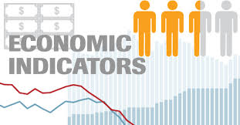
1. Introduction
Local conditions may not precisely mirror national trends.
Not every metropolitan area benefits from a national economic boom, and some communities will survive a national recession relatively unscathed.
As a result, real estate market studies usually give greater weight to metropolitan area economic indicators than to nationwide statistics.

Slide 9
1. Introduction
A complete market study report should include a map that shows where the property sits within the metropolitan area or a major city. At a smaller scale, a map should show the boundaries of the primary and secondary market areas, location of the site, nearby interstate highways, and key
Employment growth at local businesses that use office space (banking, insurance, legal services, consulting, information providers, tech services) will be the key demand determinant for new class A office space
The need for additional hotel rooms depends on continued growth in local tourist, convention, and business visitation.
Metropolitan market dynamics are the most important factors considered in projecting housing demand.

Slide 10
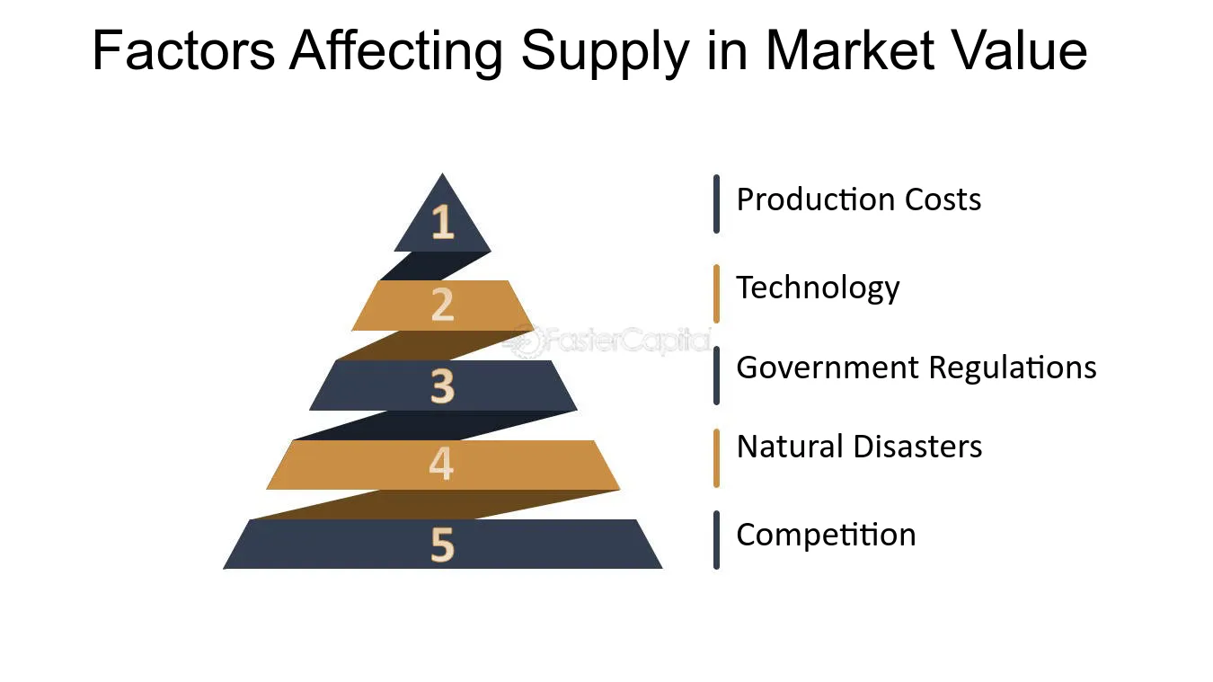
1. Introduction
The market analyst must also devote considerable attention to supply factors that affect development feasibility. Typically, supply-side analysis considers:
Macroeconomic trends affecting the market and current conditions (metropolitan area or countywide absorption, vacancy rates, and rents and prices).
local area market performance indicators and construction activity.
Characteristics of competitive buildings, both existing and proposed.

Slide 11

2. Market indicators
Real Estate Market Indicators
Number of Transactions (Market Activity)
  Measures the volume of buying and selling activity in the market.
  An increase in transactions indicates rising demand and investor confidence, while a decrease may reflect economic uncertainty or affordability constraints.
  Example: Annual residential transactions increased from 18,500 units in 2022 to 21,000 units in 2024 (+13.5%), signaling an expanding market.

Slide 12

2. Market indicators
Average Property Prices
Reflect overall market valuation and price trends influenced by demand, supply, income levels, and construction costs.
Rising prices suggest demand exceeds supply
stable or declining prices may indicate market saturation or weakening demand.
Example: The average apartment price rose from $1,200/m² to $1,320/m² over two years (+10%), driven by limited new supply and strong household income growth.

Slide 13

2. Market indicators
Occupancy Rates
Indicate the level of absorption of existing real estate stock, particularly relevant for rental and commercial markets.
High occupancy rates reflect strong demand and support rental growth
lower rates may signal oversupply.
Example: Residential occupancy reached 96%, while office occupancy remained at 88%, showing stronger demand for housing compared to office space

Slide 14

3.Economic Indicators
Brokers and private data vendors are the usual sources of raw information on conditions in the metropolitan area and the submarket, both current and historical.
However, market analysts, appraisers, and economic development professionals must verify, analyze, and interpret the statistics.
To go beyond the numbers, they need to understand the physical character, tenancy, and performance of key competitors.
learning about the competition requires field visits and personal or telephone interviews with building owners or managers.

Slide 15
3.Economic Indicators
Real estate developers and their financial partners will want to understand :
The drivers of economic growth—the mix of industries
The area’s largest employers
The nature of new and expanding businesses.
Investors must have confidence in the market’s continued economic vibrancy, and so they look for evidence of a growing labor force and new job creation.

Slide 16
3.Economic Indicators
In today’s economy, the largest employers in many markets are hospitals, universities, school districts, supermarket chains, and discount department stores.
The mix of industries found in a metropolitan area will determine the strength of demand for different types of properties.

Slide 17
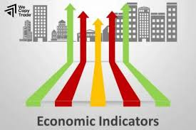
3.Economic Indicators
■ Tourist destinations and convention cities will need far more hotel rooms than their resident populations would support.
■ A city located at the confluence of three interstate highways is often a center for warehousing and distribution uses.
Deepwater ports, intermodal rail centers, and international air cargo terminals also create above-average demand for warehouse space.

Slide 18
3.Economic Indicators -Employment Statistics
Employment Statistics
Government agencies publish At-place statistics count jobs according to their location; the data are calculated from sample surveys and reports filed by employers. Monthly and annual reports on employment by industry
worker-based statistics (including unemployment rates and much of the information about the occupation and education of the labor force) from the BLS are tabulated by the respondent’s place of residence.

Slide 19
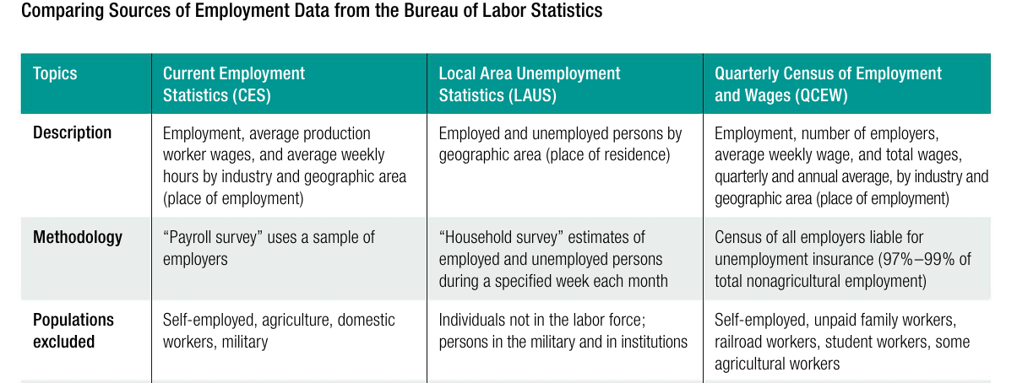
3.Economic Indicators - Employment Statistics

Slide 20

3.Economic Indicators - Employment Statistics
Market Analysis Employment Section – example www.stats.gov.sa
“The labor market in Saudi Arabia demonstrates strong performance with an overall unemployment rate of ~3% in 2025 and a high labor force participation rate (~67–68%). Saudi nationals experienced declining unemployment and increased workforce participation, particularly among women and core working-age groups.
These positive trends align with government reforms under Vision 2030, which focus on economic diversification, private sector growth, and increased local workforce involvement.”

Slide 21
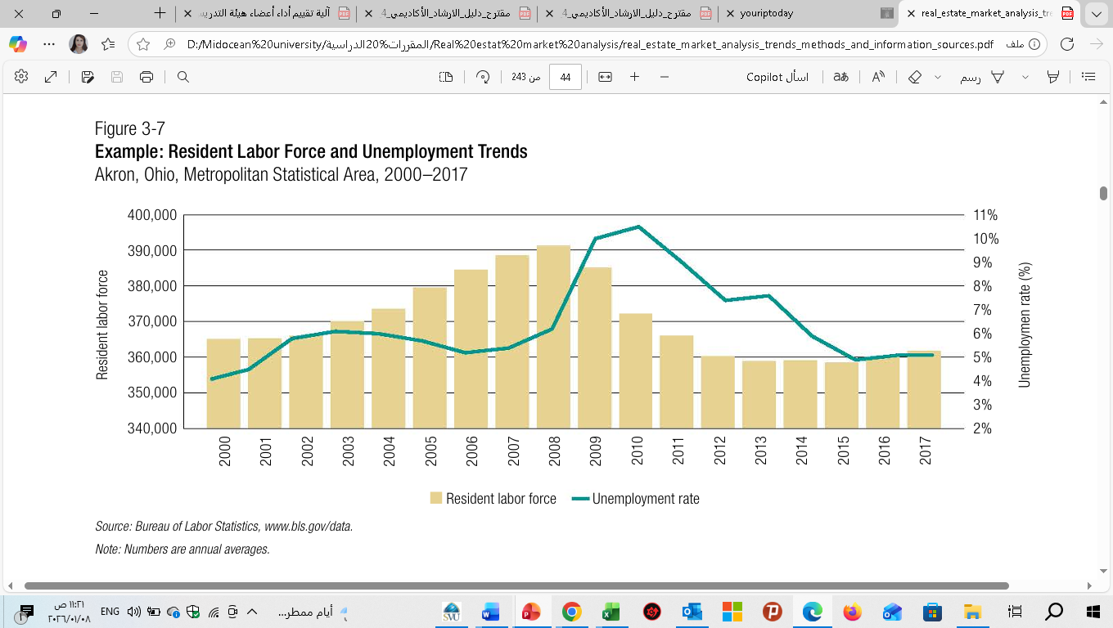
3.Economic Indicators - Employment Statistics
The economic overview should include data about total growth in nonfarm jobs over the preceding five to 10 years and about how those jobs are distributed by major industry group.

Slide 22
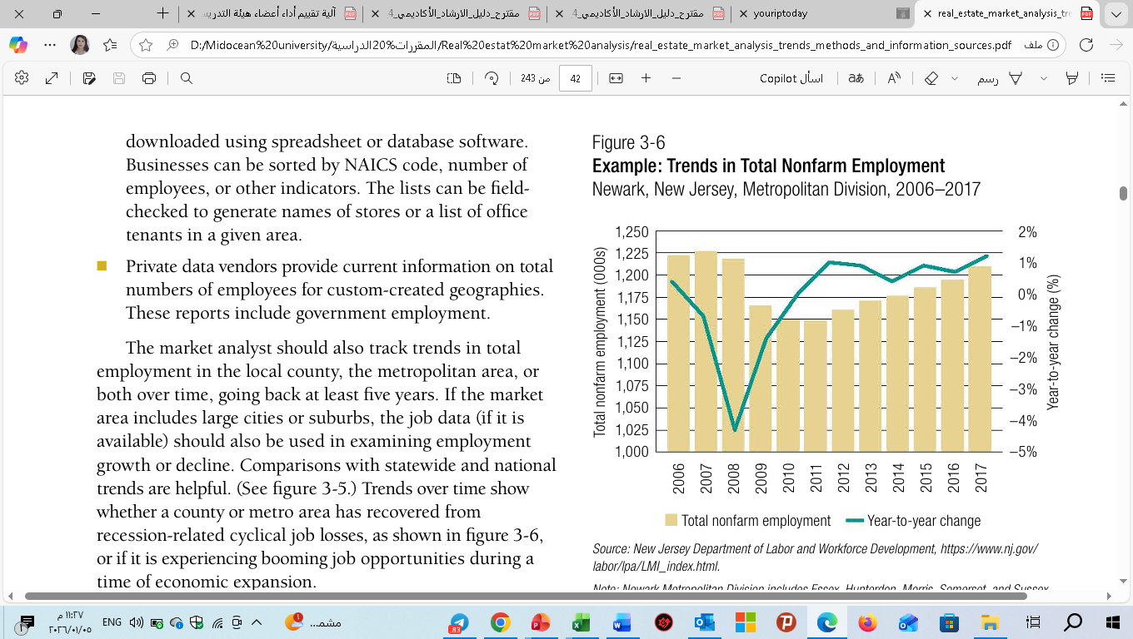
3.Economic Indicators - Employment Statistics
Given that all 8 billion people on the planet must live somewhere, how do we organize ourselves?
The numbers illustrate a very slow economic recovery.
Nonfarm employment peaked at more than 1.2 million
jobs in 2007. Ten years later, total jobs had not yet
returned to 2007 levels.
While the percentage gains look small, the number of jobs stabilized in 2011 and has increased each year after that.

Slide 23
3. Economic Indicators - Economic Diversity
Given that all 8 billion people on the planet must live somewhere, how do we organize ourselves?
Most officials seek new industry that will shake up the mix of jobs and breathe new life into the economy.
In general, greater diversity in a local economy makes it less vulnerable to economic downturns and less risky as a location for investment.
An area that depends on a few large employers or a single industry will be more vulnerable to recession. This dependence will affect both absorption of new space and continued strong occupancy in existing buildings

Slide 24
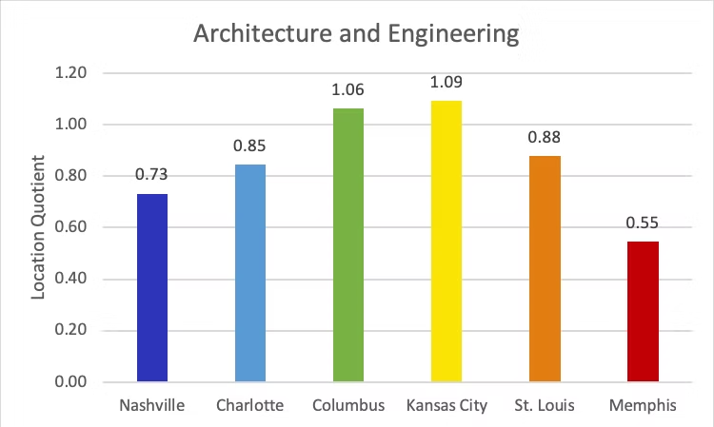
3. Economic Indicators - Economic Diversity
One way to present these data is to use location quotients (LQs), which are ratios that compare the concentration of employment by industry in a defined area.
For example, an LQ of 1.0 in mining means that the region and the nation are equally specialized in mining; while an LQ of 1.8 means that the region has a higher concentration in mining than the nation.

Slide 25
3. Economic Indicators - Key Employers and New Industries
lecture
Numerous areas of contemporary economics are connected to urban economics. My early professional goal was to become a macroeconomist. Understanding the causes and effects of booms and recessions is the goal of macroeconomists. Additionally, they aim to comprehend the
Noting the top 10 or 20 largest employers is also helpful for portraying the area’s economic base.
It is useful to focus extra attention on the area’s largest private-sector businesses while noting whether their job counts or payrolls have grown over the preceding five years.
It will help clarify which segments of the economy are generating demand for space, bringing in new workers, and so on.
-Local chambers of commerce
Economic development agencies
business magazines or newspapers
Telephone or in-person interviews
agency websites can also provide announcements and statistics

Slide 26
3. Economic Indicators - Labor Force Profile
-Labor force availability and skills are important to employers and are carefully considered when businesses make location decisions.
The report should provide background information about the educational attainment of the resident population, as well as brief descriptions of relevant community college training programs, nearby universities, and specialized trade schools.
-If the supply of available workers is too limited—or if the necessary skills cannot be found in the area—labor costs will rise and businesses may look to other locations for expansion.

Slide 27

4. Visitor Profiles and Tourism Trends
Visitor statistics are important in determining potential demand not only for hotels and resorts but also for entertainment, amusement, and cultural facilities.
Demand for hotel rooms, tourist information can include a variety of statistics:
Trends in occupied hotel room nights
Estimates of out-of-town visitation
Patronage at museums, theme parks, concerts, and sporting events—reflected in ticket sales
Breakdowns of visitors by type (convention attendees, business travelers, and pleasure visitors)

Slide 28
4. Visitor Profiles and Tourism Trends
https://www.untourism.int/un-tourism-world-tourism-barometer-data
International tourist arrivals grew 5% in January-September 2025.
Over 1.1 billion tourists travelled internationally through September, about 50 million more than in the same period of 2024.

Slide 29
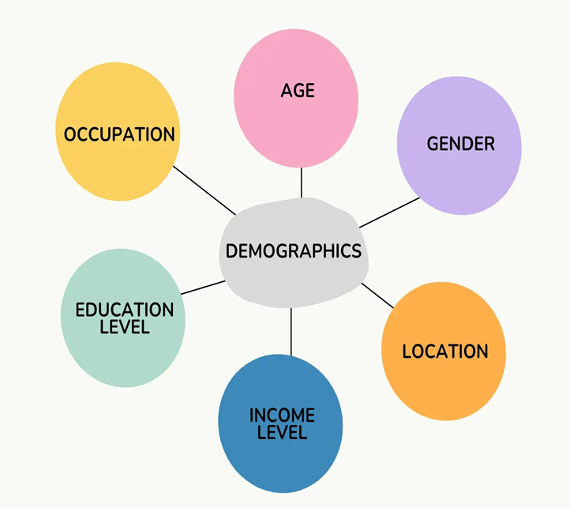
5.Consumer Demographics
Housing and retail market studies require considerable detail on local population and household demographics.
Along with population counts and trends (growth or decline over time), other data that are useful for understanding consumer characteristics include :
age distribution, median age
housing tenure (owners and renters)
household size
household composition (for example, singles versus families, households with and without children)
median and average house- hold incomes

Slide 30
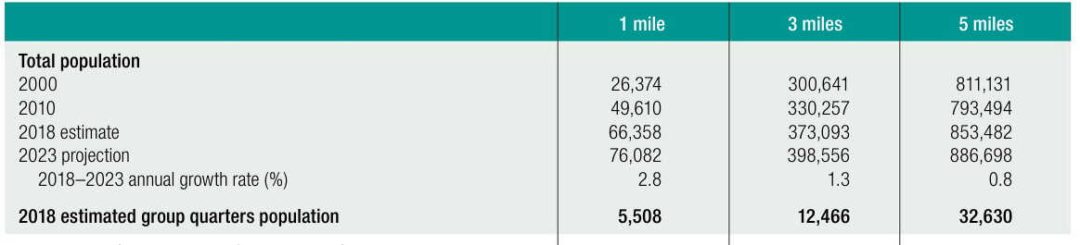
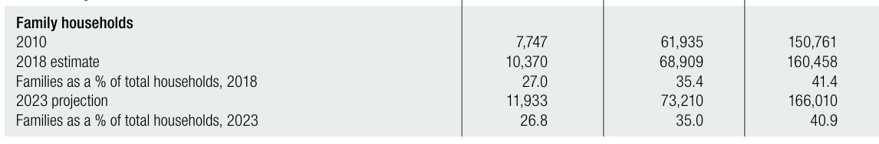
5.Consumer Demographics

Slide 31
5. Consumer Demographics -Demographic Characteristics
Younger households are more likely than others to occupy smaller units and to rent rather than own.
Their retail expenditures are much different from those of families with children and those of seniors.
Young people spend an above-average percentage of their incomes on restaurant meals and entertainment.
Households with children spend more on food consumed at home and clothing.
Ethnicity also is important because it helps shape housing preferences and shopping habits.

Slide 32
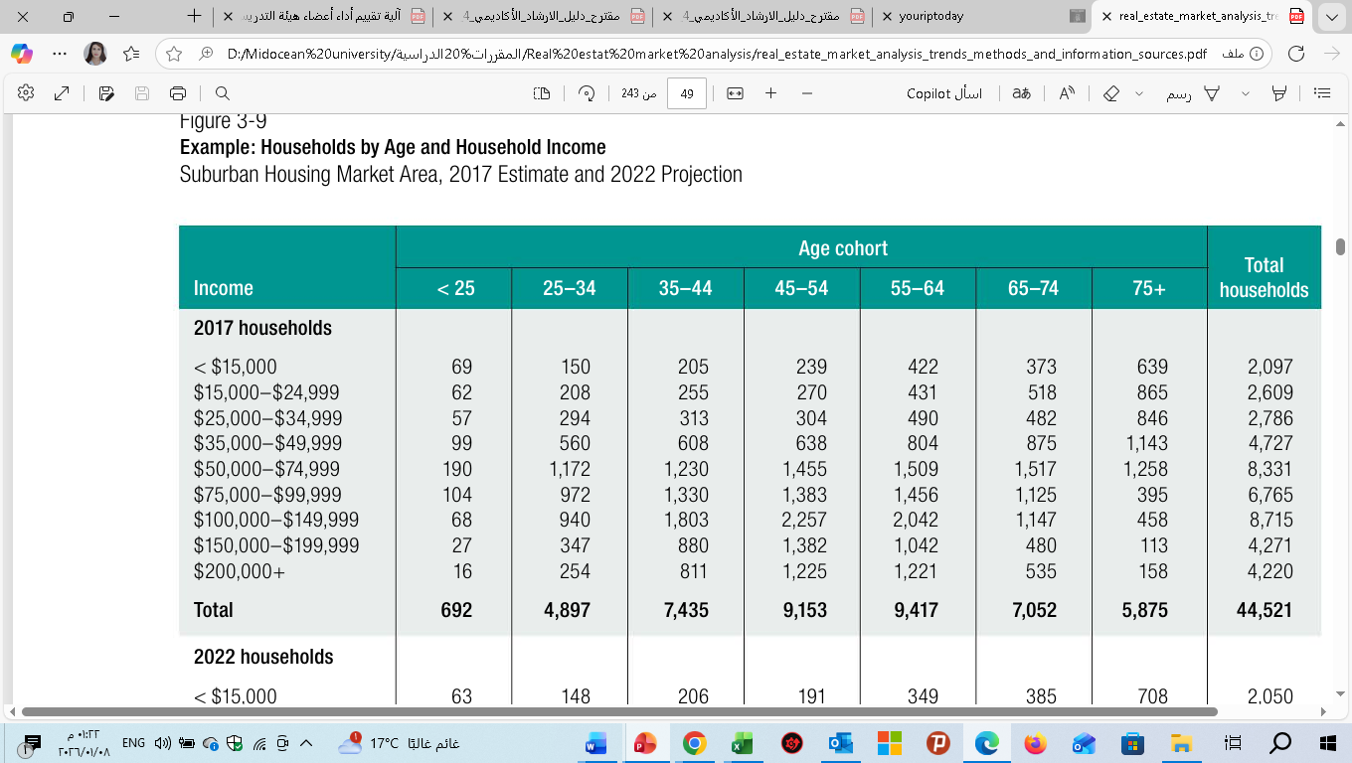
5.Consumer Demographics -Household Income
In housing market studies, data on the distribution of households by income are often cross-tabulated with data on the age of the householder.
This tabulation allows the market analyst to zero in on the number of households that would be age- and income-qualified or targeted for a proposed development.
For retirement housing, data on assets as well as current income help determine affordability

Slide 33

5. Consumer Demographics –Psychographics -Portraying Household Lifestyles
Today’s market studies often include information on trade area psychographics.
Reading and music preferences
Hobbies
Recreational pursuits
Community involvement
They can vary widely among residents in a given age or income bracket, and the differences influence shopping habits and housing preferences

Slide 34

5. Consumer Demographics –Psychographics -Portraying Household Lifestyles
Analysis of lifestyle clusters helps developers determine the types of stores, restaurants, and entertainment venues that would be best suited for a new shopping center.
Consumer preferences for home types, sizes, features, and amenities become more obvious when residential developers use lifestyle data.

Slide 35

5. Consumer Demographics -Housing Tenure
The extent to which trade area households own or rent their homes, while not a population indicator per se, is important not only for housing market studies but also for retailers.
obtaining information about existing tenants or buyers can be invaluable for identifying likely future customers.

Slide 36
6. City Real Estate Market (Example)
1. Economic Indicators
Employment Statistics
Unemployment Rate: 4.2% in 2025, down from 5.1% in 2023, indicating strengthening labour demand.
Employment Growth: The total number of jobs expanded by 2.5% annually over the past three years, outpacing the national average of 1.8%

Slide 37
6. City Real Estate Market (Example)
1. Economic Indicators
Economic Diversity
Economy is diversified across five major sectors: technology (22% of jobs), healthcare (18%), finance (15%), logistics (12%), and manufacturing (9%).
Economies with diversified industry bases tend to show more stable real estate growth than mono-sector cities (stability up to +40% in downturns) because multiple sectors attract more consistent employment growth.

Slide 38
6. City Real Estate Market (Example)
Strong economy → higher demand for space → rents rise (Space Market).
Higher rents → higher property prices (Asset Market).
Higher prices → new construction (Development Industry).
Developers need financing → capital market provides money.
New supply → feeds back into space market, affecting rents and vacancies.
This creates cycles of boom and bust.
1. Economic Indicators
Key Employers and New Industries
Major employers include:
—Tech Solutions (8,000 employees)
— Regional Health Network (6,500 employees)
— FinanceCo Bank (4,200 employees)
Emerging industries (e.g., renewable energy and biotech) added 1,200 new jobs in 2025, reflecting ongoing economic innovation.

Slide 39
6. City Real Estate Market (Example)
1. Economic Indicators
Labor Force Profile
Total labor force: 450,000 persons
Participation rate: 66.8% (above national rate of 62.3%)
Average income growth over 3 years: +6.1%
Median household income: $67,000, compared to $58,000 national median.

Slide 40
6. City Real Estate Market (Example)
Here’s the timeline graph showing Dubai’s real estate cycle:
bust: steep decline due to oversupply and global financial crisis.
2. Visitor Profiles and Tourism Trends
Annual Visitors: welcomed 3.8 million visitors in 2025, up 12% year-over-year.
Tourism Spending: Total visitor spending reached $1.45 billion in 2025, supporting hospitality properties and short-term rentals.
Occupancy Trends: Average hotel occupancy improved to 72% in 2025 from 66% in 2023, driven by stronger business travel and event tourism.
Tourism Impact on Real Estate
Visitor-related demand boosts rental markets in central districts and supports investment in hospitality real estate and mixed-use developments.

Slide 41
6. City Real Estate Market (Example)
Figure 2. Housing supply elasticity and equilibrium outcomes (illustrative).
3. Consumer Demographics
Demographic Characteristics
Total Population: 1.24 million
Population Growth (3-year): +4.7%
Median Age: 36.5 years
Age Breakdown:
— 0–17 years: 24%
— 18–34 years: 32%
— 35–54 years: 28%
— 55+ years: 16%

Slide 42
6. City Real Estate Market (Example)
Figure 5. Urban density gradient (illustrative).
3. Consumer Demographics
Household Income
Median Household Income: $67,000
Households with Income > $100,000: 28%
Households with Income < $40,000: 19%
Higher income brackets show increased demand for mid- to high-end housing and owner-occupied properties.

Slide 43
6. City Real Estate Market (Example)
3. Consumer Demographics
Psychographics
Lifestyle Trends:
— 46% of households prefer urban apartments.
— 37% are first-time homebuyers planning purchases within 1–2 years.
— 17% are investors focused on rental yields.
Younger demographics (18–34) exhibit stronger interest in walkable communities and proximity to employment centers.

Slide 44
6. City Real Estate Market (Example)
Housing Tenure
Owner-Occupied: 57% of housing units
Renter-Occupied: 39%
Vacancy Rate: 4% (below the national urban average of ~6%)
New Housing Starts: 8,500 units in 2025 vs. 7,800 in 2024 (+9% growth)

Slide 45
6. City Real Estate Market (Example)
Summary
City presents a dynamic real estate market backed by strong employment growth, diversified economic sectors, rising tourism, and favorable demographic trends.
Owner-occupancy remains resilient, while rental demand is buoyed by young professionals and transient populations linked to tourism and business travel.
Vacancy rates are low and housing starts are rising, suggesting continued upward pressure on prices and rent levels — particularly in core urban districts.

Slide 46

Conclusion
The art and science of market analysis requires judgment and vision as well as facts. Once market analysts have completed fieldwork, collected data, and prepared maps and tables, they must synthesize the findings and reach conclusions about a proposed project’s marketability or the future performance of an existing property.
lecture
03
Exercise
Write market condition paragraph for market analysis report at your city?

Slide 47



Thank You

