Slide 1


Prepared by Dr. Rana Maya
REA 621
Real Estate market analysis
Lecture 6

Slide 2



Real Estate Financial Feasibility and Risk Assessment
Lecture 6
REA621
Real Estate market analysis
Prepared by
Dr. Rana Maya

Slide 3

lecture
Abstract
06
This lecture presents a comprehensive framework for analyzing real estate financial feasibility and assessing investment risk. It integrates theoretical foundations with practical tools commonly used by developers, investors, financial institutions, and consultants.

Slide 4

lecture
06
Contents
1. Introduction to Real Estate Financial Feasibility
2. The Real Estate Development Process and Financial Decision Points
3. Core Components of Financial Feasibility
4. Investment Appraisal Techniques
5. Cash Flow Modeling in Real Estate
6. Risk in Real Estate Investment
7. Sensitivity and Scenario Analysis
8.Case Study: Market Analysis & Residential Development Feasibility

Slide 5
lecture
06
  Learning outcomes
By the end of the lecture, you will be able to:
Explain the role of financial feasibility in the real estate development process.
Construct and interpret discounted cash flow models.
Apply key investment appraisal techniques to real estate projects.
Identify major sources of risk in real estate development and investment.
Evaluate project viability under varying market and financial conditions.

Slide 6
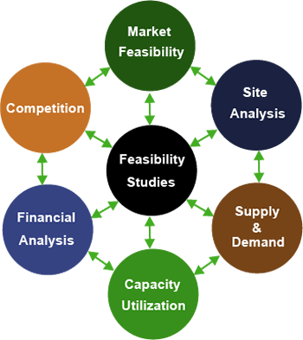
Financial feasibility analysis answers a fundamental question: Will the project generate sufficient financial returns to justify the capital invested, given its risks? This requires more than estimating profit. It involves systematic evaluation of projected revenues, development and operating costs, financing structures, timing of cash flows, and expected exit value, all adjusted for the time value of money
A project that appears profitable on a simple cost–revenue comparison may, after discounting future cash flows or accounting for risk exposure, prove financially unattractive.
Why?

Slide 7

1. Introduction to Real Estate Financial Feasibility
Local conditions may not precisely mirror national trends. Not every metropolitan area benefits from a national economic boom, and some communities will survive a national recession relatively unscathed. As a result, real estate market studies usually give greater weight to metropolitan area economic indicators than to nationwide statistics.
Real estate development and investment decisions involve committing substantial capital under conditions of uncertainty over extended time horizons. Unlike many other asset classes, real estate is characterized by high capital intensity, limited liquidity, long development cycles, regulatory complexity, and strong sensitivity to macroeconomic conditions.
For these reasons, financial feasibility and risk assessment form the foundation of rational real estate decision-making.

Slide 8

1. Introduction to Real Estate Financial Feasibility
Risk assessment complements feasibility analysis by recognizing that real estate projections are inherently uncertain. Market demand may shift, construction costs may escalate, interest rates may rise, regulatory frameworks may change, and economic cycles may affect absorption rates and property values.
Therefore, modern real estate evaluation integrates quantitative financial modeling with structured risk analysis to ensure that decisions reflect both expected return and risk exposure.

Slide 9

1. Introduction to Real Estate Financial Feasibility
Financial feasibility analysis determines whether a proposed real estate project is economically viable and capable of generating acceptable returns relative to risk.
A project is financially feasible if:
Expected revenues exceed total costs
The return meets investor expectations
The project can sustain debt obligations
Risk exposure is within acceptable limits

Slide 10
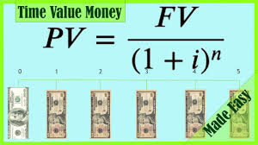
1. Introduction to Real Estate Financial Feasibility
Real estate projects are capital intensive, illiquid, and long-term. Therefore, financial evaluation must integrate:
Time value of money
Market uncertainty
Financing structure
Exit strategy
Unlike many industries, real estate feasibility depends heavily on location, absorption rates, and macroeconomic conditions.

Slide 11
2. The Real Estate Development Process and Financial Decision Points
Financial feasibility is not a single calculation; it is an ongoing evaluation across project stages:
Each stage introduces new risk and financial uncertainty.
Stage | Key Financial Question
Land Acquisition | Is land price justified by future development potential?
Concept Design | Is the project scale aligned with market demand?
Financing | What is the optimal debt–equity ratio?
Construction | Are costs within budget?
Operation | Are rental/sales projections realistic?
Exit | What is expected resale value?

Slide 12
3. Core Components of Financial Feasibility
3.1 Market Analysis
Financial feasibility begins with realistic demand estimation:
Target segment
Expected selling price per m²
Absorption rate
Rental growth expectations
Example:
A developer plans 50 residential units.
Market study shows:
Average selling price = $1,200/m²
Average unit size = 120 m²
Expected revenue per unit:
= 1,200 × 120 = $144,000
Total Gross Revenue:
= 144,000 × 50 = $7,200,000

Slide 13
3. Core Components of Financial Feasibility
3.2 Cost Estimation
Costs include:
Land cost
Hard construction cost
Soft costs (design, permits)
Marketing cost
Financing cost
Contingency (5–10%)
Cost Item | Amount ($)
Land | 1200000
Construction | 3000000
Soft Costs | 400000
Marketing | 200000
Financing | 300000
Contingency | 250000
Total Cost | 5350000

Slide 14

3. Core Components of Financial Feasibility
3.3 Time Value of Money
Money today is worth more than money tomorrow.
Future Value formula:
FV = PV(1+r)^n
Present Value formula:
PV = FV / (1+r)^n
If expected revenue of $7,200,000 is received after 3 years,
and discount rate = 12%:
PV = 7,200,000 / (1.12)^3
PV ≈ 5,124,000
This shows how timing affects feasibility.
FV=Future value of money
PV=Present value of money
R =discount rate
N =Number of years

Slide 15
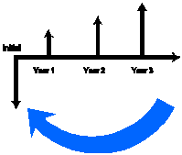
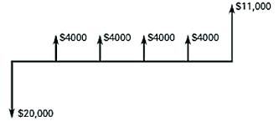
4. Investment Appraisal Techniques
4.1 Net Present Value (NPV)
NPV = Present Value of Cash Inflows − Initial Investment
If:
PV of revenues = $6,000,000
Total cost = $5,350,000
NPV = 650,000
If NPV > 0 → financially feasible.
NPV is considered the most reliable decision tool.

Slide 16
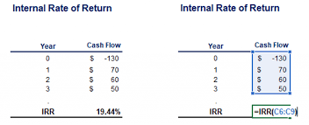
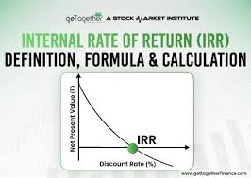
4. Investment Appraisal Techniques
4.2 Internal Rate of Return (IRR)
IRR is the discount rate that makes NPV = 0.
If project IRR = 18%
Required return = 14%
Since IRR > required return → Accept project.

Slide 17
4. Investment Appraisal Techniques
4.2 Internal Rate of Return (IRR)
Generally, an IRR of around 5% to 10% might be considered good for very low-risk investments, an IRR in the range of 10% to 15% is common for moderate-risk investments, and in investments with higher risk, such as early-stage startups, investors might look for an IRR higher .

Slide 18
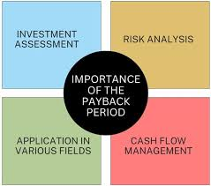
4. Investment Appraisal Techniques
4.3 Payback Period
Time required to recover initial investment.
If investment = $5,000,000
Annual net cash flow = $1,250,000
Payback = 4 years
Limitation: ignores time value of money.

Slide 19
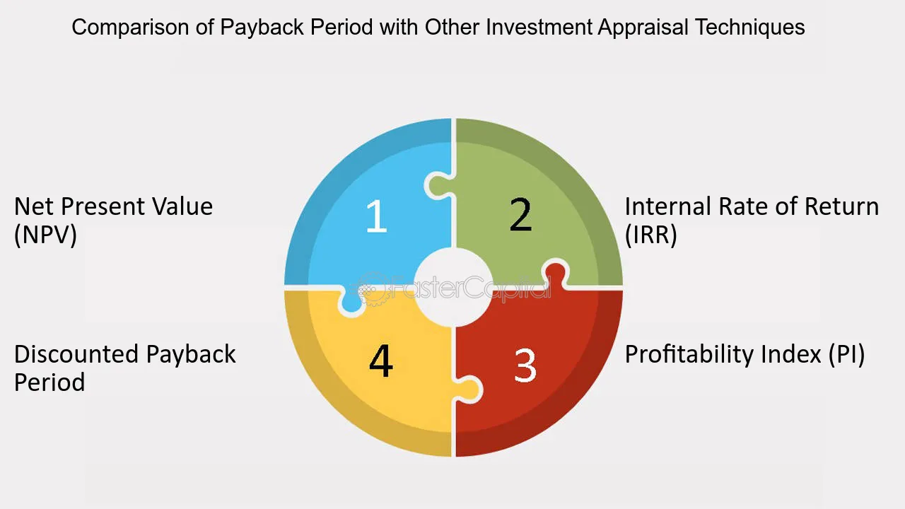
4. Investment Appraisal Techniques - exercise
Exercise 1 (Calculation)
A project requires $4,000,000 initial investment.
Expected annual cash flow = $900,000 for 6 years.
Discount rate = 10%.
Calculate:
NPV
IRR (approximate)
Payback period

Slide 20
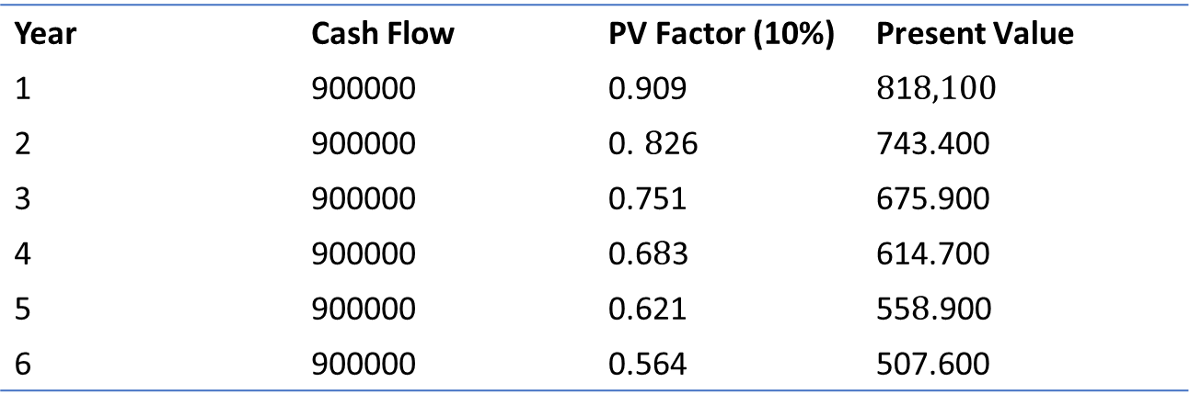
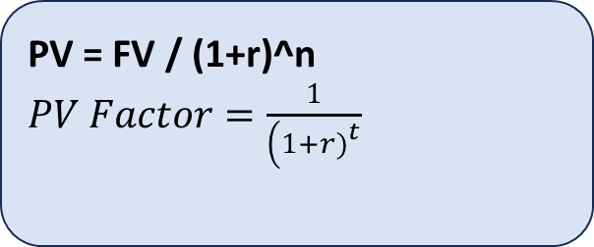
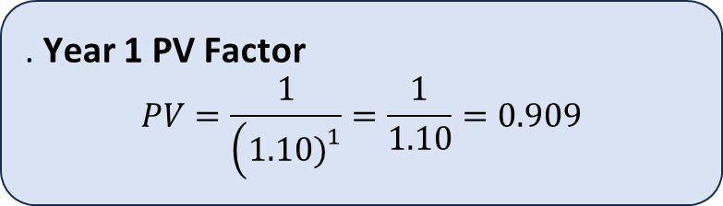
4. Investment Appraisal Techniques - exercise
FV = PV(1+r)^n
PV = FV / (1+r)^n
​$PV Factor=\frac{1}{\left(1+r{\left.)\right.}^{t}\right.}$
​
. Year 1 PV Factor
$$PV=\frac{1}{\left(1.10{\left.)\right.}^{1}\right.}=\frac{1}{1.10}=0.909$$
Year | Cash Flow | PV Factor (10%) | Present Value
1 | 900000 | 0.909 | $8$1$8,100$
2 | 900000 | 0. $8$26 | 743.400
3 | 900000 | 0.751 | 675.900
4 | 900000 | 0.6$8$3 | 614.700
5 | 900000 | 0.621 | 55$8$.900
6 | 900000 | 0.564 | 507.600

Slide 21
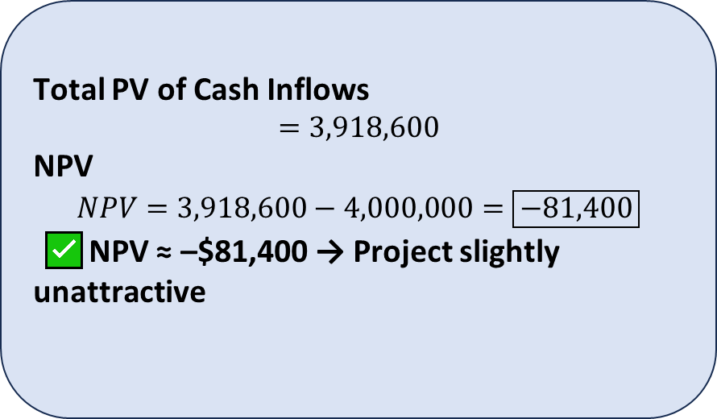
4. Investment Appraisal Techniques - exercise
Why PV Factor Decreases Each Year
Money in the future is worth less today due to:
Inflation
Risk
Opportunity cost
So the further the year → the smaller the PV factor.
Total PV of Cash Inflows
$$=3,918,600$$
NPV
$$NPV=3,918,600−4,000,000=\boxed{−81,400}$$
✅ NPV ≈ –$81,400 → Project slightly unattractive

Slide 22
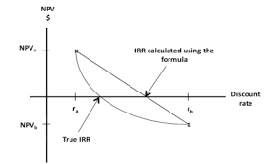
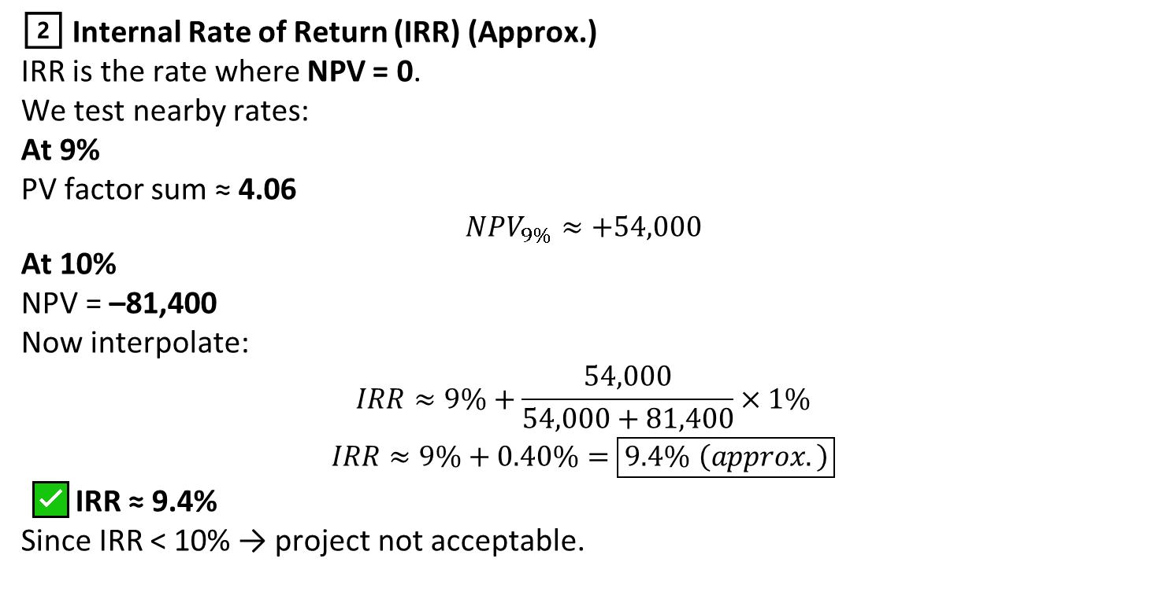
4. Investment Appraisal Techniques - exercise
2️⃣ Internal Rate of Return (IRR) (Approx.)
IRR is the rate where NPV = 0.
We test nearby rates:
At 9%
PV factor sum ≈ 4.06
$$NPV_{9\%}≈+54,000$$
At 10%
NPV = –81,400
Now interpolate:
$$IRR≈9\%+\frac{54,000}{54,000+81,400}×1\%$$
$$IRR≈9\%+0.40\%=\boxed{9.4\% \left(approx.\right)}$$
✅ IRR ≈ 9.4%
Since IRR < 10% → project not acceptable.

Slide 23

4. Investment Appraisal Techniques - exercise
📊 Final Answers
NPV: ≈ –$81,400
IRR: ≈ 9.4%
Payback Period: ≈ 4.4 years (≈ 4 years 5 months)
3️⃣ Payback Period
$$Payback=\frac{Initial Investment}{Annual Cash Flow}$$
$$=\frac{4,000,000}{900,000}=4.44 \text{years}$$
$$0.44×12≈5.3 \text{months}$$
✅ Payback ≈ 4 years 5 months
📊 Final Answers
NPV: ≈ –$81,400
IRR: ≈ 9.4%
Payback Period: ≈ 4.4 years (≈ 4 years 5 months)

Slide 24
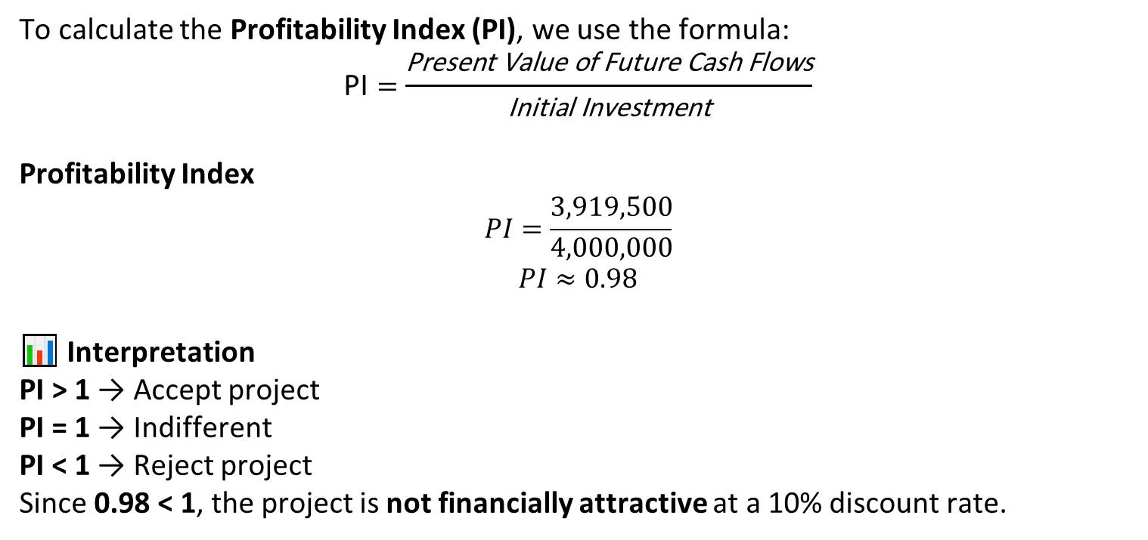
4. Investment Appraisal Techniques - exercise
nal Answers
NPV: ≈ –$81,400
IRR: ≈ 9.4%
Payback Period: ≈ 4.4 years (≈ 4 years 5 months)
To calculate the Profitability Index (PI), we use the formula:
$$\text{PI}=\frac{\text{Present} \text{Value} \text{of} \text{Future} \text{Cash} \text{Flows}}{\text{Initial} \text{Investment}}$$
Profitability Index
$$PI=\frac{3,919,500}{4,000,000}$$
$$PI≈0.98$$
📊 Interpretation
PI > 1 → Accept project
PI = 1 → Indifferent
PI < 1 → Reject project
Since 0.98 < 1, the project is not financially attractive at a 10% discount rate.

Slide 25
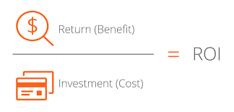
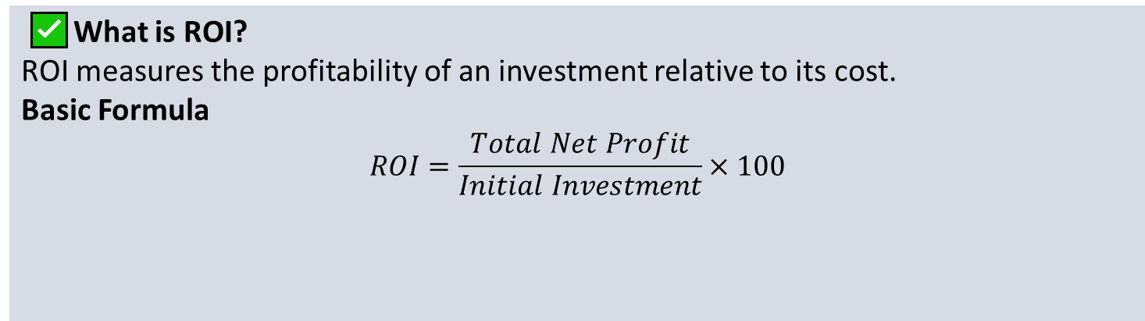
4. Investment Appraisal Techniques - exercise
✅ What is ROI?
ROI measures the profitability of an investment relative to its cost.
Basic Formula
$$ROI=\frac{Total Net Profit}{Initial Investment}×100$$

Slide 26
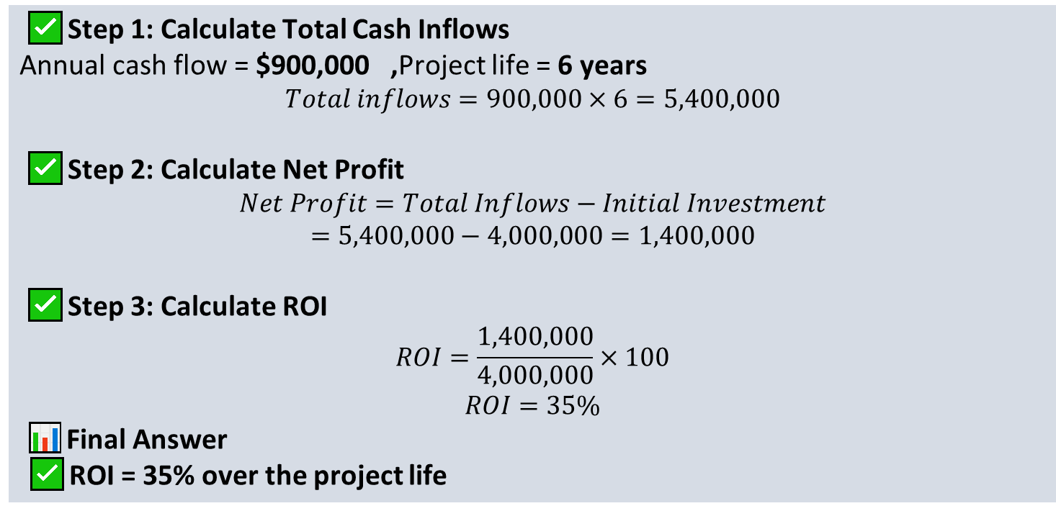
4. Investment Appraisal Techniques - exercise
✅ Step 1: Calculate Total Cash Inflows
Annual cash flow = $900,000 ,Project life = 6 years
$$Total inflows=900,000×6=5,400,000$$
✅ Step 2: Calculate Net Profit
$$Net Profit=Total Inflows−Initial Investment$$
$$=5,400,000−4,000,000=1,400,000$$
✅ Step 3: Calculate ROI
$$ROI=\frac{1,400,000}{4,000,000}×100$$
$$ROI=35\%$$
📊 Final Answer
✅ ROI = 35% over the project life

Slide 27
4. Investment Appraisal Techniques - exercise
⚠️ Important Note
ROI does not consider time value of money, unlike NPV and IRR.
That’s why:
ROI = positive (35%)
NPV = negative
IRR < discount rate
👉 Financially, the project is still not acceptable using discounted methods.

Slide 28

5. Cash Flow Modeling in Real Estate
A complete market study report should include a map that shows where the property sits within the metropolitan area or a major city. At a smaller scale, a map should show the boundaries of the primary and secondary market areas, location of the site, nearby interstate highways, and key
Real estate cash flow has two main phases:
5.1 Development Phase
Negative cash flow due to:
Land purchase
Construction
Permits
5.2 Operating Phase
Positive cash flow from:
Sales revenue
Rental income
This structured timeline enables accurate NPV and IRR calculation.

Slide 29
5. Cash Flow Modeling in Real Estate
This structured timeline enables accurate NPV and IRR calculation.
Year | Cash Flow ($)
0 | -50000000
1 | -10000000
2 | 800000
3 | 900000
4 | 1000000
5 | 1,200,000 + 8,000,000 (sale)

Slide 30
6. Risk in Real Estate Investment
6. Risk in Real Estate Investment
6.1 Market Risk
6.2 Construction Risk
6.3 Financial Risk
6.4 Regulatory Risk
6.5 Political & Macroeconomic Risk
Inflation
Currency risk
Political instability
Zoning changes
Tax increase
Permit delays
Price fluctuation
Demand decline
Oversupply
Interest rate increase
Loan default
Refinancing risk
Cost overruns
Delays
Contractor failure

Slide 31
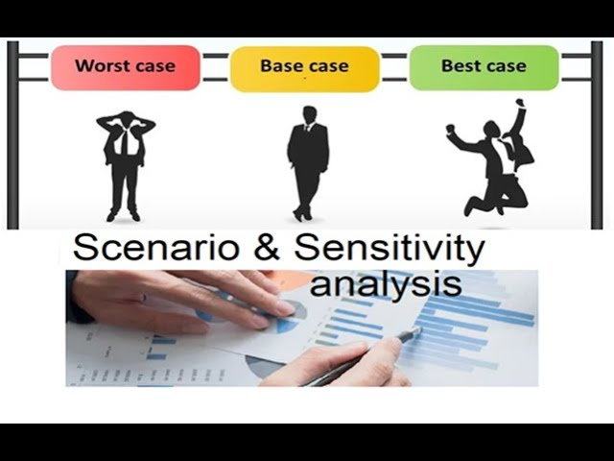
7. Sensitivity and Scenario Analysis
Sensitivity analysis tests how changes in one variable affect profitability.
Example:
If selling price decreases by 10%:
New revenue = 6,480,000
If cost remains 5,350,000
New NPV significantly decreases.
This identifies critical variables.

Slide 32
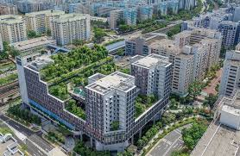
7. Sensitivity and Scenario Analysis
Case Study 1: Mid-Rise Residential Development
Project Summary:
60 units
3-year development
Total cost: $8 million
Expected sales: $10.5 million
IRR = 16%
Required return = 15%
However, sensitivity analysis shows:
8% price drop → IRR falls to 11%
Conclusion:
Project is feasible but highly sensitive to price fluctuations.
Case Study 1: Mid-Rise Residential Development
Project Summary:
60 units
3-year development
Total cost: $8 million
Expected sales: $10.5 million
IRR = 16%
Required return = 15%
However, sensitivity analysis shows:
8% price drop → IRR falls to 11%
Conclusion:
Project is feasible but highly sensitive to price fluctuations.

Slide 33
Case Study: Market Analysis & Residential Development Feasibility
1️⃣ Project Overview
Project Name: Green Heights Residences
Location: Dubai suburban growth corridor
Developer: Private real estate investment firm
Project Type: Mid-income residential apartments
Scale: 220 units (1–3 bedrooms)

Slide 34

Case Study: Market Analysis & Residential Development Feasibility
Given that all 8 billion people on the planet must live somewhere, how do we organize ourselves?
2️⃣ Market Analysis
2.1 Macro Market Overview
Key Drivers
Population growth: 2.5–3% annually
Increasing demand from expatriate workforce
Government housing initiatives
Infrastructure expansion (metro & highways)
Market Trend
Rising demand for affordable mid-income housing
Shift toward suburban living due to lower costs
Growth in rental yields (6–8%)

Slide 35
lecture
Case Study: Market Analysis & Residential Development Feasibility
Numerous areas of contemporary economics are connected to urban economics. My early professional goal was to become a | Source | % of Sessions |
| --------------------- | ------------- |
| Organic Search | 41% |
| Paid Ads (Google Ads) | 27% |
| Social Media | 18% |
| Direct | 14% |
macroeconomist. Understanding the causes and effects of booms and recessions is the goal of macroeconomists. Additionally, they aim to comprehend the
2.2 Target Market Segmentation
Segment | Characteristics | Demand Level
Young professionals | Ages 25–35, renting | High
Small families | 1–2 children | Very High
Investors | Seeking rental yield | Medium
Primary Target: Small families & young professionals

Slide 36
Case Study: Market Analysis & Residential Development Feasibility
| Competitor Project | Units | Price Range | Occupancy |
| -------------------- | ----- | ----------- | --------- |
| Sunrise Towers | 180 | $180k–$260k | 92% |
| Al Noor Residences | 250 | $160k–$240k | 95% |
| Palm View Apartments | 150 | $200k–$300k | 88% |
2.3 Competitive Analysis
Competitor Project | Units | Price Range | Occupancy
Sunrise Towers | 180 | $180k–$260k | 92 %
Al Noor Residences | 250 | $160k–$240k | 95 %
Palm View Apartments | 150 | $200k–$300k | 88 %
Insights
High occupancy indicates strong demand
Price sensitivity exists in mid-income segment

Slide 37
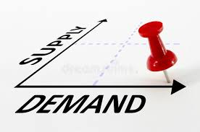
Case Study: Market Analysis & Residential Development Feasibility
3️⃣ Demand–Supply Analysis
Current Supply
1,200 units delivered in past 2 years
85% average occupancy
Projected Demand
1,800 units needed by 2028
✅ Conclusion: Market gap of ~600 units

Slide 38
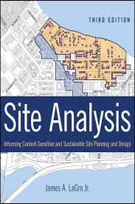
Case Study: Market Analysis & Residential Development Feasibility
| Priority Factor | % Selecting as “Very Important” |
| ----------------------- | ------------------------------- |
| Proximity to work | 72% |
| Parking availability | 65% |
| Public transport access | 58% |
| Security | 76% |
| Retail/services nearby | 49% |
4️⃣ Site Analysis
Advantages
✔ Near metro extension
✔ Access to schools & retail centers
✔ Lower land cost vs city center
Risks
⚠ Construction inflation
⚠ Potential oversupply if competitors accelerate projects

Slide 39
Case Study: Market Analysis & Residential Development Feasibility
| Priority Factor | % Selecting as “Very Important” |
| ----------------------- | ------------------------------- |
| Proximity to work | 72% |
| Parking availability | 65% |
| Public transport access | 58% |
| Security | 76% |
| Retail/services nearby | 49% |
5️⃣ Financial Feasibility
5.1 Development Cost Estimate
Cost Component | Amount (USD)
Land | 12000000
Construction | 38000000
Permits & Fees | 3500000
Marketing & Sales | 2500000
Contingency | 4000000
Total Cost | 60000000

Slide 40

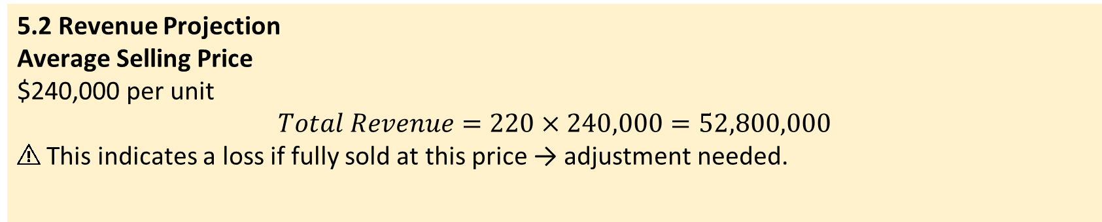
Case Study: Market Analysis & Residential Development Feasibility
Using Qualitative Research
5.2 Revenue Projection
Average Selling Price
$240,000 per unit
$$Total Revenue=220×240,000=52,800,000$$
⚠ This indicates a loss if fully sold at this price → adjustment needed.

Slide 41

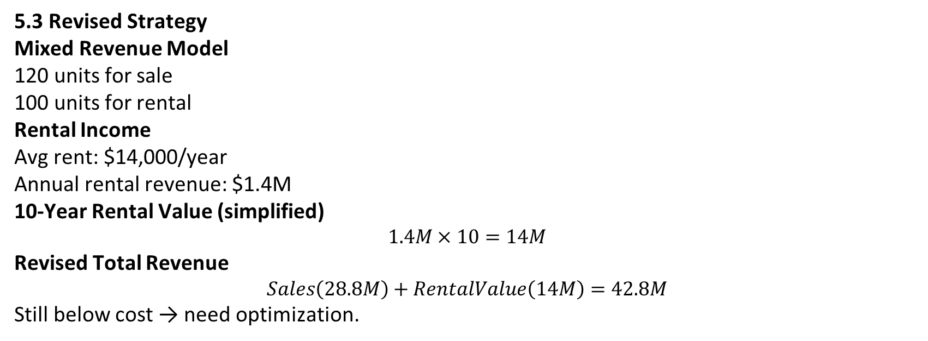
Case Study: Market Analysis & Residential Development Feasibility
5.3 Revised Strategy
Mixed Revenue Model
120 units for sale
100 units for rental
Rental Income
Avg rent: $14,000/year
Annual rental revenue: $1.4M
10-Year Rental Value (simplified)
$$1.4M×10=14M$$
Revised Total Revenue
$$Sales\left(28.8M\right)+RentalValue\left(14M\right)=42.8M$$
Still below cost → need optimization.

Slide 42

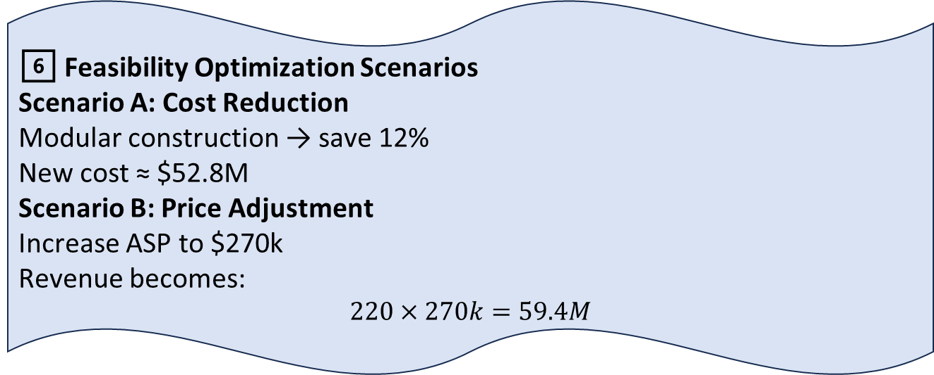
Case Study: Market Analysis & Residential Development Feasibility
6️⃣ Feasibility Optimization Scenarios
Scenario A: Cost Reduction
Modular construction → save 12%
New cost ≈ $52.8M
Scenario B: Price Adjustment
Increase ASP to $270k
Revenue becomes:
$$220×270k=59.4M$$

Slide 43
Case Study: Market Analysis & Residential Development Feasibility
| Metric | Result |
| --------------------- | -------------------------------- |
| Market Demand | Strong |
| Financial Feasibility | Conditional |
| Risk Level | Moderate |
| Recommended Strategy | Cost optimization + phased sales |
7️⃣ Feasibility Evaluation
Metric | Result
Market Demand | Strong
Financial Feasibility | Conditional
Risk Level | Moderate
Recommended Strategy | Cost optimization + phased sales
8️⃣ Final Recommendation
✅ Proceed with development if:
Construction costs reduced
Sales phased to monitor demand
Mix of sale & rental maintained

Slide 44
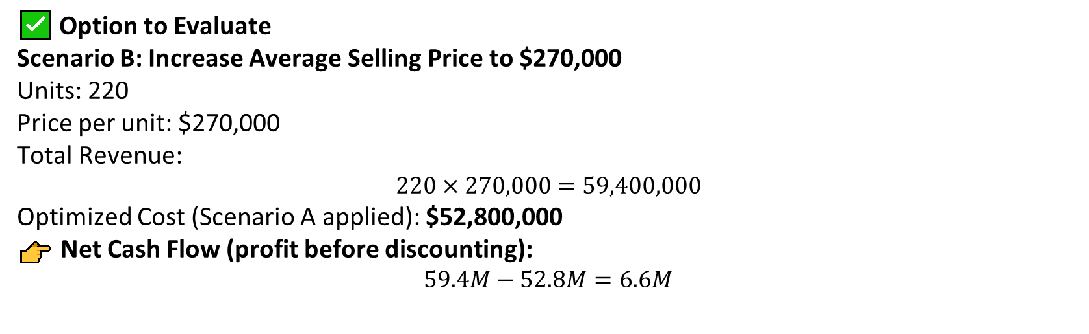
Case Study: Market Analysis & Residential Development Feasibility
✅ Option to Evaluate
Scenario B: Increase Average Selling Price to $270,000
Units: 220
Price per unit: $270,000
Total Revenue:
$$220×270,000=59,400,000$$
Optimized Cost (Scenario A applied): $52,800,000
👉 Net Cash Flow (profit before discounting):
$$59.4M−52.8M=6.6M$$

Slide 45

Case Study: Market Analysis & Residential Development Feasibility
❗ Important Assumption for NPV
To calculate NPV, we must assume a project timeline.
Assumed Cash Flow Timing
Year 0: Development cost = –52.8M
Year 2: Sales revenue received = 59.4M
Discount rate: 10%
(This is typical for residential developments.)

Slide 46
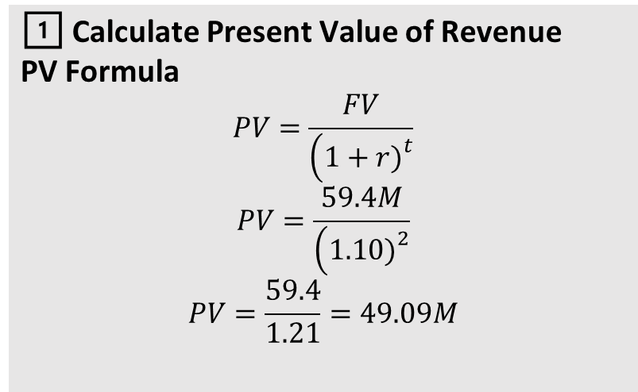
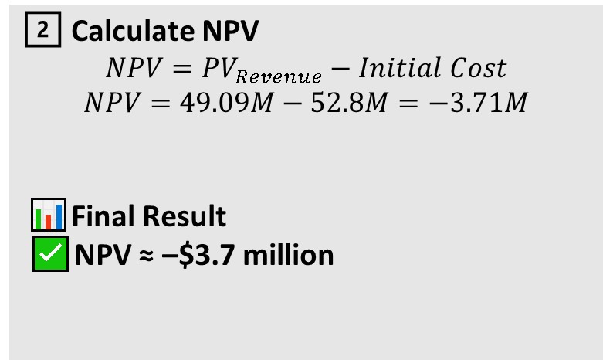
Case Study: Market Analysis & Residential Development Feasibility
1️⃣ Calculate Present Value of Revenue
PV Formula
$$PV=\frac{FV}{\left(1+r{\left.)\right.}^{t}\right.}$$
$$PV=\frac{59.4M}{\left(1.10{\left.)\right.}^{2}\right.}$$
$$PV=\frac{59.4}{1.21}=49.09M$$
2️⃣ Calculate NPV
$$NPV=PV_{Revenue}−Initial Cost$$
$$NPV=49.09M−52.8M=−3.71M$$
📊 Final Result
✅ NPV ≈ –$3.7 million

Slide 47

9. Risks and Common Mistakes
📉 Interpretation
Even after:
✔ Cost reduction
✔ Price increase
The project still has negative NPV, meaning:
❌ Not financially viable at 10% discount rate
⚠ Requires further optimization
What Would Make NPV Positive?
Possible improvements:
Increase price to ≈ $285k–$290k
Reduce costs further by 5–8%
Extend phased sales to reduce discounting
Include rental income component

Slide 48
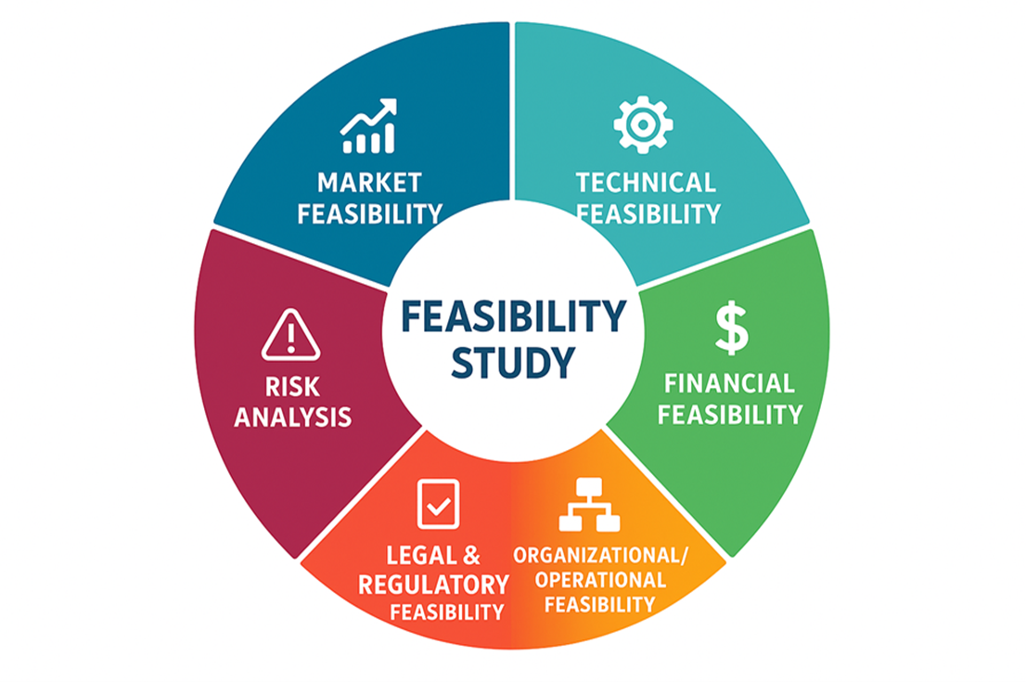
Conclusion
Financial feasibility analysis is the backbone of real estate investment decision-making. However, no financial evaluation is complete without structured risk assessment. In real estate, profitability and risk are inseparable.
lecture
06
Exercise
Do market analysis & fusibility report for real estate office project?

Slide 49



Thank You

