Slide 1


Agile Project
Management
Prepared by Eng. Ahmed Hussein, MBA, PfMP©, PMP©, CMP APMG
PMG 622
Master of Project Management
Lecture 08

Slide 2


Key Metrics and Resources to Monitor and Control Agile Projects
Lecture 8
PMG 622
Agile Project Management
Prepared by
Eng. Ahmed Hussein, MBA, PfMP©, PMP©, CMP APMG
www.midocean.ae

Slide 3
Chapter
Key Points from Previous Lecture
08
There are different methods for Hybrid PM
You customize your Hybrid methodology based on each project needs and requirements.
Hybrid PM brings more flexibility, better collaboration, more risk management, and efficient use of resources.
We can implement Hybrid and Agile on an enterprise level using SAFe® and DA™
Hybrid Methods bring the best of both worlds (Agile and Traditional) to your project.
www.midocean.ae

Slide 4

Chapter
Learning Objectives
08
Learn how and when to monitor and control Agile Projects.
Determine the main Key Performance Indicators (KPIs) to monitor an Agile Project
Use KPIs’ to forecast, analyze performance, and take decisions
Perform Risk Management in Agile Projects
www.midocean.ae

Slide 5

Chapter
KPIs and Monitoring and Controlling Agile Projects
08
www.midocean.ae

Slide 6


Chapter
Monitoring and Controlling Agile Progress
08
Monitoring and controlling is integrated throughout the whole Agile project life cycle
Agile methodologies, such as Scrum or Kanban, emphasize continuous inspection, adaptation, and collaboration
www.midocean.ae

Slide 7
Monitoring & Controlling events in Agile Projects
Event/Ceremony | Monitor | Control
Sprint Planning | Review and prioritize backlog items for the sprint | Planning involves estimating effort and committing to a set of deliverables for the sprint
Daily Standup | Provide updates, discuss impediments, adjust daily plan | The team collaboratively addresses issues and adapts the plan to optimize progress
Sprint Review | Demonstrated completed work to stakeholders | Stakeholders provide feedback, and the team reflects on what went well and what could be improved for the next sprint.
Sprint Retrospective | Reflect on sprint, examine processes, communication and overall performance | The team identifies areas for improvement and commits to implementing changes in the next sprint
Release Planning | High-level planning for upcoming releases | Adjustments are made based on feedback, changes in priorities, or evolving project requirements
Backlog Refinement | Review and refine the backlog, ensuring it is well-prioritized and contains detailed items for upcoming sprints | Adjustments are made to the backlog based on changing priorities or new information.

Slide 8
Chapter
Key Performance Indicator KPIs
08
“A measurable value that demonstrates how effectively an organization, department, process, project, or individual is achieving specific objectives. KPIs are used to evaluate performance over time, providing a quantifiable and objective measure of success or progress toward goals..”
www.midocean.ae

Slide 9
Efficiency KPI: Velocity
Chapter
08
Definition: The amount of work a team can complete in a given iteration (sprint). Indicates the team's efficiency and helps in predicting future work capacity.
Projects aim to increase velocity to speed up delivery and shorten project time and reduce cost.

Slide 10
Efficiency KPI: Burn-Down
Sprint Burn-Down: the progress of tasks within a sprint against the planned work. Provides a visual representation of work completed and remaining, aiding in timely adjustments.
Overall Burn-Down: The rate at which work is completed over time, often measured in story points. Helps in assessing the team's ability to meet goals and deliver on time.

Slide 11
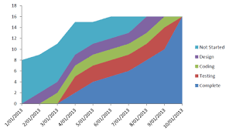
Chapter
Efficiency KPI: Cumulative Flow Diagram (CFD)
08
Definition: A visual representation showing the flow of work items across different stages. Identifies bottlenecks and helps in optimizing the flow of work through the implementation process.
Each line represents one of your workflow items as organized in a Kanban board.
www.midocean.ae

Slide 12
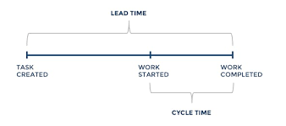
Chapter
Efficiency KPI: Lead Time vs. Cycle Time
08
Lead Time: The time it takes for a new requirement to be implemented and delivered. Reflects the speed of delivery from idea to implementation, helping to identify bottlenecks.
Cycle Time: The time taken to complete a single task or user story. Offers insights into the efficiency of the implementation process.
www.midocean.ae

Slide 13
Chapter
Example for Lead Time vs. Cycle Time
08
At Sprint 5 review, the customer asked for a new requirement. It was added to the product log and implemented after 3 sprints, each sprint is 15 days. The team worked on it from day 1 and completed it on day 8 of that sprint.
Lead time = 3 sprints x 15 days = 45 days
Cycle time = days (8 –1) = 7 days
www.midocean.ae

Slide 14


Chapter
Quality KPI: Defects (Escaped Defects)
08
Definition: The number of defects discovered by customers or end-users after the product release. Reflects the quality of the delivered product and the effectiveness of testing processes.
Note: Testing and documentation time are already included in story estimation
www.midocean.ae

Slide 15


Chapter
Value KPI: Customer Satisfaction
08
Customer Satisfaction: Measures the satisfaction level of customers or stakeholders with the delivered product. Provides insights into the alignment of the product with user expectations and needs.
Customer Satisfaction is a qualitative measure of value and measured through surveys or customer feedback.
www.midocean.ae

Slide 16
Chapter
Value KPI: Customer Value Delivered
08
There are many ways to measure value delivered to customers as:
User Story Points completed
Feature Adoption Rates
Time to Market
Percentage of Features used
Value Stream Mapping
www.midocean.ae

Slide 17
How to use these KPIs
KPIs Monitoring
Forecast future project trends
Analyze and Identify Problems
Make decisions and Take Corrective Actives

Slide 18
Chapter
Scenarios for using KPIs in the Calculator App Project
08
www.midocean.ae

Slide 19
Scenario 1: Forecasting # of Sprints and Budget
Chapter
Situation
Forecast
After 5 Sprints:
Velocity is 30
Remaining Story points = 240
Cost per Sprint = $10,000
Sprint Length = 15 days
Remaining # of Sprints = Story Points remaining / velocity
Remaining # of Sprints = 240/30 = 8 Sprints
Time left In Months = 4 Months
Money needed = cost per sprint * # of Sprints
= $10,000 * 8
= $80,000 USD
Management Asks you about when are you going to finish and how much more money do you need?
www.midocean.ae

Slide 20
Scenario 2: Analyzing Issues and problems
Chapter
Situation
What does this mean?
What can you do?
Defects highly increased in last release while velocity increased, and cycle time was reduced
It could mean different things as:
- Quality team members was absent in some days
- Team rushed testing process
- Team was efficient but there was a problem in releasing the product outside the team
- Discuss with team to identify reason in daily standup or sprint retrospective
- Review CFD to see if there has been significant changes in testing time
- Meet release team to find out about reason
www.midocean.ae

Slide 21
Scenario 3: Analyzing Issues and problems
Chapter
Situation
What does this mean?
What can you do?
Velocity is increasing but burndown chart has an upward trend due to increased number of story points
It could mean different things as:
- many new requirements are being added increasing the number of story points
- User Story estimates was revised and increased
- The project has a potential to keep growing and never ending.
- Product Owner reviews Priorities and works to eliminate low priority items
- Team works to increase velocity to reduce remaining time
- Try to capture majority of unidentified requirements in next sprint review with the customer
www.midocean.ae

Slide 22
Scenario 4: Analyzing Issues and problems
Chapter
Situation
What does this mean?
What can you do?
Overall Average Cycle time of the project is 5 days.
One story so far has a cycle time of 15 days and is not yet completed.
It could mean different things as:
- The story was too big needs to be split
- The story is too difficult
- Their was wrong estimate for the story
- There are some quality issues with this story
- The team needs training to do this story
- Discuss with team to identify reason in daily standup
- Assign more experienced team members to it
- Split the story into multiple user stories
- Focus all team effort on this task
www.midocean.ae

Slide 23
Scenario 5: Analyzing Issues and problems
Chapter
Situation
What does this mean?
What can you do?
Lead Time is high and customer satisfaction is low.
It could mean different things as:
- Features take too long
- Finished Featured are of low priority (prioritization issue)
- Discuss with team to identify reason in Retrospective and opportunities to reduce lead time
- Review the product backlog to ensure high value features are delivered first
- check with the customer what is the main reason for dissatisfaction
www.midocean.ae

Slide 24
Scenario 6: Decision Making
Chapter
Situation
Action
Two team members (out of 7) have left the team which means reduced velocity and in turn more sprints will be needed
Your project has budget cut (reduced) and tight deadline
You could analyze and decide on any of the following:
- Check possibility of hiring two replacement people in short period of time and at lower cost
- Check if current team can work overtime with incentive or increase velocity to achieve goal
- Review if we can eliminate low priority items in product backlog
Management Asks you about solutions to reduce budget and achieve timeline
www.midocean.ae

Slide 25
Chapter
Agile Risk Management
08
www.midocean.ae

Slide 26
Chapter
Defining Risk
08
“An uncertain event or condition that, if it occurs, has a positive or negative effect on one or more project objectives.”
Adapted from: Project Management Institute, Agile Practice Guide, Project Management Institute Inc., 2017, Page 397..
www.midocean.ae

Slide 27
Chapter
Agile Principles and Risk Management
08
Applying Agile principles significantly mitigate or eliminate many risks that frequently lead to project challenges and failure.
On Agile projects, risk management doesn’t have to involve formal risk documentation and meetings.
Instead, Risk Management is built into Agile roles, artifacts, and events
Our highest priority is to satisfy the customer through early and continuous delivery of valuable software.
Welcome changing requirements, even late in development. Agile processes harness change for the customer’s competitive advantage.
Deliver working software frequently, from a couple of weeks to a couple of months, with a preference to the shorter timescale.
Business people and developers must work together daily throughout the project.
Working software is the primary measure of progress.
www.midocean.ae

Slide 28
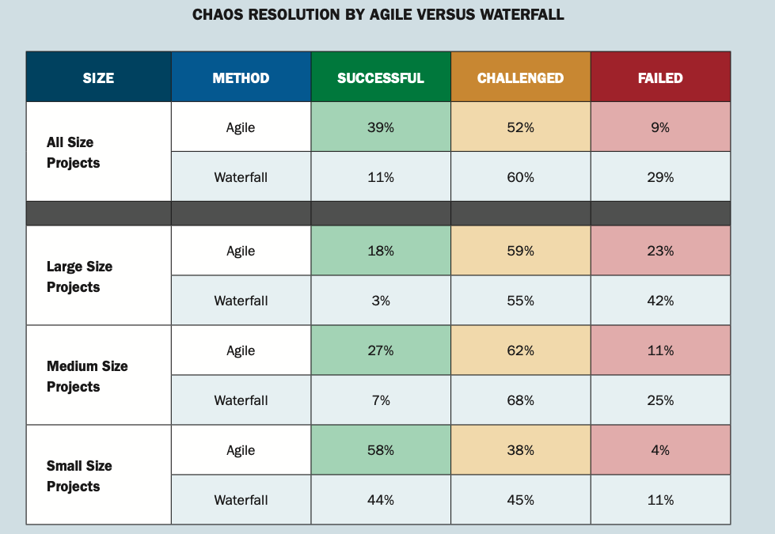
According to the Standish Group’s “2015 Chaos Report,” a study of 10,000 software projects, agile projects are more likely to succeed than traditional projects.
Adapted from: The Standish Group “2015 Chaos Report”, Page 7.

Slide 29
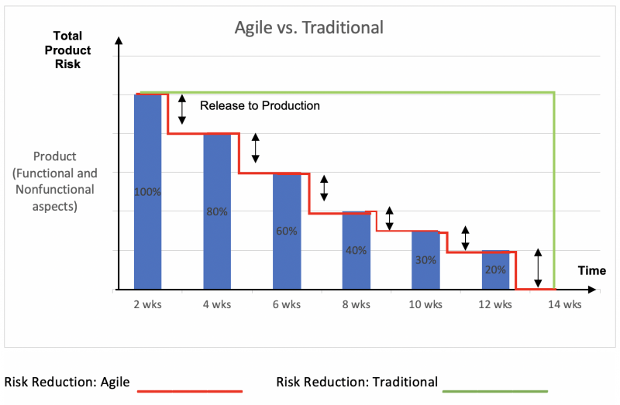
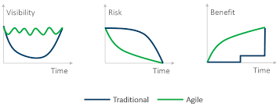
Agile Projects declining Risk Model
Risk on agile projects declines as the project progresses much faster than traditional projects.

Slide 30



Agile Characteristics that Reduce Risks
Reducing Risks Inherently
Sprints, releases, reviews, retrospectives, product owner involvement,
Definition of Done
The product owner and team agree upon the details of the definition of done ; user story estimation is all inclusive, i.e. includes times for testing and documentation
Self-Funding Projects
Agile projects can mitigate financial risk in a unique way as the self-funding project. If the product is income-generating, you could use that income to help fund the rest of your project.
Failing Fast
Instead of sinking costs into a long effort for requirements, design, and development, and then finding problems very late, agile projects identify critical problems within a few sprints saving large amounts of money.

Slide 31
Agile considerations for identifying, prioritizing, and responding to risks
Chapter
08
Agile teams should be aware of the risks that can arise during a project, they are responsible for trying to identify risks and find ways to prevent those risks from materializing.
Prioritize High-Value and High-Risk requirements first by creating a “Risk-Adjusted Backlog” giving priority to high-risk features and stories.
Teams use existing agile artifacts and meetings to manage risk (as Product Backlog, Sprint Planning, Daily Standups, Reviews and Retrospectives)
You can use traditional risk management documents if needed as:
  Risk Register
  Probability-Impact Matrix
www.midocean.ae

Slide 32
Agile Risk Management Steps
Identify risks
Assess risks
Mitigate risks
Monitor and control risks
Done during initial planning meeting, product backlog or sprint planning by brainstorming, interviewing stakeholders, and looking into similar projects
Assess the likelihood and impact of each risk to help prioritize risks, also done during initial planning or sprint planning meetings
Develop a plan to mitigate risks . This may involve avoiding, transferring, reducing impact, or probability of the risk.
Monitor and control your risk by tracking the progress of risk mitigation plans and taking corrective action as needed.
Done during initial planning or sprint planning meetings
Done during daily standups and sprint retrospectives

Slide 33
Chapter
Key Points
08
KPIs allows us to forecast, analyze, take decisions and corrective actions
There are many KPIs around efficiency, customer value, and quality
Applying Agile principles reduces project risks. We develop Risk Adjusted Backlog that prioritizes high value and high risk features.
Risk management is inherent in Agile processes and the team is responsible for identifying, prioritizing and mitigating risks.
Monitoring and controlling is done throughout agile projects using existing events and artifacts
www.midocean.ae

Slide 34

www.midocean.ae
Preparation for discussion panel:
Watch the VIDEO
“POWERFUL AGILE METRICS THAT CHANGE THE GAME”
Question:
What other KPIs can you think of using in Agile Projects?
Chapter
08
For Discussion Panel

Slide 35
www.midocean.ae
Before next lecture:
Role of the Agile PM
Watch the video
“Top 50 Agile Project Manager Interview Questions and Answers | Invensis Learning”
Chapter
08
For Next Lecture

Slide 36


Thank You

