Slide 1

Predicting and Mitigating Urban Traffic Congestion Using Artificial Intelligence
Prepared By
Name: [Musab Abdullah Alsalamah] ID No: [252000152]
Submitted in fulfillment of the requirements for the degree Master of Science in Modern artificial intelligence
At
College of Informatics
Midocean University
UAE
Supervisor Name: Dr. Yasser Abdel Hamid
College of Informatics, Midocean University, Comoros
[3-2025]

Slide 2
Introduction (Problem)
Traffic congestion at signalized intersections is a major challenge in urban environments, especially during peak hours. Drivers experience longer waiting times, increased fuel consumption, and higher emissions. Most traditional traffic signal systems rely on preset timing and cannot respond to real-time traffic conditions, which leads to inefficient traffic flow and increased congestion.

Slide 3
Introduction (Research Gap)
Traditional traffic analysis methods depend on historical data or fixed rules, which cannot capture complex or dynamic traffic patterns. As a result, congestion is often detected only after it occurs, making it difficult to manage effectively. With the increasing availability of traffic data, artificial intelligence and machine learning techniques provide an opportunity to predict congestion before it happens and improve traffic management.

Slide 4
Previous Work (Machine Learning)
Early research in traffic congestion prediction relied on classical machine learning techniques such as logistic regression, decision trees, support vector machines, and random forests. These models improved prediction performance compared to traditional statistical approaches, but they struggled to capture complex temporal relationships in traffic data, especially in rapidly changing environments.

Slide 5
Previous Work (Deep Learning)
Deep learning models, such as recurrent neural networks (RNN) and long short-term memory (LSTM), have been widely used for traffic prediction because they can capture temporal patterns in data. Hybrid models like CNN-LSTM and graph-based approaches further improved prediction accuracy. However, these models require large datasets, high computational power, and are difficult to implement in real-world traffic systems.

Slide 6
Quantitative Comparison with Previous Work
Models Performance
Key Difference:
- This study uses classification → predicts congestion (0/1)
- Previous studies use regression → predict traffic values
Performance | Metric Type | Model / Study
MAE ≈ 0.19, RMSE ≈ 0.43, MAPE ≈ 9.7% | MAE, RMSE, MAPE | GAT–BiLSTM–Attention (2024)
MAE ≈ 14, RMSE ≈ 17–19 | MAE, RMSE | Hybrid CPO–CNN–LSTM (2025)
Accuracy: 0.968, Precision: 0.893, Recall: 0.977, F1: 0.933 | Accuracy, Precision, Recall, F1 | Gradient Boosting (Proposed)

Slide 7
What AI Adds
Artificial intelligence enables better analysis of traffic behavior by identifying complex patterns in data. It allows predicting congestion before it occurs, which supports proactive traffic management. Instead of reacting to congestion after it happens, AI-based systems help decision-makers take early actions to reduce traffic buildup and improve overall traffic flow.

Slide 8
Objectives
The main objective of this study is to predict short-term traffic congestion using machine learning techniques and evaluate their performance. The study also aims to improve traffic signal timing by using predicted congestion levels. In addition, it investigates whether a Gradient Boosting model can outperform a simple historical average method in predicting congestion.

Slide 9
Data Source
The dataset used in this study was obtained from Kaggle and contains real-world traffic flow data collected from multiple road junctions over time.
It includes 48,120 records, where each observation represents traffic conditions at a specific junction and time, allowing the model to capture temporal traffic patterns.
The dataset consists of the following main attributes:
DateTime, Junction, Vehicles
The dataset contains 4 classes corresponding to the four junctions, enabling the model to learn location-specific traffic behavior.

Slide 10
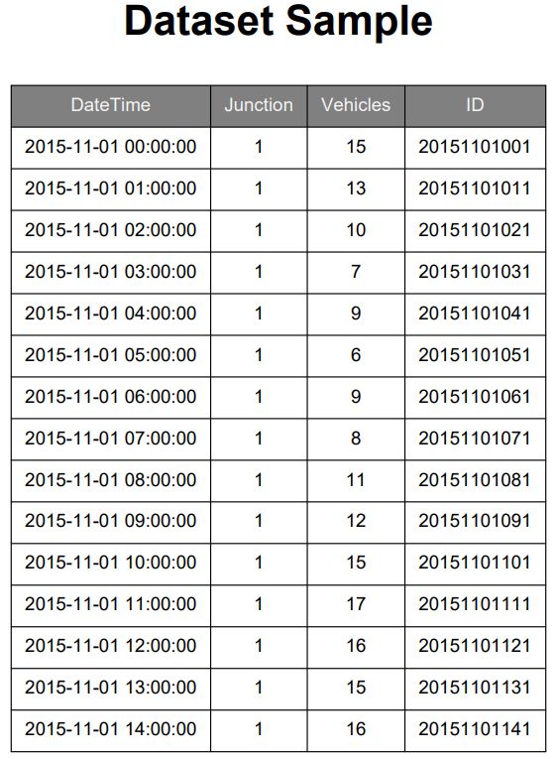
Sample Data

Slide 11
Data Preparation
Before training the model, the dataset was preprocessed to ensure consistency and usability.
First, the DateTime column was converted into a proper datetime format, and the dataset was sorted chronologically to preserve the time sequence.
Next, important time-based features were extracted, including:
- Hour of the day
- Day of the week
These features help the model capture traffic patterns more effectively.
In addition, the dataset was checked for missing values and inconsistencies. Since the dataset was relatively clean, only minimal preprocessing was required.
A new target variable called congestion was created (0 = No congestion, 1 = Congestion), transforming the problem into a classification task.

Slide 12
Models Used
This study evaluated four machine learning models: logistic regression, random forest, support vector machine, and gradient boosting. Each model was tested to compare its performance.
Gradient Boosting was selected as the final model because it provided a strong balance between accuracy and efficiency.
In addition, the model demonstrated good computational performance in terms of training and prediction time, making it suitable for practical and real-time traffic applications compared to more complex models.

Slide 13
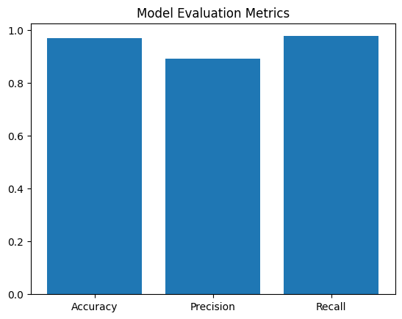
Model Evaluation
The gradient Boosting model was evaluated using accuracy, precision, recall, and F1-score.
Accuracy: 0.968
Precision: 0.893
Recall: 0.977
F1-score: 0.933

Slide 14
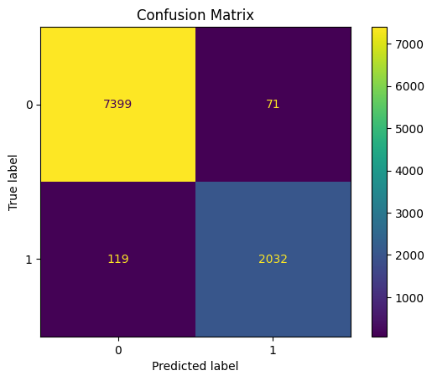
Confusion Matrix
This confusion matrix shows the classification performance of the model.

Slide 15
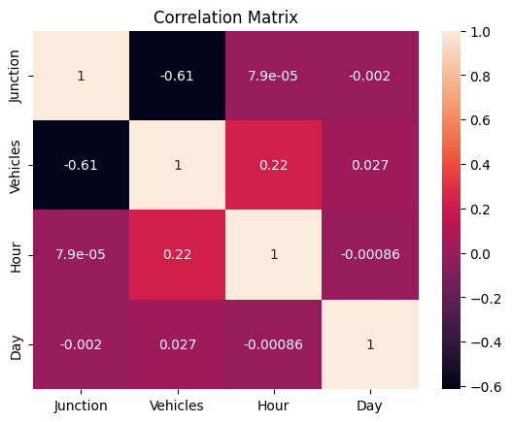
Correlation Matrix
This matrix shows relationships between variables.

Slide 16
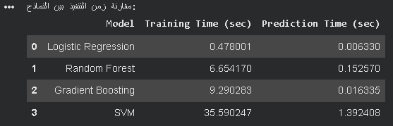
Model Efficiency
This figure compares training and prediction time of models.

Slide 17
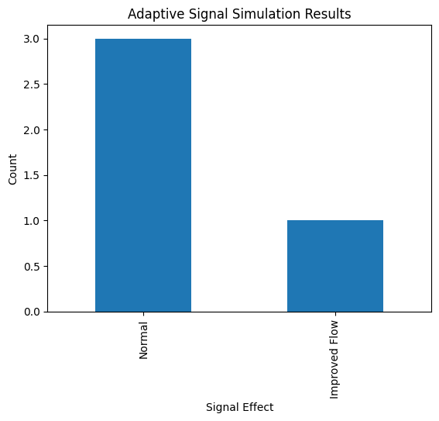
Adaptive Signal Results
This figure shows adaptive traffic signal simulation results.

Slide 18
Conclusion & Future Work
The study shows that Gradient Boosting outperforms traditional methods in predicting traffic congestion. Machine learning can effectively support traffic decision-making.
Future improvements include adding more data sources, applying advanced models, and implementing the system in real-time environments.

