Slide 1
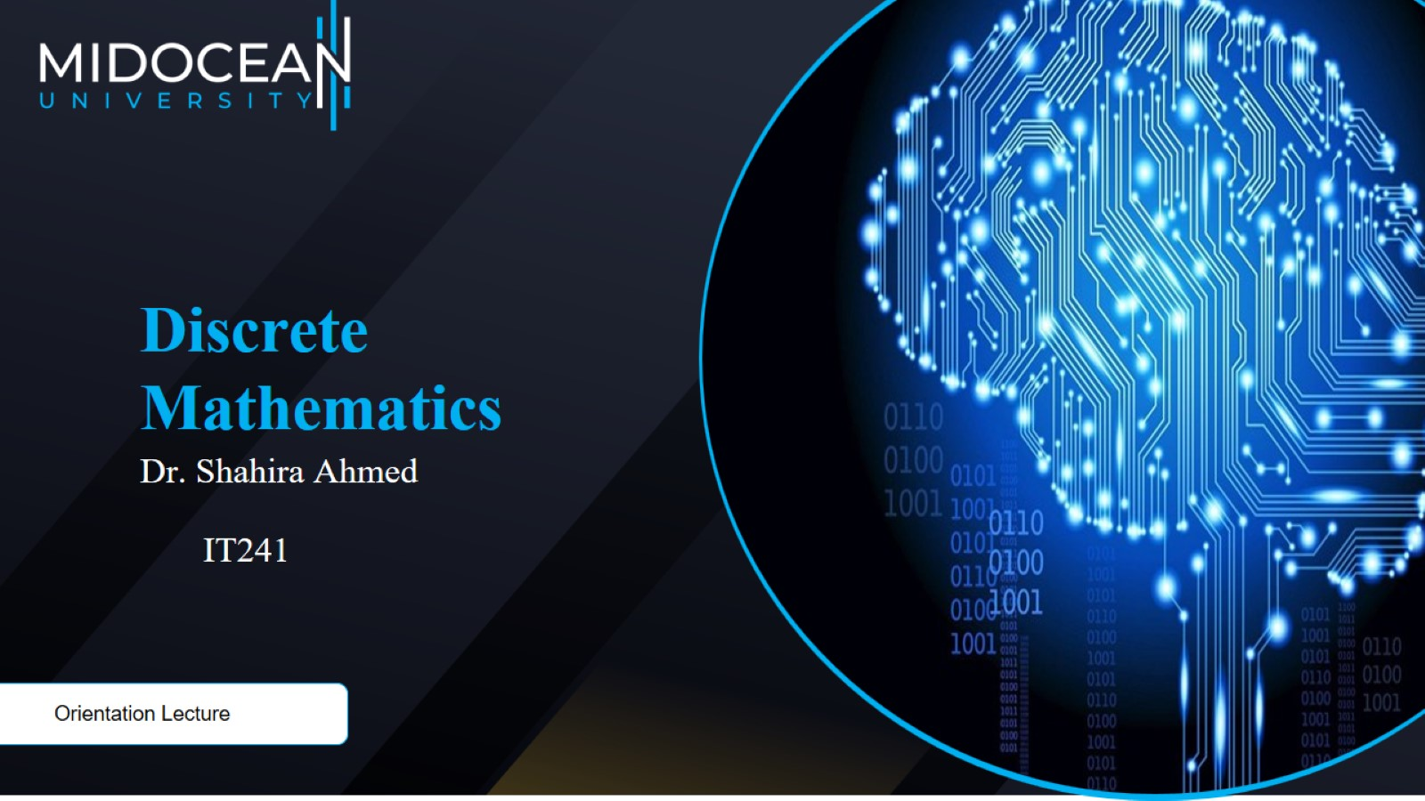

Slide 2
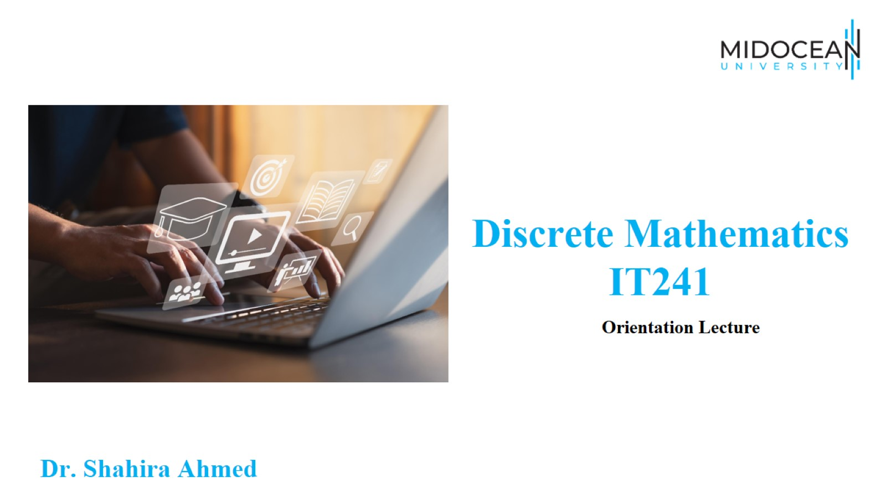

Slide 3
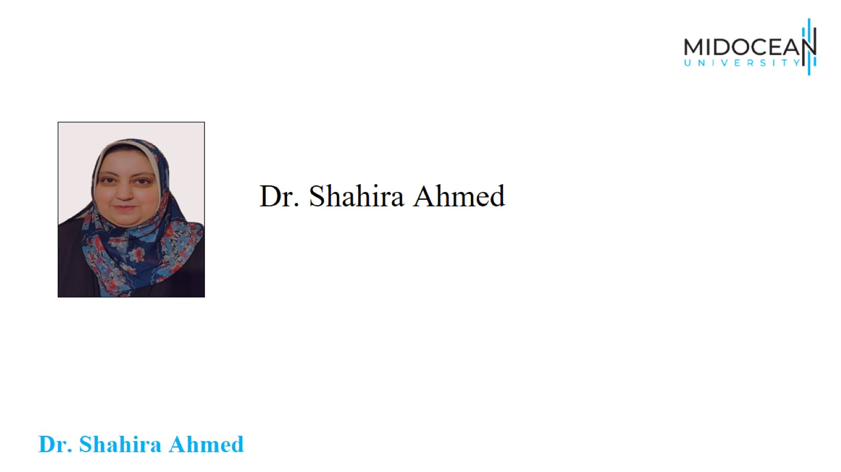
Dr. Shahira Ahmed

Slide 4
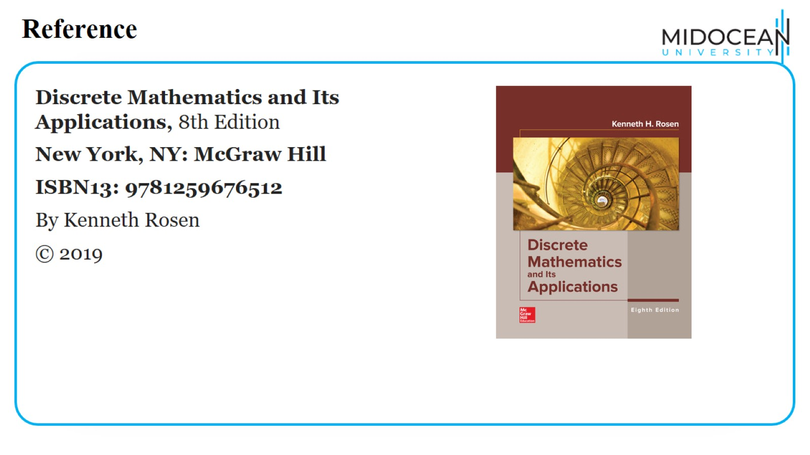
Reference

Slide 5
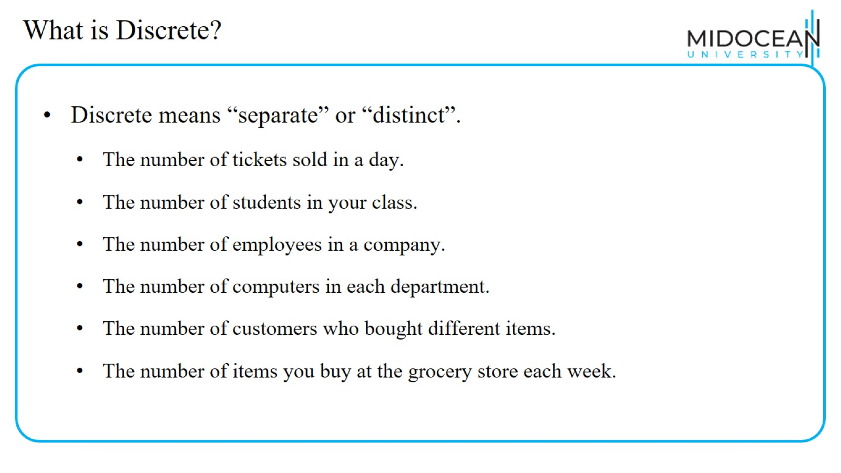
What is Discrete?

Slide 6
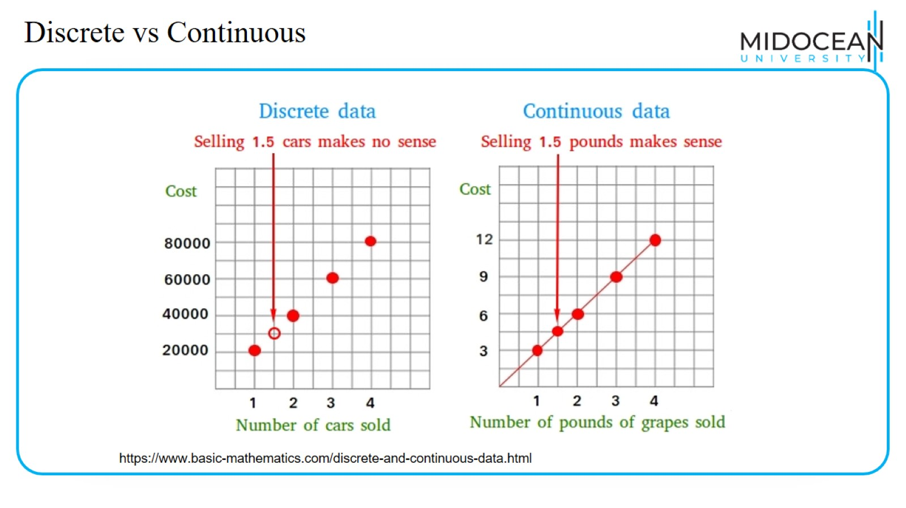
Discrete vs Continuous

Slide 7
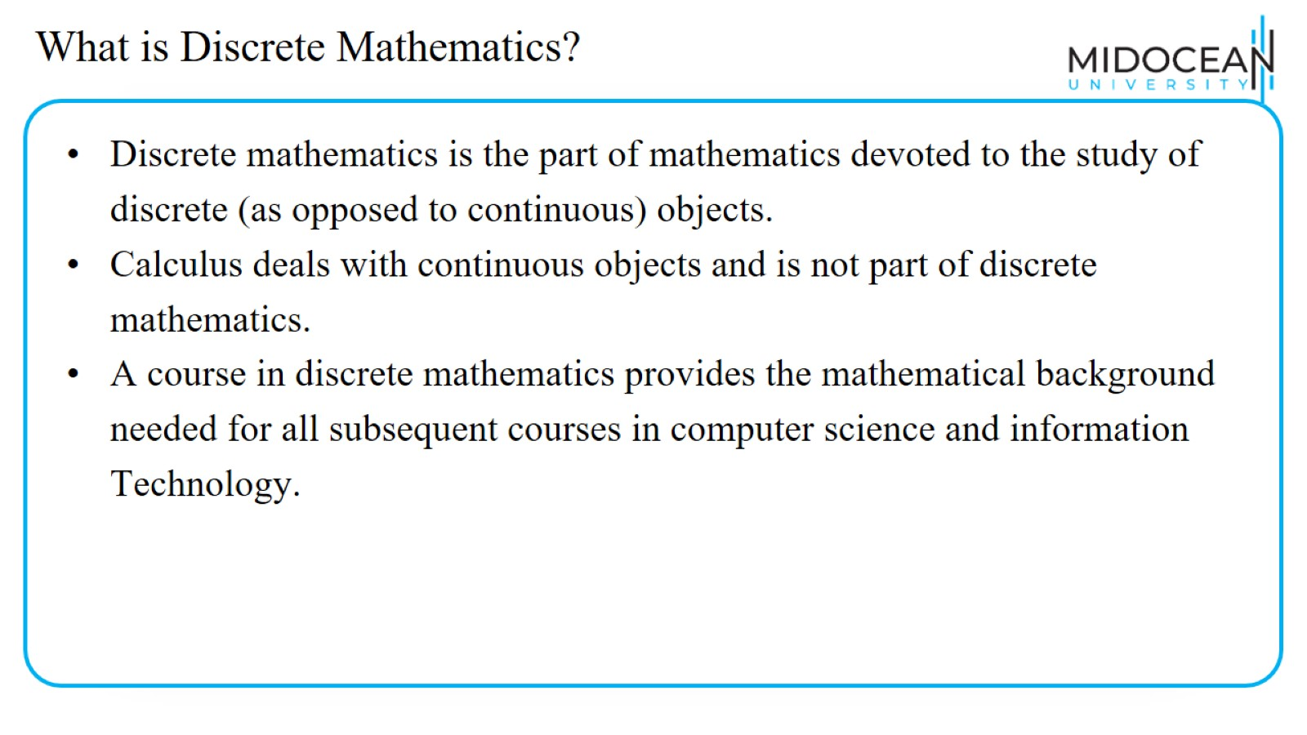
What is Discrete Mathematics?

Slide 8
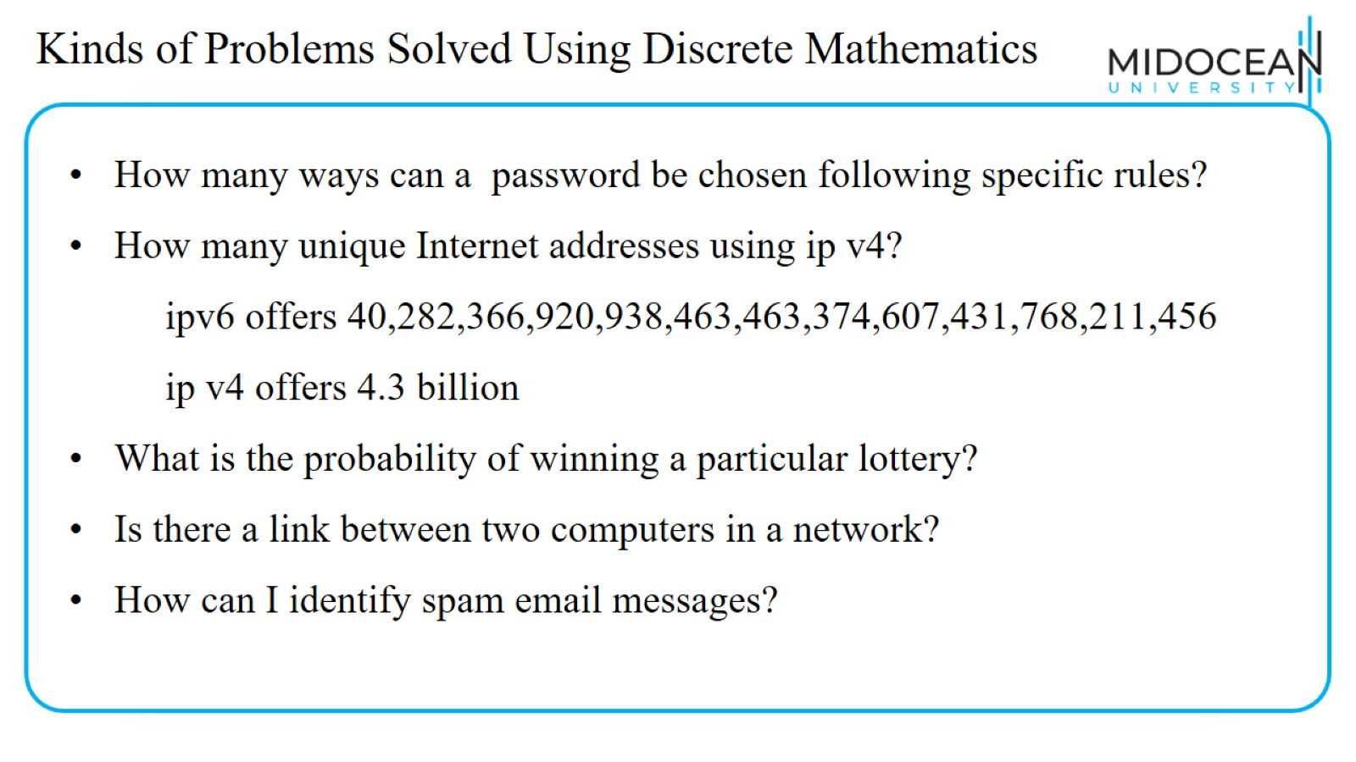
Kinds of Problems Solved Using Discrete Mathematics

Slide 9
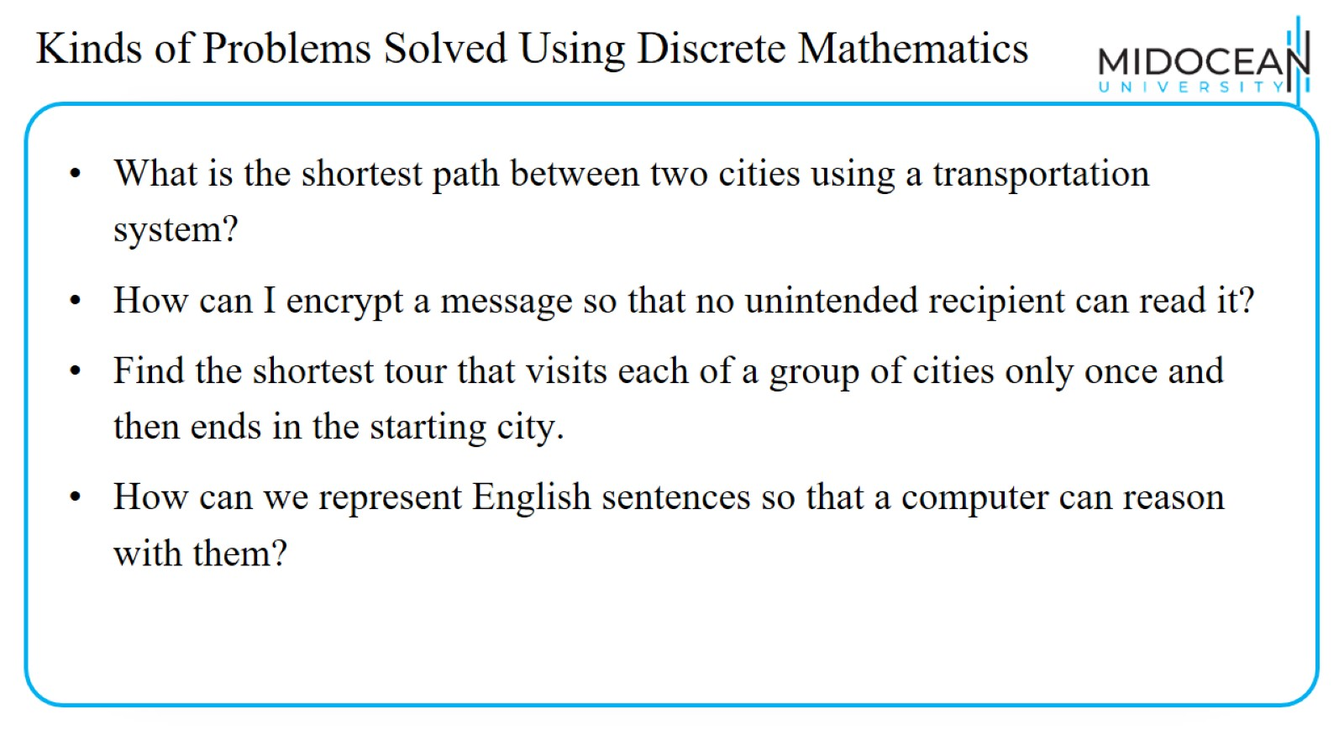
Kinds of Problems Solved Using Discrete Mathematics

Slide 10
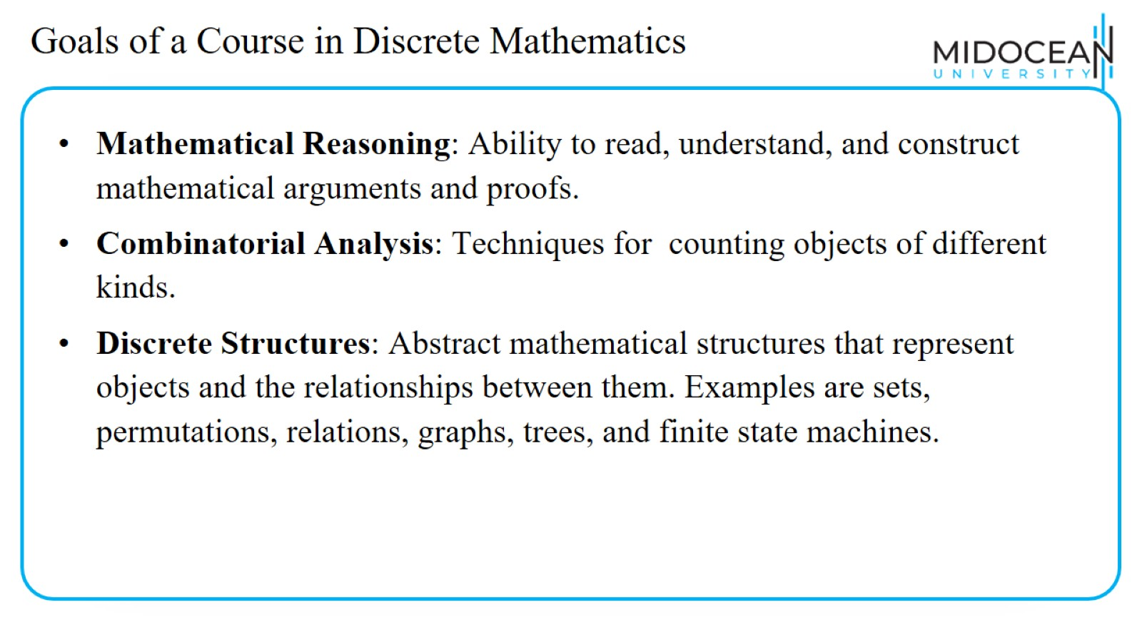
Goals of a Course in Discrete Mathematics

Slide 11
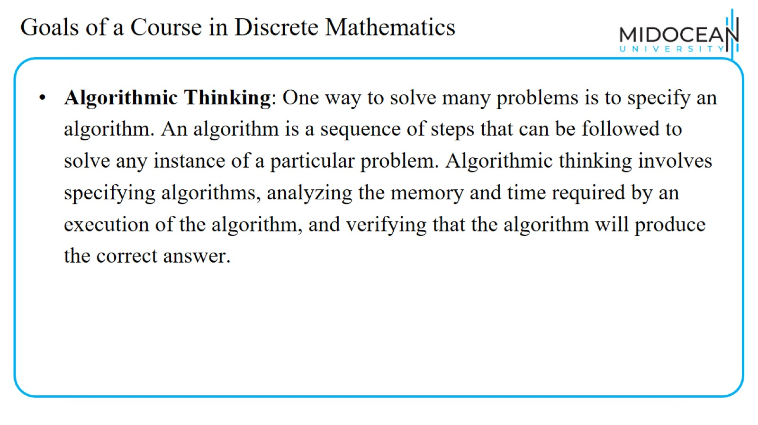
Goals of a Course in Discrete Mathematics

Slide 12
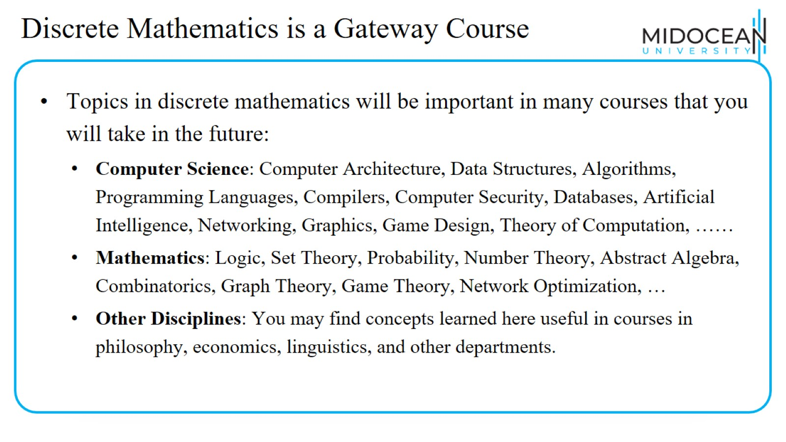
Discrete Mathematics is a Gateway Course

Slide 13


