Slide 1


Slide 2
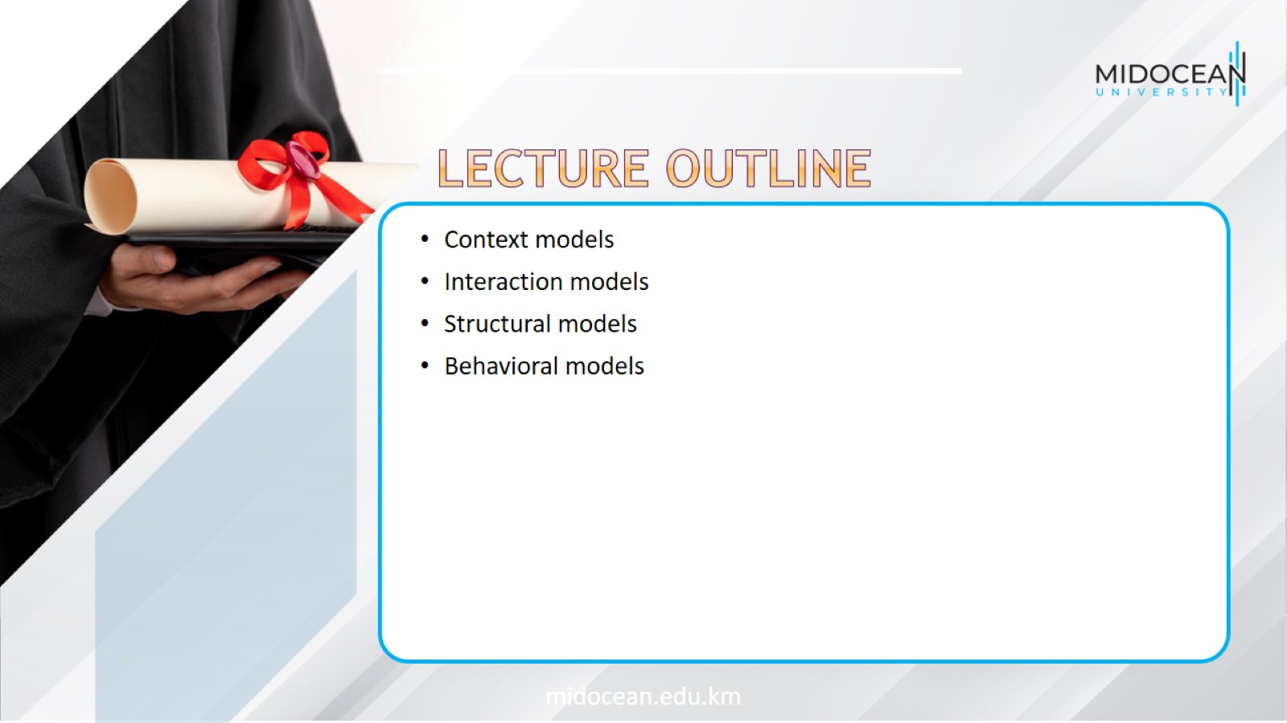

Slide 3
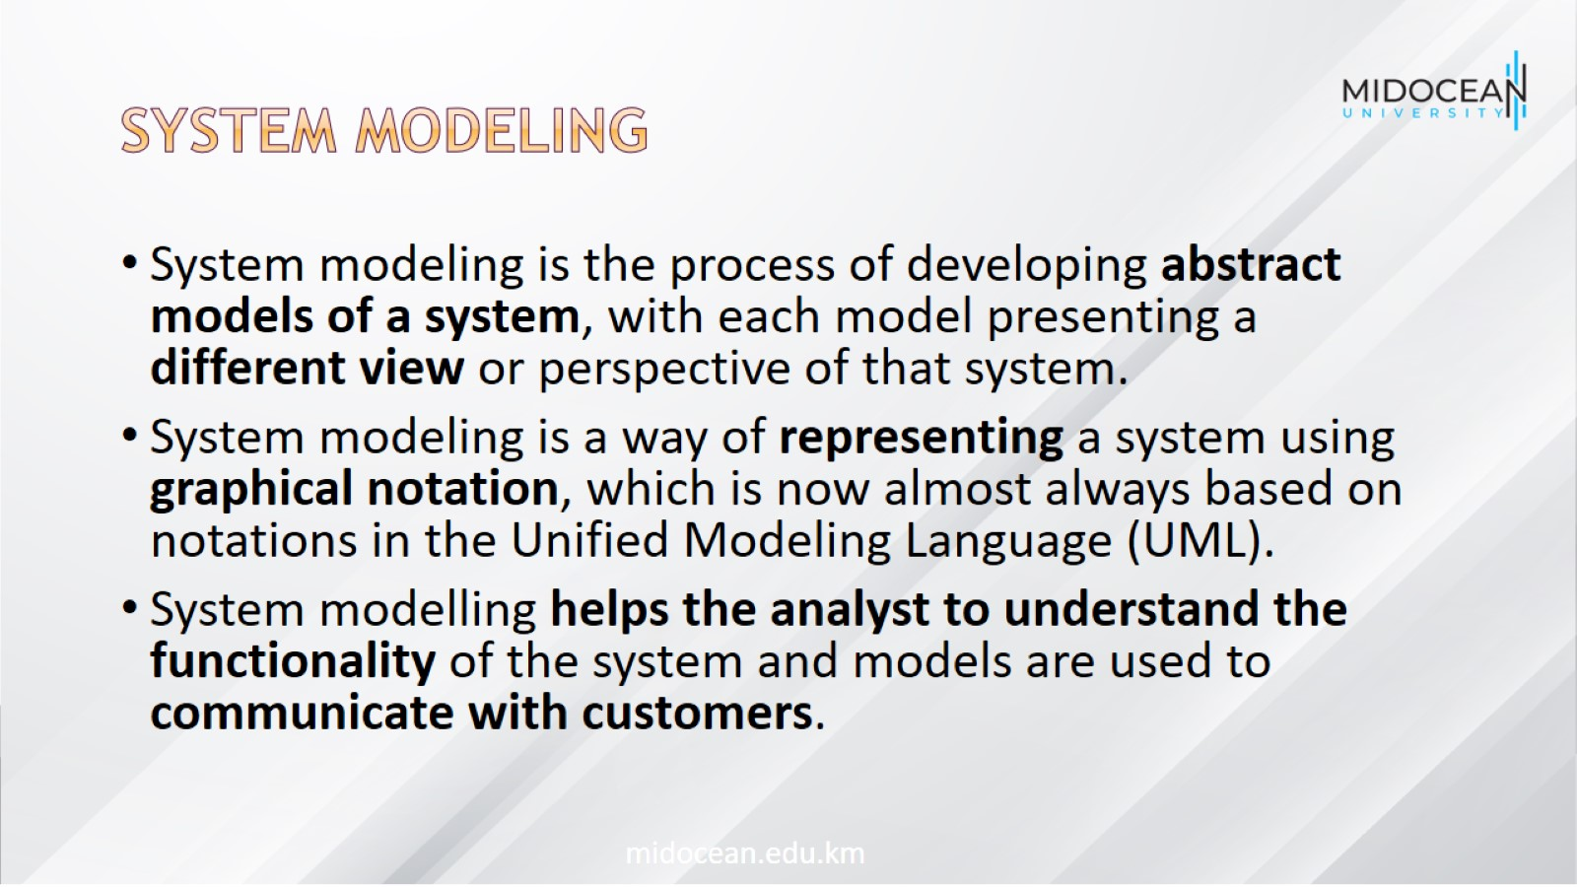
System modeling

Slide 4
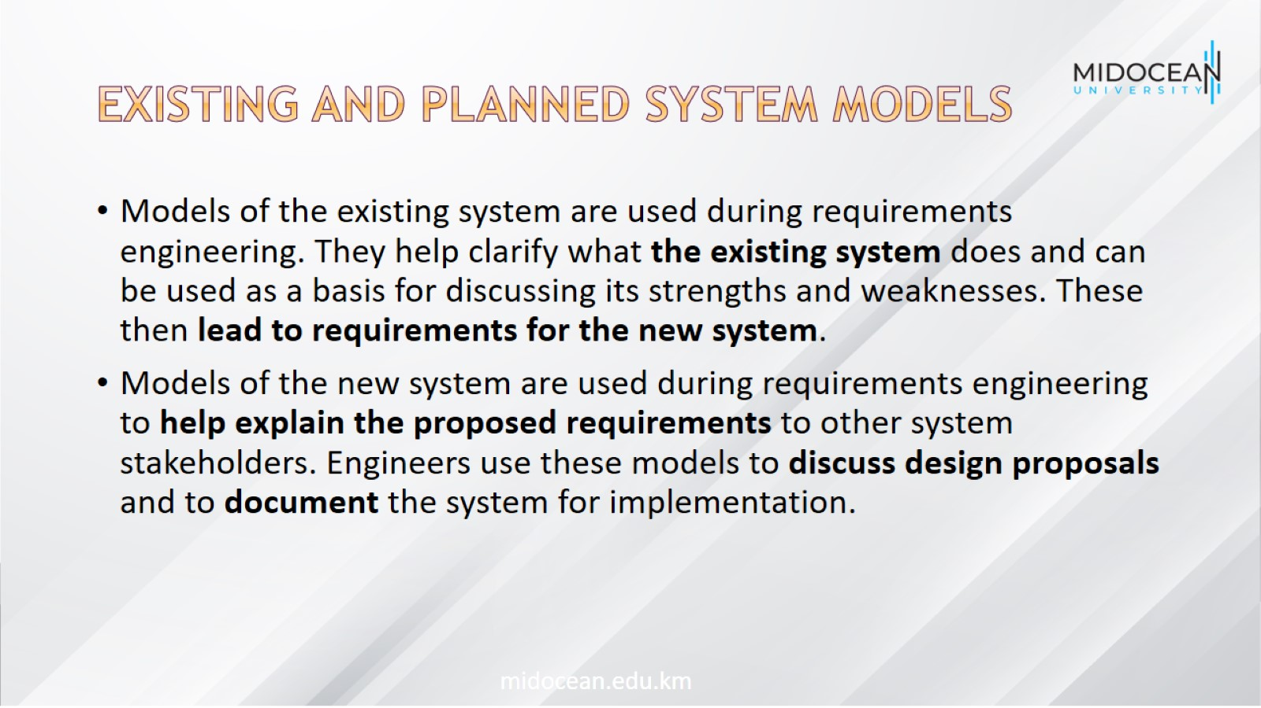
Existing and planned system models

Slide 5
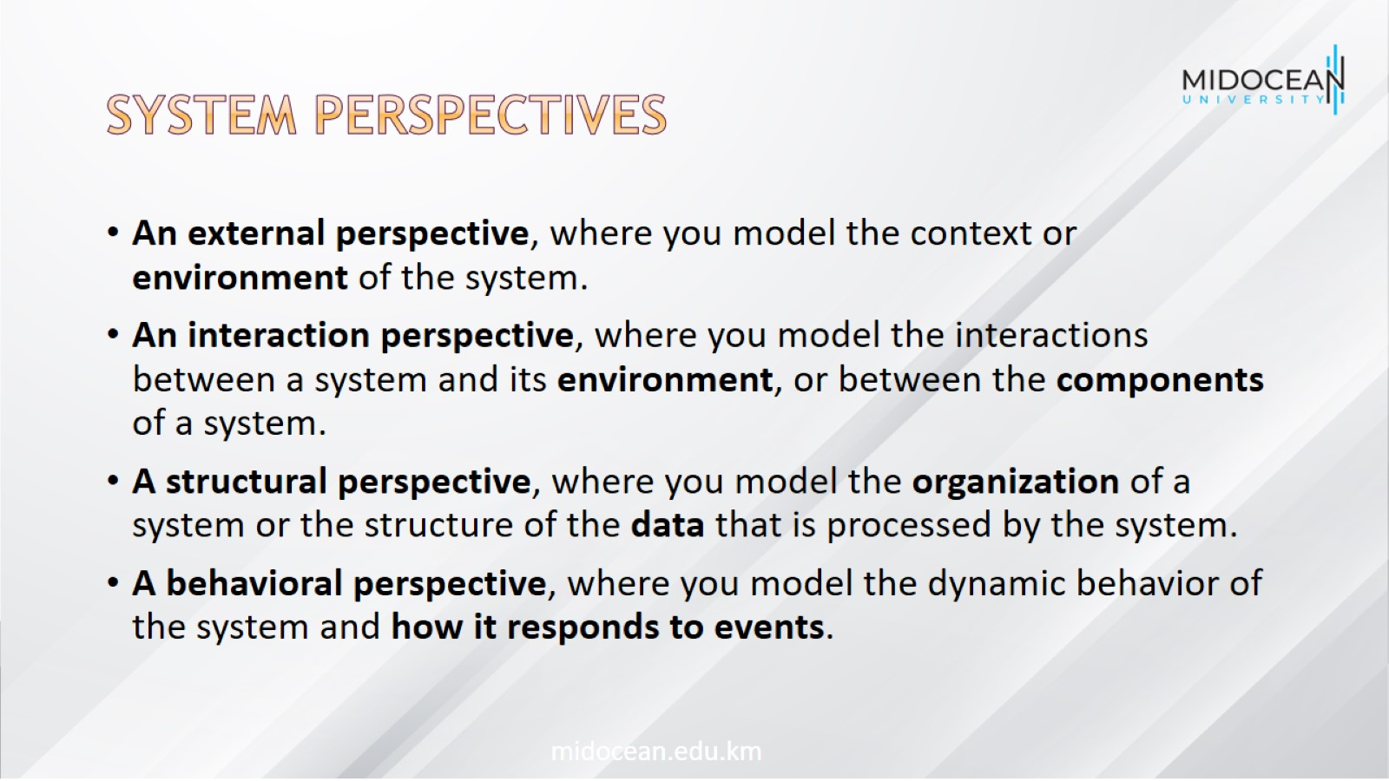
System perspectives

Slide 6
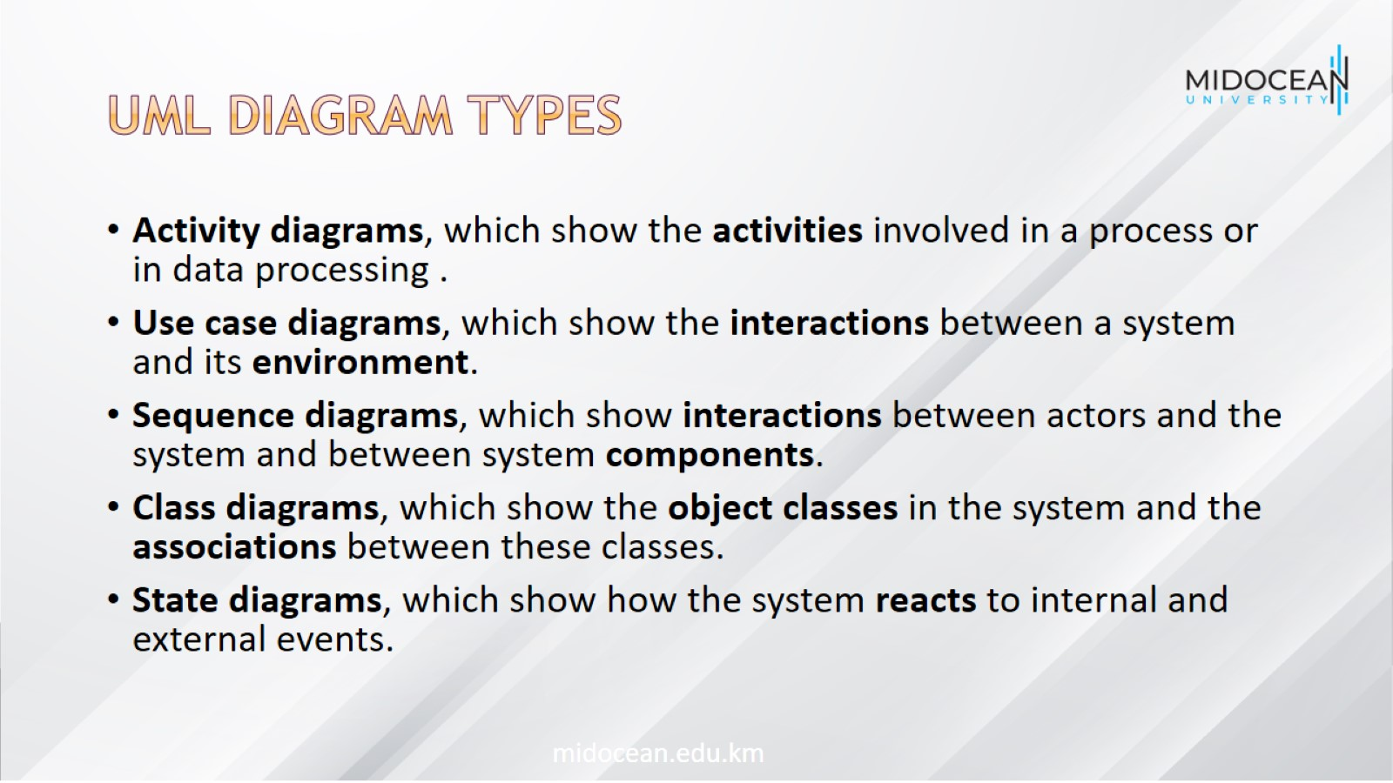
UML diagram types

Slide 7
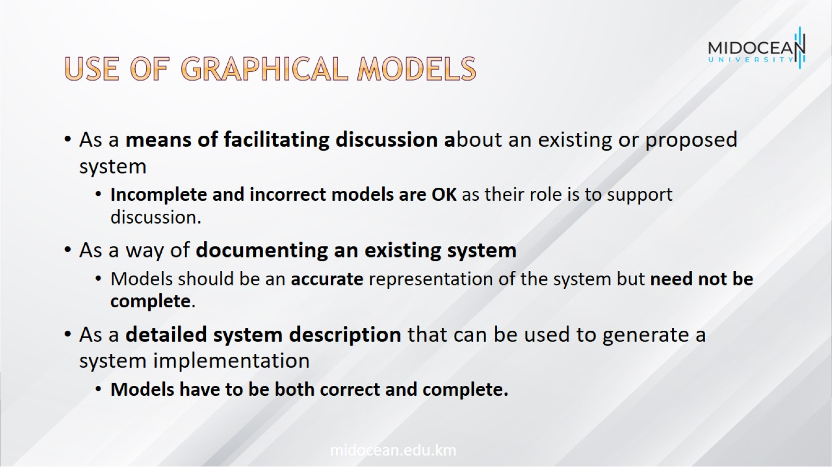
Use of graphical models

Slide 8
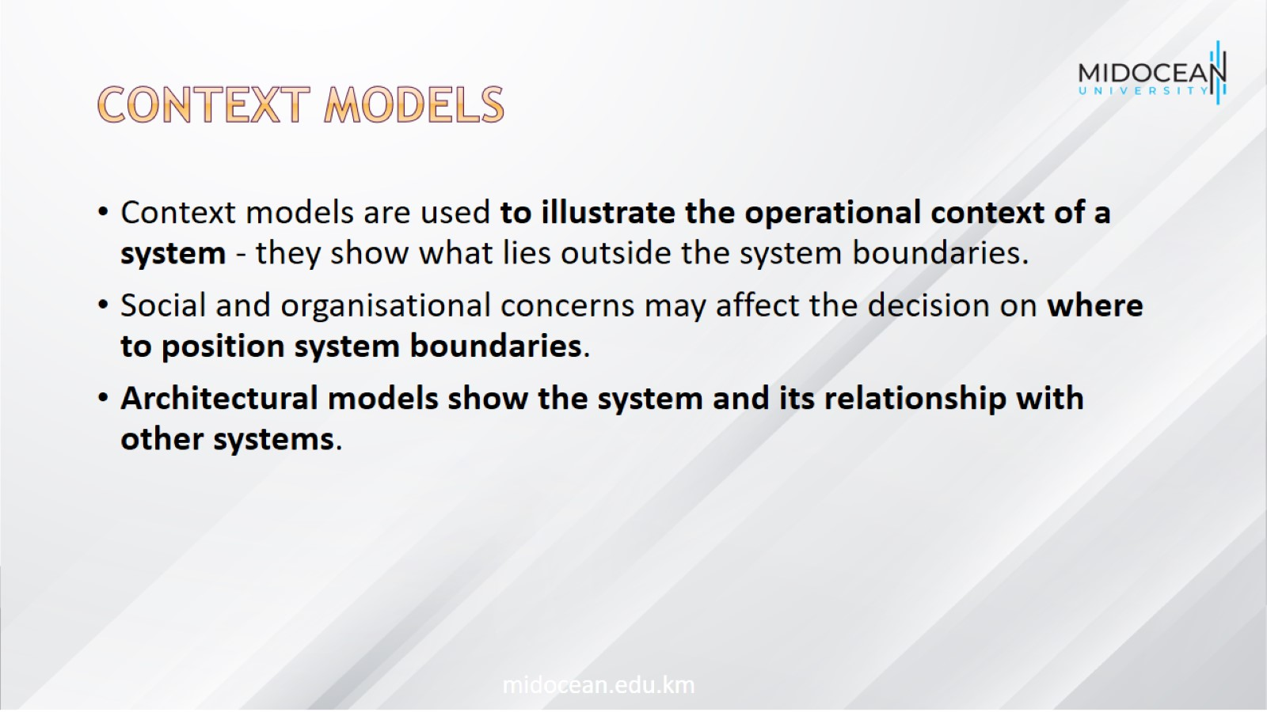
Context models

Slide 9
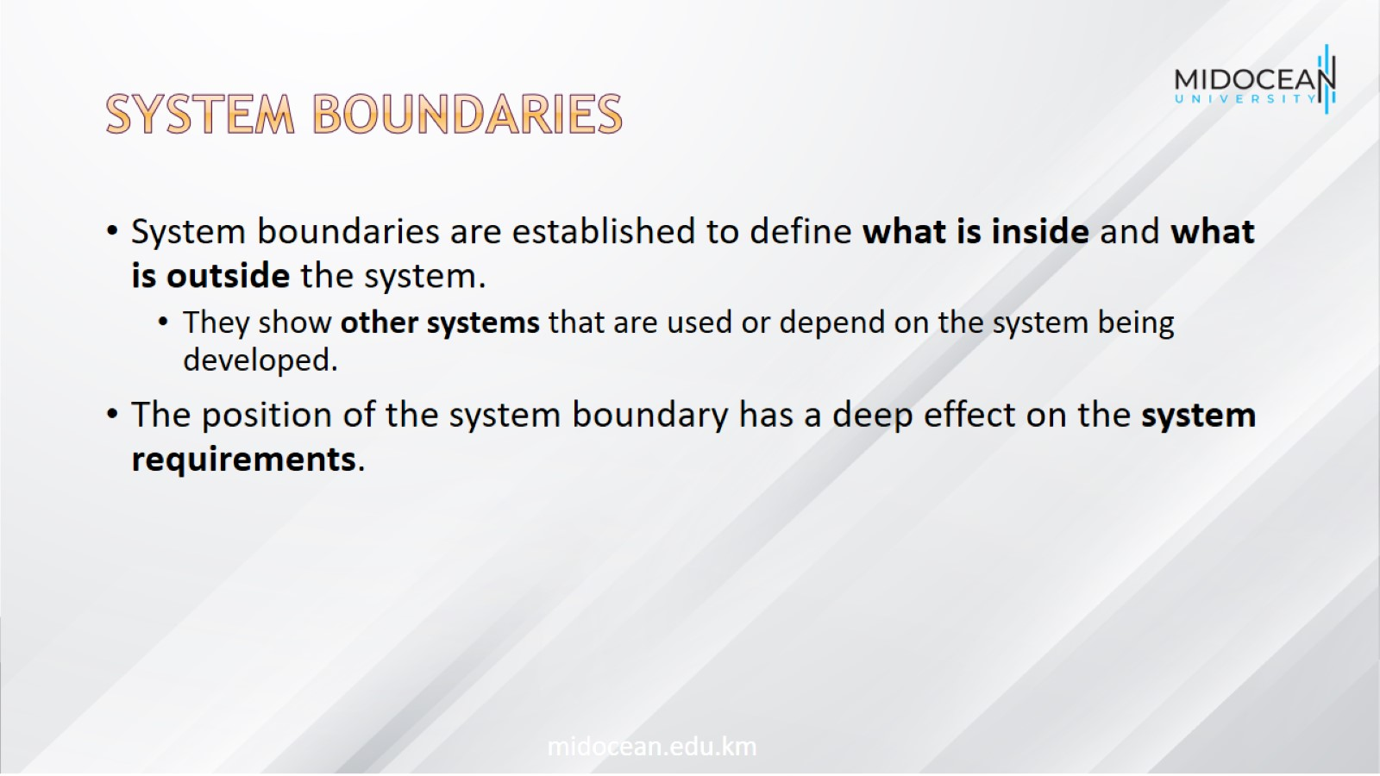
System boundaries

Slide 10
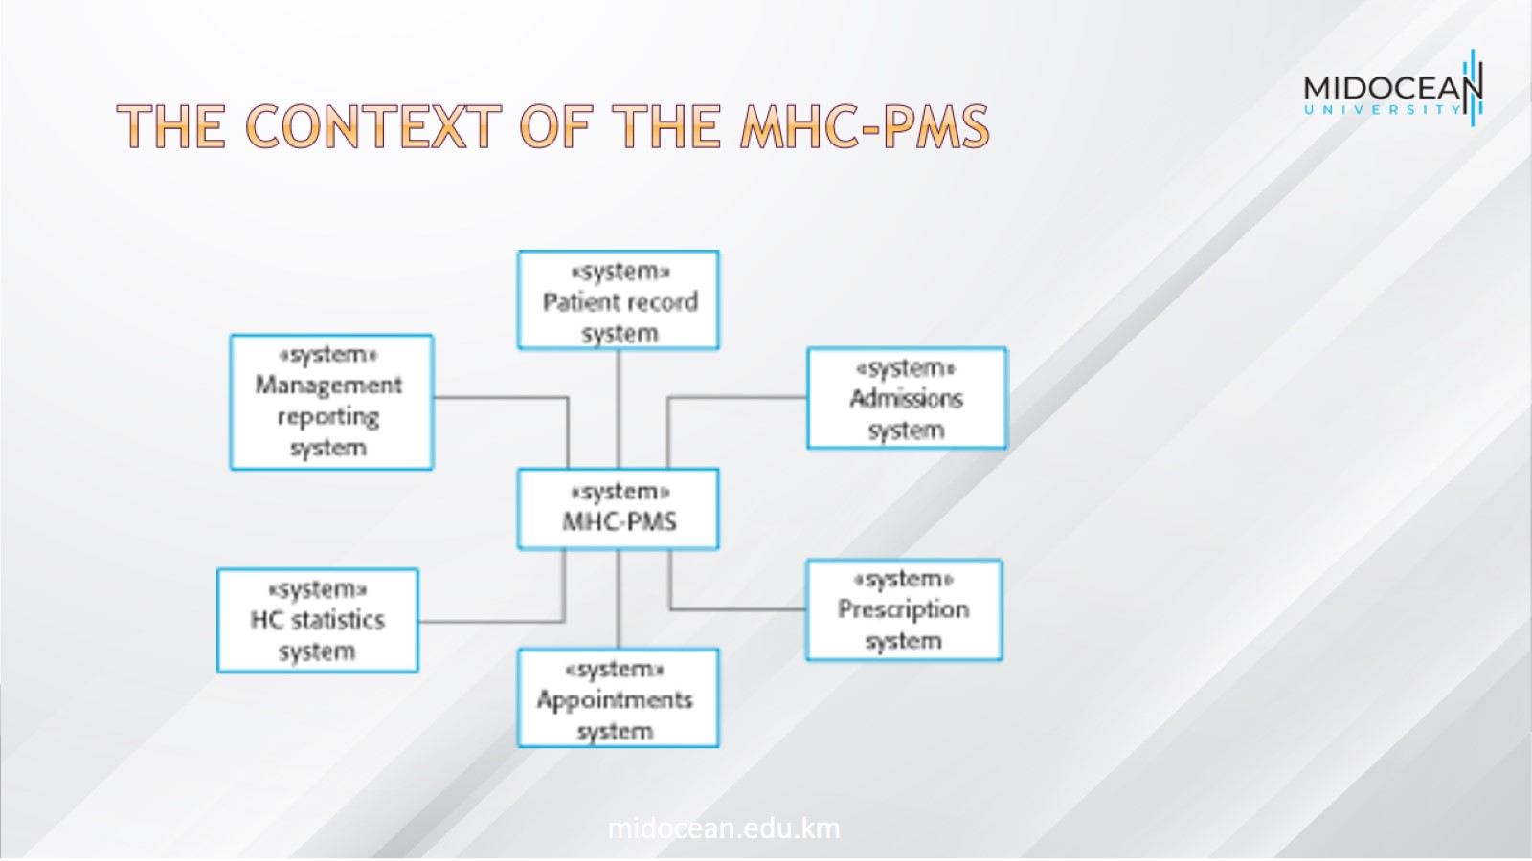
The context of the MHC-PMS

Slide 11
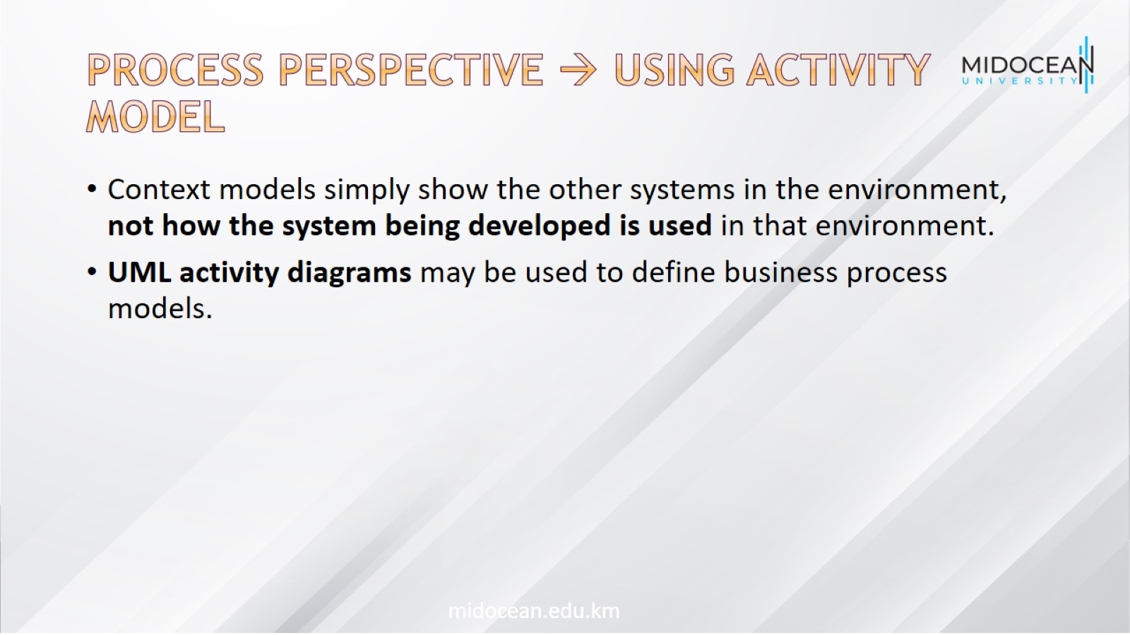
Process perspective → Using Activity model

Slide 12
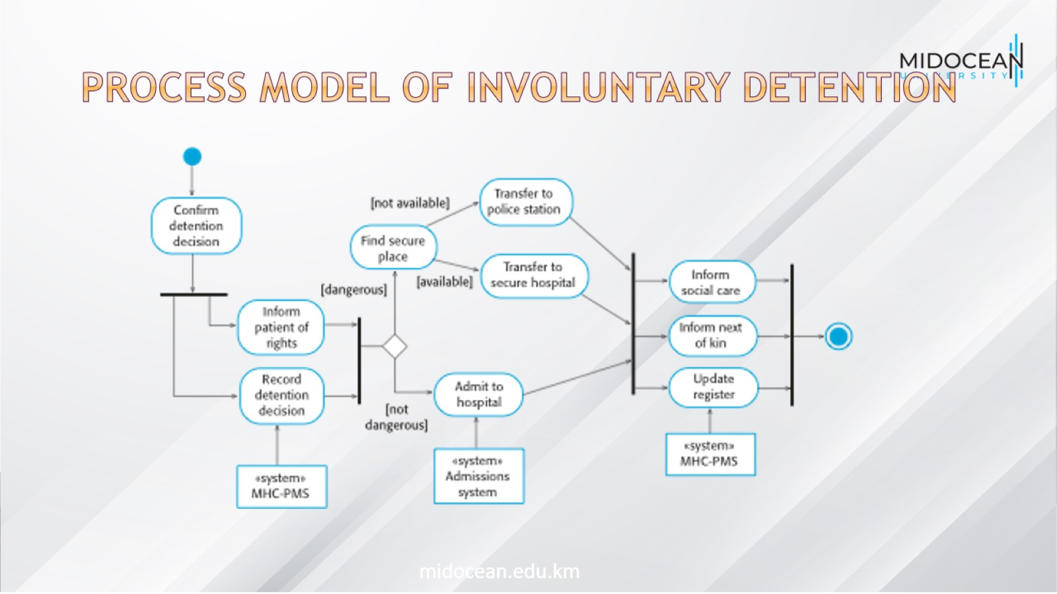
Process model of involuntary detention

Slide 13
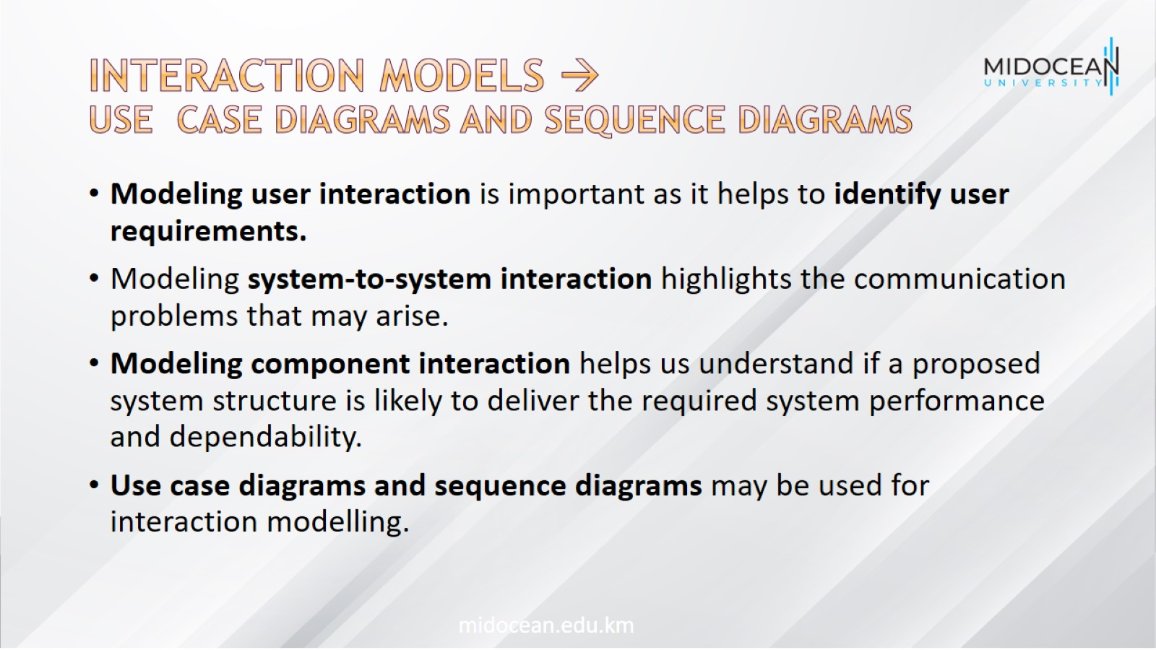
Interaction models →
Use case diagrams and sequence diagrams

Slide 14
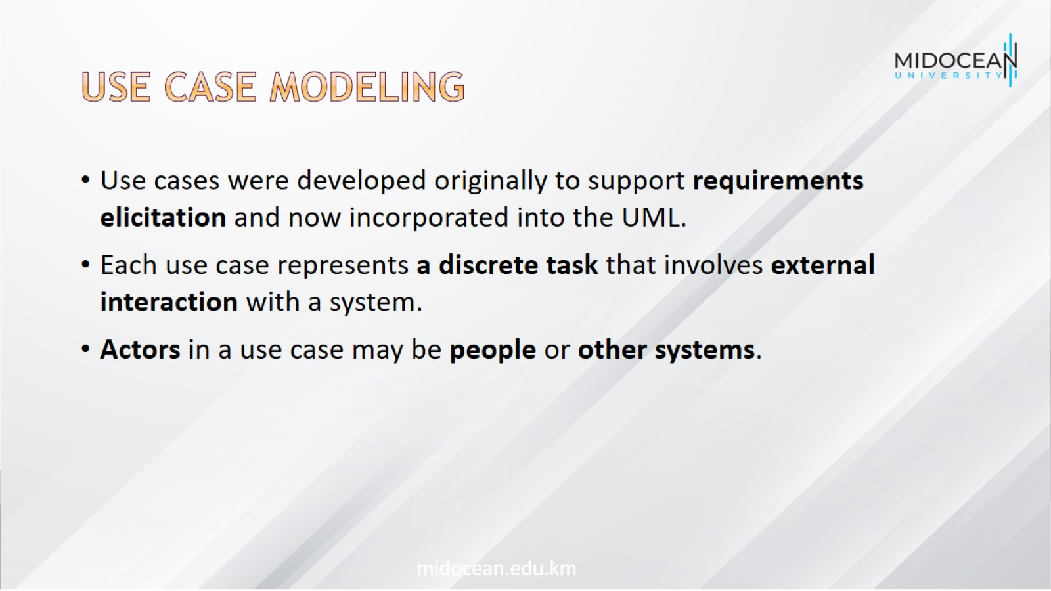
Use case modeling

Slide 15
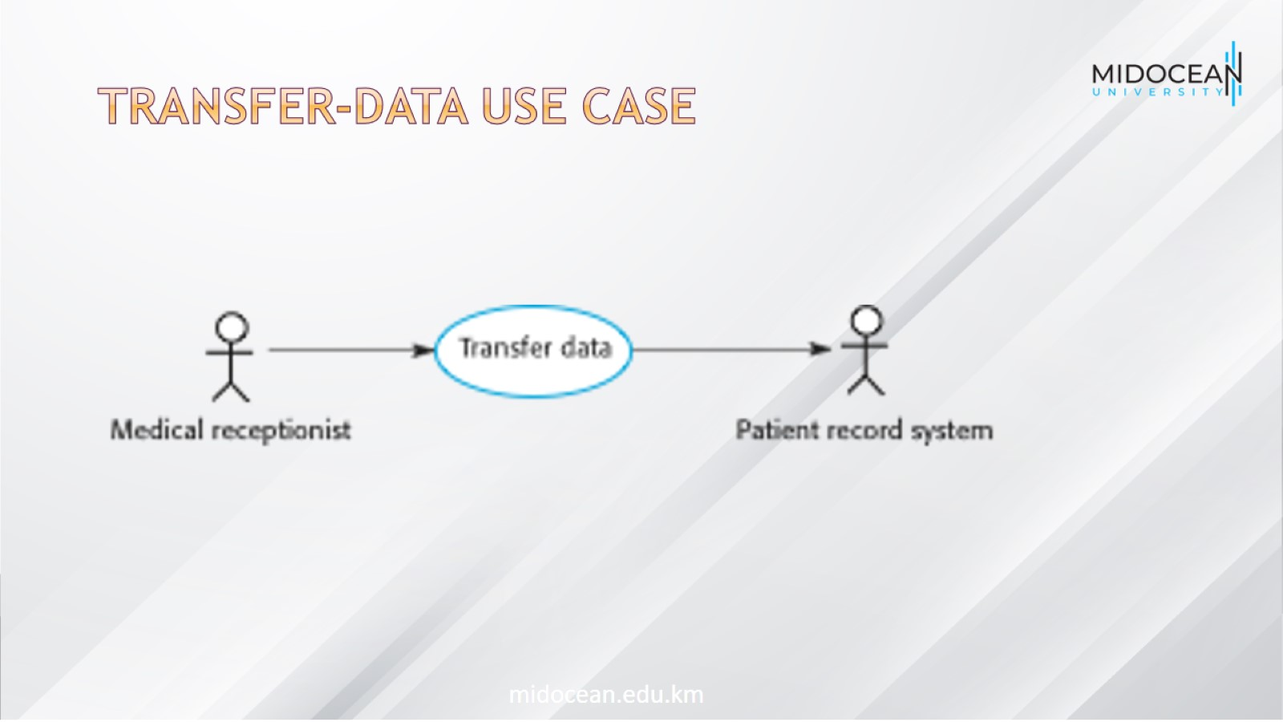
Transfer-data use case

Slide 16
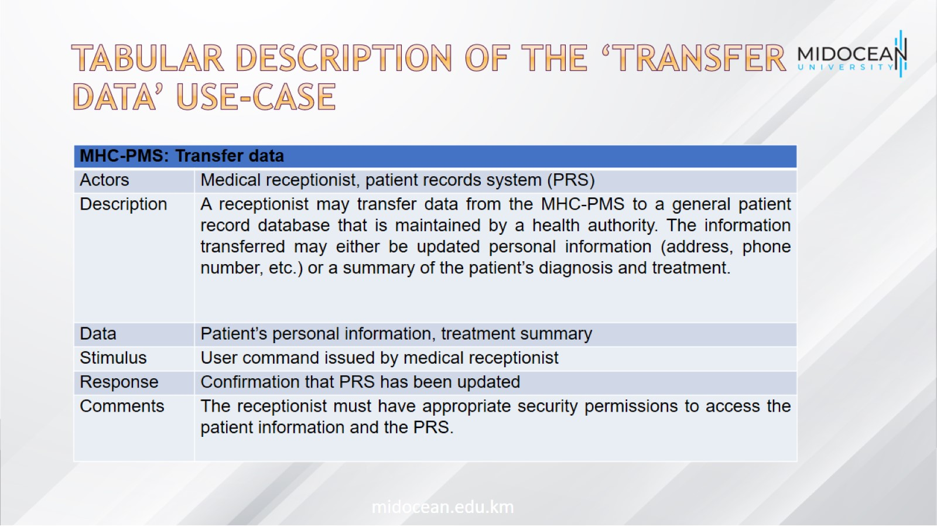
Tabular description of the ‘Transfer data’ use-case

Slide 17
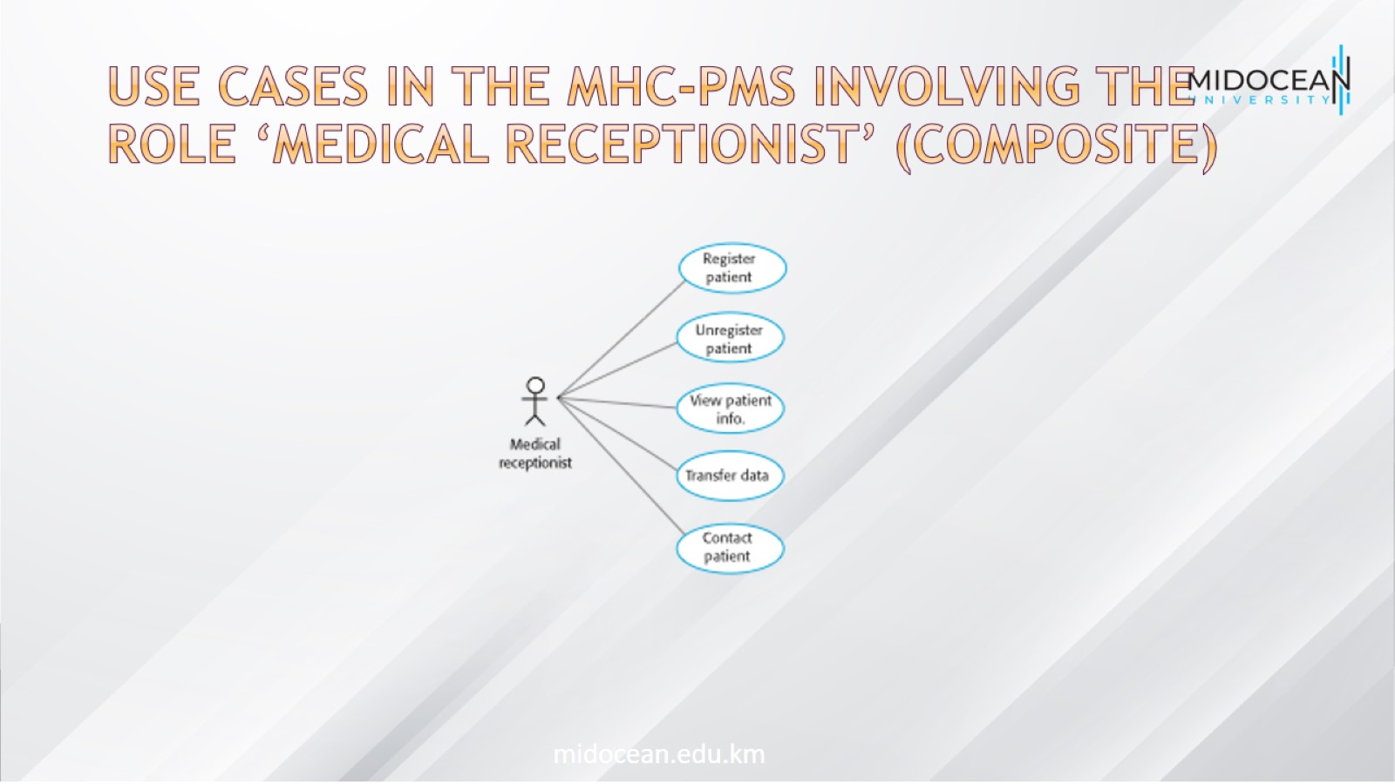
Use cases in the MHC-PMS involving the role ‘Medical Receptionist’ (Composite)

Slide 18
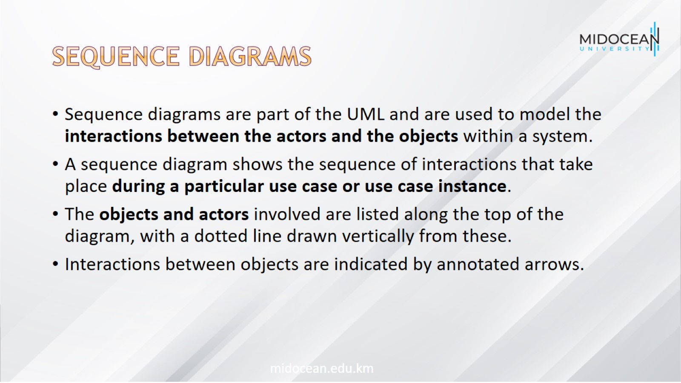
Sequence diagrams

Slide 19
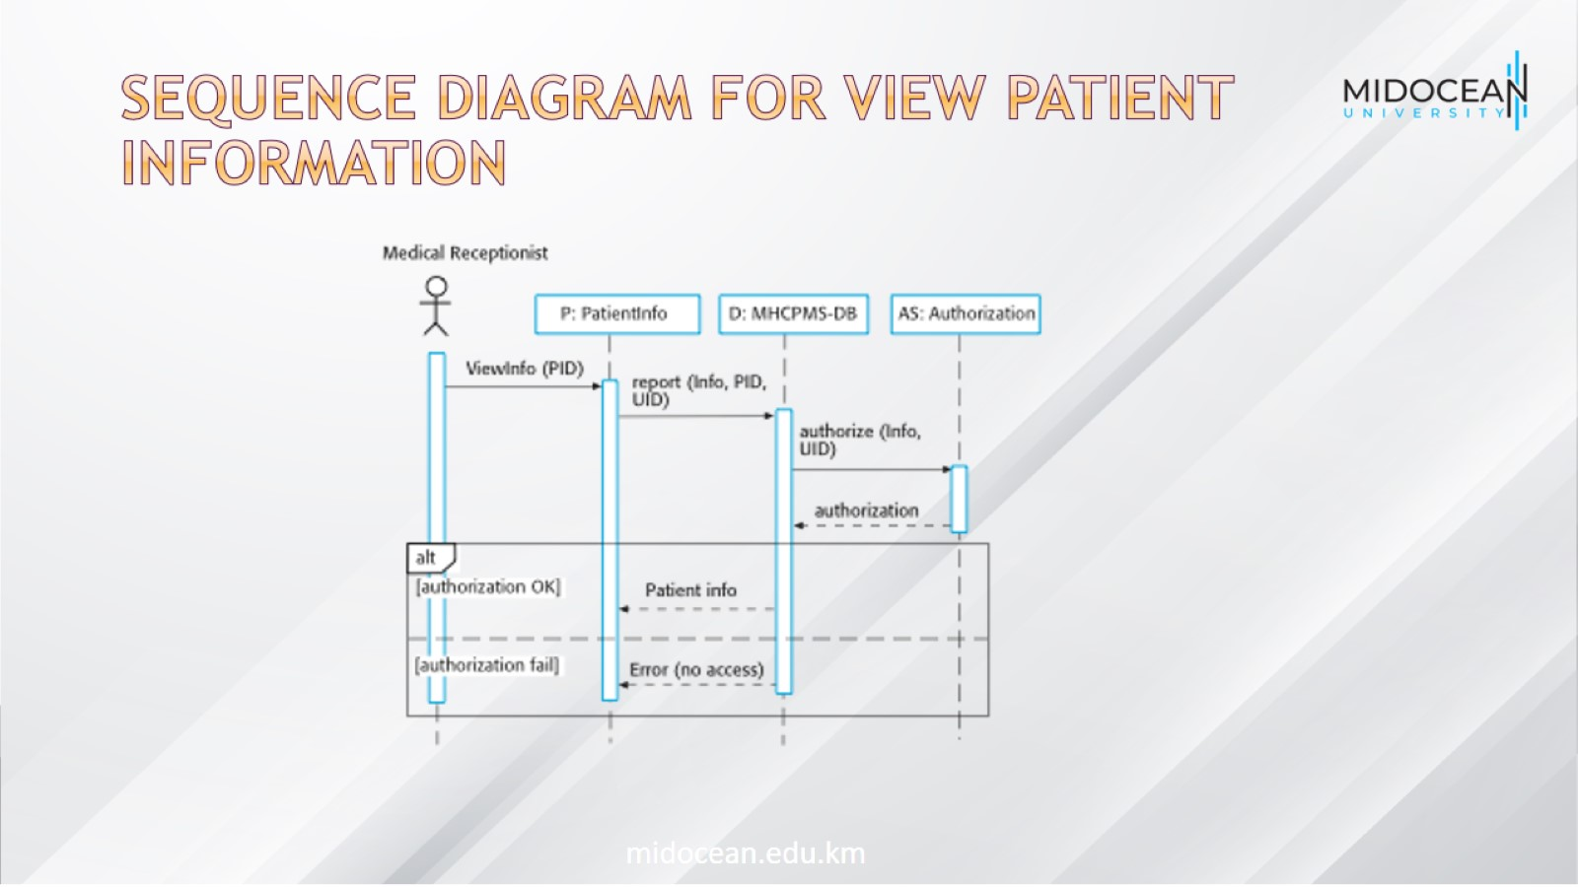
Sequence diagram for View patient information

Slide 20
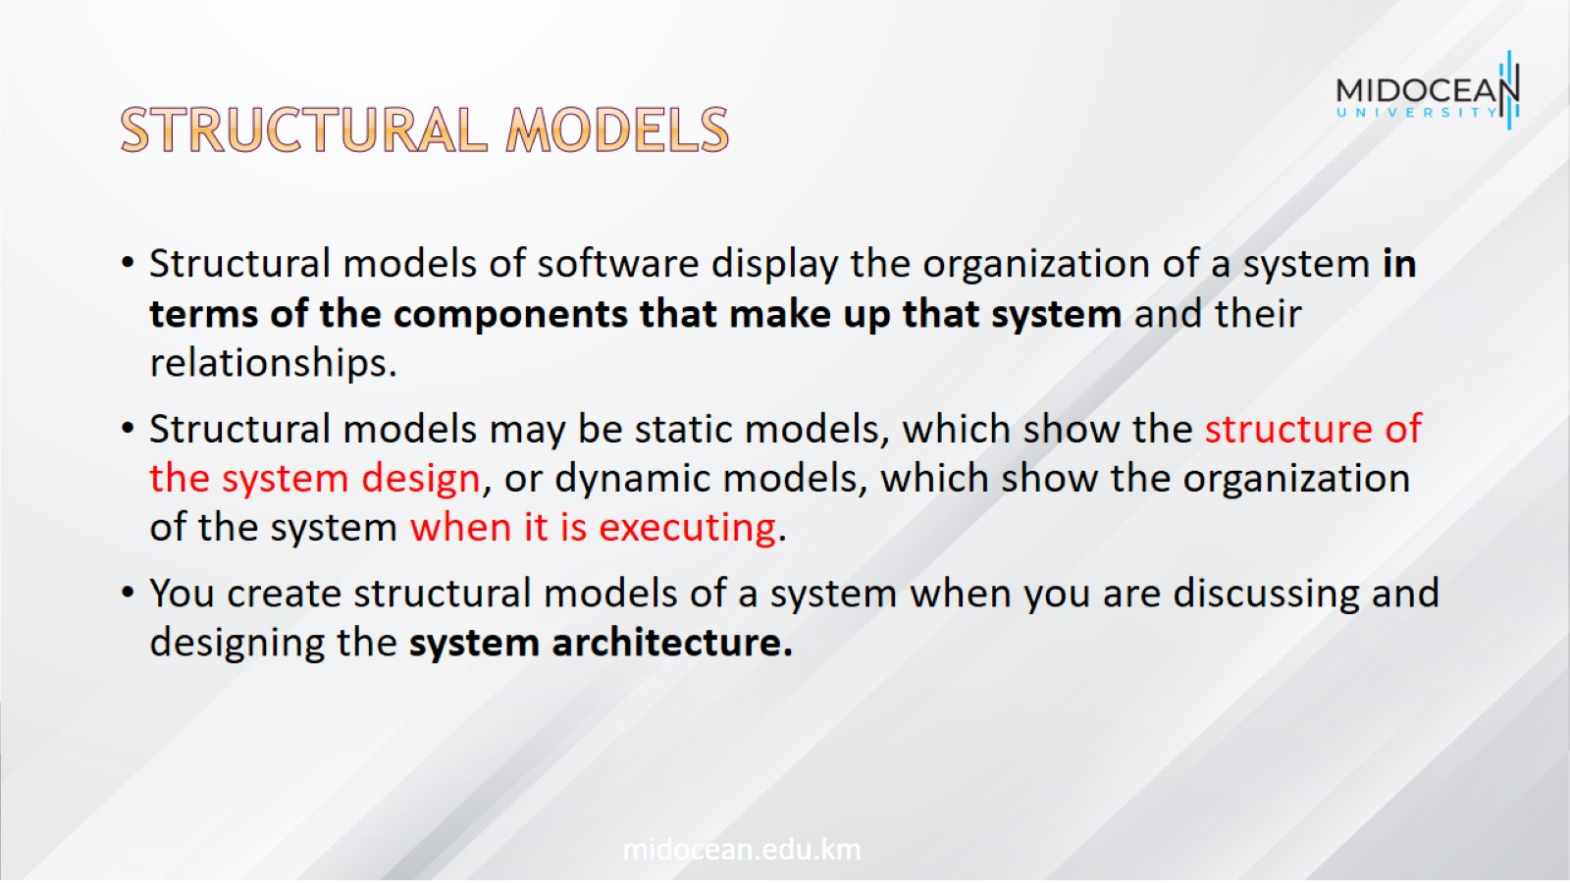
Structural models

Slide 21
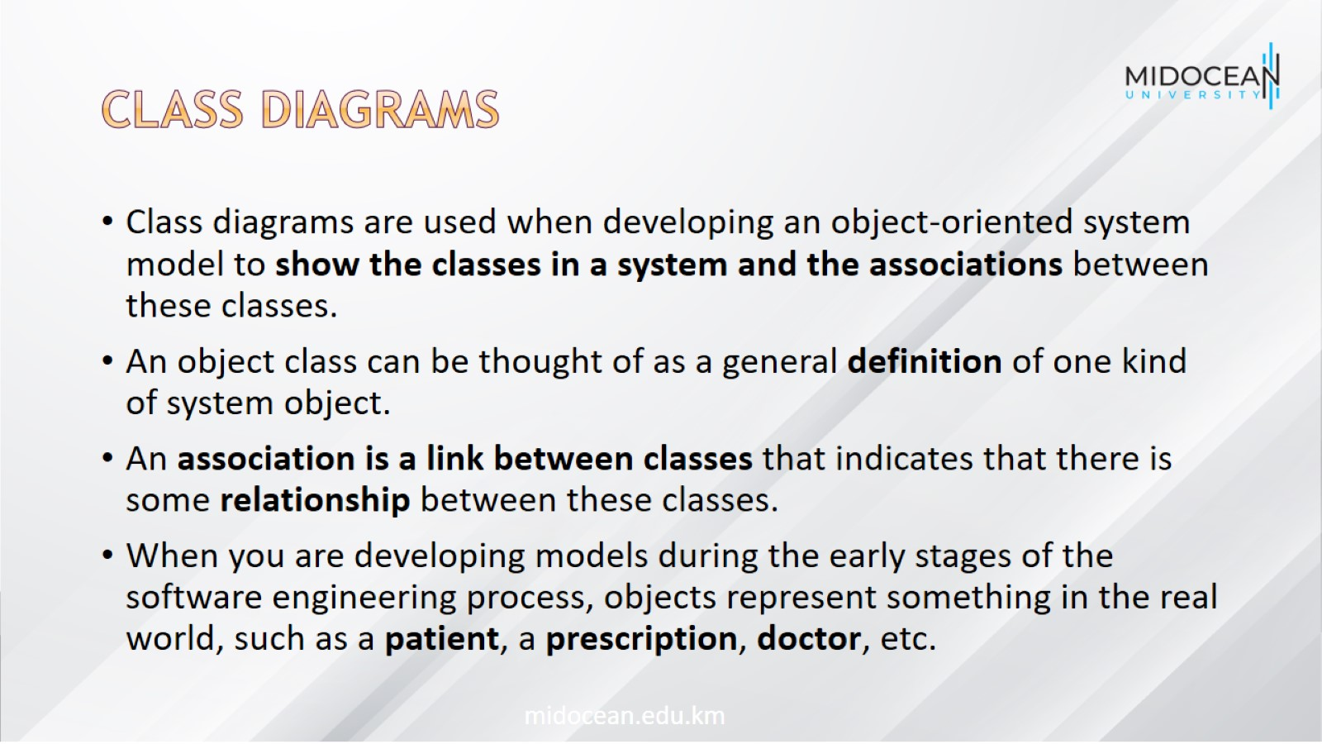
Class diagrams

Slide 22
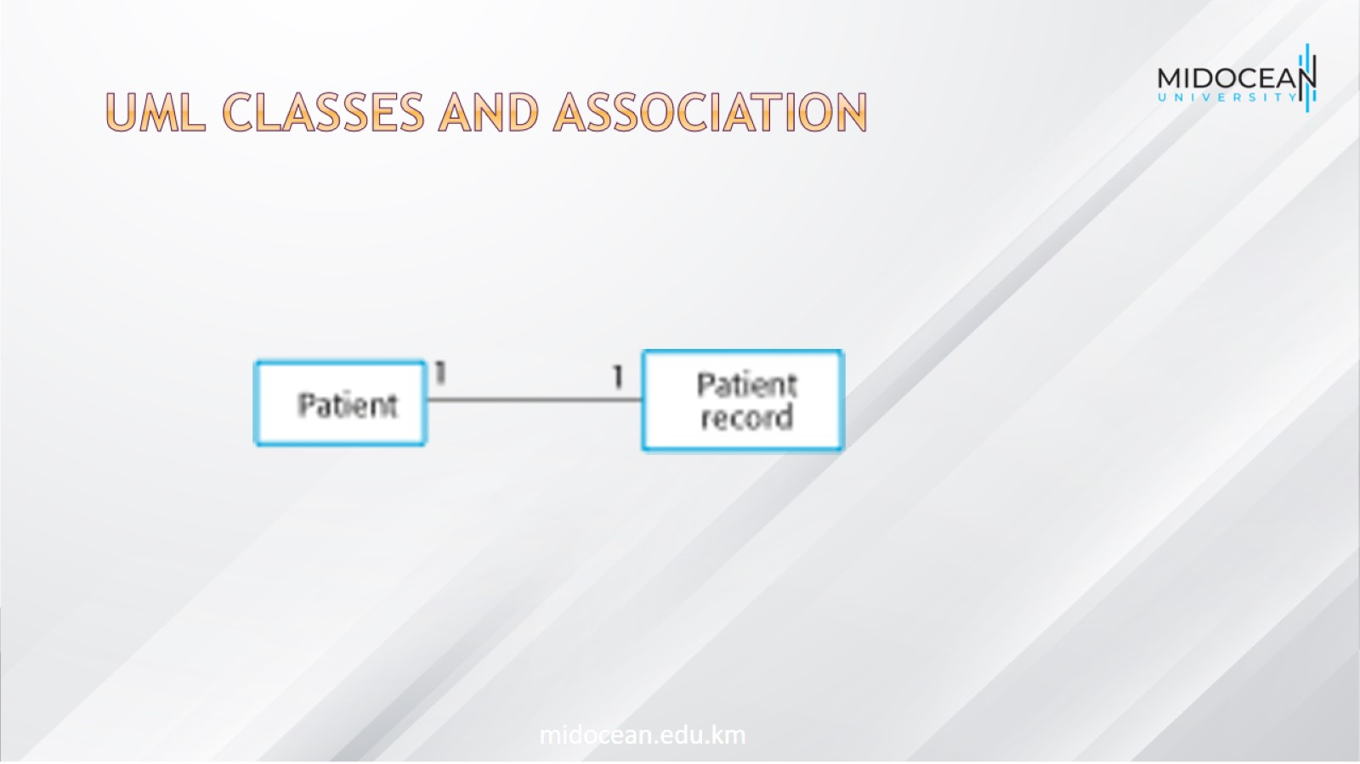
UML classes and association

Slide 23
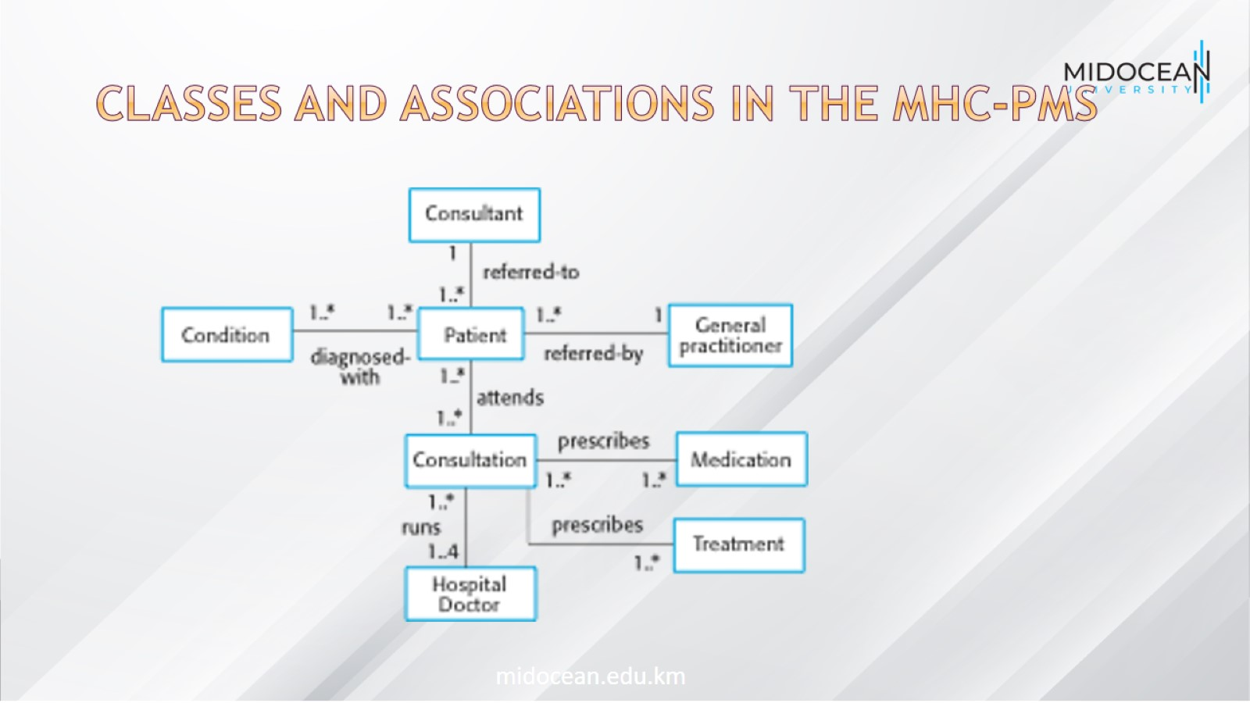
Classes and associations in the MHC-PMS

Slide 24
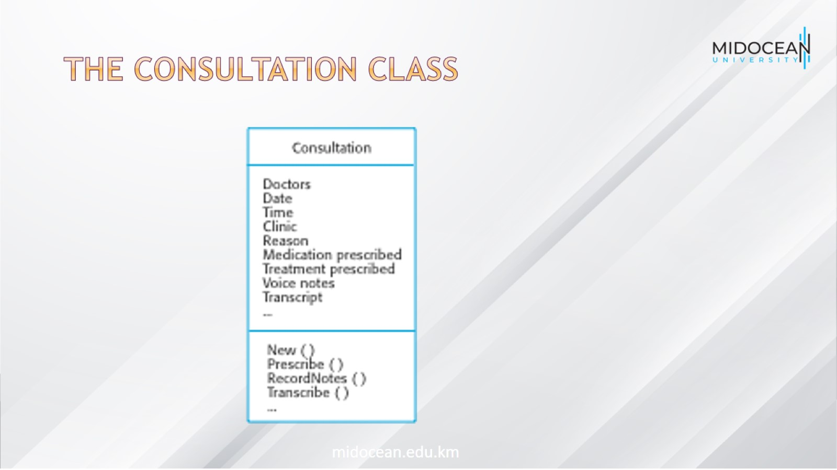
The Consultation class

Slide 25
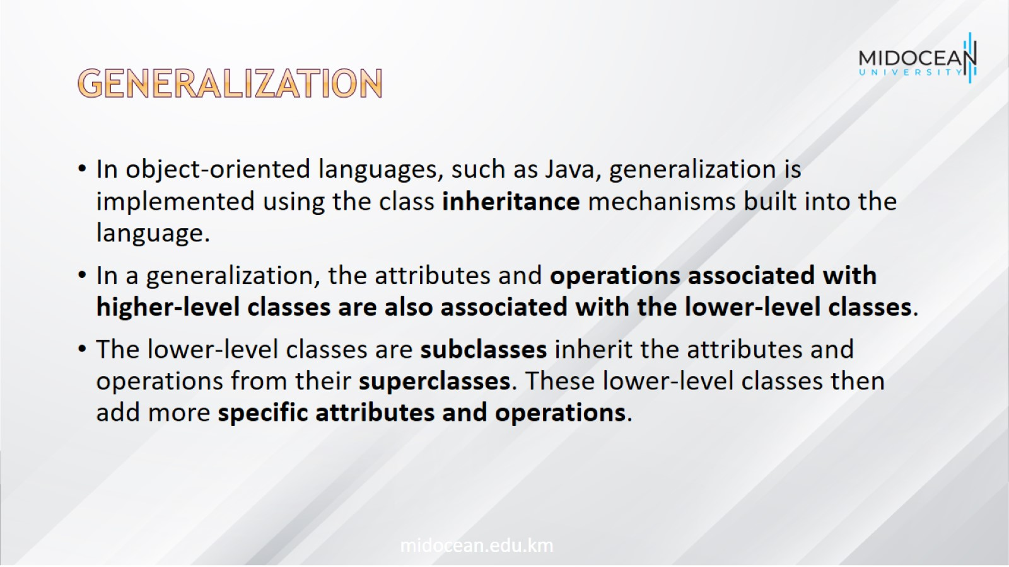
Generalization

Slide 26
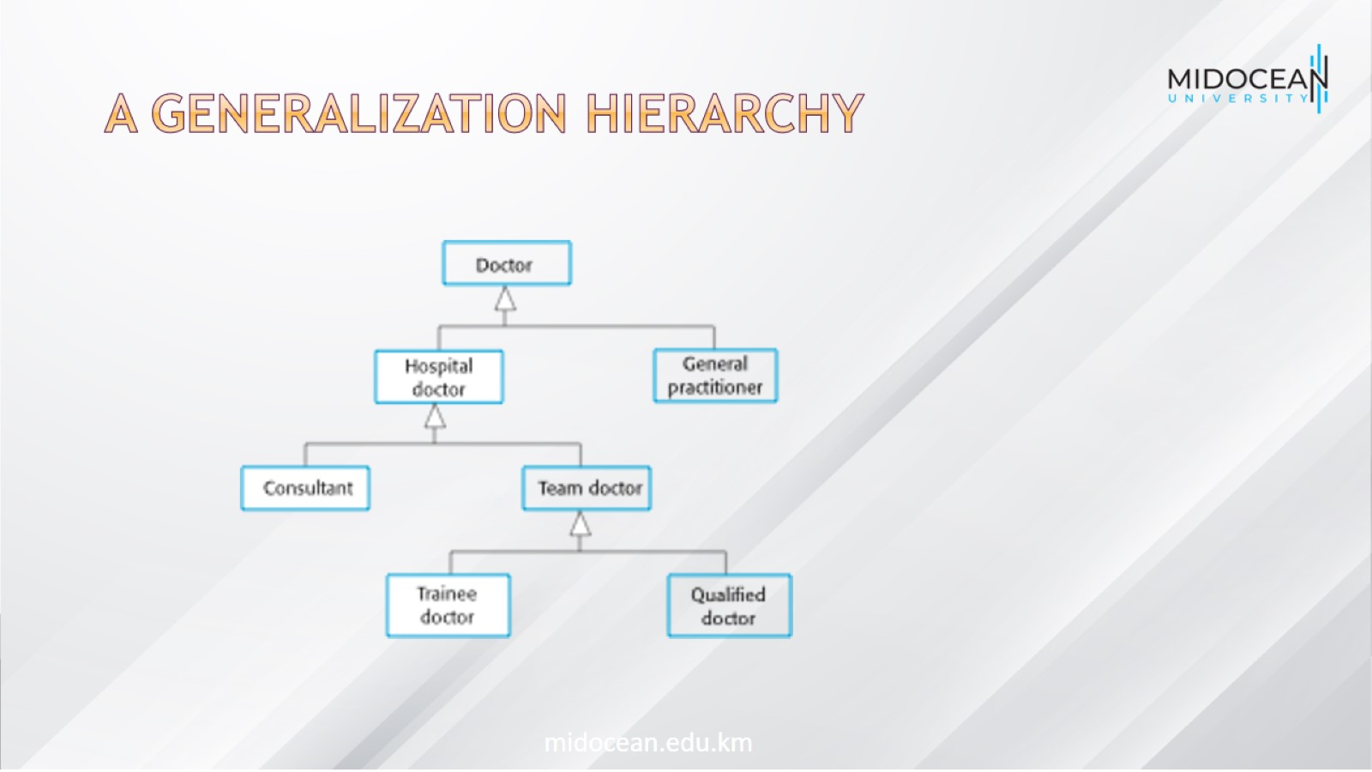
A generalization hierarchy

Slide 27
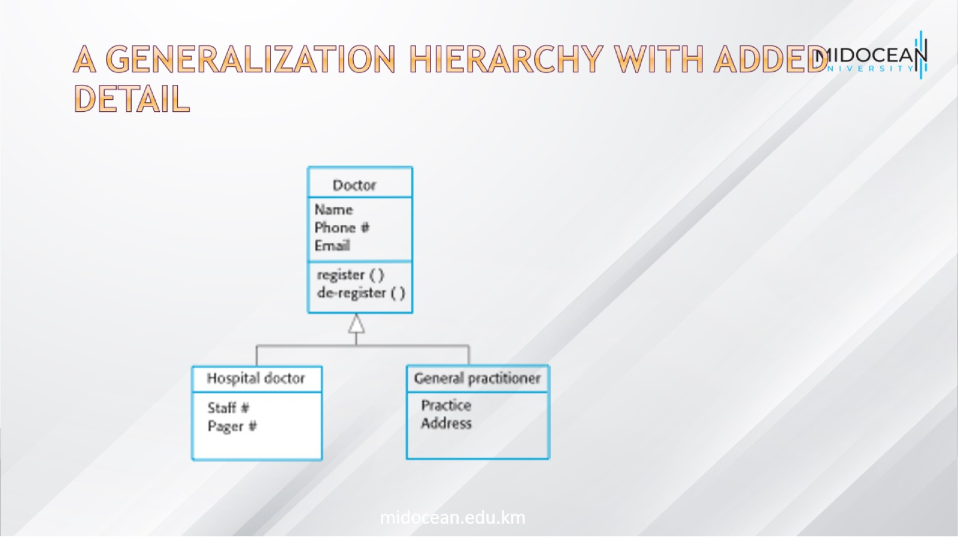
A generalization hierarchy with added detail

Slide 28
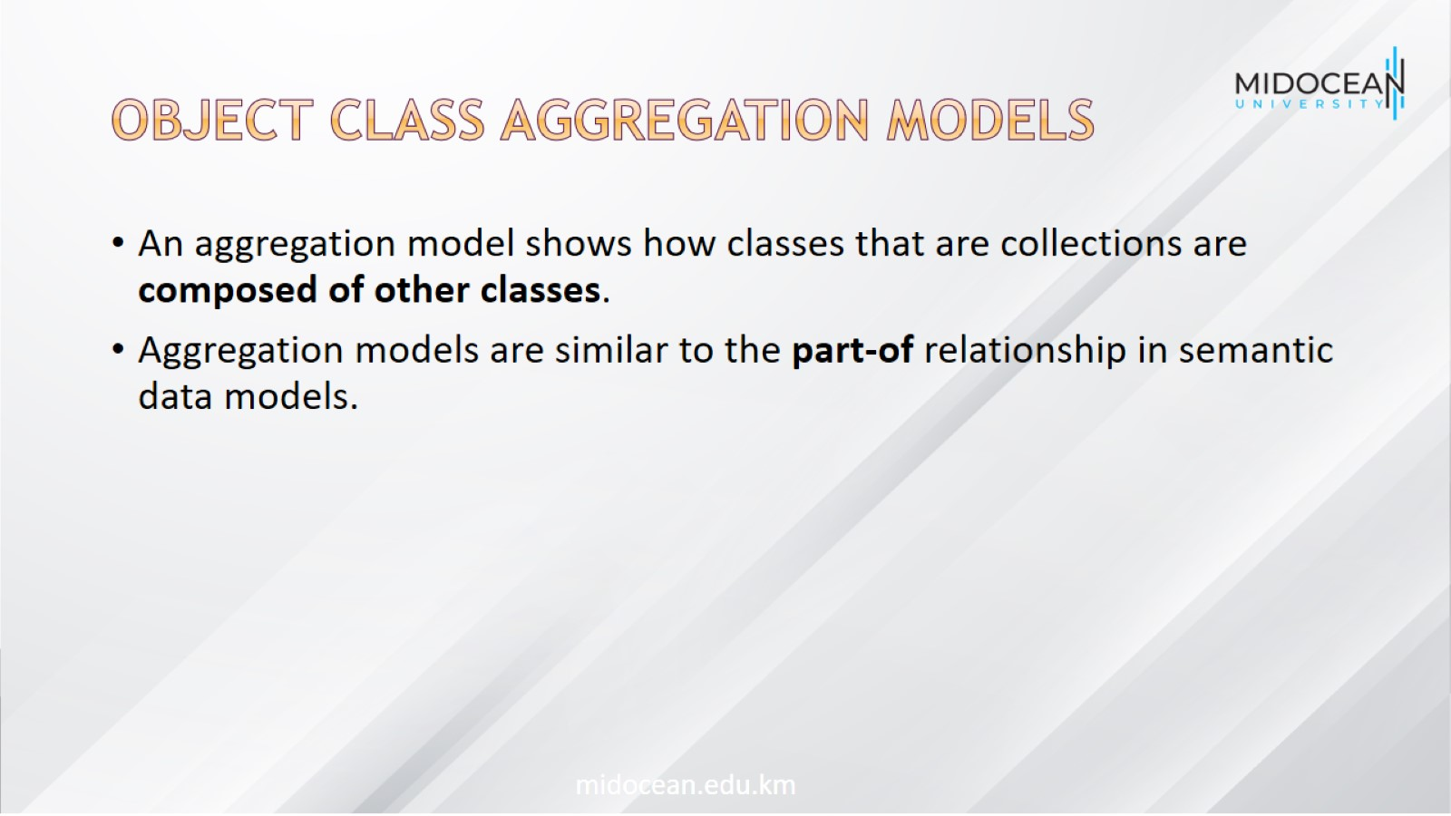
Object class aggregation models

Slide 29
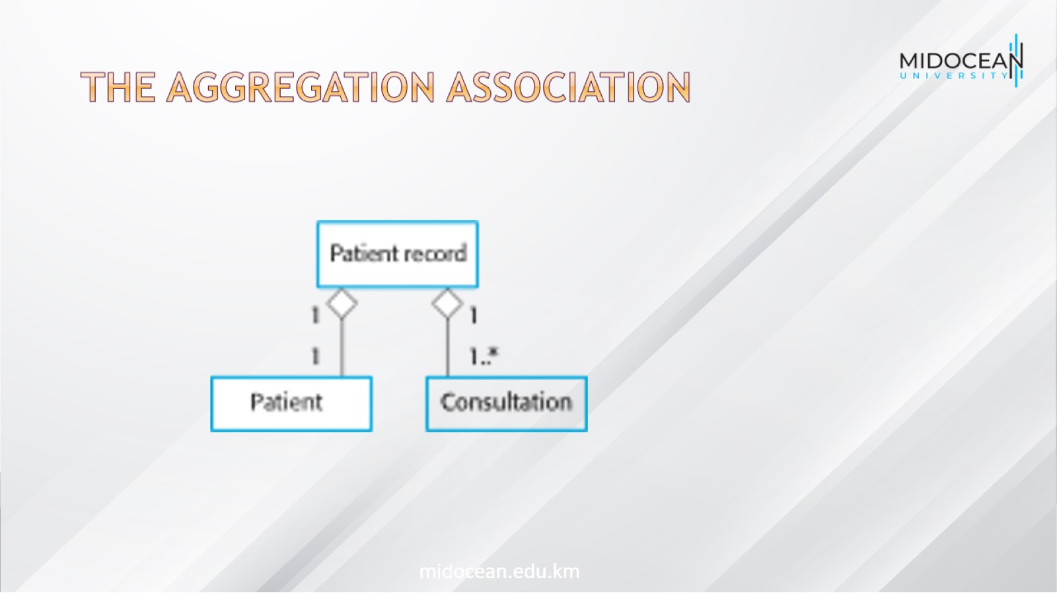
The aggregation association

Slide 30
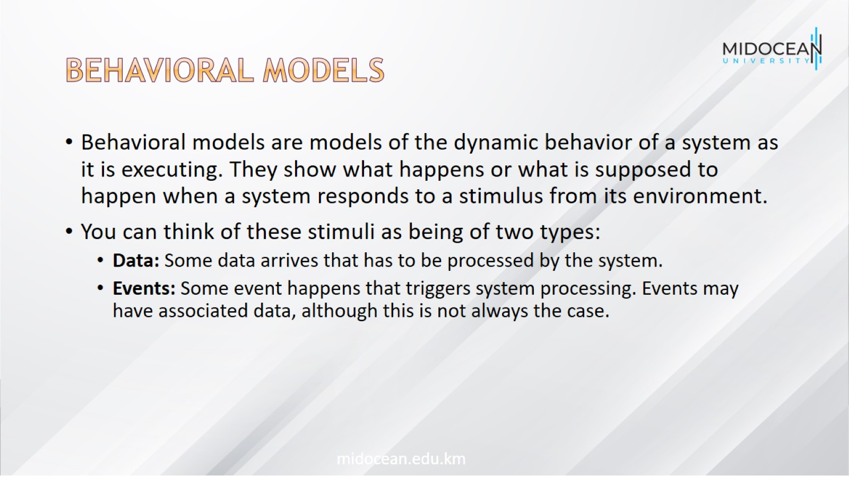
Behavioral models

Slide 31
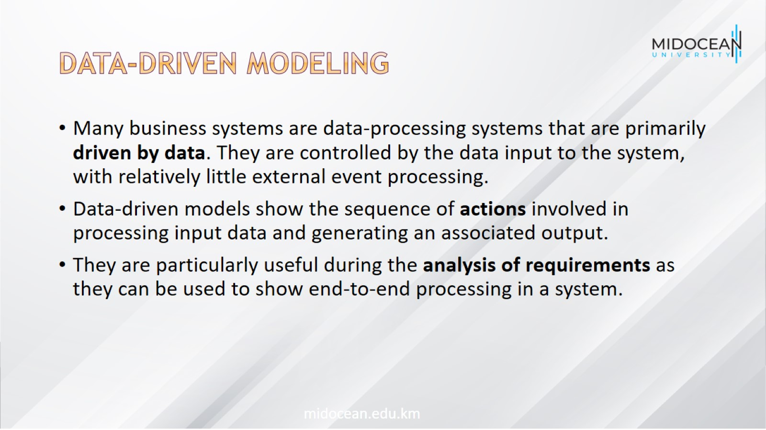
Data-driven modeling

Slide 32
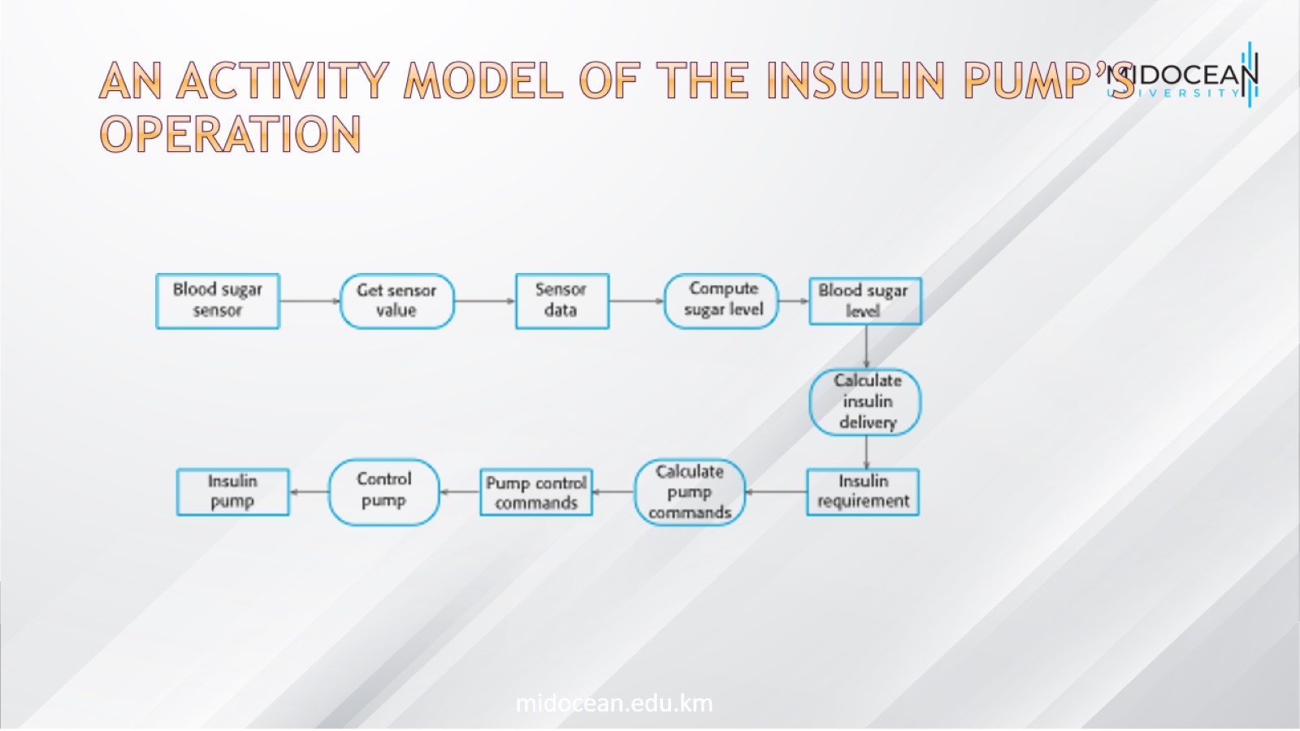
An activity model of the insulin pump’s operation

Slide 33
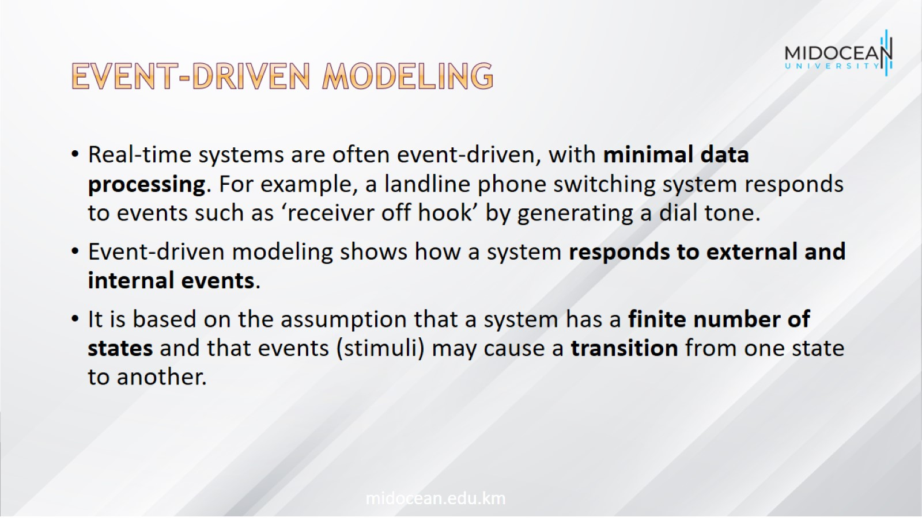
Event-driven modeling

Slide 34
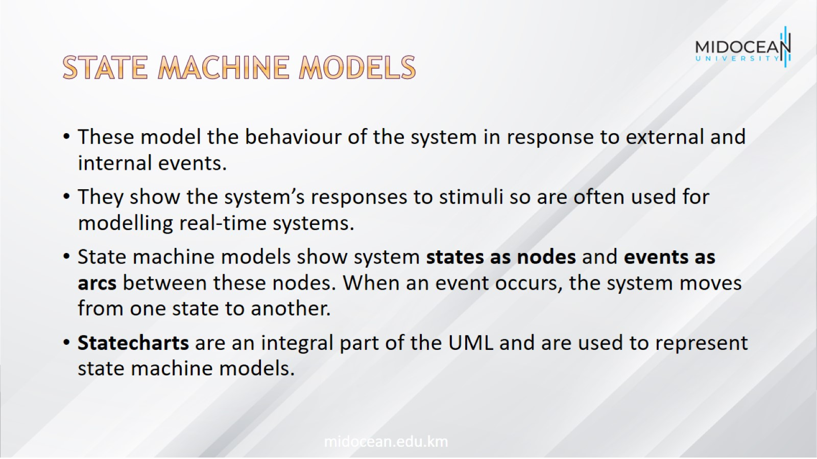
State machine models

Slide 35
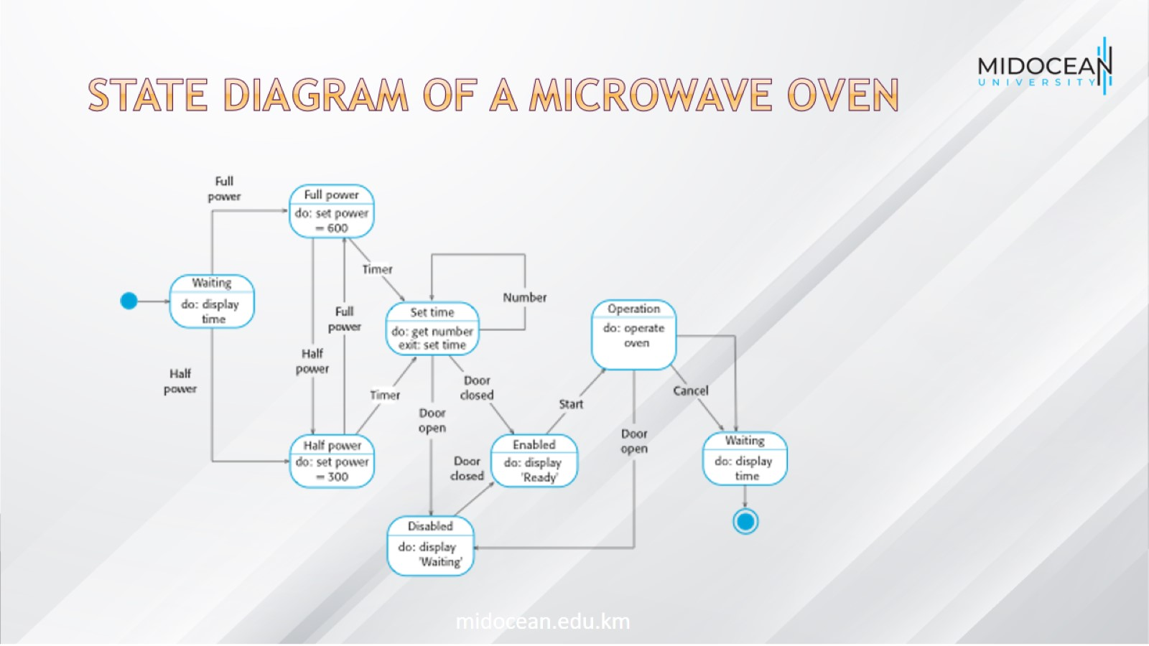
State diagram of a microwave oven

Slide 36
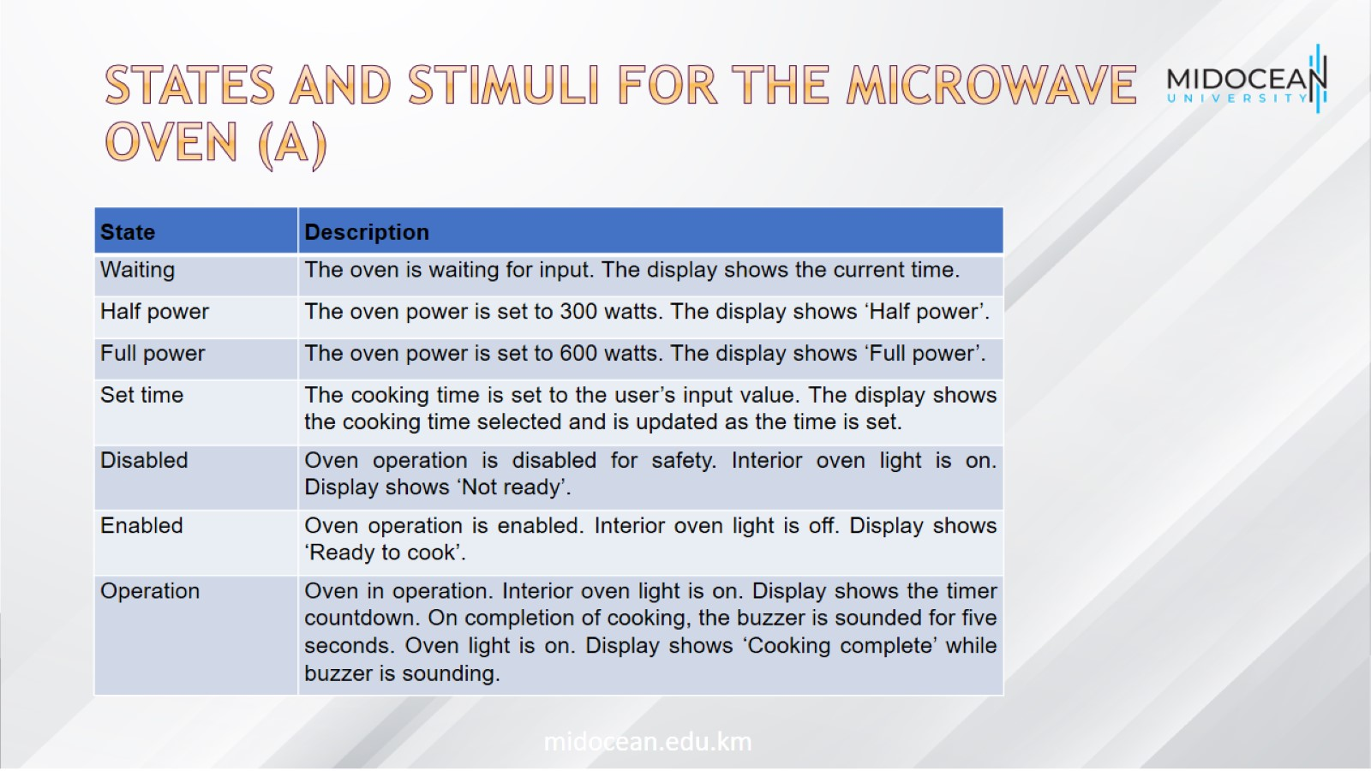
States and stimuli for the microwave oven (a)

Slide 37
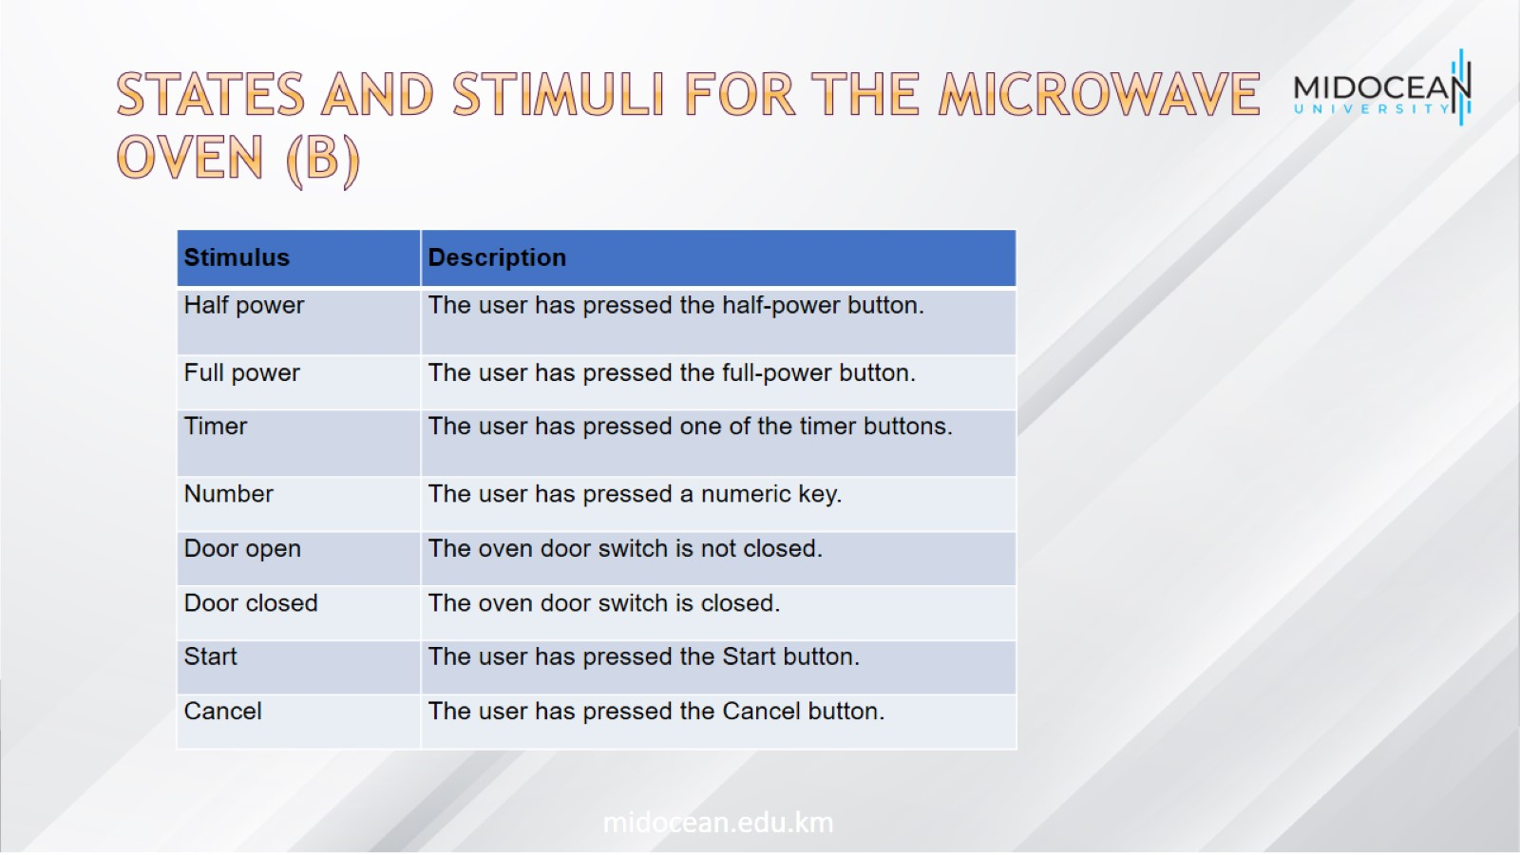
States and stimuli for the microwave oven (b)

Slide 38
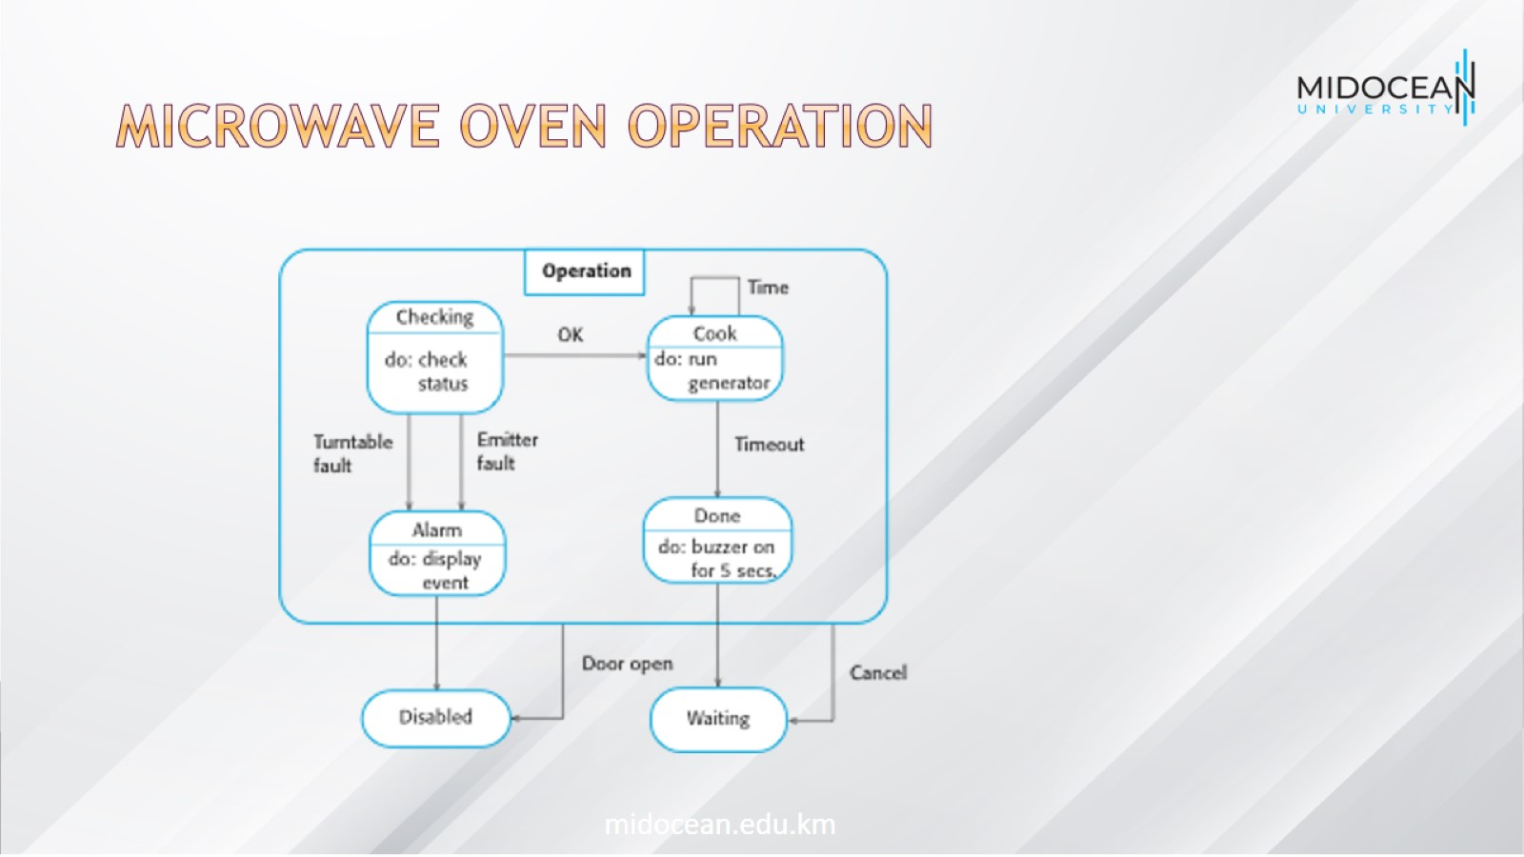
Microwave oven operation

Slide 39
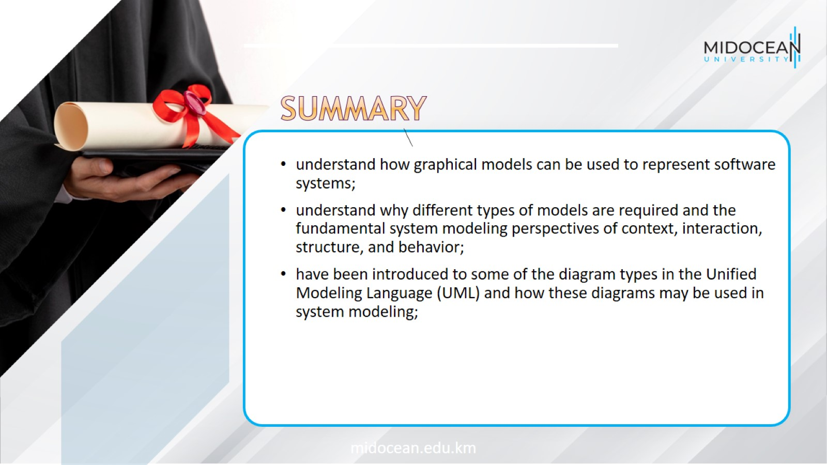

Slide 40


