Slide 1

PMG 622
Agile Project Management
LECTURE 01: An Introduction to Agile
Everyone’s Smart
University
دكتور مهندس استشاري ادارة المشروعات
Eng. Dr. Akram Mustafa Suliman Ali,
PhD. AU, BEng. & MSc. AAST, CEng CMarEng MIMarEST, PE, PMP®,
ASQ CSSBB, ISO Lead Auditor, NDT Level II,

Slide 2
Pre-course introduction

Slide 3

Introduce Yourself
YOUR NAME?
Eng. Dr. Akram Ali
EXPERIENCE / BACKGROUND?
مهندس استشاري ادارة المشروعات
PMP
ASQ CSSBB
PMC Senior Manager of Projects of accumulated value of above 3 Billion USD
PMC Senior Manager of Projects size from 50 Million USD up to 600 Million USD
Manage projects of net budget of up to 200 Million USD .
Used agile for :
Six Sigma Projects
Construction Projects
Products Development Projects

Slide 4
Course Learning Objectives
Develop an agile mindset for project delivery
Advocate for agile principles and values to create a shared mindset
Support change through educating and influencing
Practice servant leadership
Prepare for ACP exam

Slide 5
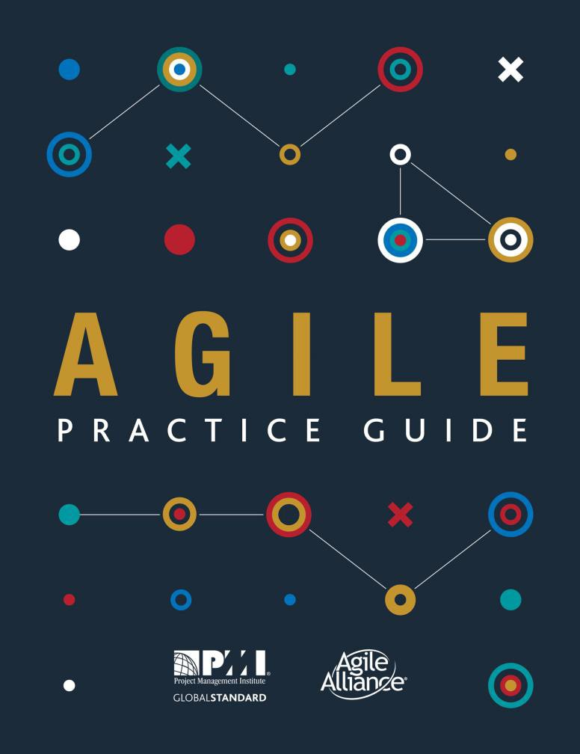
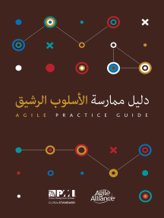
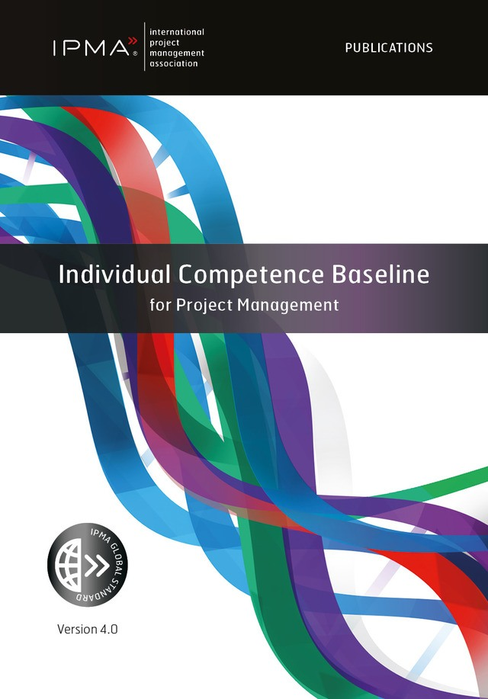
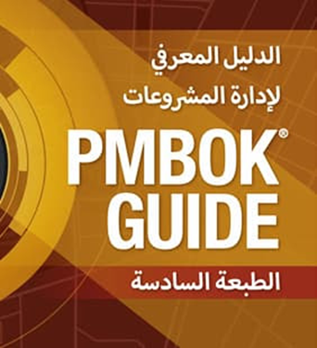
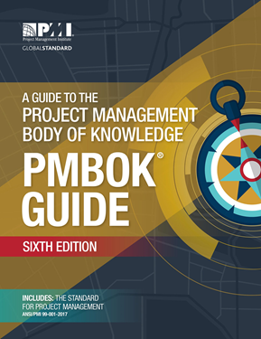
Your main reference material
PMBOK (6th ed.) & Agile Practice Guide
الدليل المعرفي لادارة المشروعات
دليل ممارسة الاسلوب الرشيق
IPMA – ICB4 – In Agile World

Slide 6


How course is delivered and how to study
Primary Course Delivery Method:
  LECTURE
How to study:
  Print material;
  watch video and
  take notes

Slide 7
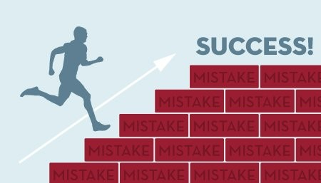

The secret to success?
The proven best learning technique . . .
  Is simply hard work . . .
Please be prepared to put in the time and effort necessary to be successful

Slide 8

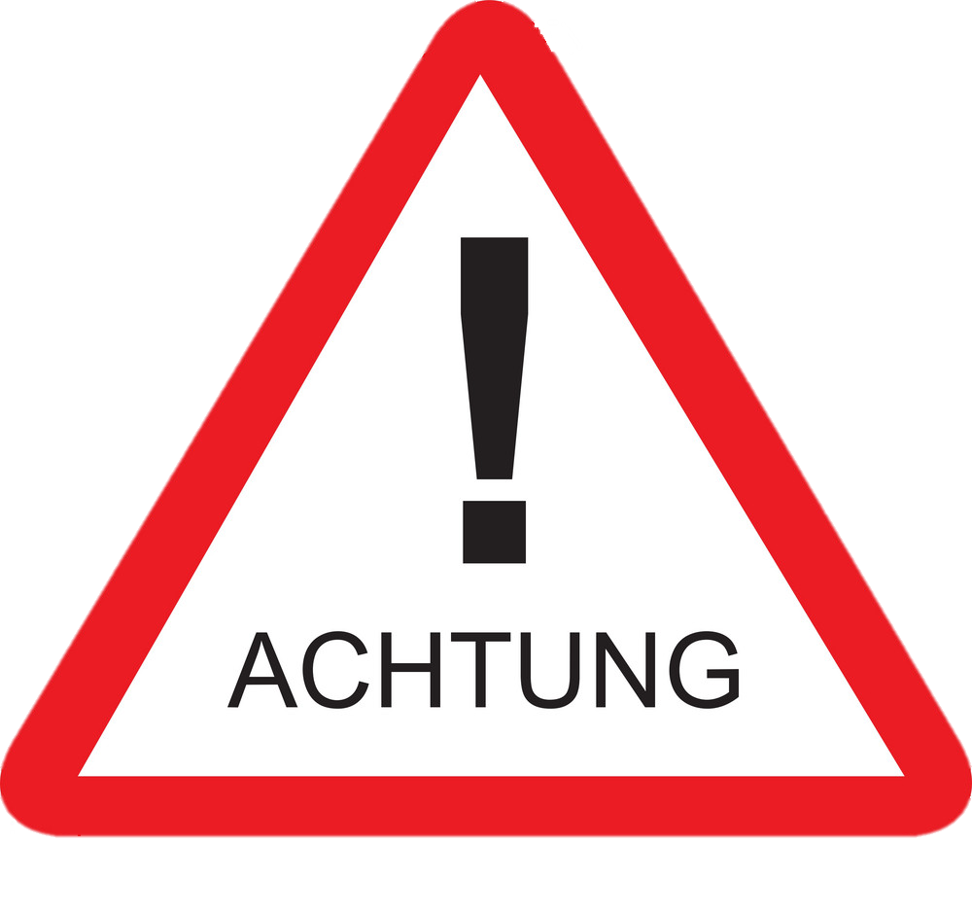
Caution!!!!!!!!!!!!!!!!!
Lecture notes are considerable references
Conflict or differences between professors is for the benefit of the student

Slide 9
Introduction to agile

Slide 10
Value
Forum Topic: The Ultimate Value Definitions List
A feature the customer is willing to pay for.
WE ARE ALL VALUE ENGINEERS

Slide 12
Origins of Agile
In 2001, 17 individuals went to The Lodge at Snowbird Ski Resort in Utah.
  Jeff Sutherland, Ken Schwaber, Alistair Cockburn, Dave Thomas, Kent, Beck, etc.
Leaders in Programming, Software Development, and Architecture.
The purpose was to find a simpler way of doing Software Development.
The Agile Manifesto was born.

Slide 13
Agile Manifesto / “4 Values”
Working products
Customer collaboration
Over
Over
Process and tools
Comprehensive documentation
Responding to change
Individuals and interactions
Contract negotiation
Following and plan
Over
Over
We are uncovering better ways of developing software by doing it and helping others do it.
Through this work we have come to value:
That is, while there is value in the items on the right, we value the items on the left more.

Slide 14
The 12 principles behind the agile manifesto [1/4]
Our highest priority is to satisfy the customer through early and continuous delivery of valuable software.
Welcome changing requirements, even late in development. Agile processes harness change for the customer's competitive advantage.
Deliver working software frequently, from a couple of weeks to a couple of months, with a preference to the shorter
Notes:
ONE
- 3.1 Characteristics of Project Life Cycles
5.2.7 Execution Practices that Help Teams Deliver Value
TWO
5.2.3 Backlog Refinement
THREE
5.2 Common Agile Practices

Slide 15
The 12 principles behind the agile manifesto [2/4]
Business people and developers must work together daily throughout the project.
Build projects around motivated individuals. Give them the environment and support they need, and trust them to get the job done.
The most efficient and effective method of conveying information to and within a development team is face-to-face conversation.
Notes:
FOUR
4.2 Servant Leadership Empowers the Team
5.2.2 Backlog Preparation
5.2.3 Backlog Refinement
FIVE
4.3 Team Composition
5.1 Charter the Project and the Team
5.2.1 Retrospectives
SIX
4.3.4 Team Structures
5.2.4 Daily Standups

Slide 16
The 12 principles behind the agile manifesto [3/4]
Working software is the primary measure of progress.
Agile processes promote sustainable development. The sponsors, developers, and users should be able to maintain a constant pace indefinitely.
Continuous attention to technical excellence and good design enhances agility.
Notes:
SEVEN
5.2.7 Execution Practices that Help Teams Deliver Value
5.2.8 How Iterations and Increments Help Delivery
Working Product
EIGHT
5.1 Charter the Project and the Team
NINE
5.2 Common Agile Practices

Slide 17
The 12 principles behind the agile manifesto
Simplicity–the art of maximizing the amount of work not done is essential.
The best architectures, requirements, and designs emerge from self organizing teams.
At regular intervals, the team reflects on how to become more effective, then tunes and adjusts its behavior accordingly.
Notes:
TEN
5.2.2 Backlog Preparation
5.2.3 Backlog Refinement
ELEVEN
4.3 Team Composition
TWELVE
5.2.1 Retrospectives

Slide 18
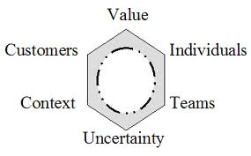
Declaration of interdependence
Increase return on investment by making continuous flow of value our focus.
Deliver reliable results by engaging customers in frequent interactions and shared ownership.
Expect uncertainty and manage for it through iterations, anticipation and adaptation.
Unleash creativity and innovation by recognizing that individuals are the ultimate source of value, and creating an environment where they can make a difference.
Boost performance through group accountability for results and shared responsibility for team effectiveness.
Improve effectiveness and reliability through situationally specific strategies, processes, and practices.

Slide 19
KNOWLEDGE WORK VS INDUSTRIAL WORK

Slide 20
The agile mindset
Agile is a mindset defined by values, guided by principles and manifested through many different practices.
Agile practitioners select practices based on their needs.
Notes:
It is worth noting that while the term “agile” became popularized after the Manifesto, the approaches and techniques being used by project teams today existed before the Agile Manifesto by many years and, in some cases, decades.

Slide 21
PMP® vs. PMI-ACP®
PMP® | PMI-ACP®
Traditional Waterfall | Agile
Over 900,000 hold this credential | Less than 30,000 hold this credential
Project Manager Average Salary $75,000 | Agile Coach Average Salary $138,000
Focuses on Delivering a Product or Service | Focuses on Delivering Value
Concerned about Project and Results | Concerned about People
Defines Project all up Front | Defines Project Incrementally

Slide 22
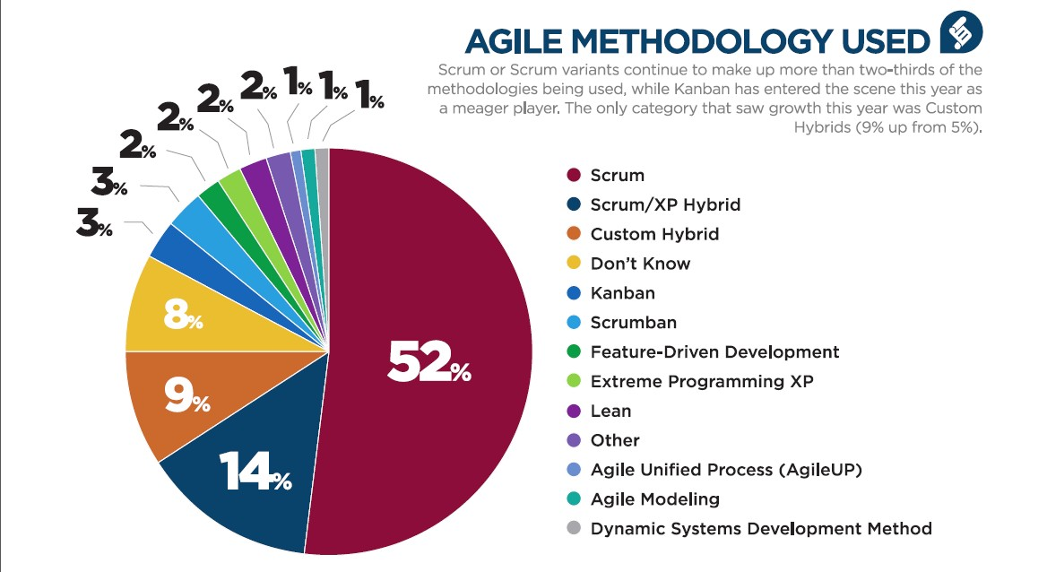
AGILE METHODOLOGY USED

Slide 23
Agile is a blanket term for many approaches
Any kind of approach, technique, framework, method, or practice that fulfills the values and principles of the Agile Manifesto.
shows agile and the Kanban Method as subsets of lean. This is because they are named instances of lean thinking that share lean concepts such as: “focus on value,” “small batch sizes,” and “elimination of waste.”

Slide 24
LEAN IS A SUPERSET FOR AGILE AND KANBAN
One way to think about the relationship between lean, agile, and the Kanban Method is to consider agile and the Kanban Method as descendants of lean thinking. In other words, lean thinking is a superset, sharing attributes with agile and Kanban.

Slide 25
Lean and agile shared heritage
Delivering value
Respect for people
Minimizing waste
Being transparent
Adapting to change, and
Continuously improving
Notes:
Project teams sometimes find it useful to blend various
methods—whatever works for the organization or team is what should be done
regardless of its origin. The objective is the best outcome regardless of the
approach used.

Slide 26
Agile = Mindset??????
Is agile an approach, a method, a practice, a technique, or a framework?
Any or all of these terms could apply depending on the situation. This practice guide, uses the term “approach” unless one of the other terms is obviously more correct.
Agile is a set of Values and Principles
Ans
Managing a project using an agile approach requires that the project team adopt an agile mindset.

Slide 27
BEING AGILE VS DOING AGILE

Slide 28
TWO strategies to fulfill agile values and principles [1/2]
The first is to adopt a formal agile approach, intentionally designed and proven to achieve desired results.
  Then take time to learn and understand the agile approaches before changing or tailoring them.
  Premature and haphazard tailoring can minimize the effects of the approach and thus limit benefits.

Slide 29
TWO strategies to fulfill agile values and principles [2/2]
The second strategy is to implement changes to project practices in a manner that fits the project context to achieve progress on a core value or principle.
  Use time boxes to create features, or specific techniques to iteratively refine features.
  Consider dividing up one large project into several releases, if that works for the specific project context.
  Implement changes that will help the project succeed— the changes do not need to be part of the organization's formal practices.
  The end goal is not to be agile for its own sake, but rather to deliver a continuous flow of value to customers and achieve better business outcomes.

Slide 30
Kanban METHOD
The Kanban Method is inspired by the original lean-manufacturing system and used specifically for knowledge work.
It emerged in the mid-2000s as an alternative to the agile methods that were prevalent at the time.

Slide 31
Kanban Method
The Kanban Method is less prescriptive than some agile approaches and less disruptive, as it is the original “start-where-you-are” approach.
Project teams can begin applying the Kanban Method with relative ease and progress toward other agile approaches if that is what they deem necessary or appropriate.

Slide 32
CASE
There is and probably always will be a lot of discussion around the Kanban Method and whether it belongs to the lean or agile movement. It was conceived in and around lean manufacturing, but is widely used in agile settings.

Slide 33
UNCERTAINTY, RISK, AND LIFE CYCLE SELECTION

Slide 34
Stacey Complexity Model (Technical / Requirements Uncertainties)
These uncertainties can contribute to high rates of change and project complexity.
As project uncertainty increases, the risk of rework increases.
When teams deliver small increments, they are better able to understand the true customer requirements faster and more accurately than with a static written specification.
Notes:
As project uncertainty increases, the risk of rework increases. and the need to use a different approach. To mitigate the impact of these risks, teams select life cycles that allow them to tackle projects with high amounts of uncertainty via small increments of work.
-
Teams can verify their work when they use small increments and can change what they do next. When teams deliver small increments, they are better able to understand the true customer requirements faster and more accurately than with a static written specification.

Slide 35
Life cycle selection for Uncertain projects
Teams can plan and manage projects with clear and stable requirements and clear technical challenges with little difficulty.
However, as the uncertainty in the project increases, the likelihood of changes, wasted work, and rework also increases, which is costly and time consuming.
Some teams have evolved project life cycles to use iterative and incremental approaches.
Many teams discover that when they explore the requirements iteratively and deliver more often incrementally, the teams adapt to changes more easily.
These iterative and incremental approaches reduce waste and rework because the teams gain feedback.

Slide 36
Approaches for managing uncertain projects
These approaches use:
  Very short feedback loops,
  Frequent adaptation of process,
  Reprioritization,
  Regularly updated plans, and
  Frequent delivery.

Slide 37
When to apply iterative, incremental and agile approaches?
These iterative, incremental, and agile approaches work well for projects that involve:
  New or novel tools, techniques, materials, or application domains.
  Require research and development;
  Have high rates of change;
  Have unclear or unknown requirements, uncertainty, or risk; or
  Have a final goal that is hard to describe.

Slide 38
uncertainty and disagreement
However, iterative and incremental approaches have their limits of applicability.
When both technology uncertainty and requirements uncertainty are very high (the top right of Figure 2-5), the project moves beyond complex to chaotic.
In order for the project to become reliably possible, it needs one of the variables (uncertainty or disagreement) to be contained.

Slide 39
Characteristics involving high uncertainty
product specification / suitability and requirements (is the right product being built?),
production capability / technical feasibility and performance (can this product be built this way?)
process suitability / process and people (is this an effective way for the team to work?)

Slide 40
Overcoming Uncertainty
By building a small increment and then testing and reviewing it, the team can explore uncertainty at a low cost in a short time, reduce risk, and maximize business value delivery.

Slide 41
Types of PM LIFECYCLES
  Predictive life cycle. A more traditional approach, with the bulk of planning occurring upfront, then executing in a single pass; a sequential process.
  Iterative life cycle. An approach that allows feedback for unfinished work to improve and modify that work.
  Incremental life cycle. An approach that provides finished deliverables that the customer may be able to use immediately.
  Agile life cycle. An approach that is both iterative and incremental to refine work items and deliver frequently.

