Slide 1



An Integrated Technical and Fundamental Stock Analysis Model for the Saudi Stock Market (Tadawul)
Master of Science in Artificial Intelligence Thesis Defense
A hybrid AI framework combining technical and fundamental analysis to generate short-term trading signals compliant with CMA regulations.
Prepared by: Malek M. Atarji
College of Informatics
Student ID: 252000474
Midocean University (UAE / Comoros)
Supervisor: Dr. Ashraf El-Sayed
252000474@st.midocean.edu.km

Slide 2







Research Problem & Objectives
The Research Gap
Main Objectives
Fragmentation between Technical Analysis (short-term) and Fundamental Analysis (intrinsic value) impacts trading decisions.
Integrate technical and fundamental indicators into a single hybrid AI model to improve decision accuracy.
Define a practical economic target: achieve +5% profit before reaching -2% loss within a 5-10 day trading horizon.
Most AI studies focus on statistical price prediction accuracy rather than actual economic performance and profitability.
Evaluate model performance using real financial metrics: Sharpe ratio, Maximum Drawdown, and Win rate.
Ensure full compliance with Capital Market Authority (CMA) regulations by relying solely on public data.
Technical Only
Fundamental Only
Misses company value
Misses timing signals
Build a reproducible framework applicable to other financial markets or companies in the future.

Slide 3



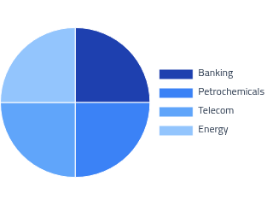
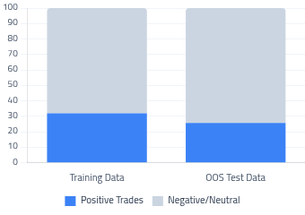
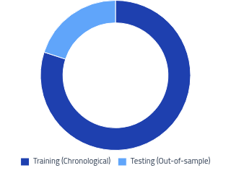








Dataset Overview & Statistics
Sector Distribution (20)
Class Balance (Positive Trades)
Chronological Split
Data Period (2021 - 2025)
Data Cleaning Pipeline
24,966
Missing values
19,742
2021
2023
2024
2025
Median impute
Start
Midpoint
Train End
Test End
Raw Records
Critical gaps
Clean Records

Slide 4







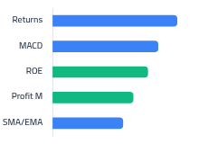







Model Architecture Deep Dive
Technical Feature Stream
Fundamental Feature Stream
Returns
SMA / EMA
RSI
MACD
Volatility
Return on Equity (ROE)
Debt-to-Equity (D/E)
Profit Margin
EPS
BiLSTM Network Architecture
XGBoost Model (Tabular)
60-Day Rolling Windows
max_depth
Top Feature Importance
Loss: BCE
6
BiLSTM (64, ret_seq=True)
Optim: Adam
n_estimators
Dropout (0.5)
Early Stopping
400
BiLSTM (32 units)
learning_rate
0.05
Dropout (0.5)
Dense (Sigmoid)
Hybrid Fusion Mechanism
Pfinal = 0.4 × PLSTM + 0.6 × PXGB
Optimal Confidence Threshold ≥ 0.75

Slide 5


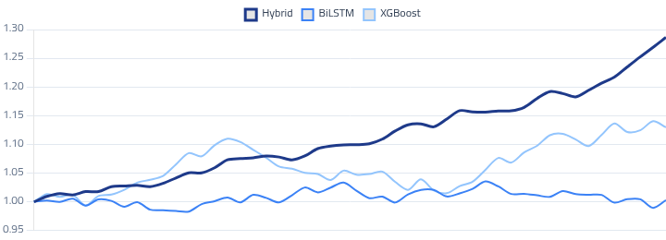



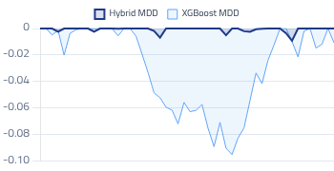
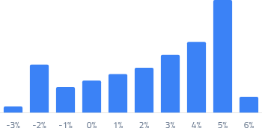


Backtesting & Risk Analysis
Trading Rules
Equity Curve Comparison
Entry: Next available closing price.
Exit: TP +5% or SL -2%.
Horizon: Max 10 trading days.
Costs: 0.30% per trade.
Risk Metrics Comparison
Model | Sharpe | Win Rate | Max DD
Hybrid | 3.50 | 42.86% | -4.55%
BiLSTM | 1.16 | 36.07% | -13.03%
XGBoost | -1.02 | 29.63% | -26.24%
Drawdown Analysis
Trade Returns Distribution
Superior risk-adjusted returns driven by selective, high-confidence trades filtering false positives.
Threshold Sensitivity (Hybrid)

Slide 6









Methodology & Hybrid Model Architecture
Data Preparation & Trading Rules
Feature Engineering
•20 TASI Companies (2021–2025); 19,742 trading records.
•Technical: Returns, MAs (SMA/EMA), RSI, MACD.
•Target: +5% (Take-Profit), -2% (Stop-Loss), 5-10 day horizon.
•Fundamental: Return on Equity (ROE), Debt-to-Equity (D/E).
•Strict chronological split with 0.30% transaction cost.
•Additional: Profit Margin, Earnings Per Share (EPS).
Technical Model: BiLSTM
Fundamental & Technical: XGBoost
•Time-series analysis using rolling windows (60 days).
•Deep integration of financial fundamentals with technicals.
•Architecture: 2 Bidirectional layers with Dropout (0.5).
•Class imbalance handling using scale_pos_weight.
•Activation: Sigmoid function with Early Stopping.
•Parameters: max_depth=6, n_estimators=400, lr=0.05.
Hybrid Integration Framework
Fixed Weight Distribution: Relies 60% on XGBoost signals (Fundamental + Technical) and 40% on BiLSTM signals (Temporal + Technical).
Threshold Selectivity: A threshold of 0.75 was identified as the optimal decision point to ensure high-quality signals and reduce losing trades.
Financial Impact: Requiring model agreement filters out false signals, increasing trading accuracy and significantly reducing Max Drawdown.

Slide 7


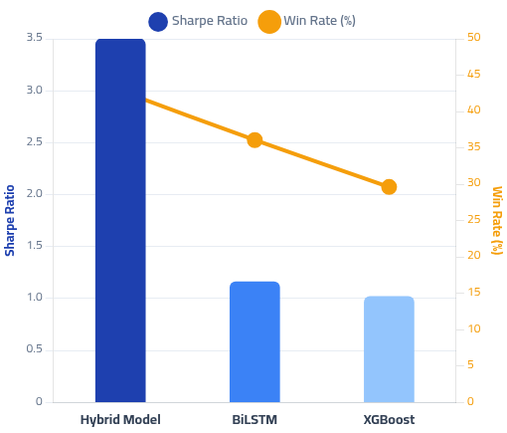



Experimental Results & Performance Comparison
Performance Summary (Optimal Threshold 0.75)
Visual Comparison: Return vs. Accuracy
(Sharpe Ratio as Risk-Adjusted Indicator - Win Rate as Trade Accuracy)
Model
Sharpe
Win Rate
Max DD
Hybrid
3.50
42.86%
-4.55%
BiLSTM
1.16
36.07%
-13.03%
XGBoost
-1.02
29.63%
-26.24%
Key Insights & Mechanism of Superiority
Higher Trade Selectivity: Raising the threshold reduces total trades but significantly increases quality and profitability.
False Signal Filtering: Alignment of technical and fundamental indicators protects the portfolio from severe drawdowns.
Wealth Stability: The hybrid model features a smooth, upward equity curve with low volatility compared to standalone models.
Strong, reliable economic performance despite moderate statistical classification accuracy.

Slide 8



Conclusion & Recommendations
Key Conclusions
•The integration of technical and fundamental analysis within a hybrid AI framework generates superior short-term trading signals in the Saudi Stock Market.
•The true value of the model derives from improving entry/exit decisions and trade selectivity, rather than merely predicting price direction accurately.
Research Contributions
Practical Implications
•Developed an interpretable hybrid model compliant with CMA regulations.
•Focus on risk-adjusted metrics (Sharpe Ratio, Max Drawdown) as primary evaluation criteria for automated trading models.
•Created a generalizable framework relying exclusively on public, structured data without utilizing unstructured rumors.
•Utilize higher decision thresholds to increase trade selectivity and minimize low-probability entries.
•Shifted the prediction problem from basic price trend classification to achieving specific, predefined economic objectives.
•Strictly enforce out-of-sample temporal testing and explicitly account for transaction and execution costs.
Limitations & Future Work
Limitations:Scope restricted to 20 companies over 5 years. Does not fully incorporate liquidity constraints or price slippage for all scenarios.
Expansion:Apply the model to alternative financial markets and integrate broader macroeconomic indicators.
Technical Dev:Explore Reinforcement Learning (RL), implement dynamic thresholds, and build continuous retraining mechanisms to adapt to shifting market conditions.

