Slide 1

Advanced Project Management APM
Prepared by Dr. Ahmad Al Ghamdi
Lecturer by Dr. Waseem Al Tabbaa
PMG 506
Advanced Project Management (APM)

Slide 2
Advanced Project Management
Prepared by Dr. Ahmad Al Ghamdi
Lecturer by Dr. Waseem Al Tabbaa
Lecture 9
PMG 506
Resource Allocation

Slide 3


Lecture 9
Resource Allocation

Slide 4
Lecture 9
Resource Allocation
This chapter addresses situations that involve resource problems. We discuss the tradeoffs involved, the difference between allocation to one project and allocation between multiple projects, the relationship between resource loading and leveling, and some of the approaches employed to solve allocation problems, including the Critical Path Method (CPM), constrained resource diagramming and scheduling, Goldratt’s “critical chain,” and several other approaches to the problem of scheduling under conditions of resource scarcity.

Slide 5
Lecture 9
Resource Allocation
9.1 CRITICAL PATH METHOD—CRASHING A PROJECT
CPM used AON notation and included a way of relating the project schedule to the level of physical resources allocated to the project. This allowed the PM to trade time for cost, or vice versa. In CPM, two activity times and two costs were often specified for each activity. The first time/cost combination was called normal, and the second set was referred to as crash. Normal times are “normal” in the same sense as the m time estimate of the three times used in PERT. Crash times result from an attempt to expedite the activity by the application of additional resources—for example, overtime, special equipment, and additional staff or material.
The allocation problem requires more careful consideration if it is decided to speed up the accomplishment of tasks and/or the total project. We need to know what additional resources it will take to shorten completion times for the various activities making up the project.

Slide 6

Lecture 9
Resource Allocation
9.1 CRITICAL PATH METHOD—CRASHING A PROJECT
While standard practice and rules of thumb are sufficient for estimating the resource needs for normal progress, careful planning is critical when attempting to expedite (crash) a project. Crash plans that appear feasible when considered activity by activity may incorporate impossible assumptions about resource availability.
Consider the data in Table 9-1. First, we compute a cost/time slope for each activity that can be expedited (crashed). Slope is defined as follows:
that is, the cost per day of crashing a project. The slope is negative, indicating that as the time required for a project or task is decreased, the cost is increased. Note that activity c cannot be expedited. Table 9-2 shows the time/cost slopes for our example.

Slide 7
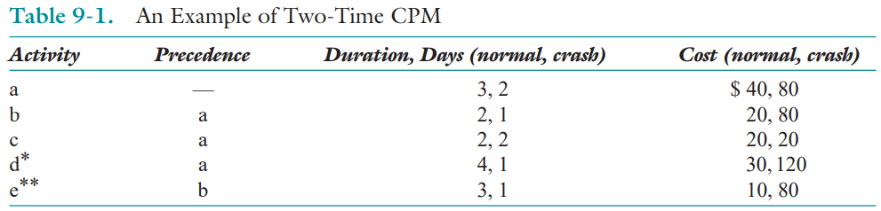
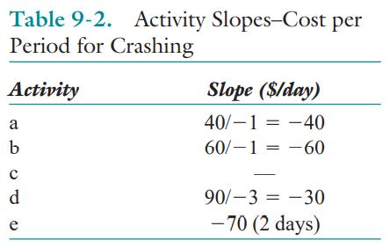
Lecture 9
Resource Allocation
9.1 CRITICAL PATH METHOD—CRASHING A PROJECT

Slide 8
Lecture 9
Resource Allocation
9.1 CRITICAL PATH METHOD—CRASHING A PROJECT
One must remember that crashing a project results in a change of the technology with which something is done. In the language of economics, it is a change in the “production function.” At times, crashing may involve a relatively simple decision to increase groups of resources already being used.
When crashing a project, our first task is to develop a table or graph of the cost of a project as a function of the project’s various possible completion dates. Starting with the normal schedule for all project activities, crash selected activities, one at a time, to decrease project duration at the minimum additional cost. To crash a project, follow two simple principles: First, focus on the critical path(s) when trying to shorten the duration of a project. Crashing a noncritical activity will not influence project duration. Second, when shortening a project’s duration, select the least expensive way to do it.

Slide 9
Lecture 9
Resource Allocation
9.1 CRITICAL PATH METHOD—CRASHING A PROJECT
Consider the network shown in Figure 9-1a that was constructed from the data in Table 9-1. It is easier to illustrate the impact of crashing on an activity-on-arrow (AOA) network than on an activity-on-node (AON) network, so we use that approach here. Also, we use dummy activities in this case not to illustrate precedence but to show time durations and slack on the time axis. As indicated in Tables 9-1 and 9-2, activity d can be partially crashed but activity e involves a technological discontinuity and must take either three days to complete at $10 or one day at $80.
The network’s critical path is a-b-e, the project duration is 8 days, and the normal total cost is $120, as illustrated in the network of Figure 9-1a. The decision about which activities to crash depends on how much we need to reduce the duration of the project. To reduce the total network duration by 1 day, we must reduce the time required by one of the activities along the critical path. Inspecting Table 9-2 to see which critical activity can be reduced at the least cost, we find it is activity a which adds $40 to the project’s current cost of $120.

Slide 10
Lecture 9
Resource Allocation
9.1 CRITICAL PATH METHOD—CRASHING A PROJECT
Activity b could be crashed at a cost of $60 or we could even crash e 2 days for a cost of $70. Of course, crashing e would only shorten the project duration by one day because when e is shortened, the path a-d-dummy, seven days long, becomes the critical path and does not allow the project to be shortened to 6 days. Of the three options, crashing a is the lowest cost and therefore preferable, see Figure 9-1b. Notice that crashing a also shortens a-d-dummy and a-c-dummy by 1 day.
Suppose the project must be crashed by 2 days. What are the options? Reconsidering Table 9-2 and Figure 9-1a, we see that we could crash activity e for 2 days ($70), but path a-d-dummy (7-days’ duration) must also be crashed at least 1 day. We choose d ($30/day) because it is cheaper than a ($40). The cost of crashing is $100, and the total project cost is $120 + $100 = $220. Alternatively, we could crash a and b, also for a cost of $100 ($40 + $60). Arbitrarily, we choose the latter option (Figure 9-1c).

Slide 11
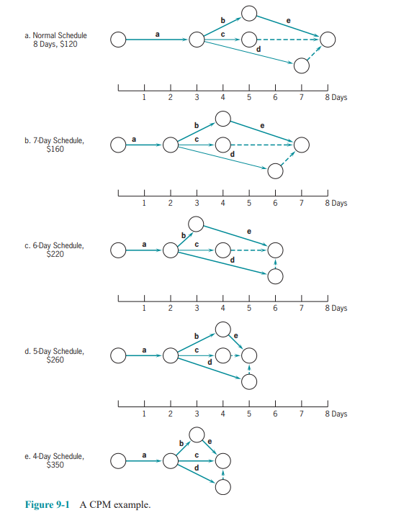
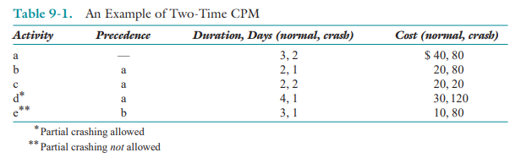
Lecture 9
Resource Allocation
9.1 CRITICAL PATH METHOD—CRASHING A PROJECT

Slide 12
Lecture 9
Resource Allocation
9.1 CRITICAL PATH METHOD—CRASHING A PROJECT
Now suppose we wanted to crash the project by 3 days, from the original 8 days down to 5 days. Clearly e must be crashed by 2 days, costing $70, and a or b by a day. We choose a, the cheapest, for an additional $40. This leaves d to be crashed by 1 day for another $30, resulting in a total crashing cost of $140 and a project cost of $120 + $140 = $260 (Figure 9-1d). Note that we did not crash b this time, as we did for 6 days. This is due to the technological discontinuity in activity e.
Last, let us consider crashing the project by 4 days down to a project duration of four days. Since we crashed e, the technological discontinuity, to reach a 5-day duration, all the remaining activities can be incrementally crashed. Thus, we can simply inspect Figure 9-1d to see what else needs incremental crashing to reduce the project by another day. Notice in Figure 9-1d that a-b-e and a-d-dummy are both critical paths. Only b and d can still be crashed so we crash each by 1 day for an additional cost beyond the 5-day schedule of Figure 9-1d of $60 $30 $90 for a total project cost of $260 + $90 = $350 (Figure 9-1e).

Slide 13
Lecture 9
Resource Allocation
9.1 CRITICAL PATH METHOD—CRASHING A PROJECT
Note that c is now critical so all activities are critical. Since the critical paths a-b-e and a-c are at their full extent of crashing, the project duration cannot be further reduced, even though activity d could be crashed another day. Thus, Figure 9-1e is not the all-crash network, although it equals the all-crash time schedule of four days.
Figure 9-2 shows the time/cost relationship of crashing the project. On the benefit side, some projects have penalty clauses that make the parent organization liable for late delivery—and sometimes bonuses for early delivery. Starting at the right (all-normal) side of Figure 9-2, note that it becomes increasingly costly to squeeze additional time out of the project. Charts such as the one shown in Figure 9-2 are useful to the PM in exercising control over project duration and cost. They are particularly helpful in dealing with senior managers who may argue for early project completion dates with little understanding of the costs involved. Similarly, such data are of great benefit when clients plead for early delivery. If the client is willing to pay the cost of crashing, or if the fi rm is willing to subsidize the client, the PM can afford to listen with a sympathetic ear.

Slide 14
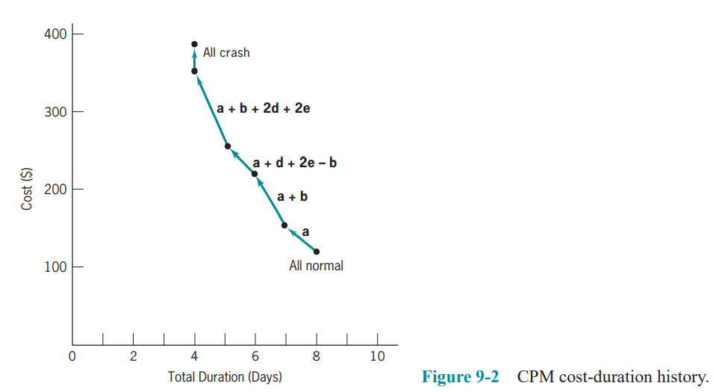
Lecture 9
Resource Allocation
9.1 CRITICAL PATH METHOD—CRASHING A PROJECT

Slide 15
Lecture 9
Resource Allocation
9.1 CRITICAL PATH METHOD—CRASHING A PROJECT
Fast-Tracking
It refers to overlapping the design and build phases of a project. Because design is usually completed before construction starts, overlapping the two activities will result in shortening the project duration. Beginning to build before design is completed might also, however, result in an increased number of change orders, subsequent loss of productivity, increased cost, and loss of time. Studies of construction projects revealed, however, that while there were more design changes in fast-tracked projects, the total number of project change orders was not significantly different than in similar projects that were not fast-tracked

Slide 16
Lecture 9
Resource Allocation
9.2 THE RESOURCE ALLOCATION PROBLEM
Schedules should be evaluated not merely in terms of meeting project milestones, but also in terms of the timing and use of scarce resources. A fundamental measure of the PM’s success in project management is the skill with which the trade-offs among performance, time, and cost are managed. It is a continuous process of cost-benefit analysis: “I can shorten this project by a day at a cost of $400. Should I do it?” “If I buy 300 more hours of engineering time, I may be able to improve performance by 2 or 3 percent. Should I do it?” Of course all such estimates are uncertain. What are the risks and how should I deal with them?
The extreme points of the relationship between time use and resource use are these:
• Time Limited: The project must be finished by a certain time, using as few resources as possible. But it is time, not resource usage, that is critical.
• Resource Limited: The project must be finished as soon as possible, but without exceeding some specific level of resource usage or some general resource constraint.

Slide 17
Lecture 9
Resource Allocation
9.3 RESOURCE LOADING
Resource loading describes the amounts of individual resources an existing schedule requires during specific time periods. Therefore, it is irrelevant whether we are considering a single work unit or several projects; the loads (requirements) of each resource type are simply listed as a function of time period. Resource loading gives a general understanding of the demands a project or set of projects will make on a fi rm’s resources. It is an excellent guide for early, rough project planning. Obviously, it is also a first step in attempting to reduce excessive demands on certain resources, regardless of the specific technique used to reduce the demands. Again, we caution the PM to recognize that the use of resources on a project is often nonlinear.
If resources of a project are increased by X percent, the output of the project usually does not increase by X percent, and the time required for the project does not decrease by X percent. The output and time may not change at all, or may change by an amount seemingly not related to X. Any time the resource base of a project is altered from standard practice, the risk that the project may not be successful is often increased.

Slide 18
Lecture 9
Resource Allocation
9.3 RESOURCE LOADING
The PM must be aware of the ebbs and flows of usage for each input resource throughout the life of the project. It is the PM’s responsibility to ensure that the required resources, in the required amounts, are available when and where they are needed.

Slide 19
Lecture 9
Resource Allocation
9.4 RESOURCE LEVELING
Large fluctuations in the required loads for various resources are a normal occurrence— and are undesirable from the PM’s point of view. Resource leveling aims to minimize the period-by-period variations in resource loading by shifting tasks within their slack allowances. The purpose is to create a smoother distribution of resource usage.
There are several advantages to smoother resource usage.
First, much less hands-on management is required if the use of a given resource is nearly constant over its period of use. The PM can arrange to have the resource available when needed, can have the supplier furnish constant amounts, and can arrange for a backup supplier if advisable. Moreover, the PM can do this with little error.
Second, if resource usage is level, the PM may be able to use a “just-in-time” inventory policy without much worry that the quantity delivered will be wrong. If the resource being leveled is people, leveling improves morale and results in fewer problems in the personnel and payroll offices because of increasing and decreasing labor levels.

Slide 20
Lecture 9
Resource Allocation
9.4 RESOURCE LEVELING
The basic procedure for resource leveling is straightforward. For example, consider the simple AOA network shown in Figure 9-7a. The activity time is shown above the arc, and resource usage (one resource, workers) is in brackets below the arc. Activities a, b, and c follow event 1, and all must precede event 4. Activity a requires two workers and takes two days, b requires two workers and takes 3 days, and c needs 4 workers and 5 days. (We addressed the problem of trade-offs between labor and activity time in the first section of this chapter.) If all these tasks are begun on their early start dates, the resource loading diagram appears as shown in Figure 9-7b, steps of decreasing labor demand varying from eight workers to four workers. If, however, task b is delayed for 2 days, the full length of its slack in this particular case, the resource loading diagram is smoothed, as shown in Figure 9-7c. The same result would have occurred if b were started as early as possible and task a were delayed until day 3.

Slide 21
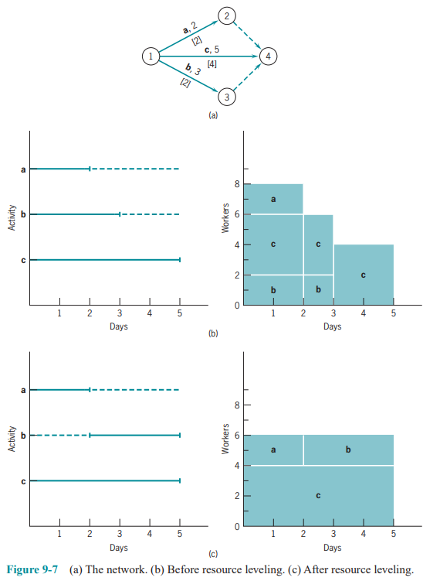
Lecture 9
Resource Allocation
9.4 RESOURCE LEVELING

Slide 22
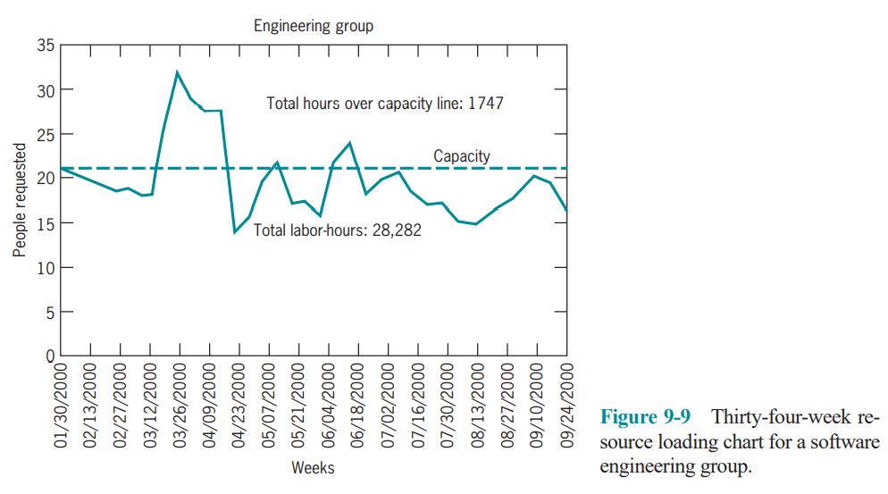
Lecture 9
Resource Allocation
9.4 RESOURCE LEVELING
Resource Loading/Leveling and Uncertainty

Slide 23
Lecture 9
Resource Allocation
9.4 RESOURCE LEVELING
Resource Loading/Leveling and Uncertainty
We try not to schedule a scarce resource for more than 85–90 percent capacity. The reason is due to disruptions, emergencies, maintenance requirements, personnel issues, and simple inefficiency of any resource that is scheduled for full production over an extended time period.
You need to consider:
Annual vacation
National holidays
Illnesses

Slide 24
Lecture 9
Resource Allocation
9.5 CONSTRAINED RESOURCE SCHEDULING
Far too often, PMs are surprised by resource constraints. The cause of this condition is usually the direct result of a failure to include resource availability in risk identification activities. The lack of a resource where and when it is needed can have many causes, but the most common causes are not difficult to identify and mitigate: failure of a supplier to produce and/or deliver, the assignment of the resource to another activity, and loss or theft of a resource. PMs often apply risk management techniques to resources known to be scarce, but neglect to consider the more common resources that usually cause the problems.
There are two fundamental approaches to constrained resource allocation problems:
Heuristic Methods
Most heuristic solution methods start with the PERT/CPM schedule and analyze resource usage period by period, resource by resource.

Slide 25
Lecture 9
Resource Allocation
9.5 CONSTRAINED RESOURCE SCHEDULING
In a period when the available supply of a resource is exceeded, the heuristic examines the tasks in that period and allocates the scarce resource to them sequentially, according to some priority rule. The major difference among the heuristics is in the priority rules they use. Remember that the technological necessities always take precedence. Some of the most common priority rules are:
As Soon as Possible
As Late as Possible
Shortest Task First
Most Resources First
Minimum Slack First
Most Critical Followers
Most Successors
Arbitrary

Slide 26
Lecture 9
Resource Allocation
9.5 CONSTRAINED RESOURCE SCHEDULING
Optimizing Methods
The methods to find an optimal solution to the constrained resource scheduling problem fall primarily into two categories: mathematical programming (linear programming, LP, for the most part) and enumeration.

Slide 27
Lecture 9
Resource Allocation
9.6 MULTIPROJECT SCHEDULING AND RESOURCE ALLOCATION
Scheduling and allocating resources to multiple projects are much more complicated than for the single-project case. The most common approach is to treat the several projects as if they were each elements of a single large project. Another way of attacking the problem is to consider all projects as completely independent.
Three important parameters affected by project scheduling are: (1) schedule slippage, (2) resource utilization, and (3) in-process inventory. The organization (or the PM) must select the criterion most appropriate for its situation.
Manufacturing Process Models
To avoid long waiting lines for projects or for activities within a project, the capacity of the scarce resource must be significantly greater than the demand for it, or else the arrival rate of jobs must be tightly controlled so that it is no longer random. Even if the arrival rate is controlled, it must still be at a level that is less than the service rate (which is still random).

Slide 28
Lecture 9
Resource Allocation
9.6 MULTIPROJECT SCHEDULING AND RESOURCE ALLOCATION
Heuristic Techniques
Discussed previously in section 9.5
A Multiproject Scheduling Heuristic
Resources are devoted to activities until the supply of available resources or activities is exhausted. If we use up the resources before all critical activities are scheduled, we can adopt one of two subheuristics. First, we may be able to borrow resources from currently active, but noncritical, tasks. Second, we may “deschedule” a currently active, noncritical task. The former presumably slows the progress of the work, and the latter stops it. In both cases, some resources will be released for use on critical tasks. Obviously, if a critical task is slowed, descheduled, or not supported, the duration of the associated project will be extended.

Slide 29
Lecture 9
Resource Allocation
SUMMARY
In this chapter, we looked at the problem of allocating physical resources, both among the multiple activities of a project and among multiple projects. The continuous problem to the PM is finding the best trade-offs among resources, particularly time. We considered resource loading, allocation, and leveling, and presented methods and concepts to aid in all these tasks.
Specific points made in the chapter were these:
• The critical path method (CPM) is a network constructed in the same manner as PERT, but it also considers the possibility of adding resources to tasks (called crashing) to shorten their duration, thereby expediting the project.
• The resource allocation problem is concerned with determining the best trade-offs between available resources, including time, throughout the duration of a project.
• Resource loading is the process of calculating the total load from project tasks on each resource for each time period of the project’s duration.

Slide 30
Lecture 9
Resource Allocation
SUMMARY
• Resource leveling is concerned with evening out the demand for various resources required in a project by shifting tasks within their slack allowances. The aid of a computer is mandatory for realistic projects.
• There are two basic approaches to addressing the constrained resources allocation problem:
— Heuristic methods are realistic approaches that may identify feasible solutions to the problem. They essentially use simple priority rules, such as shortest task first, to determine which task should receive resources and which task must wait.
— Optimizing methods, such as linear programming, find the best allocation of resources to tasks but are limited in the size of problems they can efficiently solve.
• For multiproject scheduling, three important measures of effectiveness are schedule slippage, resource utilization, and level of in-process inventory.
• When a new project is added to a multiproject system, the amount of slippage is directly related to the average resource load.

Slide 31
Lecture 9
Resource Allocation
SUMMARY
• Mathematical programming models for multi-project scheduling aim either to minimize total throughput time for all projects, minimize the completion time for all projects, or minimize the total lateness (or lateness penalty) for all projects. These models are limited to small problems.
There are a number of heuristic methods, such as the resource scheduling method, available for the multiproject scheduling problem. In the next chapter, we move to the ongoing implementation of the project and consider the project information systems used for monitoring progress, costs, performance, and so on. The chapter also describes some available computer packages for this function

Slide 32
Lecture 9
Resource Allocation
GLOSSARY
Cost/Time Slope The ratio of the increased cost for expediting to the decreased amount of time for the activity.
Followers The tasks that logically follow a particular task in time.
Heuristic A formal process for solving a problem, like a rule of thumb, that results in an acceptable solution.
Mathematical Programming A general term for certain mathematical approaches to solving constrained optimization problems, including linear programming, integer programming, and so on.
Predecessors The tasks that logically precede a particular task in time.
Priority Rules Formal methods, such as ratios, that rank items to determine which one should be next.
Resource Leveling Approaches to even out the peaks and valleys of resource requirements so that a fixed amount of resources can be employed over time.

Slide 33
Lecture 9
Resource Allocation
GLOSSARY
Resource Loading The amount of resources of each kind that are to be devoted to a specific activity in a certain time period.
Successors See followers.
Tree Search The evaluation of a number of alternatives that logically branch from each other like a tree with limbs.

Slide 34
Lecture 9
Resource Allocation
Thank you

