Slide 1


Real Estate
Finance & Investment
Prepared by Dr. Emad Zaher
Assistant Professor of Accounting
REA 631
Lecture (2)
Basic Financial Concepts & Financial reports for service and Merchandising Business

Slide 2

  Learning outcomes
LO 1 Identify the basic Accounting Equation (Finance&Investment).
LO 2 Identify the income statement (Profit & loss).
LO 3 Explain the statement of changes in owner’s Equity.
LO 4 Describe the classified balance sheet(Statement of financial position).

Slide 3
BASIC ACCOUNTING EQUATION
Investment
Finance
Finance
Resources
Obligations
Capital
Assets = Liabilities + Owner’s Equity
100.000
40.000
60.000
Prepared by Dr. Emad Zaher

Slide 4
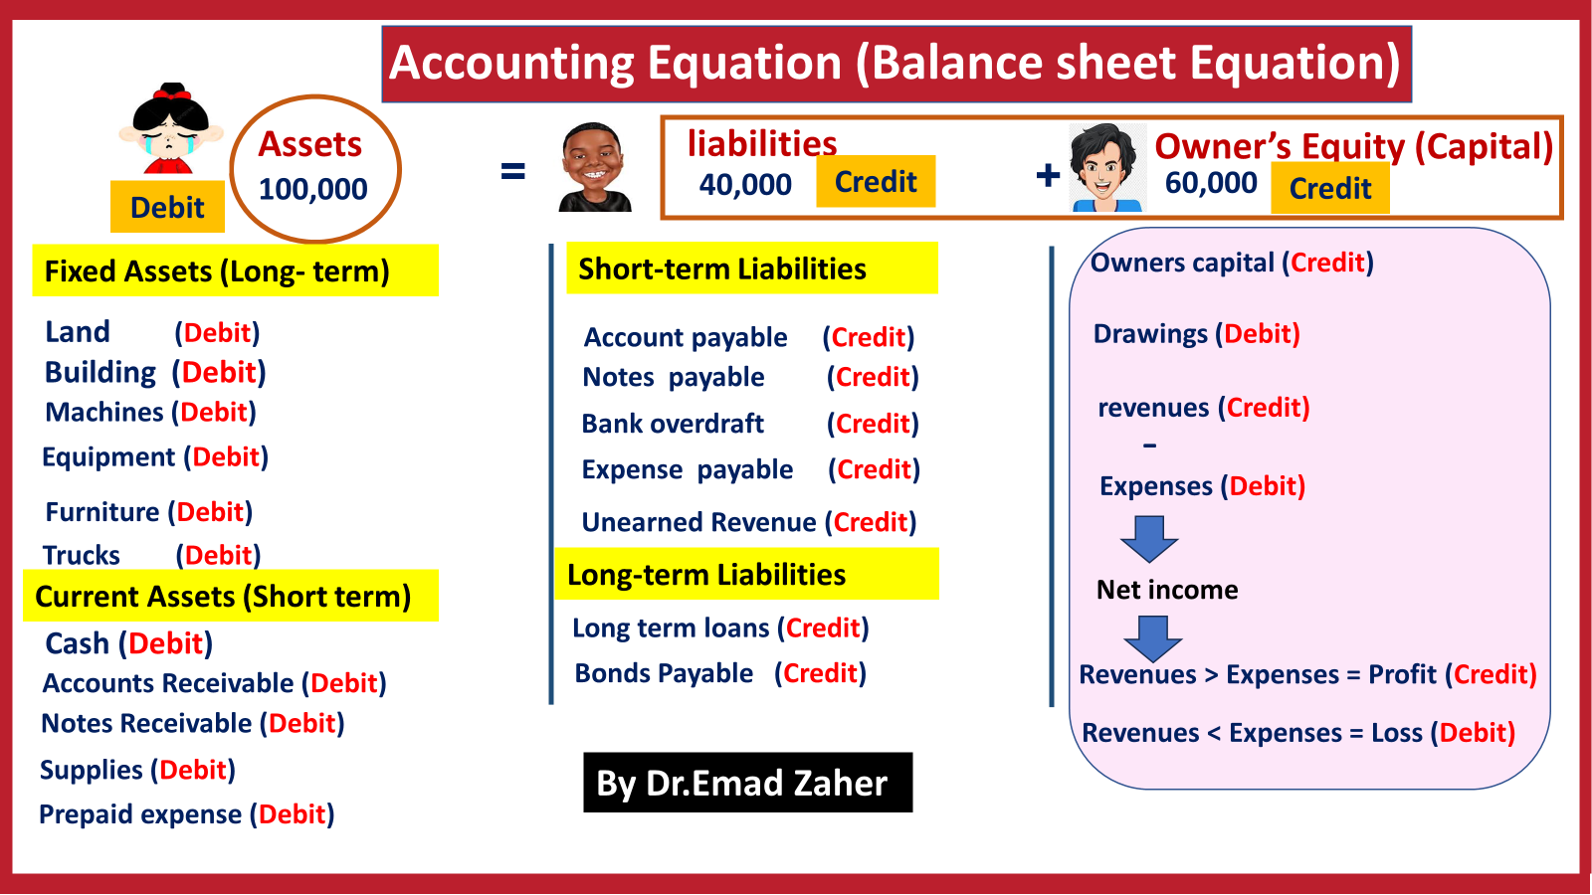

Slide 5
The Four Basic Financial Statements
Financial Statements are prepared directly from the Trial Balance.
Companies prepare four financial statements:
Income Statement (Profit & loss statement) |  | Changes in owner’s Equity Statement |  | Statement of Financial Position (Balance Sheet) |  | Statement of Cash Flows
Period of time
Period of time
Point in time
Period of time
Prepared by Dr. Emad Zaher

Slide 6
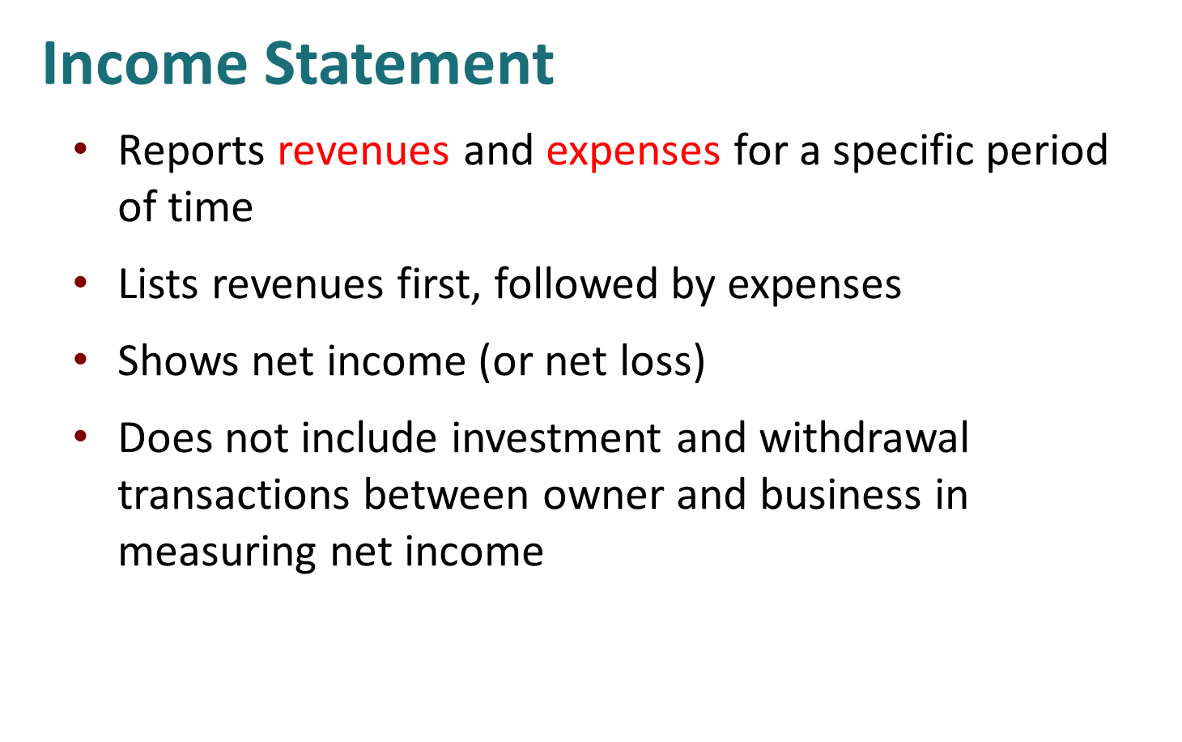
Prepared by Dr. Emad Zaher

Slide 7
Business Name…. Single-Step income statement for the year ended Dec. 31, 2022
Revenues :
Sales Revenue | ×
Service Revenue | ×
Fees Earned | ×
Commission Revenue | ×
Consulting revenue | ×
Dividends Revenue | ×
Rental revenue | ×
Total Revenues | ××
Expenses:
Salary expenses | (×)
Wages expenses | (×)
Rent expenses | (×)
Utility expense | (×)
Repair expense
Insurance expense | (×)
Interest expense | (×)
Depreciation expense | (×)
Advertising expense | (×)
Supplies expense | (×)
Total expenses | (××)
Net income | ××
Prepared by Dr. Emad Zaher

Slide 8
Revenues and expenses determine if a net income or net loss occurs as follows:
a. Revenues > Expenses: Net Income(Profit).
b. Revenues < Expenses: Net Income (loss).
Prepared by Dr. Emad Zaher

Slide 9
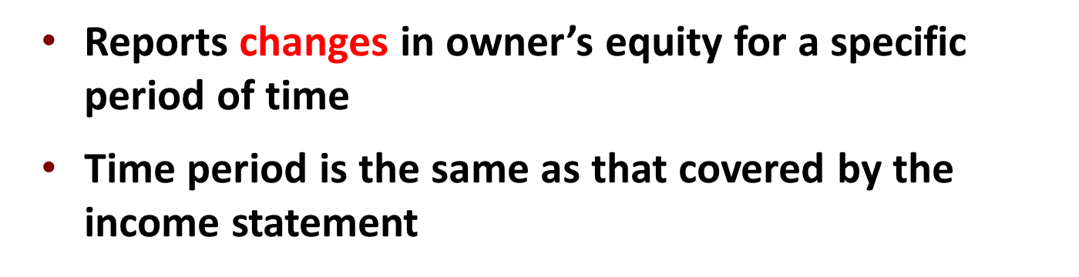
Changes in Owner’s Equity Statement
Prepared by Dr. Emad Zaher

Slide 10
Business Name…. Changes in Owner’s equity statement For the year ended Dec 31.2024
Beginning Capital | ×
Add (+) | +
Additional Investment | ×
Net income (Profit) ….from the income statement | ×
Less (-)
Drawings (Withdrawals) | (×)
Net income (Loss) …. from the income statement
Ending Capital | ××
Prepared by Dr. Emad Zaher

Slide 11
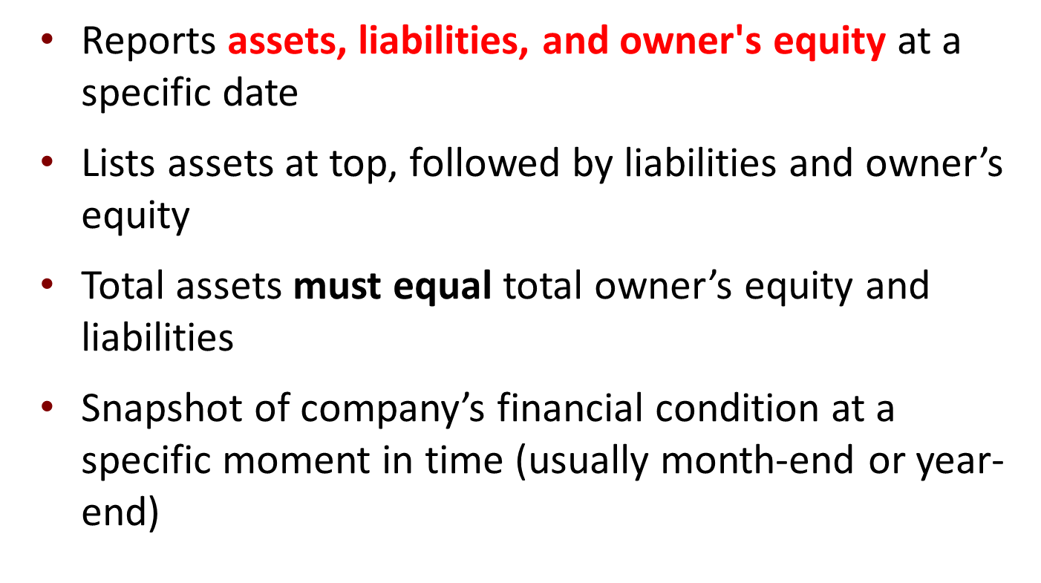
Statement of Financial Position (Balance sheet)

Slide 12
Balance Sheet At the year ended Dec 31.2024
Assets
Current assets
Cash | xx
Short-term investment | xx
Account receivable | xx
Notes receivable | xx
Inventories | xx
Prepaid expenses | xx
Total current assets |  | xx
Property, plant, and equipment (Fixed Assets) |  | xx
Land | xx
Building ( - ) Accumulated Depreciation | xx
Equipment ( - ) Accumulated Depreciation | xx
Machinery ( - ) Accumulated Depreciation | xx
Furniture ( - ) Accumulated Depreciation | xx
Total property, plant, and equipment |  | xx
Intangible assets | xx
Goodwill | xx
Copyright | xx
Trademark | Xx
Total intangible assets |  | xx
Total assets | xx
Liabilities & owner's equity
Liabilities |  | xx
Current liabilities |  | xx
Notes payable | xx
Account payable | xx
Unearned revenue | Xx
Total current liabilities |  | xx
Long term liabilities
Mortgage payable | xx
Bank loan payable | xx
Total long-term liabilities |  | xx
Total liabilities |  | xx
Owner's equity
Capital …..From the changes in owner’s equity statement |  | xx
Total liabilities & owner's equity |  | xx
Prepared by Dr. Emad Zaher

Slide 13
Example (1)
Mohamed Emad has the following Activities during the year:
Service revenue $52800- Rent expense $4800 - wages expense $33080 - advertising expense $5400- utilities expense $3600 - Mohamed withdrawals $2800- Cash $6200- Accounts receivable $3000-supplies $400- land 4000- Accounts payable $1800 - Mohamed beginning capital $8680
Required
Prepare the income statement.
Prepare the statement of owner's equity.
Prepare the balance sheet for Mohamed Emad proprietorship.
Prepared by Dr. Emad Zaher

Slide 14
Mohamed Emad Balance Sheet At the year ended Dec 31.2022
Assets
Current assets:
Cash | 6200
Accounts receivable | 3000
Supplies | 400 | 9600
Fixed Assets
Land | 4000 | 4000
Total Assets |  | 13600
Liabilities and owner's’s equity
Short term liabilities
Accounts Payable |  | 1800
Long term liabilities
Loans (If found)
Owner's equity
Capital |  | 11800
Total liabilities and Owner's equity |  | 13600
Mohamed Emad Single-Step income statement for the year ended Dec. 31, 2022
Revenues :
Service Revenue | 52800
Expenses:
Rent expenses | (4800)
Wages expenses | (33080)
Advertising expense | (5400)
Utility expense | (3600)
Total expenses | (46880)
Net income | 5920
Mohamed Emad Owner’s equity statement For the year ended Dec 31.2022
Beginning Capital | 8680
Add (+) | +
Additional Investment | 0
Net income (Profit) | 5920
Less (-)
Drawings (Withdrawals) | (2800)
Ending Capital | 11800
Prepared by Dr. Emad Zaher

Slide 15
Example(3)
Given the following trial balance:
Account title | Dr | Cr
Cash | 100,000
Accounts receivable | 30,000
Building | 90,000
Accumulated Depreciation -Building |  | 20,000
Equipment | 350,000
Accumulated Depreciation -Equipment |  | 50,000
Notes payable |  | 60,000
Accounts Payable |  | 90,000
Zaher ,Capital |  | 280,000
Zaher , Withdrawals | 30,000
Service revenue |  | 140,000
Salaries expense | 20,000
Insurance expense | 8,000
Advertising expense | 9,000
Rent expense | 3,000
Total | 640,000 | 640,000
Instructions
Prepare the income statement.
Prepare the statement of owner's equity.
Prepare the statement of financial position.

Slide 16
income statement for the year ended Dec. 31, 2022
Revenues :
Service Revenue | 140000
Expenses:
Salaries Expense | (20000)
Insurance expenses | (8000)
Advertising Expense | (9000)
Rent expense | (3000)
Total expenses | (40000)
Net income (Profit) | 100,000
Balance Sheet At the year ended Dec 31.2022
Assets
Fixed assets (Non-Current Assets) :
Building | 90,000 | 70,000
(-) Accumulated Depreciation | ( 20,000)
Equipment | 350,000
(-) Accumulated Depreciation | (50,000)
Current Assets |  | 300,000
Cash |  | 100,000
Accounts receivable |  | 30,000
Total Assets |  | 500,000
Liabilities and stockholder’s equity
Short term liabilities
Accounts payable |  | 90,000
Notes payable |  | 60,000
Long term liabilities
Loans (If found)
Owner's equity
Capital |  | 350,000
Total liabilities and Owner's equity |  | 500,000
Owner’s equity statement For the year ended Dec 31.2022
Beginning Capital | 280,000
Add (+) | +
Additional Investment | Zero
Net income (Profit) | 100,000
Less (-)
Drawings (Withdrawals) | (30,000)
Ending Capital | 350,000
Prepared by Dr. Emad Zaher

Slide 17
Merchandising Operations
Income Measurement
Sales
Revenue
Not used in a service business
Less
Cost of
Goods Sold
Equals
Gross
Profit
Less
Cost of goods sold is the total cost of merchandise sold during the period.
Operating
Expenses
Net
Income
(Loss)
Equals
Prepared by Dr. Emad Zaher

Slide 18
Companies types
service companies | merchandising companies
provide service | Sale goods
Short
Operating Cycle
Long
Operating Cycle
Multiple step - Income statement
Single step income statement
Net sales
100000
revenues
- Cost of goods sold
(60000)
100000
Gross profit
40000
- expenses
(60000)
Net income
40000
- Operating expenses:
(10000)
Income from operations
30000
Other revenues and gains:
5000
- Other expenses and losses:
(1000)
Net income
34000
Prepared by Dr. Emad Zaher

Slide 19
Companies types
Merchandising companies
Sales returns and allowance
-
Sale goods
-
sales discount
1- Net sales =
Sales
2- gross profit =
Net sales -
cost of good sold
Operating Cycle
Multiple step income statement
3- operation income =
gross profit -
operation expense
Net sales
100000
- Cost of goods sold
(60000)
+
Gross profit
40000
4- Net income
= operation income
interest revenue and gains
- Operating expenses:
(10000)
Income from operations
30000
–
interest expenses and loss
Other revenues and gains:
5000
- Other expenses and losses:
(1000)
Net income
34000
Prepared by Dr. Emad Zaher

Slide 20
Nonoperating Activities
    Various revenues and expenses and gains and losses that are unrelated to company’s main line of operations.
Other Revenues and Gains
Interest revenue from notes receivable and marketable securities.
Dividend revenue from investments in common stock.
Rent revenue from subleasing a portion of the store.
Gain from the sale of property, plant, and equipment.
Other Expenses and Losses
Interest expense on notes and loans payable.
Casualty losses from recurring causes, such as vandalism and accidents.
Loss from the sale or abandonment of property, plant, and equipment.
Loss from strikes by employees and suppliers.

Slide 21
Prepared by Dr. Emad Zaher

Slide 22
Do IT
  The multiple-step income statement for a merchandiser shows each of the following features except:
  gross profit.
  cost of goods sold.
  a sales revenue section.
  investing activities section.
Prepared by Dr. Emad Zaher

Slide 23
Do IT
Indicate whether the following statements are true or false.
The primary source of revenue for a merchandising company results from performing services for customers.
The operating cycle of a service company is usually shorter than that of a merchandising company.
Sales revenue less cost of goods sold equals gross profit.
Ending inventory plus the cost of goods purchased equals cost of goods available for sale.
Solution: 1. False 2. True 3. True 4. False
Prepared by Dr. Emad Zaher

Slide 24
Multiple step income statement
EX(1)
Sales returns and allowance
-
Sales revenue $480.000 , sales returns and allowances $ 12.000 , Sales discounts 8.000 , Salaries and wages expense 64.000 , Utilities expense 17.000 , Advertising expense 16.000 , Depreciation expense 8.000 , Freight – out 7.000 , Insurance expense 2.000 , Interest revenue 3.000 , Gain on disposal of plant assets 600 , Interest expenses 1800 , loss from vandalism 200 , Cost of goods sold 316.000
-
sales discount
1- Net sales =
Sales
= 480000 - 12000 - 8000 = 460000
2- gross profit =
Net sales -
cost of good sold
    = 460000 - 316000 = 144000 LE
3- operation income =
gross profit -
operation expense
    = 144000 - 114000 = 30000 LE
+
interest revenue and gains
4- Net income
= operation income
Salaries and wages expense 64.000
Utilities expense 17.000
Advertising expense 16.000
Depreciation expense 8.000
Freight – out 7.000
Insurance expense 2.000
3000 + 600
31600
300000 +
–
interest expenses and loss
1800 + 200
Total operating expenses | 114000
Prepared by Dr. Emad Zaher

Slide 25
DO IT
Prepared by Dr. Emad Zaher

Slide 26
Single - step income statement
Multiple step income statement
Prepared by Dr. Emad Zaher

Slide 27
DO IT
Prepared by Dr. Emad Zaher

Slide 28
Prepared by Dr. Emad Zaher

Slide 29
Multiple Choice Questions

Slide 30
1. The following items are taken from the financial statements of the Postal Service for the year ending December 31, 2014:
Accounts payable $ 18,000
Accounts receivable 11,000
Accumulated depreciation – equipment 28,000
Advertising expense 21,000
Cash 15,000
Owner’s capital (1/1/14) 102,000
Owner’s drawings 14,000
Depreciation expense 12,000
Insurance expense 3,000
Note payable, due 6/30/15 70,000
Prepaid insurance (12-month policy) 6,000
Rent expense 17,000
Salaries and wages expense 32,000
Service revenue 133,000
Supplies 4,000
Supplies expense 6,000
Equipment 210,000
What is the company’s net income for the year ending December 31, 2014?
a. $12,000
b. $28,000
c. $42,000
d. $133,000

Slide 31
income statement for the year ended Dec. 31, 2014
Revenues :
Service Revenue | 133000
Expenses:
Advertising Expense | (21000)
Depreciation expenses | (12000)
Insurance Expense | (3000)
Rent expense | (17000)
Salaries & wages expense | (32000)
Supplies expense | (6000)
Total Expenses | (91000)
Net income (Profit) | 42000
The correct Answer is c
Prepared by Dr. Emad Zaher

Slide 32
2. Misra Company compiled the following financial information as of December 31, 2023:
Revenues $340,000
Owner’s Capital (1/1/23) 140,000
Equipment 80,000
Expenses 250,000
Cash 90,000
Owner’s Drawings 20,000
Supplies 10,000
Accounts payable 40,000
Accounts receivable 70,000
Misra’s owner’s equity on December 31, 2023 is
a. $90,000.
b. $140,000.
c. $210,000.
d. $250,000.

Slide 33
income statement for the year ended Dec. 31, 2023
Revenues : | 340,000
Less (-) | (-)
Expenses | 250000
Net income (Profit) | 90,000
Owner’s equity statement For the year ended Dec 31.2023
Beginning Owner’s Capital | 140,000
Add (+) | +
Additional Investment | Zero
Net income (Profit) | 90,000
Less (-)
Drawings (Withdrawals) | (20,000)
Ending Owner’s Capital | 210,000
The correct Answer is c

Slide 34
3.The following items are taken from the financial statements of the Postal Service for the year ending December 31, 2014:
Accounts payable $ 18,000
Accounts receivable 11,000
Accumulated depreciation – equipment 28,000
Advertising expense 21,000
Cash 15,000
Owner’s capital (1/1/14) 102,000
Owner’s drawings 14,000
Depreciation expense 12,000
Insurance expense 3,000
Note payable, due 6/30/15 70,000
Prepaid insurance (12-month policy) 6,000
Rent expense 17,000
Salaries and wages expense 32,000
Service revenue 133,000
Supplies 4,000
Supplies expense 6,000
Equipment 210,000
What are total current assets at December 31, 2014?
a. $26,000
b. $36,000
c. $32,000
d. $42,000
Total current assets =
Accounts receivable 11,000+ Cash 15,000+
Prepaid insurance 6000+ Supplies 4000
= $36000
The correct Answer is B

Slide 35
5 .The income statement for the year 2023 of Nour Emad Co. contains the following information:
Revenues $70,000
Expenses:
Salaries and Wages Expense $45,000
Rent Expense 12,000
Advertising Expense 10,000
Supplies Expense 6,000
Utilities Expense 2,500
Insurance Expense 2,000
Total expenses 77,500
Net income (loss) $ (7,500)
At January 1, 2023, Nour reported owner’s equity of $50,000. Owner drawings for the year totalled $10,000. At December 31, 2023, the company will report owner’s equity of
a. $17,500.
b. $32,500.
c. $40,000.
d. $42,500.

Slide 36
Owner’s equity statement For the year ended Dec 31.2023
Beginning Owner’s Capital | 50,000
Add (+) | +
Additional Investment | Zero
Net income (loss) | (7500)
Less (-)
Drawings (Withdrawals) | (10,000)
Ending Owner’s Capital | 32,500
The correct Answer is b

Slide 37
7.Misra Company compiled the following financial information as of December 31, 2014:
Revenues $340,000
Owner’s Capital (1/1/14) 140,000
Equipment 80,000
Expenses 250,000
Cash 90,000
Owner’s Drawings 20,000
Supplies 10,000
Accounts payable 40,000
Accounts receivable 70,000
Misra’s assets on December 31, 2014 are
a. $180,000.
b. $250,000.
c. $360,000.
d $490,000.
Total Assets=
Equipment 80,000+ Cash 90,000+Supplies 10,000+ Accounts receivable 70,000
= $250,000
The correct Answer is b

Slide 38
8. As of December 31, 2014, Calexico Company has assets of $42,000 and owner's equity of $20,000. What are the liabilities for Calexico Company as of December 31, 2014?
a. $22,000.
b. $20,000.
c. $42,000.
d. $62,000.
9. Net income results when
a. Assets > Liabilities.
b. Revenues = Expenses.
c. Revenues > Expenses.
d. Revenues < Expenses.
10. Owner's capital at the end of the period is equal to
a. owner's capital at the beginning of the period plus net income minus liabilities.
b. owner's capital at the beginning of the period plus net income minus drawings.
c. net income.
d. assets plus liabilities.
The correct Answer is a
The correct Answer is c
The correct Answer is b

Slide 39



Thank You

