Slide 1

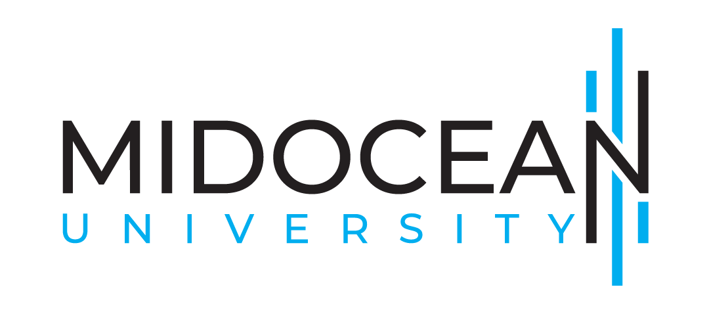
Agile Project
Management
Prepared by Eng. Ahmed Hussein, MBA, PfMP©, PMP©, CMP APMG
PMG 622
Master of Project Management
Lecture 07

Slide 2


Hybrid life cycles: Designing and Customizing Agile and Traditional Lifecycles
Lecture 7
PMG 622
Agile Project Management
Prepared by
Eng. Ahmed Hussein, MBA, PfMP©, PMP©, CMP APMG
www.midocean.ae

Slide 3

Chapter
Learning Objectives
07
Determine the Need for Hybrid Project Management Methodologies
Identify when to use Hybrid Project Management
Define the main Hybrid Project Management Methods
Determine the challenges facing Hybrid Project Management
Determine steps to implement Hybrid Project Management
Identify tools needed for Hybrid Project Management
Learn the main Enterprise Hybrid Project Management Methodologies
www.midocean.ae

Slide 4
Chapter
Key Points from Previous Lecture
07
Scrum has very minimal documents (product Backlog, Sprint Backlog) and uses many visual tools (Kanban Board, Burndown Charts, Velocity Charts)
Scrum is characterized by fast problem solving and decision making in sprint planning, daily scrum, sprint review and retrospective
As all Agile frameworks, Scrum is flexible and adapts to changing needs
Scrum involves the customer and focus on delivering high priority, high value features first
www.midocean.ae

Slide 5

Chapter
Hybrid Project Management Overview
07
www.midocean.ae

Slide 6
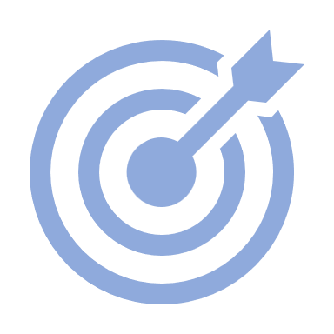

Agile vs Waterfall Approaches
Plan
Develop
Test
Final Outcome
Deploy
Classic/Traditional/Predictive/Waterfall Approach
Project Timeline
Agile/Incremental/Adaptive Approach
Iteration 1
Iteration 2
Iteration 3
………….
Iteration N
Develop
Test
Develop
Test
Develop
Test
Develop
Test
Plan
Deploy
Plan
Deploy
Plan
Deploy
Plan
Deploy
Intermediate Outcome
Intermediate Outcome
Intermediate Outcome
Final Outcome

Slide 7
Chapter
Hybrid
07
“something (such as a power plant, vehicle, or electronic circuit) that has two different types of components performing essentially the same function.”
Merriam-Webster Dictionary
www.midocean.ae

Slide 8
Chapter
Hybrid Project Management
07
Hybrid project management is a combination of two or more project management methodologies, such as waterfall and agile.
It is a flexible approach that allows teams to tailor their project management process to the specific needs of their project.
By blending the best features of the waterfall and agile methodologies, organizations can capitalize on the strengths of each approach while mitigating their weaknesses, and
Create a flexible and adaptable approach that is well-suited for a variety of projects.
www.midocean.ae

Slide 9
Chapter
Hybrid Project Management
07
“ The goal of project management is to produce business value in the best possible way given the current environment. It does not matter if that way is Agile or Predictive.
The question to ask is: How can we be most successful?”
Adapted from: Project Management Institute, Agile Practice Guide, Project Management Institute Inc., 2017, Page 29.
www.midocean.ae

Slide 10
The Need for Hybrid PM Methodologies (1/2)
Addressing Methodology Limitations
Traditional: Rigidity and limited adaptability
Agile: Potential lack of structure for certain projects
Flexibility in Project Adaptation
Projects have diverse characteristics and requirements
A one-size-fits-all approach may not be suitable
Tailored Solutions for Varied Projects
Hybrid approach combines the best of both worlds
Customizable to meet the specific needs of each project
Adaptability to Changing Requirements
Projects often face evolving priorities and scope
Hybrid model enables adjustments without compromising control

Slide 11
The Need for Hybrid PM Methodologies (2/2)
Efficient Resource Utilization
Optimizes resource allocation throughout the project lifecycle
Maximizes the benefits of both predictive and adaptive methodologies
Faster Response to Stakeholder Demands
Evolving stakeholder expectations require agile responses
Hybrid approach facilitates continuous communication and collaboration
Balancing Control and Flexibility
Provides structure while allowing for iterative development
Enables project managers to maintain control over project outcomes
Effective Management of Project Complexity
Suitable for projects with varying levels of uncertainty
Addresses challenges posed by dynamic project environments

Slide 12



When to use Hybrid PM Methodology
Projects with a mix of well-defined requirements and uncertain requirements
Complex projects
Projects with a High degree of Risk

Slide 13
Chapter
Hybrid Project Management Methods
07
www.midocean.ae

Slide 14
Chapter
1. Agile followed by Waterfall
07
Early processes utilize agile then followed by Waterfall.
Used when there is uncertainty, complexity, and risk in the earlier portion of the project, and then a more defined and repeatable portion of the project.
Ex. Developing a high-tech new product then rollout and train many users.
Agile Agile Agile
Waterfall Waterfall Waterfall
Adapted from: Project Management Institute, Agile Practice Guide, Project Management Institute Inc., 2017, Page 26.
www.midocean.ae

Slide 15
Chapter
2. Combined Agile and Waterfall Simultaneously
07
Most Used Hybrid method, used when incrementally transitioning from Waterfall to Agile.
Some Agile approaches like short iterations, daily standups, retrospectives, with other Waterfall aspects as upfront estimation, work assignment, and progress tracking.
Ex. Project planned as Waterfall for the whole project with each Work Package done in a Sprint Style and apply all sprint process tools and techniques.
Agile Agile Agile
Waterfall Waterfall Waterfall
Adapted from: Project Management Institute, Agile Practice Guide, Project Management Institute Inc., 2017, Page 26.
www.midocean.ae

Slide 16
Chapter
3. Largely Waterfall With Agile Components
07
Portions of the project with uncertainty, complexity, or unclear scope is being tackled in Agile, but the remainder is being managed using Waterfall approaches.
Ex. An engineering company that is building a facility, with one component of it using new material and technology not tested before.
Agile Agile Agile
Waterfall Waterfall Waterfall
Adapted from: Project Management Institute, Agile Practice Guide, Project Management Institute Inc., 2017, Page 27.
www.midocean.ae

Slide 17
Chapter
4. Largely Agile with Waterfall Components
07
Used when a particular element is non-negotiable or can’t be done using Agile approaches.
Ex. Integrating and external component developed by a different vendor that cannot partner in a collaborative and Agile way.
Waterfall Waterfall Waterfall
Agile Agile Agile
Adapted from: Project Management Institute, Agile Practice Guide, Project Management Institute Inc., 2017, Page 27.
www.midocean.ae

Slide 18
Comparing Hybrid vs. Agile vs. Waterfall
Element | Hybrid | Agile | Waterfall
Approach | Blends elements of traditional and Agile | Iterative and incremental | Sequential and linear
Flexibility | High | Very High | Low
Adaptability | High | Very High | Low
Documentation | Moderate | Minimal | Extensive
Stakeholder Engagement | Emphasized | High | Moderate
Iterative Development | Yes | Yes | No
Planning | Structured and adaptable | Adaptive and collaborative | Detailed and extensive
Risk Management | Balanced approach with risk mitigation | Emphasized | Addressed but less flexibility
Project Visibility | Moderate | High | Low
Recommended When | Projects with evolving requirements, high risk and complexity | Complex and uncertain projects | Well-defined and stable projects

Slide 19
Case Study: Achieving Stakeholder Expectations with a Hybrid Approach
Chapter
07
Background:
A large software development project aimed to create a new enterprise-level application for a multinational corporation. The project had complex requirements, involving multiple departments, stakeholders with diverse expectations, and a need for adaptability due to evolving industry standards.
Challenges:
Diverse Stakeholder Expectations: Stakeholders ranged from IT professionals to end-users, each with unique expectations. Traditional Waterfall approaches struggled to accommodate evolving demands and changes from various stakeholders.
Evolving Industry Standards: The industry was undergoing rapid changes, with new standards and technologies emerging during the project. Adapting to these changes was crucial to ensure the final product remained competitive and aligned with industry best practices.
Need for Structure and Predictability: The project required a structured approach to manage resources, timelines, and budgets. Stakeholders, particularly those from finance and project management, sought predictability in delivery schedules and costs.
www.midocean.ae

Slide 20
Case Study: Achieving Stakeholder Expectations with a Hybrid Approach
Chapter
07
Solution: The project adopted a hybrid methodology, incorporating structured planning elements from Waterfall and the adaptability of Agile.
  Structured Planning Phase: The project began with a comprehensive planning phase, where requirements were defined in detail. A project plan was established, providing stakeholders with a clear timeline, milestones, and resource allocation.
  Agile Iterations for Adaptability: Once the planning phase was completed, the development phase embraced Agile iterations. Regular sprints allowed for continuous feedback from stakeholders, ensuring that their evolving needs were addressed promptly.
  Frequent Stakeholder Engagement: Regular sprint reviews and demonstrations were conducted for stakeholders. This frequent engagement allowed stakeholders to visualize progress, provide feedback, and make necessary adjustments to the project scope.
  Real-Time Adjustments to Industry Changes: Agile's flexibility facilitated real-time adjustments to industry changes. As new standards emerged, the development team could adapt the project scope and features to align with the latest industry requirements.
www.midocean.ae

Slide 21
Case Study: Achieving Stakeholder Expectations with a Hybrid Approach
Chapter
07
Results:
Balanced Stakeholder Satisfaction: The hybrid approach allowed for a balance between the structured planning desired by some stakeholders and the adaptability required by others. Finance and project management stakeholders were reassured by the structured planning, while end-users appreciated the ability to influence the evolving product.
Timely Delivery of Industry-Compliant Product: The project remained on schedule despite industry changes. Agile iterations facilitated the timely integration of new standards and technologies, ensuring the final product was both up-to-date and delivered on time.
Enhanced Communication and Collaboration: The hybrid approach fostered improved communication and collaboration among stakeholders. Regular engagements and feedback sessions created a transparent and inclusive project environment.
Project Success and Continued Adaptation: The software was successfully launched and met stakeholder expectations. The hybrid methodology allowed the project team to adapt to post-launch feedback, ensuring ongoing success in the competitive market.
www.midocean.ae

Slide 22
How to implement Hybrid Project Management Methods
Chapter
07
www.midocean.ae

Slide 23
Chapter
As a PM you define the Hybrid Process!
07
“ In Hybrid Project Management, you as a Project Manager select the right processes, tools, and techniques to from the different methodologies and when and where to implement them in your project.”
Adapted from: Project Management Institute, Agile Practice Guide, Project Management Institute Inc., 2017, Page 29.
www.midocean.ae

Slide 24
Steps to Implement Hybrid Methodology
Assessment and Planning
Project Evaluation
Stakeholder Engagement
Communication Plan
Team Training and Development
Skills Assessment
Training Programs
Pilot Project Implementation
Select a Pilot
Evaluate and Adjust
Adaptation and Flexibility
Continuous Improvement
Effective Tool Utilization
Project Management Tools
Collaboration Platforms
Change Management Strategies
Addressing Resistance
Cultural Alignment
Monitoring and Reporting
Key Performance Indicators (KPIs)
Regular Reporting
Documentation and Knowledge Sharing, and Celebrating
Knowledge Sharing
Celebrate Success
Strategic Planning
Expectation Management
Feedback Mechanisms

Slide 25
Tools for Hybrid Project Management (1/2)
Project Management Tools
Example: Jira - facilitates project planning, tracking, and release management.
Collaboration Platforms
Enhance team communication and collaboration, enabling real-time information sharing.
Example: Microsoft Teams - fosters communication, file sharing, and virtual collaboration.
Task and Workflow Management
Tools for effective task and workflow management, ensuring project progress visibility.
Example: Trello - facilitates task tracking, prioritization, and team collaboration.
Communication and Documentation Tools
Tools facilitating clear communication and effective documentation for knowledge sharing.
Example: Confluence - supports collaborative documentation and information sharing.
Resource Allocation and Tracking
Support optimal resource allocation and tracking throughout the project lifecycle.
Example: Monday.com - offers resource management features and real-time project tracking.
Tools supporting both traditional and agile methodologies, ensuring integration.

Slide 26
Tools for Hybrid Project Management (2/2)
Integrated Reporting Systems
Reporting systems provide insights into project performance and key performance indicators (KPIs).
Example: Tableau - enables data visualization for analytics.
Version Control and Integration
Version control tools manage changes in project deliverables and ensure seamless integration.
Example: Git - facilitates version control and collaboration
Risk Management Software
Software aiding in identifying, assessing, and mitigating project risks with real-time updates.
Example: RiskWatch - supports comprehensive risk management
Agile Development Tools
Tools supporting agile practices and adapting to changing project requirements.
Example: VersionOne - an tool for planning and tracking agile projects.
User Training and Support Systems
Training for tools and provide ongoing support for optimized usage.
Example: Udemy - offers training courses.

Slide 27
Chapter
Benefits of using a Hybrid Methodology
07
Enhanced Flexibility
Allows adaptable project execution.
Adapts to changing project requirements.
Improved Collaboration
Facilitates stakeholder collaboration.
Enhances communication and goal alignment.
Efficient Risk Management
Integrates robust risk strategies.
Proactively identifies and mitigates risks.
Optimized Resource Utilization
Efficient allocation throughout the project lifecycle.
Maximizes benefits of predictive and adaptive methods.
Increased Transparency
Enhances visibility into project progress.
Facilitates clear communication and decision-making.
www.midocean.ae

Slide 28
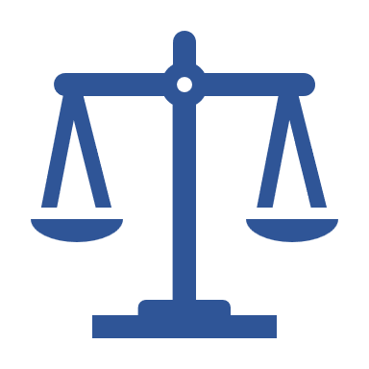
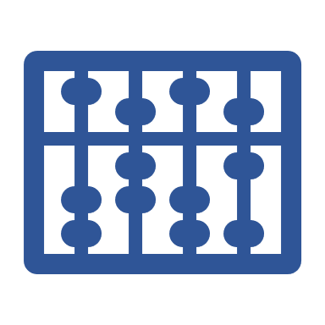
Challenges with Hybrid PM Methodology
Balancing Flexibility with Structure
It can be difficult to find the right balance between the flexibility of the agile methodology and the structure of the waterfall methodology.
Coordinating Multiple Methodologies
It can be challenging to coordinate multiple methodologies and ensure that the team is working together effectively.
Managing Expectations
It is important to manage the expectations of stakeholders and ensure that they understand the hybrid project management methodology and its implications.

Slide 29
Chapter
Enterprise Hybrid Methodologies
06
www.midocean.ae

Slide 30
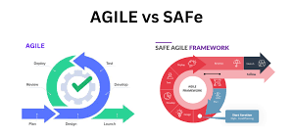
Chapter
SAFe ® Hybrid Framework
07
Many larger organizations and projects are not suited to get the benefits of Agile development.
Scaled Agile Framework (SAFe®) is a tool to help larger projects and enterprises implement Agile concepts.
Scaled Agile Framework SAFe® takes the concepts of agile development and provides a “larger picture” methodology that allows you to use agile approaches across programs, portfolios and an entire company.
www.midocean.ae

Slide 31
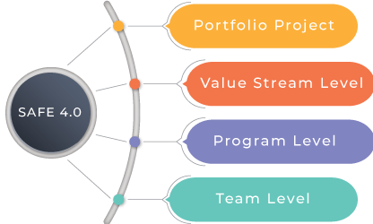
Chapter
SAFe ® Hybrid Framework
07
www.midocean.ae

Slide 32
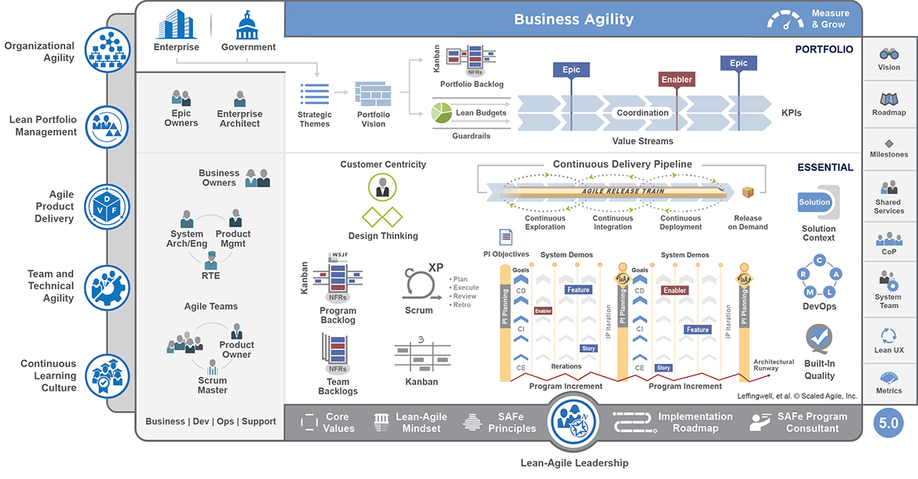
SAFe®

Slide 33
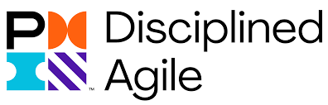
Chapter
Disciplined Agile® (DA™) Framework
07
Disciplined Agile (DA) is a hybrid tool kit that uses Agile, Lean, and traditional strategies to guide the best Way of Working (WoW) for a team or organization.
DA is context sensitive; rather than prescribing a collection of "best practices," it guides how to choose and evolve a fit-for-purpose WoW that is best for you given the situation you face.
The DA tool kit provides guidance to help organizations streamline their processes based on project needs, providing a solid foundation for business agility.
www.midocean.ae

Slide 34
Chapter
Disciplined Agile® (DA™) Framework
07
Four Layers
Foundation
Disciplined DevOps
Value Streams
Disciplined Agile Enterprise
www.midocean.ae

Slide 35
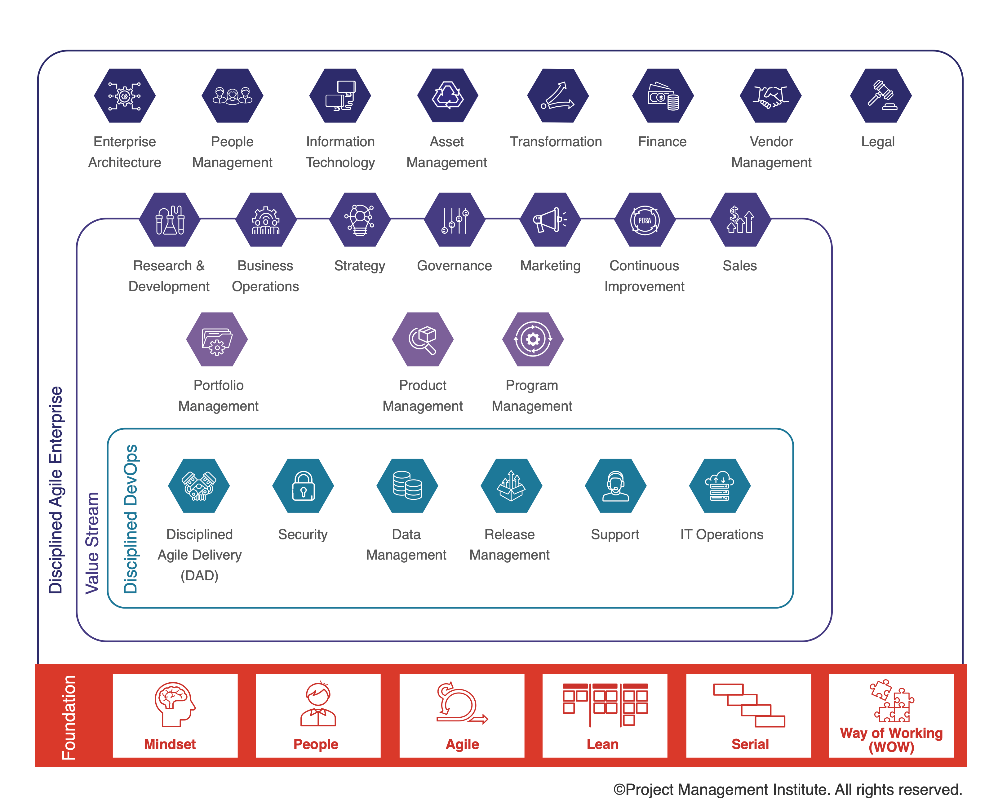
Disciplined Agile® (DA™) Framework

Slide 36
Chapter
Key Points
07
There are different methods for Hybrid PM
You customize your Hybrid methodology based on each project needs and requirements.
Hybrid PM brings more flexibility, better collaboration, more risk management, and efficient use of resources.
We can implement Hybrid and Agile on an enterprise level using SAFe® and DA™
Hybrid Methods bring the best of both worlds (Agile and Traditional) to your project.
www.midocean.ae

Slide 37

www.midocean.ae
Preparation for discussion panel:
Watch the VIDEO
“Hybrid Project Management – What is that?”
Question:
What benefits do you see in applying Hybrid Project Management?
Chapter
07
For Discussion Panel

Slide 38
www.midocean.ae
Before next lecture:
Monitoring and Controlling Agile Projects
Read the Article
“Risk Management in Agile: How To Control Risk In Agile”
Read the Article
“How to Manage Resources in Agile Project Management?”
Chapter
07
For Next Lecture

Slide 39


Thank You

