Slide 1




English Language 2
Samara Jasim
ENG102
Orientation

Slide 2


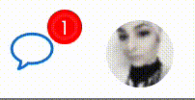



Who Am I?
Samara Jasim
  Lecturer: specialized in Teaching English as a Foreign Language Field
  Educational Consultant
  Sworn Translator
How to contact me?
    via email at samara@esu.ac.ae
    via Moodle messages

Slide 3
Course Details
This course aims to:
Develop basic skills to deal with people in business situations;
Increase knowledge of key business concepts worldwide;
Expand vocabulary related to general business situations; and
Develop confidence to deal with people and basic issues in the business world.

Slide 4


Learning Resources
Credit Hours:
5 credit hours.
  Required Textbook:
  Market Leader, Course Book, Pre-Intermediate, by Pearson
  Market Leader, Practice Book, Pre-Intermediate, by Pearson
  Essential References:
1. A Dictionary

Slide 5
What is this course about?
  Market Leader is a multi-level business English course for businesspeople and students of business English. It has been developed in association with the Financial Times, one of the leading sources of business information in the world. It consists of 12 units based on topics of great interest to everyone involved in international business.

Slide 6
Course Content
Course Unit | No.of. Weeks | Contact Hours
Unit 1: Careers | 2nd | 5
Unit 2: Companies | 3rd | 5
Unit 3: Selling | 4th | 5
Unit 4: Great Ideas | 5th | 5
Unit 5: Stress | 6th | 5
Unit 6: Entertaining | 7th | 5
Unit 7: New Business | 8th | 5
Unit 8: Marketing | 9th | 5
Unit 9: Planning | 10th | 5
Unit 10: Managing People | 11th | 5

Slide 7
Assessment Tools
  Multiple Choice, T&F, Matching, Arranging, Audio Questions
  80% marks
    10 weekly quizzes (open on Saturdays, at 22:00 ksa and close next Saturday at 21:00 ksa)
    The duration of each quiz is (24 minutes only = 3 minutes for each question)
    8 Marks for each of short exam.
    8 questions
  20% Final Examination

Slide 8

Assessment Tools

Slide 9
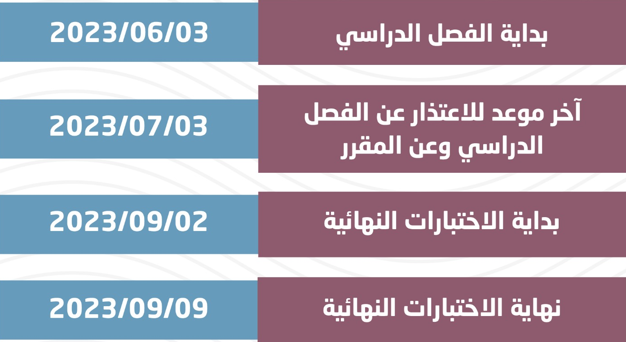
Academic Calendar

Slide 10
Academic Calendar

Slide 11
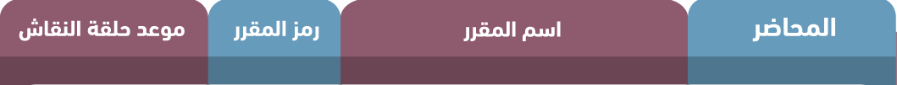
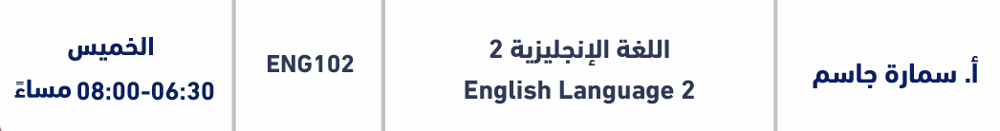
Academic Calendar

Slide 12
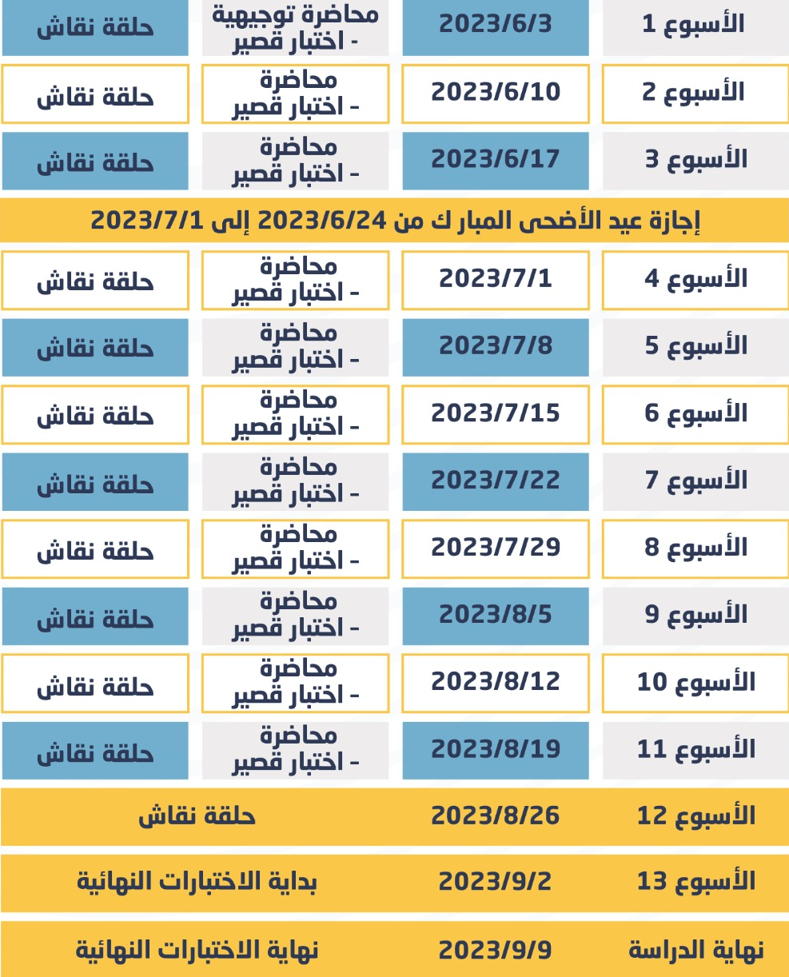
Academic Calendar

Slide 13

Thank You

