Slide 1

Project Financial Management
Prepared by
Dr. Walaa Mohamed
Lecture 8
Everyone’s Smart
University
PMG 615
Financial Modeling and Evaluation (part three)

Slide 2

Objectives of this lecture
This lecture covers:
- Loan drawings and debt service
Debt cover ratios
Sensitivity analysis
Investor analysis

Slide 3
LOAN DRAWINGS AND DEBT SERVICE
During the construction period the model takes into account:
The required ratio between equity and debt
The priority of drawing between equity and debt
Any limitations on the use of debt (e.g., ECA loans to be used only for exported equipment, or costs in one currency to be funded by loans in that currency)
and having done so calculates:
  A drawdown schedule for both equity and debt;
Drawings on the debt give rise to interest payments (IDC), which also need to be funded.
Important note:
Debt drawdown involves gradually issuing funds rather than releasing the entire amount at once. By slowly drawing down the debt, lenders can verify that funds are not misspent before providing more money.

Slide 4
LOAN DRAWINGS AND DEBT SERVICE
During the operating period the model takes into account:
  Priorities for allocation of net operating cash ﬂow
  Allocation of cash for debt repayment
  Calculation of interest payments, allowing for hedging contracts

Slide 5
DEBT: EQUITY RATIO
As already discussed, a high ratio of debt is the essence of project ﬁnance. Within prudent limits, therefore, Sponsors wish to limit the amount of equity they invest in a project, to improve their own return, and thus to raise the maximum level of debt.
Once the maximum level of debt a project can raise has been determined, the difference between this ﬁgure and project costs in principle determines the amount of equity acquired (although some of the gap may be ﬁlled with mezzanine debt or public-sector grants.

Slide 6
1.1 LEVEL OF DEBT
Two factors determine the level of debt that can be raised for a project:
Lender’s cash ﬂow cover requirements. There is obviously a fundamental difference between a project with a Project Agreement that provides reasonable certainty of revenues and hence cash ﬂow cover for debt service and a project such as a merchant power plant selling into a competitive and comparatively unpredictable market with no form of hedging of the revenue risks; it is evident that the latter type of project cannot raise the same level of debt as the former.
Similarly, a project in a high-risk country cannot raise as much debt as the same project in a low-risk country, because the lenders will consider the cash ﬂow less certain, even if it is contracted through a Project Agreement.

Slide 7
1.1 LEVEL OF DEBT (continued)
The certainty of the cash ﬂow affects the level of cash ﬂow cover that the lenders wish to have: the less certain the lenders consider the cash ﬂow to be, the higher the cover ratio they will require.

Slide 8
1.1 LEVEL OF DEBT (continued)
Lenders’ views on leverage. Lenders also have views about the debt: equity ratio that is appropriate for particular types of project, e.g.:
90 : 10 for an infrastructure project with a Project Agreement with no usage risk (e.g., a public hospital or prison)
85 : 15 for a power or process plant project with an Offtake Contract
80 : 20 for an infrastructure project with usage risk (e.g., a toll road or mass transit project)
70 : 30 for a natural resources project
50 : 50 for a merchant power plant project with no Offtake Contract or price hedging

Slide 9
1.2 DEBT COVER RATIOS
The level of debt that can be raised for a project is based primarily on its projected ability to pay interest and repay loan principal installments as they fall due, with a comfortable margin of safety. To assess this margin of safety, lenders calculate cover ratios, namely:
    Annual debt service cover ratio (ADSCR)
    Loan life cover ratio (LLCR)
    The project life cover ratio (PLCR), or the Reserve Cover Ratio for a natural resources project

Slide 10
1. DEBT: EQUITY RATIO
1.2 DEBT COVER RATIOS (continued)
It should be noted that none of these cover ratios can be calculated for a period before the Project Company begins operating, as they all deal with the relationship between operating cash ﬂow and the level of debt or debt service requirements.

Slide 11
1.2 DEBT COVER RATIOS (continued)
1.2.1 Annual debt service cover ratio (ADSCR):
The ADSCR assesses the Project Company’s ability to service its debt from its annual cash ﬂow, and is calculated as:
Operating cash ﬂow of the project over the year—i.e., operating revenues less operating expenses— taking account of any Maintenance Reserve Account (The reserve account of cash balances set aside to cover a project's maintenance and repair expenses )or similar Reserve Accounts covering anything other than debt service, and ignoring any noncash items such as depreciation.
divided by
  Debt service of the project over the year— i.e., interest payments and principal repayments, ignoring transfers to or from Reserve Accounts for debt service.
Thus, if operating cash ﬂow for the year is 120, interest payments are 55, and loan repayments are 45, the ADSCR would be 1.2: 1 (120 ÷ (55 + 45)).

Slide 12
1.2 DEBT COVER RATIOS (continued)
1.2.1 Annual debt service cover ratio (ADSCR) continued:
From the perspective of the lender, higher DSCRs are preferable because they indicate that the borrower has ample financial resources with which to repay their loan.
In their initial Base Case projections, the lenders look at the projected ADSCR for each period throughout the term of the loan and check that this does not fall below their required minimum at any time. The actual ADSCRs are reviewed (and projections may be recalculated) once the project is in operation.

Slide 13
1.2 DEBT COVER RATIOS (continued)
1.2.1 Annual debt service cover ratio (ADSCR) continued:
The minimum ADSCR requirement obviously varies between projects, but very approximate levels for standard projects could be:
  1.2 : 1 for an infrastructure project with a Project Agreement with no usage risk (e.g., a public hospital or prison)
  1.3 : 1 for a power or process plant project with an Offtake Contract
  1.4 : 1 for an infrastructure project with usage risk (e.g., a toll road or mass transit project)
    1.5 : 1 for a natural resources project
    2.0 : 1 for a merchant power plant project with no Offtake Contract or price hedging
Higher cover levels would be required for a project with nonstandard risks, or located in a country with a poor credit risk.

Slide 14
1.2 DEBT COVER RATIOS (continued)
1.2.1 Annual debt service cover ratio (ADSCR) continued:
It should be noted that, unlike in corporate loans, the cash ﬂow cover ratio for annual interest (as opposed to total debt service) is not generally considered a signiﬁcant measurement. This is because corporate loans are often renewed from year to year, whereas project ﬁnance loans have to be repaid because the project has a ﬁnite life; therefore, the Project Company must be able to reduce its debt each year as scheduled, and payment of interest alone is generally not adequate.

Slide 15
LOAN DRAWINGS AND DEBT SERVICE
1. DEBT: EQUITY RATIO
1.2 DEBT COVER RATIOS (continued)
1.2.1 Annual debt service cover ratio (ADSCR) continued:
If you know the following information about project A
Operating revenue= $ 1,000,000
Operating expenses= $ 700,000
Interest payment= $ 50,000
Loan (principle) repayment = $ 40,000
Calculate Annual debt service cover ratio (ADSCR)

Slide 16
1.2 DEBT COVER RATIOS (continued)
1.2.2 LOAN LIFE COVER RATIO:
The LLCR is based on a similar calculation, but taken over the whole term of the loan:
Projected operating cash ﬂow (calculated as for the ADSCR), from the date on which the project is projected to begin operations, to the date on which the loan is repaid, discounted to its NPV at the same interest rate as that assumed for the debt (taking account of any interest swap or other hedging)
divided by
Debt outstanding on the calculation date, less the balance of debt-related Reserve Accounts
The minimum initial LLCR requirement in Base Case projections for “standard” projects is around 10% higher than the ﬁgures shown above for minimum ADSCR.

Slide 17
1.2 DEBT COVER RATIOS (continued)
1.2.2 LOAN LIFE COVER RATIO:
LLCR is a useful measure for the initial assessment of a project’s ability to service its debt as a whole and for continuing to look at it over its remaining life, but clearly it is not so useful if there are likely to be signiﬁcant cash ﬂow ﬂuctuations from year to year. ADSCR is thus a more signiﬁcant measure of a Project Company’s ability to service its debt as it falls due.

Slide 18
1.2 DEBT COVER RATIOS (continued)
1.2.2 PROJECT LIFE COVER RATIO:
Another point that lenders check is whether the project has capacity to make repayments after the original ﬁnal maturity of the debt, in case there have been difﬁculties in repaying all of the debt in time. This extra debt service capacity is known as the “tail,” and lenders normally expect at least a year or two of cash ﬂow cover in this way. The tail can be based on:
  The general ability of the Project Company to keep operating and so generating cash after the loan term (in any case the technical life of the project should be signiﬁcantly longer than the loan term)
  The existence of Input Supply and Offtake Contracts, or a Concession Agreement, which speciﬁcally ensure that the Project Company will continue to operate

Slide 19
1.2 DEBT COVER RATIOS (continued)
1.2.2 PROJECT LIFE COVER RATIO:
The value to lenders of the tail can be calculated using the PLCR; here the net cash ﬂow before debt service for the whole life of the project (not just the term of the debt as for the LLCR) is discounted to its NPV, and this ﬁgure is divided by the debt outstanding. Obviously the PLCR will be higher than the LLCR; lenders may wish to see it around 15 –20% higher than the minimum ADSCR.

Slide 20
CALCULATING COVER RATIOS
Table 12.9 sets out cover ratio calculations for a typical project, with:
    An even annual cash ﬂow before debt service of 220
    1000 loan, repaid in equal annual principal installments over 10 years
    Interest rate on the loan of 10% p.a. (= NPV discount rate)
If it is assumed that the project generates 200 p.a. of cash for a further 3 years after the end of the loan (i.e., years 11–13), the NPV of the total 12 year cash ﬂow is 1499, and so the initial PLCR is 1.50 :1 (1499 ÷ 1000).

Slide 21
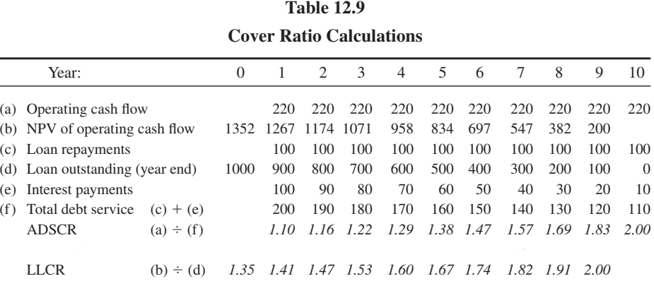

Slide 22
THE BASE CASE AND CHANGES IN ASSUMPTIONS
Once the lenders and Sponsors agree that the ﬁnancial model’s structure and calculation formulae reﬂect the project and its contracts correctly, the basic input assumptions are settled, and the ﬁnancial structure and terms are agreed to and also incorporated in the model, the ﬁnal run of the model on this basis is known as the “Base Case” or “banking case.” This ﬁnal calculation usually takes place just before signing or Financial Close, to enable the lenders to check that, using fully up-to-date assumptions and the ﬁnal versions of the Project Con- tracts, the project still provides them with adequate coverage for their loan.
But the project does not stand still thereafter, and lenders continue to review their exposure. As will be seen, adverse changes in ADSCR or LLCR in the future may affect the ability of the Project Company to pay dividends to the investors, or even put the Project Company into default on the loan. However, if a new projection is to be calculated once the project is under way, someone has to decide how the input assumptions previously used should be changed. If the Project Company is left to decide the assumptions, the lenders may not agree and vice versa.

Slide 23
THE BASE CASE AND CHANGES IN ASSUMPTIONS
There is no simple answer to this problem, but as far as possible it is usually best to use objective rather than subjective sources for revising projections where this is possible, e.g.:
  Macroeconomic assumptions (including commodity prices) can be based on an economic review published by one of the lenders or another outside source, so long as this is a general publication, not speciﬁc to the project.
  Changes in operating or revenue assumptions should generally be based on the actual performance of the Project Company.
  Lenders usually have the greatest weight in the ﬁnal decision on the assumption changes, but where possible investors should ensure that these decisions are based on and are required to follow speciﬁc advice from the Lenders’ Engineer, market, insurance, or other advisers, who should have expertise on the issues involved, rather than leaving it to an arbitrary decision by the lenders.

Slide 24
SENSITIVITY ANALYSIS
The ﬁnancial model also needs to be sufﬁciently ﬂexible to allow both investors and lenders to calculate a series of “sensitivities” (also known as “cases”) showing the effects of variations in the key input assumptions in the Base Case when initially reviewing the project. Such sensitivities may include calculating the effect on cover ratios and returns of:
    Construction cost overrun (usually based on a full drawing of the contingency funding)
    Payment of the LDs under the EPC Contract to cover delays or failure of the project to perform as speciﬁed
    Delay in completion (say for 6 months) without LDs from the EPC Contractor
    Reduction in performance without LDs from the EPC Contractor
    Higher downtime or lower availability
    Reduced volume of sales or usage of the project
    Reduced sale prices

Slide 25
SENSITIVITY ANALYSIS
Such sensitivities may include calculating the effect on cover ratios and returns of (continued):
    Breakeven sales prices
    Higher input costs
    Higher operating costs
    Higher interest rates (where these are not yet ﬁxed)
    Exchange rate movements
In summary, the sensitivities look at the ﬁnancial effect of the commercial and ﬁnancial risk aspects of the project not working out as originally expected.
Lenders also usually run a “combined downside case” to check the effects of several adverse things happening at once (e.g., 3 months’ delay in completion, a 10% drop in sale prices, and 10% more downtime). This calculation of several different things happening at once is also called “scenario analysis.”

Slide 26
What is Scenario Analysis?
Scenario analysis is a process of examining and evaluating possible events or scenarios that could take place in the future and predicting the various feasible results or possible outcomes. In financial modeling, the process is typically used to estimate changes in the value of a business or cash flow, especially when there are potentially favorable and unfavorable events that could impact the company.
Managers typically start with three basic scenarios:
Base case scenario – It is the average scenario, based on management assumptions. An example – when calculating the net present value, the rates most likely to be used are the discount rate, cash flow growth rate, or tax rate.
Worst case scenario – Considers the most serious or severe outcome that may happen in a given situation. An example – when calculating the net present value, one would take the highest possible discount rate and subtract the possible cash flow growth rate or the highest expected tax rate.
Best case scenario – It is the ideal projected scenario and is almost always put into action by management to achieve their objectives. An example – when calculating the net present value, use the lowest possible discount rate, the highest possible growth rate, and the lowest possible tax rate.

Slide 27
INVESTORS’ ANALYSIS
Investors usually aim at a minimum level of equity IRR, which may vary according to when they come into the project. A resale of equity when the project is complete and operating successfully may give the original investors an opportunity for a quicker realization of value in their investment.
1. INVESTORS’ RETURNS
Investors usually have “hurdle rates” for the IRR on their equity (equity IRR), above which an investment is acceptable, and below which it is not. The hurdle rates are generally ﬁxed based on:
    The investor’s cost of capital (based on the investor’s own mixture of equity and debt), which is also used as the discount rate for an NPV calculation on the investment
    The additional return over cost of capital required for particular types of risk (e.g., type of project, location, extent to which risks are hedged by Project Agreements, extent to which the investment adds to or diminishes the spread of risk in the investor’s portfolio, etc.)

Slide 28
INVESTORS’ ANALYSIS
A hurdle rate is the minimum rate of return on a project or investment required by a manager or investor. It allows companies to make important decisions on whether or not to pursue a specific project. The hurdle rate describes the appropriate compensation for the level of risk present—riskier projects generally have higher hurdle rates than those with less risk.

Slide 29
INVESTORS’ ANALYSIS
1. INVESTORS’ RETURNS (continued)
Setting a required return for the risk based on the Project Company’s equity IRR may be circular in nature, because the equity IRR is dependent on the level of gearing, which is itself dependent on the risk: but it is common practice nonetheless.
Equity IRRs in projects with moderate risk, such as a power project with a PPA, or an infrastructure project with limited usage risk, tend to be in the range of 12 – 20% (pretax, and as a nominal basis, i.e., including inﬂation in the cash ﬂow projections). This is relatively low compared to returns on other types of new equity investment, reﬂecting the lower level of risk: in fact, the returns obtained are akin to a return on subordinated or mezzanine debt rather than a true “equity” return. Market rates for equity IRRs have developed in industries where projects are frequently put out to investors for bidding by governments or Offtakers, such as power generation and public infrastructure.
Investors may require their investment to show a positive NPV, and to achieve a minimum payback period in addition to meeting an IRR hurdle.

Slide 30
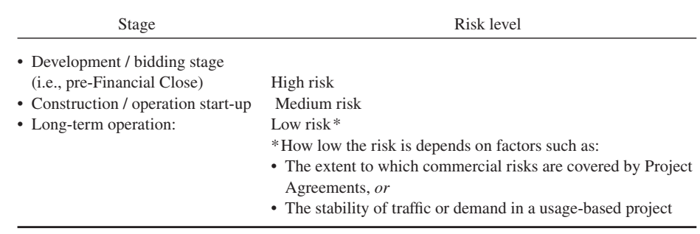
INVESTORS’ ANALYSIS
2. TIMING OF EQUITY COMMITMENT
The return required by investors also varies depending on when they come into the project. Investors come into projects at different stages and with different in- vestment strategies. Any project has various different levels of risk over time:

Slide 31
INVESTORS’ ANALYSIS
2. TIMING OF EQUITY COMMITMENT (continued)
If the project develops successfully, the equity IRR required by new investors therefore declines as it passes through these various stages.
A Sponsor developing a project who brings in another Sponsor to commit the required balance of the equity shortly before Financial Close expects to be compensated for having assumed the highest risk. This can be achieved by requiring the new Sponsor to pay a premium for its shares (a higher price per share than that paid by the original Sponsor), or crediting the original Sponsor with a notional high rate of interest on cash already spent on the project, which is taken into account when calculating each Sponsor’s share of development costs, and allocating shares based on this.

Slide 32
INVESTORS’ ANALYSIS
2. TIMING OF EQUITY COMMITMENT (continued)
As an alternative to selling equity at a premium, the original Sponsor may take money out of the project by charging the Project Company a development fee, which is usually payable at Financial Close. This is in effect an early return on in- vestment, which, since it is funded as part of the project development costs, is partly ﬁnanced by the lenders. A development fee can thus be used as an alternative way for one Sponsor to compensate another for taking the development risk. Development fees may be contentious with lenders, but can be acceptable, pro- vided that the original Sponsor’s real cash investment has not been effectively reduced to an unacceptably low level by doing this, and obviously also provided that the project can support the corresponding increase in debt.

Slide 33
INVESTORS’ ANALYSIS
2. EQUITY RESALE
Another investor may not be willing or able to sustain the high level of costs and risks in the development and construction stages of the project, but may buy shares in the Project Company from the original investors when the project is completed and operating smoothly, at a higher price that reﬂects the lower equity IRR now acceptable because of the reduction in risk.
A sale of part or all of their equity investment when the project is complete and operating successfully is likely to offer Sponsors and other original investors a chance for a signiﬁcant improvement in their originally projected return. Indeed, to achieve their return objectives, some investors such as project ﬁnance investment funds may depend on a proﬁtable sale of their equity at this stage of the project’s life.

Slide 34

Reference:
Principles of Project Finance
By:E.R. Yescombe
First edition
This lecture taken from chapter 12 & 13

