Slide 1


Financial Accounting
Prepared by Dr. Emad Zaher
Assistant Professor of Accounting
MGM611
Lecture (7)
Financial Analysis

Slide 2

Chapter Outline
  Learning Objectives
LO 1 Apply horizontal and vertical analysis to financial statements.
LO 2 Analyze a company’s performance using ratio analysis.
LO 3 Apply the concept of sustainable income.

Slide 3
Basics of Financial Statement Analysis
Apply horizontal and vertical analysis to financial statements.
Characteristics
Comparison
Bases
Tools of
Analysis
Liquidity
Profitability
Solvency
Intracompany
Industry averages
Intercompany
Horizontal
Vertical
Ratio
Prepared by Dr. Emad Zaher

Slide 4
Horizontal Analysis
Horizontal analysis, also called trend analysis, is a technique for evaluating a series of financial statement data over a period of time.
  Purpose is to determine the increase or decrease.
  Commonly applied to the
    statement of financial position,
    income statement, and
    statement of retained earnings.
Prepared by Dr. Emad Zaher

Slide 5
Prepared by Dr. Emad Zaher

Slide 6
$12,000 – $23,500 = $(11,500)
Notes:
For the dollar change in cash, subtract the base year amount of $23,500 from the current year amount of $12,000 to determine the change in cash was a negative $11,500.

Slide 7
($11,500 ÷ $23,500) × 100% = 48.94%
Complete the analysis for the other assets.
Prepared by Dr. Emad Zaher

Slide 9
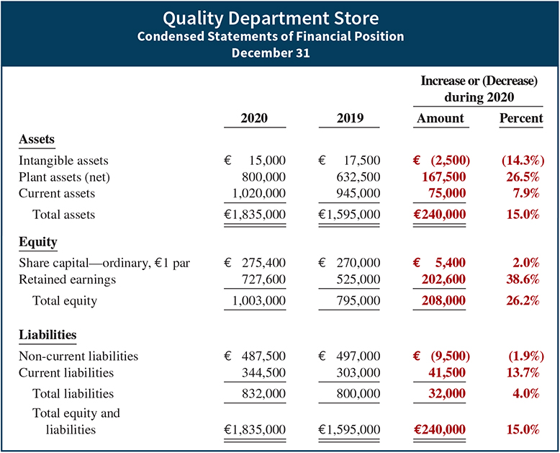
Horizontal Analysis
Illustration 18.5
Horizontal analysis of
statements of financial position
Changes suggest that the company expanded its asset base during 2020 and financed this expansion primarily by retaining income rather than assuming additional long-term debt.
Prepared by Dr. Emad Zaher

Slide 10
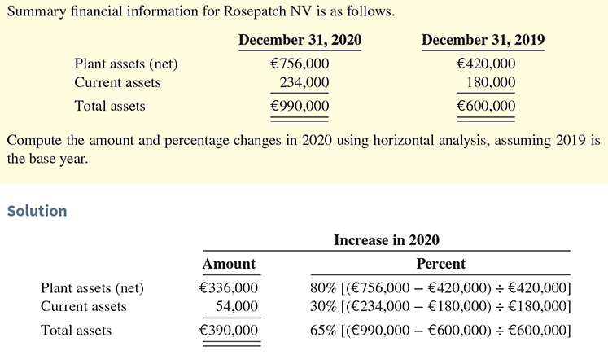
DO IT! 1 Horizontal Analysis

Slide 11
Vertical Analysis
Vertical analysis, also called common-size analysis, is a technique that expresses each financial statement item as a percent of a base amount (see Decision Tools).
  On an income statement, we might say that selling expenses are 16% of net sales.
  Vertical analysis is commonly applied to the
    statement of financial position and
    income statement.
Prepared by Dr. Emad Zaher

Slide 12
($12,000 ÷ $315,000) × 100% = 3.8%
($23,500 ÷ $289,700) × 100% = 8.1%
Notes:
This slide shows the asset section of Clover Incorporated’s comparative balance sheets. All line-items on this financial statement should be expressed in terms of total assets. Total assets are equal to 100%.
Let’s calculate the percentage of total assets made up of cash and cash equivalents. Divide the total cash and cash equivalents for 2007 by the total assets for 2007, and multiply the result by 100%. At the end of 2007, cash and cash equivalents make up 3.8% of total assets. The same measure shows the percentage for 2006 to be 8.1%.
Try to calculate the percent of total assets for accounts receivable and inventory before going to the next screen.

Slide 13
Notes:
The completed computations are shown. How did you do? Accounts receivable makes up 19% of total assets in 2007, and 13.8% in 2006. There has been a drop in total current assets and an increase in property and equipment from 2006 to 2007.

Slide 14
Prepared by Dr. Emad Zaher

Slide 15
Notes:
Let’s go back to the comparative income statements of Clover Incorporated and complete our component calculations.
All line-items on the income statement will be expressed as a percent of total sales. Begin by setting total sales equal to 100%.
Determine the cost of goods sold percentages. For 2007, divide cost of goods sold of $360,000 by sales of $520,000 and multiply by 100%. For 2007, cost of goods sold was 69.2% of total sales.
Before moving on, calculate the gross margin percent for each year as well as the percentages for the other line items.

Slide 16
Ratio Analysis
Ratio analysis expresses the relationship among selected items of financial statement data.
Financial Ratio Classifications
Liquidity
Profitability
Solvency
Measures short-term ability of the company to pay its maturing obligations and to meet unexpected needs for cash.
Measures the income or operating success of a company for a given period of time.
Measures the ability of the company to survive over a long period of time.
Prepared by Dr. Emad Zaher

Slide 17
Ratio Analysis
Liquidity Ratios
Measure the short-term ability of the company to pay its maturing obligations and to meet unexpected needs for cash.
  Short-term creditors such as bankers and suppliers are particularly interested in assessing liquidity.
  Ratios include the current ratio, the acid-test ratio, accounts receivable turnover, and inventory turnover.
Prepared by Dr. Emad Zaher

Slide 18
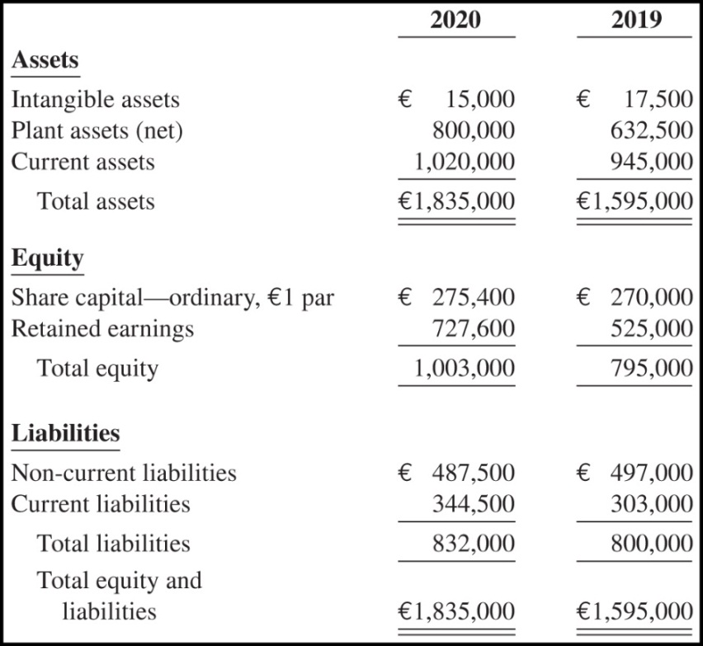
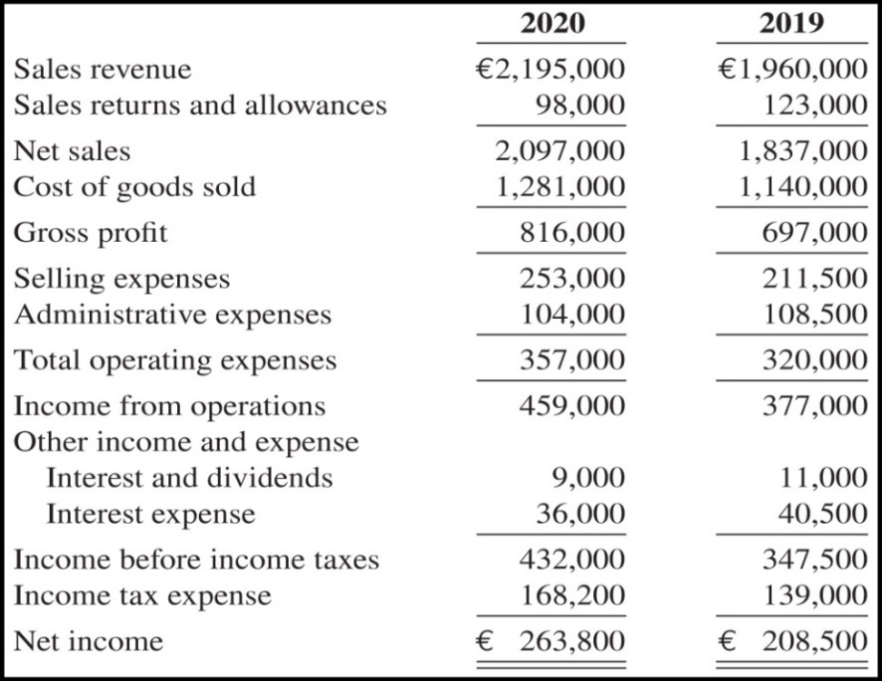
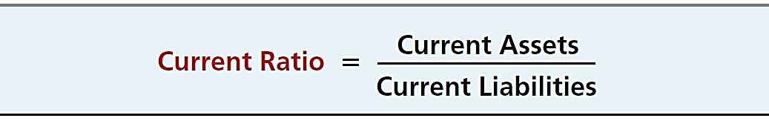

QUALITY DEPARTMENT STORE
Statement of Financial Position
QUALITY DEPARTMENT STORE
Condensed Income Statements
For the Years Ended December 31

Slide 19
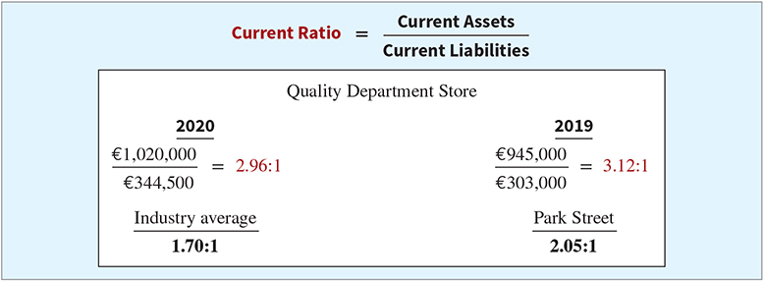
Ratio Analysis
Liquidity Ratios
1. CURRENT RATIO
Ratio of 2.96:1 means that for every euro of current liabilities, Quality has €2.96 of current assets.

Slide 20
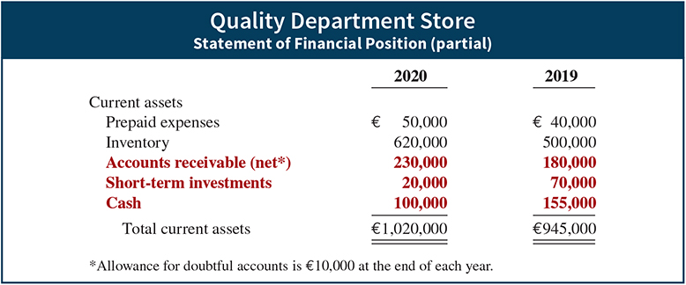
Ratio Analysis
Liquidity Ratios
2. ACID-TEST RATIO

Slide 21
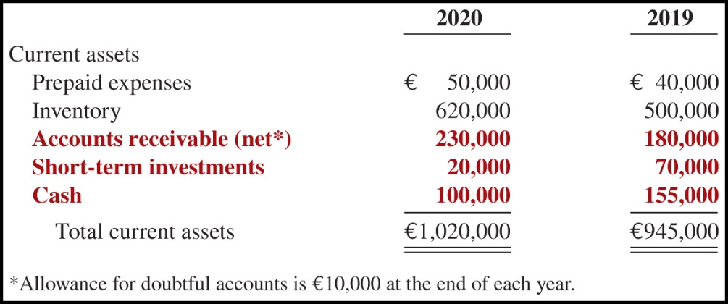
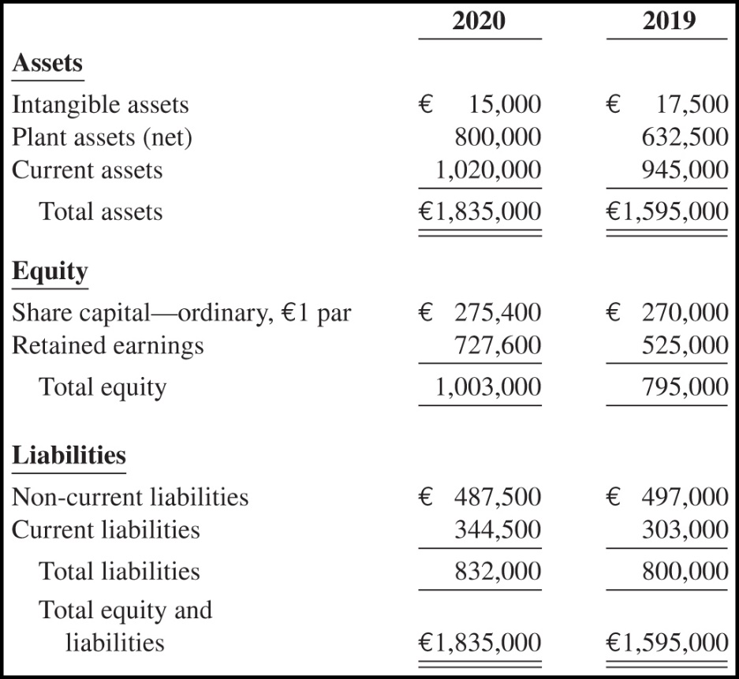
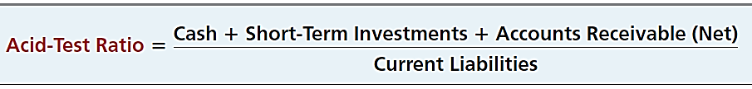
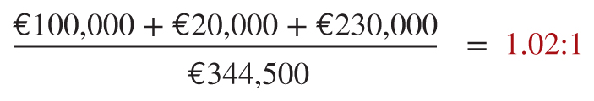
QUALITY DEPARTMENT STORE
Statement of Financial Position
QUALITY DEPARTMENT STORE
Statement of Financial Position
Illustration 14-12

Slide 22
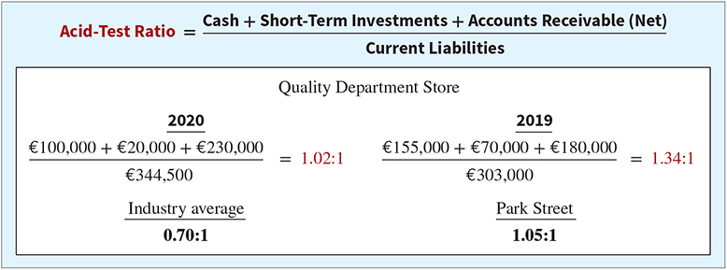
Ratio Analysis
Liquidity Ratios
2. ACID-TEST RATIO
Acid-test ratio measures immediate liquidity.

Slide 23
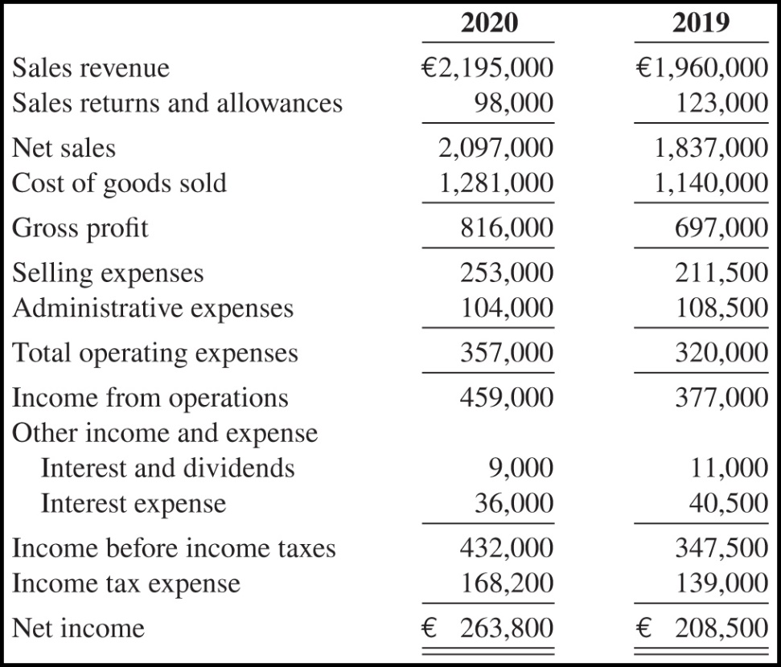

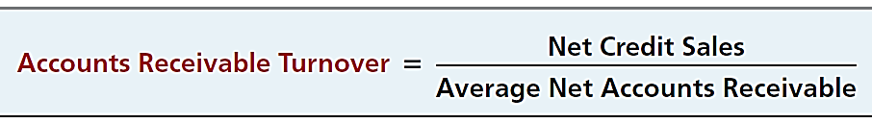
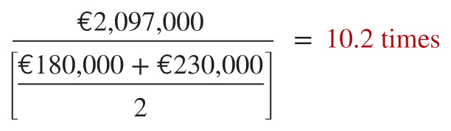
QUALITY DEPARTMENT STORE
Condensed Income Statements
For the Years Ended December 31
QUALITY DEPARTMENT STORE
Statement of Financial Position

Slide 24
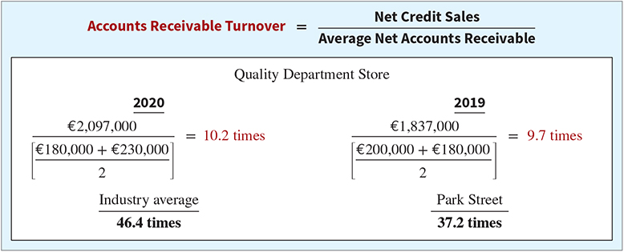
Ratio Analysis
Liquidity Ratios
3. ACCOUNTS RECEIVABLE TURNOVER
Measures the number of times, on average, the company collects receivables during the period.

Slide 25
Ratio Analysis
Liquidity Ratios
3. ACCOUNTS RECEIVABLE TURNOVER
€2,097,000
= 10.2 times
(€180,000 + €230,000) / 2
A variant of the accounts receivable turnover ratio is to convert it to an average collection period in terms of days.
365 days / 10.2 times = every 35.78 days
Accounts receivable are collected on average every 36 days.

Slide 26


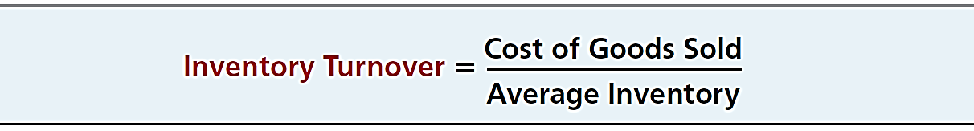
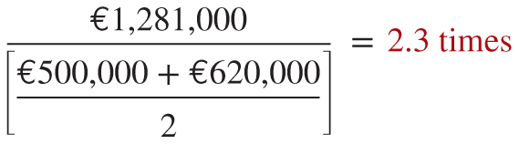
QUALITY DEPARTMENT STORE
Condensed Income Statements
For the Years Ended December 31
QUALITY DEPARTMENT STORE
Statement of Financial Position
Illustration 14-12

Slide 27
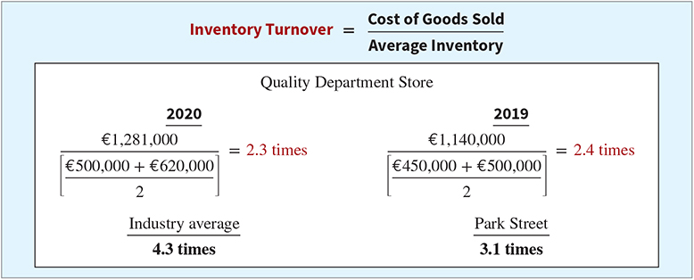
Ratio Analysis
Liquidity Ratios
4. INVENTORY TURNOVER
Measures the number of times, on average, the inventory is sold during the period.

Slide 28
Ratio Analysis
Liquidity Ratios
4. INVENTORY TURNOVER
€1,281,000
= 2.3 times
(€500,000 + €620,000) / 2
A variant of inventory turnover is the days in inventory.
365 days / 2.3 times = every 159 days
Inventory turnover ratios vary considerably among industries.
Prepared by Dr. Emad Zaher

Slide 29
Ratio Analysis
Profitability Ratios
Measure the income or operating success of a company for a given period of time.
  Income affects the company’s ability to obtain debt and equity financing, their liquidity position, and their ability to grow.
  Ratios include the profit margin, asset turnover, return on assets, return on ordinary shareholders’ equity, earnings per share, price-earnings ratio, and payout ratio.
Prepared by Dr. Emad Zaher

Slide 30
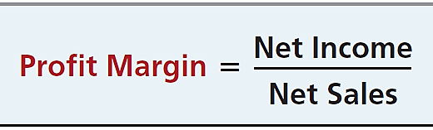
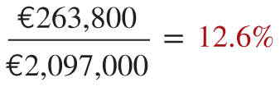
QUALITY DEPARTMENT STORE
Condensed Income Statements
For the Years Ended December 31
QUALITY DEPARTMENT STORE
Condensed Statements of Financial Position

Slide 31
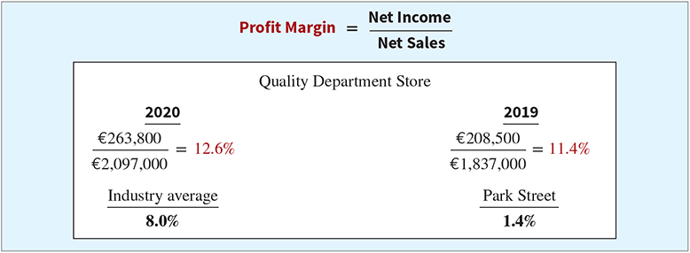
Ratio Analysis
Profitability Ratios
5. PROFIT MARGIN
Measures the percentage of each euro of sales that results in net income.

Slide 32
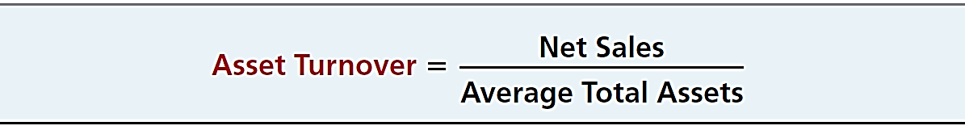
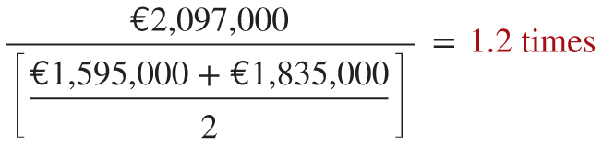
QUALITY DEPARTMENT STORE
Condensed Income Statements
For the Years Ended December 31
QUALITY DEPARTMENT STORE
Condensed Statements of Financial Position
Illustration 14-12

Slide 33
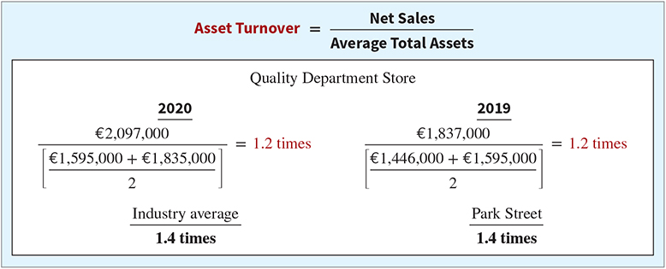
Ratio Analysis
Profitability Ratios
6. ASSET TURNOVER
Measures how efficiently a company uses its assets to generate sales.

Slide 34
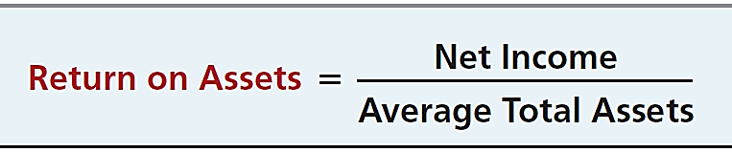
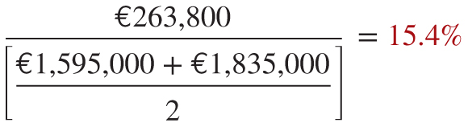
QUALITY DEPARTMENT STORE
Condensed Income Statements
For the Years Ended December 31
QUALITY DEPARTMENT STORE
Condensed Statements of Financial Position
Illustration 14-12

Slide 35
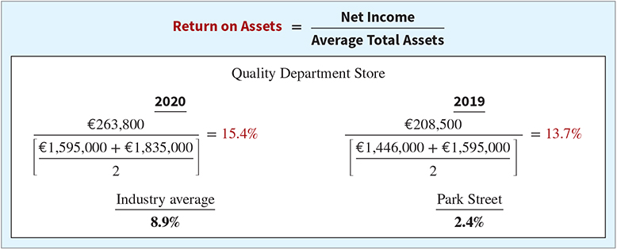
Ratio Analysis
Profitability Ratios
7. RETURN ON ASSETS
An overall measure of profitability.

Slide 36
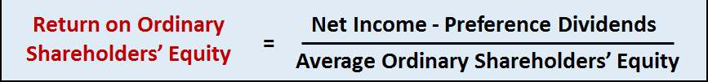
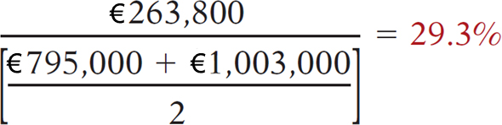
QUALITY DEPARTMENT STORE
Condensed Statements of Financial Position
QUALITY DEPARTMENT STORE
Condensed Income Statements
For the Years Ended December 31
Illustration 14-12

Slide 37
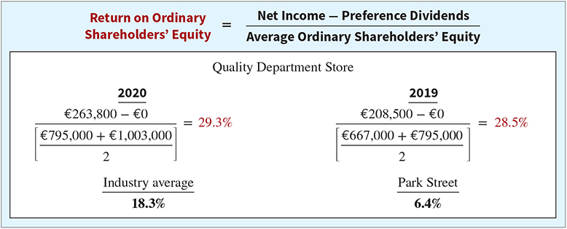
Ratio Analysis
Profitability Ratios
8. RETURN ON ORDINARY SHAREHOLDERS’ EQUITY
Shows how many euros of net income the company earned for each euro invested by the owners.

Slide 38
Ratio Analysis
Profitability Ratios
8. RETURN ON ORDINARY SHAREHOLDERS’ EQUITY
With Preference Shares
  Deduct preferred dividend from net income.
Prepared by Dr. Emad Zaher

Slide 39

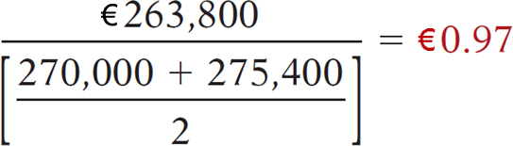
QUALITY DEPARTMENT STORE
Condensed Statements of Financial Position
QUALITY DEPARTMENT STORE
Condensed Income Statements
For the Years Ended December 31
Illustration 14-12

Slide 40
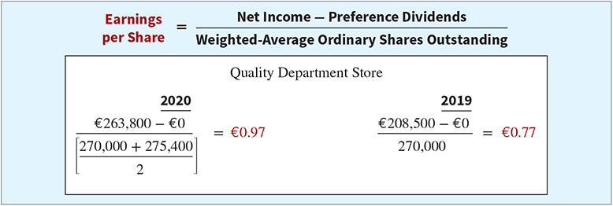
Ratio Analysis
Profitability Ratios
9. EARNINGS PER SHARE (EPS)
A measure of the net income earned on each ordinary share.

Slide 41
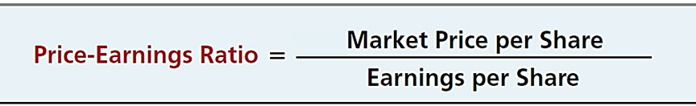
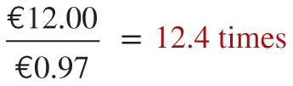
QUALITY DEPARTMENT STORE
Condensed Statements of Financial Position
QUALITY DEPARTMENT STORE
Condensed Income Statements
For the Years Ended December 31
Illustration 14-12

Slide 42
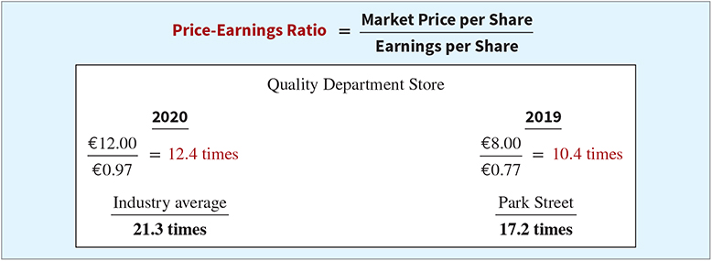
Ratio Analysis
Profitability Ratios
10. PRICE-EARNINGS RATIO
Reflects investors’ assessments of a company’s future earnings.

Slide 43
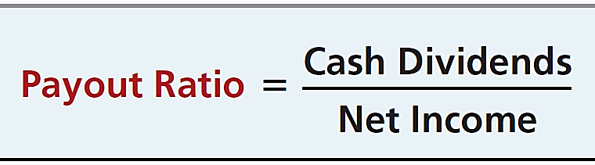
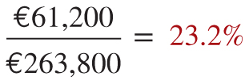
QUALITY DEPARTMENT STORE
Condensed Statements of Financial Position
QUALITY DEPARTMENT STORE
Condensed Income Statements
For the Years Ended December 31
Illustration 14-12

Slide 44
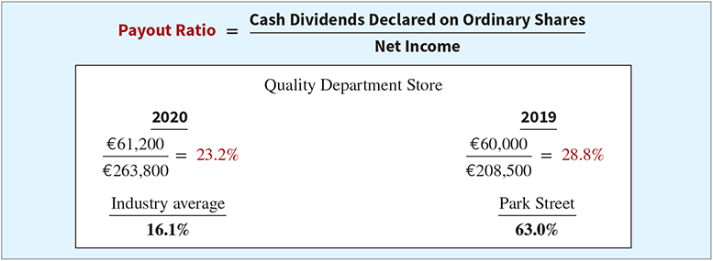
Ratio Analysis
Profitability Ratios
11. PAYOUT RATIO
Measures the percentage of earnings distributed in the form of cash dividends.

Slide 45
Ratio Analysis
Solvency Ratios
Solvency ratios measure the ability of a company to survive over a long period of time.
  Debt to Assets and
  Times Interest Earned
  are two ratios that provide information about debt-paying ability.
Prepared by Dr. Emad Zaher

Slide 46
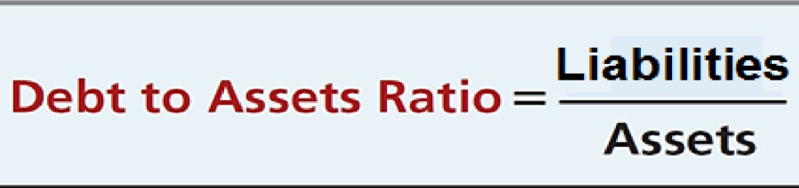
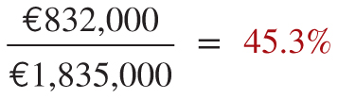
QUALITY DEPARTMENT STORE
Condensed Statements of Financial Position
QUALITY DEPARTMENT STORE
Condensed Income Statements
For the Years Ended December 31
Illustration 14-12

Slide 47
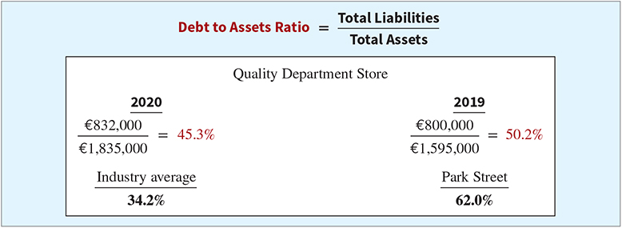
Ratio Analysis
Solvency Ratios
12. DEBT TO TOTAL ASSETS RATIO
Measures the percentage of the total assets that creditors provide.

Slide 48
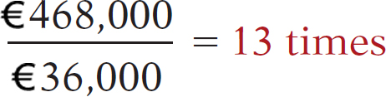
QUALITY DEPARTMENT STORE
Condensed Statements of Financial Position
QUALITY DEPARTMENT STORE
Condensed Income Statements
For the Years Ended December 31
Illustration 14-12

Slide 49
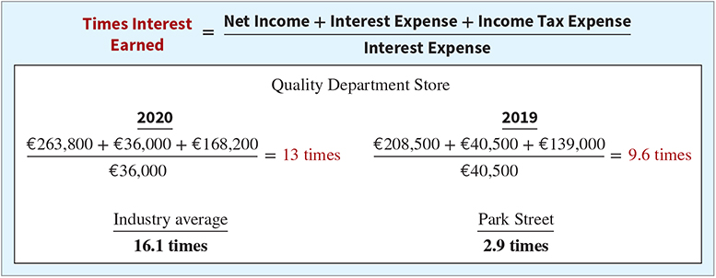
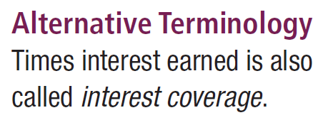
Ratio Analysis
Solvency Ratios
13. TIMES INTEREST EARNED
Provides an indication of the company’s ability to meet interest payments as they come due.

Slide 50
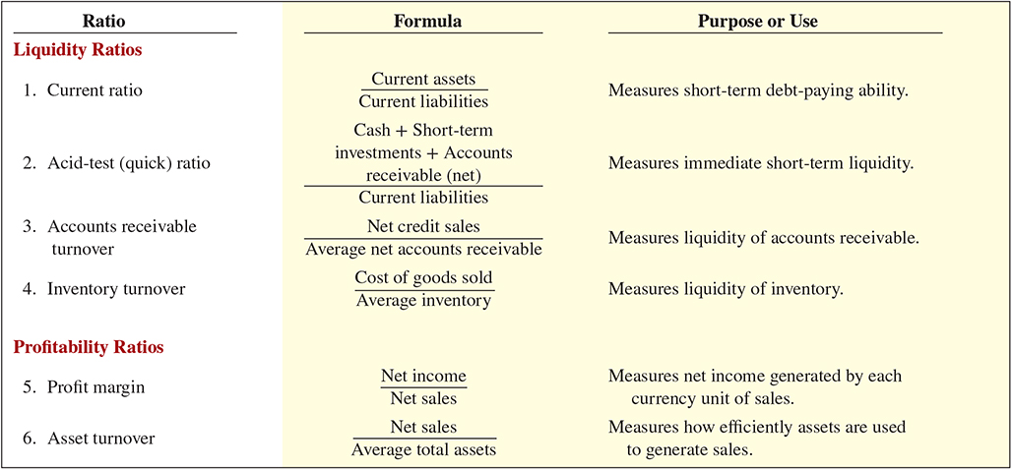
Ratio Analysis
Summary of Ratios
Prepared by Dr. Emad Zaher

Slide 51
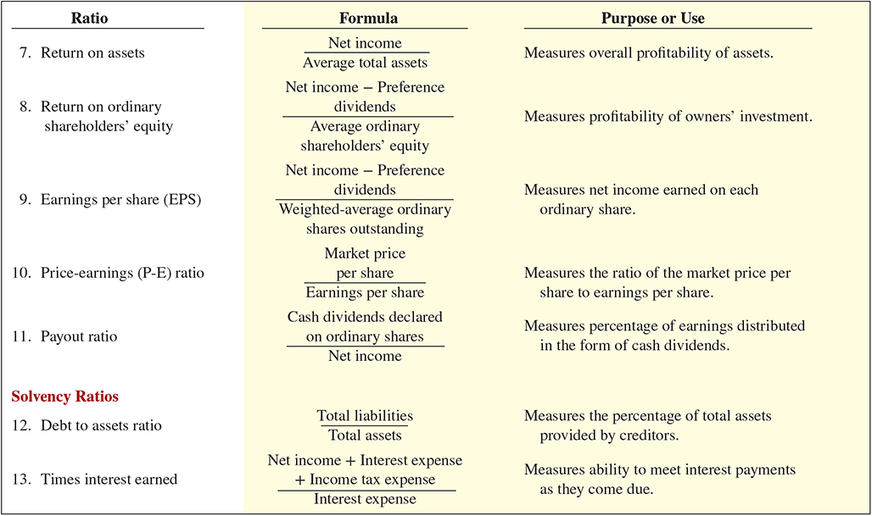
Summary of Ratios
Prepared by Dr. Emad Zaher

Slide 52



Thank You

