Slide 1


Research Plan
Prepared by Dr. Fayez Jrad
Content of Research Proposal
(RPC001)
Lecture 01 Part B

Slide 2



Research Plan
Lecture 01 Part B
(PMG (RPC001)
Content of Research Proposal
Prepared by
Dr. Fayez Jrad
www.midocean.ae

Slide 3
Chapter
Contents
02
The concept and objectives of the Research Proposal
The stages of the research process
Research Proposal components:
Research Title
Introduction
Research problem
The importance of the research
Research Hypotheses
www.midocean.ae

Slide 4
Contents
Literature Review
Research Methodology
Research Structure
Research limits
Initial reference list
www.midocean.ae

Slide 5
Learning objectives and skills
By the end of this chapter, you will be able to understand the following knowledge:
Research plan concept and objectives
Formulating Research Objectives and their importance
Concept and types of Research Hypotheses
The stages of the Research Process
Drafting the title of the search
Writing and summarizing Previous Studies
Formulation of the Problem Statement and Research Questions
The importance of defining the research method
www.midocean.ae

Slide 6
Learning objectives and skills
By the end of this chapter, you will possess the following Skills:
The ability to acquire the skills necessary to formulate the research title.
The ability to define the Problem Statement.
The ability to formulate The Research Questions and Hypotheses.
The ability to formulate the Research Objectives and the Importance of the Study.
The ability to write the Literature review of the study.
The ability to formulate the limits of the study.
The ability to create the General Structure of the Research Framework.
www.midocean.ae

Slide 7
The Objectives of the Research Proposal
The research plan is the broad line guiding the researcher when conducting his study. It is a written proposal prepared by the researcher, which reflects the researcher’s perceptions about the Research Problem and how to Address and Solve it.
أهمية وجود خطة بحث تتضمن الأهداف والأساليب والخطوات المحددة تكمن في توجيه الباحث بشكل موجه نحو تحقيق الأهداف المحددة للبحث. فهي تساعد على تنظيم عملية البحث، وتحديد السلوكيات اللازمة لتحقيق النتائج المرجوة. كما تسهل عملية متابعة تقدم البحث وتحديد أي تعديلات يجب إجراؤها أثناء العمل على البحث.
www.midocean.ae

Slide 8
- The research plan represents the future preconceived notion of the Methodology to implement the research in terms of the data collection method, the scientific method used, how to address and analyze the problem, and how to present the results.
Accordingly, the research plan represents steps and rules the researcher adheres to during the research process.
www.midocean.ae

Slide 9
- Every scientific research must be preceded by a clear research plan prepared by the researcher with the guidance of his academic supervisor.
- Many researchers face difficulties in preparing their research plans, and this chapter deals with the steps for preparing the research in detail with examples from some research carried out in the field of administrative sciences.
www.midocean.ae

Slide 10
The Topic and Objectives of the Research Proposal
- The topic has to be essential and contemporary and has yet to be addressed by previous researchers.
- The research topic is realistic and convincing.
- The researcher must be able to use the tools of scientific research
- The researcher's familiarity with the necessary knowledge about the research field.
www.midocean.ae

Slide 11
The Components' of the Research Proposal
Research Title.
Introduction.
Research problem.
The importance and objectives of the research.
Research Hypotheses.
Literature review.
Research Methodology.
Research limits.
The General Perception of the Research Structure.
Initial reference list.
www.midocean.ae

Slide 12
1. Research Title
A good research title should reflect three points:
1. Research content in a few expressive words.
2. Ability to attract the reader's attention.
3. Distinguish the research topic.
www.midocean.ae

Slide 13
1. Research Title
Research title tips:
Simple, concise and attractive.
Using Expressive words and keywords.
Avoid unnecessary excitement or exaggeration.
Avoid using abbreviations.
Take your time to specify the full title of the research after you have identified the problem. ,
www.midocean.ae

Slide 14

Research Title
Recommended
Field
أثر التدريب في رفع مستوى أداء العاملين: دراسة تطبيقية على مطاعم الوجبات السريعة
Research Title
التدريب وأداء العاملين
أثر اتخاذ القرارات الإدارية على رضا العاملين والعملاء: دراسة تطبيقية على قطاع المصارف بالمملكة العربية السعودية
رضا العاملين والعملاء
www.midocean.ae

Slide 15
Research Title Examples
كفاءة الاسواق المالية وإمكانية التكامل بين دول مجلس التعاون لدول الخليج العربي.
أثر خصائص الوظيفة على الالتزام التنظيمي للعاملين في القطاع الحكومي للمملكة العربية السعودية.
أثر جودة لجان المراجعة على مستوى الافصاح الاختياري بشركات المساهمة السعودية.
The Effect Of Brande-Marketing On The Brand’s Equity By Application On The Egyptian Business Faculties.
Investigating Performance Outcomes under Institutional Pressures and Environmental Orientation Motivated Green Supply Chain Management Practices.
www.midocean.ae

Slide 16
2. The Introduction
The primary purpose of the introduction in the research proposal is to give a general background about the research problem.
The introduction includes:
A general introduction to the phenomenon to be studied.
Highlighting the researcher's motives for taking up the research topic.
Briefly describe the main issues and sub-problems to be addressed in the research.
Statement of the relevance of the topic and the research problem to the general topic of the intended field of science
www.midocean.ae

Slide 17
3. Research Problem
It’s a general question followed by a set of sub-questions that clarify the different aspects of the study problem.
Unrecommended when defining the Research problem:
Choosing a broad, general problem.
Choosing the first problem that comes to the researcher’s mind.
To Stick to a limited problem.
Hesitation and wasting time without settling on a specific research problem.
Lack of clarity in the formulation of the research problem.
www.midocean.ae

Slide 18
Why should the research problem be identified?
To guide the search path and not deviate from its objectives.
To Clarify the scientific and practical importance of the topic under study.
It helps the researcher in formulating the study hypotheses.
It helps the researcher to identify the Research Limitations.
www.midocean.ae

Slide 19
How is the research topic chosen?
Sources for selecting the research point:
Work environment and work experience
wide readings
Literature Review
Assigned by someone
www.midocean.ae

Slide 20
Criteria for choosing a Research Topic:
Researcher's interest
Scientific value
Innovative research
Possibility to complete the research (time and funding)
Compatibility with the degree awarding body
Availability of data
It does not conflict with security and the country’s national interest.
Not inconsistent with ethical standards.
www.midocean.ae

Slide 21
Formulating the Research Problem:
Declarative form: a declarative sentence
Example: "The research problem is that there are shortcomings in the field of manpower planning in the government sector in the Arab Republic of Egypt.“
مثال: "تتمثل المشكلة البحثية في وجود قصور في مجال تخطيط القوى العاملة بالقطاع الحكومي في جمهورية مصر العربية".
www.midocean.ae

Slide 22
Formulating Research Problem & Questions:
The problem is formulated in a set of questions or in the form of a general question from which several sub-questions fall.
Example: To what extent do material and moral incentives contribute to improving the performance of employees of the Ministry of Education in the Sultanate of Oman?
مثال: السؤال المحوري: إلى أي مدى تسهم الحوافز المادية والمعنوية في تحسين أداء موظفي وزارة التربية والتعليم
www.midocean.ae

Slide 23
Sub-questions:
What are the most important material incentives offered to employees of the Ministry of Education in the Sultanate of Oman?
What is the effect of material incentives on improving the performance of employees of the Ministry of Education in the Sultanate of Oman?
What are the moral incentives offered to employees of the Ministry of Education in the Sultanate of Oman?
What is the effect of moral incentives on improving the performance of employees of the Ministry of Education in the Sultanate of Oman?
www.midocean.ae

Slide 24
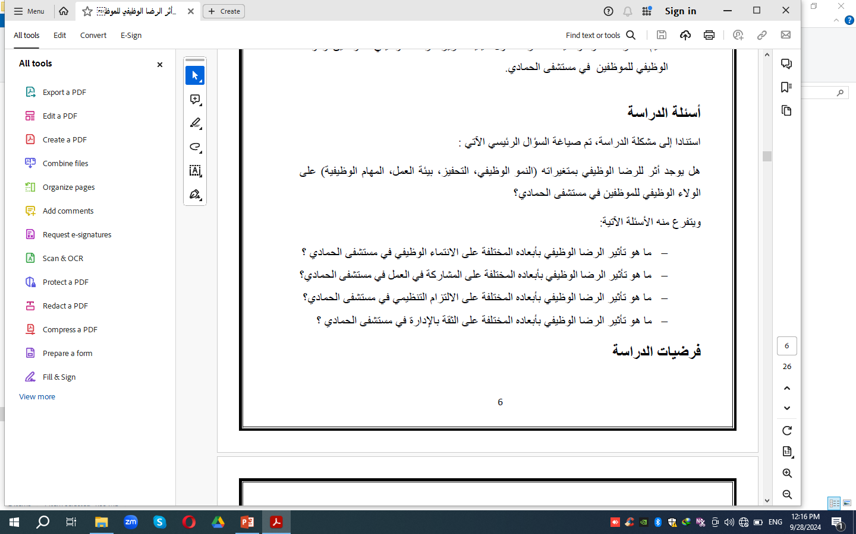
السؤال المحوري:
إلى أي مدى تسهم الحوافز المادية والمعنوية في تحسين أداء موظفي وزارة التربية والتعليم في سلطنة عمان؟
التساؤلات الفرعية:
  ما هي أهم الحوافز المادية التي تقدم للعاملين بوزارة التربية والتعليم بسلطنة عمان؟
  ما هو اثر الحوافز المادية في تحسين أداء العاملين بوزارة التربية والتعليم بسلطنة عمان؟
  ما هي الحوافز المعنوية التي تقدم للعاملين في وزارة التربية والتعليم بسلطنة عمان؟
  ما هو اثر الحوافز المعنوية في تحسين أداء العاملين بوزارة التربية والتعليم بسلطنة عمان؟
www.midocean.ae

Slide 25
4. Importance & Objectives of Research
Research Objectives
The objectives answer the researcher's question to himself: Why is this study conducted?
Specific
  Measurable
SMART
Achievable
  Realistic
Timely
www.midocean.ae

Slide 26
4. Importance & Objectives of Research
An example of writing the objectives and importance of the study:
The objectives of the study are as follows:
To Identify the most important material incentives offered to employees of the Ministry of Education in the Sultanate of Oman.
To Identify the impact of the material incentives offered to the employees of the Ministry of Education in the Sultanate of Oman.
www.midocean.ae

Slide 27
An example of writing the objectives of study:
  ما هي أهم الحوافز المادية التي تقدم للعاملين بوزارة التربية والتعليم بسلطنة عمان؟
  ما هو اثر الحوافز المادية في تحسين أداء العاملين بوزارة التربية والتعليم بسلطنة عمان؟
  مثال على كتابة أهداف وأهمية الدراسة:
  تتمثل أهداف الدراسة فيما يلي:
  التعرف على أهم الحوافز المادية التي تقدم للعاملين بوزارة التربية والتعليم بسلطنة عمان.
  التعرف على مدى تأثير الحوافز المادية التي تقدم للعاملين بوزارة التربية والتعليم بسلطنة عمان.
www.midocean.ae

Slide 28
4. Importance & Objectives of Research
The Importance of the Study:
- The importance of the topic compared to other topics.
- The importance of research for different segments of society.
- Theoretical significance.
- Practical importance.
www.midocean.ae

Slide 29



Slide 30
4. Importance & Objectives of Research
The researcher must take into consideration, when writing the objectives and importance of the research, some points, including:
Both of them should be related to the research topic.
To write the objectives of his study first and then its importance.
Choose expressions that suggest humility when expressing the importance of the study, such as “the current study may be useful in ………” or “the study may be useful in ……….”
www.midocean.ae

Slide 31
5. Research Hypotheses
A research hypothesis is a statement of expectation or prediction that will be tested by research.
Following are some hints for the formulation of your hypothesis:
- Be sure to read on the topic to familiarize yourself with it before making a final decision. It would be best if you made sure that the topic is researchable in an interdisciplinary sense, meaning that there is sufficient published material on the topic in the legal literature and in the literature.
www.midocean.ae

Slide 32
5. Research Hypotheses
As noted, a research hypothesis is more than just a topic. It has two elements (variables) that are in relation to each other.
Remember that within the word "hypothesis" is the word "thesis." Your hypothesis is what you propose to “prove” by your research.
As a result of your research, you will arrive at a conclusion, a theory, or an understanding that will be useful or applicable beyond the research itself.
www.midocean.ae

Slide 33

5. Research Hypotheses
- Your hypothesis must involve an issue or question that cannot be answered exclusively by only one discipline. Please limit your inquiry to the pieces of literature of 2 or 3 disciplines. Choosing a hypothesis where you are already familiar with the disciplines most relevant to the topic is best.
www.midocean.ae

Slide 34
5. Research Hypotheses
Avoid judgmental words in your hypothesis. Value judgments are subjective and are not appropriate for a hypothesis. You should strive to be objective. Therefore, the use of personal opinion should be avoided.
Be Sure each term in your hypothesis is clearly understood and defined.
Know that your hypothesis may change over time as your research progresses.
www.midocean.ae

Slide 35
5. Research Hypotheses
Characteristics of a reasonable hypothesis:
The reasonableness of the assumption
Verifiable
The ability to explain the phenomenon studied
The hypothesis is wholly or partially consistent with the relevant theories
The simplicity of the assumptions
Possibility to confirm
www.midocean.ae

Slide 36
5. Research Hypotheses
Sources of Hypotheses:
Researcher's’ experience
Specialties
- The resemblance between the phenomenon.
- Observations from past studies, present-day experiences, and from competitors.
- Scientific theories.
- General patterns that influence people’s thinking process.
www.midocean.ae

Slide 37
5. Research Hypotheses
Types of hypotheses:
Simple Hypothesis
It shows a relationship between one dependent variable and a single independent variable. For example – If you eat more vegetables, you will lose weight faster. Eating more vegetables is independent while losing weight is the dependent variable.
www.midocean.ae

Slide 38
5. Research Hypotheses
Descriptive hypothesis:
It deals with one variable:
Example: The consumer is deceived by the advertisements that he is exposed to in various advertising means.
مثال: يتعرض المستهلك للخداع من خلال الإعلانات التي يتعرض لها في مختلف الوسائل الإعلانية.
www.midocean.ae

Slide 39
5. Research Hypotheses
Correlational hypothesis:
It expresses the existence of a relationship between two variables without specifying the direction of this relationship, that is, without specifying who caused the other.
Example: There is a relationship between product quality and achieved sales volume.
مثال: هناك علاقة بين جودة المنتج وحجم المبيعات المتحقق.
www.midocean.ae

Slide 40
5. Research Hypotheses
Causal hypothesis:
It states a causal relationship between the two variables, and therefore, it shows the direction of the relationship between them.
Example: Increasing product quality increases the number of customers gained
مثال: تؤدي زيادة جودة المنتج إلى زيادة عدد العملاء المكتسبين
www.midocean.ae

Slide 41
5. Research Hypotheses
Null Hypothesis: The null hypothesis assumes no relationship between the two variables, as opposed to the alternative hypothesis, which assumes a positive or negative relationship between the two variables.
Example:
• The null hypothesis: There is no significant relationship between the sex of the worker and his level of productivity.
• The alternative hypothesis: There is a significant relationship between the sex of the worker and the level of his productivity.
www.midocean.ae

Slide 42
5. Research Hypotheses
General notes on the formulation of hypotheses
1. The hypotheses of the study can be one hypothesis or several.
2. It is recommended that the hypothesis not be long or complex
3. Hypothesis is testable and verifiable
4. Determining the questions of the study before developing hypotheses.
5. The development of study hypotheses takes place before the start of the study and data collection.
6. Knowledge and experience are needed in hypothesis formulation.
www.midocean.ae

Slide 43
6. Previous Studies
Previous Studies are one of the most important parts of Scientific Research, and there is no complete Scientific Research without containing previous studies.
Previous studies are identified as all the previous research that has tackled the topic in which the researcher is digging through discussion and studying. Whenever a researcher is on to a certain subject essential
www.midocean.ae

Slide 44
6. Previous Studies
The researcher will need to get back to these previous studies, analyze them, study them properly, and then identify the similarities and differences between them and his research.
It generally occupies the second section of the framework of scientific research.
The previous studies also help the researcher avoid repeating the already studied areas and never fall into the same mistakes that other researchers committed.
www.midocean.ae

Slide 45
6. Previous Studies
The previous studies contribute to the enhancement and enrichment of scientific research and provide the researcher with solid ground and substantial information about the research being done. This is how the researcher should be acquainted with all the information related to their research.
www.midocean.ae

Slide 46
6. Previous Studies
It is also important to mention the mutual points between the research and the previous studies, plus stating the significant trends of the other researchers and the ways they followed in the previous studies. And to state whether these studies have found a solution for the described problems or not.
www.midocean.ae

Slide 47
6. Previous Studies
Several terms should be taken into consideration, which are:
Refer only to the primary sources and avoid the marginal ones.
Making sure that the information is correct and from confidential sources such as precise scientific magazines.
Displaying only the parts convenient to the scientific research content, not the whole study.
Displaying the ideas in a precise and swift manner.
www.midocean.ae

Slide 48
6. Previous Studies
The inclusion of previous studies in the study plan achieves some objectives:
- Emphasizing that the chosen study's problem has not been addressed before, or it has been addressed without sufficient depth and detail.
- Previous studies help the researcher formulate the study’s objectives in light of the summary of previous studies.
- Benefit from previous researchers' experiences in formulating questions and hypotheses of the study and the scientific method used in these studies.
www.midocean.ae

Slide 49
7. Research Methodology
- Determine the research method to be used
- Determine the sources of data acquisition
- Determine the study population and sample type
www.midocean.ae

Slide 50
8. Research Limitation
The limitations of a study are its flaws or shortcomings which could be the result of the unavailability of resources, small sample size, flawed methodology, etc.
No study is completely flawless or inclusive of all possible aspects. Therefore, listing the limitations of your research reflects honesty and transparency and shows that you have a complete understanding of the topic.
www.midocean.ae

Slide 51
8. Research Limitation
The three limits of Scientific Research:
Temporal Limits
Spatial Limits
Objective Boundaries
www.midocean.ae

Slide 52
9. Research Structure
It includes chapters and sections that will be covered by the study in addressing the researcher's topic.
The general structure of the search is shown in the form of main points or titles of chapters and sections only
www.midocean.ae

Slide 53
10. Research References
It contains all the sources and references he benefited from and referred to in preparing his plan.
It is possible to add another group of references more closely related to the subject of the research to reassure the researcher himself, the supervisor of the study, and the research plan discussion committee that a sufficient number of references are initially available.
www.midocean.ae

Slide 54



Thank You

