Slide 1


DIGITAL MARKETING STRATEGY
Prepared by Dr. Heba Ziad
Digital Marketing Strategy
COURSE CODE –MKT711
Introduction lecture

Slide 2



DIGITAL MARKETING STRATEGY
Introduction lecture
COURSE CODE –MKT711
Prepared by
Dr. Heba Ziad
www.midocean.ae

Slide 3

Course outline
Course description
Learning outcomes
Chapters
Parts of course
References
Assessment
www.midocean.ae

Slide 4
This course aims to introduce students to the basic concepts, role and importance OF digital marketing strategy that support digital marketing Implementation, this course also aims to understand the Marketing Strategy in the Digital Age and Recognize Current and emerging technologies that support Digital Marketing Strategy: An Integrated Approach to Online Marketing.
Course Description
www.midocean.ae

Slide 5
At the end of this course, the student will be able to:
DEVELOPING DIGITAL MARKETING STRATEGIES
INTEGRATING DIGITAL INTO WIDER ORGANIZATION STRATEGY
BARRIERS, CONSIDERATIONS AND DATA PROTECTION IN DIGITAL MARKETING STRATEGY
FIND THE TECHNOLOGY THAT WILL BEST SUPPORT DIGITAL MARKETING STRATEGY IN DIFFERENT ECOSYSTEM
LEARN ABOUT THE INTEGRATING DIGITAL CHANGE INTO YOUR WIDER ORGANIZATION
RECOGNIZE USING CHANNEL STRATEGY TO REACH YOUR CUSTOMERS
EXAMINE CRTICAL STRATEGIC ISSUES BY COLLECTING COMPLEX STRATEGIC INFORMATION
REALISE MARKETING AUTOMATION, MESSAGING AND EMAIL MARKETING -
UNDERSTAND CONVERSION, RETENTION AND MEASUREMENT
DELIVERING AND PUTTING TOGETHER YOUR DIGITAL MARKETING STRATEGY
www.midocean.ae

Slide 6

Chapter
CHAPTERS
01
The main innovations included in the chapters are as follow
CHAPTER 1 - The foundations of digital marketing
CHAPTER 2 - Upgrading Digital Marketing Strategy: Strategic Platform for Digital Marketing
CHAPTER 3 – Integrating digital change into your wider organization
CHAPTER 4 - Using channel strategy to reach your customers
CHAPTER 5 – Marketing automation, messaging and email marketing - The unsung heroes
CHAPTER 6 -Conversion, retention and measurement
CHAPTER 7 -Tailoring your final digital marketing strategy
www.midocean.ae

Slide 7
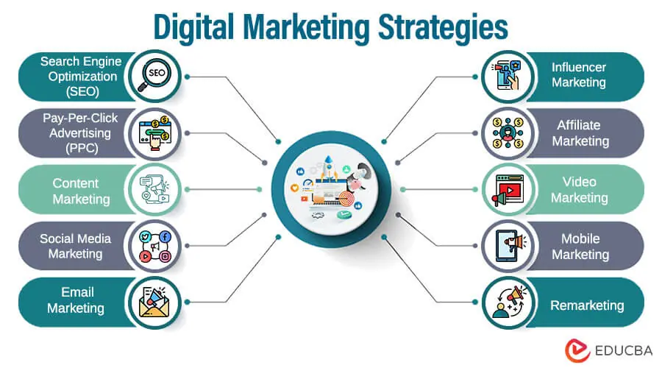
www.midocean.ae
Chapter
01

Slide 8
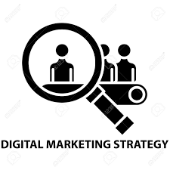
Because a strategy helps you in “setting the direction to the destination you want to reach.”
Digital marketing strategies are the tools companies use to advertise themselves in the digital world and draw in customers through websites, search engines, social media, email, and online ads.
Chapter
What is digital marketing strategy?
01
Digital marketing strategies are the techniques and approaches businesses use to promote their products, services, or brands through online platforms.
www.midocean.ae

Slide 9

Types of digital marketing strategy.
There are many digital marketing strategies out there. Some deliver better results than others, so we’ll examine the 11 most effective digital marketing strategies used in current industry.
Chapter
01
Types of digital marketing strategy
www.midocean.ae

Slide 10
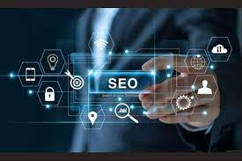
1. Search Engine Optimization (SEO)
Search Engine Optimization involves implementing techniques and strategies to enhance website ranking, visibility, and traffic in search engines.
Example: A finance company may improve its website content using relevant keywords like loans, investment to appear on the first page of a search engine.
2. Pay-Per-Click Advertising (PPC)
Pay-Per-Click, also known as Cost-Per-Click (CPC), is an online advertising model where advertisers pay publishers only when any users click on their ad.
Example: Advertisers may use specific keywords related to their products to target audiences on popular platforms like Google Ads, Facebook Ads, etc.
3. Content Marketing
Content marketing is creating, delivering, and sharing valuable and useful content to attract target audiences to increase brand awareness.
Example: An IT-based company can publish blogs, articles, videos, podcasts, and infographics to provide useful product information.
Type Of Digital Marketing strategy
Chapter 01
www.midocean.ae

Slide 11

4. Social Media Marketing
Social Media Marketing refers to using social media platforms to promote business products, increase brand awareness and build relationships with potential audiences.
Example: An e-commerce company may use Facebook, Instagram, or Twitter to reach a wide range of customers, increasing their sales and website traffic.
5. Email Marketing
Email marketing is a digital strategy for building customer loyalty, promoting products, and increasing sales. It involves sending emails and newsletters to target subscribers.
Example: A fashion brand company can send promotional and exclusive discount emails to their subscribers to promote the latest arrivals of their products.
6. Influencer Marketing
Influencer marketing is a collaboration between influencers, like famous social media personalities and brands, to promote brands’ products.
Example: Beauty companies can partner with popular Instagram influencers to endorse their beauty products through sponsored posts or product reviews.
Type Of Digital Marketing strategy
Chapter
01
www.midocean.ae

Slide 12


7. Affiliate Marketing
Affiliate marketing is a cost-effective online strategy where companies compensate affiliates for promoting their brand, sales and driving website traffic.
Example: Affiliates can use their blogs, websites, and social media profile to promote the company’s products and earn commissions for every sale made through their unique affiliate links.
8. Video Marketing
Video marketing is creating and sharing content to educate, entertain, promote products, and increase brand visibility.
Example: A training company can upload product videos, sponsored videos, tutorials, or customer testimonials on platforms like YouTube.
Type Of Digital Marketing strategy
www.midocean.ae

Slide 13
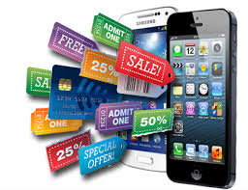
9. Mobile Marketing
Mobile marketing involves advertising brands using SMS, MMS, mobile applications, mobile websites, in-game advertising, etc.
Example: A jewelry company can send new branch launches or sales discount information via SMS to customers or display ads within popular mobile apps.
10. Remarketing
Remarketing or retargeting is reaching out to previously engaged customers for a brand’s product or services.
Example: A sportswear company can send new arrival ads to customers to remind them of the brand so they can purchase their products or can ask for feedback.
Type Of Digital Marketing strategy
Chapter 01
www.midocean.ae

Slide 14
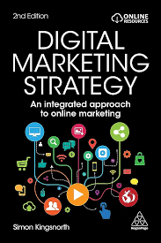
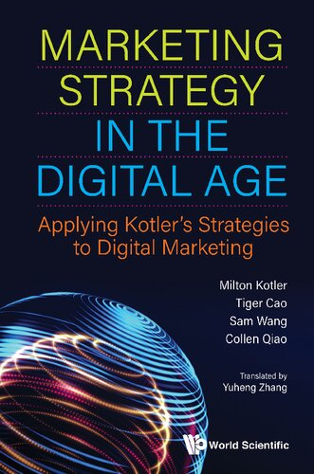
/11737 | September 2020 By (author): Milton Kotler
REFERENCES
www.midocean.ae

Slide 15


www.midocean.ae

Slide 16


www.midocean.ae

Slide 17
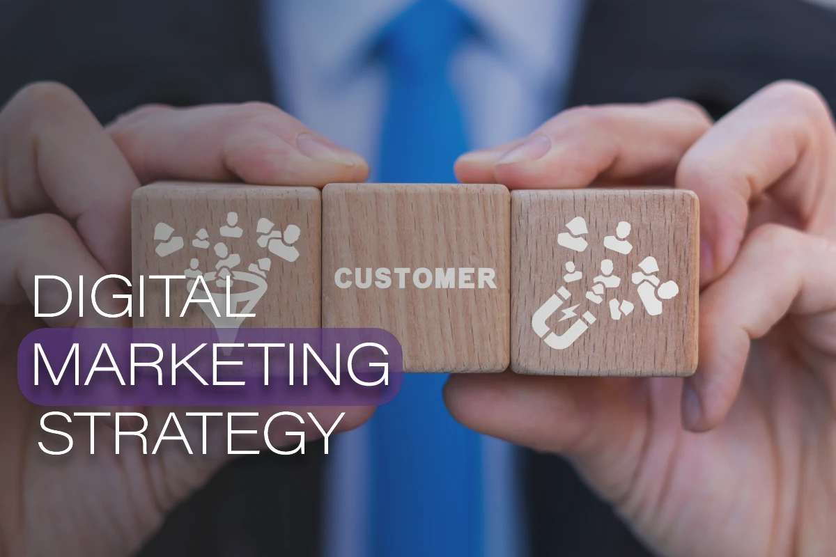

Thank You

