Slide 1



Host Firewalls and Antivirus Software
Lecture 6
HCIA-Security
Prepared by
Dr. Abdelrhman Ahmed

Slide 2
Chapter
Foreword
06
• Firewalls were first applied to buildings to isolate fire and prevent fire from spreading from one area to another.
• In the communications field, firewalls are mainly used to protect a network against attacks and intrusions from other networks.
• Antivirus software is a type of program tool that is used to remove known harmful program code, such as viruses and Trojan horses, from computers.

Slide 3
Chapter
Objectives
06
• Upon completion of this course, you will be able to:
□ Describe the definition and categories of firewalls.
□ Describe the main functions of firewalls.
□ Describe the concept of antivirus software.
□ Distinguish antivirus software from firewalls.

Slide 4
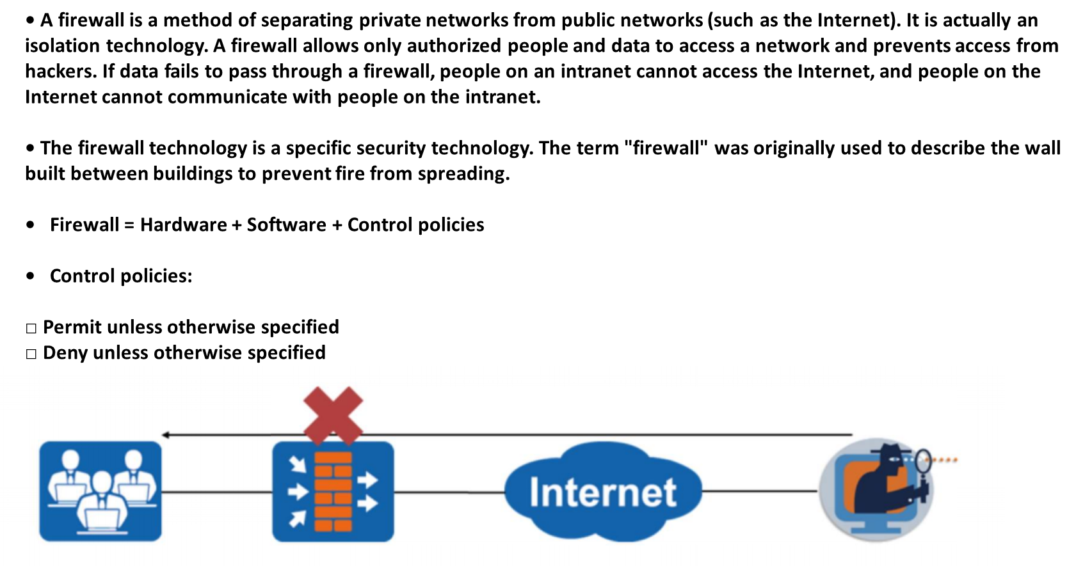
Chapter
What Is a Firewall?
06

Slide 5
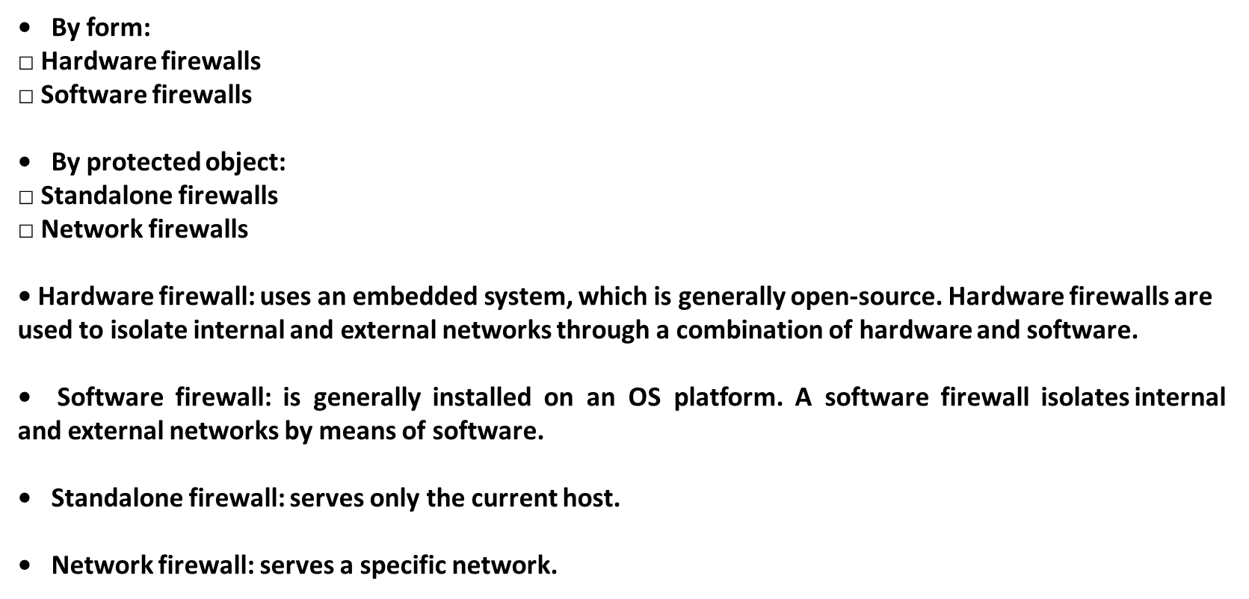
Chapter
Firewall Classification
06

Slide 6
Chapter
Windows Firewalls
06
• A Windows firewall is a software firewall built in the Windows OS.

Slide 7
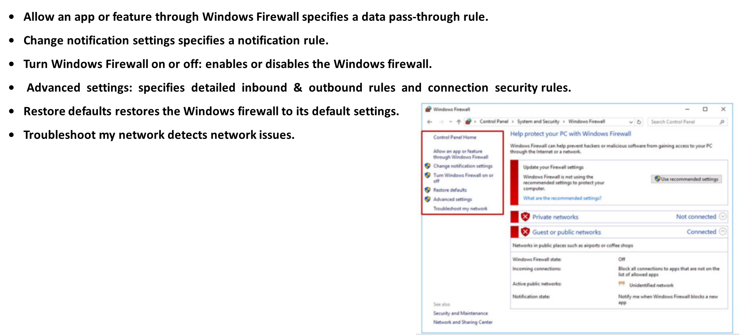
Chapter
Windows Firewall Settings
06

Slide 8
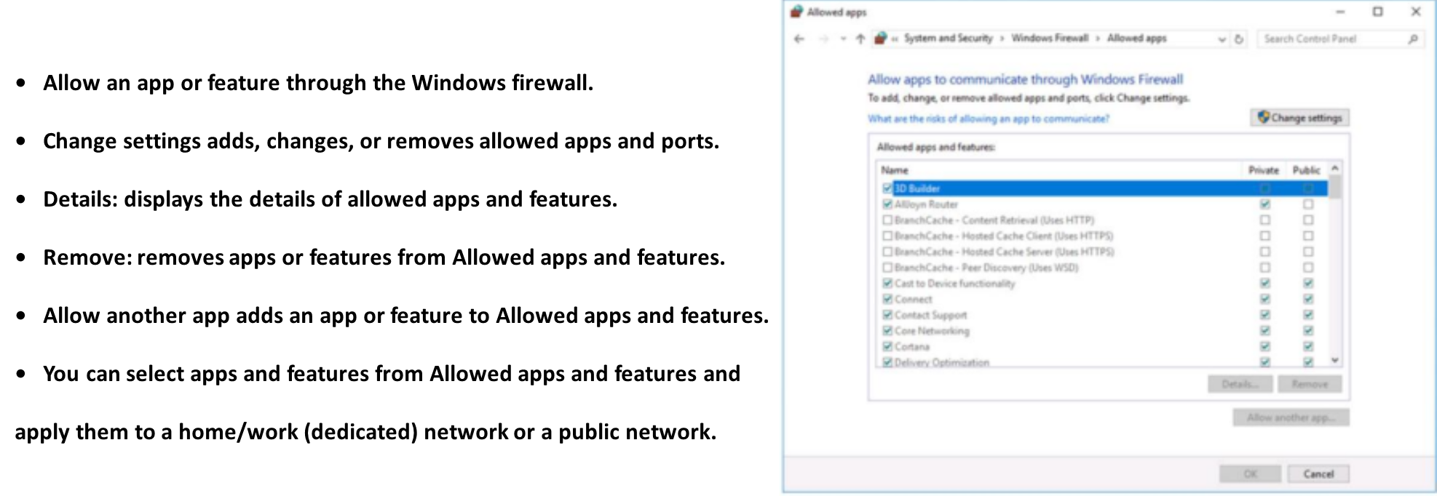
Chapter
Windows Firewall Rule Settings
06

Slide 9
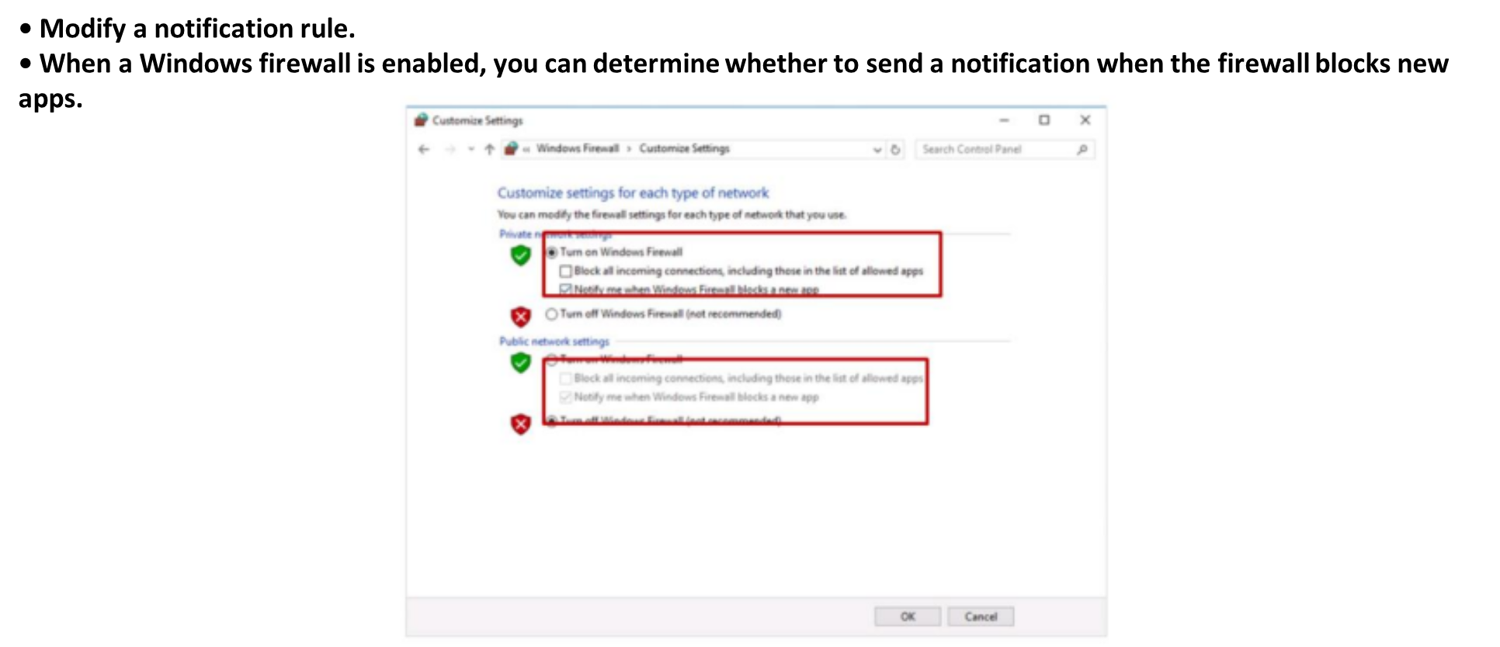
Chapter
Windows Firewall Notification Rule
06

Slide 10
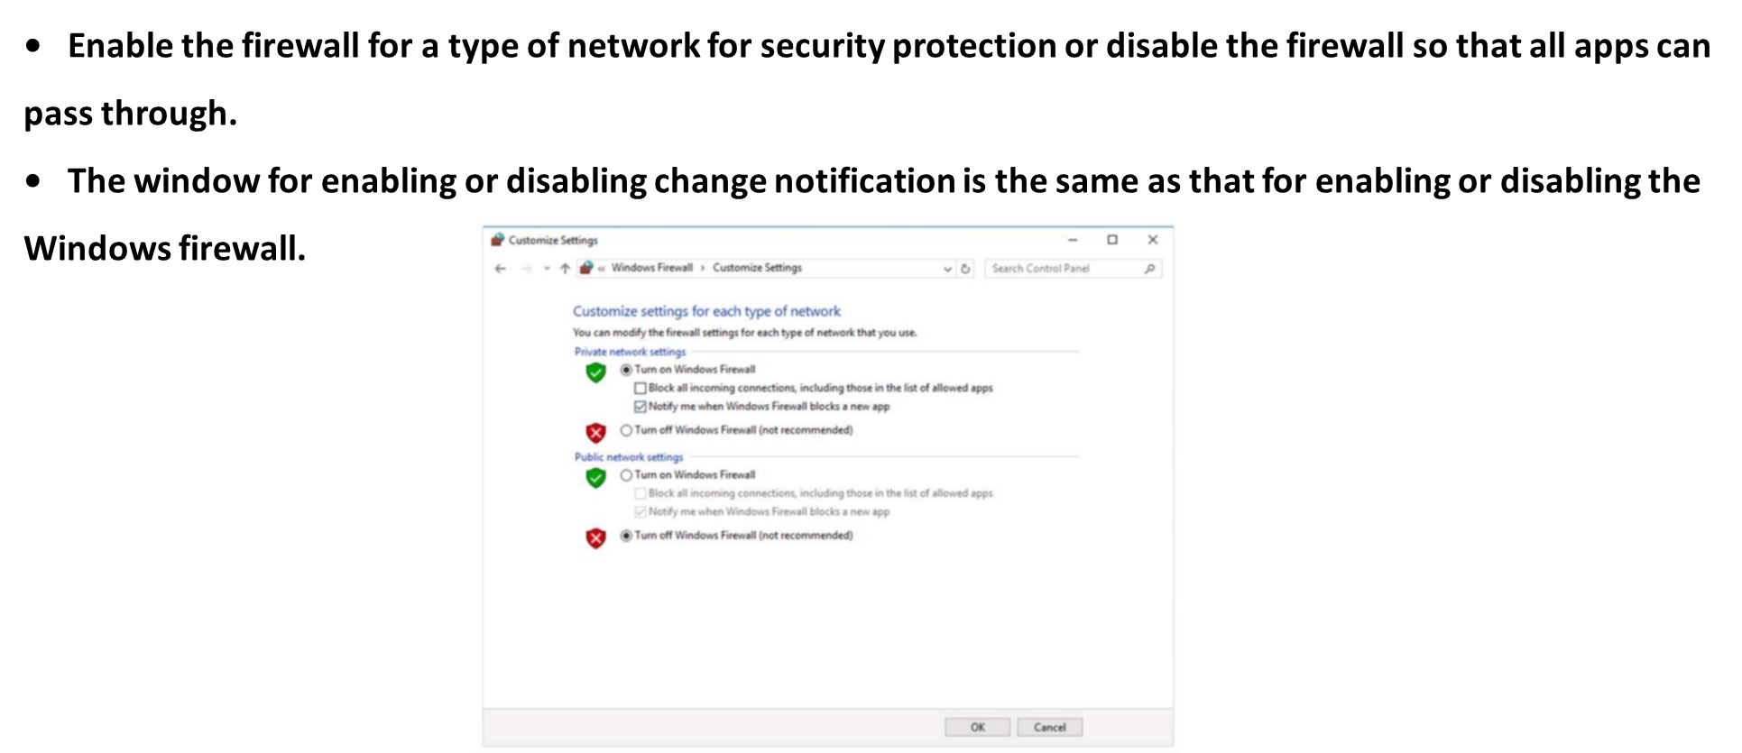
Chapter
Enabling or Disabling a Windows Firewall
06

Slide 11
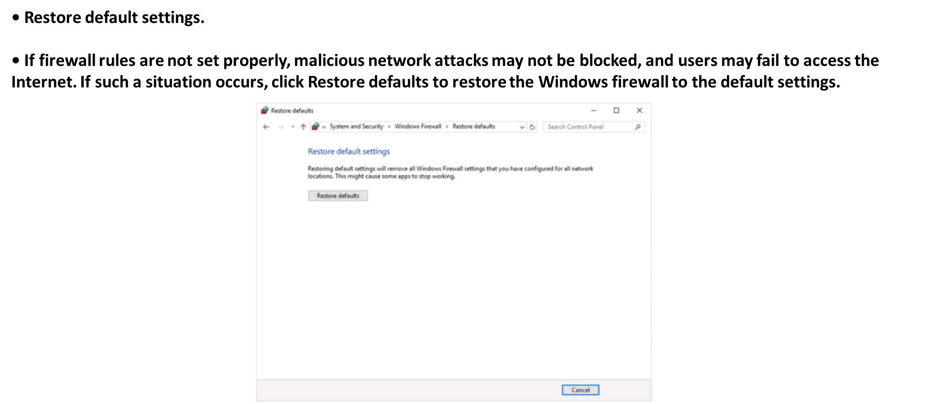
Chapter
Initializing Windows Firewall Settings
06

Slide 12
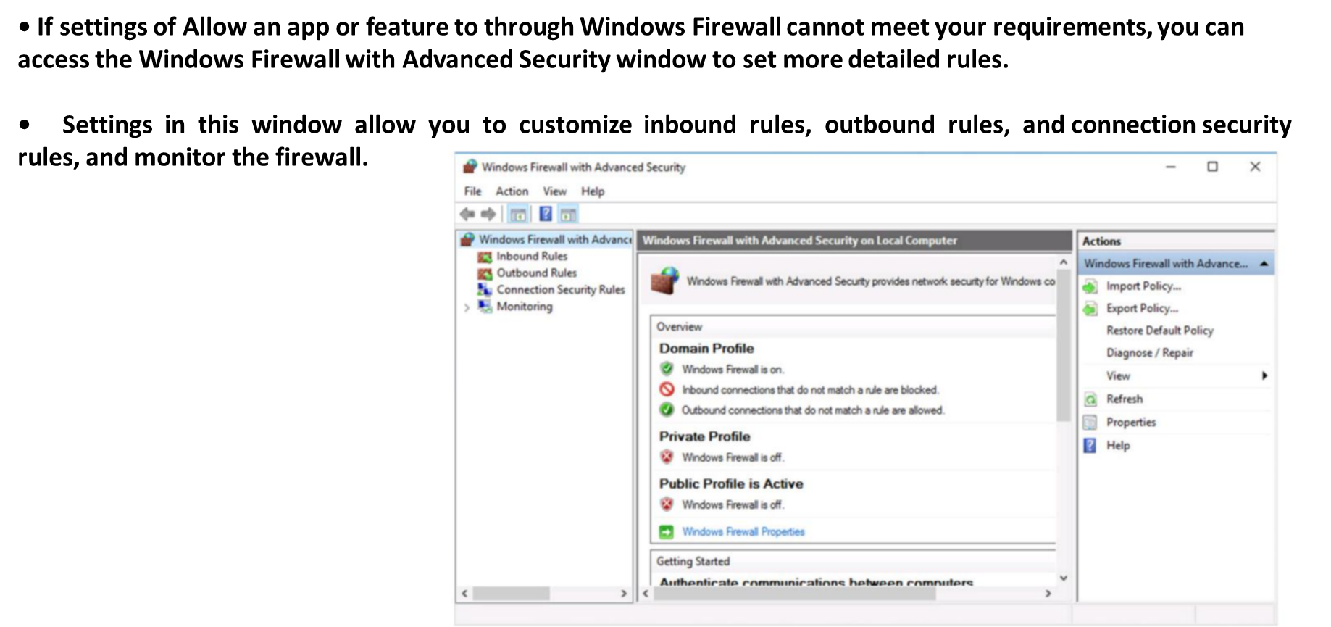
Chapter
Advanced Windows Firewall Settings
06

Slide 13
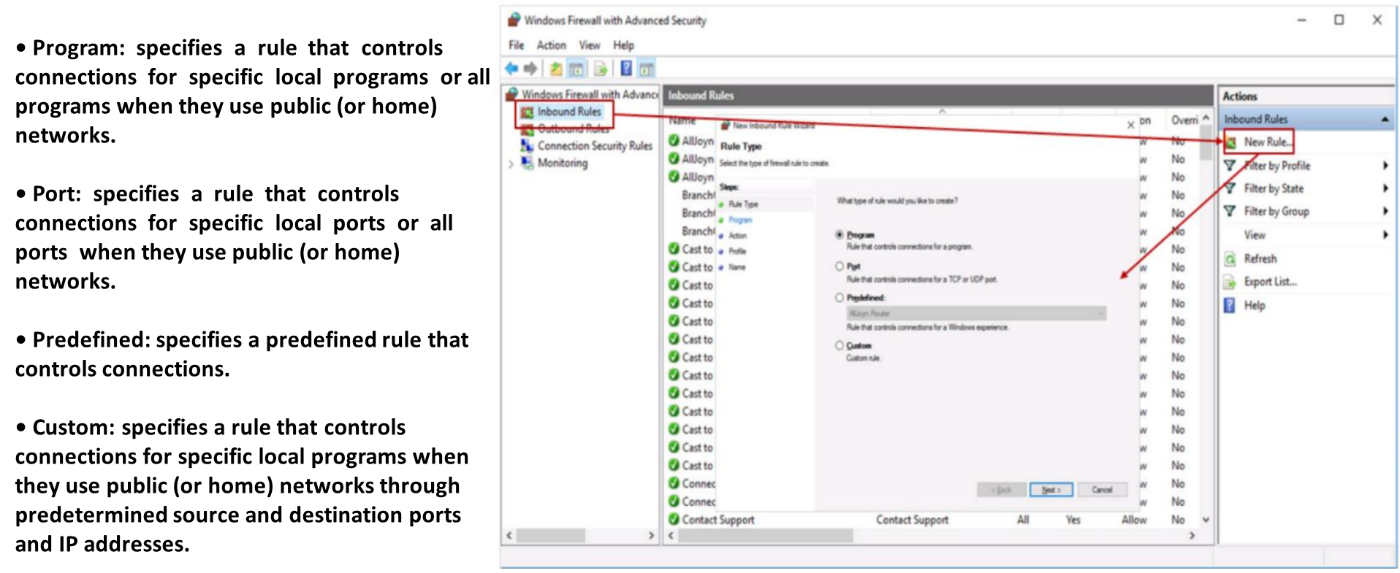
Chapter
Windows Firewall Rule Settings
06

Slide 14
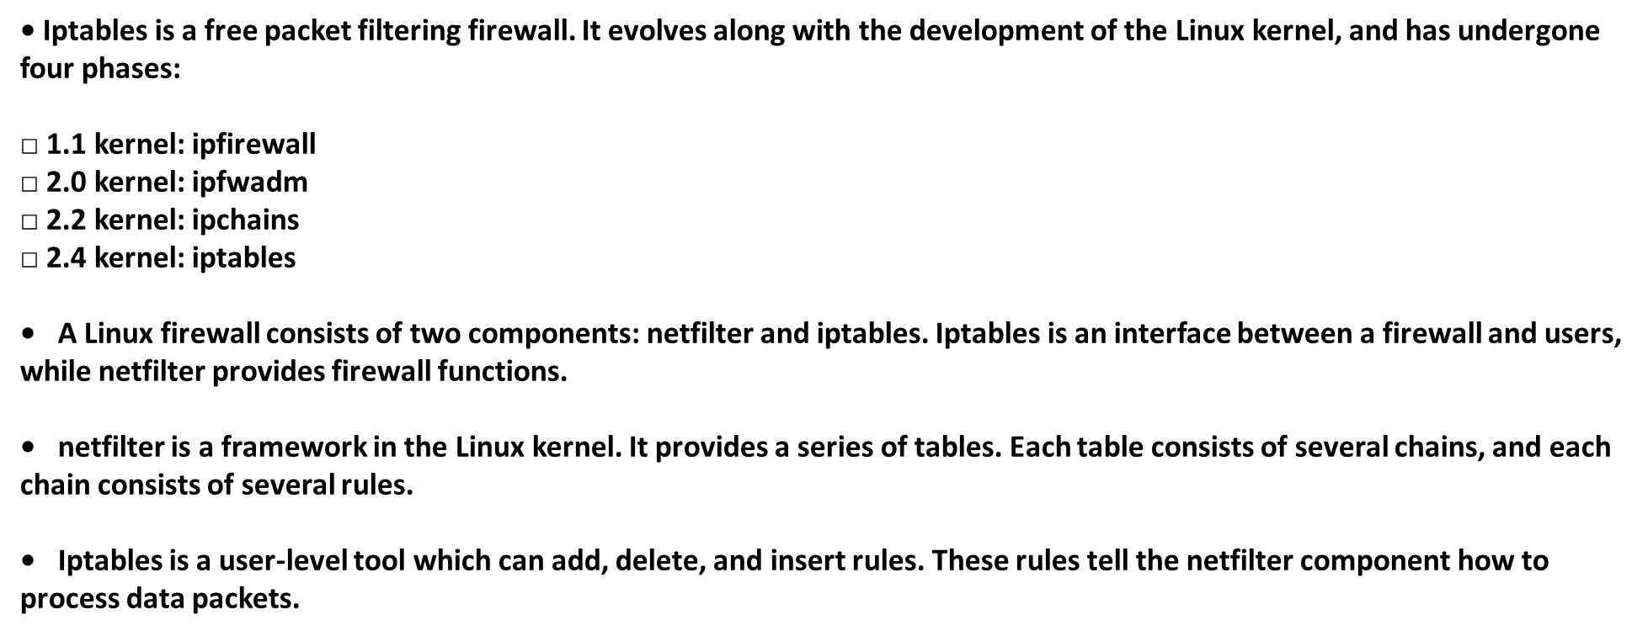
Chapter
Iptables Introduction
06

Slide 15
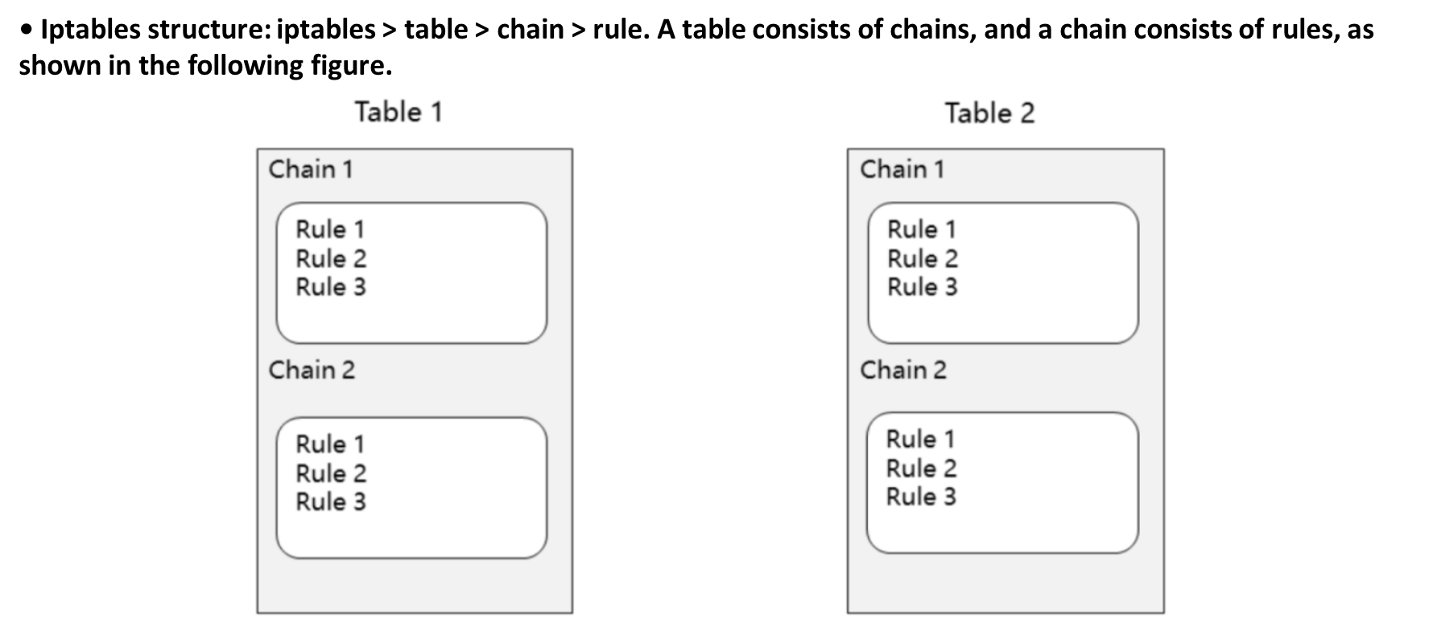
Chapter
Iptables Structure
06

Slide 16
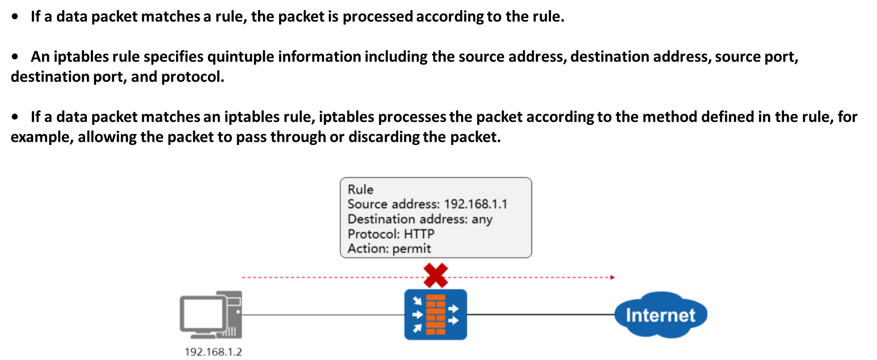
Chapter
Basic Concepts of Iptables - Rule
06

Slide 17
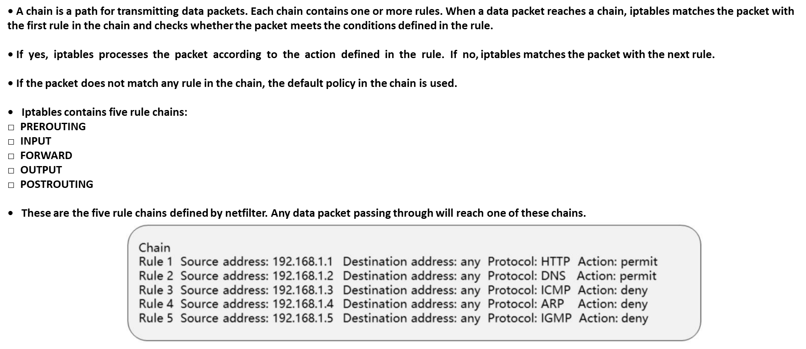
Chapter
Basic Concepts of Iptables - Chain
06

Slide 18
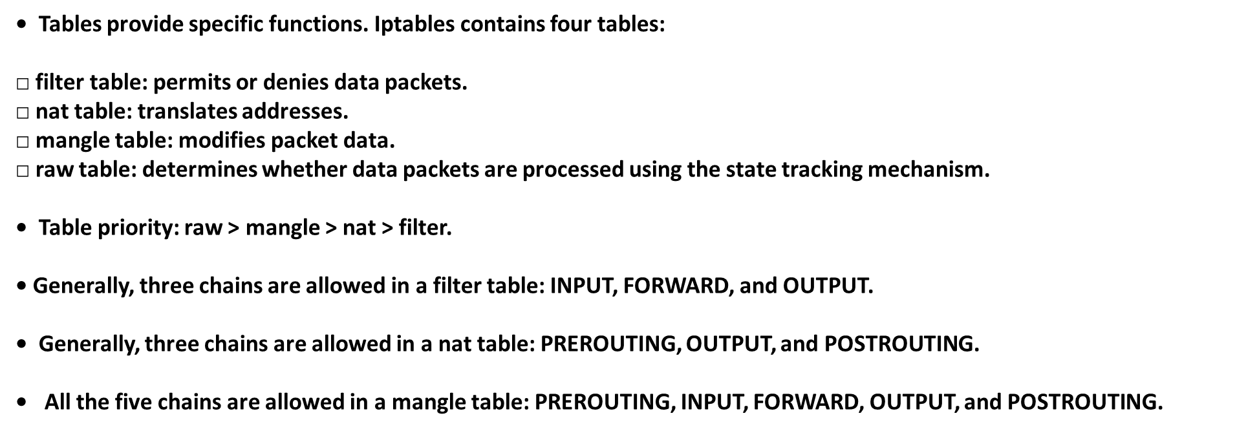
Chapter
Basic Concepts of Iptables - Table
06

Slide 19
Chapter
Process of Transmitting Data Packets by Iptables
06

Slide 20
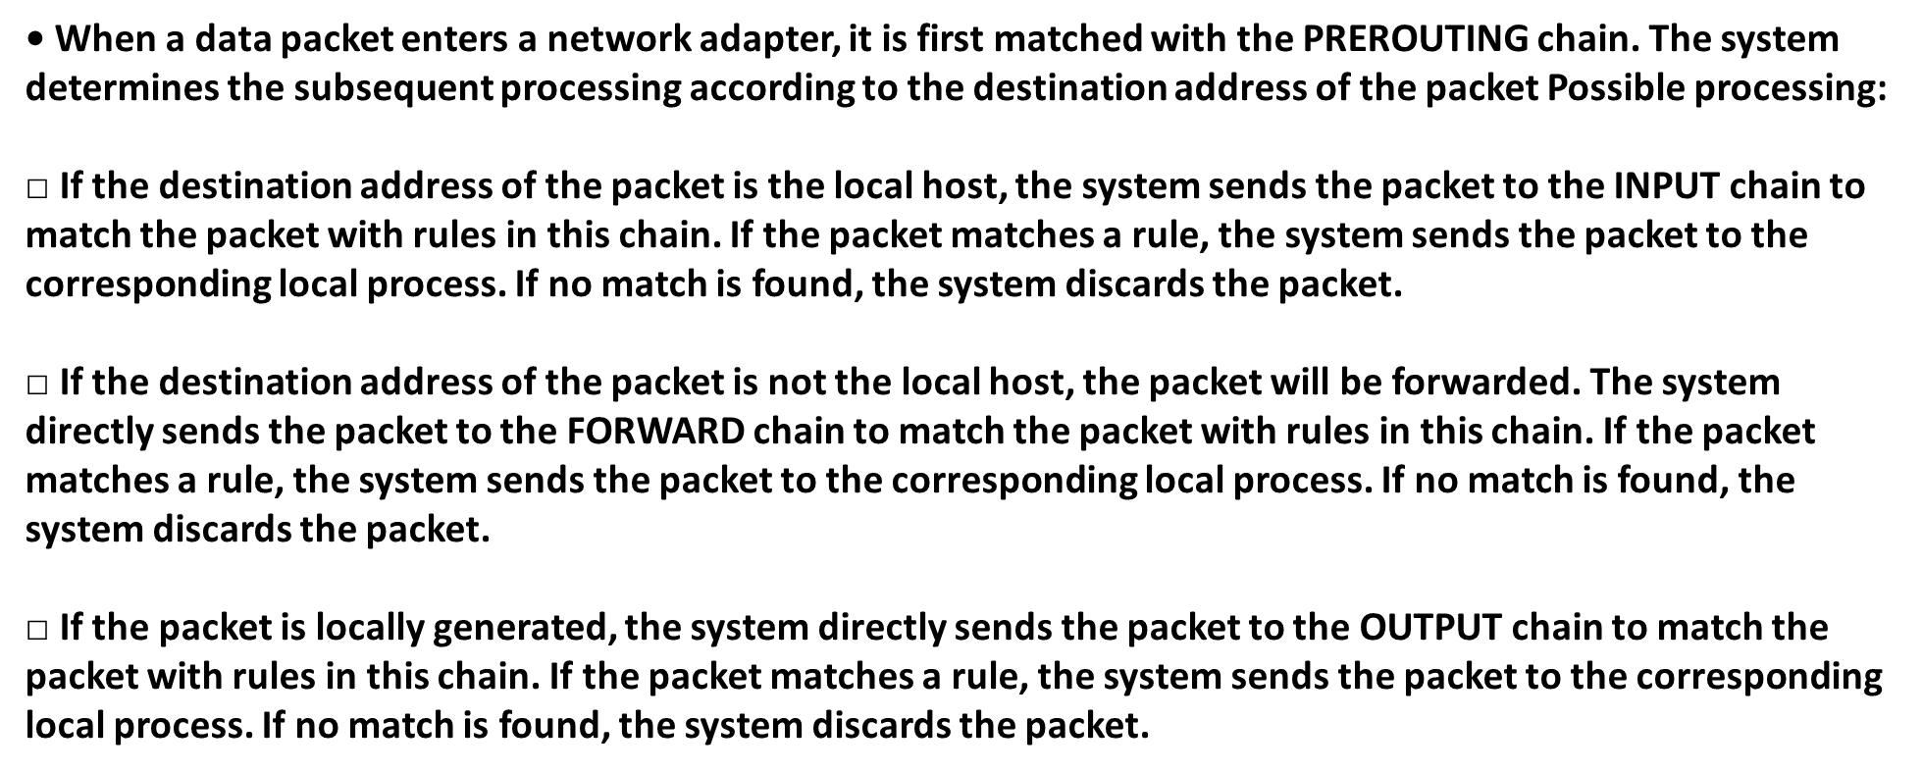
Chapter
Process of Transmitting Data Packets by Iptables
06
• When a data packet enters a network adapter, it is first matched with the PREROUTING chain. The system determines the subsequent processing according to the destination address of the packet Possible processing:
□ If the destination address of the packet is the local host, the system sends the packet to the INPUT chain to match the packet with rules in this chain. If the packet matches a rule, the system sends the packet to the corresponding local process. If no match is found, the system discards the packet.
□ If the destination address of the packet is not the local host, the packet will be forwarded. The system directly sends the packet to the FORWARD chain to match the packet with rules in this chain. If the packet matches a rule, the system sends the packet to the corresponding local process. If no match is found, the system discards the packet.
□ If the packet is locally generated, the system directly sends the packet to the OUTPUT chain to match the packet with rules in this chain. If the packet matches a rule, the system sends the packet to the corresponding local process. If no match is found, the system discards the packet.

Slide 21
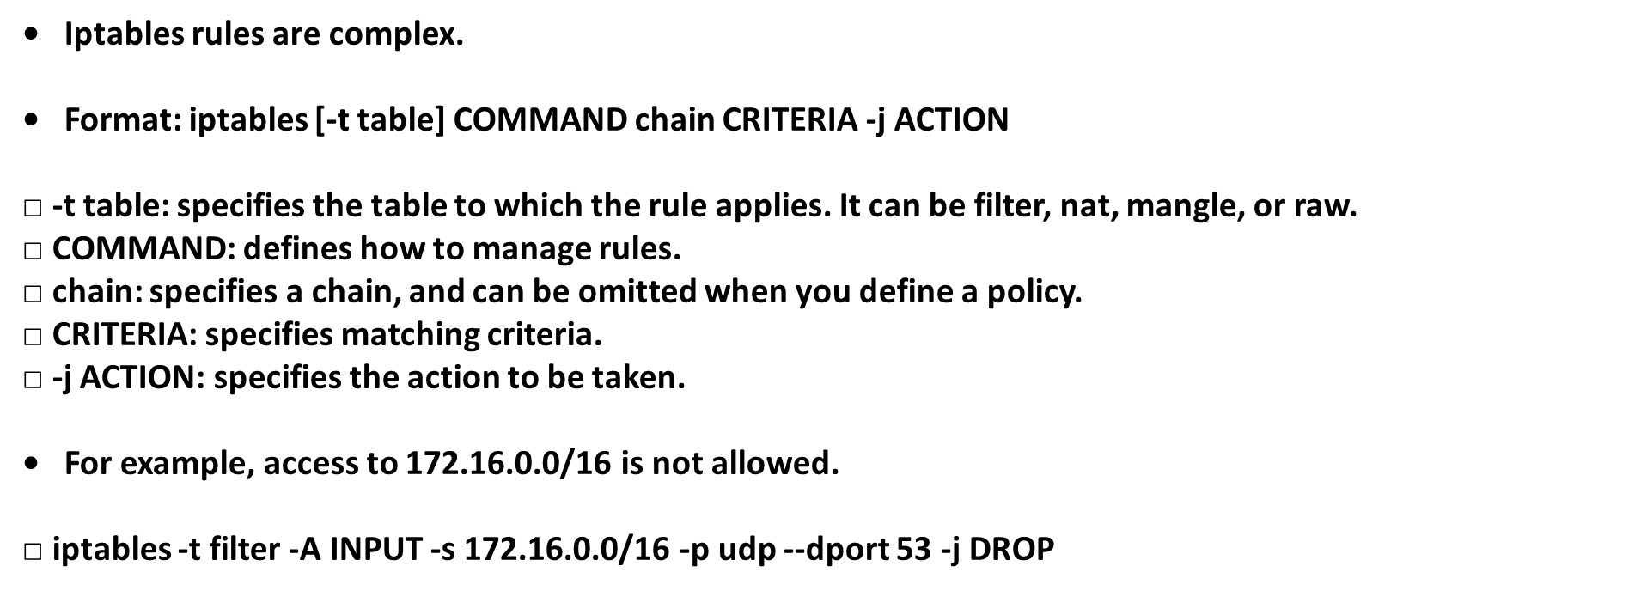
Chapter
Iptables Rules
06

Slide 22
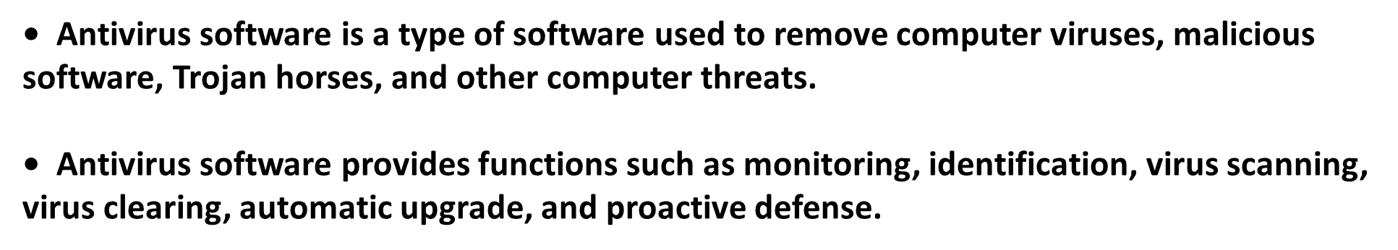
Chapter
What Is Antivirus Software?
06
What Is Antivirus Software?

Slide 23
Chapter
Basic Functions of Antivirus Software
06
• Virus prevention: prevents viruses from attacking computers.
• Virus identification: scans for viruses in the programs or files running on a computer and compares the viruses against the virus signature database to identify them.
• Virus clearing: restores infected objects according to different types of viruses and their infection characteristics.

Slide 24
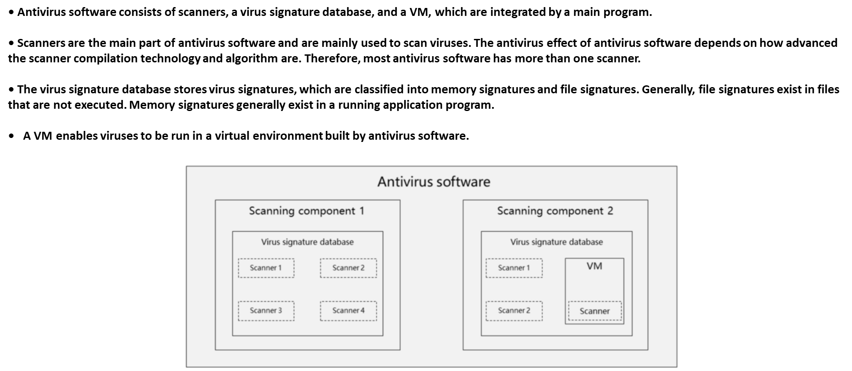
Chapter
Antivirus Software Components
06

Slide 25
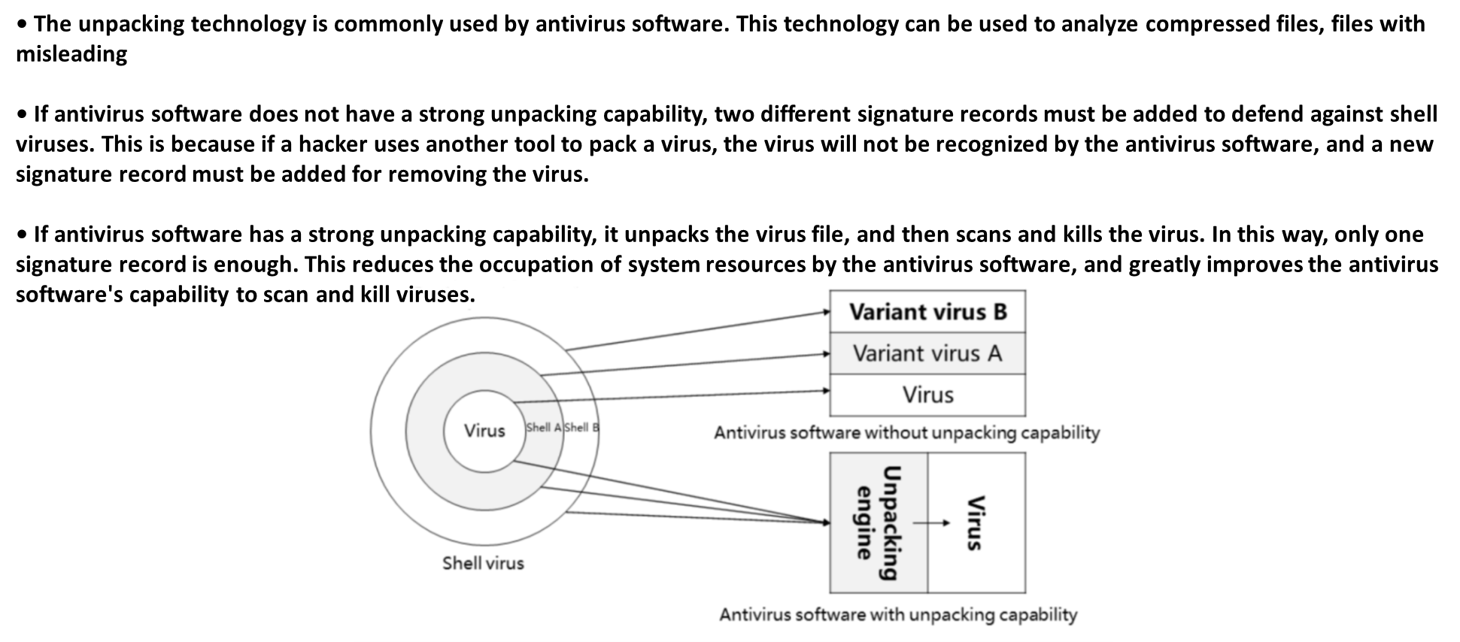
Chapter
Key Technologies of Antivirus Software - Unpacking
06

Slide 26
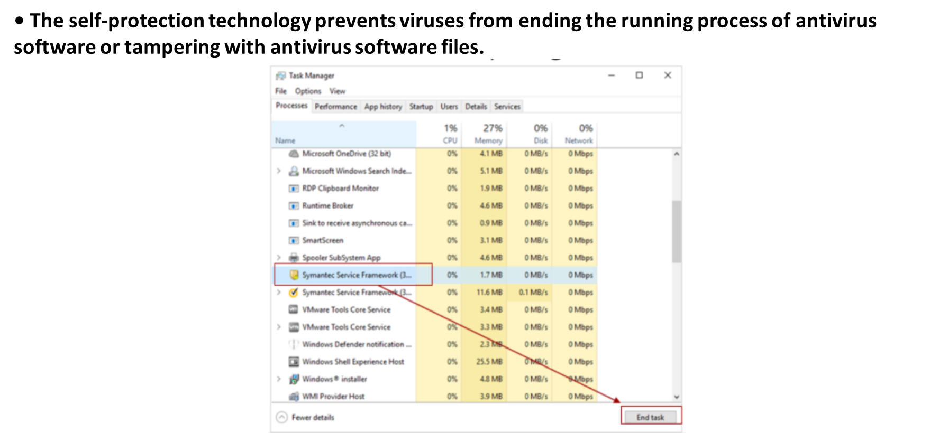
Chapter
Key Technologies of Antivirus Software - Self­ protection
06

Slide 27
Chapter
Key Technologies of Antivirus Software - Repair
06
• Antivirus software usually deletes infected files to remove viruses. In this case, some system files may be deleted by mistake. As a result, the system breaks down and cannot start. The repair technology of antivirus software repairs damaged files.

Slide 28
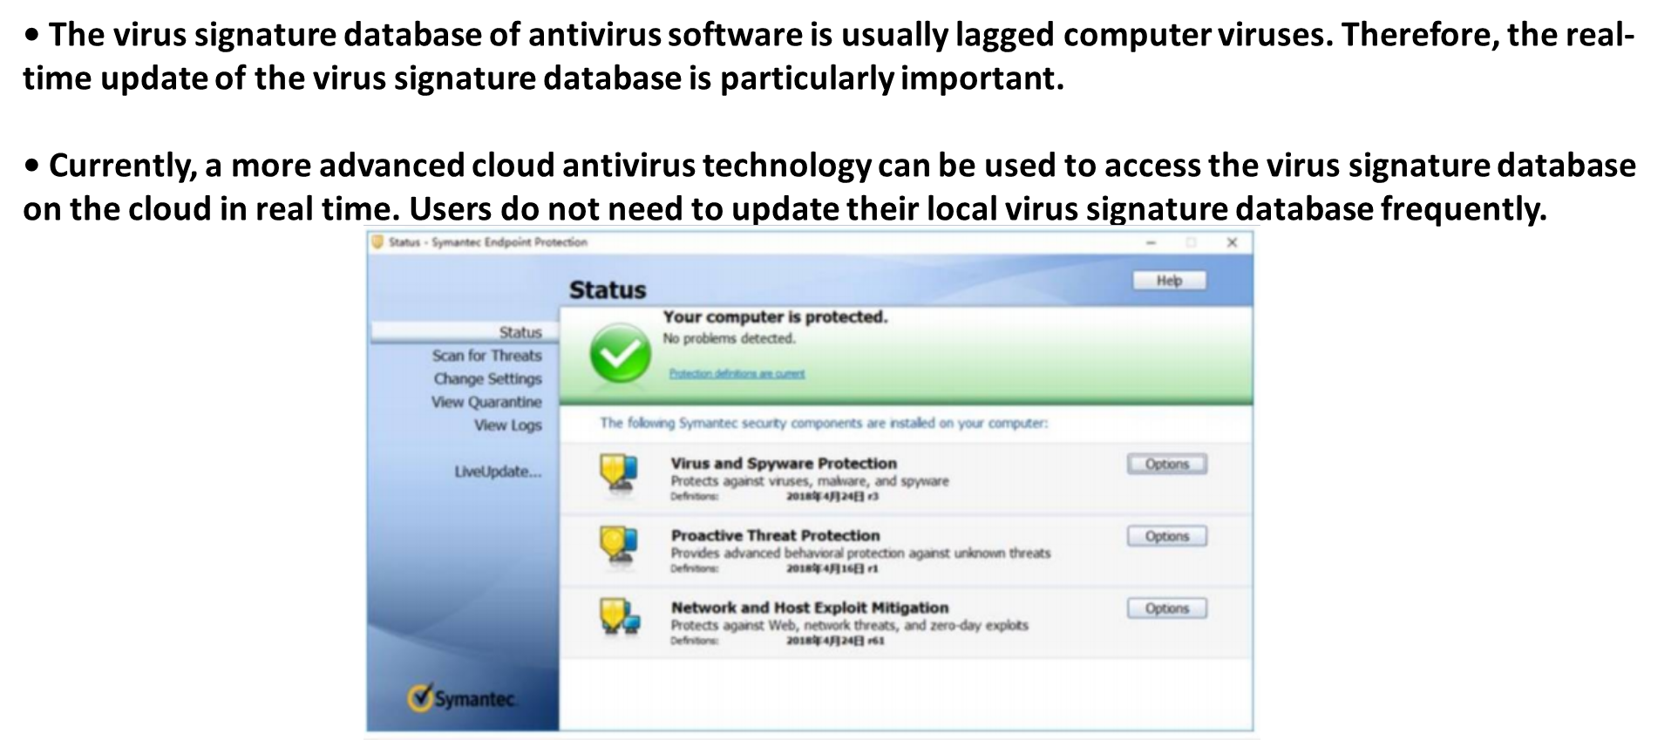
Chapter
Key Technologies of Antivirus Software - Real- Time Update
06

Slide 29
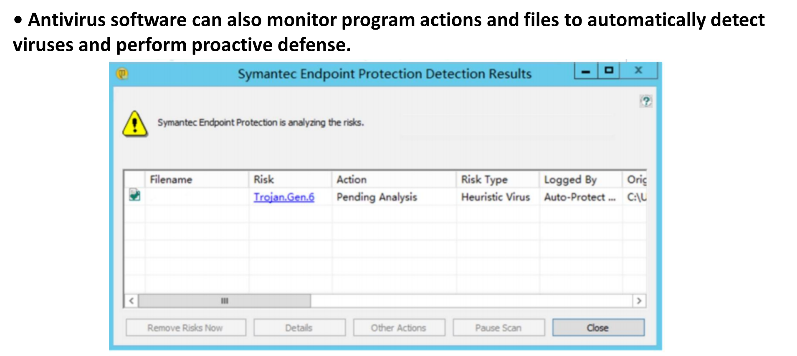
Chapter
06
Key Technologies of Antivirus Software - Proactive Defense

Slide 30
Chapter
Mainstream Antivirus Software in China
06

Slide 31
Chapter
What antivirus software do user need ?
06

Slide 32
Chapter
Common Knowledge of Antivirus Software
06
• Antivirus software cannot scan or kill all viruses.
• Antivirus software cannot kill all scanned viruses.
• It is unnecessary to install two or more sets of antivirus software on one OS of a computer (unless for compatible or green versions), although many types of antivirus software are compatible. In addition, you are advised to view the list of incompatible programs.
• Antivirus software may clear, delete, forbid access to, or isolate infected files. It also may not process the files.

Slide 33
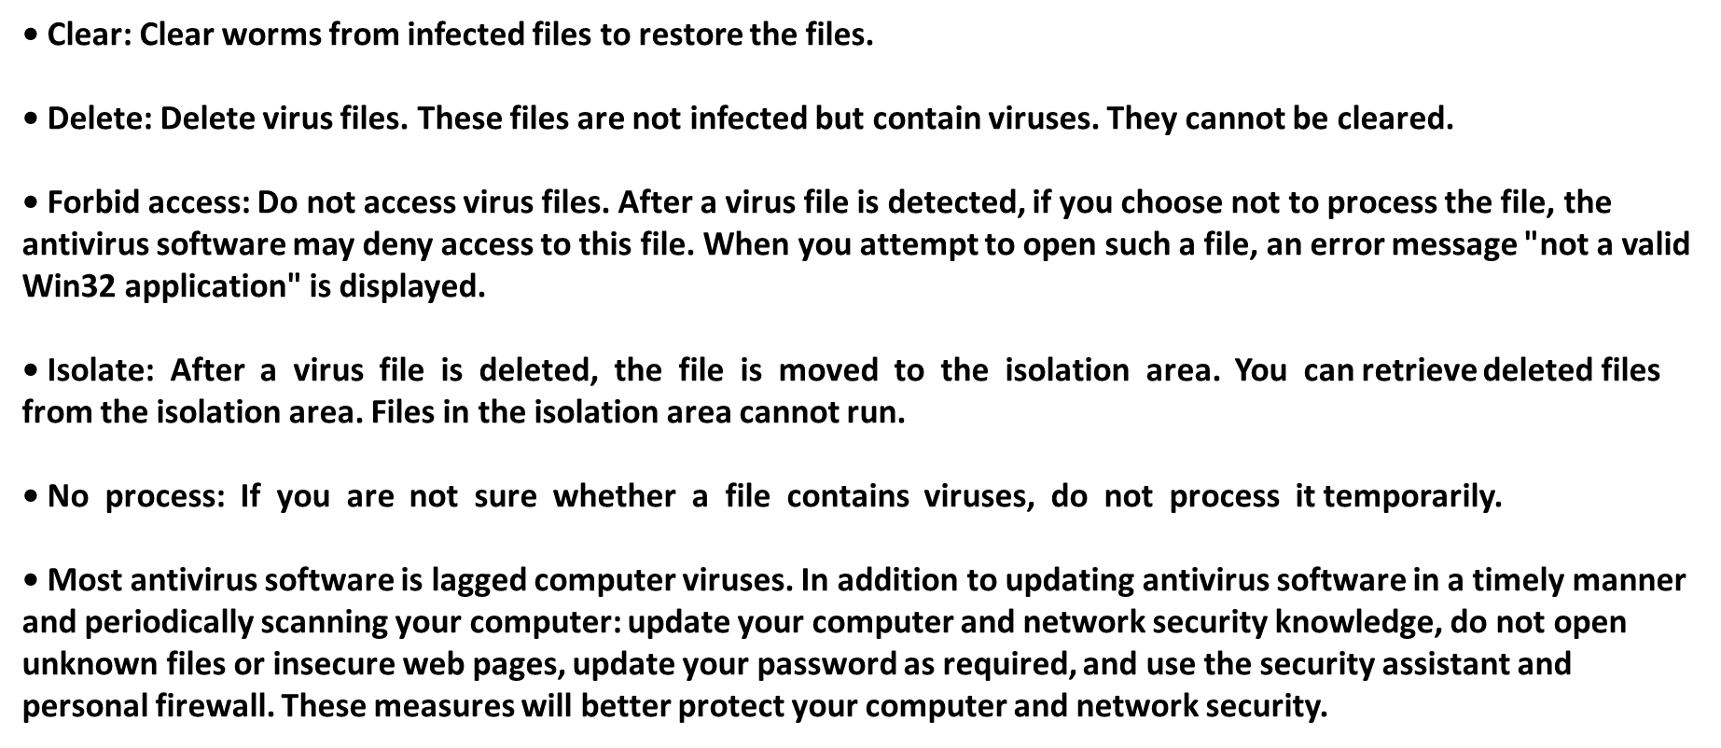
Chapter
Common Knowledge of Antivirus Software
06

Slide 34



Thank You

