Slide 1

Supply chain Management
Prepared by Dr. Badur elgasim
Lecture 1
PMG 660
Understanding the Supply Chain

Slide 2


Learning Objectives
After reading this chapter, you will be able to:
1. Discuss the goal of a supply chain and explain the impact of supply chain decisions on the success of a firm.
2. Identify the three key supply chain decision phases and explain the significance of each one.
3. Describe the cycle and push/pull views of a supply chain.
4. Classify the supply chain macro processes in a firm.

Slide 3

What is a Supply Chain?
All stages involved, directly or indirectly, in fulfilling a customer request
Includes manufacturers, suppliers, transporters, warehouses, retailers, and customers
Within each company, the supply chain includes all functions involved in fulfilling a customer request (product development, marketing, operations, distribution, finance, customer service)

Slide 4
What is a supply chain?
Consider a customer walking into a Wal-Mart store to purchase detergent.
The supply chain begins with the customer and his or her need for detergent.
The next stage of this supply chain is the Wal-Mart retail store that the customer visits.

Slide 5
What is a supply chain?
Wal-Mart stocks its shelves using inventory that may have been supplied from a finished-goods warehouse or a distributor using trucks supplied by a third party.
The distributor in turn is stocked by the manufacturer (say, Proctor & Gamble [P&G] in this case.

Slide 6
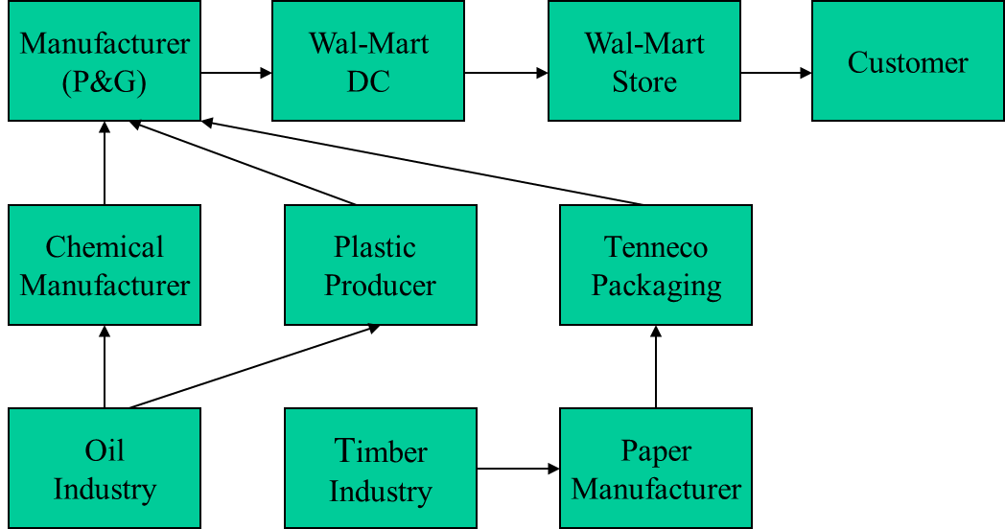
What is a supply chain?
P&G manufacturing plant receives raw material from a variety of suppliers. For example, packaging material may come from Tenneco packaging, while Tenneco receives raw materials to manufacture the packaging from other suppliers. This supply chain is illustrated in Figure 1-1.
Examples: Fig. 1.1 Detergent supply chain (Wal-Mart),

Slide 7
The Objective of a Supply Chain
Maximize overall value created
Supply chain value: difference between what the final product is worth to the customer and the effort the supply chain expends in filling the customer’s request
Value is correlated to supply chain profitability (difference between revenue generated from the customer and the overall cost across the supply chain)

Slide 8
The Objective of a Supply Chain
Example: Dell receives $2000 from a customer for a computer (revenue)
Supply chain incurs costs (information, storage, transportation, components, assembly, etc.)
Difference between $2000 and the sum of all of these costs is the supply chain profit
Supply chain profitability is total profit to be shared across all stages of the supply chain
Supply chain success should be measured by total supply chain profitability, not profits at an individual stage

Slide 9
The Objective of a Supply Chain
For example,
a customer purchasing a wireless router from Best Buy pays $60, which represents the revenue the supply chain receives.
Best Buy and other stages of the supply chain incur costs to convey information, produce components, store them, transport them, transfer funds, and so on.
The difference between the $60 that the customer paid and the sum of all costs incurred by the supply chain to produce and distribute the router represents the supply chain profitability or surplus.

Slide 10
The Objective of a Supply Chain
Sources of supply chain revenue: the customer
Sources of supply chain cost: flows of information, products, or funds between stages of the supply chain
Supply chain management is the management of flows between and among supply chain stages to maximize total supply chain profitability

Slide 11
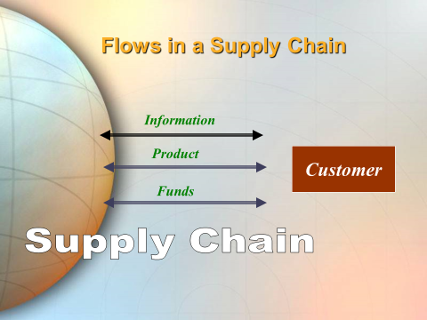
The importance of supply chain decisions
There is a close connection between the design and management of supply chain flows (product, information, and funds) and the success of a supply chain.
Wal-Mart, Dell Computer, and Seven-Eleven Japan are examples of companies that have built their success on superior design, planning, and operation of their supply chain.

Slide 12
The importance of supply chain decisions
Wal-Mart has been a leader at using supply chain design, planning, and operation to achieve success.
From its beginning, the company invested heavily in transportation and information infrastructure to facilitate the effective flow of goods and information.
Wal-Mart designed its supply chain with clusters of stores around distribution centers to facilitate frequent replenishment at its retail stores in a cost-effective manner. Frequent replenishment allows stores to match supply and demand more effectively than the competition.

Slide 13
The importance of supply chain decisions
Wal-Mart has been a leader in sharing information and collaborating with suppliers to bring down costs and improve product availability. The results are impressive.
In their 2004 annual report, the company reported a net income of more than $9 billion on revenues of about $250 billion. These are dramatic results for a company that reached annual sales of only $1 billion in 1980. The growth in sales represents an annual compounded growth rate of 26 percent.

Slide 14
Decision Phases of a Supply Chain
Supply chain strategy or design
Supply chain planning
Supply chain operation

Slide 15
Decision Phases of a Supply Chain
Successful supply chain management requires many decisions relating to the flow of information, product, and funds.
Each decision should be made to raise the supply chain surplus.
These decisions fall into three categories or phases, depending on the frequency of each decision and the time frame during which a decision phase has an impact.
As a result, each category of decisions must consider uncertainty over the decision horizon.

Slide 16

1- Supply chain strategy or design
Strategic decisions made by companies include whether to outsource or perform a supply chain function in-house
Strategic supply chain decisions: the structure of the supply chain and what processes each stage will perform:
  Locations and capacities of facilities
  Products to be made or stored at various locations
  Modes of transportation
  Information systems
During this phase, given the marketing and pricing plans for a product,, how resources will be allocated, and what processes each stage will perform.

Slide 17
2- Supply chain planning
For decisions made during this phase,
the time frame considered is a quarter to a year. Therefore,
the supply chain's configuration determined in the strategic phase is fixed.
The goal of planning is to maximize the supply chain surplus that can be generated over the planning horizon

Slide 18
- Supply chain planning-cont
Planning decisions:
  Which markets will be supplied from which locations
  Planned buildup of inventories
  Subcontracting, backup locations
  Inventory policies
  Timing and size of market promotions
Must consider in planning decisions demand uncertainty, exchange rates, competition over the time horizon

Slide 19
3-Supply chain operation
During this phase,
firms allocate inventory or production to individual orders,
set a date that an order is to be filled,
generate pick lists at a warehouse,
allocate an order to a particular shipping mode and shipment,
set delivery schedules of trucks, and place replenishment orders.

Slide 20
Supply chain operation-cont
Because operational decisions are being made in the short term (minutes, hours, or days).
there is less uncertainty about demand information. Given the constraints established by the configuration and planning policies.
the goal during the operation phase is to exploit the reduction of uncertainty and optimize performance.

Slide 21
Process views of a supply chain
A supply chain is a sequence of processes and flows that take place within and between different stages and combine to fill a customer need for a product.
There are two different ways to view the processes performed in a supply chain.
1. Cycle View: The processes in a supply chain are divided into a series of cycles, each performed at the interface between two successive stages of a supply chain.

Slide 22
Process views of a supply chain
2. Push/Pull View:
The processes in a supply chain are divided into two categories depending on whether they are executed in response to a customer order or in anticipation of customer orders.

Slide 23
1-Pull processes:
are initiated by a customer order
Example:
Dell: Dell assembles its computers to order and therefore, all processes except for those involved in the procurement cycle are “pull

Slide 24
2-push processes:
are initiated and performed in anticipation of customer orders.
Example:
Compaq: All processes except for those involved in customer order cycle are of “push” type

Slide 25
3-Cycle view of supply chain processes
Given the five stages of a supply chain shown in Figure 1-2, all supply chain processes can be broken down into the following four process cycles, as shown in Figure 1-3:
• Customer order cycle
• Replenishment cycle
• Manufacturing cycle
• Procurement cycle

Slide 26
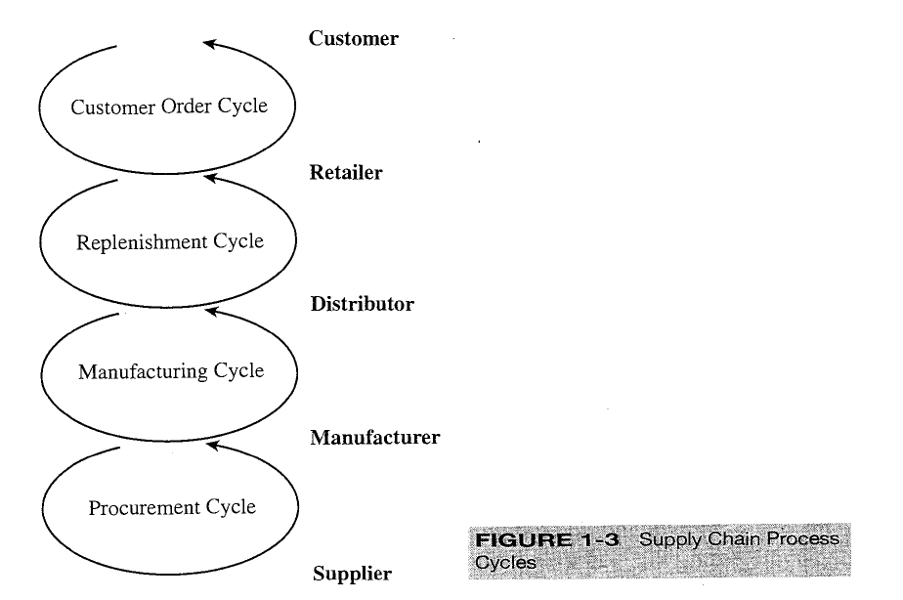
Process views of a supply chain
Cycles: A sequence of steps characterizing the transactions that take places among two successive stages of the supply chain.
The five stages thus result in four supply chain process cycles. Each cycle occurs at the interface between two successive stages of the supply chain. Not every supply chain will have all four cycles clearly separated
Stages

Slide 27
Customer order cycle
All the processes directly involved in receiving and filling a customer order
Replenishment cycle
All the processes involved in replenishing retailer inventory
Manufacturing Cycle
All processes involved in generating the product that will fill the customer, retailer and distributor orders. It is driven by the actual orders placed with the manufacturer, forecasts for expected future demand, and the current product availability in the manufacturer’s finished-product warehouse.
Procurement Cycle
All the processes necessary to ensure that materials are available for manufacturing to occur according to schedule.

Slide 28
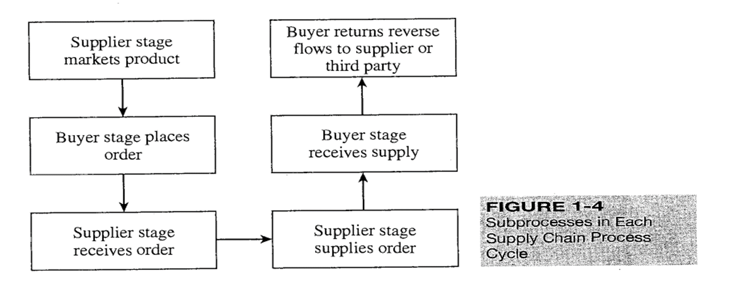
Each cycle consists of six sub processes as shown in Figure 1-4.
Each cycle starts with the supplier marketing the product to customers.
A buyer then places an order that is received by the supplier.
The supplier supplies the order, which is received by the buyer.
The buyer may return some of the product or other recycled material to the supplier or a third party. The cycle of activities then begins all over again.

Slide 29
Process views of a supply chain
Depending on the transaction in question, the sub processes in Figure 1-4 can be applied to the appropriate cycle.
When customers shop online at Amazon, they are part of the customer order cycle-with the customer as the buyer and Amazon as the supplier.
In contrast, when Amazon orders books from a distributor to replenish its inventory, it is part of the replenishment cycle-with Amazon as the buyer and the distributor as the supplier.

Slide 30
Process views of a supply chain
Within each cycle, the goal of the buyer is to ensure product availability and to achieve economies of scale in ordering.
The supplier attempts to forecast customer orders and reduce the cost of receiving the order.
The supplier then works to fill the order on time and improve efficiency and accuracy of the order fulfillment process.
The buyer then works to reduce the cost of the receiving process. Reverse flows are managed to reduce cost and meet environmental objectives.

Slide 31
Process views of a supply chain
Even though each cycle has the same basic sub processes, there are a few important differences between cycles.
In the customer order cycle, demand is external to the supply chain and thus uncertain.
In all other cycles, order placement is uncertain but can be projected based on policies followed by the particular supply chain stage.
For example, in the procurement cycle, a tire supplier to an automotive manufacturer can predict tire demand precisely once the production schedule at the manufacturer is known.

Slide 32
Process views of a supply chain
The second difference across cycles relates to the scale of an order.
Whereas a customer buys a single car, the dealer orders multiple cars at a time from the manufacturer,
and the manufacturer, in turn, orders an even larger quantity of tires from the supplier.
As we move from the customer to the supplier, the number of individual orders declines and the size of each order increases.
Thus, sharing of information and operating policies across supply chain stages becomes more important as we move farther from the end customer.

Slide 33
Process views of a supply chain
A cycle view of the supply chain is very useful when considering operational decisions because it clearly specifies the roles of each member of the supply chain. The detailed process description of a supply chain in the cycle view forces a supply chain designer to consider the infrastructure required to support these processes. The cycle view is useful, for example, when setting up information systems to support supply chain operations.

Slide 34
Supply Chain Macro Processes in a Firm
Supply chain processes discussed in the two views can be classified into:
  Customer Relationship Management (CRM)
  Internal Supply Chain Management (ISCM)
  Supplier Relationship Management (SRM)
Integration among the above three macro processes is critical for effective and successful supply chain management

Slide 35
Reference
Supply chain management
Strategy, Planning, and Operation
By: Sunil Chopra,
-3rd ed.
Chapter 1

