Slide 1



Digital Forensics
Lecture 10
HCIA-Security
Prepared by
Dr. Abdelrhman Ahmed

Slide 2
Chapter
10
Forward
• Today, computers are used the world over. The pervasiveness of computers has led to an ever-increasing number of computer-related court cases, such as electronic commerce disputes and cybercrimes. In the process of judging or handling disputes and criminal cases, a new form of litigation evidence has emerged, namely, digital evidence. The characteristics that distinguish digital evidence and digital forensics from traditional physical evidence and forensic methods pose new research topics in the field of law and computer science.
• This document describes the digital forensic process and presents the technologies and tools used in digital forensics.

Slide 3
Chapter
10
Objectives
• Upon completion of this course, you will be able to:
□ Describe the process of digital forensics.
□ Describe digital forensic technologies.
□ Use digital forensic tools.

Slide 4

Chapter
10
Cybercrime
• Definition:
□ In violation of legal regulations, a bad actor deliberately:
■ Invades a computer information system or compromises the functionality of the system and its related data and applications
■ Produces or disseminates computer viruses
■ Affects the normal operation of a system or causes detrimental effects
• Cybercrimes usually take two forms:
□ Use of computers to store information related to criminal activities
□ Direct use of computers as a crime tool to launch criminal activities

Slide 5
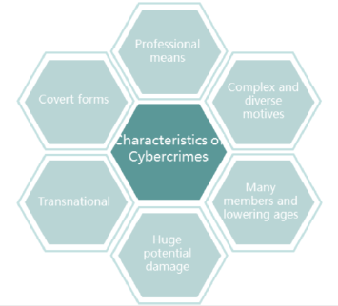
Chapter
10
Characteristics of Cybercrimes
• Over the past decade or so, the number of cybercrimes have risen year on year.
Cybercrimes generally have the following characteristics:

Slide 6
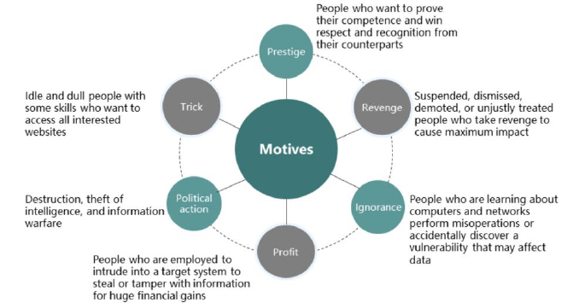
Chapter
10
Cybercrime Motives
• The motives of cybercrime are complicated and diverse.

Slide 7
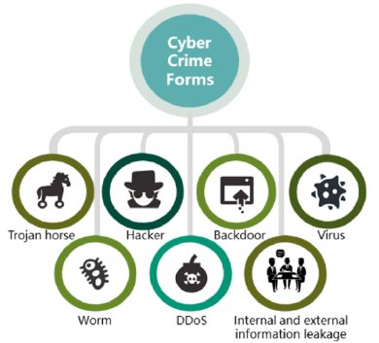
Chapter
10
Forms of Cybercrime
• Cybercrimes take various forms. Common forms are listed as follows:

Slide 8
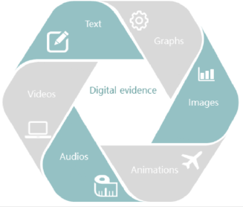
Chapter
10
Overview of Digital Forensics
• Digital evidence
□ Digital evidence is information stored or transmitted in binary form during the operation of a computer or computer system and is used in a court case.
□ Digital evidence is also known as electronic evidence and computer evidence.

Slide 9
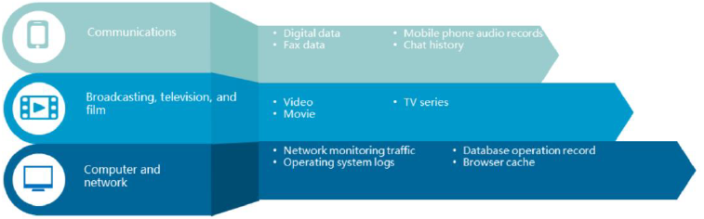
Chapter
10
Analysis of System Time Change Events
• Common digital evidence in judicial practices falls into three categories:
□ Digital evidence related to modern communications technologies
□ Digital evidence related to other modern information technologies, such as broadcasting, television , and film
□ Digital evidence related to computer technologies or network technologies

Slide 10
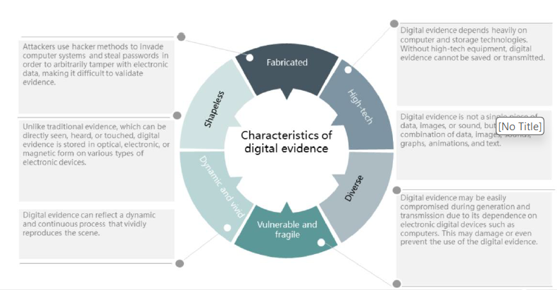
Chapter
10
Characteristics of Digital Evidence

Slide 11

Chapter
10
Concept of Computer Forensics
• Computer forensics is also known as digital forensics or electronic forensics.
Definition:
□ Computer forensics refers to the process of confirming, protecting, extracting, archiving, and presenting at a court digital evidence that exists in computers and related peripherals. This evidence must be reliable, persuasive, and acceptable by the court.

Slide 12
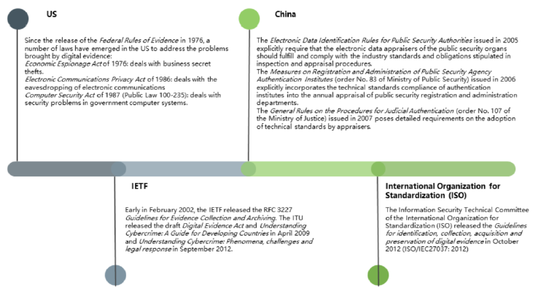
Chapter
10
Regulations & Standards for Digital Forensics

Slide 13
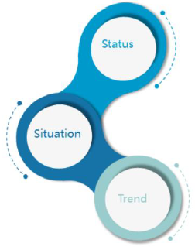
Chapter
10
Status & Trend of Digital Forensics
Status:
1. China was a late adopter of computers and therefore relevant laws and regulations are insufficient.
2. Academic research on cybercrimes mainly focuses on its characteristics, preventive measures, and impact on people. Forensics technologies are no longer sufficient to combat cybercrimes or to protect network and information security.
3. China must independently develop computer forensic tools and software that can meet its specific requirements and comprehensively check computers and network systems.
Trend:
1. Integration of other theories and technologies (such as Al, machine learning, neural network, data mining, and information security technologies) into forensic technologies
2. Specialization and automation of forensic tools
3. Sufficient information reserved during network protocol design for potential forensic activities

Slide 14
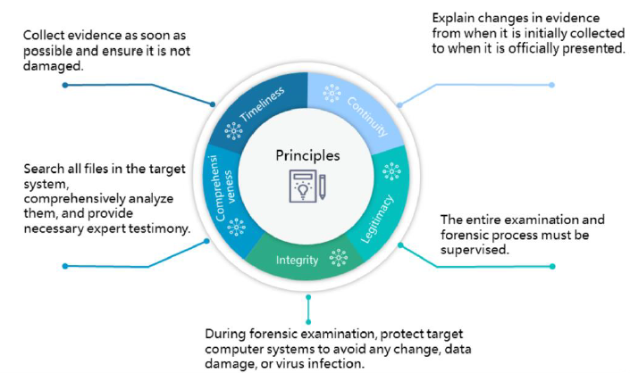
Chapter
10
Principles of Digital Forensics

Slide 15
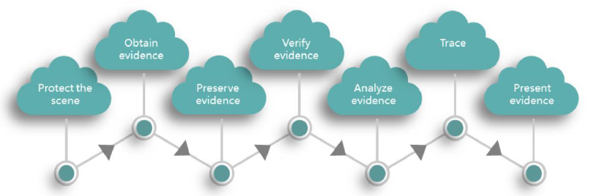
Chapter
10
Digital Forensic Process
• According to the characteristics of digital evidence, it is essential to collect evidence as soon as possible during digital forensics to ensure that it has not been damaged. Digital forensics usually involves the following steps:

Slide 16

Chapter
10
Protecting the Scene
• Before digital forensics is performed, freeze the target
computer system so that the criminal suspect cannot damage
evidence. Avoid any changes to system settings, damage to
hardware or data, or virus infection.
• Avoid changes in evidence. However, if changes occur from
when evidence is initially collected to when it is officially
presented, they must be explained. In addition, the whole
process of digital forensics must be supervised.

Slide 17


Chapter
10
Obtaining Evidence
• Search all files in the target system, including existing normal files, deleted files that still exist on disks (for example, files not overwritten by new files), hidden files, password-protected files, and encrypted files.
• Forensic tools:
□ Hardware tools
□ Software tools

Slide 18
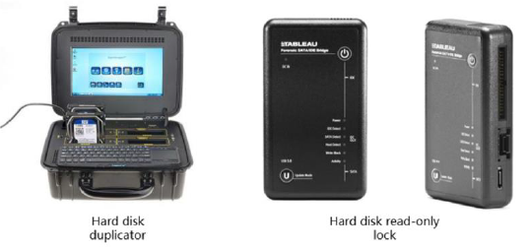
Chapter
10
Hardware Forensic Tools (1)
• Hard disk duplicator : mirrors the content of a hard disk to ensure that the data in the original hard disk
is not modified. This must be ensured because direct operation is not permitted on the original hard
disk during forensics.
• Hard disk read-only lock : blocks the write channel of a hard disk to ensure that data in the storage
medium is not modified during data obtaining and analysis, thereby ensuring data integrity.

Slide 19
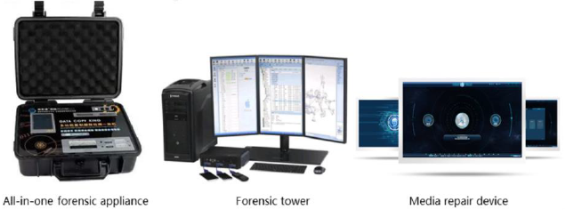
Chapter
10
Hardware Forensic Tools (2)
All-in-one forensic appliance: a forensic device that clones, reads, and destructs evidence.
Forensic tower: provides functions such as mobile phone forensic analysis, mobile phone mirroring, mobile phone chip mirroring, and media forensics.
Media repair device: repairs electronic data storage media, such as electronic hard disks,
mechanical hard disks, mirroring files, USB drives, and TF cards.

Slide 20
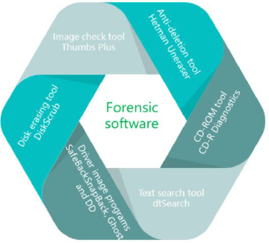
Chapter
10
Software Forensic Tools
• For ease of research, developers have created a wide variety of computer forensic tools as follows:

Slide 21
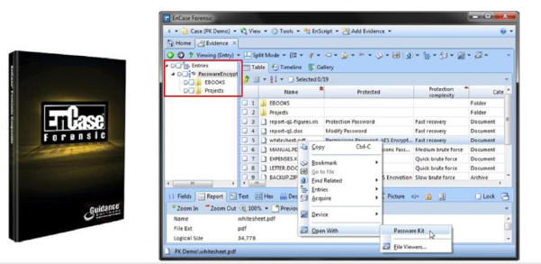
Chapter
10
Example Software Forensic Tool - EnCase
• EnCase is a forensic application completely integrated with the Windows Ul. It provides functions such as data browsing, search, disk browsing, data preview, case creation, evidence file creation, and case saving.

Slide 22

Chapter
10
Digital Forensics Related Technologies
• Digital forensics related technologies:
□ Network packet analysis and forensics
□ Log forensics
□ Honeypot forensics
□ Covert code forensics
□ Data mining
• Emerging forensic technologies:
□ Chip forensics
□ Cloud forensics
□ loT forensics
□ Side-channel attack (SCA) forensics

Slide 23
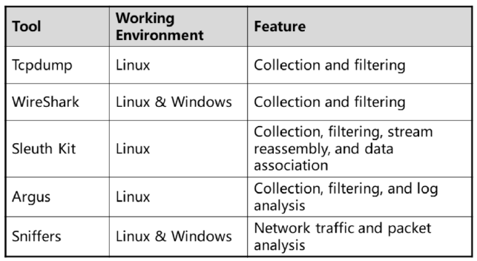
Chapter
10
Packet Analysis & Forensics
• Packet capture tools and their features:

Slide 24
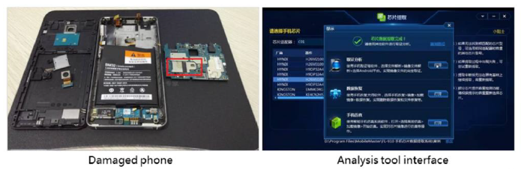
Chapter
10
Chip Forensics
• Joint Test Action Group analysis: Access the internal register of the analysis processor through the Test Access Port (TAP) inside the chip. Forensics can be implemented even if the phone is damaged.
• The red box in the figure shows the phone chip. You can use the analysis tool to collect evidence from the damaged phone chip.

Slide 25
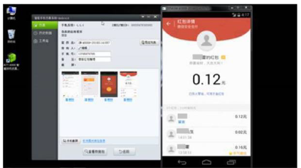
Chapter
10
Dynamic Simulation
• Dynamic simulation is used to simulate a mobile phone in order to restore the chat history and group discussion information, extract files in chat software, and analyze the number of reposts, impact scope, source of information, and more.
As shown in the following figure, a simulator is used to simulate the operational environment of a mobile phone and display the digital red envelop records.

Slide 26

Chapter
10
Preserving Evidence
• The preservation of evidence directly affects the legal effect of the evidence. Only preservation technologies that conform to legal regulations can guarantee the authenticity and reliability of evidence.
• Evidence preservation technologies:
□ Encryption
□ Digital envelope and digital signature
□ Digital certificate
□ Timestamp

Slide 27
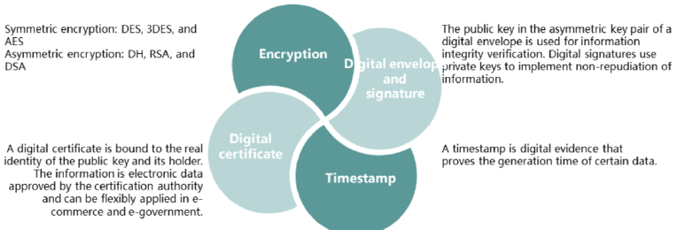
Chapter
10
Evidence Preservation Technologies
• Avoid changes in system settings, hardware damage, data damage, and virus infection during forensics to preserve evidence in its initial state.

Slide 28

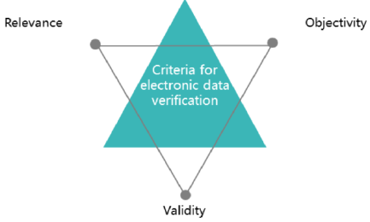
Chapter
10
Verifying Evidence
• Verify the integrity of evidence and determine whether it complies with applicable standards.

Slide 29
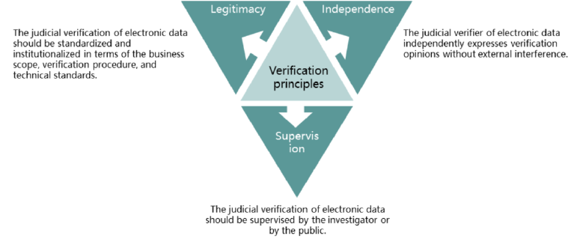
Chapter
10
Principles of Digital Evidence Verification
• Electronic data verification is a special scientific and technical activity and has its own specific principles.

Slide 30
Chapter
10
Analyzing Evidence
• Evidence analysis: Search for and match keywords or key phrases in the obtained data flows or information flows to analyze the relevance of events. Evidence analysis technologies include:
□ Password cracking and data decryption
□ File attribute analysis
□ Digital digest analysis
□ Log analysis
□ Reverse engineering

Slide 31

Chapter
10
Tracing
• With the upgrade of cybercrime technologies, forensics has been combined with network security tools, such as intrusion detection, to implement dynamic forensics. The purpose of tracing is to find the attack source.
• Forensic tracing technologies:
□ Log analysis
■ Operating system logs
■ Firewall logs
■ Application software logs
□ Trapping (honeypot)
□ Tracing and capturing suspects using related devices

Slide 32

Chapter
10
Forensic Tracing Technologies
• Hackers usually use data encryption, log clearing, sniffer, stepping stone, or a bastion host to hide or clear intrusion traces. Therefore, it is necessary to implement forensic tracing on intrusion information. Common tracing technologies are as follows:
□ ping, netstat, tracert, and nslookup commands
□ Packet analysis
□ Log analysis
□ Link test
□ Packet record
□ Packet tag tracing
□ Spam tracing

Slide 33

Chapter
10
Presenting Evidence
• Mark the extraction time, place, device, extractor, and witness of the evidence, submit the evidence to the judicial authority in a visible form, and provide a complete supervision chain.

Slide 34



Thank You

