Slide 1


Publishing and Sharing, Reports
Prepared by Eng. Ahmed Hussein, MBA, PfMP©, PMP©, CMP APMG
Course: From Data to Decisions using Power BI
Lecture 09

Slide 2


Power BI Workflow
(The Analytics Journey)
Lecture
09
Connect Data
Model Data
Create Visualizations
Transform Data
Build Reports/ Dashboards
Publish/ Share
Make Decision
Tables loaded
Connected relationships
Professional Layout
Reliable tables
Charts and KPIs
Decision-ready report
Each stage adds value — skip one and the chain breaks
2

Slide 3


Orientation
What we will cover
Lecture
  Publishing Reports to Cloud
  Dashboards & Enterprise Sharing
  Data Connections & Refresh Automation
3

Slide 4

1. Publishing Reports to Cloud
Lecture
09
4
Notes:
Learn step-by-step how to deploy local .pbix files into target Workspaces, navigate cloud artifacts, and understand semantic models.

Slide 5



Why Publish Reports?
Collaboration
Access interactive reports
Automated Pipelines
Break down data silos. Workspaces enable multi-author development and centralized analytics for team members.
Access interactive reports anytime, anywhere via web browsers, Microsoft Teams embeds, and native iOS/Android apps.
Eliminate manual file emailing. Cloud scheduled refreshes keep semantic models automatically synchronized with database updates.
5

Slide 6
Power BI Desktop vs Service
Capability / Feature | Power BI Desktop (Client) | Power BI Service (Cloud SaaS)
Primary Function | Report Authoring & Data Modeling | Report Consumption & Distribution
Data Transformations | Full Power Query M engine | Dataflows & Datamarts (Cloud ETL)
DAX Calculations | Create Calculated Columns & Measures | Measures only (Quick Measures)
Dashboards & Sharing | Not Supported (Saved as .pbix) | Pin Tiles, Apps, Share Links, RLS
Data Sync | Manual Refresh click | Scheduled Gateway Automated Refresh
6

Slide 7

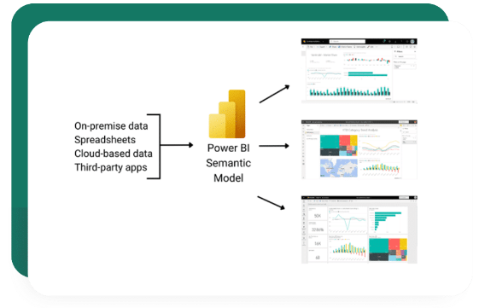
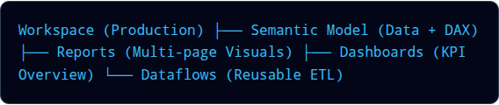
What is a Workspace?
Centralized Collaboration Hub
A Workspace is a cloud container in Power BI Service used to collaborate on and manage organizational analytics assets.
7

Slide 8
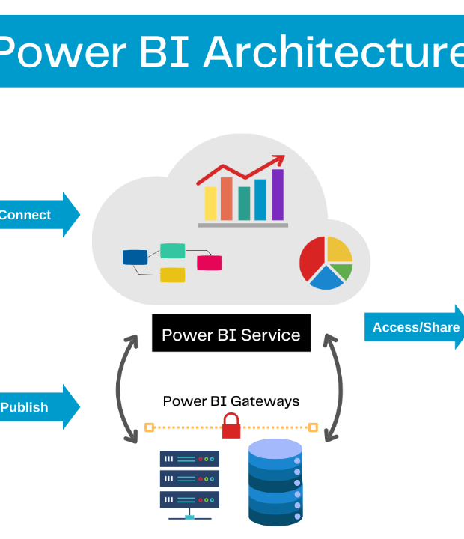
Publishing Workflow
End-to-End Enterprise Flow
Data moves systematically from source systems into client Desktop authoring, then uploads into cloud Workspaces.
Once published, the dataset becomes a reusable Semantic Model, powering interactive reports, executive dashboards, and automated consumer alerts.
8
8

Slide 9



Publishing Steps
Save Local .PBIX File
Ensure all Power Query transformations are applied and DAX measures test successfully without syntax errors.
Authenticate Organizational Account
Click "Sign In" in the top-right corner of Desktop using your Microsoft Entra ID (Azure AD) work account.
Click "Publish" on Home Ribbon
Select your destination cloud Workspace (e.g., "Sales Analytics - Production") and initiate the upload.
9

Slide 10


Understanding Semantic Models
Report ≠ Semantic Model
One Model → Many Reports
Power BI cleanly separates the data layer (Semantic Model) from the presentation layer (Report).
Multiple team members can build separate specialized reports (e.g., Sales, Finance, HR) connected to one central Semantic Model.
This decoupling enables a single unified dataset to serve as the single source of truth across the enterprise.
Prevents duplicate DAX logic and inconsistent business metrics.
10
10

Slide 11
What Gets Published?
Semantic Model
Report Visuals
Metadata & RLS
Tables, imported data rows, relationships, hierarchies, DAX measures, and connection strings.
Visual canvas layouts, pages, slicers, custom color palettes, bookmarks, and mobile view definitions.
Row-Level Security role definitions, dataset descriptions, and sensitivity classification tags.
11

Slide 12
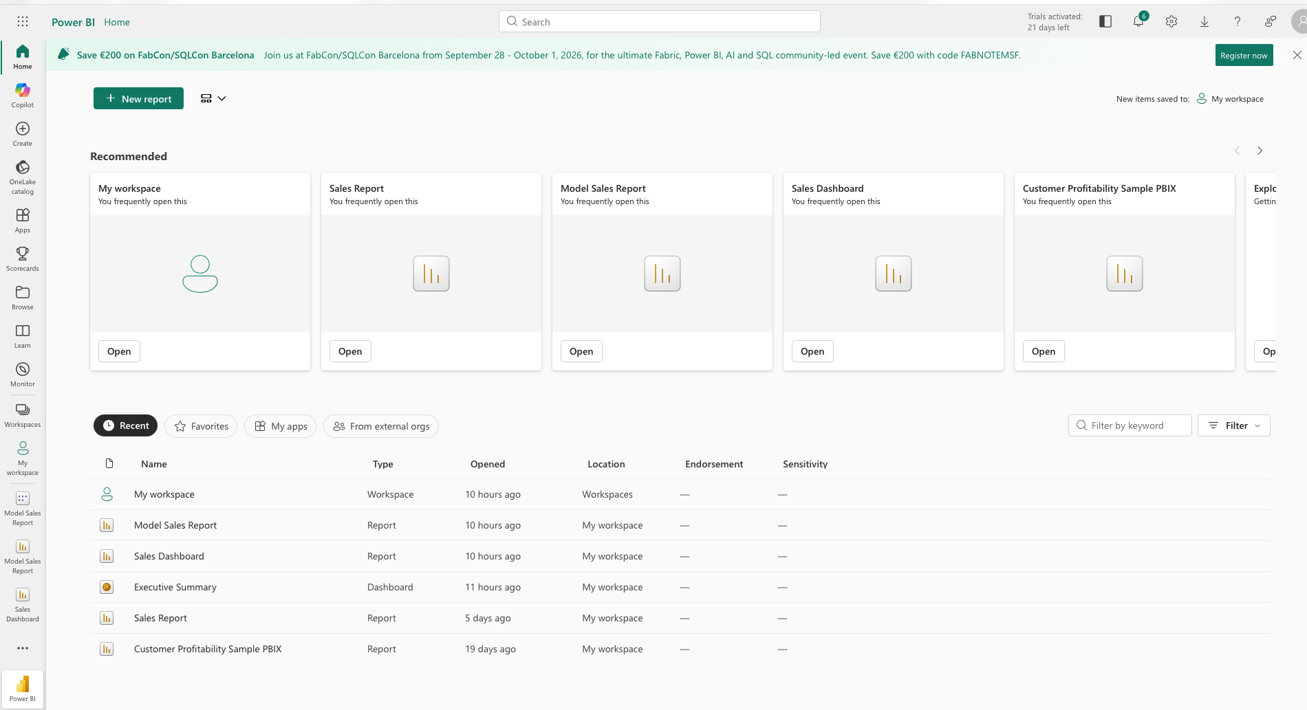
Navigating Power BI Service
Home: Quick access to top KPIs, frequent reports, and company announcements.
Workspaces: Folder containers holding team reports and datasets.
Apps: Packaged, read-only analytics distribution bundles for end-users.
Recent & Favorites: One-click access to starred or recently viewed items.
12

Slide 13
Republishing & Overwriting
Overwriting Prompt
Important Cautions
Publishing a report with the exact same name as an existing cloud report triggers a replace warning dialog.
Protect Cloud Credentials:
Overwriting a semantic model resets dataset credentials in Service. You must re-verify cloud connection settings post-overwrite.
Replacing updates both the visual layouts and underlying DAX measures in the cloud workspace.
13
13

Slide 14
Publishing Best Practices
Standardized Names
Separate Workspaces
Dataset Metadata
Use clear, consistent naming conventions (e.g., [Dept]_[Subject]_[Env] like FIN_Revenue_PROD).
Isolate Development, Staging, and Production environments across different workspaces.
Add descriptive tags, owner contacts, and column definitions in the dataset settings tab.
14

Slide 15
2. Dashboards & Enterprise Sharing
Lecture
09
15
Notes:
Construct high-level executive dashboards, master workspace permission roles, and publish organization-wide Apps.

Slide 16
Power BI Report vs Dashboard
Feature | Power BI Report | Power BI Dashboard
Page Count | Multi-page detailed canvases | Single-page executive screen
Data Sources | Bound to 1 Semantic Model | Pins tiles from MULTIPLE reports & models
Interactivity | Slicers, cross-highlighting, drill-down | Static tile snapshots (Click tile → Opens Report)
Exclusive Features | Visual tooltips, page navigation | Data Alerts, Q&A natural language, mobile tiles
16

Slide 17
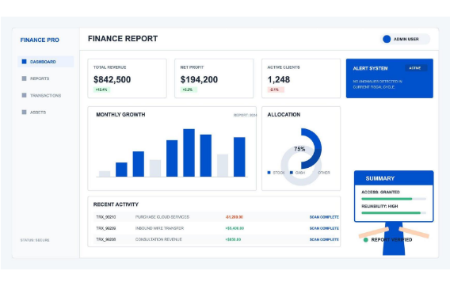
Creating Dashboards
360-Degree Executive View
Dashboards aggregate key metrics into a single high-level screen for rapid executive decision-making.
Hover over any visual in a report
Click the "Pin visual" pin icon
Select "Existing Dashboard" or "New Dashboard"
Resize and arrange tiles on the dashboard canvas
17

Slide 18
Pinning Options
Pinning Single Visual Tile
Pin Live Page
Pins a single isolated chart or KPI card.
  Fast loading time
  Combines visuals from seperate reports
  Supports setting numeric Data Alerts
Embeds an entire interactive report page into the dashboard.
  Preserves interactive slicers on dashboard
  Maintains exact page layout & colors
  Does NOT support Data Alerts on tiles
18
18

Slide 19

Sharing Reports & Dashboards
Direct Link Sharing
Licensing Requirements
Generate secure share links for targeted colleagues within your Microsoft Entra tenant.
Recipient needs Power BI Pro or Premium Per User (PPU) license
Option to allow/disallow re-sharing &
building downstream reports
Pro License ($10/mo): Required for both content creators AND consumers viewing shared reports in standard capacity.
Premium Capacity (F64/P1): Allows free Power BI accounts to view published content.
19
19

Slide 20
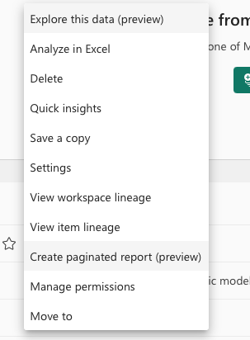
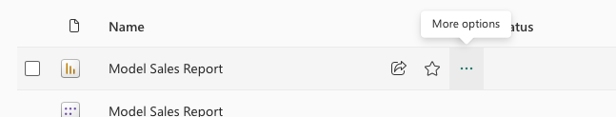
Workspace Roles
Role | Publish & Edit | Manage Users | Reshare Content | View Content
Admin | Yes | Yes | Yes | Yes
Member | Yes | No | Yes | Yes
Contributor | Yes | No | No | Yes
Viewer | No | No | No | Yes
20

Slide 21

Power BI Apps Distribution
Gold Standard for Organizational Distribution
An **App** is a packaged bundle of finalized reports, dashboards, and links created from a single Workspace.
Clean, unified navigation menu for business users
Prevents consumers from altering workspace authoring assets
Staging benefit: Update reports in workspace privately, then click "Update App" to publish to consumers
21

Slide 22
Row-Level Security (RLS)
1. Authoring in Desktop
2. Assigning in Service
Create security roles using DAX filter expressions in Power BI Desktop under Modeling → Manage Roles.
After publishing, go to Dataset Settings → Security in Power BI Service.
Map Microsoft Entra users or security groups to defined roles (e.g. assigning John to "US_Sales_Role").
[SalesRegion] = USERPRINCIPALNAME()
22
22

Slide 23
3. Data Connections & Refresh Automation
Lecture
09
23
Notes:
Construct high-level executive dashboards, master workspace permission roles, and publish organization-wide Apps.

Slide 24
Why Refresh Data?
Data Synchronization
Decision Accuracy
Automated Timeliness
Business data changes constantly in databases and ERPs; published reports must reflect current records.
Operational teams rely on up-to-date metrics for daily inventory, sales tracking, and financial reconciliation.
Automated scheduled refreshes execute during off-peak hours without manual intervention from report authors.
24

Slide 25
Data Connection: 1. Import Mode
How It Works
Refresh Requirement
Data is extracted from source systems and compressed into Power BI's in-memory engine.
Blazing fast DAX calculation speed
Supports all Power Query transformation functions
Full DAX modeling flexibility
Data in cloud is static until a data refresh occurs.
1 GB dataset size limit per model (Standard Pro)
Requires scheduled refresh setup
25
25

Slide 26
Data Connection: 2. Direct Query
Zero Data Storage in Cloud
Best For Big Data
Power BI stores NO data rows in the cloud semantic model.
Visual interactions generate native SQL queries directly against the source database in real-time.
Ideal for massive datasets (Terabytes/Petabytes) exceeding Import limits
Guarantees strictly real-time reporting
Performance is limited by source database speed
26

Slide 27
Data Connection: 3. Live Connection
Enterprise Centralized Model
Report Layer Only
Connects a Power BI report directly to an existing hosted tabular model or published Fabric/Power BI Semantic Model.
The report contains visual layouts only. Modeling, calculated tables, and DAX measures are strictly managed in the centralized source dataset.
27
27

Slide 28
Comparing Connection Modes
Criterion | Import Mode | Direct Query | Live Connection
Data Location | Power BI Cloud Memory | Source Database | Analysis Services / Fabric
DAX Performance | Blazing Fast (In-Memory) | Depends on Source DB | Fast (Enterprise Server)
Data Freshness | Scheduled Sync | Real-time | Real-time / Near Real-time
Model Flexibility | Full (Data & DAX) | Limited DAX functions | Report layer visualizations only
28

Slide 29
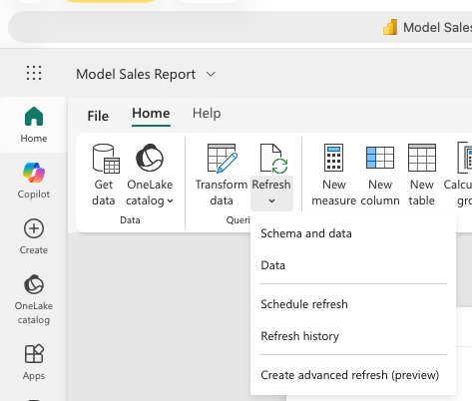
Manual "Refresh Now"
Immediate On-Demand Sync: Located in the Semantic Model options menu in Power BI Service.
Testing & Validation: Use "Refresh Now" immediately after publishing to test database connectivity and credentials.
Apps: Packaged, read-only Ad-Hoc Updates: Ideal for triggering off-schedule updates when stakeholders demand instant figures before a big meeting.
Rate Limits: On-demand refreshes count against your daily refresh limit (8/day for Pro, 48/day for Premium).
29

Slide 30
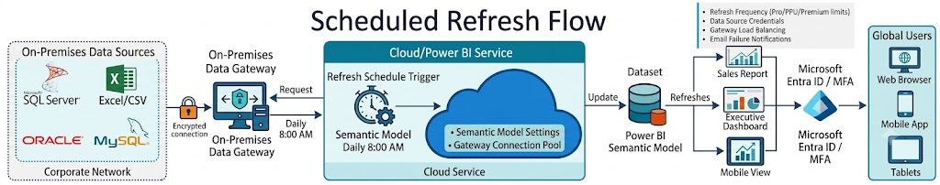
Scheduled Refresh Flow
Cloud-to-On-Premises Refresh Pipeline
Power BI Service triggers scheduled refreshes according to user-defined time slots.
Power BI Service: Initiates refresh schedule
Azure Service Bus: Encrypted relay tunnel
On-Premises Gateway: Queries local SQL/Files
Semantic Model: Updates in-memory compressed rows
30

Slide 31
Configuring Refresh Steps
Open Dataset Settings
Configure Data Source Credentials
Enable Scheduled Refresh Toggle
In Power BI Service workspace, locate your Semantic Model → Settings → Gateway & Cloud Connections.
Enter database credentials (e.g., OAuth2, Windows Authentication, or Database SQL user login).
Set refresh frequency (Daily/Hourly), time zone, and target execution times (e.g., 6:00 AM daily).
31

Slide 32
Refresh Frequency & Limits
Power BI Pro
Capacity 8 Refreshes / Day
Premium / Fabric
Capacity 48 Refreshes / Day
Scheduled in 30-minute time increments.
Best for daily or multi-shift operational updates.
Allows half-hourly refresh schedules
32
32

Slide 33
Monitoring Refresh History
Inspecting Execution Logs
Failure Notifications
Click Dataset Settings → Refresh History to view past execution statuses.
Start and end execution duration
Completed vs Failed status
Power BI Service automatically sends email notifications to the dataset owner upon refresh failure.
33
33

Slide 34
Troubleshooting Refresh Errors
Common Root Cause | Error Symptom | Remediation Action
Expired Credentials | InvalidCredentialsException | Re-enter database password in Dataset Settings
Gateway Offline | GatewayUnreachableException | Verify gateway host server status & Windows service
Database Schema Changes | Column 'X' not found | Fix Power Query step or update source table columns
File Moved / Deleted | Could not find file path | Relocate local Excel file to SharePoint / OneDrive cloud URL
34

Slide 35
Demo on Power BI
Lecture
09
35

Slide 36
Examples for some free Power BI Courses on YouTube
Duration Level | English Course | Arabic Course
Quick Overview (~20–30 mins) | [Power BI Tutorial for Beginners] • Focus: Service navigation, dashboard basic setup, and cloud publishing walkthrough. | شرح Power BI في 35 دقيقة • Focus: Fast-paced overview from data load to report creation and cloud publishing.
Crash Course (~1–2 hours) | Learn Power BI - Tutorial for Beginners • Focus: End-to-end dashboard creation, Power Query basics, and Power BI Service deployment. | كورس Power BI شامل للمبتدئين • Focus: Core concepts, Power Query data cleaning, data modeling, and basic visualization.
Comprehensive Deep-Dive (~6–8 hours) | Power BI for Data Analytics - Full Course • Focus: Structured ETL, DAX, relational data modeling, interactive dashboards, and cloud sharing. | كورس باور بي أي من الصفر حتى الاحتراف | Power BI Full Playlist Best For: A detailed step-by-step series that builds real-world dashboards, explores DAX functions, and demonstrates Power BI Service sharing features.
Masterclass / Bootcamp (8+ hours) | Power BI Full Course Tutorial (8+ Hours) • Creator: Learnit Anytime • Focus: Advanced DAX, data modeling optimization, workspace administration, gateway setup, and governance. | دورة احتراف Power BI وتحليل البيانات الشاملة Best For: In-depth professional training covering complex data modeling, Time Intelligence DAX, gatekeeper management, and enterprise governance.
36

Slide 37

Exercise: Publishing and Sharing
Using the reports you have already created from previous lectures:
From Power BI Desktop:
Publish the report to your workspace
2. From Power BI Service:
Schedule refreshes to once/day
Share the report (get the share link)
Add user permissions to the report
Create a dashboard containing only 2 visuals from your report
Lecture
09
Exercise
37

Slide 38
Lecture
Key Points
08
Decoupled Architecture: Publishing separates your project into a central Semantic Model and a Report so one dataset can securely power multiple enterprise solutions.
Reports vs. Dashboards: Multi-page Reports provide detailed interactive analysis, while single-page Dashboards aggregate high-level KPI tiles pinned across multiple reports.
Data Refresh Pipeline: Import Mode relies on Scheduled Refresh and On-Premises Data Gateways to update data, whereas DirectQuery queries source databases in real time.
Monitoring & Mobility: Automated Data Alerts, scheduled Subscriptions, and mobile-optimized layouts ensure stakeholders stay informed securely across all modern devices.
Governance & Distribution: Enterprise access is secured through Workspace Roles (Admin, Member, Contributor, Viewer), Row-Level Security (RLS), and packaged Power BI Apps.
Time
Cost
Scope
38

Slide 39
Lecture 10:
Capstone Project (End to End Case for a real dataset)
Lecture
09
Next Lecture
39

Slide 40

Thank You

