Slide 1


Slide 2
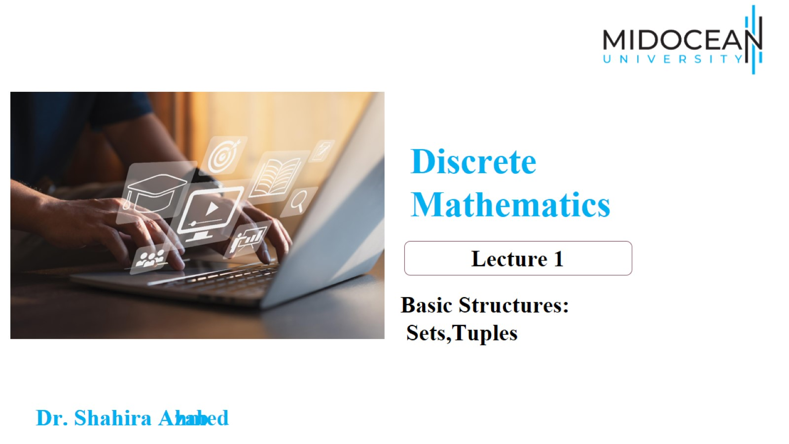

Slide 3
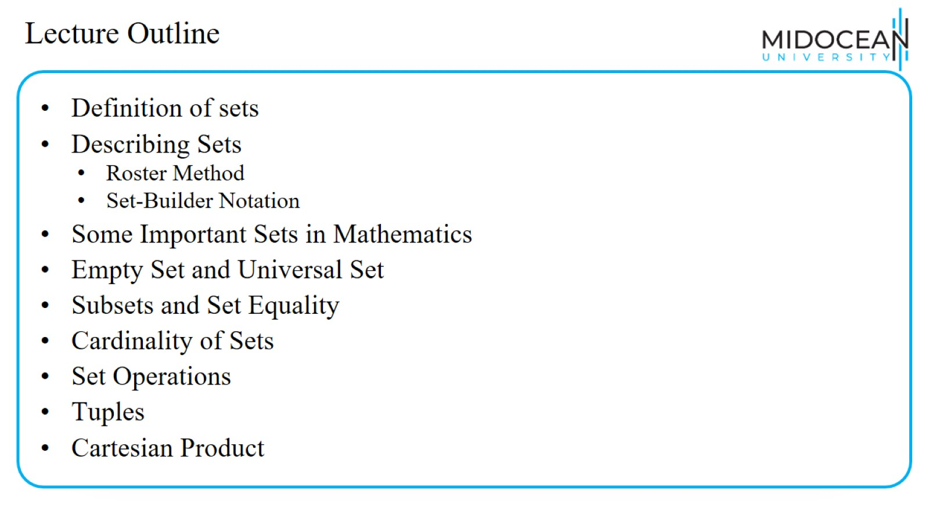
Lecture Outline

Slide 4
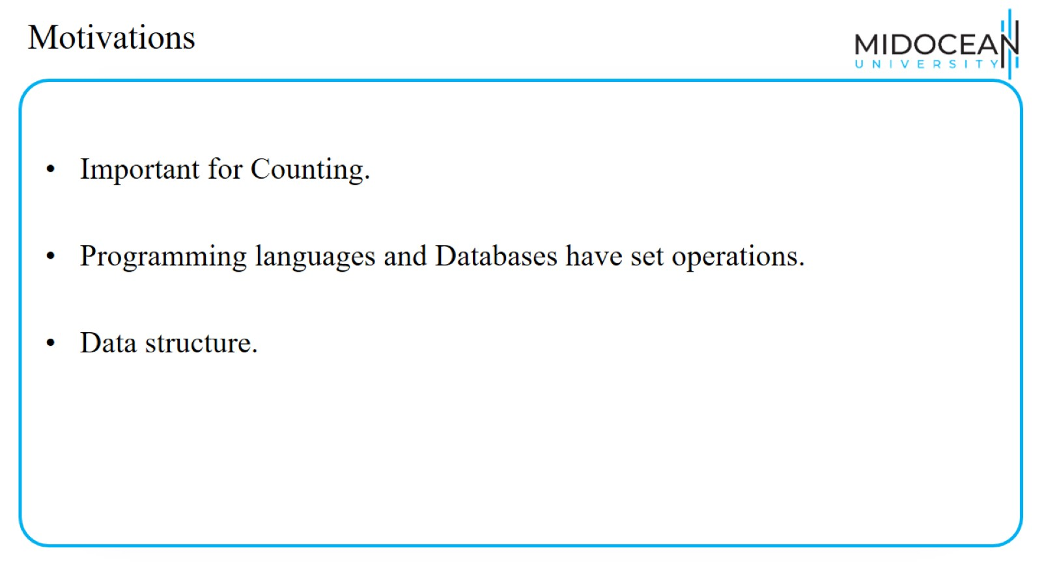
Motivations

Slide 5
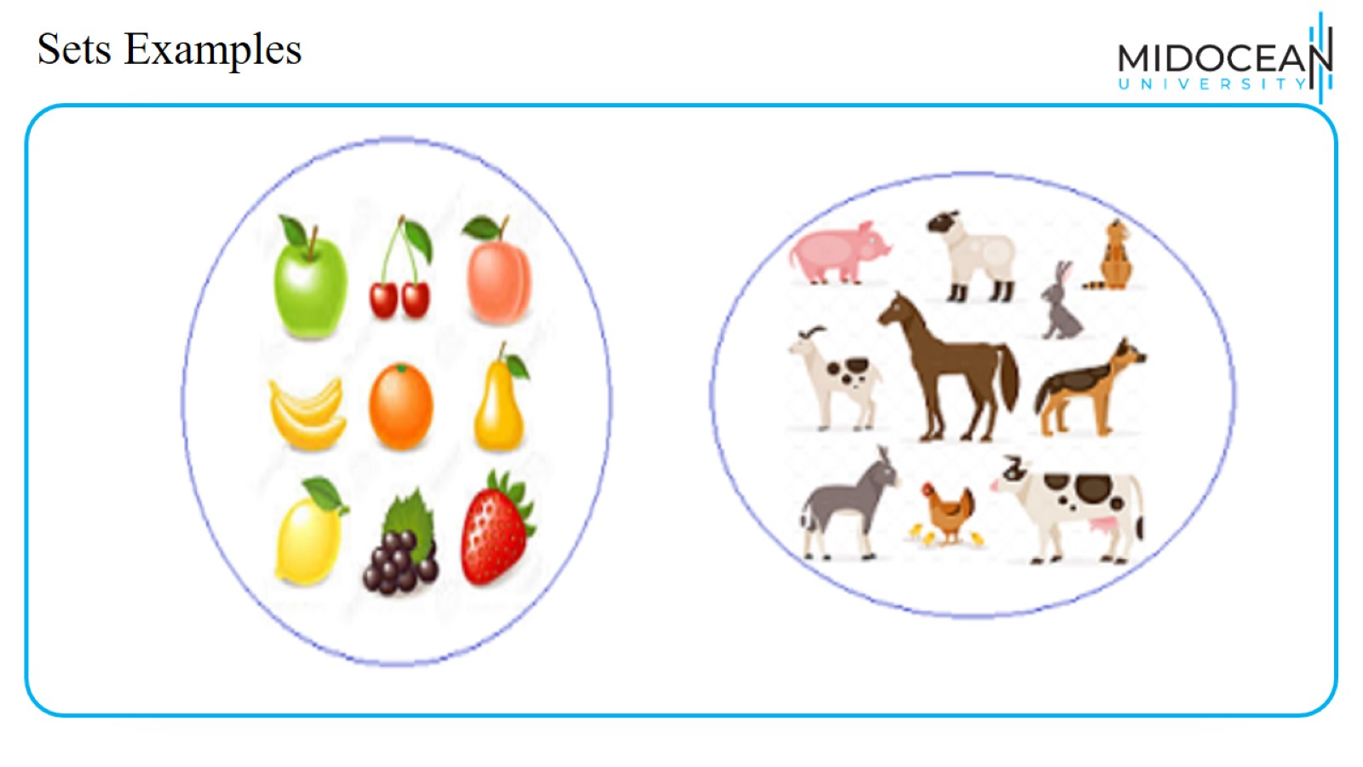
Sets Examples

Slide 6
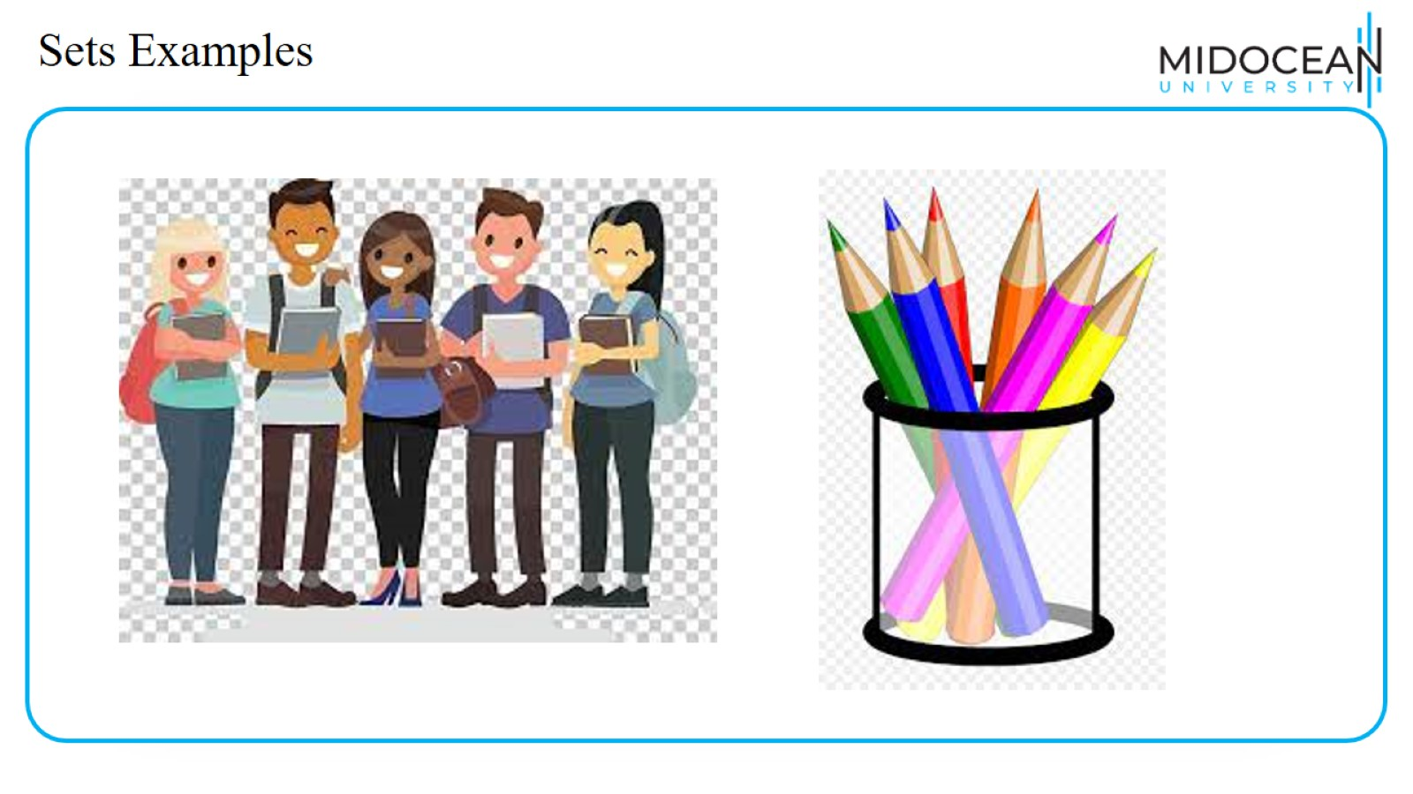
Sets Examples

Slide 7
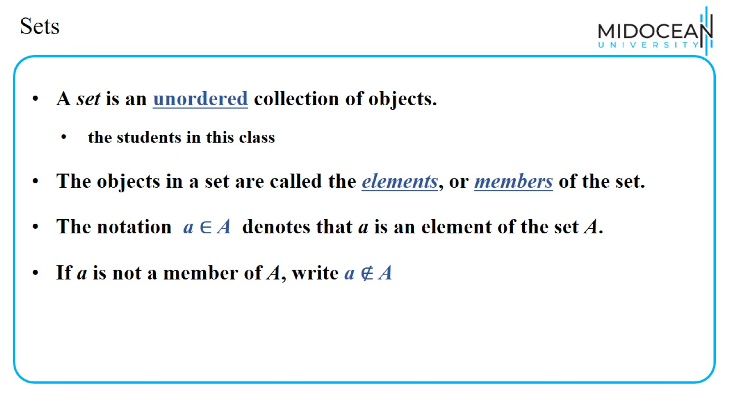
Sets

Slide 8
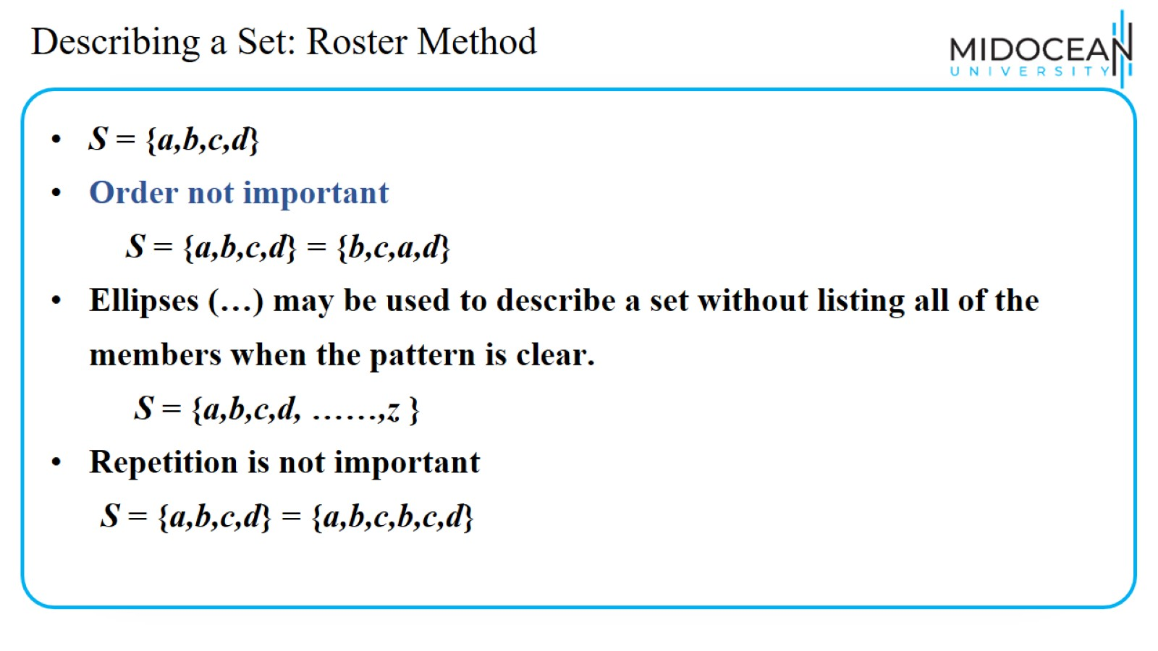
Describing a Set: Roster Method

Slide 9
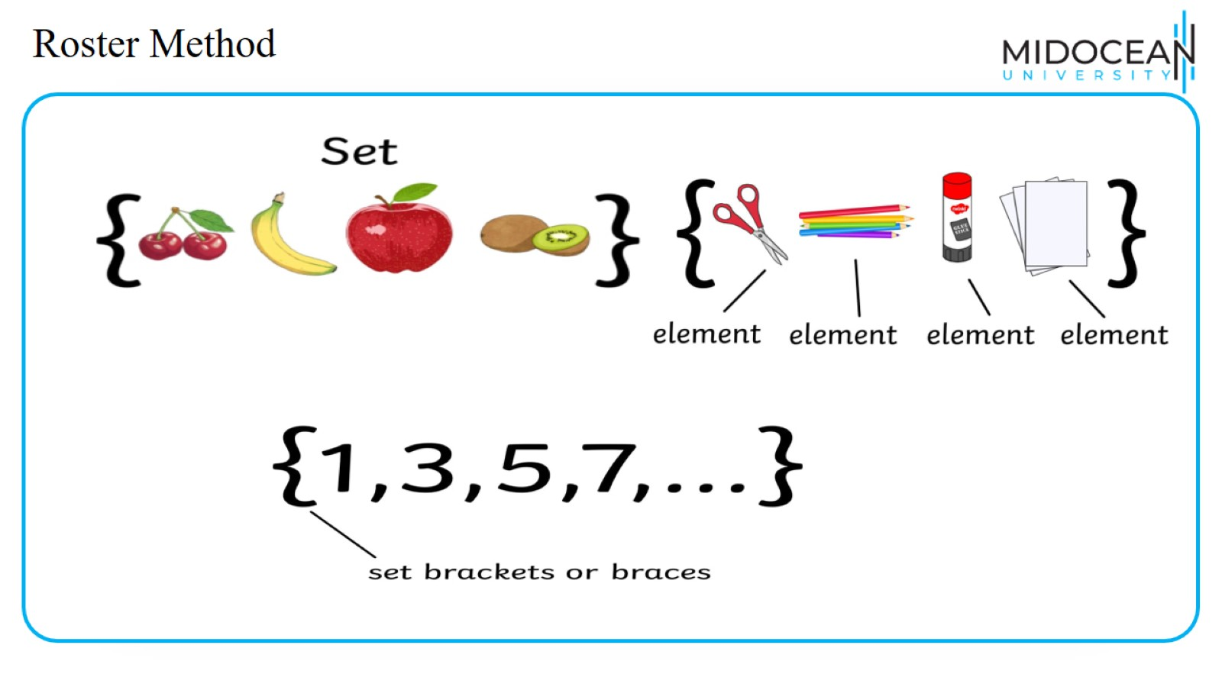
Roster Method

Slide 10
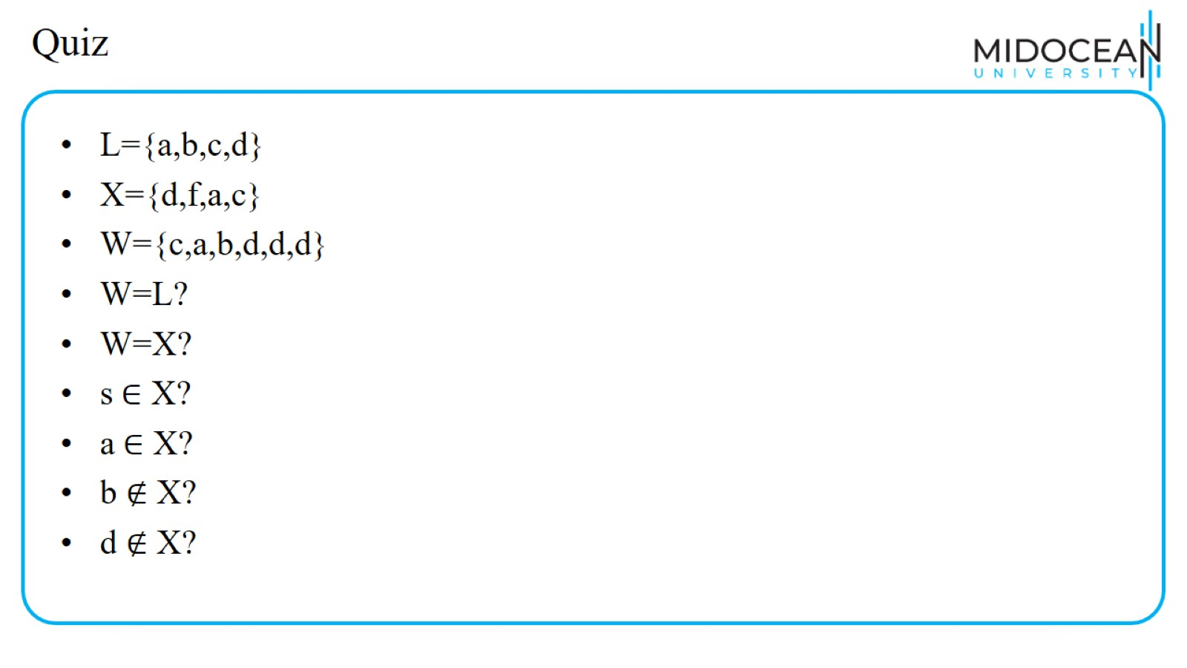
Quiz

Slide 11
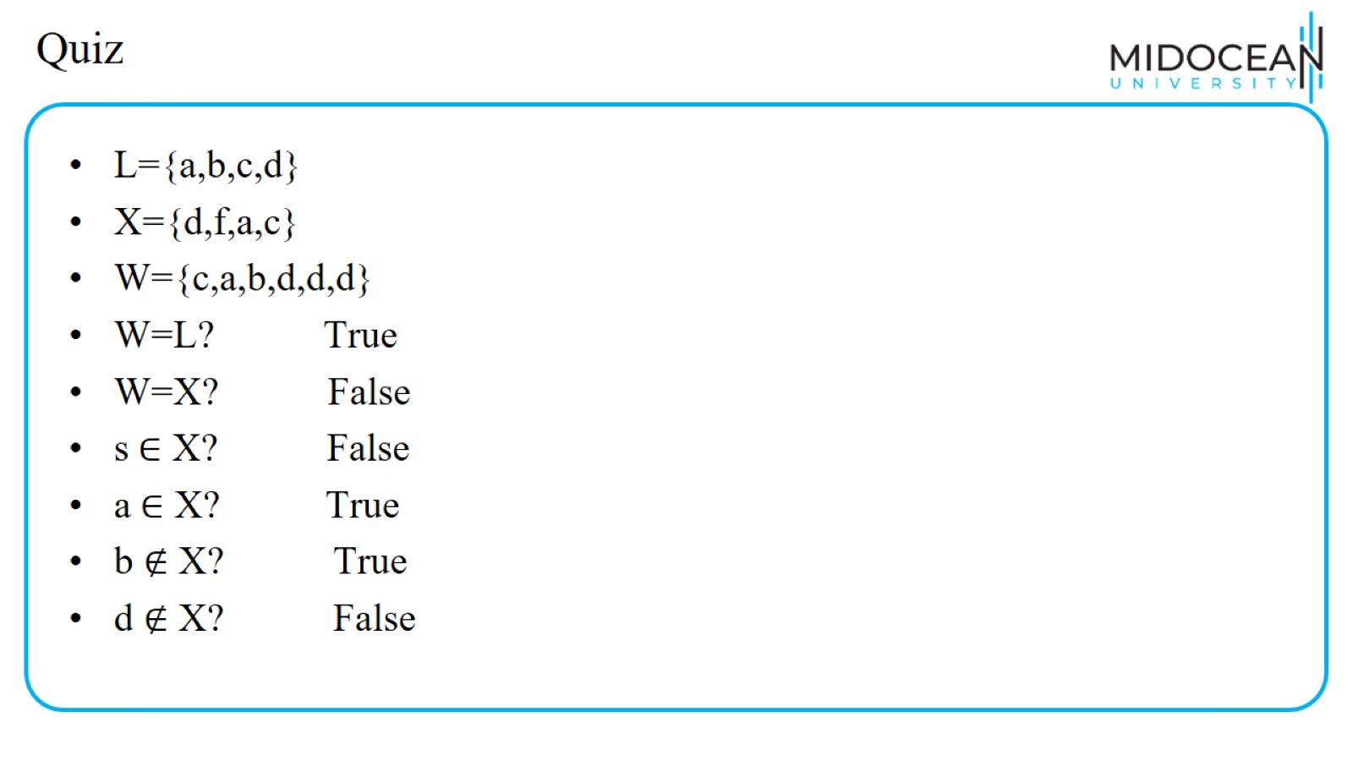
Quiz

Slide 12
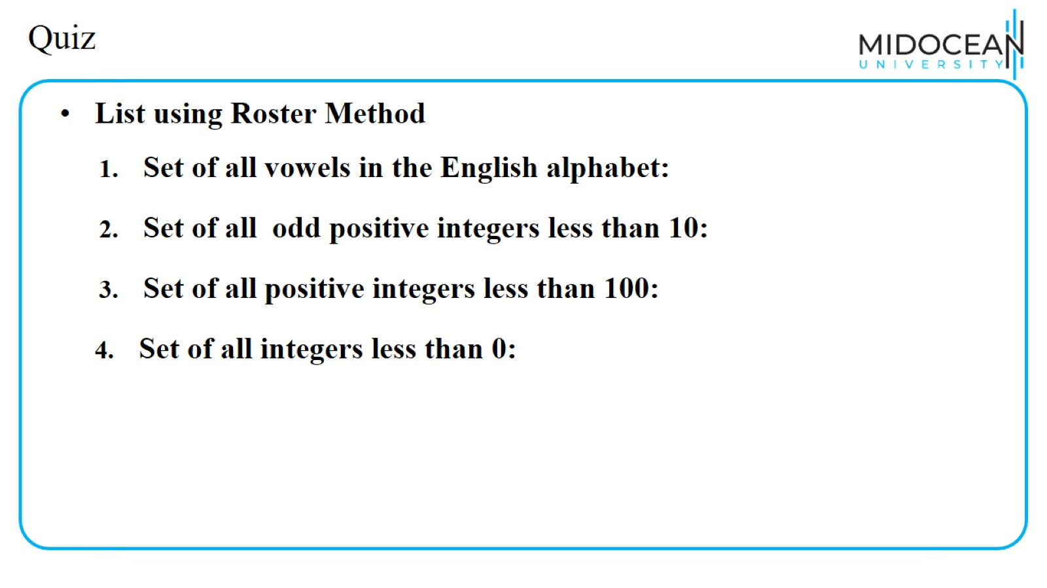
Quiz

Slide 13
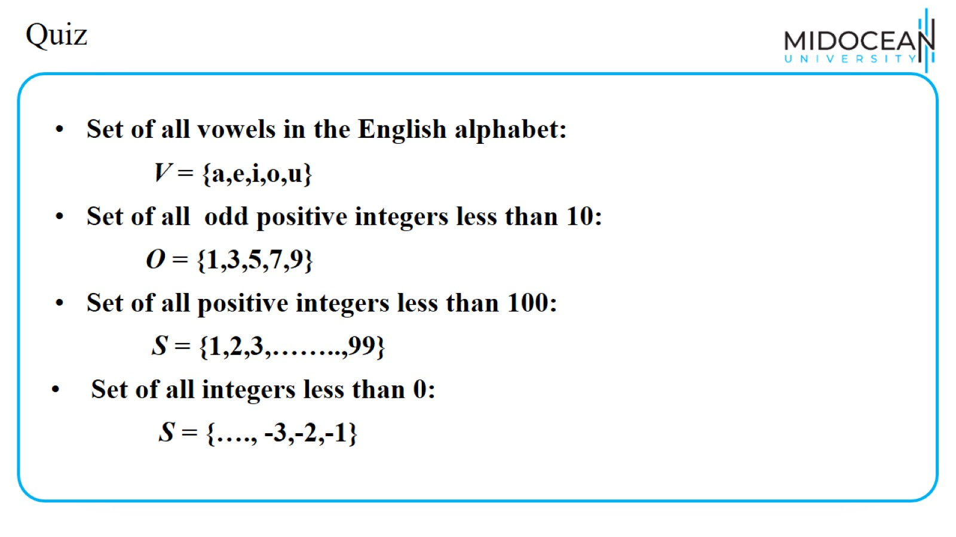
Quiz

Slide 14
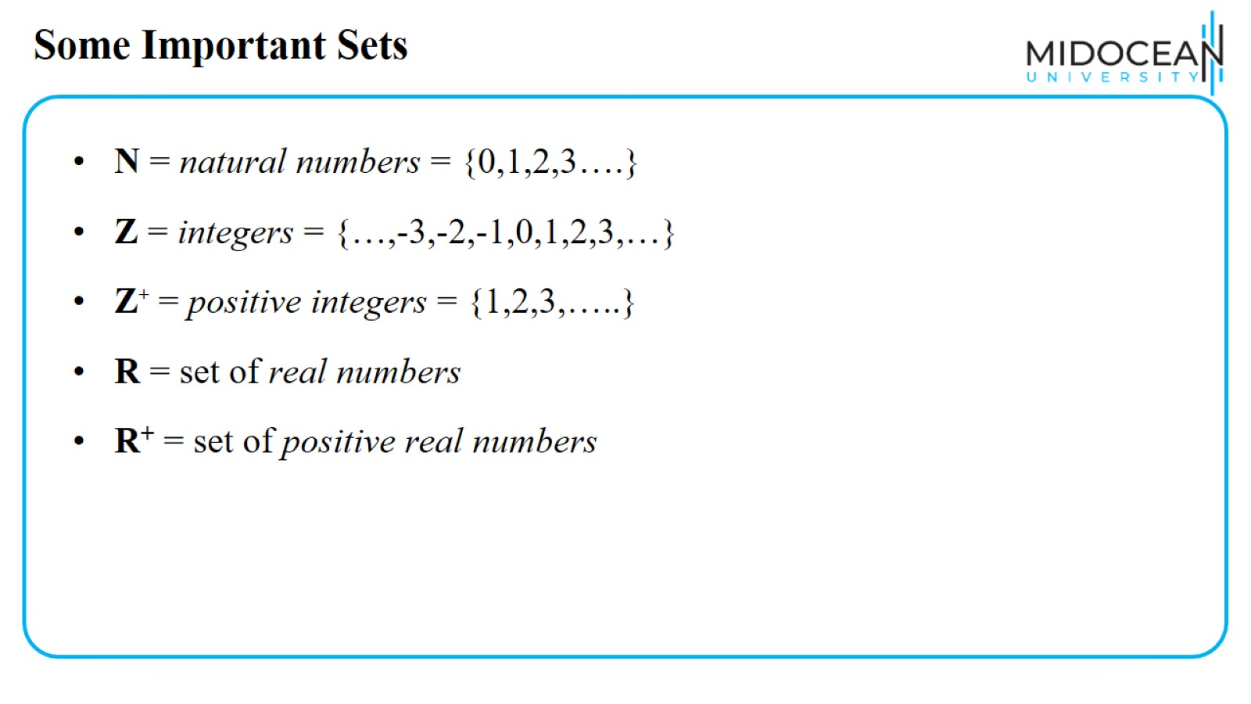
Some Important Sets

Slide 15
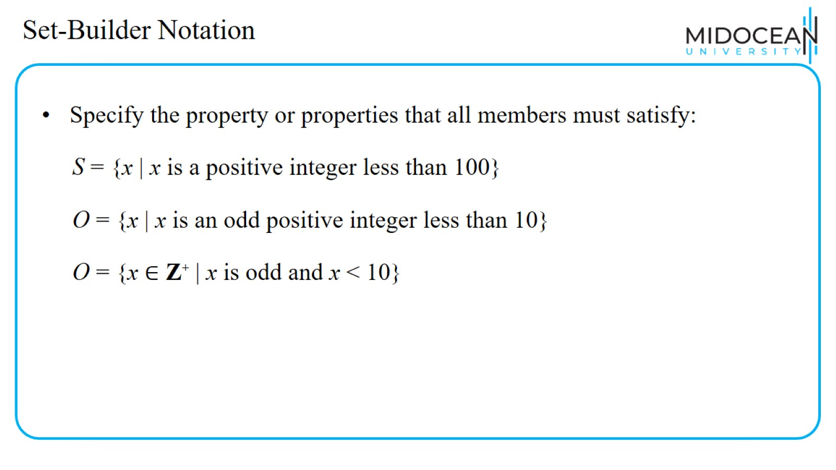
Set-Builder Notation

Slide 16
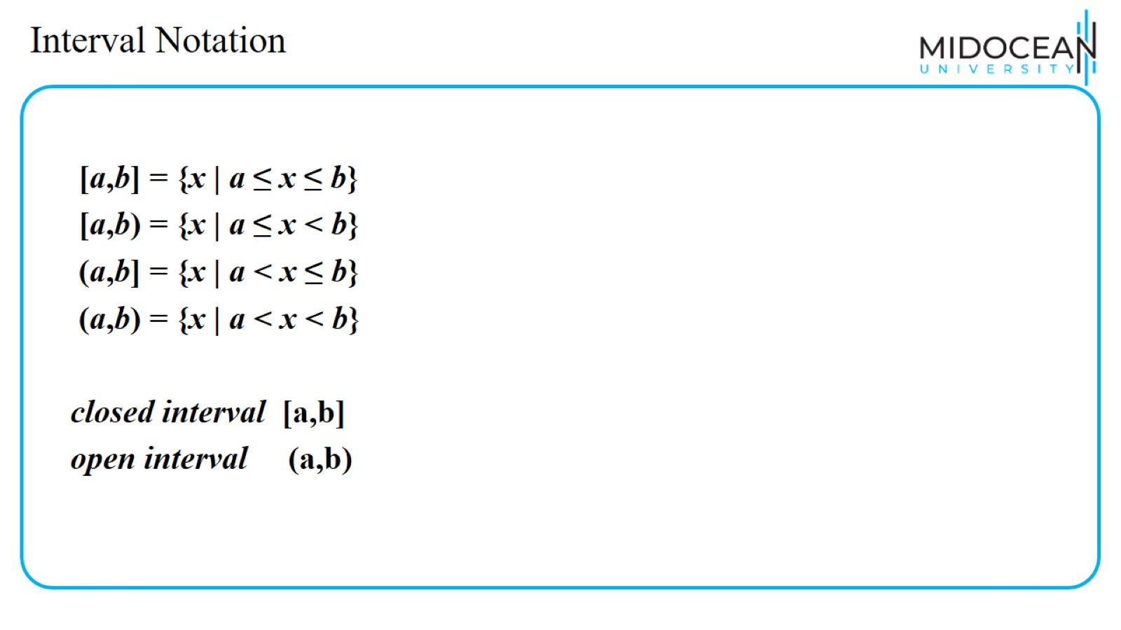
Interval Notation

Slide 17
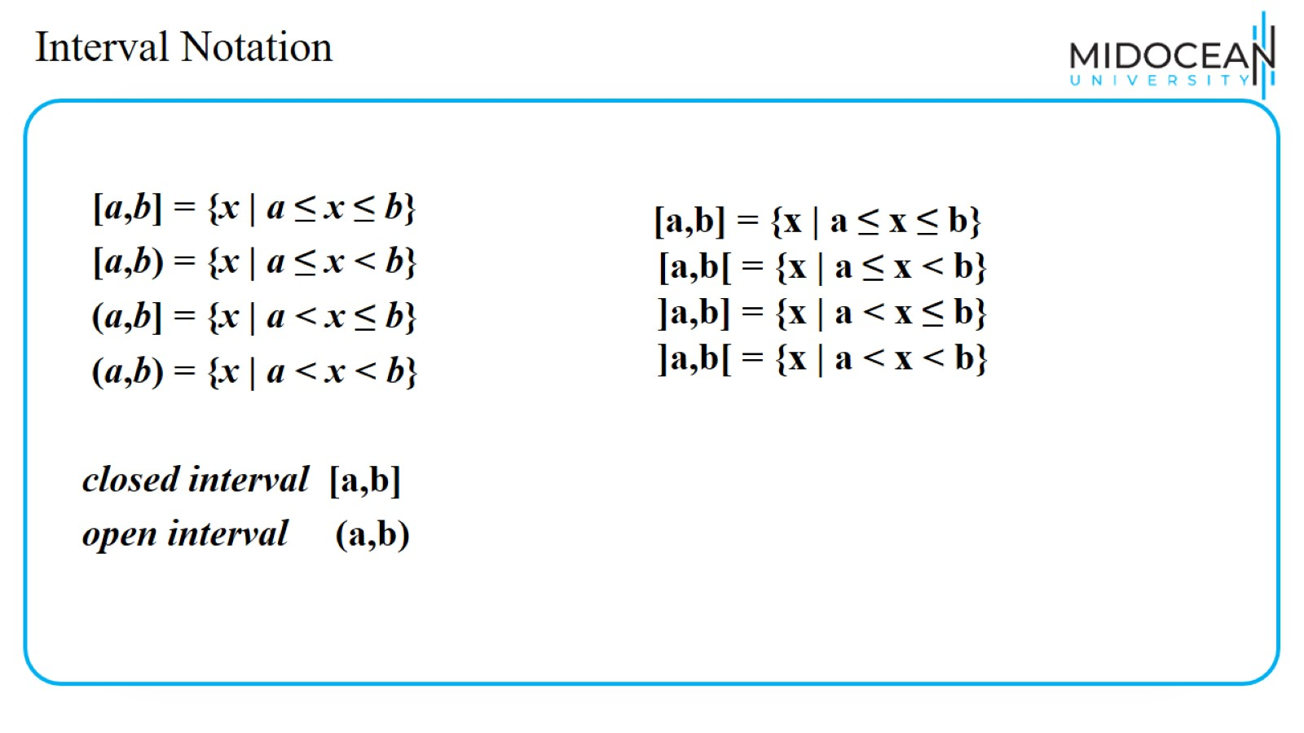
Interval Notation

Slide 18
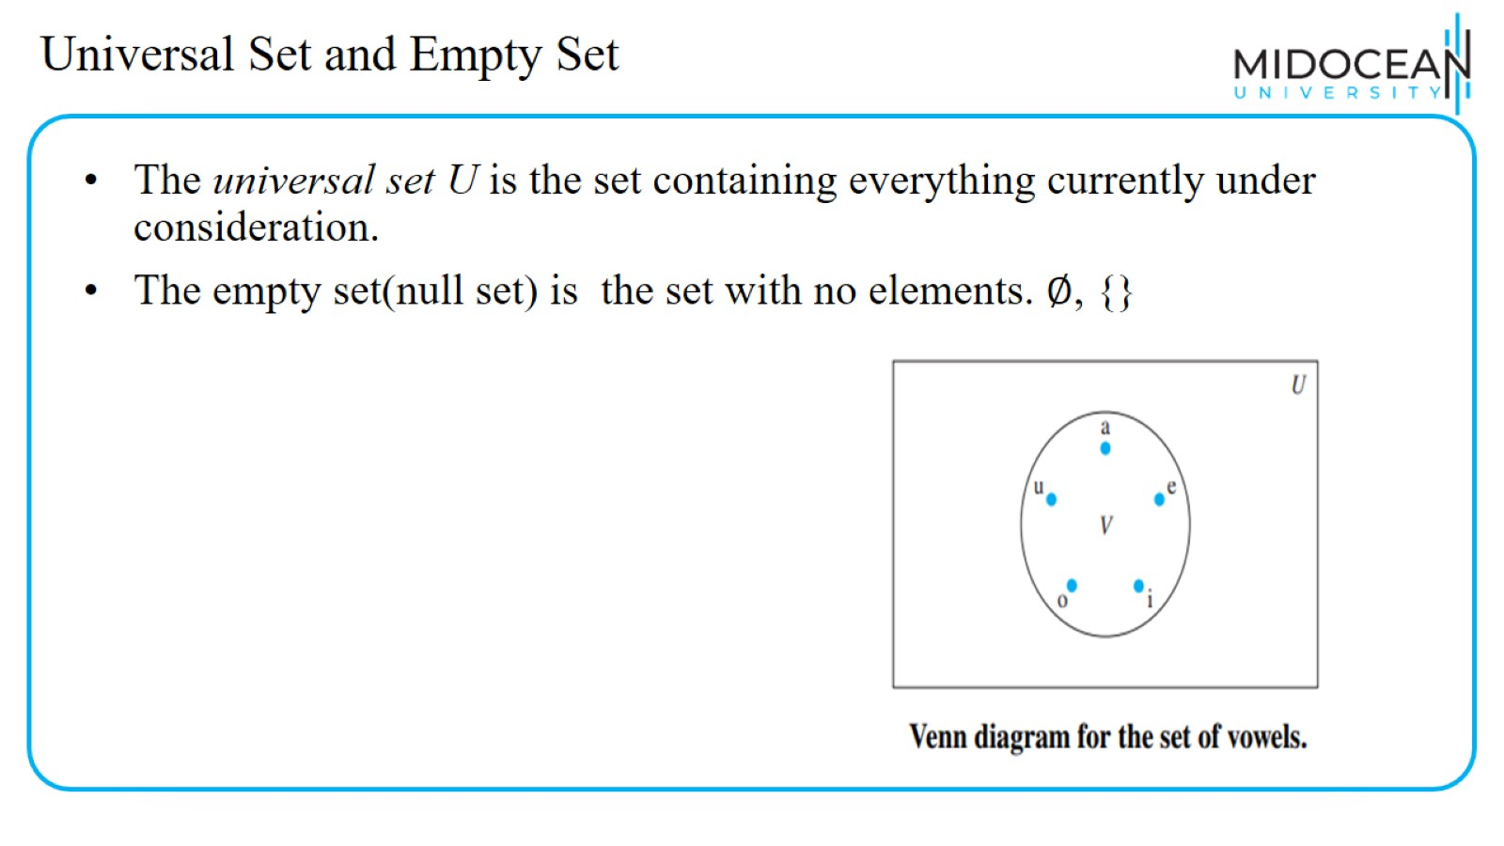
Universal Set and Empty Set

Slide 19
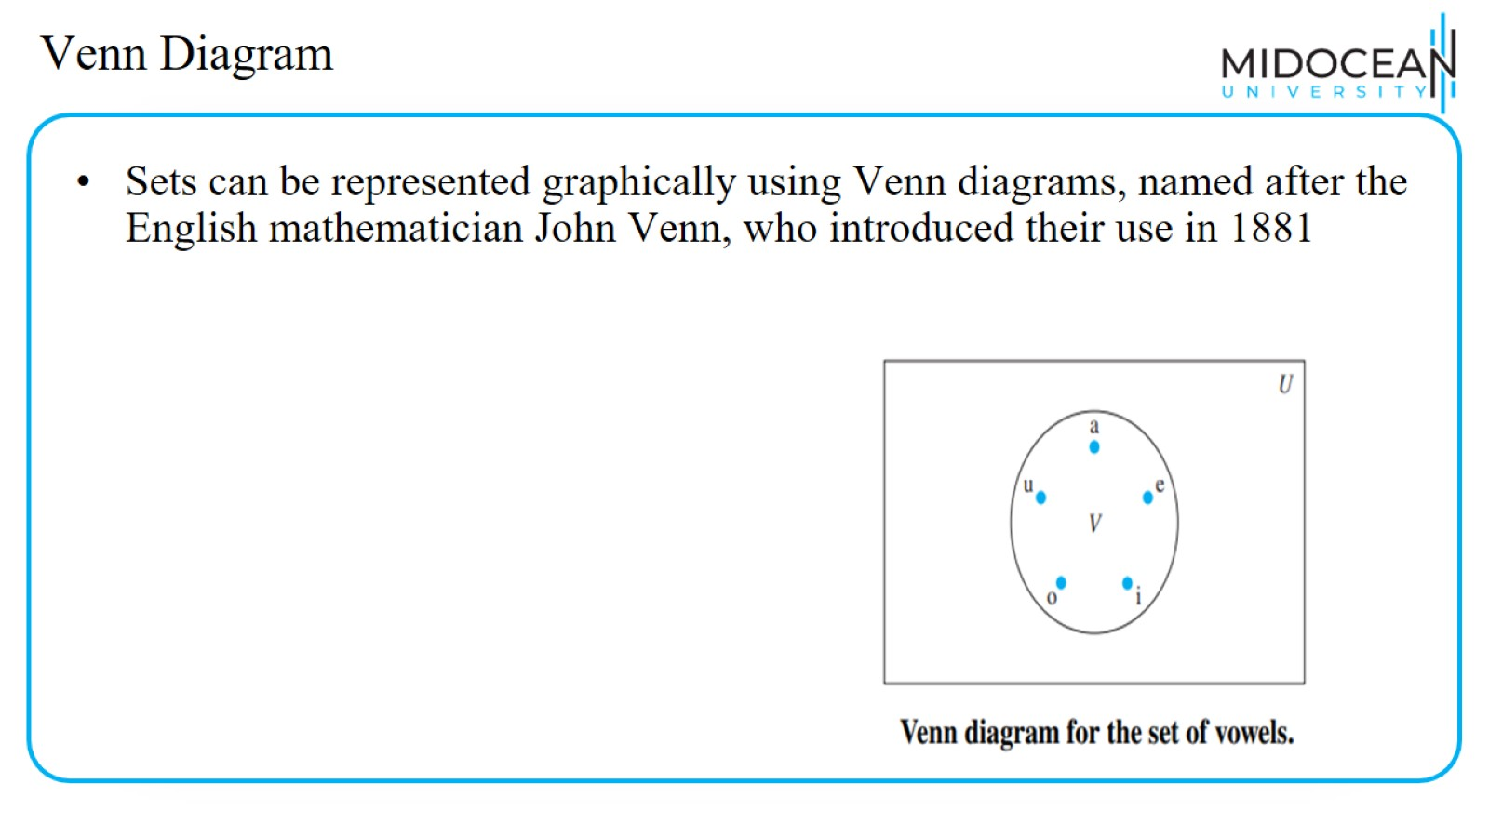
Venn Diagram

Slide 20
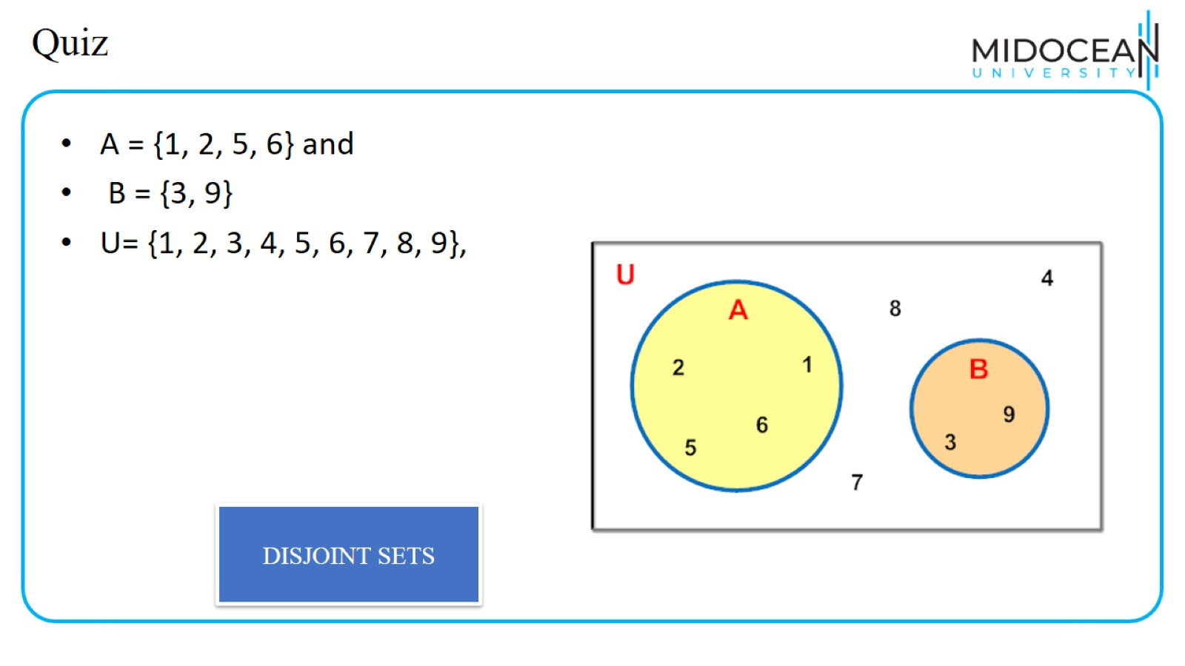
Quiz

Slide 21
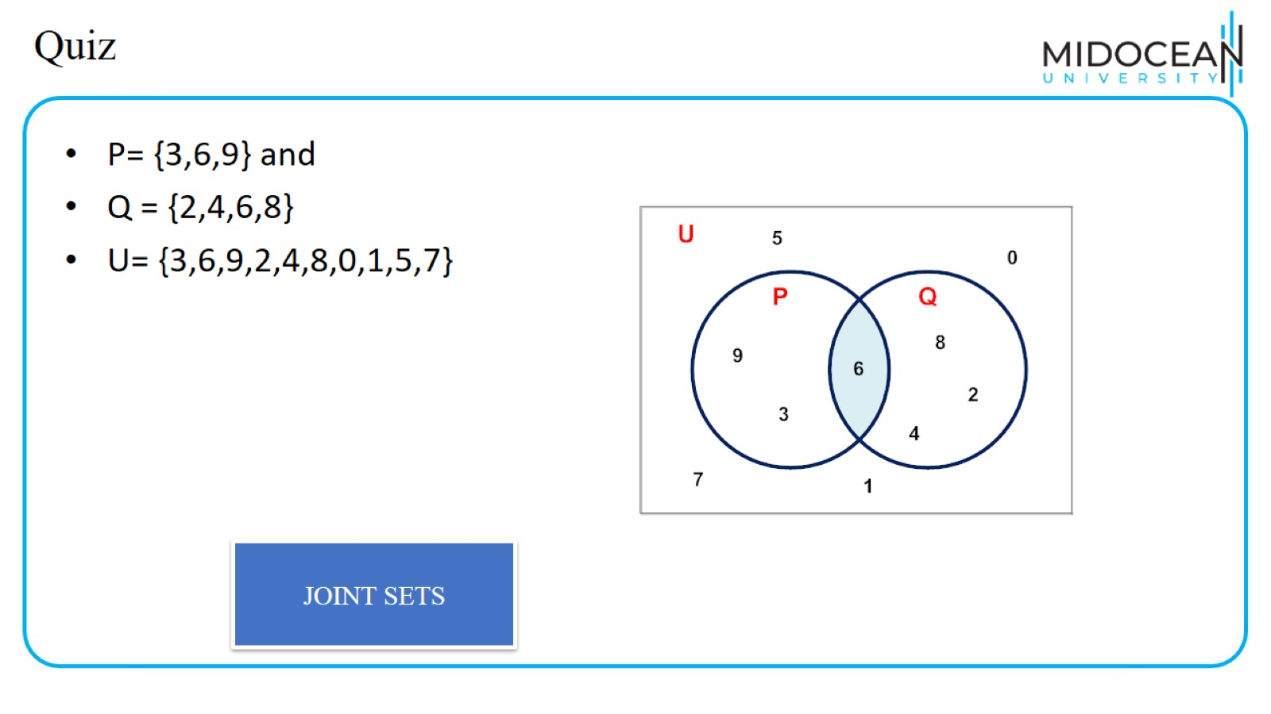
Quiz

Slide 22
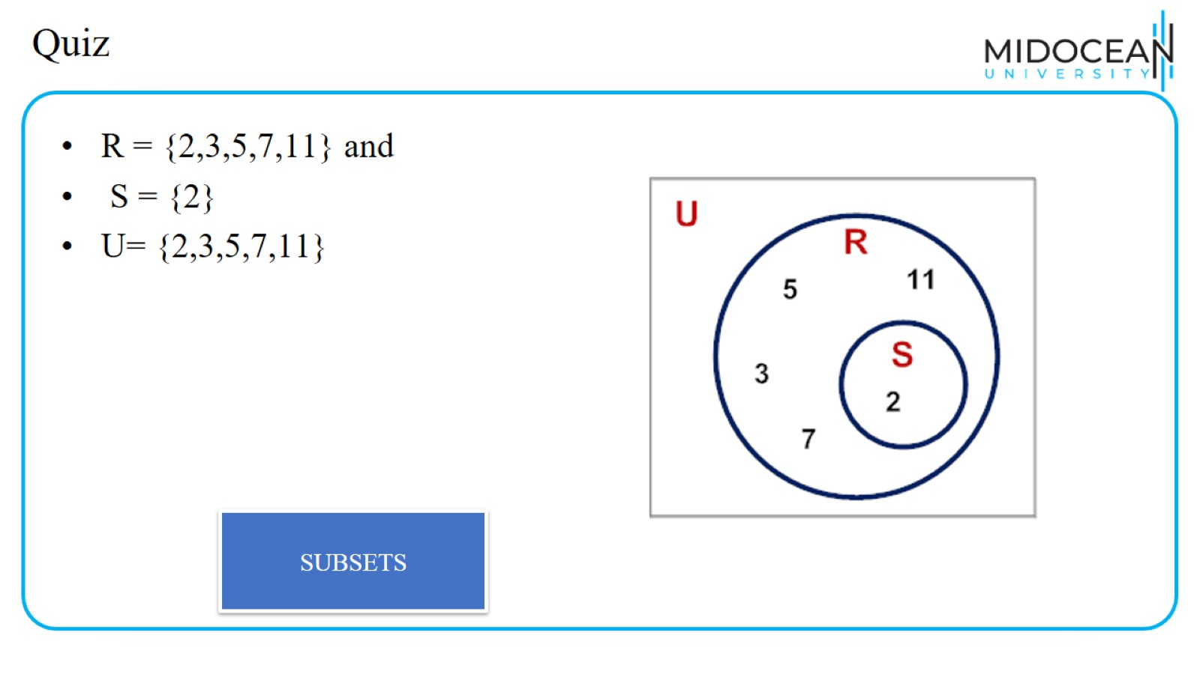
Quiz

Slide 23
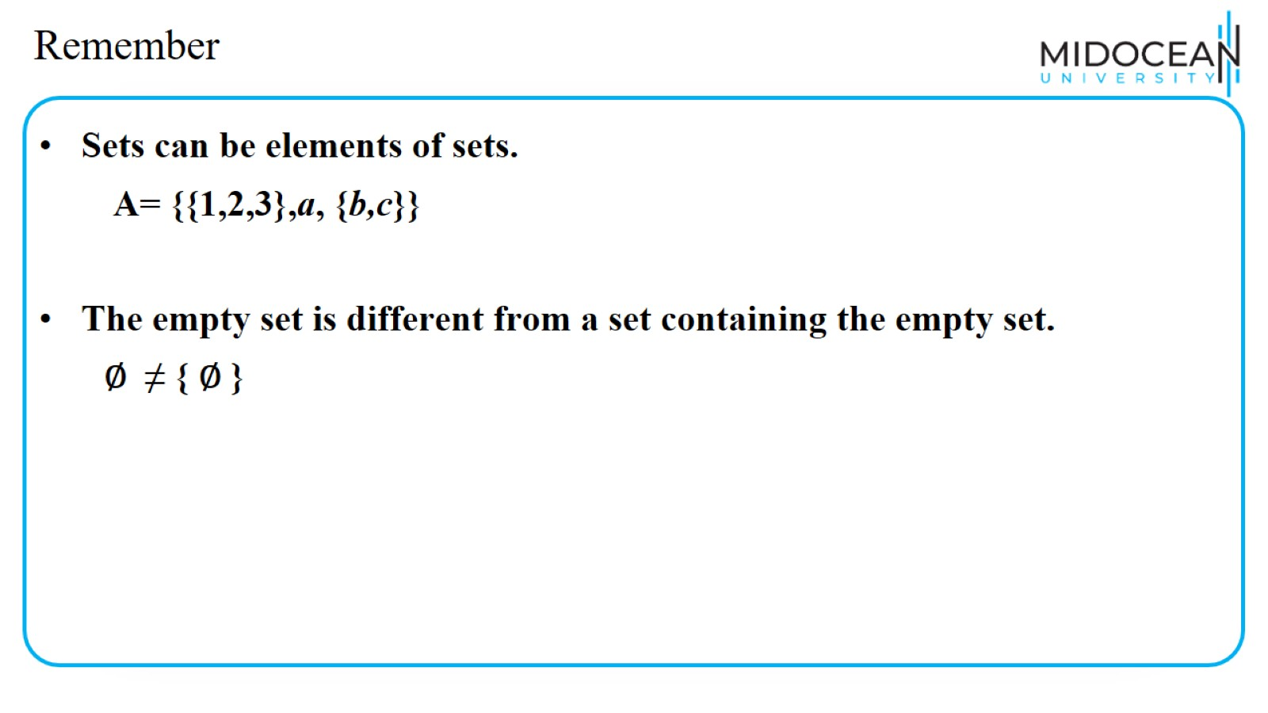
Remember

Slide 24
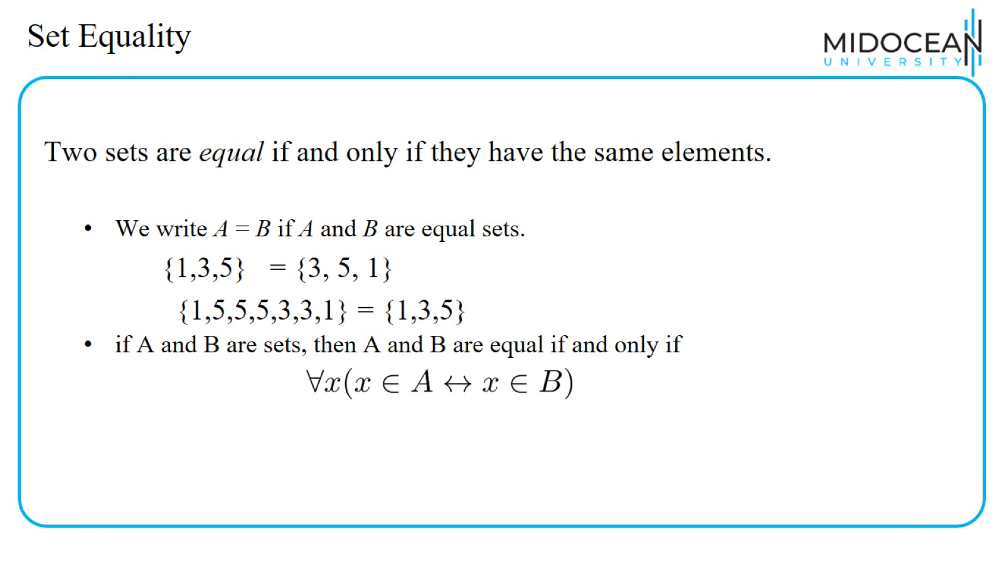
Set Equality

Slide 25
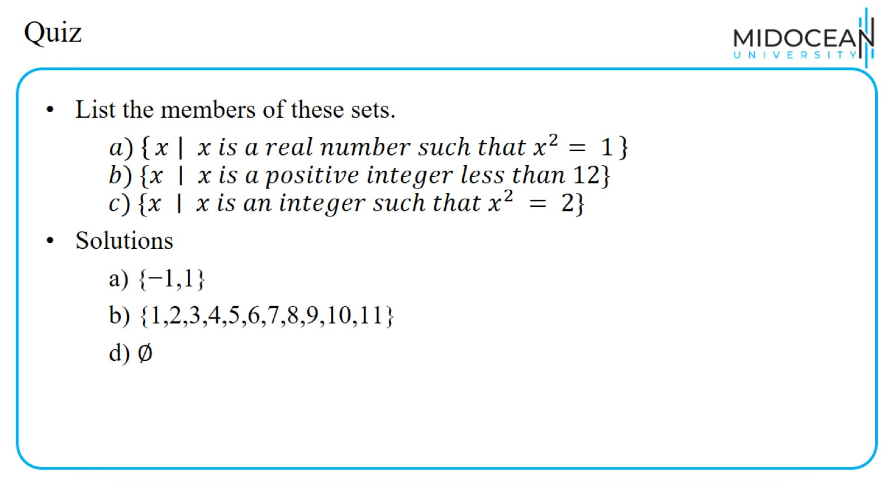
Quiz

Slide 26
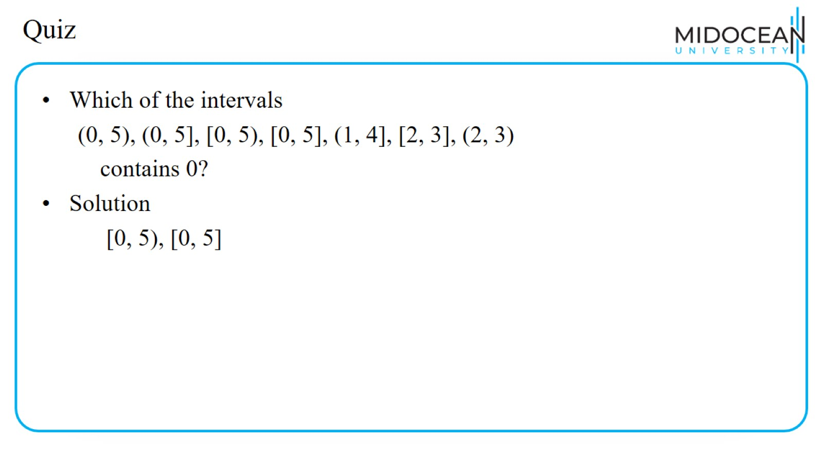
Quiz

Slide 27
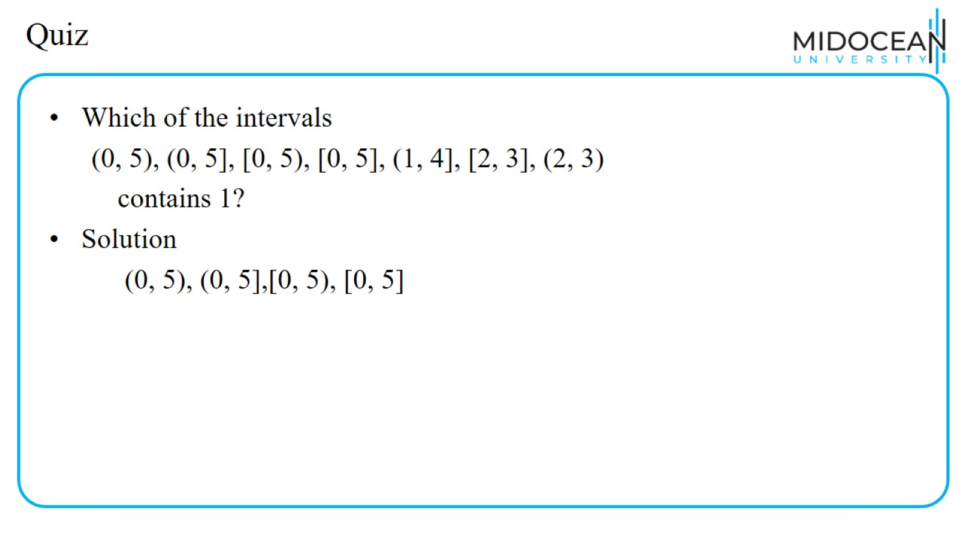
Quiz

Slide 28
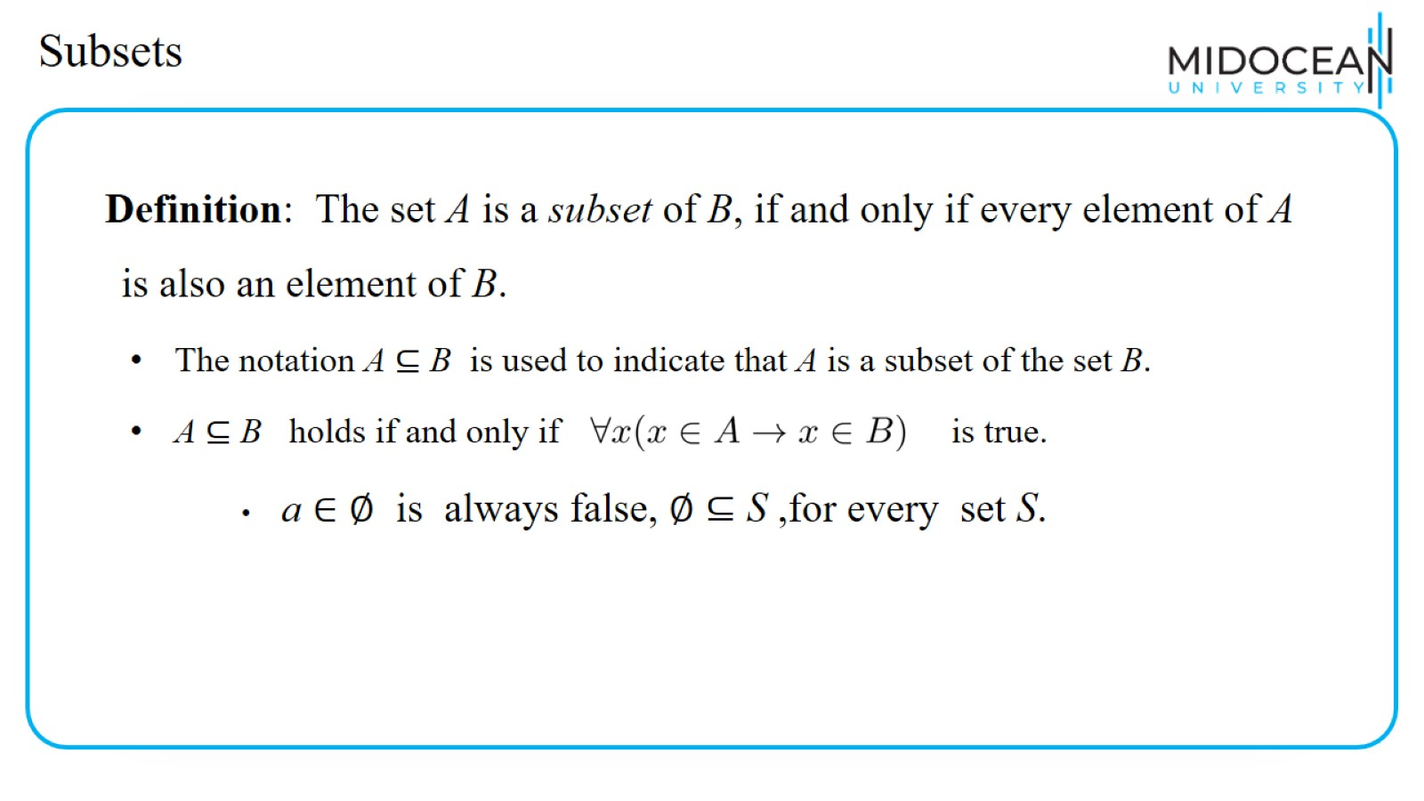
Subsets

Slide 29
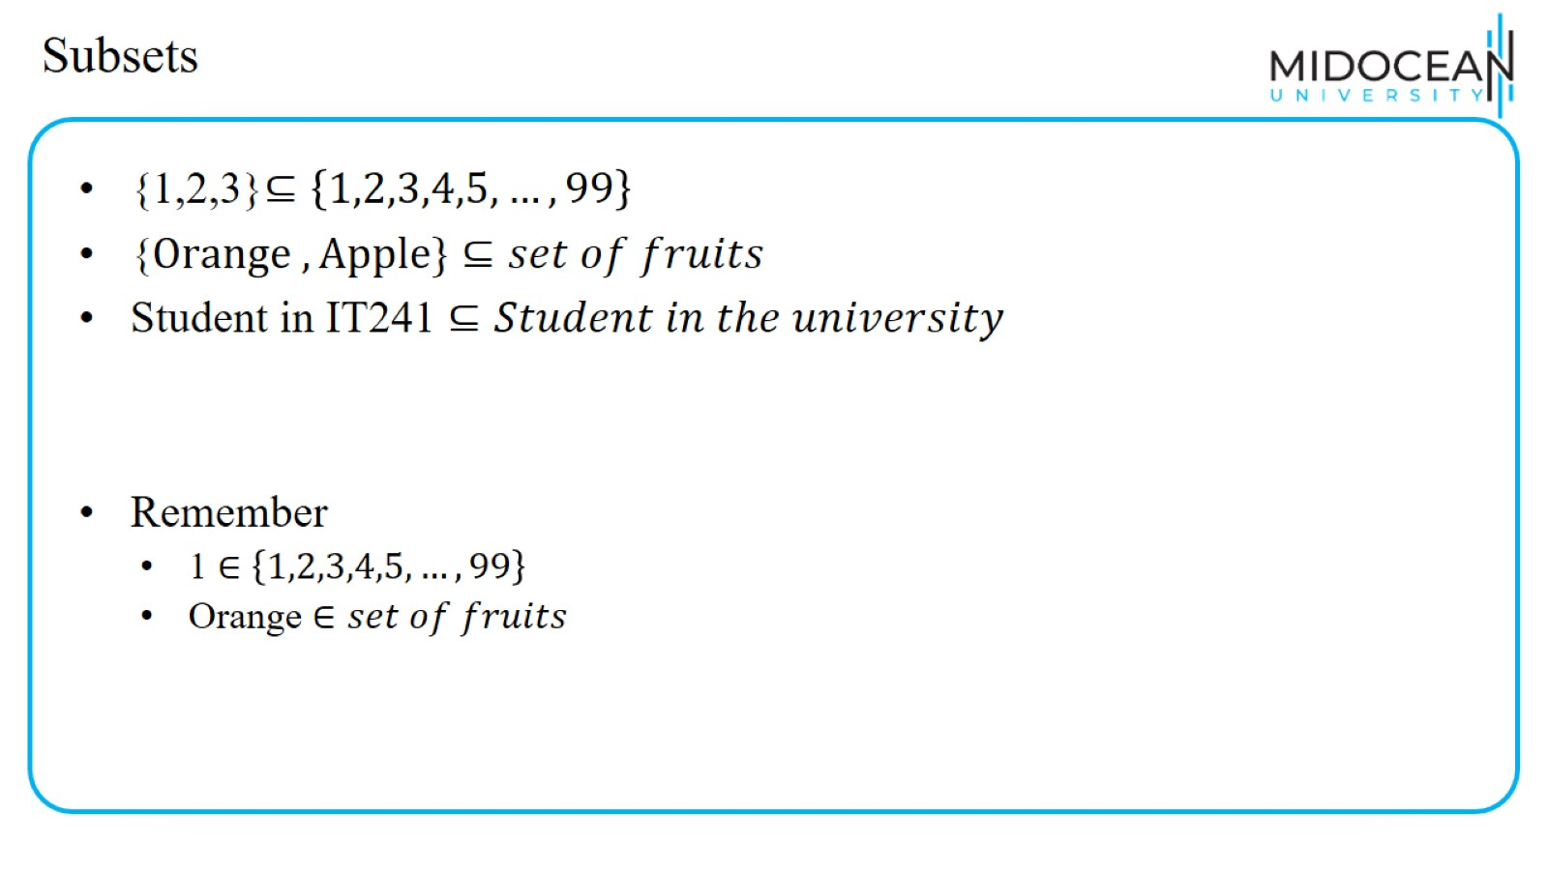
Subsets

Slide 30
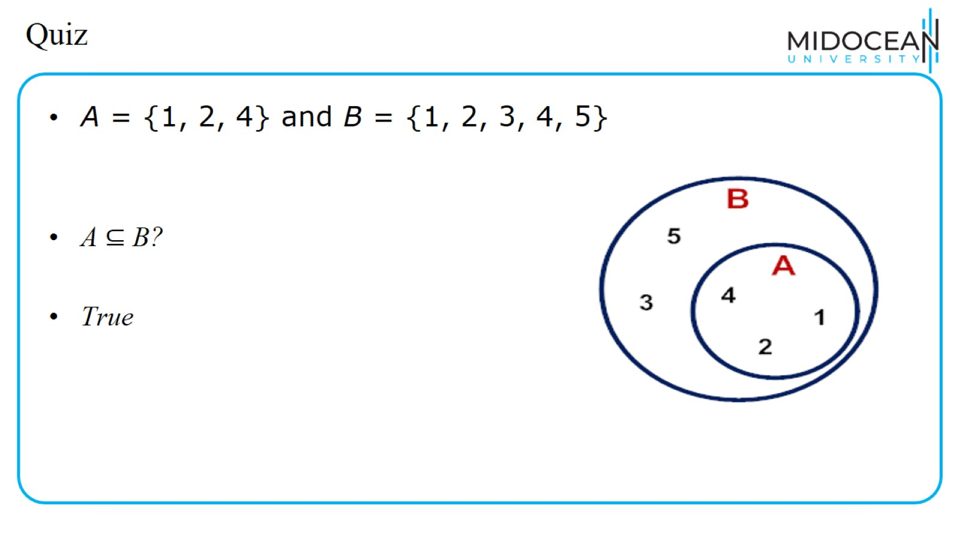
Quiz

Slide 31
Quiz

Slide 32
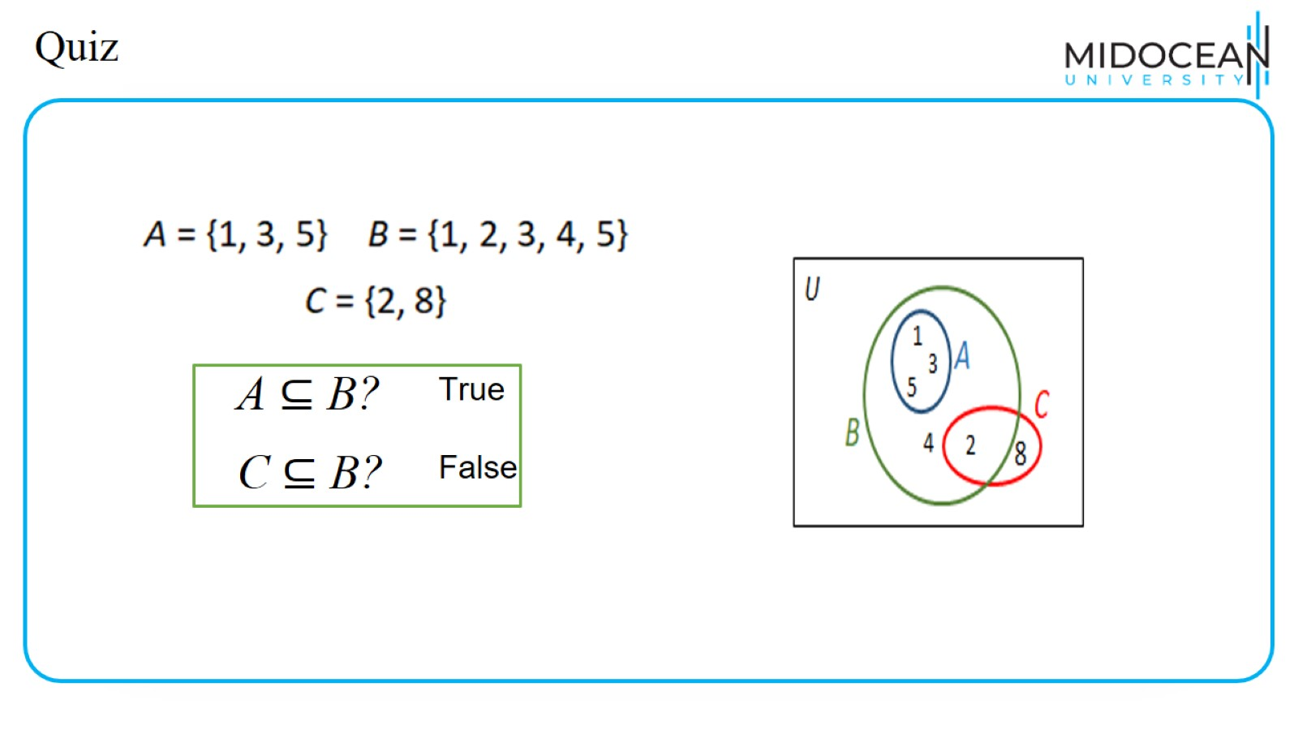
Quiz

Slide 33
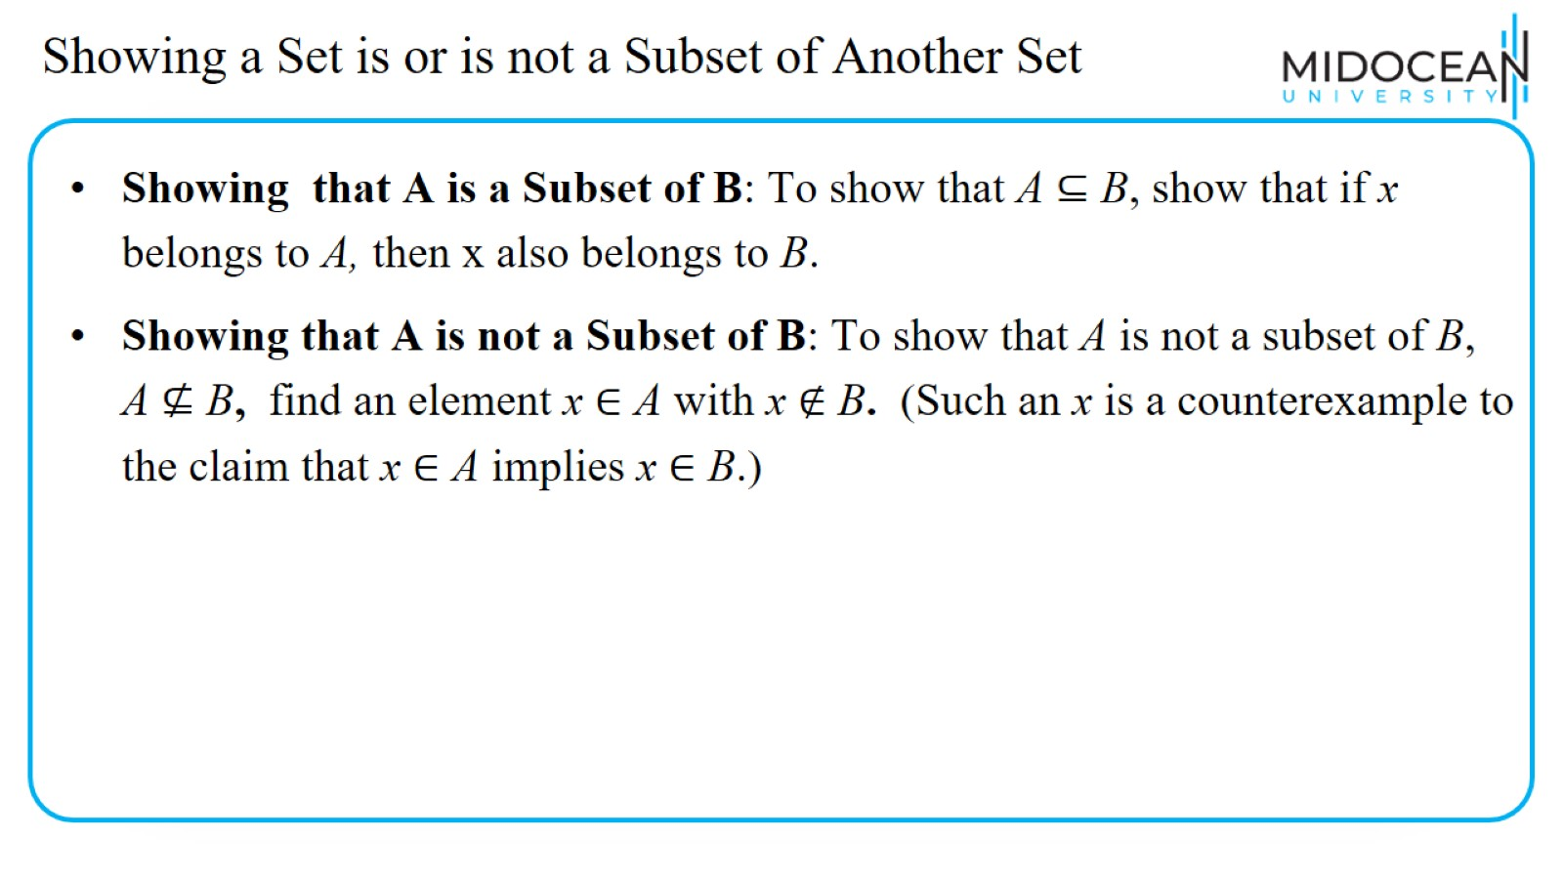
Showing a Set is or is not a Subset of Another Set

Slide 34
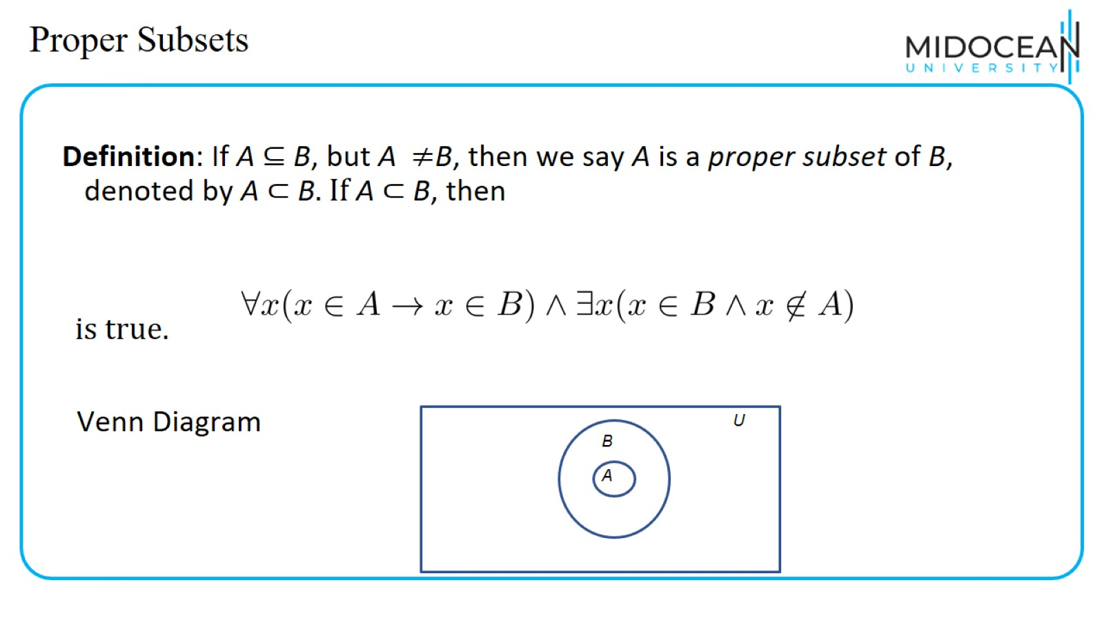
Proper Subsets

Slide 35
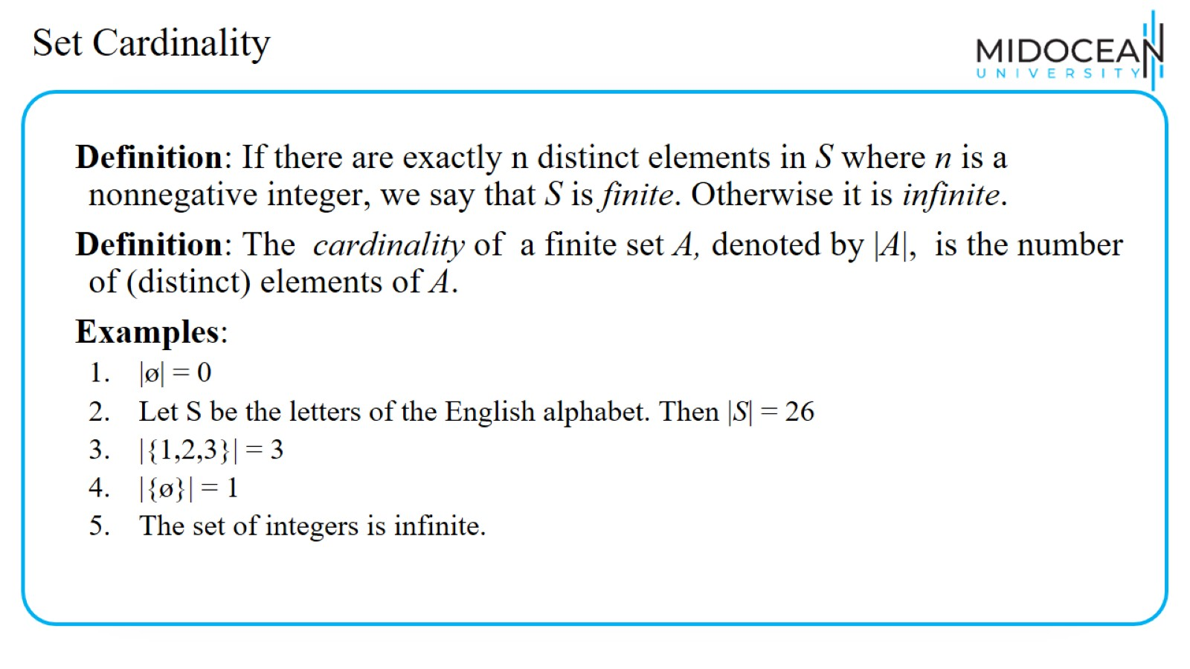
Set Cardinality

Slide 36
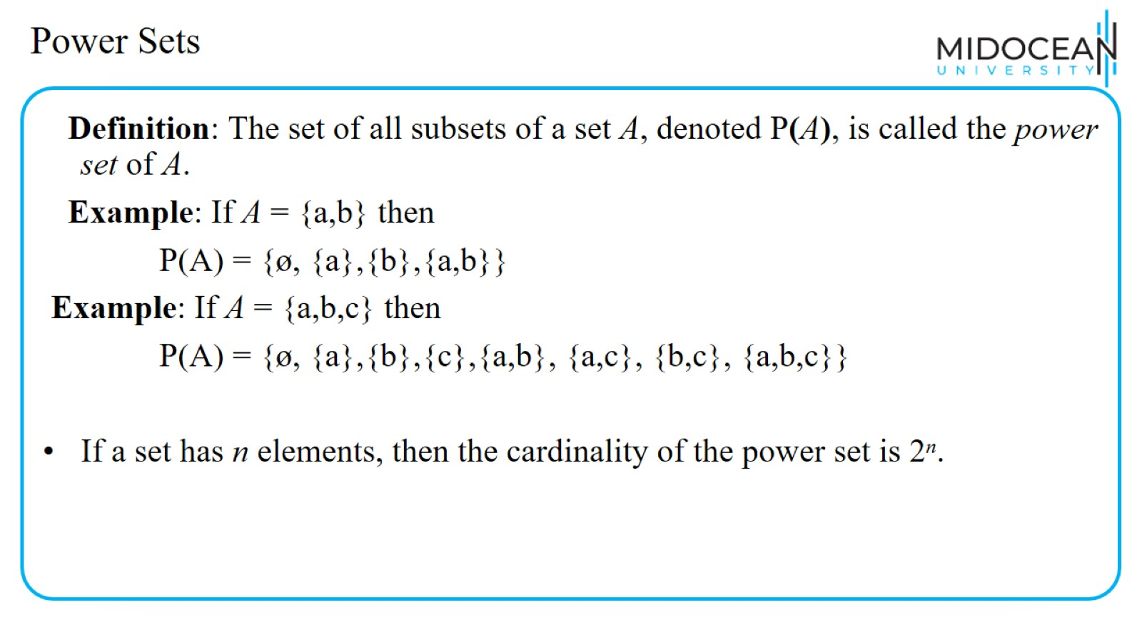
Power Sets

Slide 37
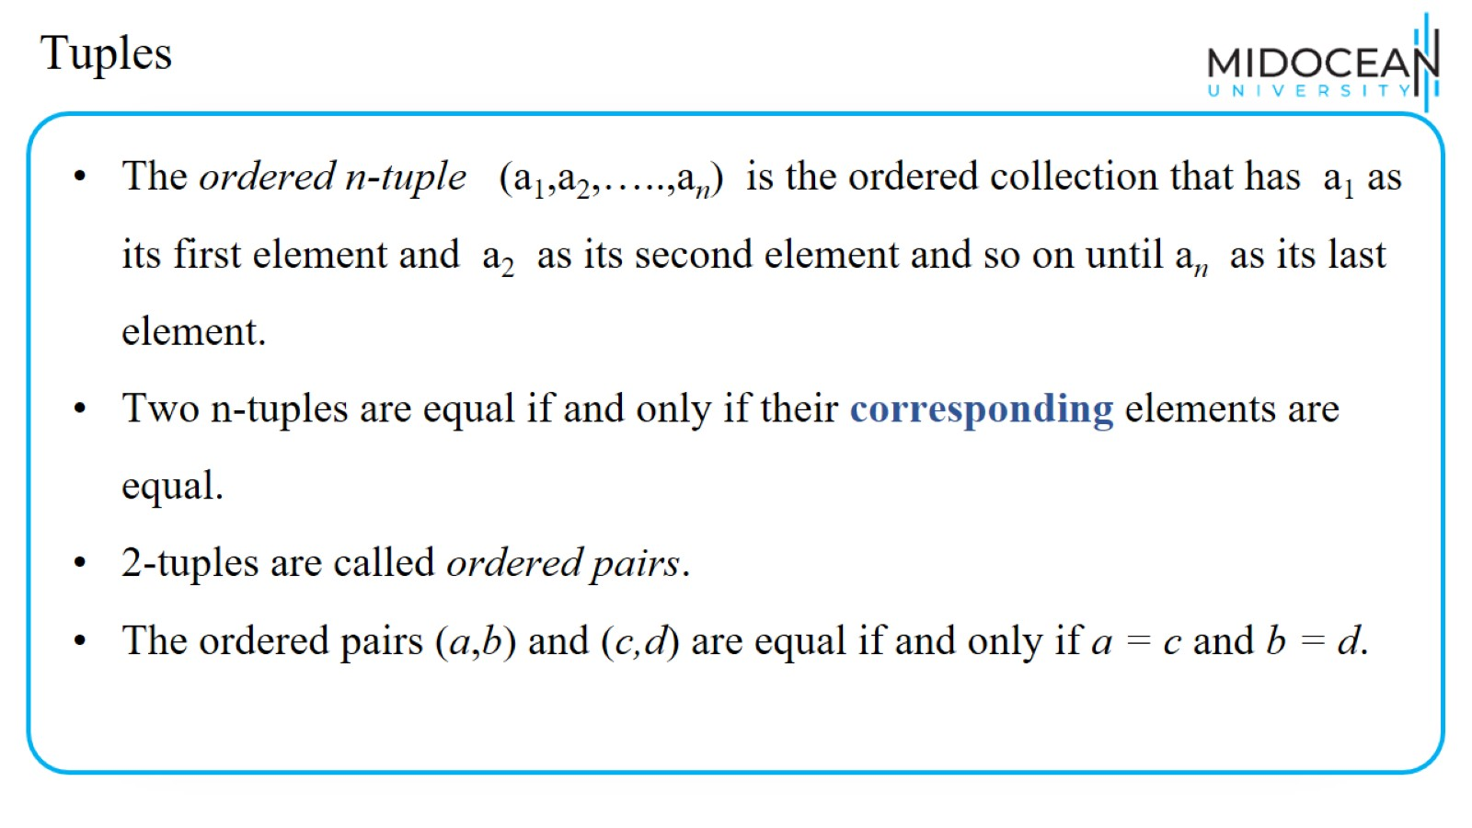
Tuples

Slide 38
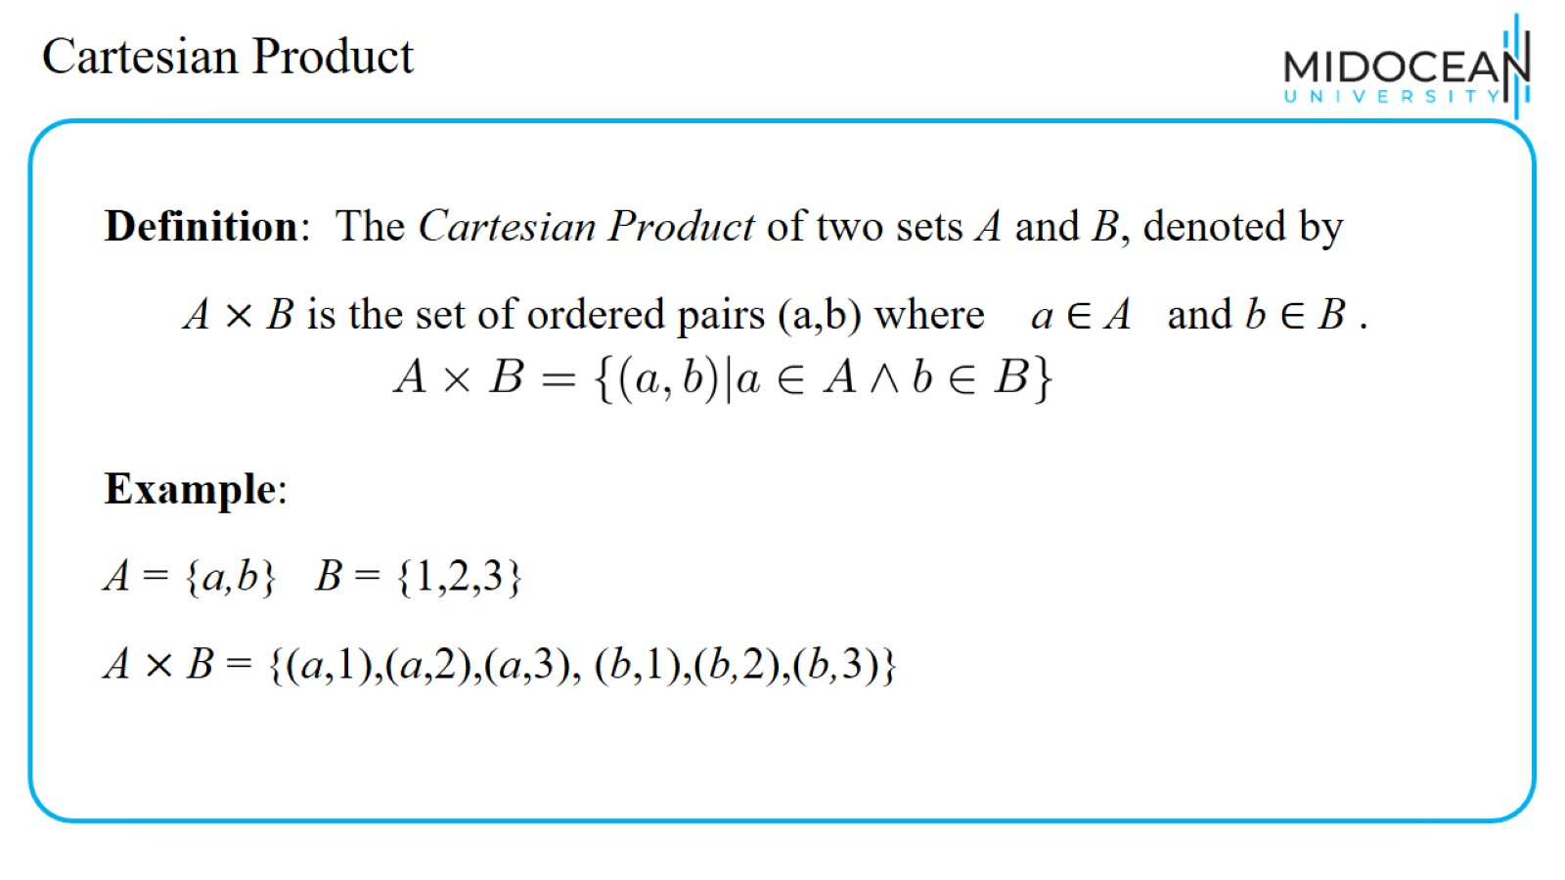
Cartesian Product

Slide 39
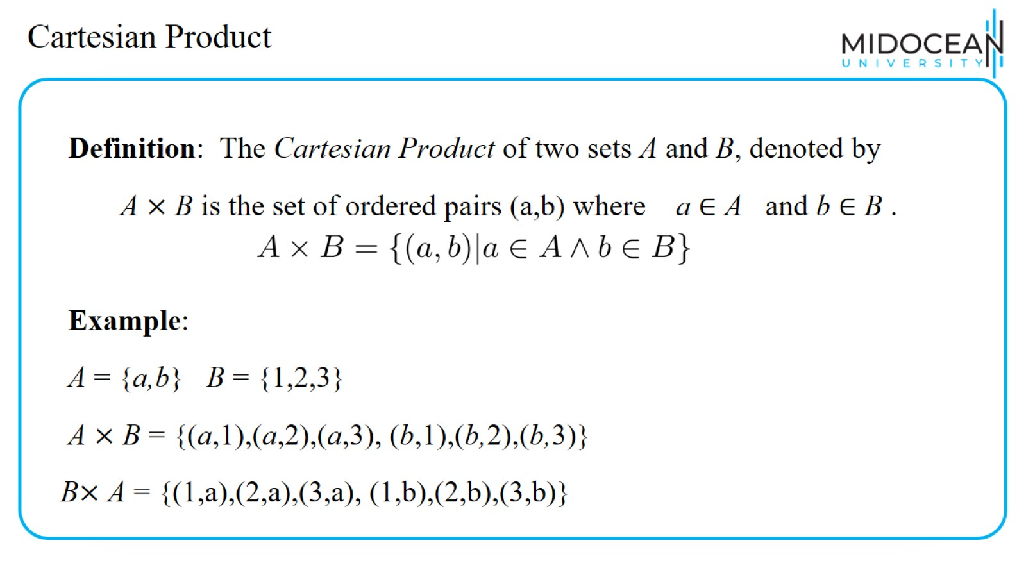
Cartesian Product

Slide 40
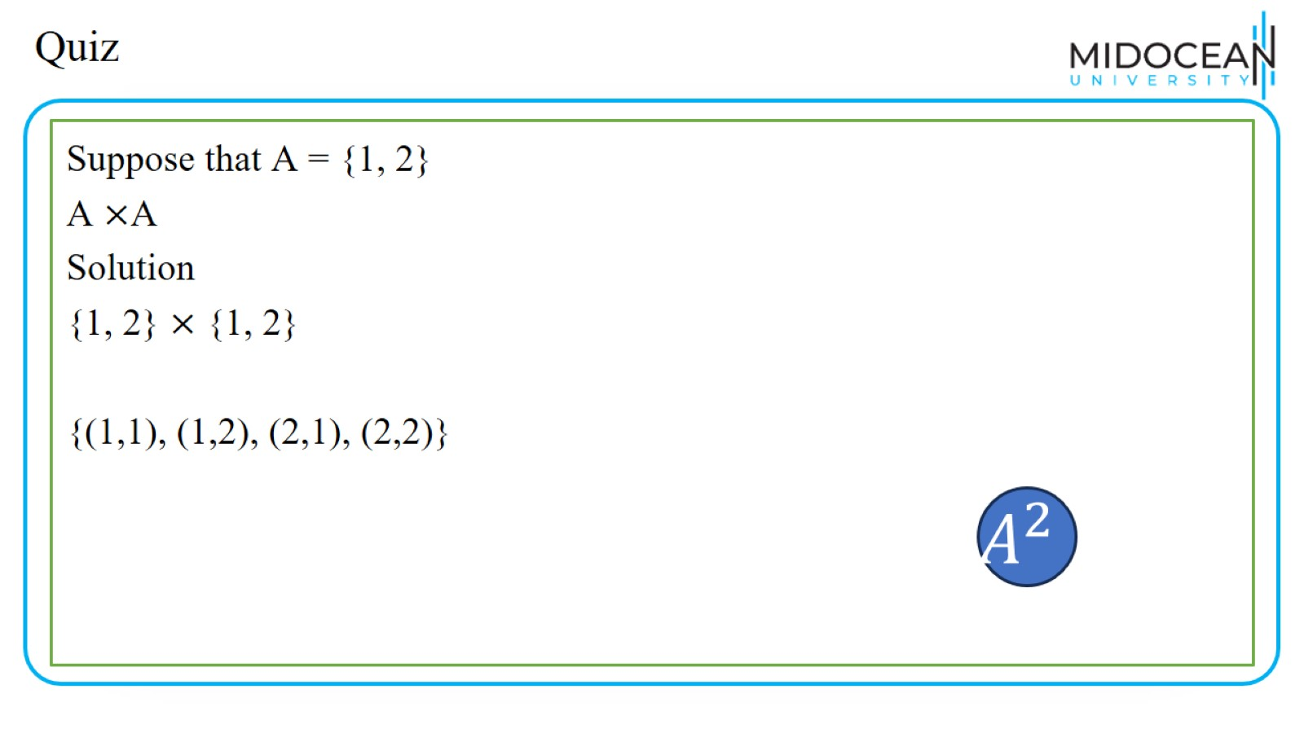
Quiz

Slide 41
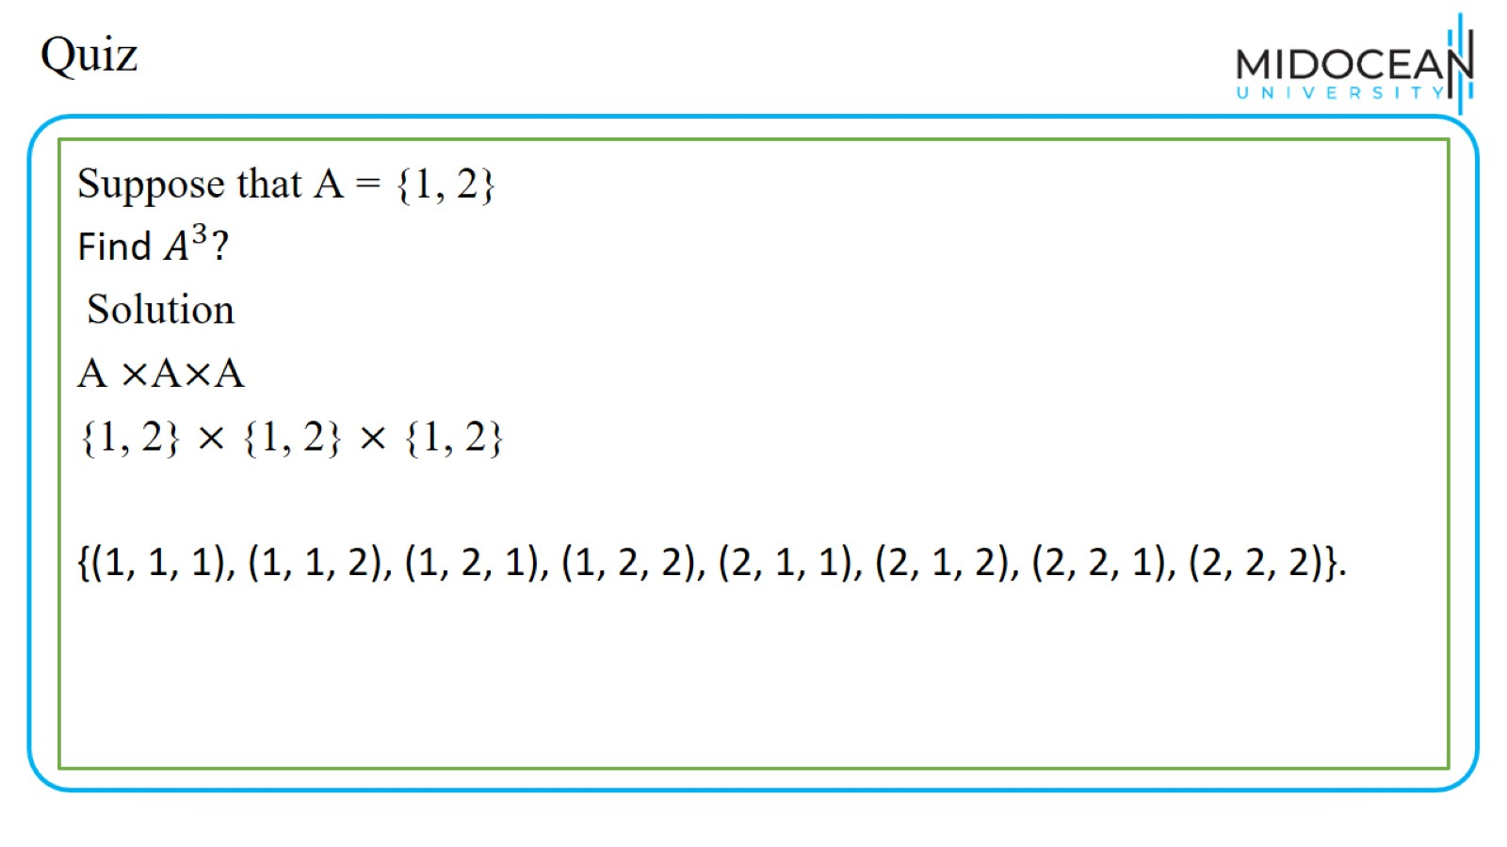
Quiz

Slide 42
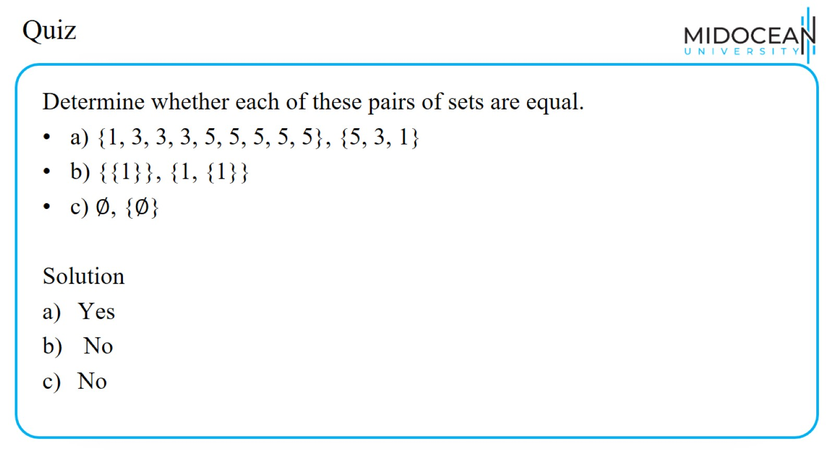
Quiz

Slide 43
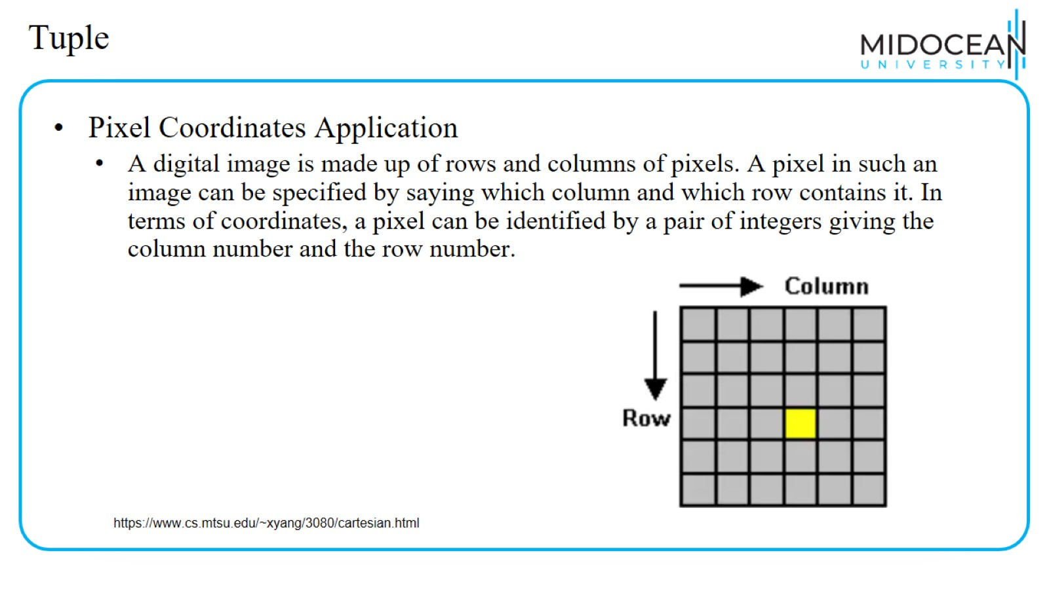
Tuple

Slide 44
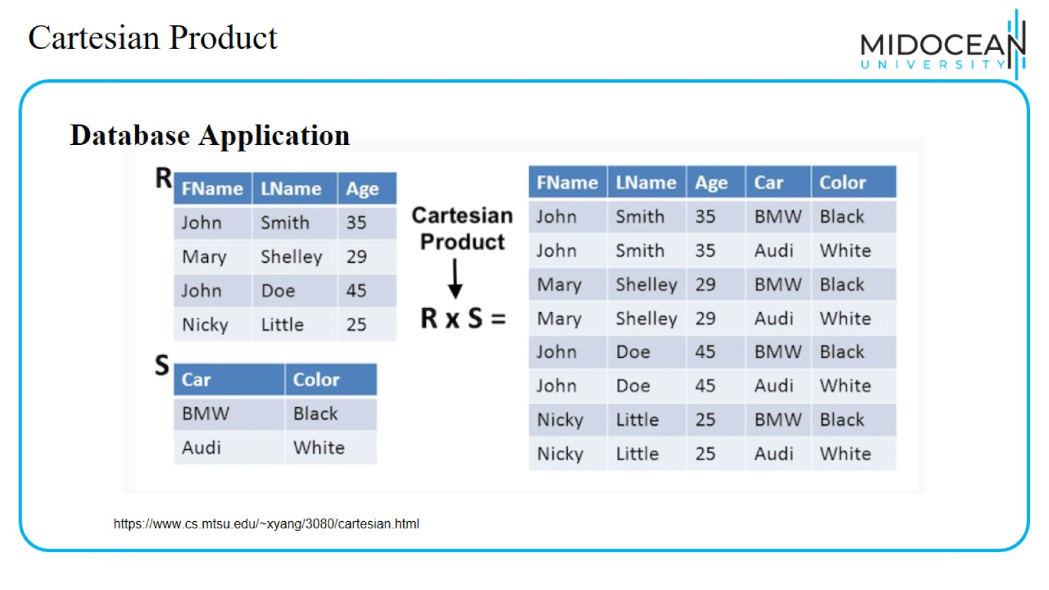
Cartesian Product

Slide 45
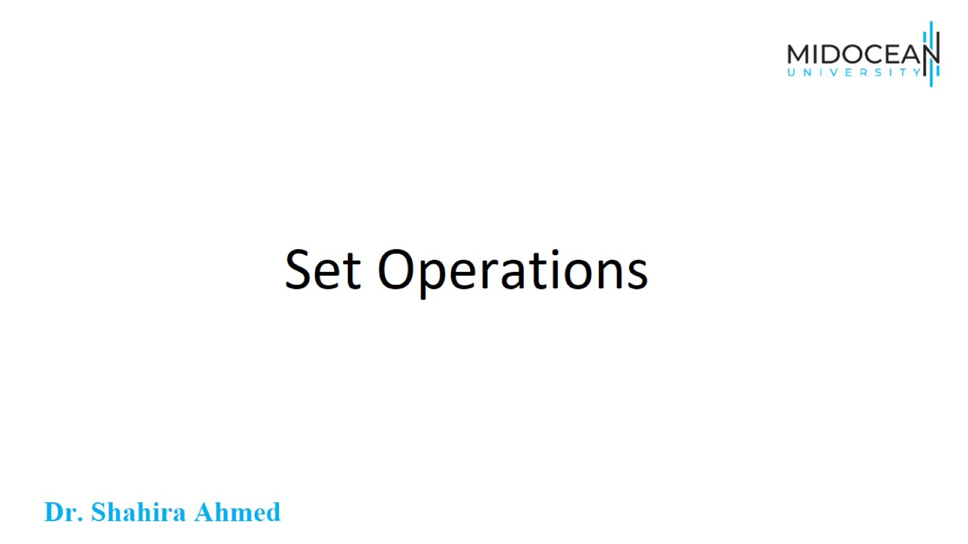
Set Operations

Slide 46
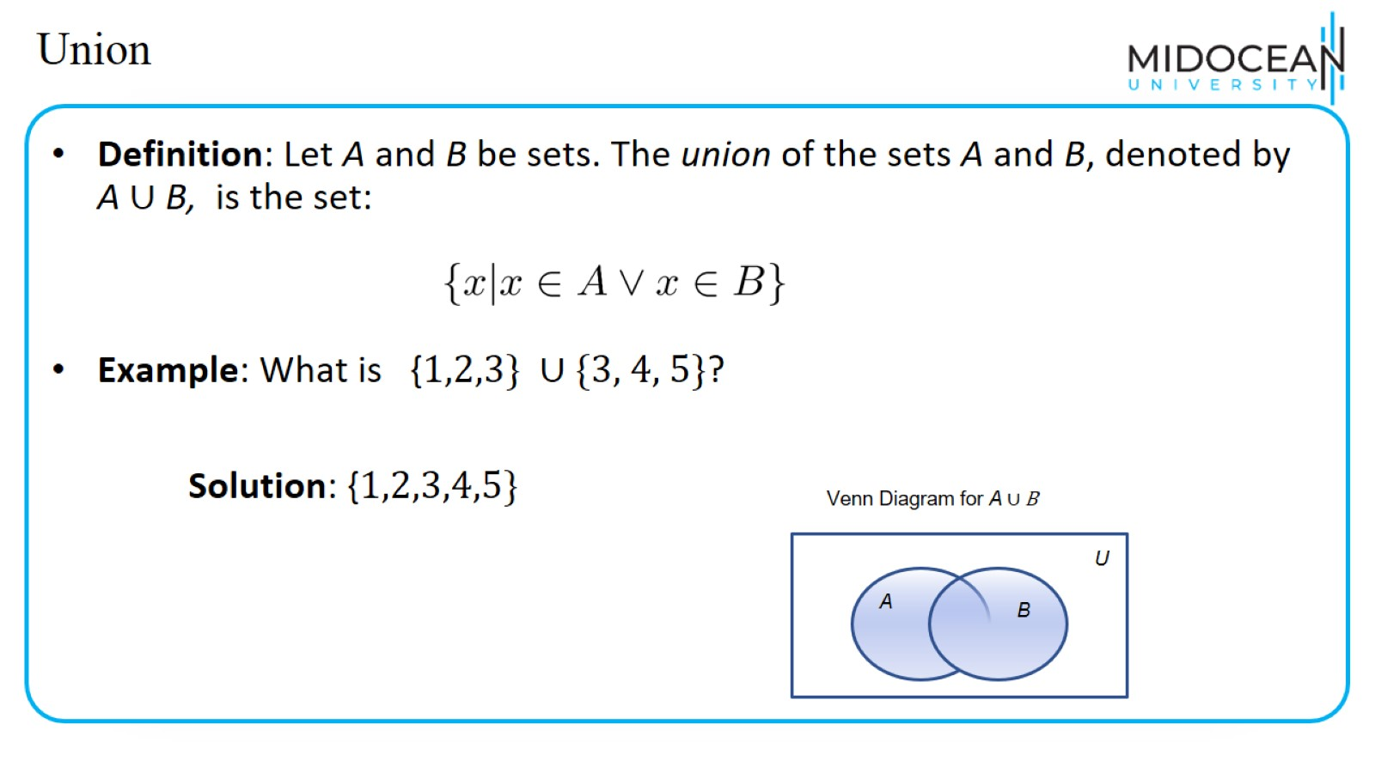
Union

Slide 47
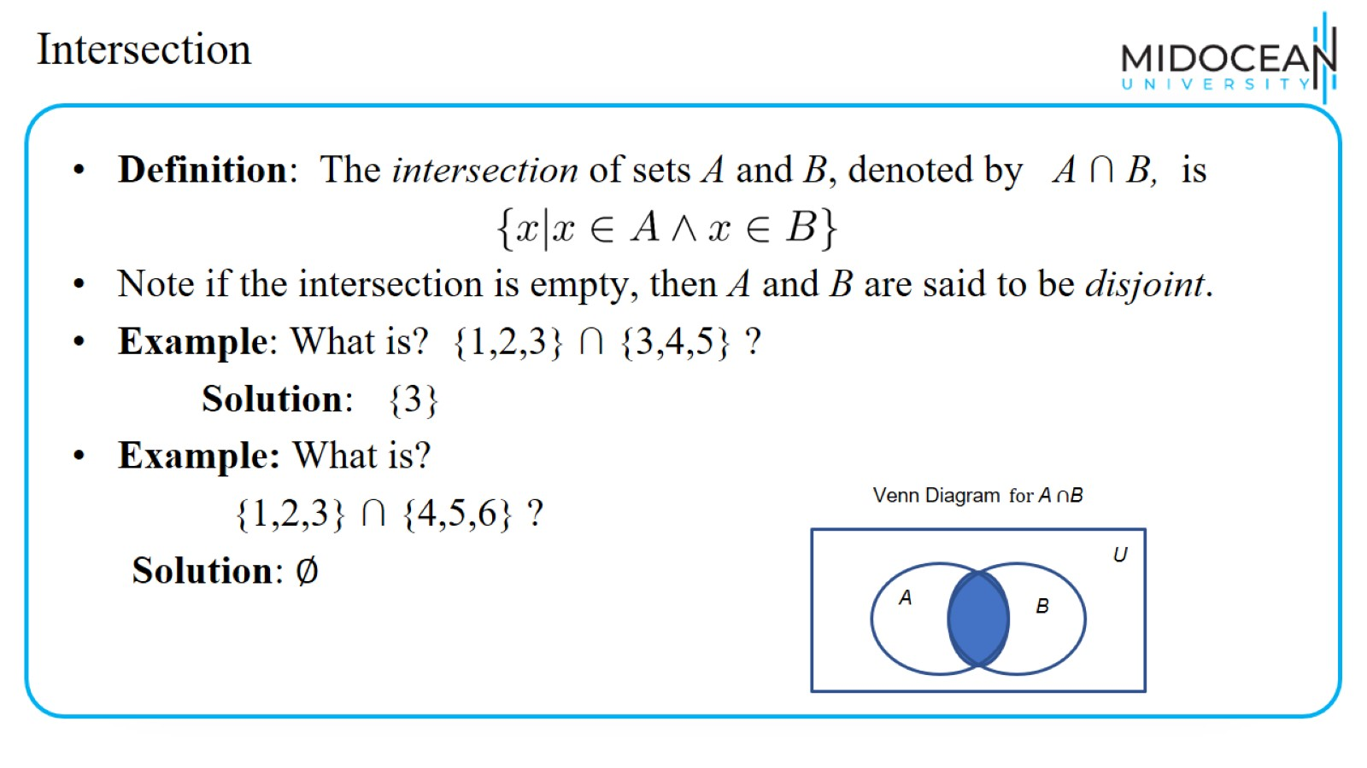
Intersection

Slide 48
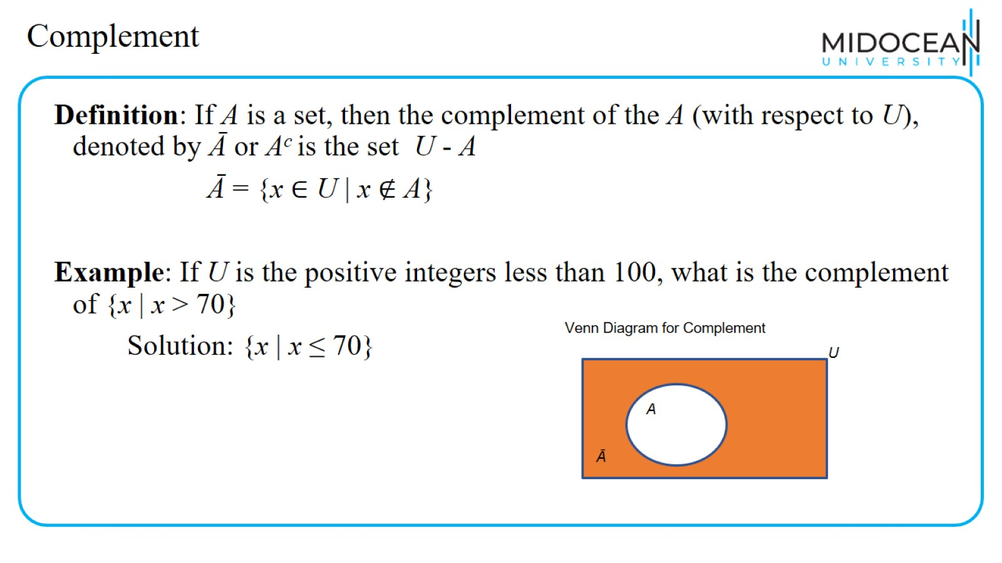
Complement

Slide 49
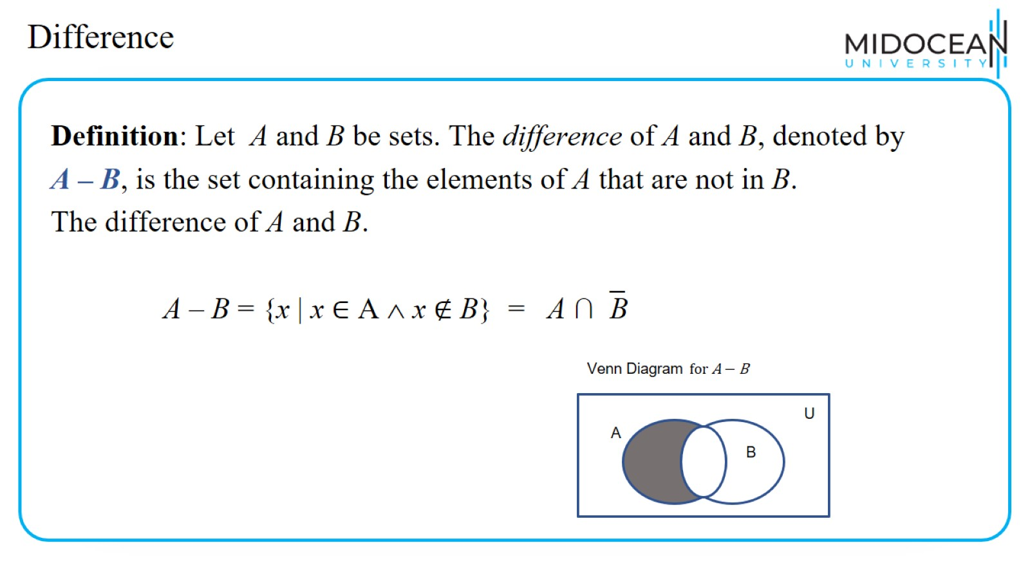
Difference

Slide 50
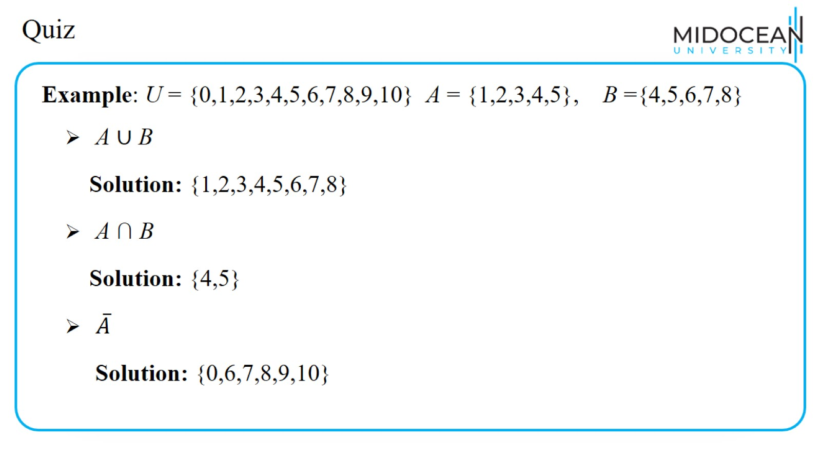
Quiz

Slide 51
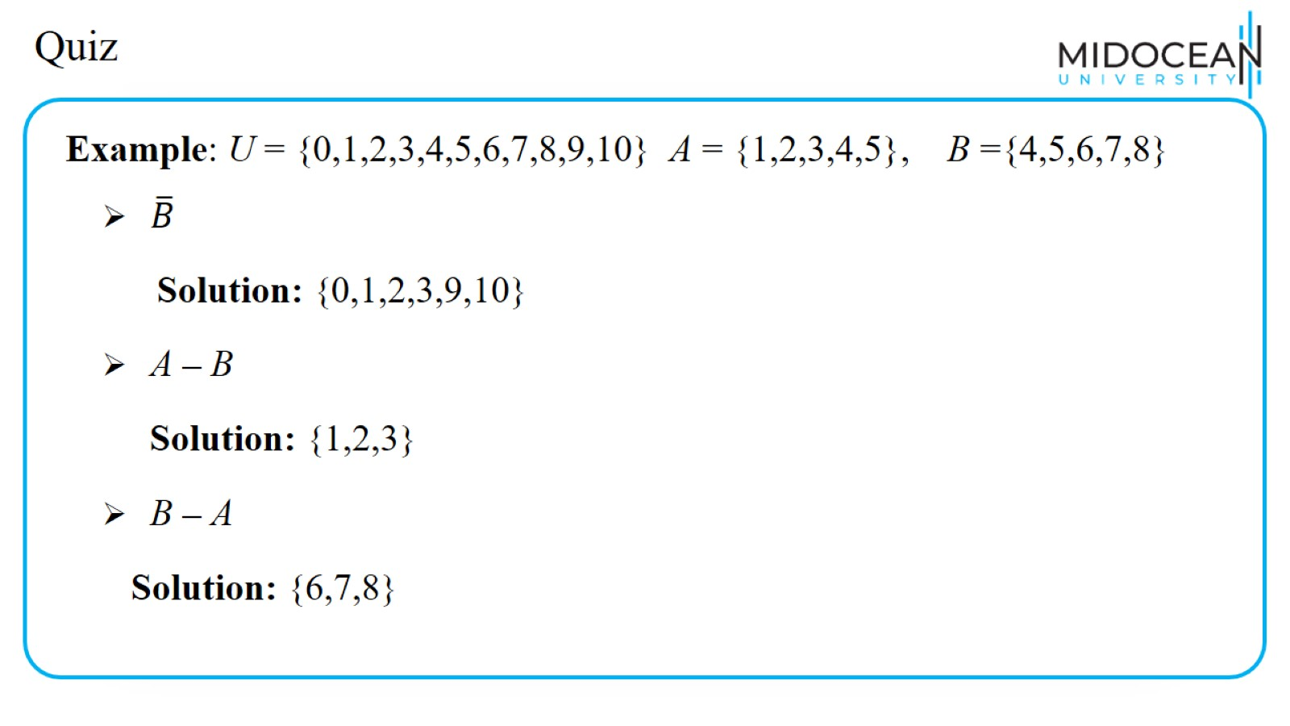
Quiz

Slide 52
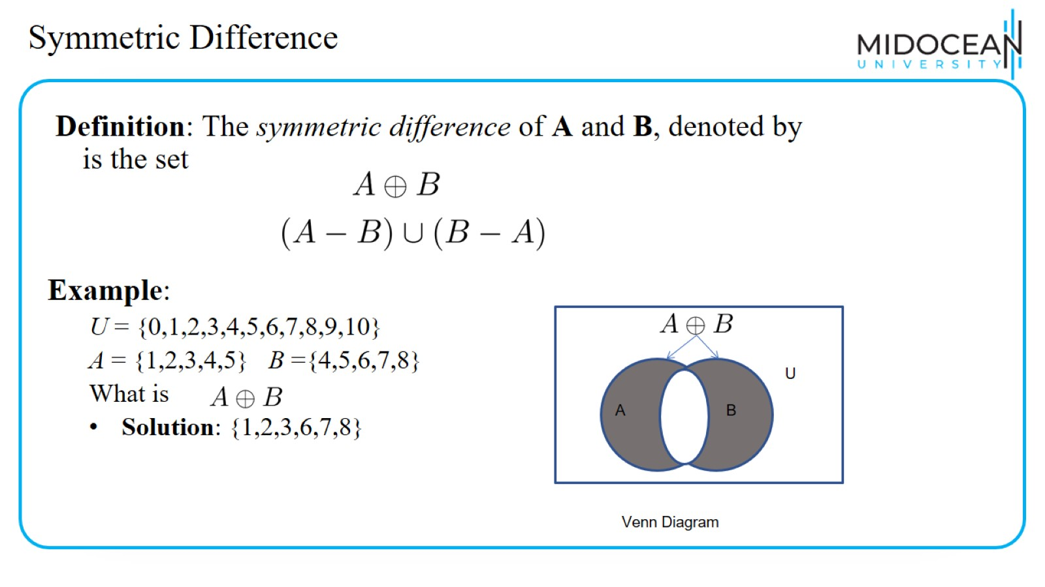
Symmetric Difference

Slide 53

Cardinality of union of two set

Slide 54

Set Identities

Slide 55

Set Identities

Slide 56

Set Identities

Slide 57

Quiz

Slide 58

Quiz

Slide 59

Quiz

Slide 60

Quiz

Slide 61

Quiz

Slide 62

Quiz

Slide 63

Quiz

Slide 64

Summary

Slide 65


