Slide 1





Interaction Design (DGM 729)
Prepared by
Dr. Mohamed Owies
Lecture 6
Interaction Design(DGM 729)

Slide 2



Chapter 6
Research Methods
Interaction Design

Slide 3




Lecture 6
Content
lecture 6 includes the following points:
Method 7
Learning Plan
Method 8
Guerilla User Research
Method 9
Proto-Personas
Method 10
Heuristic Markup
Method 11
Comparative Assessment
Method 12
Content Patterns
If You Only Do One Thing…

Slide 4
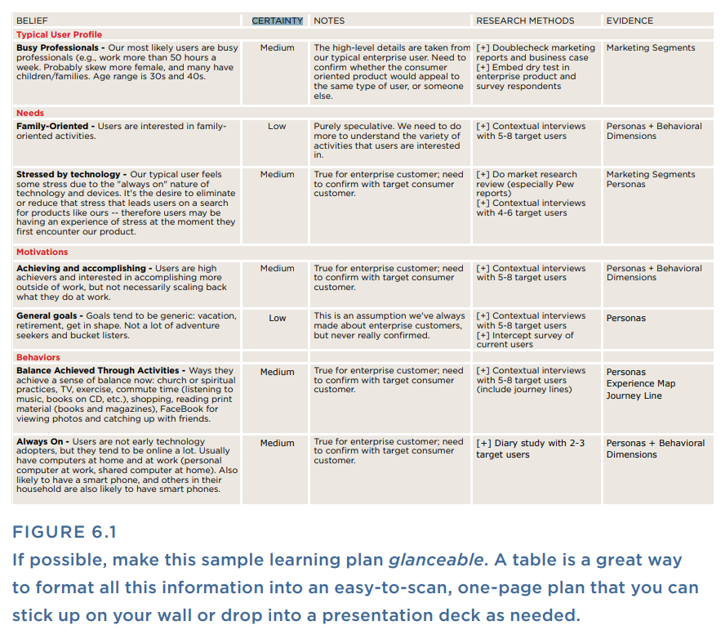
Lecture 6
Method 7 Learning Plan
What do you know, what don’t you know, and how are you going to learn it? A learning plan sounds like a formal concept, but really it’s just about taking the time to ask yourself where the gaps are in your current understanding of users’ needs and experiences, and how you can fill in that understanding.
A surprisingly large number of people claim to practice user-centered design, but fail to ever actually speak with or spend time with users. Don’t be like them.

Slide 5
Lecture 6
Method 7 Learning Plan
One of the core tenets of a user-centered philosophy is that you respect and learn from your users’ sometimes unpredictable lives. A learning plan is a simple tool that you can use by yourself or with a team to map out what you know and what you need to learn (see Figure 6.1).

Slide 6
Lecture 6
Method 7 Learning Plan
Use When
You’re first bringing a user-centered mindset to an organization
(whether in an official or unofficial capacity).
You first start out in a new job as a UX team of one.
You’ve started a new project, and you need to know more about your product and your users.

Slide 7
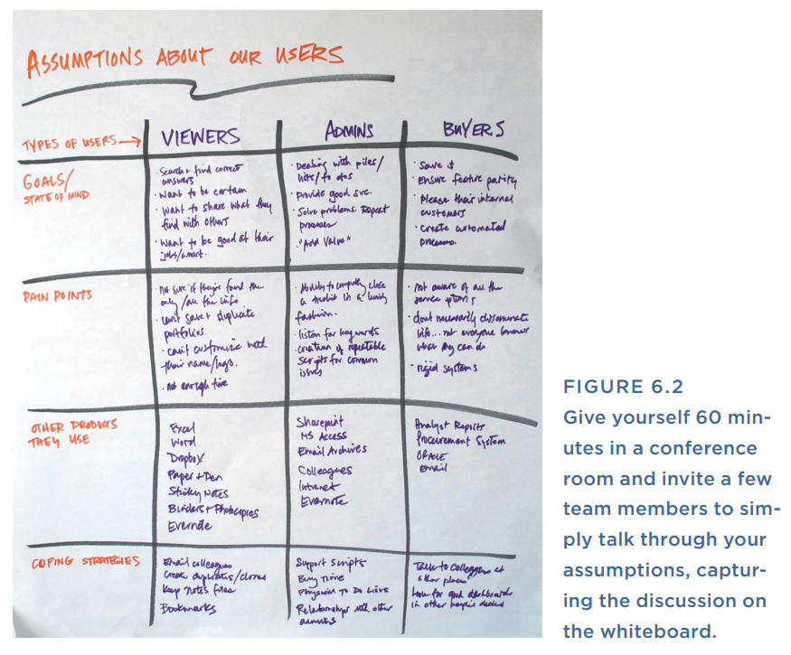
Lecture 6
Method 7 Learning Plan
Try It Out
1. Start with what you know.
Set aside 30 minutes or an hour to free-list everything you think
you know about your users (see Figure 6.2). What are your working
assumptions? Think about things like the following:
• What are your main segments/types of users?
• What motivates them?
• What frustrates them? What delights them?
• What features and functions are most important to them?
• What considerations are key in their purchase and reuse decisions?

Slide 8
Lecture 6
Method 7 Learning Plan
Try It Out
Do they use your competitor’s products? When and how?
What frustrates them about your product?
What do they like best about your product?
What parts of your product do they use the most? The least?
What parts of the product do you want them to use the most?
2. Separate certainties from assumptions.
For each assumption, indicate how confident you are in that assumption. While you do this, look for any questions that can be grouped together and simplified.

Slide 9
Lecture 6
Method 7 Learning Plan
3. Brainstorm research methods.
Now, for each of your questions, brainstorm how you might go about getting more data or info in this area. Also think about what resources will be required to actually answer these questions (for example, face-to-face time with users, a Web intercept survey, access to server log data, etc.).
4. Plan outputs.
Finally, for each area that you’d like to research further, think about what form your evidence will take (for example, presenting and distributing new personas).

Slide 10
Lecture 6
Method 8 Guerilla User Research
What concerns are top of mind for users? How do they really behave? How are people using your product today?
There is one key requirement of user research, and it’s simple but not always easy: You have to actually talk to users. It doesn’t have to be a lot of them. Even just two or three is better than none at all. In guerrilla user research, you make it a priority to talk to and learn from at least a few users, first-hand and by whatever means necessary.
Guerrilla user research can take any number of forms, from calling a user on the phone to approaching people in a coffee shop.

Slide 11
Lecture 6
Method 8 Guerilla User Research
Use When
You’re forming goals and priorities for design and feel that you need grounding in an understanding of user goals.
The team is making decisions for the product without any primary
or first-hand knowledge of user needs. (You know this is happening when you find yourself in stalemate design arguments, or when you see people rationalizing product choices by speculating how a fictitious user, or even they themselves, would use the product.)

Slide 12
Lecture 6
Method 8 Guerilla User Research
Try It Out
Think about your target users.
Start by asking yourself whom you’d like to talk to and how. Think about what characterizes your users. How old are they, on average? What kinds of behaviors and interests might they have? Where might they live and work? How do they spend their free time? Once you have a basic idea of whom you’re looking for, think about where this type of person might be likely to spend his or her time. If it’s the type of situation or place that you could easily get access to, go there and ask the random people you meet if they’d be willing to participate in a short study. For example, let’s say your target customer is creative freelancers.
Creative freelancers are known to spend lots of time working in coffee shops. So you would plan to spend an afternoon in a coffee shop, politely asking people you see working on their laptops if they would be interested in doing a short user study.

Slide 13
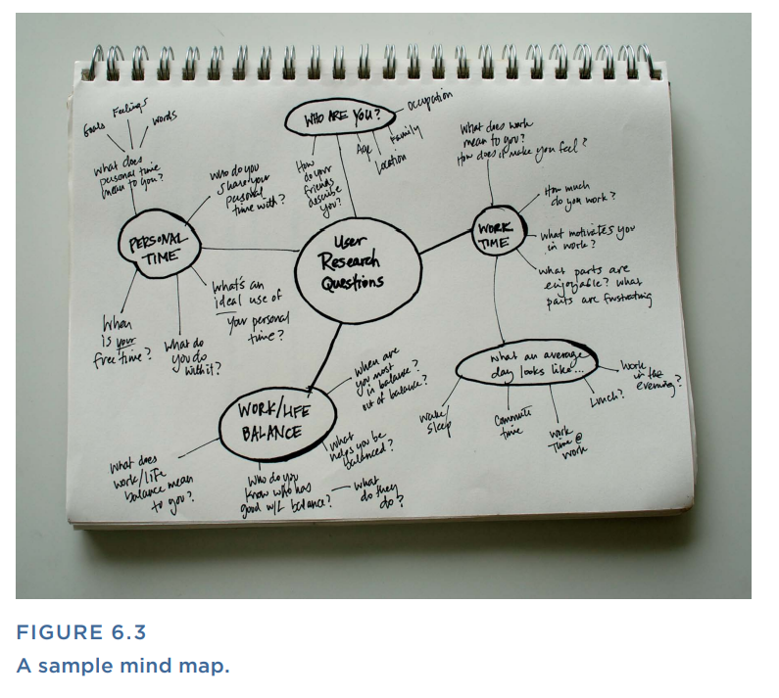
Lecture 6
Method 8 Guerilla User Research
2. List your research questions: Think about what you’re trying to learn from your users and list your questions. Articulate why you’re doing this work and what you hope to learn from it. Do a mind map to get your questions out of your head and onto paper or a white board (see Figure 6.3). To do a mind map, start by writing the topic in the middle (in this case, “user research questions.”)
3. Go into the field: For the research session, ideally meet with the user in his own environment: work, or home, or somewhere he spends a lot of time. Ask him to show you as much as he is comfortable sharing about what’s relevant and important in his own environment. If he’s okay with it, take pictures or videos to document what you see as visceral artifacts to remind you of this person and the things you learned about him. During your conversation, be sure you’re covering all the research questions that you listed in step2.

Slide 14
Lecture 6
Method 8 Guerilla User Research
4. Mine the data for insights.
After you’re done with your research interviews, spend some time reviewing your notes from all the interviews and looking for the answers to those questions that you listed at the beginning.

Slide 15
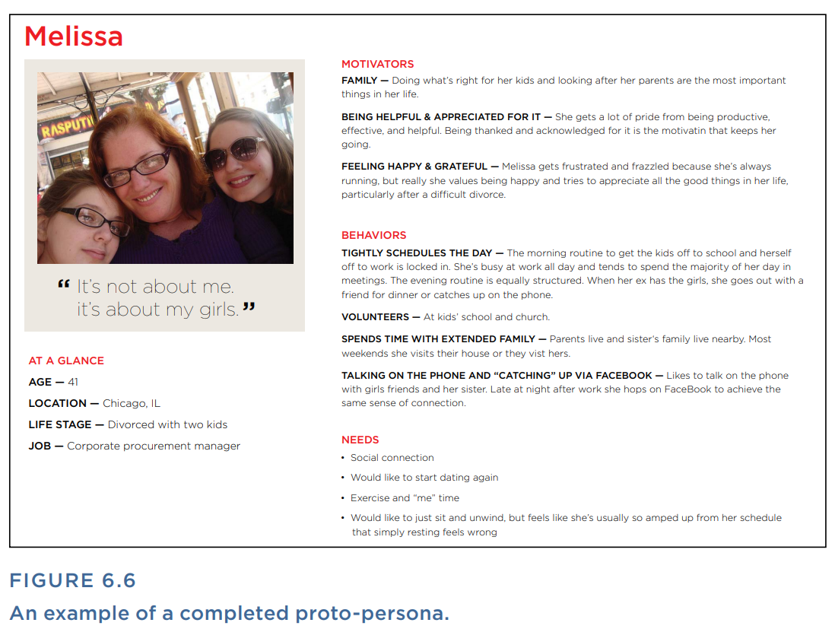
Lecture 6
Method 9 Proto - Personas
How can you think empathetically about your customers’ needs, goals, and challenges when using your product? Proto-personas are a technique to provoke empathetic, customer-oriented thinking without necessarily requiring you to do exhaustive customer research or have loads of statistical data to underpin your thinking (see Figure 6.6).
Proto-personas are inspired by the UX technique of a simpler name, personas. Personas are a time-tested tool of the user experience field. A persona is a composite picture of a collection of users boiled down into one relatable, human profile. A persona is usually presented as an individual person with a name, a face, and a backstory. Personas usually explain that person’s needs, values, goals, frustrations, and desires.

Slide 16
Lecture 6
Method 9 Proto - Personas
Personas are made as human as possible to further enhance the sense that this is a real person with a messy life and quirky ways of coping with very recognizable human situations. A persona is a fictitious composite based on extensive user research that you or someone else has observed firsthand. The trouble is, creating good personas takes time and resources.
Proto-personas are a modified version of personas that stimulate the same type of empathetic and user-oriented thinking, but with less investment in time. They can be created with the help of the cross functional team, which makes them a quick and inclusive tool for turning on the user experience goggles.

Slide 17
Lecture 6
Method 9 Proto - Personas
Use When
You have an unclear picture of your target user.
You find that you and the team talk about users and their motivations in generic and non-specific terms.
You sense that the team needs a more empathetic and human centered way of thinking about users.
Try It Out
1. Plan a working session with the team: Schedule an hour or so for a working session and invite a Cross functional team to help you create the proto-personas. Since this is a group activity, the number of people involved matters. Aim for no fewer than 4 people and no more than 12. Any more and the group becomes a bit unwieldy. Consider including people who have direct access to customers (for example, sales people or call center representatives). They will have great firsthand insights about customers.

Slide 18
Lecture 6
Method 9 Proto - Personas
2. Set expectations:
Once you have everyone assembled, explain that thinking of users as individual people with unique needs helps you create products that are easy to use and respect your users’ time. Help them understand that UX is a frame of mind, and this activity will help get them in that frame of mind. Explain that what you are about to do is an unscientific technique that will nevertheless get everyone thinking differently about the people who use your products.

Slide 19
Lecture 6
Method 9 Proto - Personas
3. Create teams:
Organize the group into small teams of about three people. Ask each team to discuss what they know or suspect to be true about your users, and then focus in on one particular type of user that they want to develop as a proto-persona.

Slide 20
Lecture 6
Method 9 Proto - Personas
4. Fill in basic information for each proto-persona:
Give each team a poster-sized persona template and ask them to fill in the details of a fictitious but realistic person they might expect to use their product. Ask them to create a story for this person, including a name, where they live, what they do for a living, what frustrates them, what a day in their life looks like, and what they are doing before, after, and during the use of your product.

Slide 21
Lecture 6
Method 9 Proto - Personas
5. Bring the proto-personas to life:
Ask each team to add photos, quotes, and other forms of real-life “color” to their posters. For this, you can simply give them a stack of stock photos or a selection of magazines and have them pick images to represent their persona and what a day in their life might look like.

Slide 22
Lecture 6
Method 9 Proto - Personas
6. Share and discuss as a group.
After the teams have each assembled their posters, ask each one to share the story of their proto-persona. As a group, discuss your reactions to the proto-personas. What questions do the proto-personas raise that you might want to explore or research further? Discuss how you’d like to use these personas in the future and if there are any particular proto-personas that are especially relevant and effective in getting the team to think empathetically.

Slide 23

Lecture 6
Method 10 Heuristic Markup
How does a user experience the product from beginning to end? Heuristic markups are inspired by heuristic evaluations. A heuristic evaluation is a fancy term for a review of a product to see how well it complies with recognized usability principles. In a typical heuristic evaluation, a user experience professional audits a product and identifies any parts that don’t conform to established standards and best practices.
A heuristic markup is conceptually similar to a heuristic evaluation, but it places less emphasis on recognized standards and more emphasis on your own gut reactions and responses as you move through the product.

Slide 24
Lecture 6
Method 10 Heuristic Markup
A heuristic markup helps you tell the story of how a user might experience the product from start to finish. In a heuristic markup, you start at the beginning of the product and record your thought process as you move through the experience. A heuristic markup is easy to do and surprisingly fun. Plus, taking the time to really notice what you notice is a good way to lift the goggles of familiarity.
Use When
You want to assess the basic quality of the product and spot potential opportunities for improvement.
In the design process, if you want to check your work as new designs are under way.

Slide 25
Lecture 6
Method 10 Heuristic Markup
Try It Out
1. Block off a good amount of time.
Set aside some time to really use the product, from start to finish. Plan more time than you think you need. This gives you enough time to take notes and capture your observations.
2. Begin at the beginning.
Think about where a typical user starts with your product. Is it with a Web search? A trip to the app store? If your product includes a physical device, does their experience begin with the process of opening the product box? Whatever it is, try to approach your offering from the same angle that first-timers would.

Slide 26
Lecture 6
Method 10 Heuristic Markup
Take screenshots or pictures and record your thoughts as you move from screen to screen or step to step. A PowerPoint document is a great place to store your images and observations. At each step or screen in the process, paste a screenshot on a new slide and add a note (or several) about what you are noticing and thinking about in your user’s mindset. Or use a screen recorder that also records sound (Silverback works well) and record your stream of consciousness as you move through the product, thinking aloud as you go.

Slide 27
Lecture 6
Method 10 Heuristic Markup
3. Pay attention to your reactions.
As you progress through the product, be alert to the subtle responses and questions that you find yourself having. Often, we encounter these thoughts so quickly that we may not be fully conscious that we’ve had them. They can still influence our perceptions of the quality of the product, though. Try to go slowly and be attentive to what your inner voice is saying.

Slide 28
Lecture 6
Method 10 Heuristic Markup
4. Go from beginning to end.
Continue moving through the product, recording images and observations as you go.
5. Share what you find.
When you’re done, you’ll have a candid and easy-to-share narrative that illustrates potential areas for improvement within the product. Keep in mind that you may be critiquing someone else’s hard work here, so be sure to soften any overly sharp or critical language before you share it with others. Capture the feeling, but leave the expletives out. At the end, include a summary of the key takeaways—the small handful of things that you believe are most critical.

Slide 29
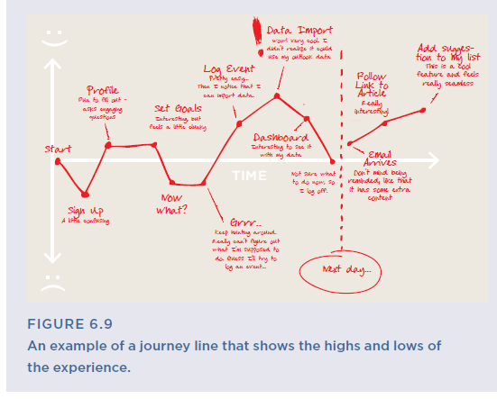
Lecture 6
Method 10 Heuristic Markup
Tips and Tricks for Heuristic Markups
• Adopt a persona. If you have some sense of who your users are, it can be helpful to create a backstory of your motivations and what you’re trying to accomplish to guide your thinking as you move through the product. (Use your proto-personas if you have them.)
• Record emotions. Along with your thought process, it can be illuminating to record your emotional responses to each step or screen (see Figure 6.9). Did it make you feel happy? Surprised? Confused? Frustrated? Make an emotional graph of the entire experience to help you pinpoint the most critical areas to improve or, alternately, to preserve. Think in terms of the seven universal human emotions: anger, joy, sadness, disgust, fear, contempt, and surprise.

Slide 30
Lecture 6
Method 11 Comparative Assessment
What are the standards and best practices that customers are likely to expect in a product like yours? A comparative assessment is a slight variation on the competitive assessment. In a competitive assessment, you evaluate your direct competitors.
In a comparative assessment, you look at products and services that your customers are likely to encounter and use, although they may not necessarily be your direct competitors. The idea behind a comparative assessment is that people develop their expectations from the products and services that they use every day.

Slide 31
Lecture 6
Method 11 Comparative Assessment
They may be benchmarking the experience you provide not against your direct competitors, but against eBay, Amazon, iTunes, and so on. A comparative assessment is a good way to start thinking about and discussing what an optimal experience looks like, even before you’ve begun creating any designs.
Use When
• You’re trying to establish vision and expectations for a new user experience.
• The team seems to be focusing on feature-by-feature comparison against competitors and not aiming to create a simple, holistic user experience.
• You keep hearing comparisons like “it should be the Apple of ______,” but nothing more specific.

Slide 32
Lecture 6
Method 11 Comparative Assessment
1. Pick which products to evaluate.
Create a list of the products you want to include in your assessment. This should be a small, manageable number. Five is about right. Ten is probably too many.

Slide 33
Lecture 6
Method 11 Comparative Assessment
2. Create a list of areas to evaluate.
Next, determine the framework that you will use to evaluate each product. A framework can be as simple as a spreadsheet with a column for each key question in your evaluation and a row for each product.

Slide 34
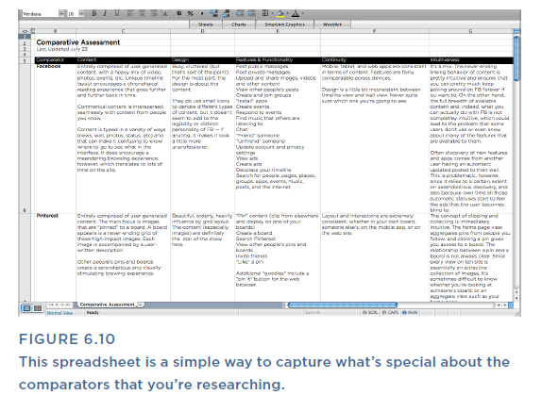
Lecture 6
Method 11 Comparative Assessment
The areas you focus on may be influenced by the domain you are evaluating and your goals for the project, but here are some common areas to focus on in your framework:
• Content • Design
• Features and functionality • Continuity or flow
• Intuitiveness • Strengths, weaknesses, opportunities
3. Walk through each product.
Now, with these focus areas in mind, begin to assess each product. Imagine that you have never encountered this product before and try to see it with fresh eyes. Take screenshots as you go and note your assessment of each product, as shown in Figure 6.10.

Slide 35
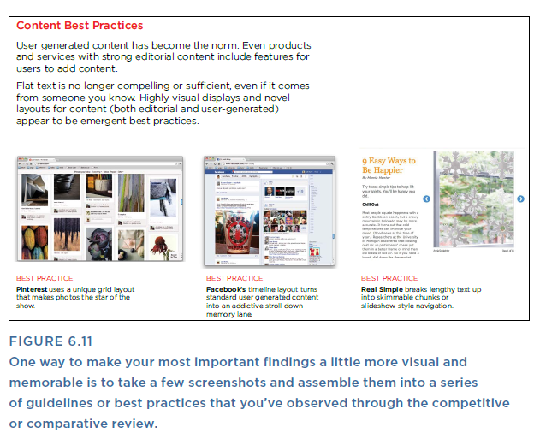
Lecture 6
Method 11 Comparative Assessment
4. Answer your questions.
Once you’ve assessed each product or offering, fill in your framework, so you can easily compare across offerings.
5. Summarize findings or guidelines.
Finally, consider documenting key insights from the assessment in a “guidelines” document that you can refer to as you proceed through the process of user-centered design, as shown in Figure 6.11. (These can be used in conjunction with “Design Principles,” described in Chapter 7, “Design Methods.”) Your guidelines can serve as a cheat sheet for fundamental design standards that you’ll want to meet or exceed.

Slide 36
Lecture 6
Method 12 Content Patterns
What content and capabilities do users have access to in your products, how is it structured, and what is the overall quality?
In a content inventory, you sit down with the product or service and attempt to create a representative sampling of all the types of information, assets, and functionality that it includes—sort of an index of the world. If that sounds painstaking, it is. You can get many of the same benefits (intimate understanding of structure, deeper familiarity with the content, etc.) with a lot less effort. Content patterns are less comprehensive than a traditional content inventory, but they do show the recurring patterns of content and functionality that exist and how they are they structured.

Slide 37
Lecture 6
Method 12 Content Patterns
Use When
• You want to get deeply familiar with the structure, information, and capabilities of your website or product (often this is at the beginning of a project).
Try It Out
1. Pick key sections.
Start by picking a few representative sections to feature in your sampling. Within each of these sections, look for recurring patterns or structures in the way that content is configured and presented. For example, case studies, articles, help files, and so on. This could also apply to features and functionality, which may have their own recurring patterns.

Slide 38
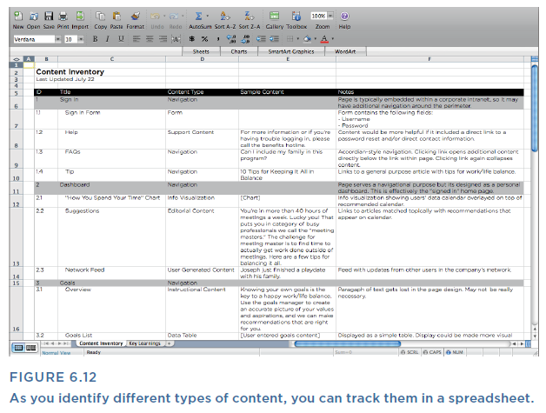
Lecture 6
Method 12 Content Patterns
2. Find the patterns.
List all the elements that come together to make up a unit of content. (For example, an article is comprised of a title, a byline, date, author, several long form paragraphs, some images, and finally some tags and categories, which are used as metadata for searching and filtering.) Repeat this process for each new type of content that you find.
3. Document what you find.
Put the patterns you’ve found into a spreadsheet, or to make it easy to visualize the structure and patterns of your content, make a diagram or a map of the different types of content you find (see Figures 6.12–6.14).

Slide 39
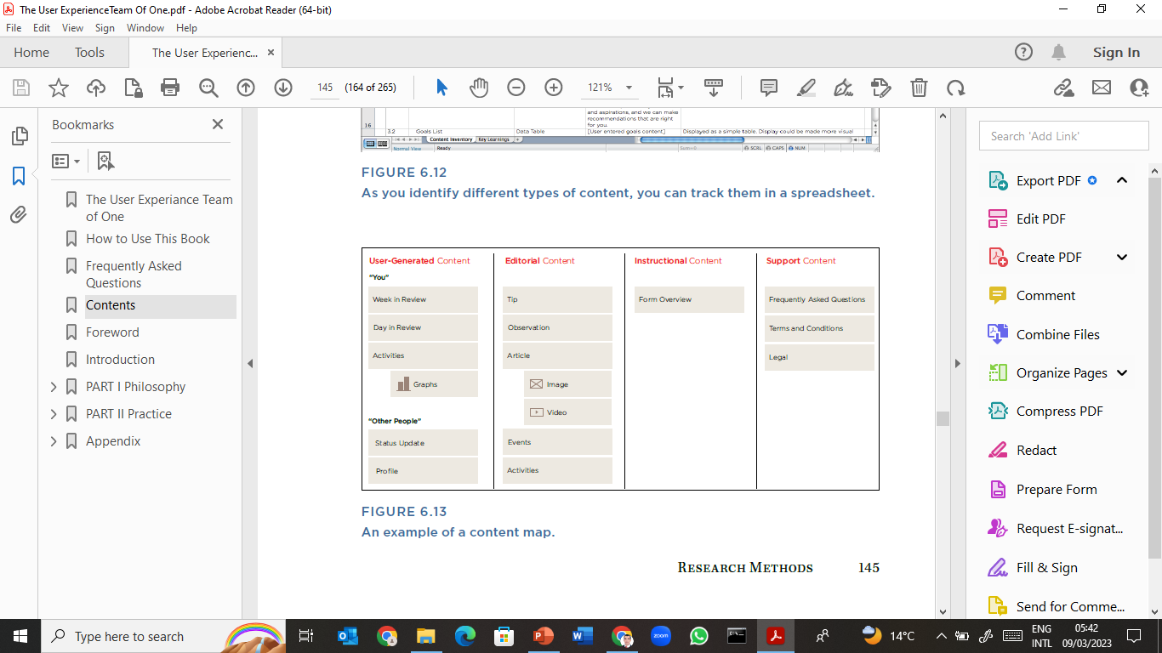
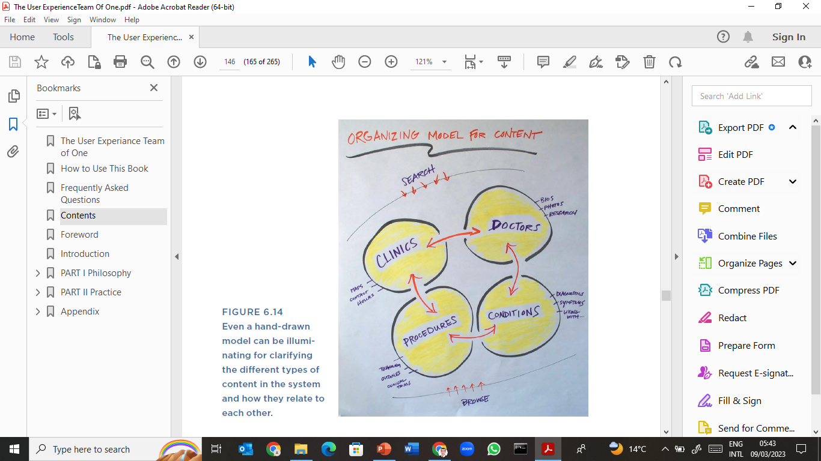
Lecture 6
Method 12 Content Patterns
4. Summarize key findings.
Finally, use this analysis to identify significant observations or findings. What are your top observations? What specific recommendations would you make to improve the product?
5. Share and discuss.
Optionally, share your findings with the team and discuss what actions you’d like to take, based on what you’ve learned.

Slide 40
Lecture 6
If You Only Do One Thing…
The methods in this chapter cover a variety of investigative activities for learning more about your product, your users, your competitive landscape, and even what you don’t know now but need to learn more about. At the core, however, these methods are about looking past what’s familiar and known in order to see the product with fresh eyes.
So if you only have time to do one thing, try the one method that best helps you see the world through your users’ eyes: “Guerilla User Research.” It will enable you not only to see areas for improvement in your product, but it will also give you a better sense of who your users are and what matters to them.

Slide 41

Lecture 5
Thank You

