Slide 1




AWS Cloud Security Foundations– AWS-CSF
Dr. Ibrahim Gomaa
Lecture 8: Securing your infrastructure

Slide 2


Lecture
Course Outline
8
Lecture 8: Securing your infrastructure
Topics
Structure of a three-tier web application
Using a VPC
Setting up public and private subnets and internet protocols
Using AWS security groups
Using AWS network ACLs
Using AWS load balancers
Pulling it all together
Protecting your compute resources
Lab
Securing VPC Resources by Using Security Groups
AWS Cloud Security Foundations– AWS-CSF
Lecture 8: Securing your infrastructure
Dr. Ibrahim Gomaa

Slide 3
Lecture
8
Securing your infrastructure
Structure of a three-tier
web application
AWS Cloud Security Foundations– AWS-CSF
Lecture 8: Securing your infrastructure
Dr. Ibrahim Gomaa

Slide 4
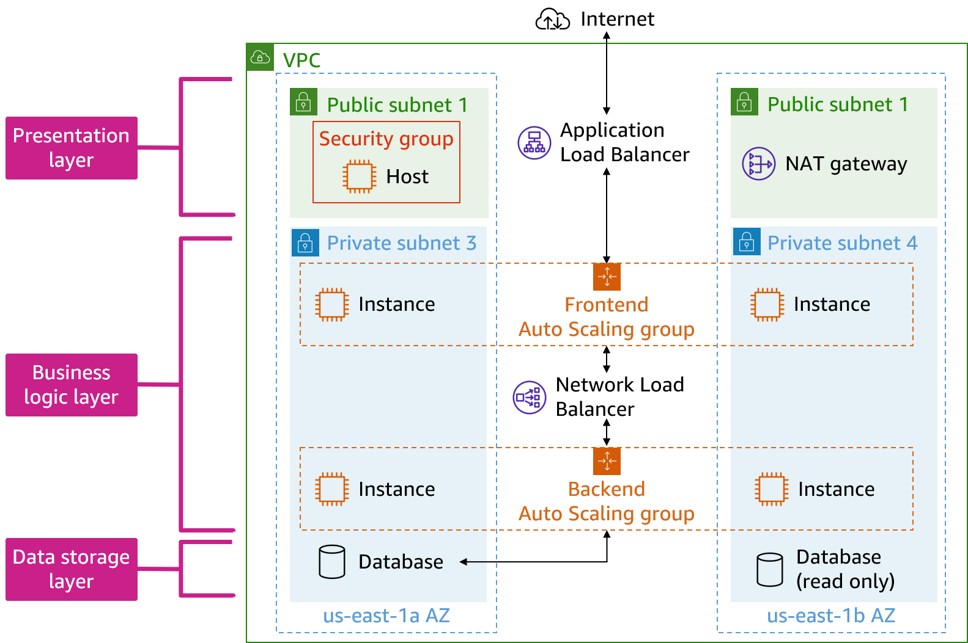
Lecture
8
Structure of a three-tier web application
Three-tier architecture
AWS Cloud Security Foundations– AWS-CSF
Lecture 8: Securing your infrastructure
Dr. Ibrahim Gomaa

Slide 5
Lecture
Securing your infrastructure
8
Using a VPC
AWS Cloud Security Foundations– AWS-CSF
Lecture 8: Securing your infrastructure
Dr. Ibrahim Gomaa

Slide 6

Lecture
8
Using a VPC
Amazon Virtual Private Cloud (Amazon VPC)
Provision a logically isolated section of the AWS Cloud where you can launch AWS resources in a virtual network that you define.
Control your virtual networking resources, including the following:
  Select the IP address range.
  Create subnets.
  Configure route tables and network gateways.
Customize the network configuration for your VPC.
Use multiple layers of security.
Amazon Virtual Private Cloud (Amazon VPC)
AWS Cloud Security Foundations– AWS-CSF
Lecture 8: Securing your infrastructure
Dr. Ibrahim Gomaa

Slide 7
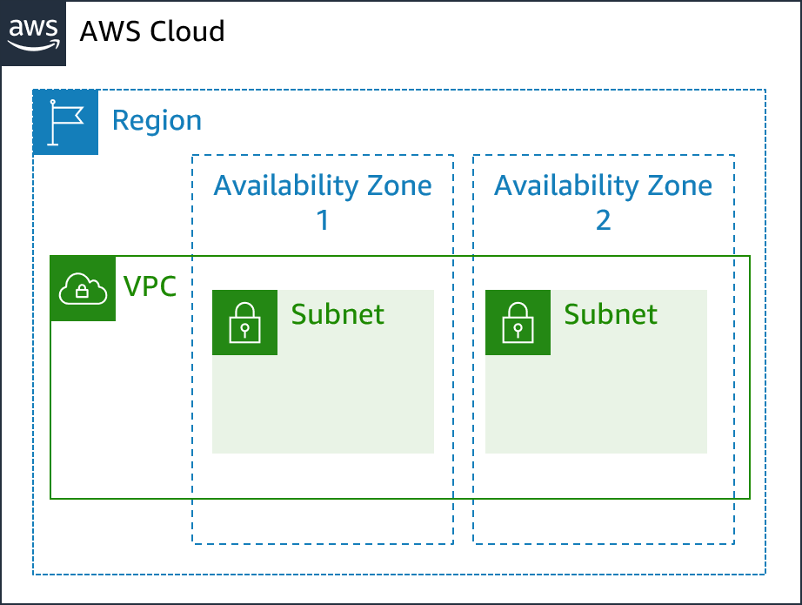
Lecture
8
Using a VPC
VPCs and subnets
VPC
  Is logically isolated from other VPCs
  Is dedicated to your AWS account
  Belongs to a single AWS Region and can span multiple Availability Zones
Subnet
  Is a range of IP addresses that divide a VPC
  Belongs to a single Availability Zone
  Is classified as public or private
AWS Cloud Security Foundations– AWS-CSF
Lecture 8: Securing your infrastructure
Dr. Ibrahim Gomaa

Slide 8
Lecture
Securing your infrastructure
8
Setting up public and private subnets and internet protocols
AWS Cloud Security Foundations– AWS-CSF
Lecture 8: Securing your infrastructure
Dr. Ibrahim Gomaa

Slide 9
Lecture
8
Setting up public and private subnets and
internet protocols
Internet gateway
Provides a target in your VPC route tables for internet-routable traffic
Performs network address translation (NAT) for instances that have been assigned public IPv4 addresses
Supports IPv4 and IPv6 traffic
Doesn't incur an additional charge in your account
AWS Cloud Security Foundations– AWS-CSF
Lecture 8: Securing your infrastructure
Dr. Ibrahim Gomaa

Slide 10
Lecture
8
Setting up public and private subnets and
internet protocols
NAT gateway
Supports instances in a private subnet to connect to the internet or other AWS services
Prevents the internet from initiating a connection to those instances
Requires that you specify the following at creation:
  Public subnet in which the NAT gateway should reside
  An Elastic IP address to associate with the NAT gateway
After creation, requires that you update the route table for one or more of your private subnets to direct internet-bound traffic to the NAT gateway
AWS Cloud Security Foundations– AWS-CSF
Lecture 8: Securing your infrastructure
Dr. Ibrahim Gomaa

Slide 11
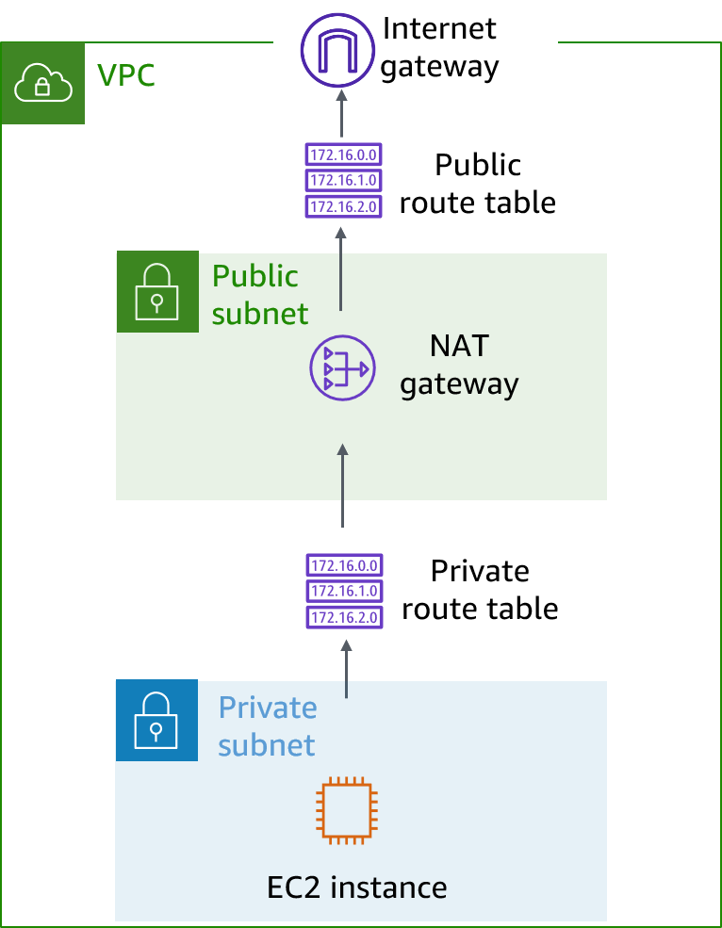
Lecture
8
Setting up public and private subnets and
internet protocols
Private subnet
All subnets consist of a contiguous range of IP addresses.
Interfaces that are attached to instances in private subnets cannot be reached from outside the parent VPC.
Private subnets are often used to host database instances that don't need to be accessed through the public internet.
AWS Cloud Security Foundations– AWS-CSF
Lecture 8: Securing your infrastructure
Dr. Ibrahim Gomaa

Slide 12
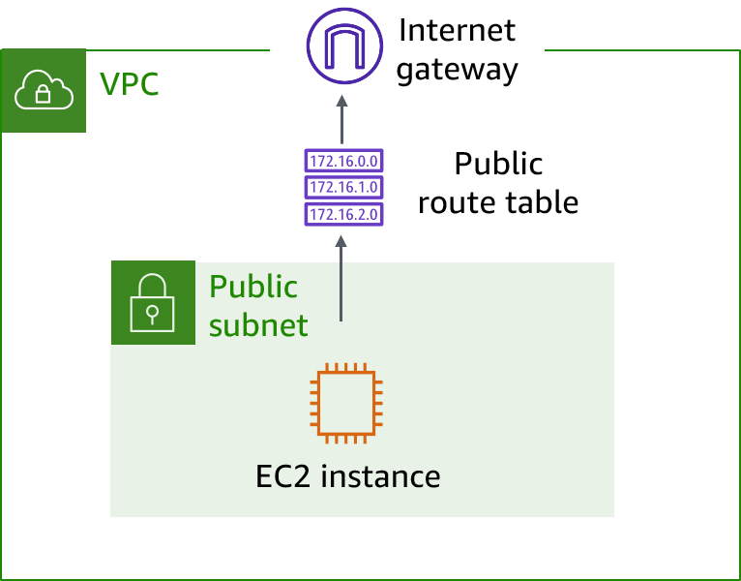
Lecture
8
Setting up public and private subnets and
internet protocols
Public subnet
When external traffic needs to reach an interface, such as an Amazon Elastic Compute Cloud (Amazon EC2) instance, the interface requires the following:
  A public IP address must be assigned to an EC2 instance.
  The subnet's route table must include an entry to the interface.
With these two factors in place, the subnet is considered to be a public subnet.
AWS Cloud Security Foundations– AWS-CSF
Lecture 8: Securing your infrastructure
Dr. Ibrahim Gomaa

Slide 13
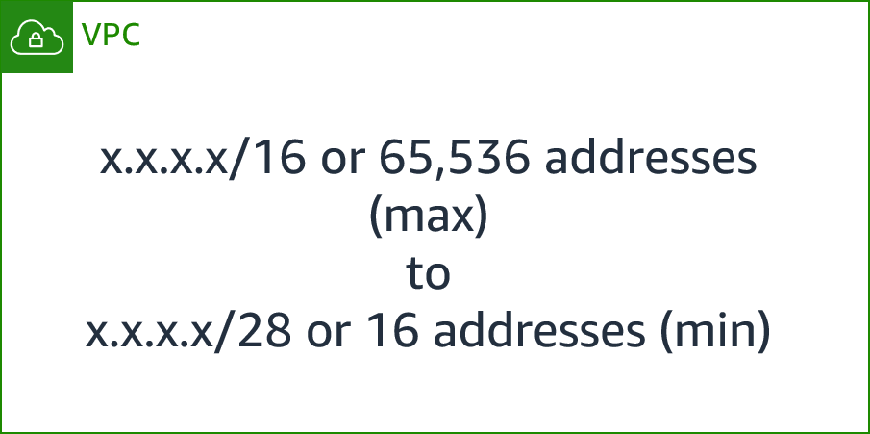
Lecture
8
Setting up public and private subnets and
internet protocols
IP addressing
When you create a VPC, you assign a CIDR range (a range of private addresses).
You cannot change the range in a VPC or subnet, but you can add more CIDR ranges to your VPC.
The largest CIDR block size is /16, and the smallest is /28.
The CIDR ranges of subnets shouldn't overlap.
AWS Cloud Security Foundations– AWS-CSF
Lecture 8: Securing your infrastructure
Dr. Ibrahim Gomaa

Slide 14
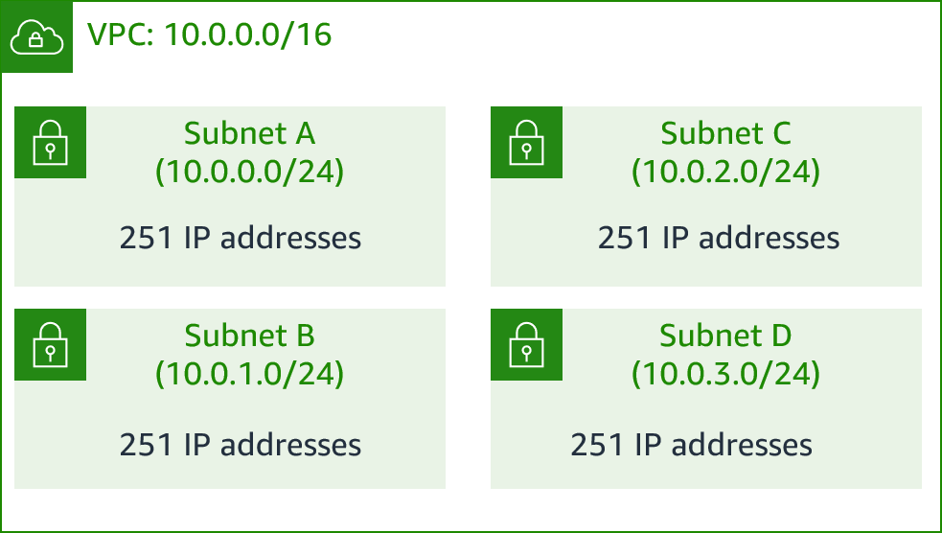
Lecture
8
Setting up public and private subnets and
internet protocols
Reserved IP addresses
Example: A VPC with an IPv4 CIDR block of 10.0.0.0/16 has 65,536 total IP addresses. The VPC has four subnets, all with /24 CIDR blocks. Although each subnet has 256 IP addresses, only 251 IP addresses are available for use in each.
IP Addresses for CIDR Block 10.0.0.0/24 | Reserved for
10.0.0.0 | Network address
10.0.0.1 | Internal communication
10.0.0.2 | Domain Name System (DNS) resolution
10.0.0.3 | Future use
10.0.0.255 | Network broadcast address
AWS Cloud Security Foundations– AWS-CSF
Lecture 8: Securing your infrastructure
Dr. Ibrahim Gomaa

Slide 15
Lecture
8
Setting up public and private subnets and
internet protocols
Public IP address
A public IP address is an IP address that is used to access the internet.
A public IP address can be automatically assigned if you modify the subnet's auto-assign public IP address properties.
Public IP addresses are dynamic. If you stop or start your instance, a new public IP is assigned. For production projects, use an Elastic IP address rather than an assigned public IP, which will be dissociated if you stop the instance.
AWS Cloud Security Foundations– AWS-CSF
Lecture 8: Securing your infrastructure
Dr. Ibrahim Gomaa

Slide 16
Lecture
8
Setting up public and private subnets and
internet protocols
Elastic IP address
Is associated with an AWS account
Is static and doesn't change over time
Comes from Amazon's pool of IPv4 addresses
  If you unassign an Elastic IP address, you are charged until you remove it completely.
Elastic IP addresses get allocated to your account and stay the same. Use an Elastic IP address when you work on a long-term project and configuring IP addresses can be time-consuming.
AWS Cloud Security Foundations– AWS-CSF
Lecture 8: Securing your infrastructure
Dr. Ibrahim Gomaa

Slide 17
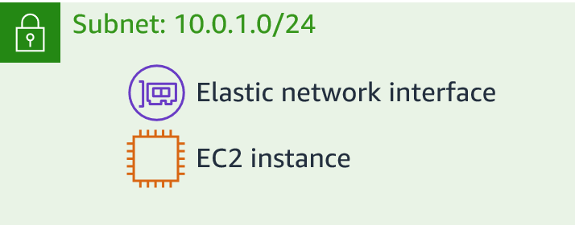
Lecture
8
Setting up public and private subnets and
internet protocols
Elastic network interface
An elastic network interface is a virtual network interface. You can do the following:
  Attach it to an instance.
  Detach it from the instance, and attach it to another instance to redirect network traffic.
Its attributes follow when it is reattached to a new instance.
Each instance in your VPC has a default network interface, which can be assigned a private IPv4 address from your VPC's range.
AWS Cloud Security Foundations– AWS-CSF
Lecture 8: Securing your infrastructure
Dr. Ibrahim Gomaa

Slide 18
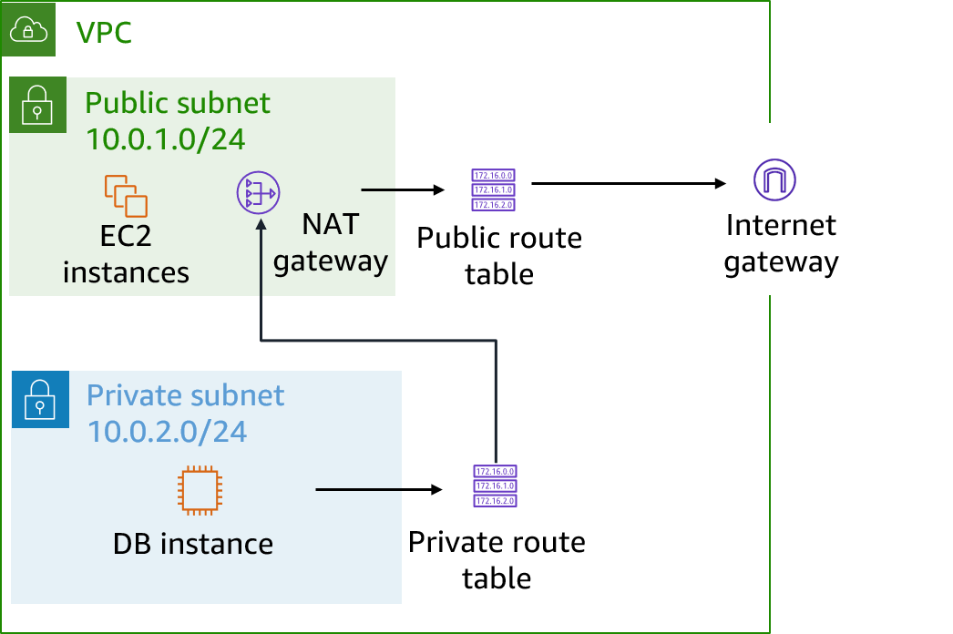
Lecture
8
Setting up public and private subnets and
internet protocols
Route tables and routes
A route table contains a set of rules (or routes), which you can configure to direct network traffic from your subnet.
Each route specifies a destination and a target.
By default, every route table contains a local route for communication within the VPC.
Each subnet should have its own route table.
AWS Cloud Security Foundations– AWS-CSF
Lecture 8: Securing your infrastructure
Dr. Ibrahim Gomaa

Slide 19
Lecture
Securing your infrastructure
8
Using AWS security groups
AWS Cloud Security Foundations– AWS-CSF
Lecture 8: Securing your infrastructure
Dr. Ibrahim Gomaa

Slide 20
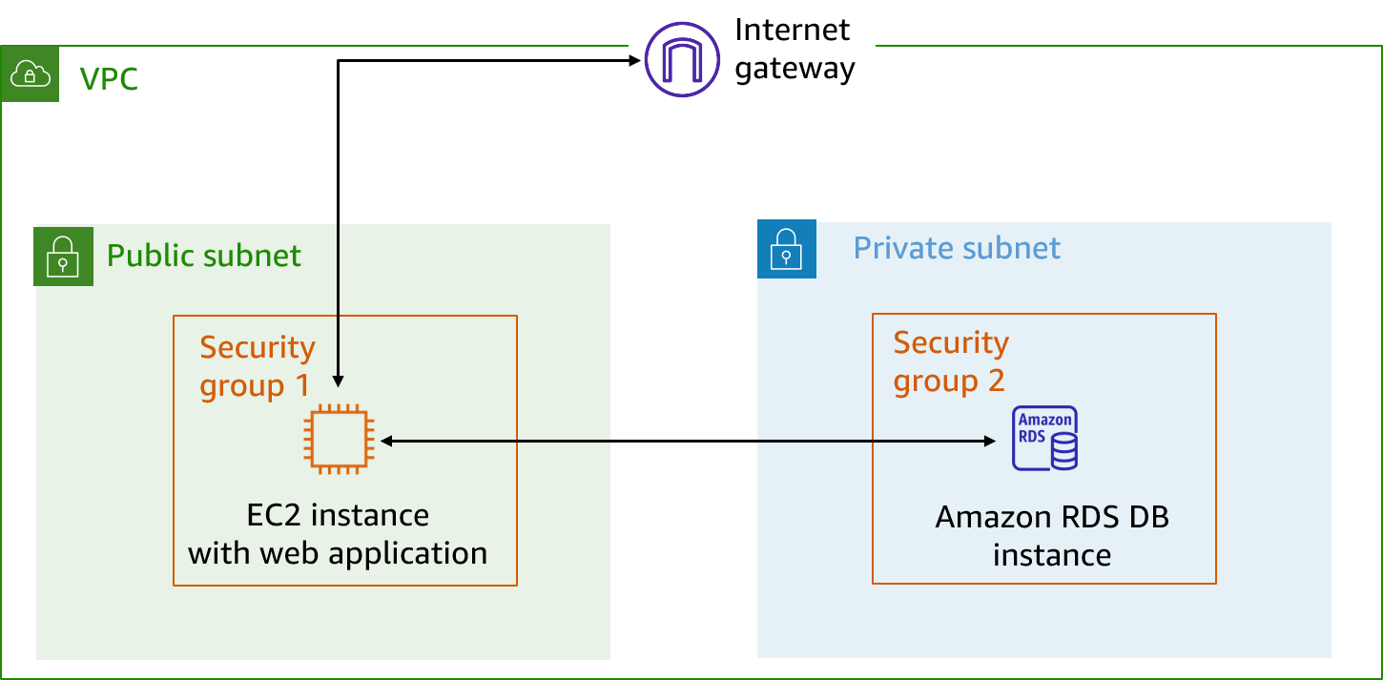
Lecture
8
Using AWS security groups
Security groups (1 of 2)
A security group acts as a virtual firewall for an EC2 instance, and controls inbound and outbound traffic for the instance. Security groups act at the instance level, not the subnet level.
AWS Cloud Security Foundations– AWS-CSF
Lecture 8: Securing your infrastructure
Dr. Ibrahim Gomaa

Slide 21
Lecture
8
Using AWS security groups
Security groups (2 of 2)
Security groups have rules that control inbound and outbound instance traffic.
Default security groups deny all inbound traffic and allow all outbound traffic. This is considered stateful.
Inbound
Source | Protocol | Port Range | Description
sg-xxxxxxxx | All | All | Allow inbound traffic from network interfaces that are assigned to the same security group.
Outbound
Destination | Protocol | Port Range | Description
0.0.0.0/0 | All | All | Allow all outbound IPv4 traffic.
::/0 | All | All | Allow all outbound IPv6 traffic.
AWS Cloud Security Foundations– AWS-CSF
Lecture 8: Securing your infrastructure
Dr. Ibrahim Gomaa

Slide 22
Lecture
Securing your infrastructure
8
Using AWS network ACLs
AWS Cloud Security Foundations– AWS-CSF
Lecture 8: Securing your infrastructure
Dr. Ibrahim Gomaa

Slide 23
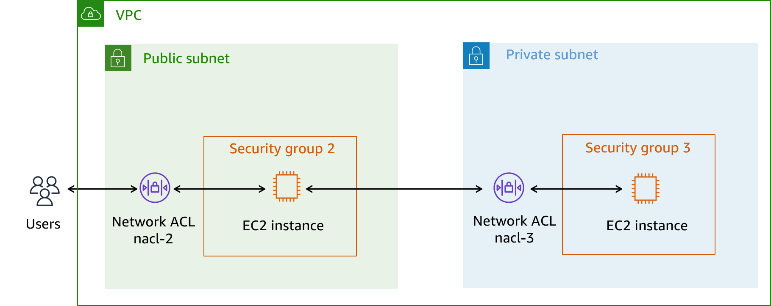
Lecture
8
Using AWS network ACLs
Network ACLs (1 of 2)
A network access control list (ACL) is an optional layer of security for your VPC. A network ACL acts as a firewall to control traffic in and out of one or more subnets. To add another layer of security to your VPC, you can set up network ACLs with rules that are similar to your security group rules
AWS Cloud Security Foundations– AWS-CSF
Lecture 8: Securing your infrastructure
Dr. Ibrahim Gomaa

Slide 24
Lecture
8
Using AWS network ACLs
Network ACLs (2 of 2)
A network ACL has separate inbound and outbound rules, and each rule can
either allow or deny traffic. Network ACLs are stateless.
Each VPC automatically comes with a modifiable default network ACL. By default, it allows all inbound and outbound IPv4 traffic.
You can create a custom network ACL and associate it with a subnet. By default, each custom network ACL denies all inbound and outbound traffic until you add rules.
Default inbound and outbound rules
Rule | Type | Protocol | Port Range | Source | Allow/Deny
100 | All IPv4 traffic | All | All | 0.0.0.0/0 | ALLOW
* | All IPv4 traffic | All | All | 0.0.0.0/0 | DENY
AWS Cloud Security Foundations– AWS-CSF
Lecture 8: Securing your infrastructure
Dr. Ibrahim Gomaa

Slide 25
Lecture
8
Using AWS network ACLs
Comparing security groups and network ACLs
Attribute | Security Groups | Network ACLs
Scope | Instance or interface level | Subnet level
Supported Rules | Allow rules only | Allow and deny rules
State | Stateful (return traffic is automatically allowed, regardless of rules) | Stateless (return traffic must be explicitly allowed by rules)
Order of Rules | All rules are evaluated before a decision is made to allow traffic | Rules are evaluated in number order before a decision is made to allow traffic
AWS Cloud Security Foundations– AWS-CSF
Lecture 8: Securing your infrastructure
Dr. Ibrahim Gomaa

Slide 26
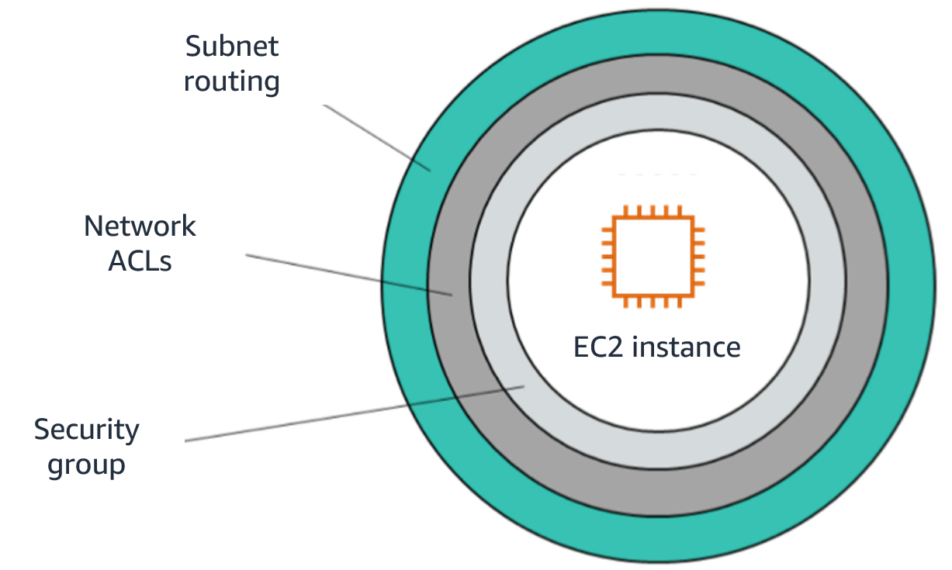
Lecture
8
Using AWS network ACLs
VPC security features
Security groups
Network ACLs
Subnets
Route tables
Note: VPC Flow Logs can log activity down to the interface level.
AWS Cloud Security Foundations– AWS-CSF
Lecture 8: Securing your infrastructure
Dr. Ibrahim Gomaa

Slide 27
Lecture
Securing your infrastructure
8
Using AWS load balancers
AWS Cloud Security Foundations– AWS-CSF
Lecture 8: Securing your infrastructure
Dr. Ibrahim Gomaa

Slide 28
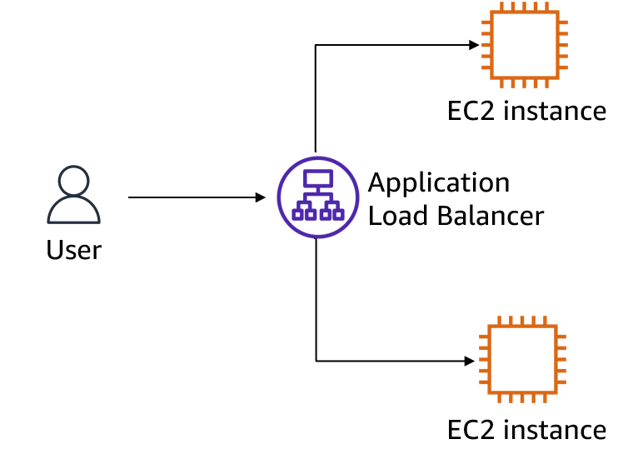
Lecture
8
Using AWS load balancers
Elastic Load Balancing (ELB)
Distributes incoming application traffic
Supports high availability
Performs health checks on instances
Provides the following:
  Application Load Balancer
  Network Load Balancer
  Classic Load Balancer
AWS Cloud Security Foundations– AWS-CSF
Lecture 8: Securing your infrastructure
Dr. Ibrahim Gomaa

Slide 29



Lecture
8
Using AWS load balancers
Data protection in ELB
Single point of contact
Encryption
at rest
Encryption
in transit
AWS Cloud Security Foundations– AWS-CSF
Lecture 8: Securing your infrastructure
Dr. Ibrahim Gomaa

Slide 30
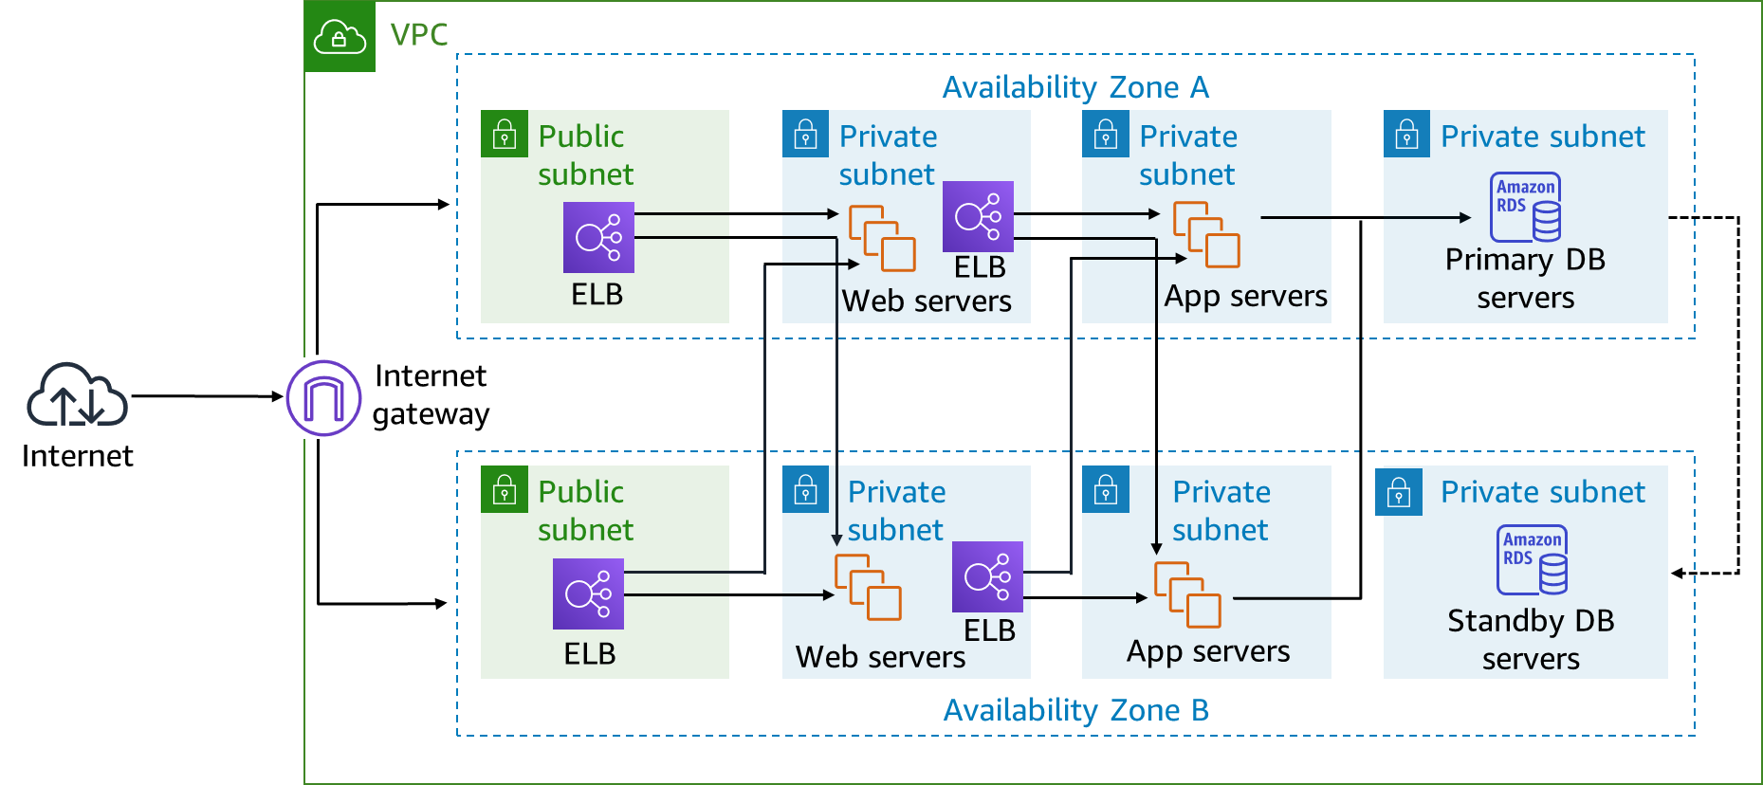
Lecture
8
Using AWS load balancers
Load balancers in action
AWS Cloud Security Foundations– AWS-CSF
Lecture 8: Securing your infrastructure
Dr. Ibrahim Gomaa

Slide 31
Lecture
Securing your infrastructure
8
Pulling it all together
AWS Cloud Security Foundations– AWS-CSF
Lecture 8: Securing your infrastructure
Dr. Ibrahim Gomaa

Slide 32
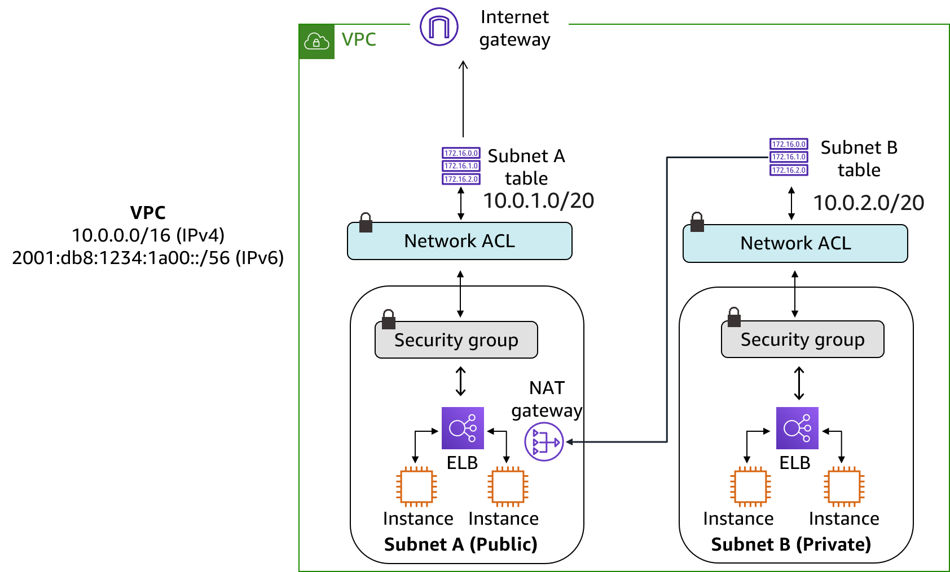
Lecture
8
Pulling it all together
Workflow
AWS Cloud Security Foundations– AWS-CSF
Lecture 8: Securing your infrastructure
Dr. Ibrahim Gomaa

Slide 33
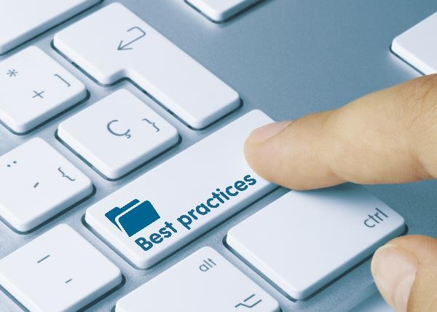
Lecture
8
Pulling it all together
Best practices to protect your network
Control traffic at all layers.
Inspect and filter your traffic at the application level.
Automate network protection.
Limit exposure by only allowing the minimum required access.
AWS Cloud Security Foundations– AWS-CSF
Lecture 8: Securing your infrastructure
Dr. Ibrahim Gomaa

Slide 34
Lecture
Securing your infrastructure
8
Protecting your compute resources
AWS Cloud Security Foundations– AWS-CSF
Lecture 8: Securing your infrastructure
Dr. Ibrahim Gomaa

Slide 35

Lecture
8
Protecting your compute resources
Amazon Inspector
Run automated security assessments on EC2 instances and applications.
Identify application security issues.
Enforce security standards and best practices.
Generate assessment reports.
Amazon Inspector
AWS Cloud Security Foundations– AWS-CSF
Lecture 8: Securing your infrastructure
Dr. Ibrahim Gomaa

Slide 36

Lecture
8
Protecting your compute resources
Security benefits of Amazon Inspector
Automate tasks to help you respond to security issues
Regularly monitor your resources
Benefit from AWS security expertise
Integrate security into DevOps
AWS Cloud Security Foundations– AWS-CSF
Lecture 8: Securing your infrastructure
Dr. Ibrahim Gomaa

Slide 37
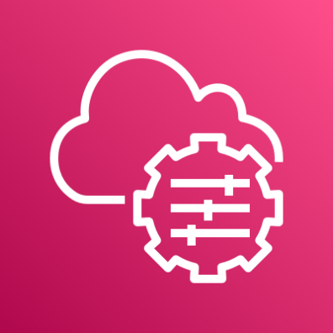
Lecture
8
Protecting your compute resources
AWS Systems Manager
AWS Systems Manager gives you visibility and control of your infrastructure on AWS. The service includes capabilities that help you automate management tasks. You can collect system inventory, apply operating system patches, maintain up-to-date antivirus definitions, and configure operating systems and applications at scale.
Amazon Inspector uses the widely deployed AWS Systems Manager Agent (SSM Agent) to collect the software inventory and configurations from your EC2 instances.
The collected application inventory and configurations are used to assess workloads for vulnerabilities.
AWS Systems Manager
AWS Cloud Security Foundations– AWS-CSF
Lecture 8: Securing your infrastructure
Dr. Ibrahim Gomaa

Slide 38
Lecture
Securing your infrastructure
8
Thanks
AWS Cloud Security Foundations– AWS-CSF
Lecture 8: Securing your infrastructure
Dr. Ibrahim Gomaa

