Slide 1

Organizational Behavior
Prepared by Dr. Walid K. El Leithy
Lecture 3
PMG 671
Organizational Behavior

Slide 2

Chapter
03
Personality & Values
This chapter will enable you to:
Contrast the two types of ability: intellectual and physical.
Identify the key biographical characteristics and describe how they are relevant to OB.
Define learning and outline the principles of the three major theories of learning.

Slide 3
Chapter
03
Personality & Values
This chapter will enable you to:
4. Define shaping and show how it can be used in OB.
5. Define personality, describe how it is measured, and explain the factors that determine an individual’s personality.

Slide 4
Chapter
03
Personality & Values
This chapter will enable you to:
Describe the Myers-Briggs Type Indicator personality framework and assess its strengths and weaknesses.
Identify the key traits in the Big Five personality model and demonstrate how the Big Five traits predict behavior at work.

Slide 5
Chapter
03
Personality & Values
This chapter will enable you to:
8. Identify other personality traits relevant to OB.
9. Define values, demonstrate the importance of values, and contrast terminal and instrumental values.
10. Show the relationship between individual personality and the workplace.
11. Identify Hofstede’s five value dimensions of national culture.

Slide 6
Chapter
03
Ability
Ability is an individual’s capacity to perform the various tasks in a job. It is made up of two sets of factors:
Intellectual Abilities
  The abilities needed to perform mental activities like thinking and reasoning.
Physical Abilities
  The capacity to do tasks demanding stamina, strength, and similar characteristics.

Slide 7
Chapter
03
Dimensions of Intellectual Ability
Intellectual Ability
Number Aptitude
Verbal Comprehension
Perceptual Speed
Inductive Reasoning
Deductive Reasoning
Spatial Visualization
Memory

Slide 8
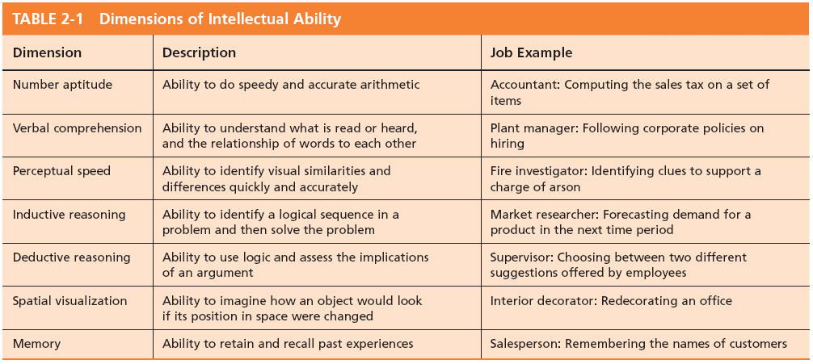
Chapter
03
Dimensions of Intellectual Ability

Slide 9
Chapter
03
Nine Basic Physical Abilities
Strength Factors
  Dynamic strength
  Trunk strength
  Static strength
  Explosive strength
Flexibility Factors
  Extent flexibility
  Dynamic flexibility
Other Factors
  Body coordination
  Balance
  Stamina

Slide 10
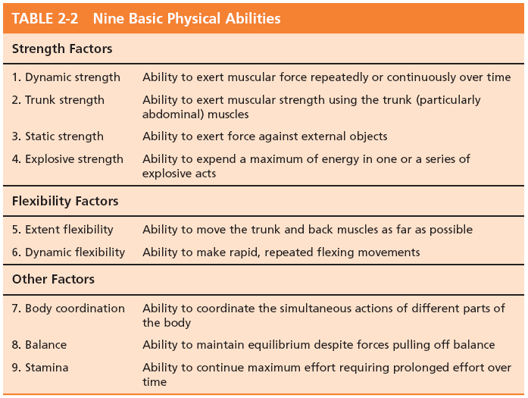
Chapter
03
Nibe Basic Physical Abilities

Slide 11
Chapter
03
Biographical Characteristics
Objective and easily obtained personal characteristics:
Age
  Older workers bring experience, judgment, a strong work ethic, and commitment to quality.
Gender
  Very few differences exist between men and women that affect job performance.
Race
  The biological heritage used to identify oneself.
  Contentious issue: differences exist, but could be more culture-based than race-based.

Slide 12

Chapter
03
Biographical Characteristics
Gender:
The Qatari Business Women’s Forum (QBWF) was set up to raise awareness of the role that women play in business in Qatar.

Slide 13
Chapter
03
Learning
Learning is any relatively permanent change in behavior that occurs as a result of experience
Learning components:
Involves Change
Is Relatively Permanent
Is Acquired Through Experience

Slide 14
Chapter
03
Theories of Learning
Classical Conditioning
  A type of conditioning in which an individual responds to some stimulus that would not ordinarily produce such a response.
Operant Conditioning
  A type of conditioning in which desired voluntary behavior leads to a reward or prevents a punishment.
Social-Learning Theory
  People can learn through observation and direct experience.

Slide 15
Chapter
03
Classical Conditioning
Pavlov’s Dog Drool
Key Concepts:
  Unconditioned stimulus
    A naturally occurring phenomenon.
  Unconditioned response
    The naturally occurring response to a natural stimulus.
  Conditioned stimulus
    An artificial stimulus introduced into the situation.
  Conditioned response
    The response to the artificial stimulus.
This is a passive form of learning. It is reflexive and not voluntary—not the best theory for OB learning.

Slide 16
Chapter
03
Operant Conditioning
Skinner’s Behaviorism
B. F. Skinner’s concept of Behaviorism: behavior follows stimuli in a relatively unthinking manner.
Key Concepts:
  Conditioned behavior: voluntary behavior that is learned, not reflexive.
  Reinforcement: the consequences of behavior which can increase or decrease the likelihood of behavior repetition.
  Pleasing consequences increase likelihood of repetition.
  Rewards are most effective immediately after performance.
  Unrewarded/punished behavior is unlikely to be repeated.

Slide 17
Chapter
03
Social Learning Theory
Based on the idea that people can also learn indirectly: by observation, reading, or just hearing about someone else’s—a model’s—experiences.
Key Concepts:
  Attentional processes
    Must recognize and pay attention to critical features to learn.
  Retention processes
    Model’s actions must be remembered to be learned.
  Motor reproduction processes
    Watching the model’s behavior must be converted to doing.
  Reinforcement processes
    Positive incentives motivate learners.

Slide 18
Chapter
03
Shaping: A Managerial Tool
Systematically reinforcing each successive step that moves an individual closer to the desired response
Four Methods of Shaping Behavior:
  Positive reinforcement
    Providing a reward for a desired behavior (learning).
  Negative reinforcement
    Removing an unpleasant consequence when the desired behavior occurs (learning).

Slide 19
Chapter
03
Shaping: A Managerial Tool
  Punishment
    Applying an undesirable condition to eliminate an undesirable behavior (“unlearning”).
  Extinction
    Withholding (hagb) reinforcement of a behavior to cause its cessation (“unlearning”).

Slide 20
في المرة الأولى التي تذهب فيها إلى محل البقالة مع طفلك يطلب منك شراء الحلوى في البداية فإنك ترفض ، ولكن عندما يبدأ في البكاء تشتري له الحلوى ، وهذا يعزز الفكرة في ذهنه أنه في كل مرة يلقي فيها نوبة غضب في سيحصل على شوكولاتة من محل بقالة ، ويواصل القيام بذلك ، وتستمر في مكافأة سلوكه عن غير قصد ، ثم يومًا ما تقول ببساطة “لا” لطلبه على الرغم من نوبات الغضب التي يمر بها ، ويبكي ولكنك تجاهلت هذا في المناسبتين التاليتين وفي النهاية عندما تذهب إلى المتجر للمرة الثالثة تدرك أنه لم يعد يلقي بنوبات الغضب.

Slide 21
Chapter
03
Schedules of Reinforcement: A Critical Issue
There are two major types:
Continuous Reinforcement
  A desired behavior is reinforced each time it is demonstrated.
Intermittent Reinforcement
  A desired behavior is reinforced often enough to make the behavior worth repeating but not every time it is demonstrated.
  Multiple frequencies.

Slide 22
Chapter
03
Types of Intermittent Reinforcement
Ratio
  Depends on the number of responses made.
Interval
  Depends on the time between reinforcements.
Fixed
  Rewards are spaced at uniform time intervals or after a set number of responses.
Variable
  Rewards that are unpredictable or that vary relative to the behavior.

Slide 23
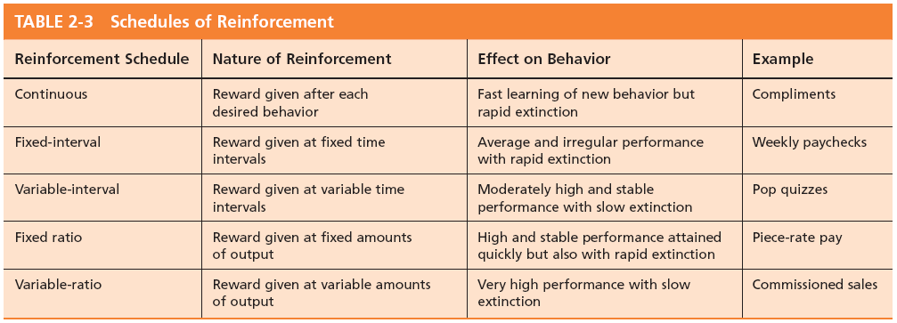
Chapter
03
Schedule of Reinforcement

Slide 24
Chapter
03
What is Personality?
The dynamic organization within the individual of those psychophysical systems that determine his unique adjustments to his environment.
Gordon Allport.
Personality is the sum total of ways in which an individual reacts and interacts with others, the measurable traits a person exhibits.

Slide 25
Chapter
03
What is Personality?
Measuring Personality
  Helpful in hiring decisions.
  Most common method: self-reporting surveys.
  Observer-ratings surveys provide an independent assessment of personality—often better predictors.

Slide 26
Chapter
03
Personality Determinants
Heredity
  Factors determined at conception: physical stature, facial attractiveness, gender, temperament, muscle composition and reflexes, energy level.
  This ‘Heredity Approach’ argues that genes are the source of personality.
  Twin studies: raised apart but very similar personalities.
  Parents don’t add much to personality development.
  There is some personality change over long
  time periods.

Slide 27
Chapter
03
Personality Traits
Traits are enduring مستمر characteristics that describe an individual’s behavior.
  The more consistent the characteristic and the more frequently it occurs in diverse situations, the more important the trait.
Two dominant frameworks are used to describe personality:
  Myers-Briggs Type Indicator (MBTI)
  Big Five Model

Slide 28
Chapter
03
The Myers- Briggs Type Indicator
Most widely used instrument in the world.
Participants are classified on four axes to determine one of 16 possible personality types, such as ENTJ.
Extroverted (E)
Introverted (I)
Sociable and Assertive
Quiet and
Shy
Sensing (S)
Intuitive (N)
Unconscious
Processes
Practical and
Orderly
Thinking (T)
Feeling (F)
Uses Values & Emotions
Use Reason
and Logic
Judging (J)
Perceiving (P)
Want Order
& Structure
Flexible and Spontaneous

Slide 29
Chapter
03
Myers- Briggs Types and Their Uses
Each of the sixteen possible combinations has a name, for instance:
  Visionaries (INTJ) – original, stubborn, and driven.
  Organizers (ESTJ) – realistic, logical, analytical, and business-like.
  Conceptualizer (ENTP) – entrepreneurial, innovative, individualistic, and resourceful.
Research results on the validity of MBTI are mixed.
  MBTI is a good tool for self-awareness and counseling.
  Should not be used as a selection test for job candidates.

Slide 30
Chapter
03
The Big Five Model of Personality Dimensions
Extroversion
Sociable, gregarious, and assertive
Agreeableness
Good-natured, cooperative, and trusting
Conscientiousness
Emotional Stability
Openness to Experience
Responsible, dependable, persistent, and organized
Calm, self-confident, secure under stress (positive), versus nervous, depressed, and insecure under stress (negative)
Curious, imaginative, artistic, and sensitive

Slide 31
Chapter
03
How do The Big Five Traits Predict Behavior?
Research has shown this to be a better framework.
Certain traits have been shown to strongly relate to higher job performance:
  Highly conscientious people develop more job knowledge, exert greater effort, and have better performance.
  Other Big Five Traits also have implications for work.
    Emotional stability is related to job satisfaction.
    Extroverts tend to be happier in their jobs and have good social skills.
    Open people are more creative and can be good leaders.
    Agreeable people are good in social settings.

Slide 32

Chapter
03
The Big Five Traits

Slide 33
Chapter
03
Other Personality Traits Relevant to OB
Core Self-Evaluation
  Represent a stable personality trait which includes an individual's subconscious, fundamental evaluations about themselves, their own abilities and their own control. People who have high core self-evaluations will think positively of themselves and be confident in their own abilities.
Machiavellianism
  A pragmatic, emotionally distant power-player who believes that ends justify the means.
  High Machs are manipulative, win more often, and persuade more than they are persuaded. Flourish when:
    they have direct interaction;
    they work with minimal rules and regulations;
    their emotions distract others.

Slide 34
Chapter
03
Other Personality Traits Relevant to OB
Narcissism
  A narcissist is an arrogant, entitled, self-important person who needs excessive admiration.
  Less effective in their jobs.
Self-Monitoring
  The ability to adjust behavior to meet external, situational factors.
  High self-monitors conform more and are more likely to become leaders.

Slide 35
Chapter
03
Other Personality Traits Relevant to OB
Risk Taking
  The willingness to take chances.
  May be best to align propensities النزعات with job requirements.
  Risk takers make faster decisions with less information.
  Creates positive change in the environment.

Slide 36
Chapter
03
Values
Values are basic convictions قناعات on how to conduct yourself or how to live your life that are personally or socially preferable— “How To” live life properly.
Attributes of Values:
Content Attribute—that the mode of conduct or end-state is important.
  Intensity Attribute—just how important that content is.
Value System:
  A person’s values rank-ordered by intensity.
  Tends to be relatively constant and consistent.

Slide 37
Chapter
03
Classifying Values- Rokeach Value Survey
Terminal Values
  Desirable end-states of existence; the goals that a person would like to achieve during his or her lifetime.
Instrumental Values
  Preferable modes of behavior or means of achieving one’s terminal values.
People in same occupations or categories tend to hold similar values, but:
  values vary between groups
  value differences make it difficult for groups to negotiate and may create conflict.

Slide 38

Chapter
03
Value Different Between Groups

Slide 39
Chapter
03
Linking Personality & Values To The WorkPlace
Person- Job Fit
Managers are less interested in someone’s ability to do a specific job than in that person’s flexibility.
John Holland’s Personality-Job Fit Theory
  Six personality types.
  Vocational Preference Inventory (VPI).
Key Points of the Model:
  There appear to be intrinsic حقيقي differences in personality between people.
  There are different types of jobs.
  People in jobs congruent with their personality should be more satisfied and therefore turnover should reduce.

Slide 40

Chapter
03
Holland’s Personality Typology & Occupations

Slide 41
Chapter
03
Still Linking Personality To The Workplace
In addition to matching the individual’s personality to the job, managers are also concerned with Person-Organization Fit.
  The employee’s personality must fit with the organizational culture.
  People are attracted to organizations that match their values.
  Those who match are most likely to be selected.
  Mismatches will result in turnover.
  Can use the Big Five personality types to match to the organizational culture.

Slide 42
Chapter
03
Linking Cultures & Behaviors
Hofstade’s Framework: Power Distance
Power Distance is the extent to which a society accepts that power in institutions and organizations is distributed unequally.
  Low distance
    Relatively equal power between those with status/wealth and those without status/wealth
  High distance
    Extremely unequal power distribution between those with status/wealth and those without status/wealth

Slide 43
Chapter
03
Linking Cultures & Behaviors
Hofstade’s Framework: Power Distance
Individualism
  The degree to which people prefer to act as individuals rather than a member of groups.
Collectivism
  A tight social framework in which people expect others in groups of which they are a part to look after them and protect them.

Slide 44
Chapter
03
Linking Cultures & Behaviors
Hofstade’s Framework: Power
Masculinity
  The extent to which society values the work roles of achievement, power, and control, and where assertiveness and materialism are also valued.
Femininity
  The extent to which there is little differentiation between roles for men and women.

Slide 45
Chapter
03
Linking Cultures & Behaviors
Hofstade’s Framework: Power
Uncertainty avoidance is the extent to which a society feels threatened by uncertain and ambiguous situations and tries to avoid them.
High Uncertainty Avoidance:
Society does not like ambiguous situations and tries to avoid them.
Low Uncertainty Avoidance:
Society does not mind ambiguous situations and embraces them.

Slide 46
Chapter
03
Linking Cultures & Behaviors
Hofstade’s Framework: Power
Long-term Orientation
  A national culture attribute that emphasizes the future, thrift, and persistence.
Short-term Orientation
  A national culture attribute that emphasizes the present and the here and now.

Slide 47
Chapter
03
Linking Cultures & Behaviors
Hofstade’s Framework: Power
There are regional differences within countries.
The original data is old and based on only one company.
Hofstede had to make many judgment calls while doing the research.
Some results don’t match what is believed to be true about given countries.
Despite these problems it remains a very popular framework.

Slide 48
Chapter
03
Globe Framework For Assessing Cultures
Identifies nine dimensions of national culture.
Similar to Hofstede’s framework with these additional dimensions:
  Humane Orientation: how much society rewards people for being generous, and kind.
  Performance Orientation: how much society encourages and rewards performance improvement and excellence.

Slide 49
Chapter
03
Summary & Managerial Implications
Ability
    Directly influences employees’ level of performance.
    Managers need to focus on ability in selection, promotion, and transfer.
    Fine-tune job to fit incumbent’s abilities.
  Biographical Characteristics
    Should not be used in management decisions: possible source of bias.
  Learning
    Observable change in behavior = learning.
    Reinforcement works better than punishment.

Slide 50
Chapter
03
Summary & Managerial Implications
Personality
  Screen for the Big Five trait of conscientiousness.
  Take into account the situational factors as well.
  MBTI can help with training and development.
Values
  Often explain attitudes, behaviors, and perceptions.
  Higher performance and satisfaction achieved when the individual’s values match those of the organization.

