Slide 1

Entrepreneurship & Innovation
Prepared by Dr. Amany Ramadan
ENT 611
Entrepreneurship & Innovation
Lecture 3

Slide 2


Chapter
Product or Service Feasibility Analysis
3
www.midocean.ae

Slide 3
Product or Service Feasibility Analysis
An analysis that determines the degree to which a product or service idea appeals to potential customers and identifies the resources necessary to produce it.
Two questions:
  Are customers willing to purchase our product or service?
  Can we provide the product or service to customers at a profit?
www.midocean.ae

Slide 4
Product or Service Feasibility Analysis
Primary research: Information that an entrepreneur collects firsthand and analyze it.
Primary research techniques include the following:
  Customer surveys and questionnaires
  Focus groups
www.midocean.ae

Slide 5
Focus Group
www.midocean.ae

Slide 6
Focus Group
A market research technique that involves enlisting a small number of potential customers (usually 8 to 12) to give feedback on specific issues about a product or service (or the business idea itself ).
www.midocean.ae

Slide 7
Secondary research
www.midocean.ae

Slide 8
Information that has already been compiled and is available for use.
Usually less expensive to collect than primary data.
It includes the following sources:
Demographic data (CAPMAS),
Market research that someone already compiled it, studies and surveys available for purchase.
Articles
World Wide web.
Local data
www.midocean.ae

Slide 9
Prototype
www.midocean.ae

Slide 10
An original, functional model of a new product that entrepreneurs can put into the hands of potential customers so they can see it, test it, and use it.
www.midocean.ae

Slide 11
Financial Feasibility Analysis
www.midocean.ae

Slide 12
Capital requirements –an estimate of how much start-up capital is required to launch the business.
Estimated earnings – forecasted income statements
Return on investment – Combining the previous two estimates to determine how much investors can expect their investments to return.
www.midocean.ae

Slide 13
The Business Plan
www.midocean.ae

Slide 14
A written summary of:
  An entrepreneur’s proposed business venture
  The operational and financial details
  The marketing opportunities and strategy
  The managers’ skills and abilities.
A business plan is the best insurance against launching a business destined to fail or mismanaging a potentially successful company.
www.midocean.ae

Slide 15
The Business Plan:
Two Essential Functions
www.midocean.ae

Slide 16
Guiding the company by charting its future course and defining its strategy for following it.
Attracting lenders and investors who will provide needed capital.
www.midocean.ae

Slide 17
A Plan Must Pass Three Tests
www.midocean.ae

Slide 18
1. The Reality Test – proving that:
  A market really does exist for your product or service.
  You can actually build or provide it for the cost estimates in the plan.
2. The Competitive Test – evaluates:
  A company’s position relative to its competitors.
  Management’s ability to create a company that will gain an edge over its rivals.
3. The Value Test – proving that:
  A venture offers investors or lenders an attractive rate of return or a high probability of repayment.
www.midocean.ae

Slide 19
Why Take the Time to Build a Business Plan?
www.midocean.ae

Slide 20
Although building a plan does not your chances of succeeding in businguarantee success, it does increase.
A plan is like a road map that serves as a guide on a journey through unfamiliar, harsh, and dangerous territory. Don’t attempt the trip without a map!
www.midocean.ae

Slide 21
Key Elements of a Business Plan
www.midocean.ae

Slide 22

Title Page and Table of Contents
Executive Summary
Vision and Mission Statement
Company History
Business and Industry Profile
www.midocean.ae

Slide 23
Title Page and Table of Contents
Executive Summary
Mission Statement
Company History
Business and Industry Profile
Business Strategy
Description of Products/Services
www.midocean.ae

Slide 24
Features vs. Benefits
Feature – a descriptive fact about a product or service.
Benefit – what a customer gains from the product or service feature.
www.midocean.ae

Slide 25
Key Elements of a Business Plan
(continued)
www.midocean.ae

Slide 26
Marketing Strategy
  Document market claims
  Show customer interest
Competitor Analysis
Description of Management Team
Plan of Operation
Projected Financial Statements
Loan or Investment Proposal
www.midocean.ae

Slide 27
Examples
www.midocean.ae

Slide 28
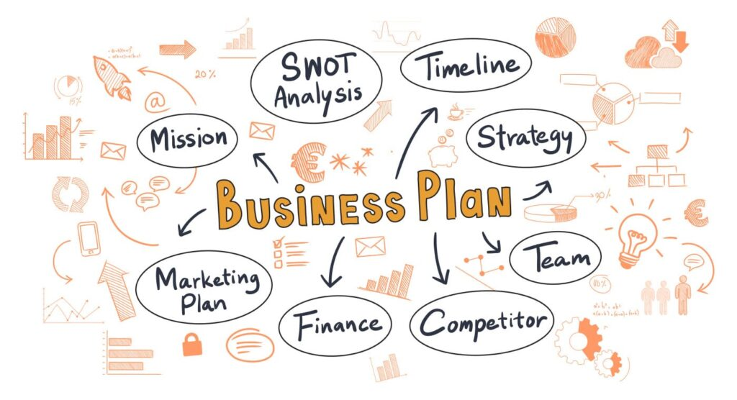
www.midocean.ae

Slide 29
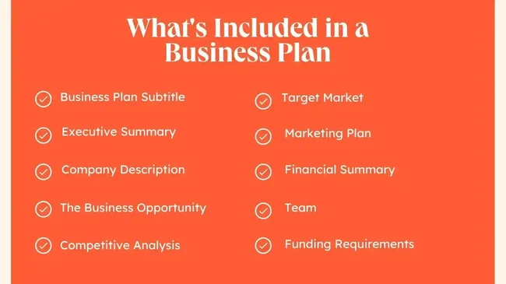
www.midocean.ae

Slide 30
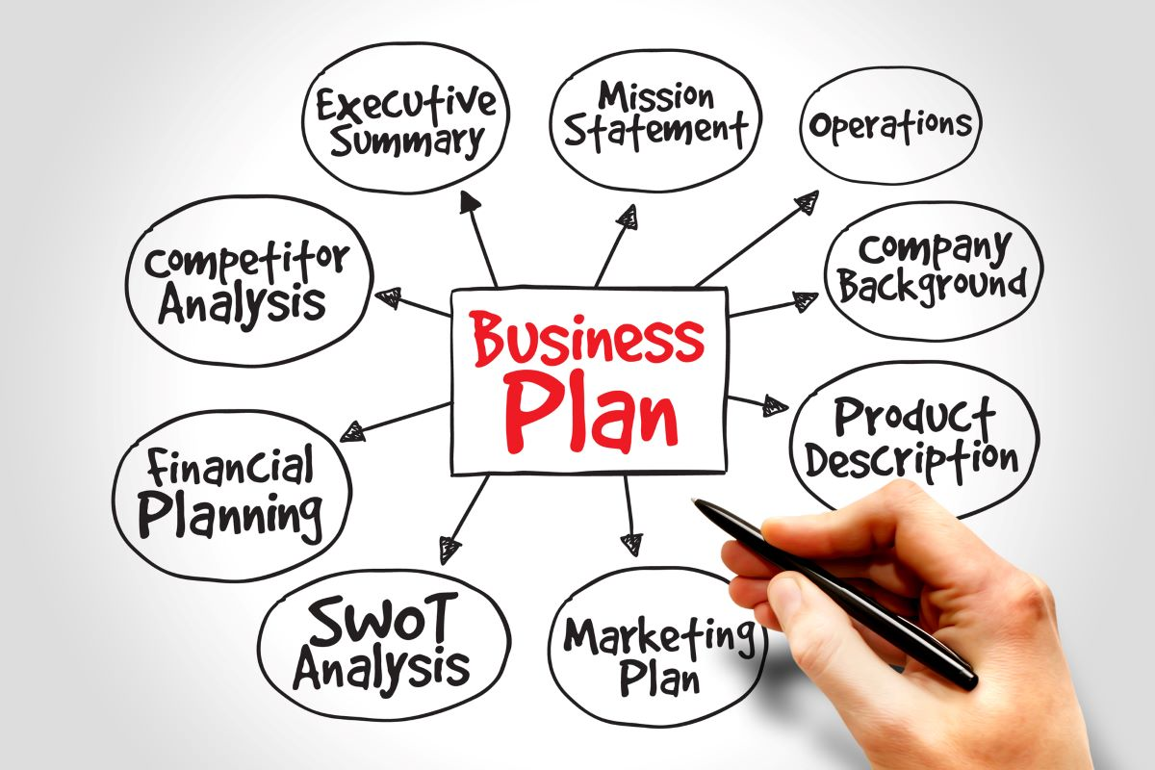
www.midocean.ae

Slide 31
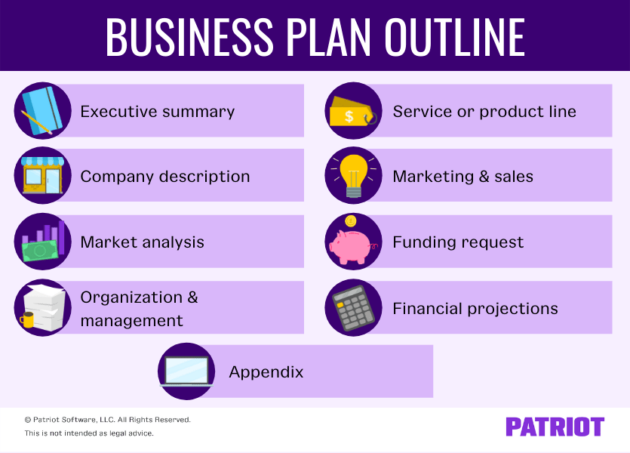
www.midocean.ae

Slide 32
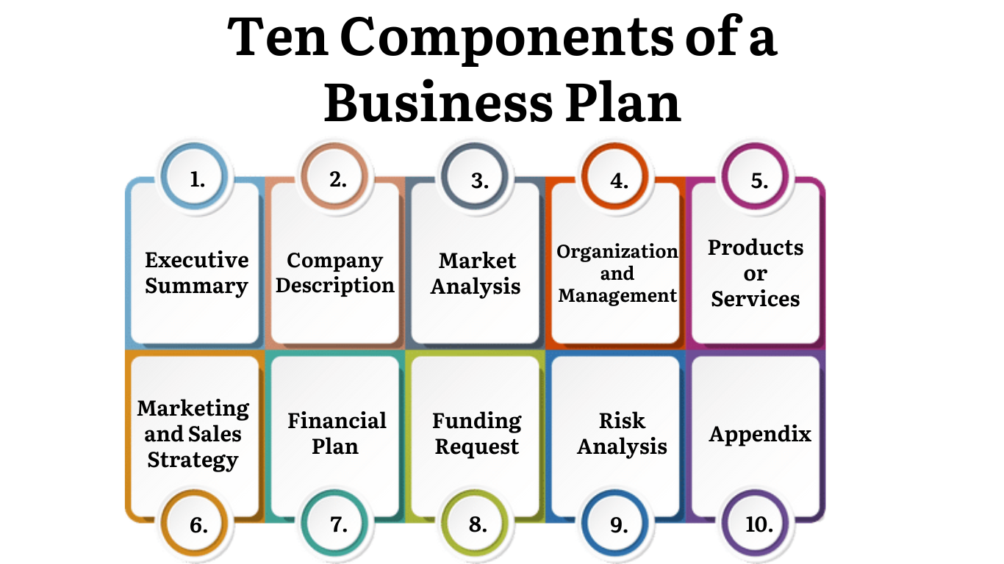
www.midocean.ae

Slide 33
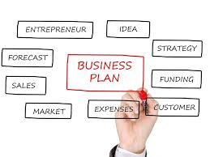
www.midocean.ae

Slide 34
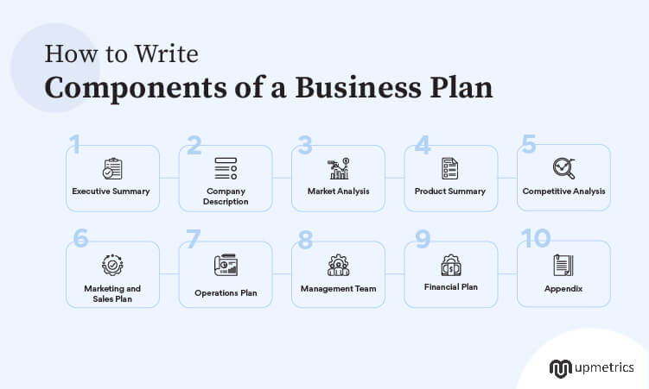
www.midocean.ae

Slide 35
The “5 Cs” of Credit Capital
www.midocean.ae

Slide 36
The “5 Cs” of Credit Capital
Capacity
Collateral
Character
Conditions
www.midocean.ae

Slide 37
The “5 Cs” of Credit Capital
Small business owners need to be aware of the criteria bankers use in evaluating the credit-worthiness of loan applicants-the five Cs of credit: capital, capacity, collateral, character, and conditions.
1. Capital- Lenders expect small businesses to have an equity base of investment by the owner(s) that will help support the venture during times of financial strain.
www.midocean.ae

Slide 38
The “5 Cs” of Credit Capital
2. Capacity- A synonym for capacity is cash flow. The bank must be convinced of the firm's ability to meet its regular financial obligations and to repay the bank loan, and that takes cash.
3. Collateral- It includes any assets the owner pledges to the bank as security for repayment of the loan.
www.midocean.ae

Slide 39
The “5 Cs” of Credit Capital
4. Character- Before approving a loan to a small business, the banker must be satisfied with the owner's character.
5. Conditions- The conditions-interest rates, the health of the nation's economy, industry growth rates, etc.-surrounding a loan request also affect the owner's chance of receiving funds.
www.midocean.ae

Slide 40

www.midocean.ae
There are no guarantees for success.
Creating a business plan will be valuable primarily because of the process itself.
The business planning process may provide insight to increase the chances for success.
The business plan: Entrepreneurs benefit; lenders and investors demand it!
Chapter
3
Conclusion

Slide 41



Thank You

