Slide 1

Lecture 6
Digital Leaders

Slide 2

Last Lecture, we leaned about
  The Digital Revolution
    Digitization
    Digitalization
    Digital Transformation
    Digital transformation in media
  Digital Leadership
    Definition
    Goals & strategy
  Digital leadership & Digital Transformation
  Importance of Digital Leadership in the Era of Digitalization
Lec.6

Slide 3
Lecture outline
Lec.6
Today’s Lecture we will Know about
  Digital Leaders
  8 components of digital leadership
    1. Media competence, 2. Agility, 3. Personal responsibility and autonomy, 4. Interconnected thinking and acting, 5. Innovation and vision, 6. Clear communication, 7. People in focus, 8. Transparency
  8 key leadership strengths
    1. Self-awareness, 2. communication, 3. Presentation Skills, 4. negotiation 5. Critical Thinking, 6. Conflict resolution skills, 7. creative problem-solving,
    8. Decision Making

Slide 4
Introduction & Learning Outcomes
Digital leadership, however, doesn’t just happen like that, it has to be learned. Simply knowing the current technologies and transferring traditional management tools one-to-one to the virtual space is not enough to meet the demands of modern everyday working life. Instead, you need a new way of working, tailored to digital transformation and true “digital leaders” who lead by example.
Learn about digital leaders and the strengths they should have.
Learn about the 8 components of digital leadership
Lec.6

Slide 5


Lec.6
Digital Leaders

Slide 6
Digital Leaders
Lec.6
Digital leaders act on three levels:
  they encourage members of the organization to consolidate knowledge gained through their individual activities,
  they consolidate and share knowledge within the team or group to foster deeper understanding,
  they mediate knowledge between members of the organization or groups, and they bring outside knowledge into the organization .

Slide 7
Digital Leaders
Lec.6
Digital leaders are responsible for maintaining effective communication with employees, the executive team, and the information technology team inside the business, as well as coordinating across these three groups in order to realize digitalization or digital applications.
Digital leaders must be transparent, unbiased, and sympathetic in order to facilitate communication between these three groups and to resolve inter-unit issues.

Slide 8
Digital Leaders
Lec.6
Additionally, the digital leader's expertise of business, digital literacy, and management science will enhance the success of the open, unbiased, and empathic policies and behaviors that the digital leader is expected to exhibit.
Successful digital leaders of the future will possess great coaching abilities, enabling them to foster dynamic, empowering, and high-performance cultures.

Slide 9
Digital Leaders
Lec.6
Digital leaders are characterized by an inventive mindset, networking intelligence, adaptability, motivational coaching, digital intelligence, democratic compromise behaviors, and a capacity to learn from their failures.
Digital leaders with vision, courage, inspiration, intellectual stimulation, passion, strategic thinking/planning, focus, collaboration, innovation, adaptability, communication, emotional intelligence, spiritual intelligence, responsibilities and accountability, technology, entrepreneurial, and adaptive ideas should be able to shape societies, solve problems, and think critically.

Slide 10
Digital Leaders
Lec.6
According to the evaluations, digital leaders possess a specific amount of digital expertise and experience, a vision for businesses to achieve their digital goals, and the ability to adjust their ideas and policies to changing situations.
Due to the qualities of digital leadership, it can be compared to other leadership styles. Digital leadership practices are inextricably linked to emotional intelligence and leadership types such as transformational and transactional leadership

Slide 11
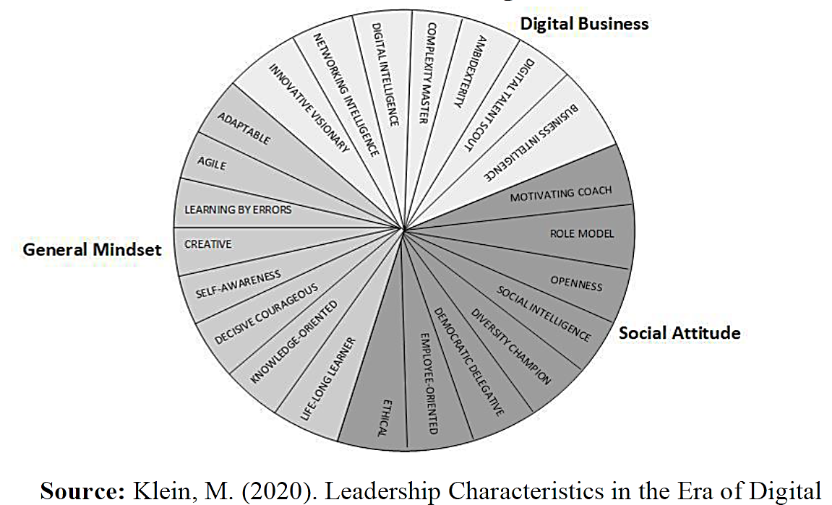
Digital Leaders
Lec.6
Characteristics of
digital leaders

Slide 12
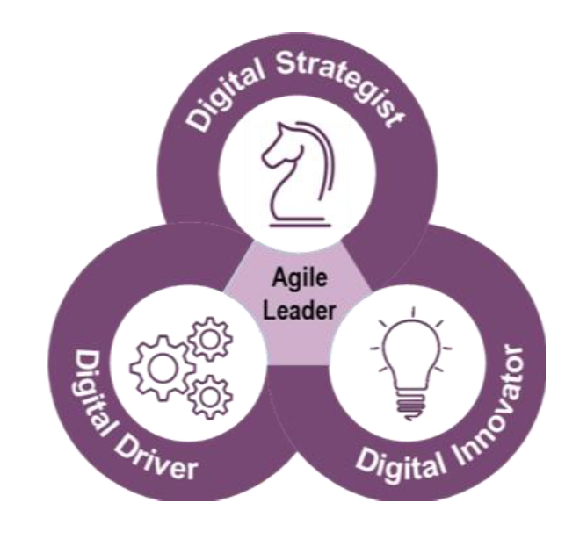
Digital Leaders
Lec.6
An Agile leader is a combination of Digital Strategist, Digital Innovator, and Digital Driver.
A digital strategist stays ahead of emerging trends and technologies, experiments with them personally where possible, and finds ways to apply them to drive transformative change for customers and/or business operations.
A digital innovator disrupts the status quo and keeps moving the organization toward the vision for winning in the future.
Lastly, a digital driver builds trust and collaborates across the organization with diverse stakeholders to enable rapid action.
Critical Skills of Digital Leaders

Slide 13
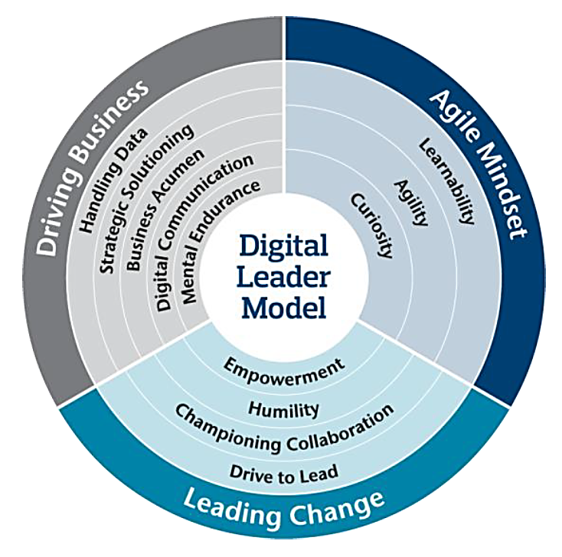
Digital Leaders
Lec.6
Digital Leader Model shows the important skills sets that are required to be a digital leader.
Leading change is about steering people in a volatile work environment, promoting and inspiring collaboration, empowering team members to embrace change and drive their self-development, being self-aware and be willing to move into the role of a humble facilitator.
Digital Leader Model

Slide 14
Digital Leaders
Lec.6
To overcome the challenges derived from the digital transformation, leaders are required to develop a combination of digital and human skills, mainly related to the ability to communicate effectively in a digitalized context, create cohesion between geographically distant followers, foster initiative and change attitudes, and deal with complex and fast problem solving.
Inspirational leaders will remain pivotal in making the right decisions, as “humans will continue to enjoy a strong comparative advantage over machines.”

Slide 15

Lec.6
8 Components of
Digital Leadership

Slide 16
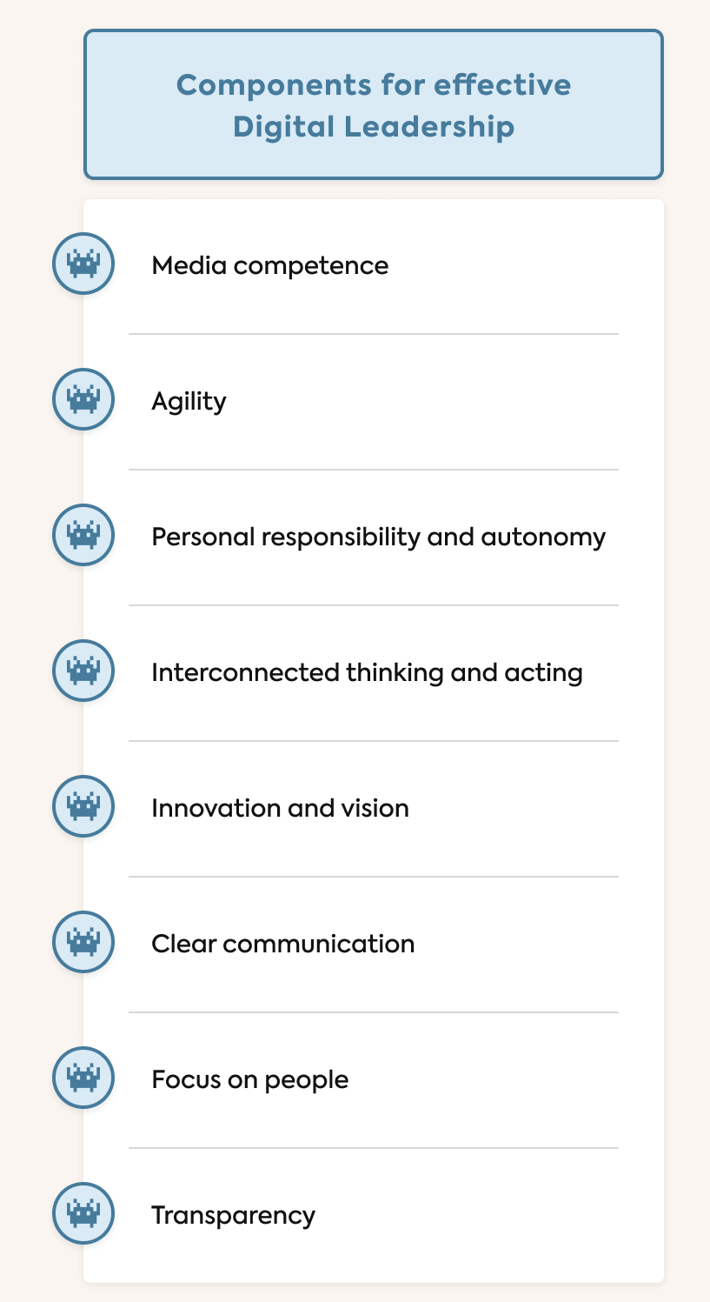
Lec.6
8 components of digital leadership
1. Media competence: An effective digital leader is technically savvy and knows digital programs and media so well they can use them optimally to achieve business goals.
2. Agility: Nowadays, the demands placed on companies change frequently and at high speed. Being able to react flexibly to these changes is essential to remain competitive. Complex tasks can no longer be planned in detail over the long term, especially when it comes to digital and IT-related projects.

Slide 17
Lec.6
8 components of digital leadership
3. Personal responsibility and autonomy: Digital leadership means creating the framework for teams to work autonomously. An open culture of feedback, individual appreciation and plenty of room for maneuver ensure that employees are motivated to get to work and are willing to contribute to the company achieving its goals.
4. Interconnected thinking and acting: digital leaders must link existing knowledge within their network in a meaningful way and bring employees together in interdisciplinary teams. After all, it is practically essential these days for people to work on projects across departments or companies.

Slide 18
Lec.6
8 components of digital leadership
5. Innovation and vision
Good digital leaders take a courageous approach, develop innovative solutions and a vision together with their team, and strive to use creative approaches to solve tomorrow’s problems today. e.g. launching new digital initiatives or revising business processes.
6. Clear communication: Communicating openly and clearly is one of the most important digital leadership skills. When teams work independently and from different locations, it is all the more crucial that there is plenty of communication.

Slide 19
Lec.6
8 components of digital leadership
7. People in focus
Employees, with their needs, potential, strengths and weaknesses, are the focus of digital leadership. A better approach would be to use digital business models that put the employee at the center and that are based on structural support and inspiration.
8. Transparency, in terms of corporate values and goals or strategies for the future: Employees no longer just want to know what they have to do, but also why they should do it. Communicating this “purpose” transparently and providing all employees with the necessary information at all times is the main task of digital leaders.

Slide 20
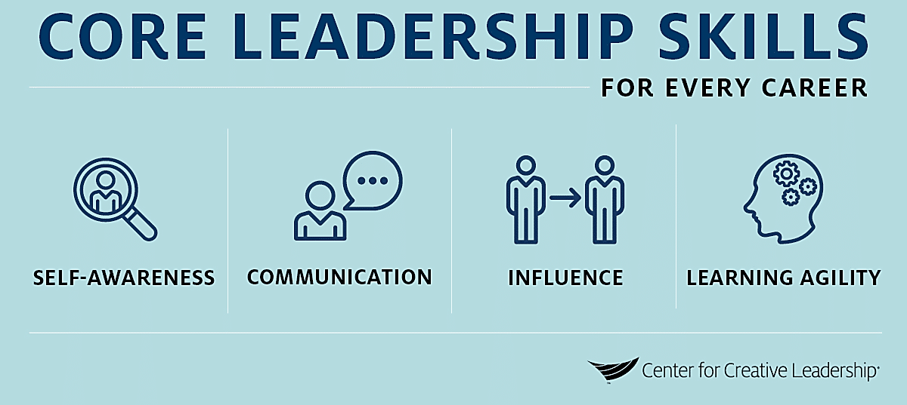
Lec.6
8 key leadership strengths

Slide 21
8 key leadership strengths
1. Self-awareness
Lec.6
Self-awareness is, in essence, the ability to monitor your own emotions and reactions as a leader.
Practicing self-awareness allows you to better react to situations or people who may trigger you.
Developing self-awareness better equips you as a leader to become aware of your emotions and build a toolkit for how to handle them in a professional situation.
Being more self-aware can lead to avoiding unnecessary conflict. It will also help you set a good example for your team.

Slide 22
8 key leadership strengths
1. Self-awareness
Lec.6
Leaders who display self-awareness are also able to adapt their leadership style to the needs of their team. For example, if a team is feeling stressed or under increased pressure, a leader with good self-awareness will know how to provide the support and encouragement needed.
Here are some quick tips to help you become more self-aware as a leader:
    1. Keep an open mind
    2. Stay focused
    3. Understand your own strengths and weaknesses
    4. Know your emotional triggers
    5. Practice self-discipline
    6. Seek feedback from your team

Slide 23
8 key leadership strengths
2. Communication
Lec.6
Leadership is communication. To be an effective leader, you must be able to communicate effectively. Your success, and that of your organization is reliant on it.
As a leader, you need to be a skilled communicator in relationships at many levels, and with a wide range of different audiences.
Therefore, it is vital that you are able to think clearly, and critically you must learn to handle the rapid flow of information within your organization, and among customers, partners, employees, and other stakeholders and influencers.

Slide 24
8 key leadership strengths
2. Communication
Lec.6
Your communication as a leader must be purposeful, and intentional.
The ability to know when, what and exactly how to communicate is an art.
Delivering effective communication is vital to gain trust, align in pursuit of targets and goals, and inspire change.
Leaders who lack strong communication skills often find themselves in situations where information is misunderstood or lacking. This can ultimately lead to relationships souring and place barriers between you, and your teams which can inhibit success.

Slide 25
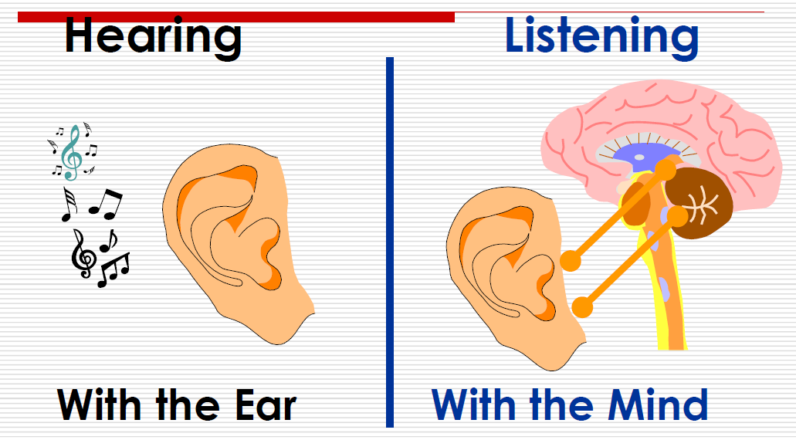
8 key leadership strengths
2. Communication
Lec.6
Communication
  Verbal
  Non-Verbal
  Active Listening
  ACTIVELY Listen—Not Hear
    Listen ACTIVELY to your customers, your supervisors, your colleagues, and anyone else who comes inContact with your business.
    Active Listening is one of the main KEYS to SUCCESS

Slide 26
8 key leadership strengths
2. Communication
Lec.6
8 P’s of Office Meeting Protocol
  Punctual
  Prepared
  Participatory
  Positive
  Productive
  Polite
  Proactive
  Professional
Did You Know That
  55%Body Language
  38%Tone
  7%Verbal
  100%TOTAL

Slide 27
8 key leadership strengths
3. Presentation Skills
Lec.6
A good presentation skills must include:
  Know Your Audience's Needs and connect with your audience.
    Leaders match information with the needs and desires of others who share their vision. Persuasion, enlightenment and inspiration require engaging not only the minds but also the hearts of listeners.
  Sharpen your message: The 3 Cs: Have a Clear, Concise, and Consistent Message.
    Clarity: Identifying your main ideas
    Keep it concise: Aim for short, direct sentences.
    Consistency in communication usually means two things: repetition and frequency
  Tell a story with data and specific examples
  Use Effective Nonverbal Communication
  Closing statement

Slide 28
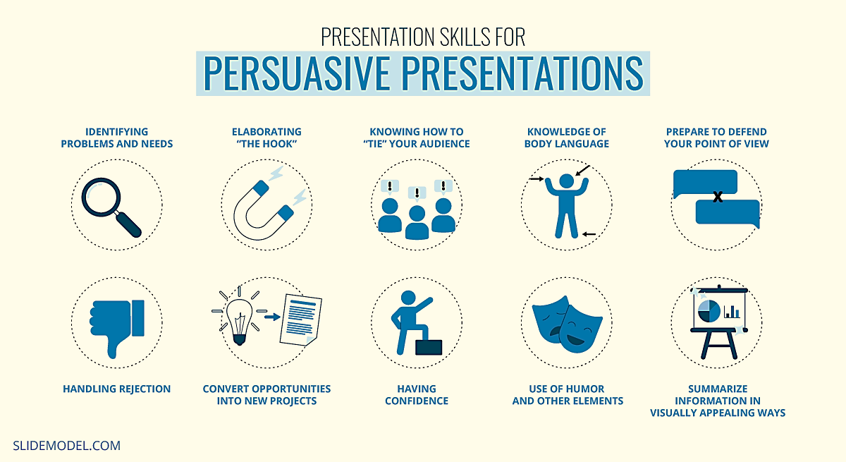
8 key leadership strengths
3. Presentation Skills
Lec.6

Slide 29

8 key leadership strengths
4. Negotiation
Lec.6
Negotiation is a process of interaction by which two or more parties who consider they need to be jointly involved in an outcome, but who initially have different objectives, seek by the use of argument and persuasion to resolve their differences in order to achieve a mutually acceptable solution.
Getting to YES
What is Negotiation?
The only game where both parties WIN
Negotiation Golden Rules
  Don’t Give it--Trade it
  There is Always a Better Offer than 1st one
  Everything is Open to Change
  Always Aim High
Basic Concepts
Two Parties
No Unilaterally imposed decision
Negotiation is a process

Slide 30
8 key leadership strengths
4. Negotiation
Lec.6
In a negotiation, an effective leader will look to understand the needs and interests of those they lead and work to satisfy those needs. Effective negotiators are able to find common ground between parties, build trust, and manage conflict. They are also able to see the “big picture” and possess long-term thinking.
The way we view things determines how they will be perceived in reality. As an effective negotiator, it’s vital to keep your viewpoints open and avoid involving ego and bias. This ultimately means you need to keep your emotions in check throughout any negotiation. Managing emotions can have a positive impact in any negotiation situation. This can ultimately translate into easier negotiations, problem-solving, and decision-making.

Slide 31
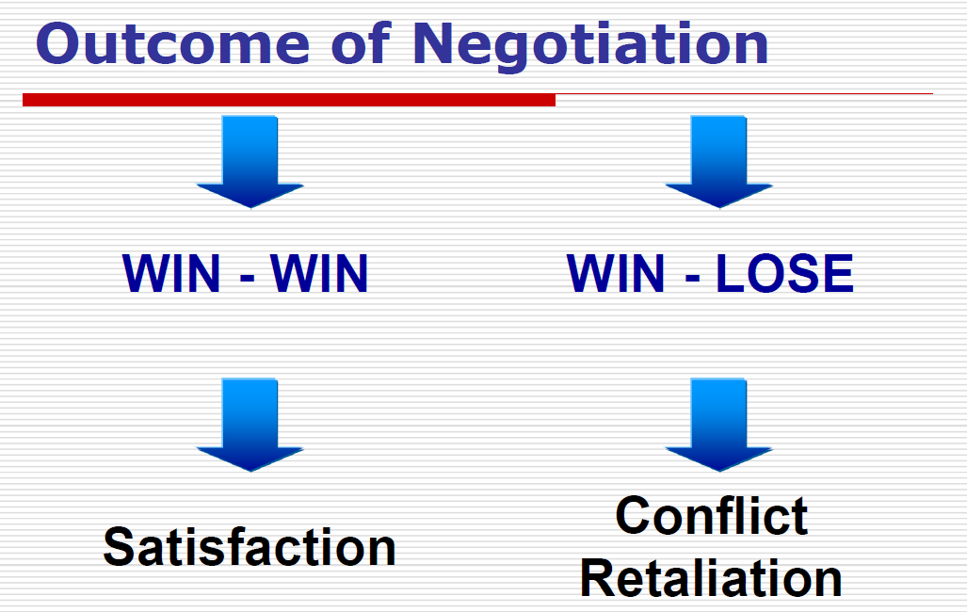
8 key leadership strengths
4. Negotiation
Lec.6
Elements of Negotiation
Two or more parties
Involved for desired outcome
Different interests and objectives
Some possibility to modify position
Hope of desirable acceptable outcome
Degree of POWER over other
Verbal Interaction between people
Negotiation is a means to resolve differences

Slide 32
8 key leadership strengths
5. Critical Thinking
Lec.6
Critical Thinking:
  Is a manner of reasoning which places intellectual standards and principles on ordered thinking structures and processes.
  Involves contemplation and reasoning with regard to what results will be brought about if any of a number of alternatives are chosen in a decision-making or action process.
  Focuses on important aspects of information; it involves the asking of questions about data, then creating arguments and ideas that help in decision-making and problem-solving processes.
  In critical thinking, an individual must utilize control over the following thought-process attributes:
  Direction provided by the person.
  Monitoring done by individual.
  Self-discipline applied.
  Self-correction made by the critical thinker.

Slide 33
8 key leadership strengths
5. Critical Thinking
Lec.6
Critical thinkers:
  Understand an argument‘s structure (including issues, rationale, and conclusions).
  Know that language and persuasion have a powerful impact on the portrayal and framing of arguments.
  Understand that arguments used in the critical thinking process are based on individual assumptions of reality, values, and ethics.
  Are fully aware of the patterns of inductive and deductive reasoning and how they are used in critical thinking (inductive reasoning involves going from the known data to previously unknown information; deductive reasoning involves supporting an idea with evidence and examples).
  Understand that emotions can affect judgment.
  Are willing to give fair hearing to all sides of an issue.
  Recognize implications and suggestions that are made by media sources.
  Can detect reasoning errors.

Slide 34
8 key leadership strengths
6. Conflict resolution skills
Lec.6
  Understand an argument‘s structure (including issues, rationale, and conclusions).
  Know that language and persuasion have a powerful impact on the portrayal and Conflict occurs when two or more people’s interests are not in alignment with each other. It can also occur due to an individual’s biases, cultural beliefs, social status, and other factors determining which values they prioritize above the ones others might not.
  Conflict is an inevitable part of any organization, whether it is between co-workers, managers and employees, or different departments within the company. While conflict can sometimes be beneficial, allowing for creativity and different perspectives to be brought to the table, it can also quickly escalate and become detrimental to the business.
  Generally, conflict should not be considered good or bad, rather it may be viewed as a necessity to facilitate meaningful relationships between people and groups.

Slide 35
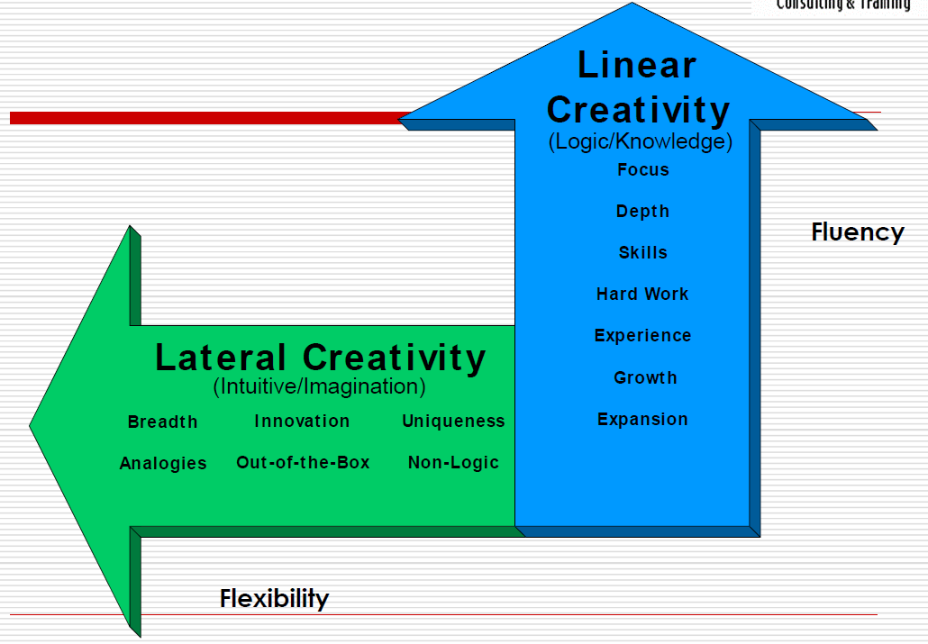
8 key leadership strengths
7. Creative Problem Solving
Lec.6
Types of Creativity
What is Creativity?
A way of thinking and doing that brings unexpected and original ideas to fruition; to produce novel and useful ideas.
“The best way to have a good idea is to have lots of them”
Linus Pauling (2-time Nobel prize winner)

Slide 36
8 key leadership strengths
7. Creative Problem Solving
Lec.6
How the Mind Works
Information is placed in zones (files)
Logical links are automatically created (index)
Information from all the senses can be converted and stored as regular data
“Accept that creativity is not something that we learn,
it‘s something that we‘ve forgotten but can relearn”
Edward de Bono
Which do YOU think came first Problem-Solving or Decision Making?
If you don‘t have a problem to solve or improve; or an opportunity to seize or are looking for one, then you don‘t have a decision to make.

Slide 37
8 key leadership strengths
8. Decision Making
Lec.6
Decisions are choices made from among options recognized by the decision maker. The decision-making process involves alternative development and analysis followed by the selection of an option.
There are various types of decisions, including:
  Programmed decisions (standard or regular responses to routine or uncomplicated problems allowing for pre-programmed solutions).
  Programmed decisions involve familiar and straightforward solutions. They are the most common type of decision faced by individuals in the office, and they are often handled by the use of the use of a routine approach.

Slide 38
8 key leadership strengths
8. Decision Making
Lec.6
  Non-programmed decisions (responses to unique and unstructured problems and situations requiring special or custom-made solutions).
  Non-programmed decisions are made in situations where standard procedures, policies, and rules cannot be applied to attain an adequate solution. They include situations such as crisis, in which case judgment, creativity, and intuition must be used. Principles and basic problem-solving processes are also utilized in the marketing of non-programmed decisions.

Slide 39
8 key leadership strengths
8. Decision Making
Lec.6
The Decision-Making Process
Decision making is a process. The rational or classical model of decision making involves the following:
    1.Problem definition and identification.
    2.The setting of priorities, criteria, and objectives.
    3.The consideration of causes and development of alternatives.
    4.Analysis of perceived alternatives.
    5.Selection of an alternative.
    6.Development of a plan.
    7.Implementation of the plan.
    8.Follow up and control—till you reach follow through.

Slide 40
Conclusion
Lec.6
We learned about
  Digital Leaders
  8 components of digital leadership
    1. Media competence, 2. Agility, 3. Personal responsibility and autonomy, 4. Interconnected thinking and acting, 5. Innovation and vision, 6. Clear communication, 7. People in focus, 8. Transparency
  8 key leadership strengths
    1. Self-awareness, 2. communication, 3. Presentation Skills, 4. negotiation 5. Critical Thinking, 6. Conflict resolution skills, 7. creative problem-solving,
    8. Decision Making

Slide 41


References
Lec.6
Bli-Group-Wp. (2011). Leadership Course material. Amideast Egypt. Business Intelligence, Training & Consulting, http://bli-group.com/
Alp Erdoğan, F., & Sağbaş, M. (2022, February 20). Digital Leadership: A Systematic Conceptual Literature Review. Research Gate. Retrieved March 1, 2023, from https://www.researchgate.net/publication/358729671_Digital_Leadership_A_Systematic_Conceptual_Literature_Review
Impey, C. (2020, January 24). Clear, concise, consistent – The three Cs of effective communication . Clear, concise, consistent – the three Cs of effective communication. Retrieved March 1, 2023, from https://www.bccpa.ca/news-events/latest-news/2020/clear-concise-consistent-the-three-cs-of-effective-communication/
Mimi. (n.d.). Presentation skills for leaders. Bliss Communications. Retrieved March 1, 2023, from https://www.mimibliss.com/what-we-do
Genard, G. (2017, November 19). Leadership skills: The 5 essential speaking techniques. Genard Method Public Speaking Training. Retrieved March 1, 2023, from https://www.genardmethod.com/blog/leadership-skills-the-5-essential-speaking-techniques
Model, S. (2022, December 21). Presentation skills 101: A guide to presentation success. SlideModel. Retrieved March 9, 2023, from https://slidemodel.com/presentation-skills-guide/

Slide 42



Thank You

