Slide 1



Orientation
HCIA-Security
Prepared by
Dr. Abdelrhman Ahmed

Slide 2
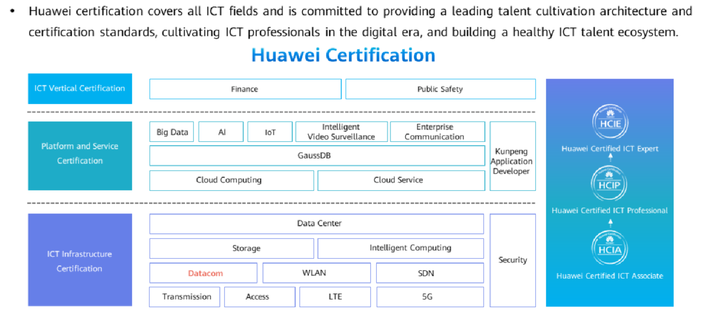
Chapter
Portfolio
01

Slide 3

Chapter
01
Portfolio

Slide 4
Chapter
01
Objectives
On completion of this program, the participants will be able to:
(1).Understand the basic concepts of information security.
(2).Understand information security common specifications.
(3).Configure network devices Know some common security attacks.
(4).Understand the basic process of security operation and maintenance.
(5).Understanding of safety analysis methods and evidence collection methods.
(6).Understand basic firewall technology and configuration.

Slide 5
Chapter
Objectives
01
(7).Understand NAT technology.
(8).Understand firewall dual-system hot back principles.
(9).Know basic network instructions.
(10).Know the basic component of operating system.
(11).Understanding the common risks and defense methods of operating systems.
(12).Understand encryption principles.
(13).Understand encryption application and practice the related configurations.

Slide 6
Chapter
Target Audience
01
Cyber security junior engineer who hopes to have information security capabilities.

Slide 7
Chapter
Prerequistes
01
Basic knowledge of TCP/IP.
Basic knowledge of Routing and Switching.

Slide 8



Thank You

