Slide 1

Explainable Transformer-Based Anomaly Detection
for Large-Scale System Logs
Thesis Defense Presentation
Hesham Bashatah — ID No. 253001893
Anas Barro — ID No. 253001086
Master of Science in Artificial Intelligence
College of Informatics — Midocean University
Supervisor: Dr. Wesam Ahmed

Slide 2
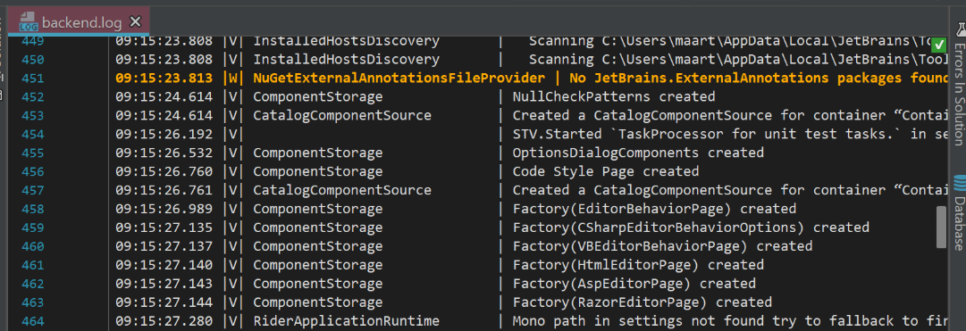
Agenda
01
Introduction and Background
02
Contributions
03
Methodology
04
Results and Analysis
05
Conclusion and Future Work
06
References

Slide 3
INTRODUCTION & BACKGROUND
03
System Logs Are Operational Evidence at Scale
Modern systems continuously generate operational evidence, but anomalies often emerge from context across multiple events.
WHAT OPERATIONAL LOGS LOOK LIKE
WHY LOG ANALYSIS IS CHALLENGING
01
HIGH VOLUME
APPLICATION LOG
Millions of events can be generated across modern distributed environments.
2026-08-15 19:04:11 INFO api-gateway GET /orders/78421 200
2026-08-15 19:04:14 WARN payment retry=1 timeout=2500ms
2026-08-15 19:04:17 ERROR payment upstream timeout
02
SEQUENTIAL
An event may become meaningful only when interpreted with what happened before and after it.
SYSTEM / INFRASTRUCTURE LOG
Aug 15 19:04:11 node-07 kernel eth0 link is up
Aug 15 19:04:16 node-07 WARN memory pressure detected
Aug 15 19:04:18 node-07 ERROR worker exited code=1
03
CONTEXT-DEPENDENT
Anomalies can emerge from changes in meaning, order, frequency, or surrounding behavior.
BGL DATASET — RESEARCH DATA
- 1117838570 2005.06.03 R02-M1-N0-C:J12-U11 ...
- 1117838571 2005.06.03 R02-M1-N0-C:J12-U11 ...
KERNDTLB 1117838574 2005.06.03 R02-M1-N0-C:J12-U11 ...
Anomalies may be abnormal patterns across a sequence of familiar events — not only unusual individual messages.

Slide 4
INTRODUCTION
Research Contributions
The contribution is centered on the detection framework and objectively evaluated explainability—not on preprocessing.
01
Compact Semantic Detection Framework
Frozen MiniLM semantic event embeddings are combined with a lightweight trainable Transformer classifier.
02
Integrated Post-hoc Explainability
SHAP and Event Occlusion explain influential event positions after detection without changing the classifier decision.
03
Objective XAI Evaluation
Explanation quality is assessed through faithfulness, stability, baseline robustness, concentration, agreement, and runtime.
04
Evidence-Based Explainer Selection
Event Occlusion is selected as the primary explainer from measured evidence; SHAP remains complementary.

Slide 5
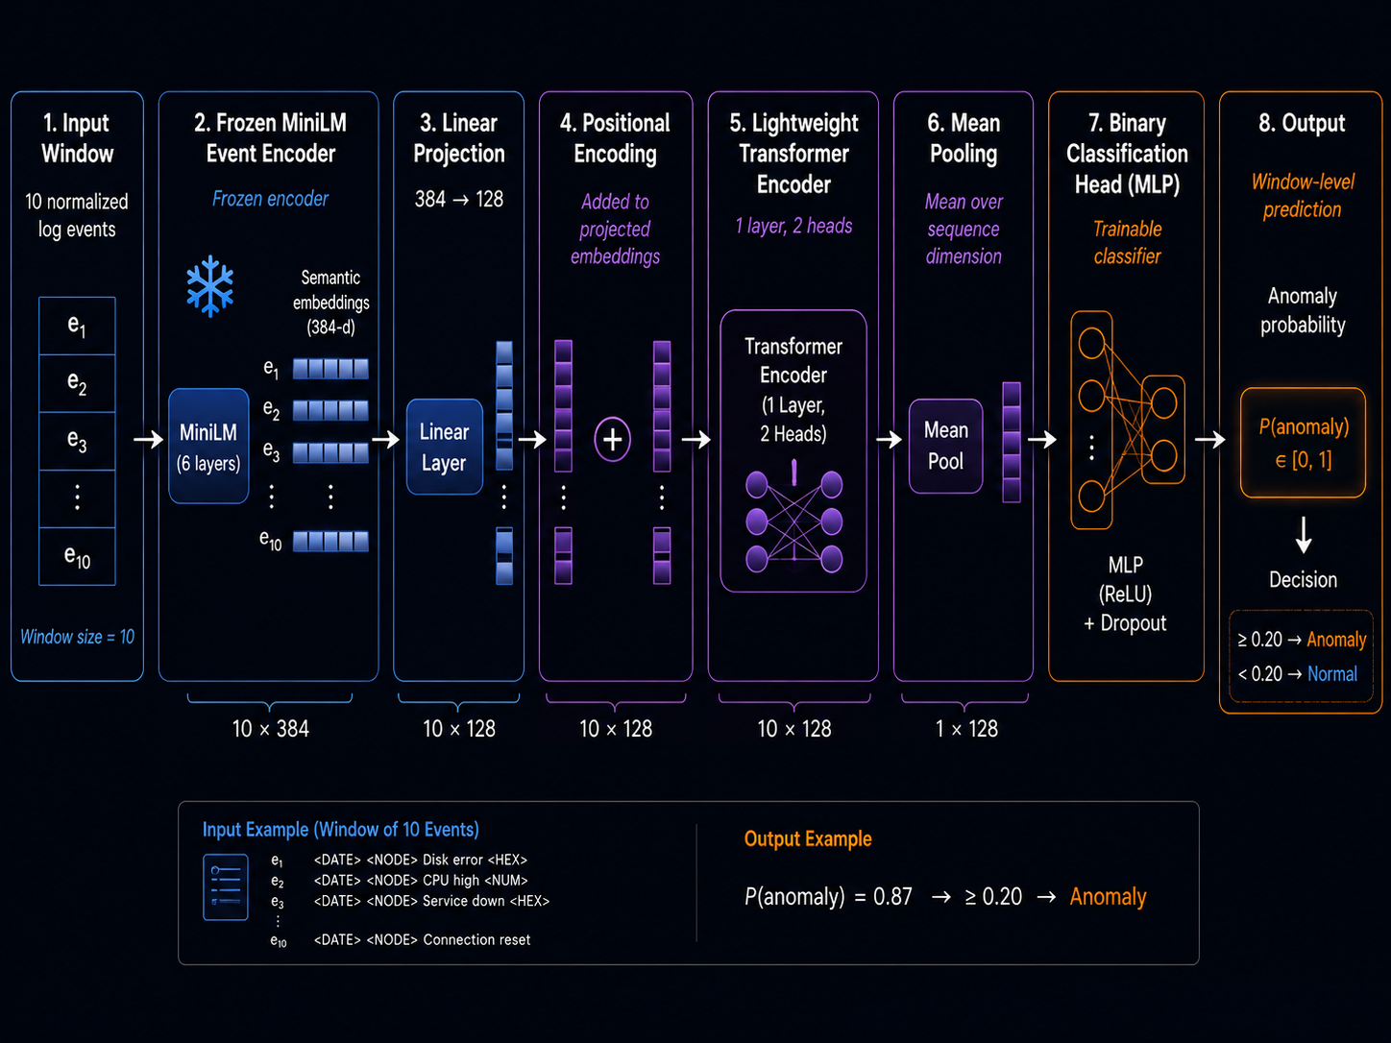
METHODOLOGY
PROPOSED FRAMEWORK

Slide 6
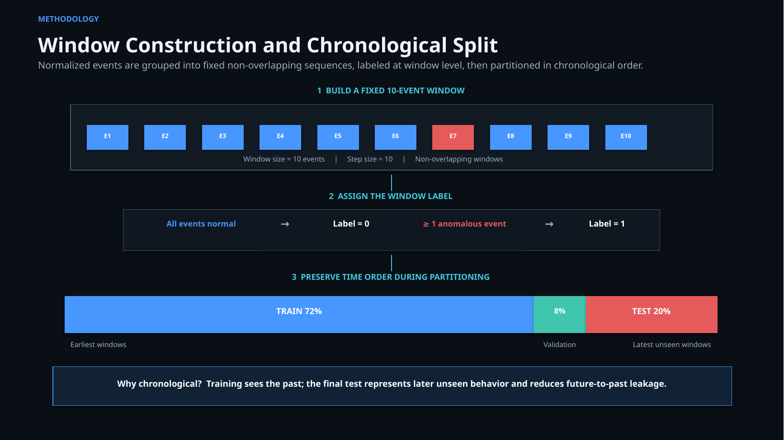

Slide 7
METHODOLOGY
Class Imbalance Handling
Objective: preserve the real chronological distribution while making the model more sensitive to rare anomalous windows.
THE PROBLEM
NORMAL WINDOW
Normal windows
ANOMALOUS WINDOW
1
2
3
4
5
6
7
8
9
10
≫
1
2
3
4
5
6
7
8
9
10
10 normal events → Label 0
Anomalous windows
≥1 anomalous event → Label 1
Consequence: overall Accuracy can remain high even if rare anomalies are missed.
OUR RESPONSE
ACTION
WHAT WE DID
Preserve distribution
• Keep the original chronological class distribution.
No resampling
• No oversampling • No undersampling • No synthetic sequences.
Weighted BCE
• Increase anomaly sensitivity through the training loss rather than altering the data.
HOW WE JUDGE IT
Accuracy is reported, but Precision + Recall + F1 are emphasized for anomaly detection.

Slide 8
METHODOLOGY
Evaluation Metrics
Because BGL is imbalanced, Accuracy is not interpreted alone — Precision, Recall and F1 are emphasized.
DETECTION PERFORMANCE
Metric
Equation
What It Tells Us
Precision
TP / (TP + FP)
How many predicted anomaly windows are actually anomalous; reflects false-alarm control.
Recall
TP / (TP + FN)
How many actual anomaly windows are detected; reflects missed-anomaly control.
F1-Score
2 × (Precision × Recall) / (Precision + Recall)
Primary model-selection metric; balances Precision and Recall.
Accuracy
(TP + TN) / (TP + TN + FP + FN)
Overall correctness, but interpreted cautiously because the dataset is imbalanced.
EXPLANATION QUALITY
Metric
Equation
What It Tells Us
Faithfulness
Comprehensivenessₖ = z(X) − z(X \ Tₖ)
If removing top-ranked events reduces the anomaly logit, the attribution is supported by perturbation evidence.
Stability
Repeated-run attribution consistency
Checks whether repeated explanations remain consistent for the same case and method.

Slide 9
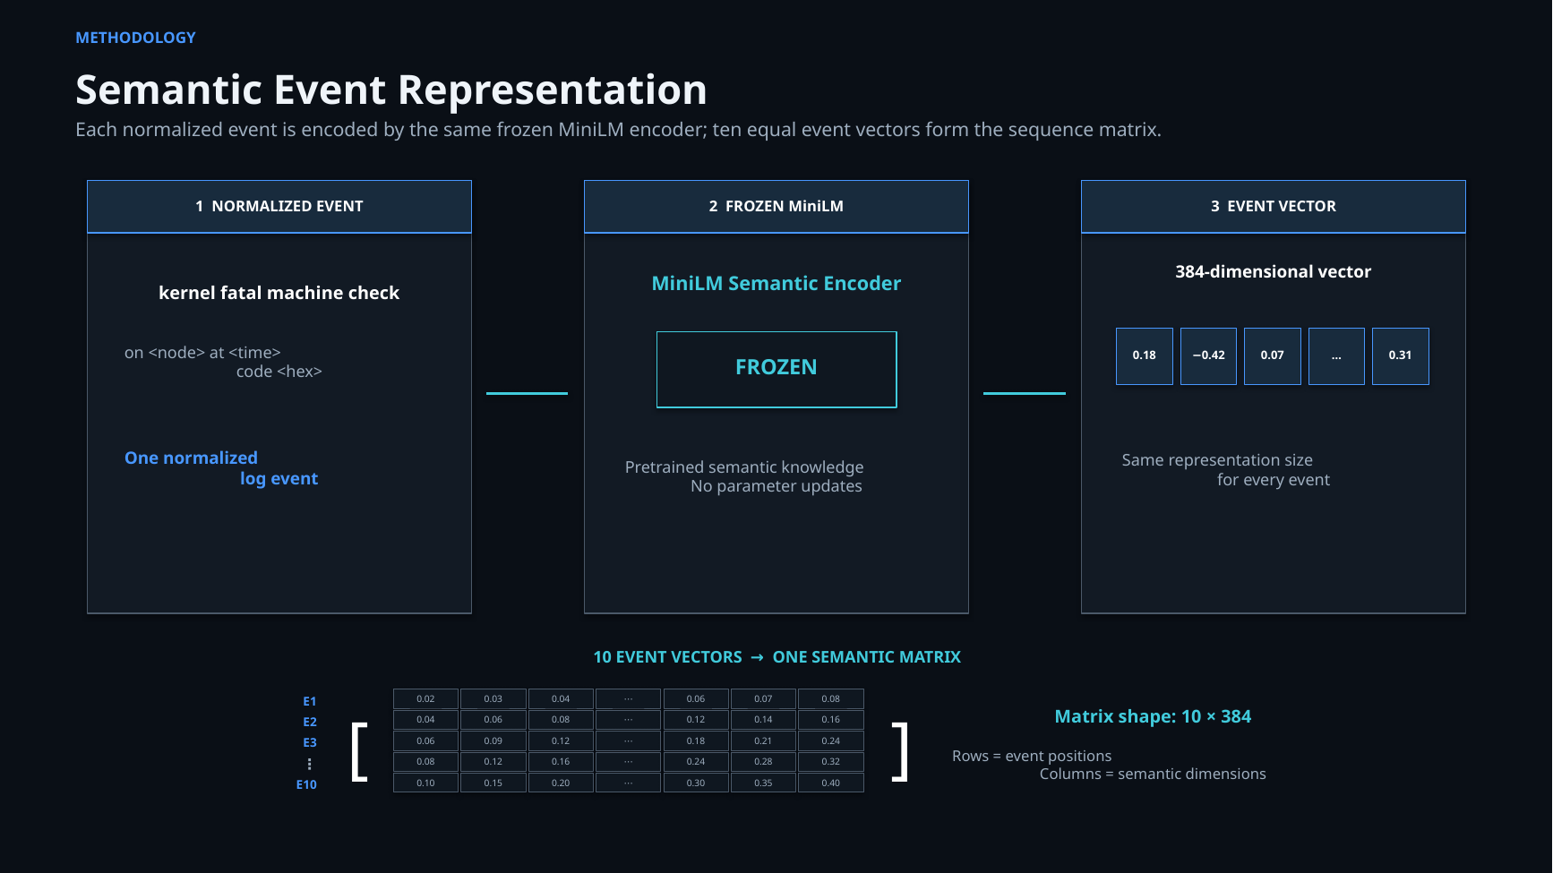

Slide 10
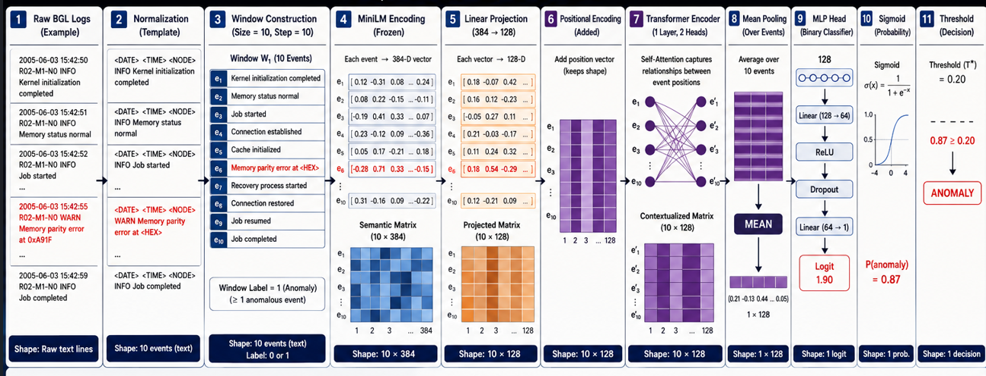
METHODOLOGY
Model Architecture

Slide 11
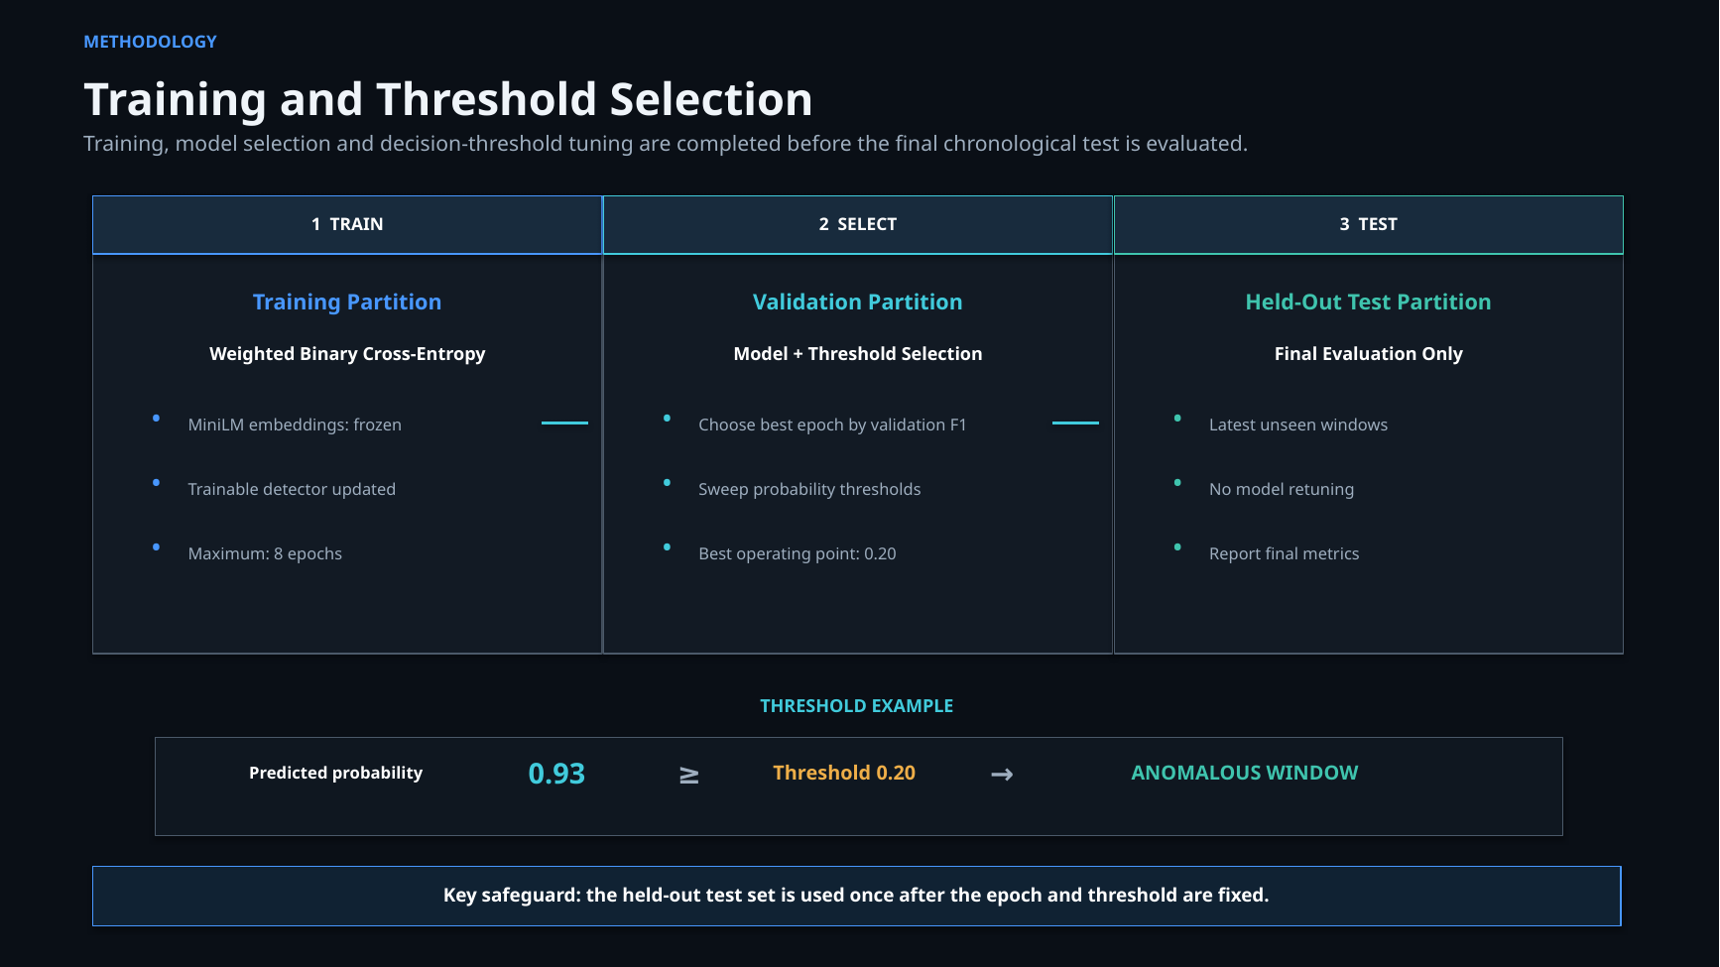

Slide 12
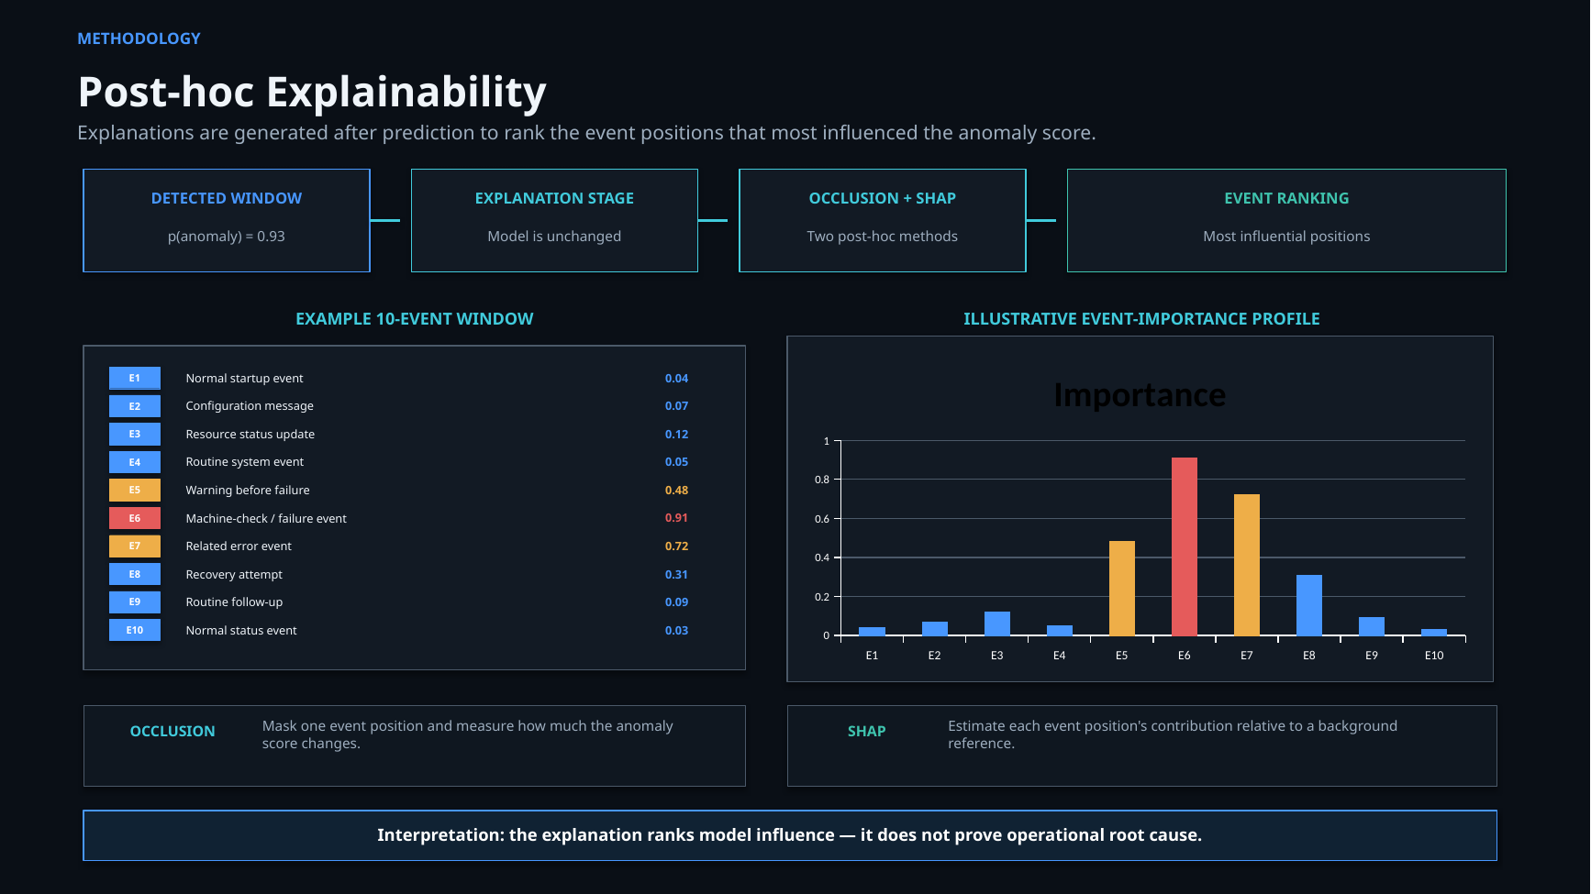

Slide 13
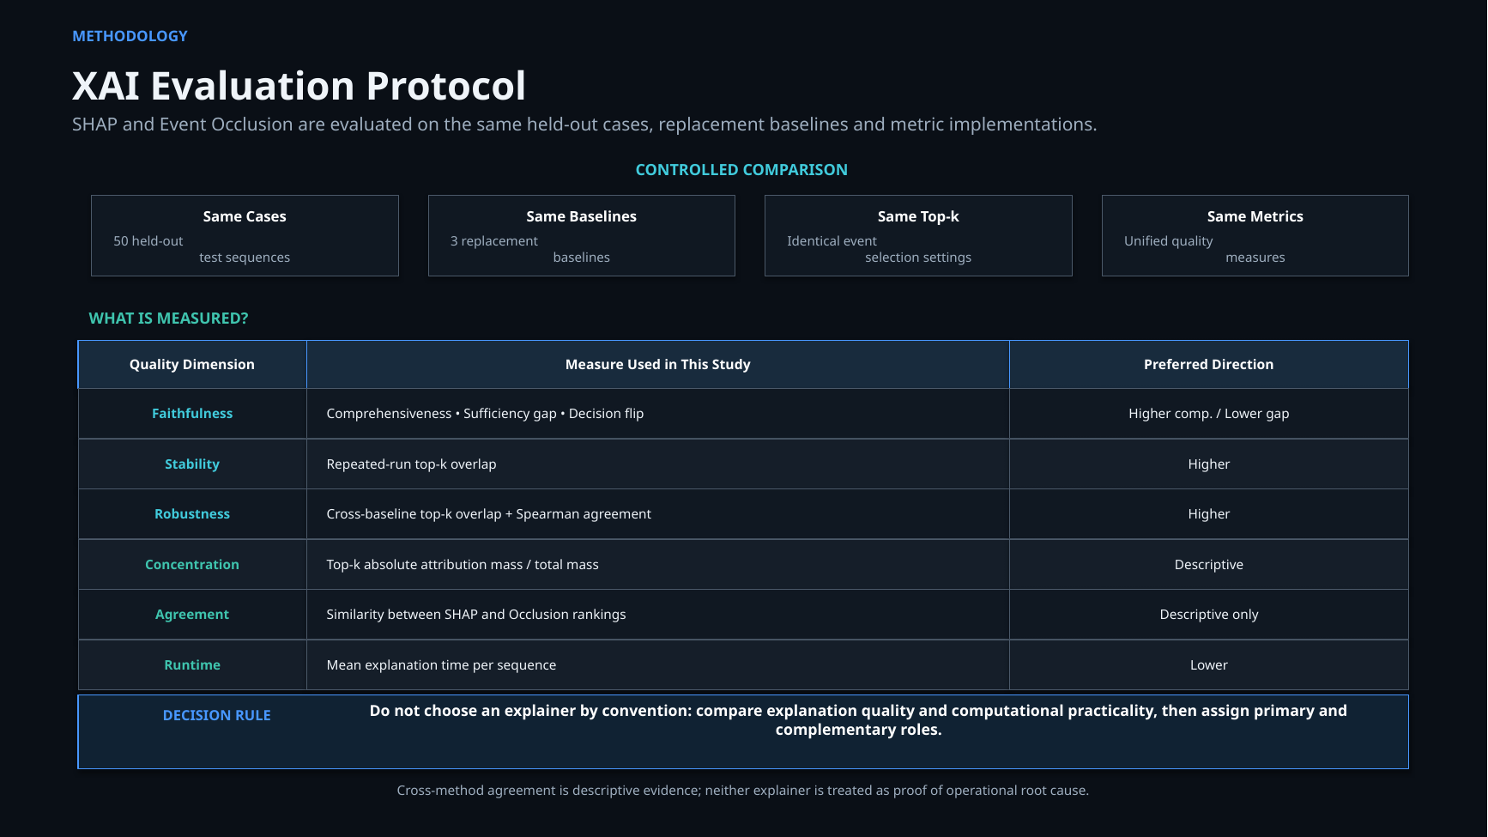

Slide 14
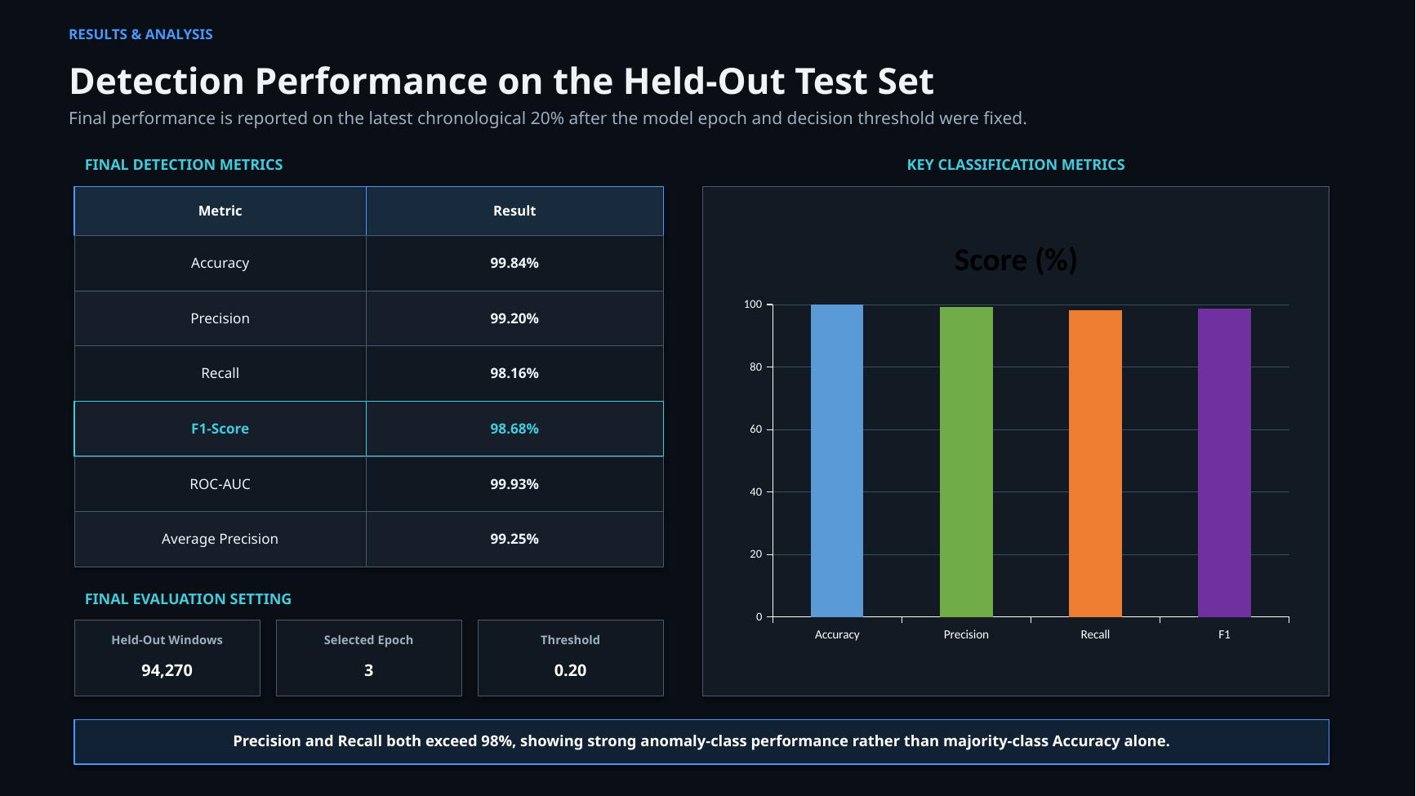

Slide 15
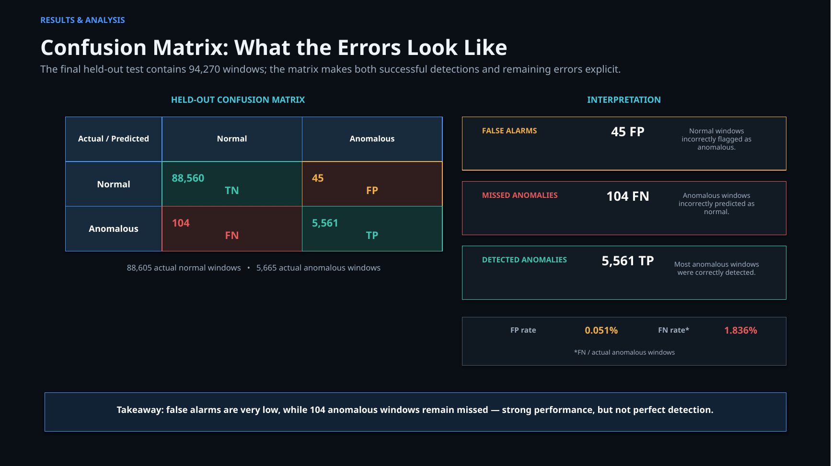

Slide 16
RESULTS & ANALYSIS | 19
Contextual Comparison with Representative BGL Studies
Precision, recall and F1 are compared where reported; each study keeps one consistent color.
Study / Reference
Precision
Recall
F1
Other
XAI / Explainability
COMMON DETECTION METRICS BY STUDY
LAnoBERT [11]
—
—
87.49%
AUROC
97.21%
No matched event-level
XAI benchmark
LogSD [15]
96.00%
96.64%
96.27%
PRC
97.16%
No matched
XAI benchmark
LogFormer [12]
96.00%
97.00%
97.00%
—
No matched event-level
XAI benchmark*
Proposed Model
(This Work)
99.20%
98.16%
98.68%
AP
99.25%
SHAP + Event Occlusion
Quantitative XAI evaluation
— = not reported in Thesis V9 comparison evidence. Study-specific AUROC/PRC/AP are retained in the table only.
Missing metrics are not plotted. Each study uses the same color across Precision, Recall and F1.
Contextual comparison only — differences in preprocessing, anomaly units, windowing, supervision, splitting and threshold policies prevent a controlled head-to-head ranking.

Slide 17
RESULTS & ANALYSIS
SHAP vs Event Occlusion: Explainability Results
Both methods were benchmarked on the same 50 held-out sequences using three replacement baselines and common evaluation measures.
COMPARATIVE OUTCOME
RESULT SUMMARY
Dimension
SHAP
Event Occlusion
Faithfulness
Comparable
Comparable
Repeated-run Stability
Lower
Stronger
Baseline Robustness
Lower
Stronger
Runtime
Slower
≈20.8× faster
Role
Complementary
Primary
Directional summary only — not raw metric magnitudes
EVIDENCE-BASED CHOICE
Event Occlusion is selected as the primary explainer; SHAP is retained as a complementary attribution method.
WHY?
Faithfulness is practically similar, but Occlusion is more stable, more robust across baselines, and approximately 20.8× faster.
Interpretation remains local to model-decision sensitivity; these explanations are not causal root-cause evidence.

Slide 18
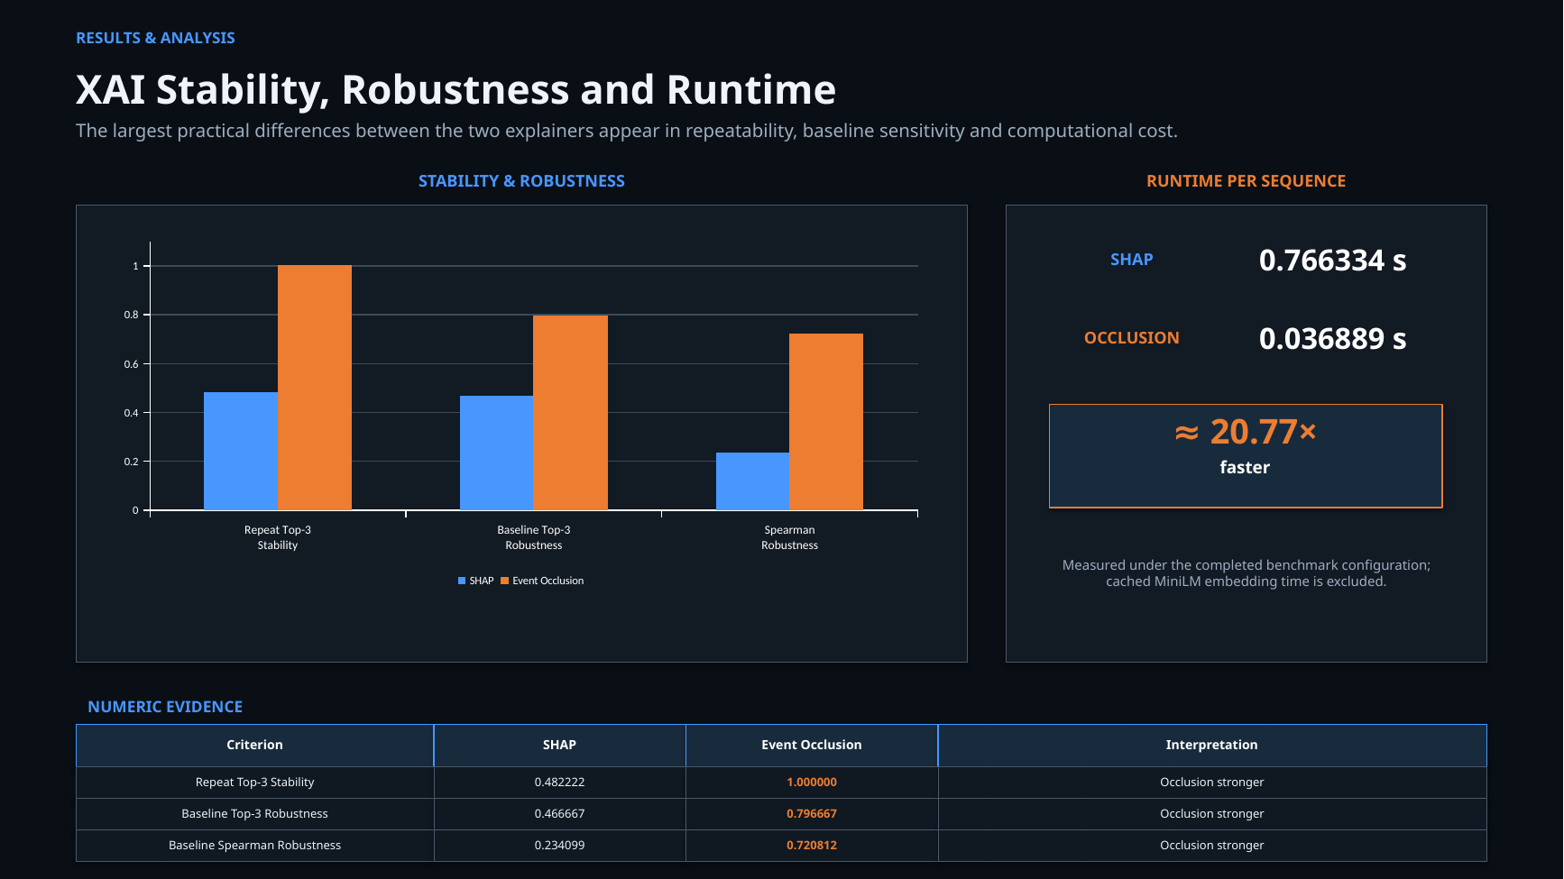

Slide 19
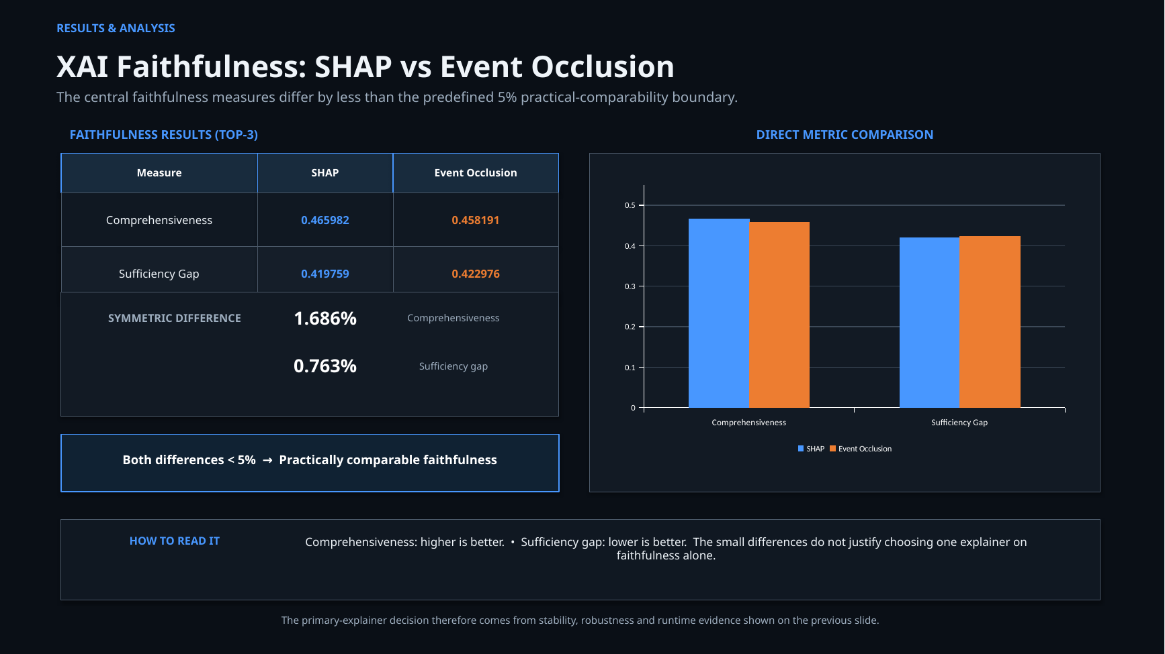

Slide 20
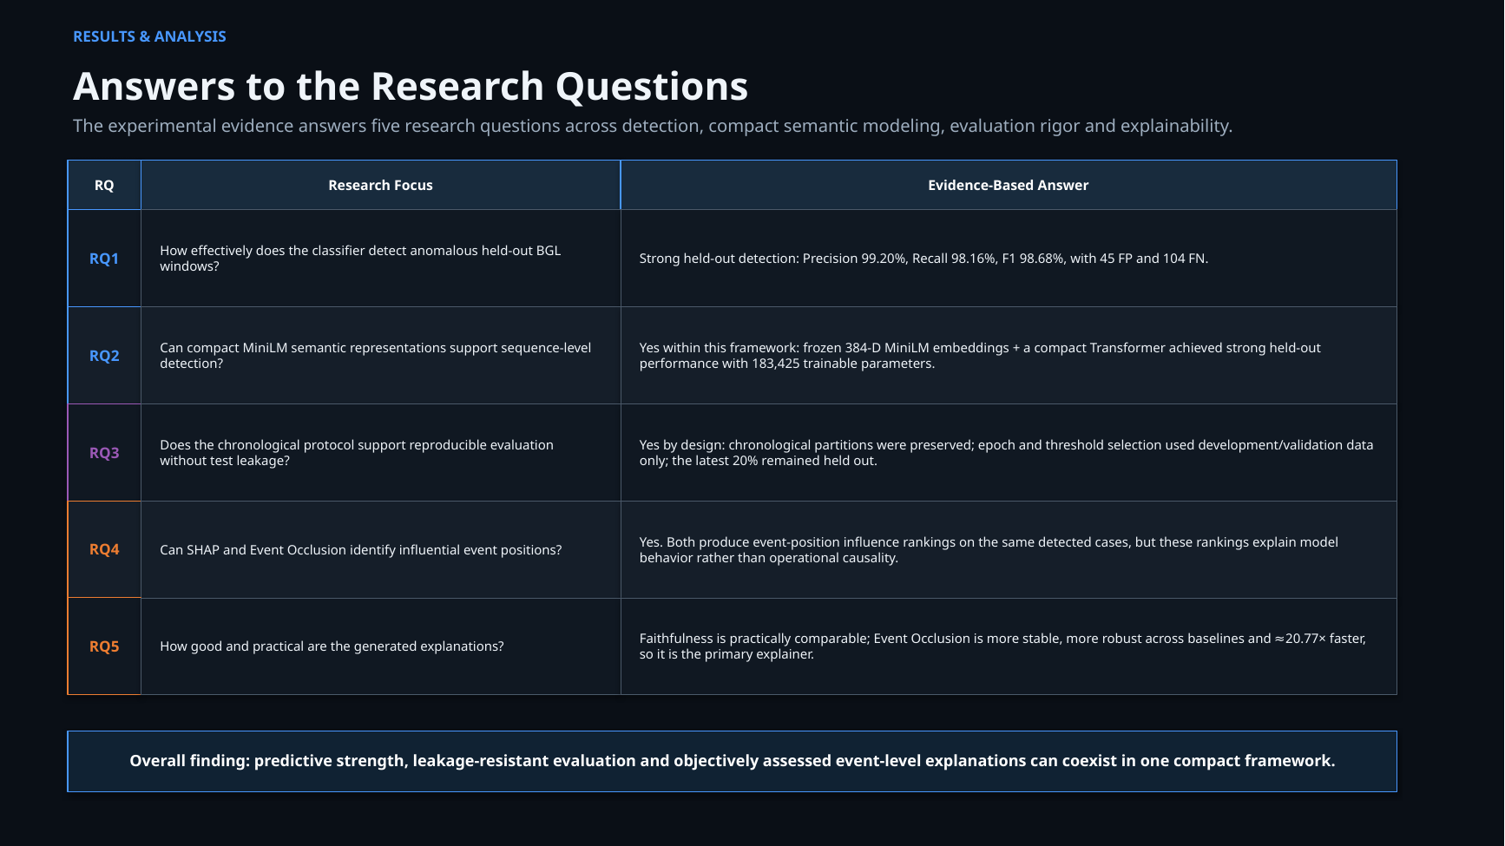

Slide 21
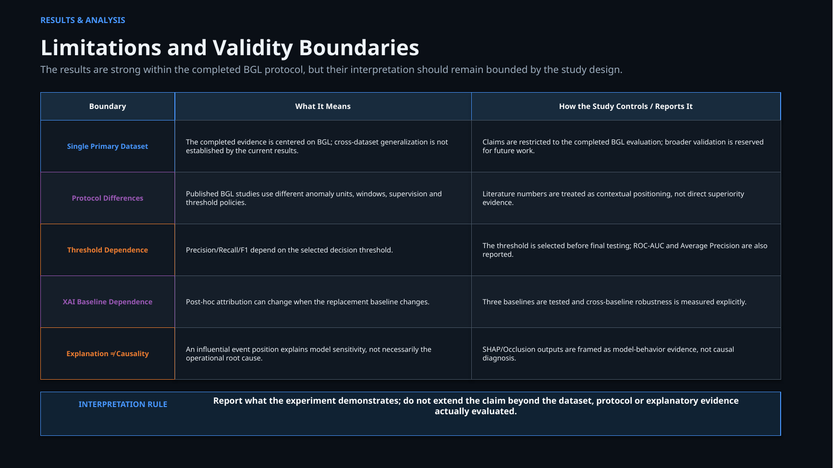

Slide 22
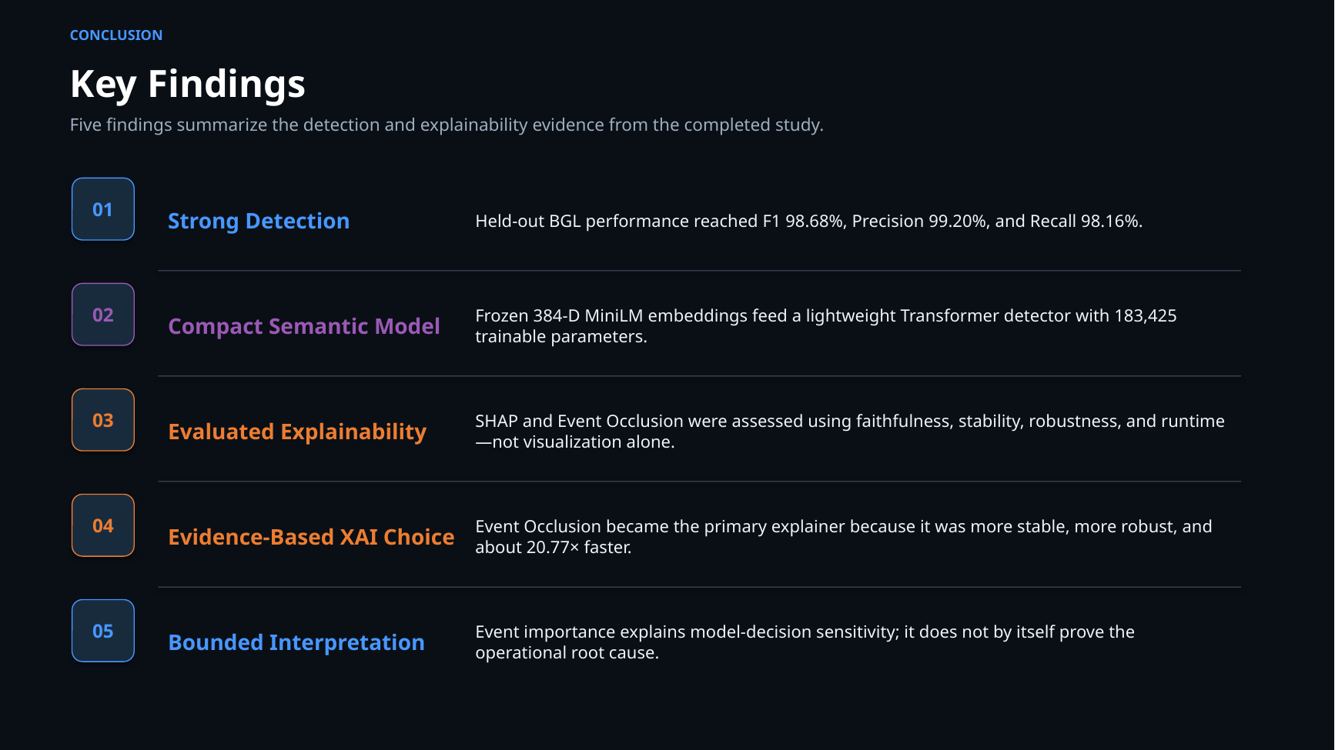

Slide 23
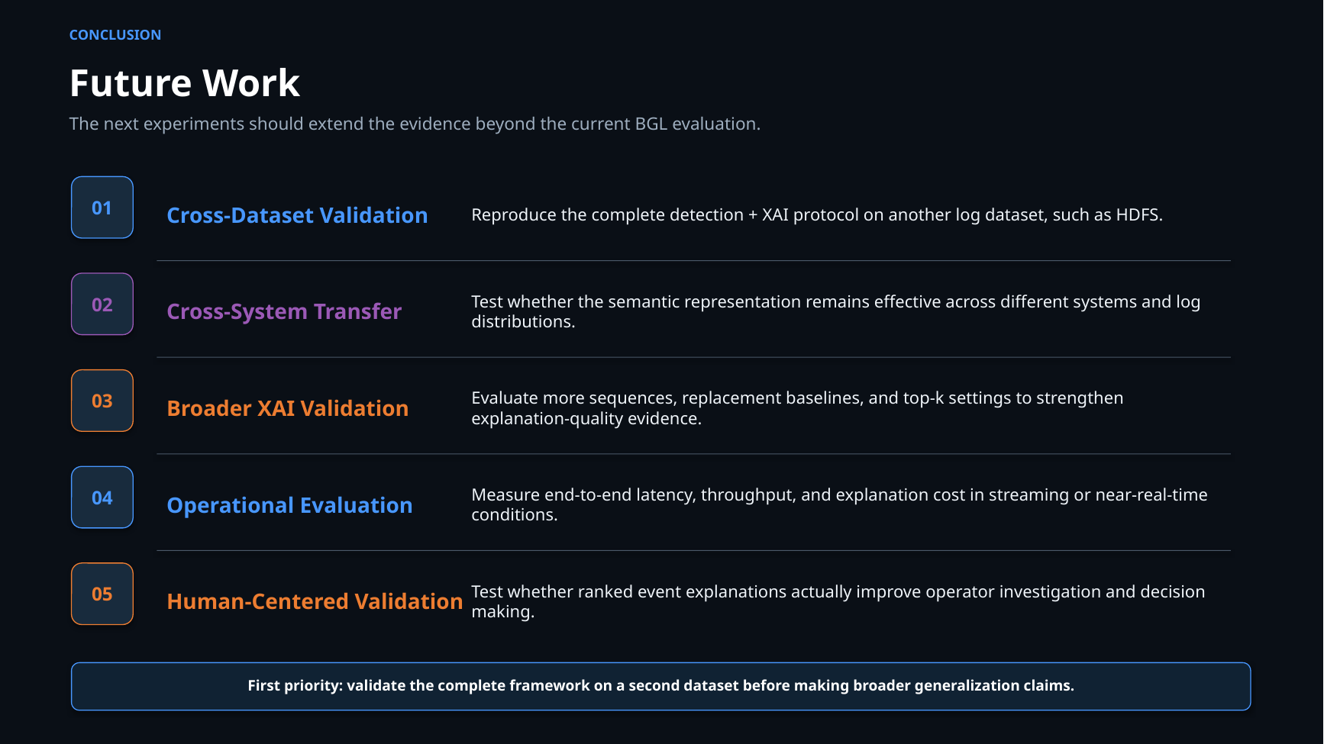

Slide 24
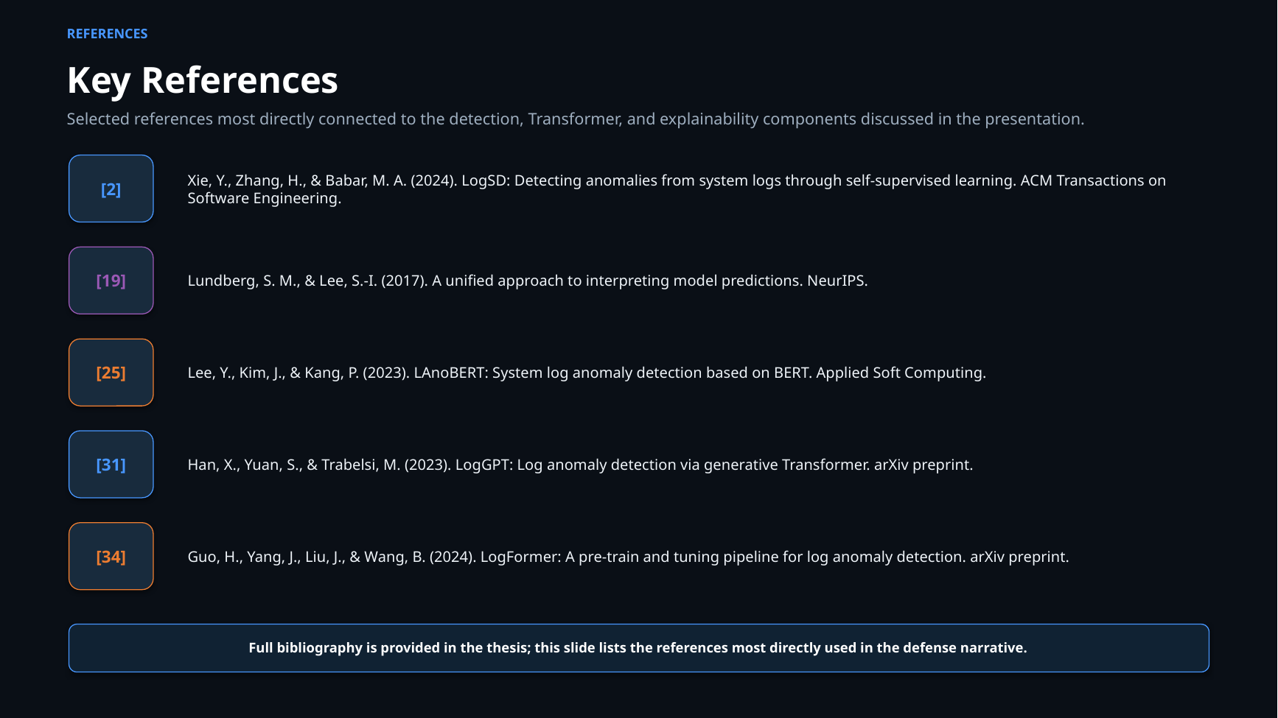

Slide 25


