Slide 1
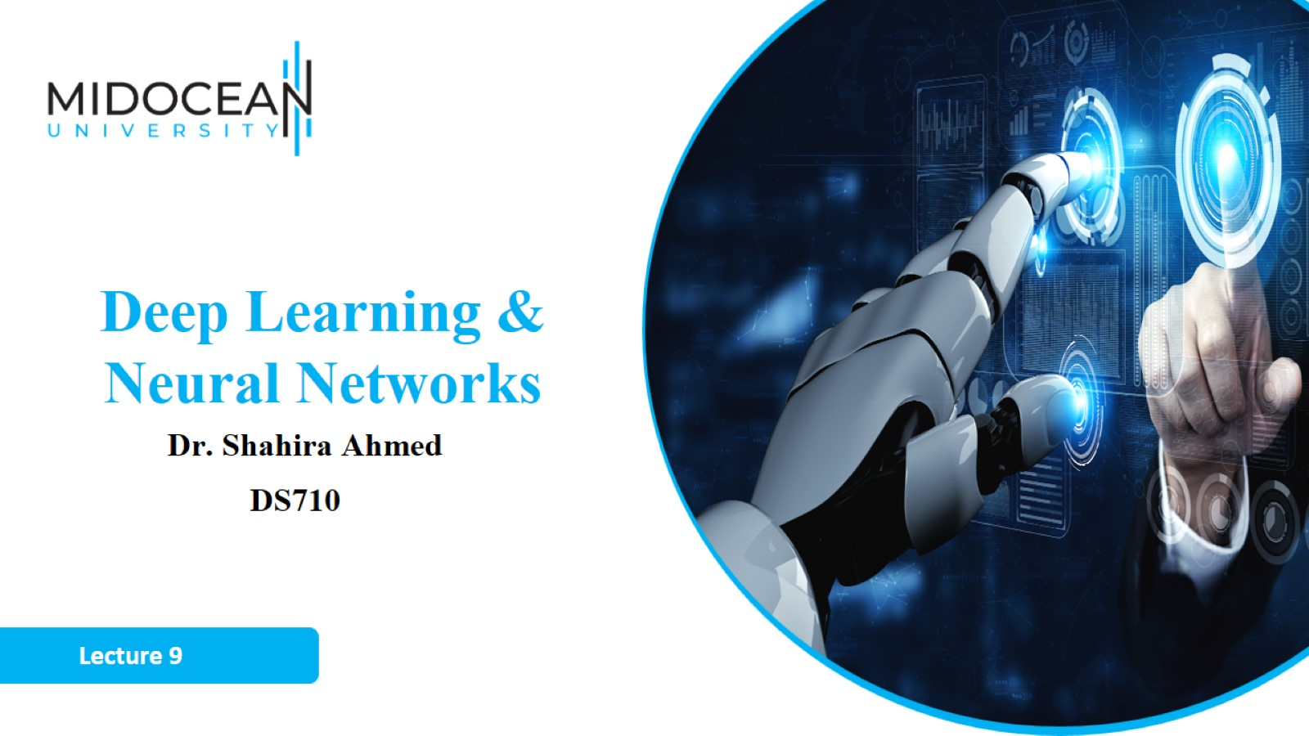

Slide 2


Slide 3
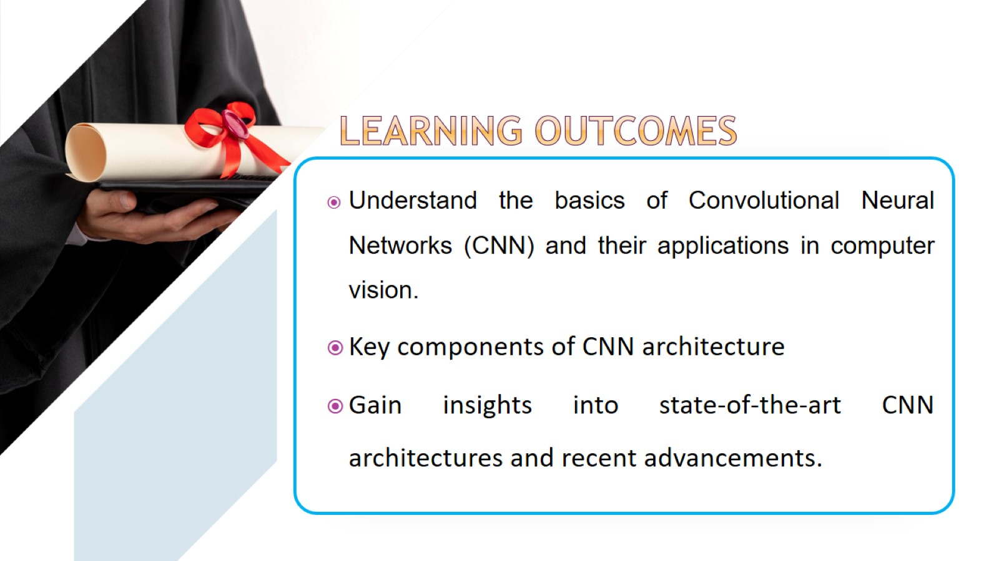

Slide 4
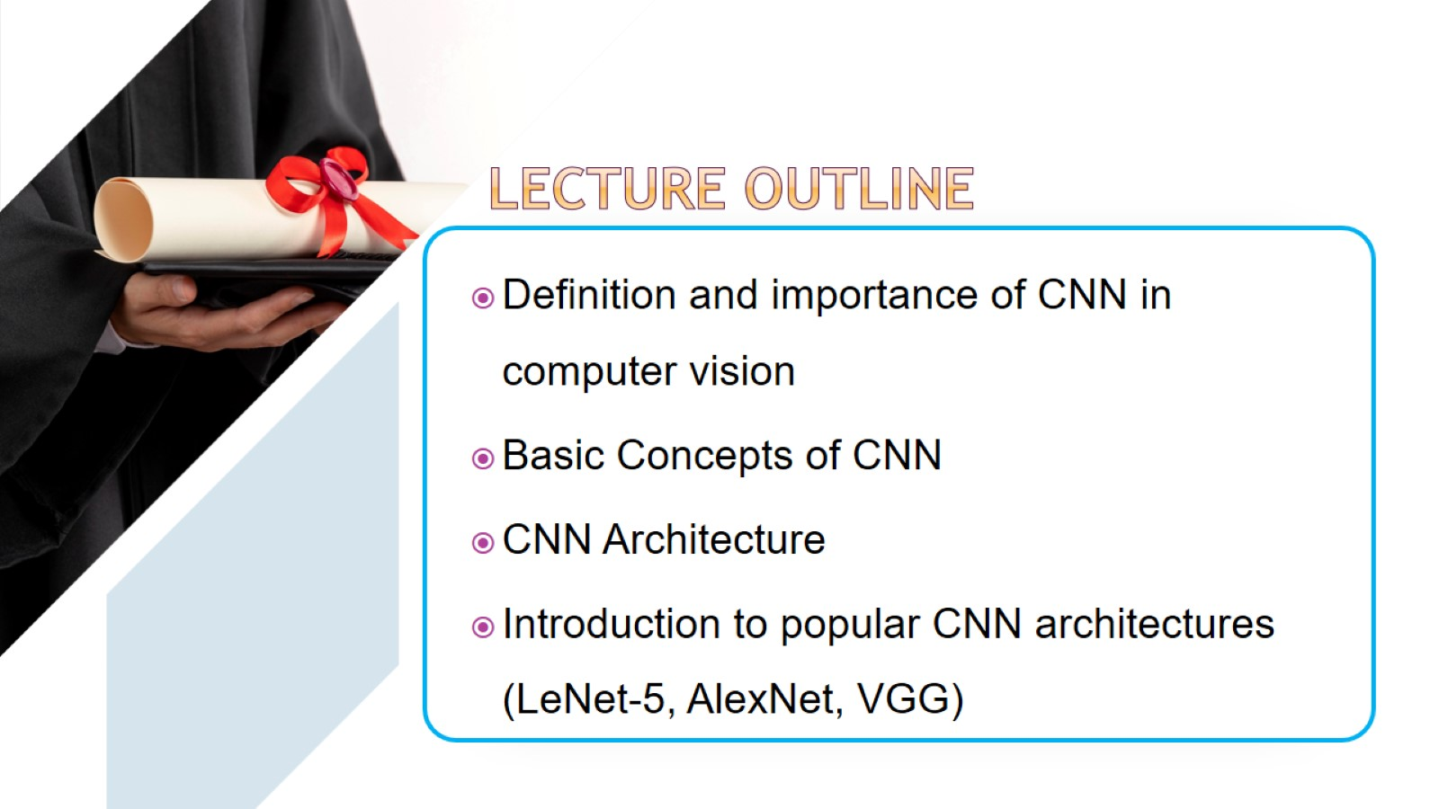

Slide 5
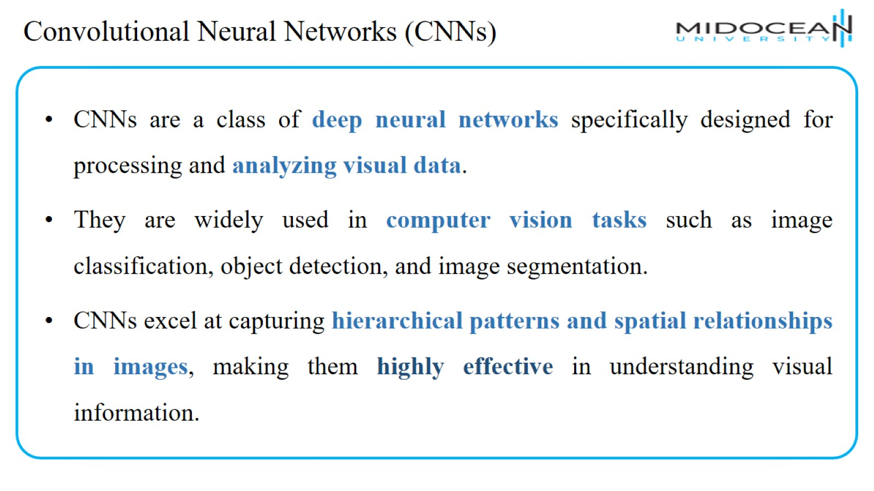
Convolutional Neural Networks (CNNs)

Slide 6
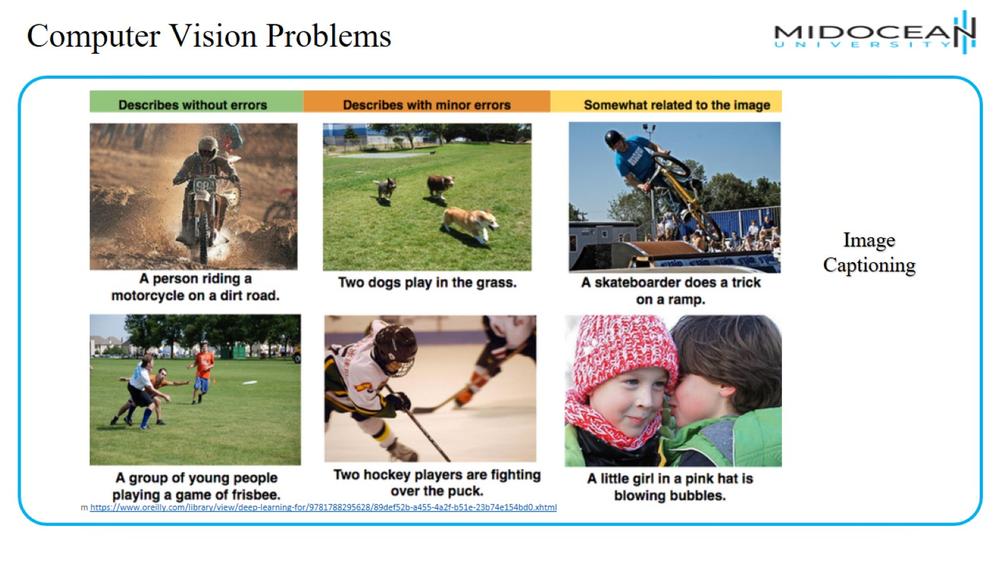
Computer Vision Problems

Slide 7
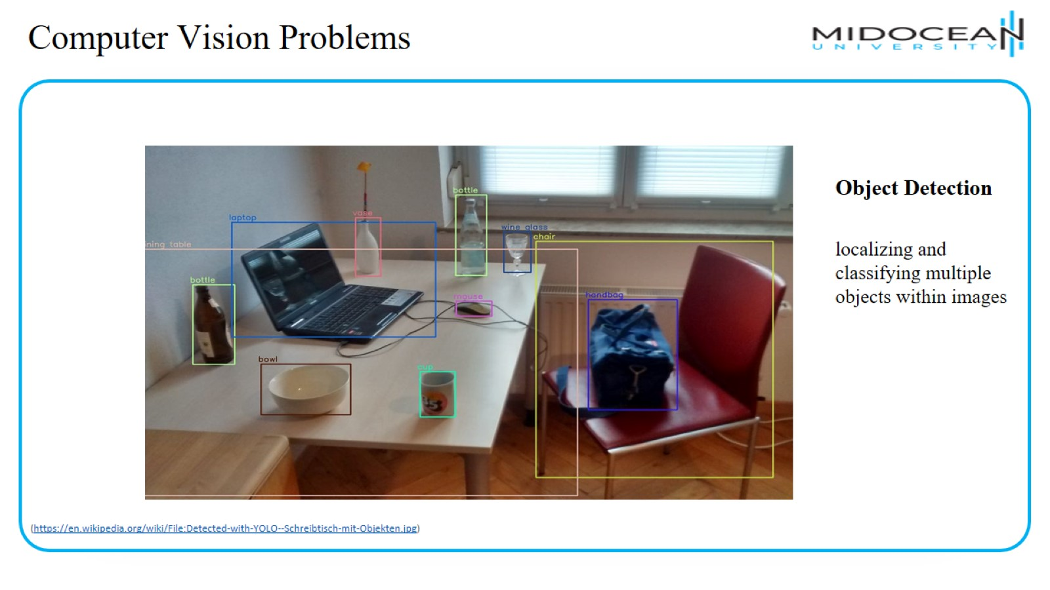
Computer Vision Problems

Slide 8
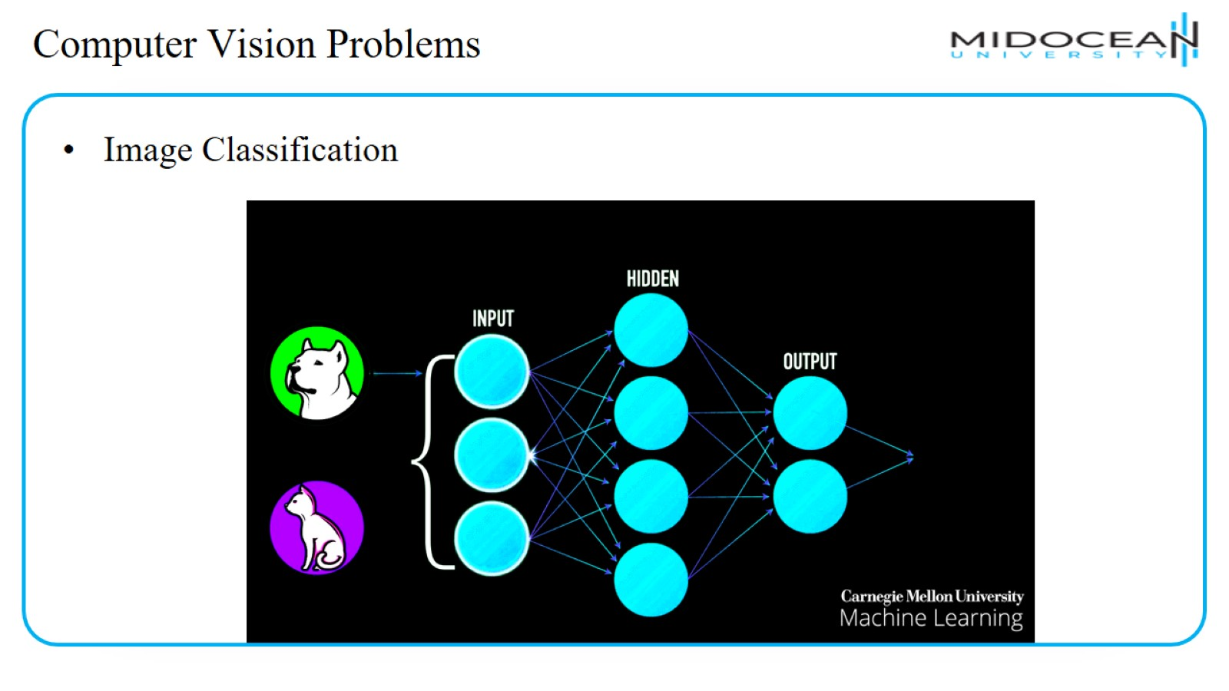
Computer Vision Problems

Slide 9
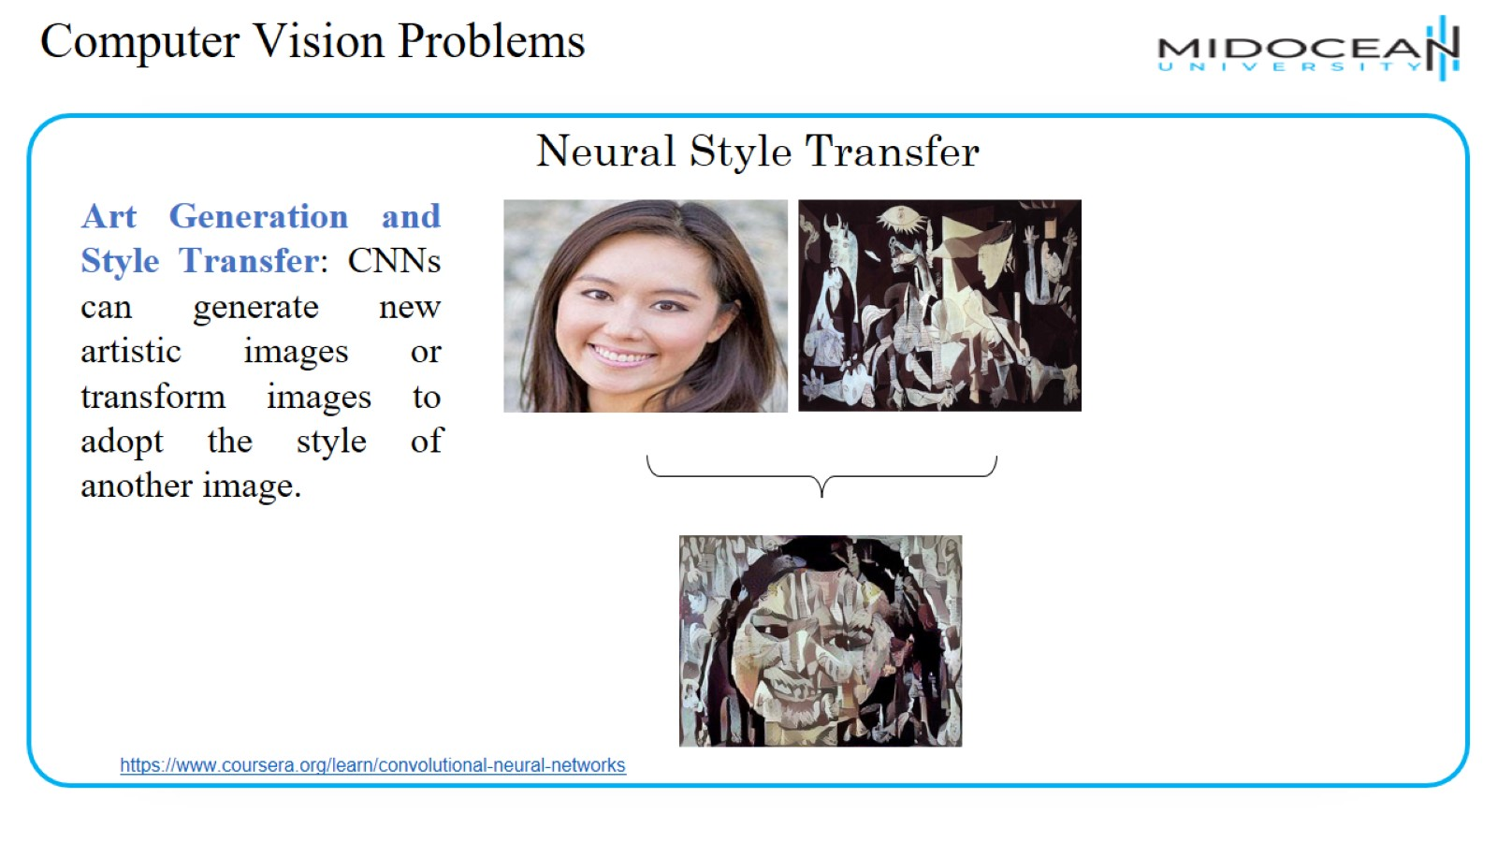
Computer Vision Problems

Slide 10
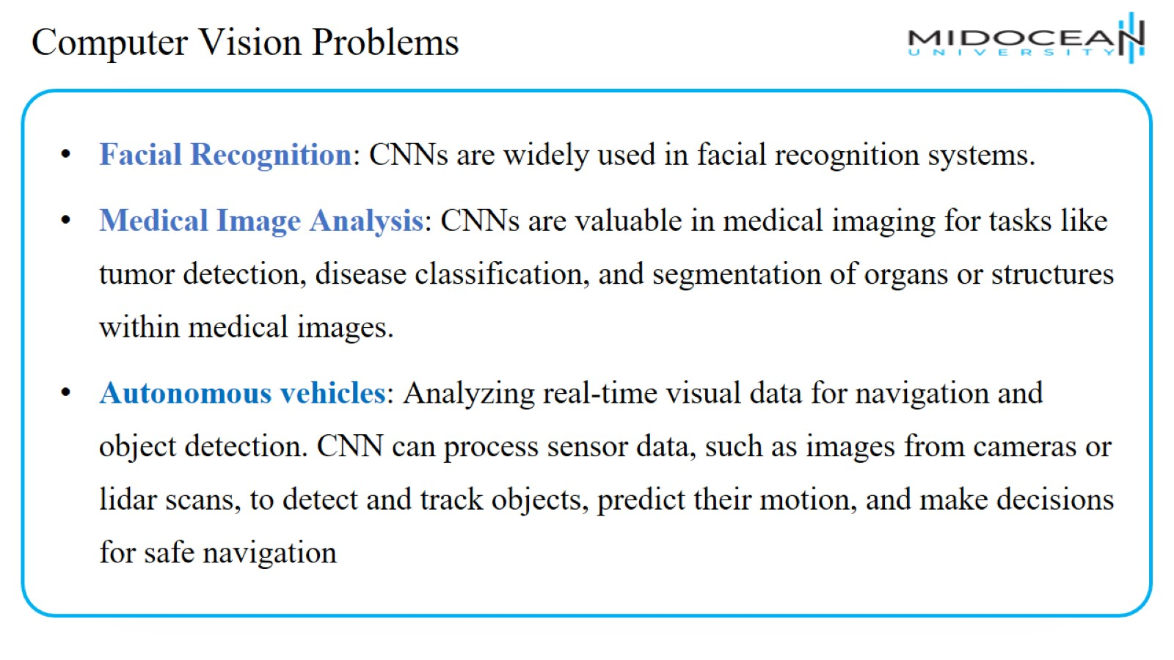
Computer Vision Problems

Slide 11
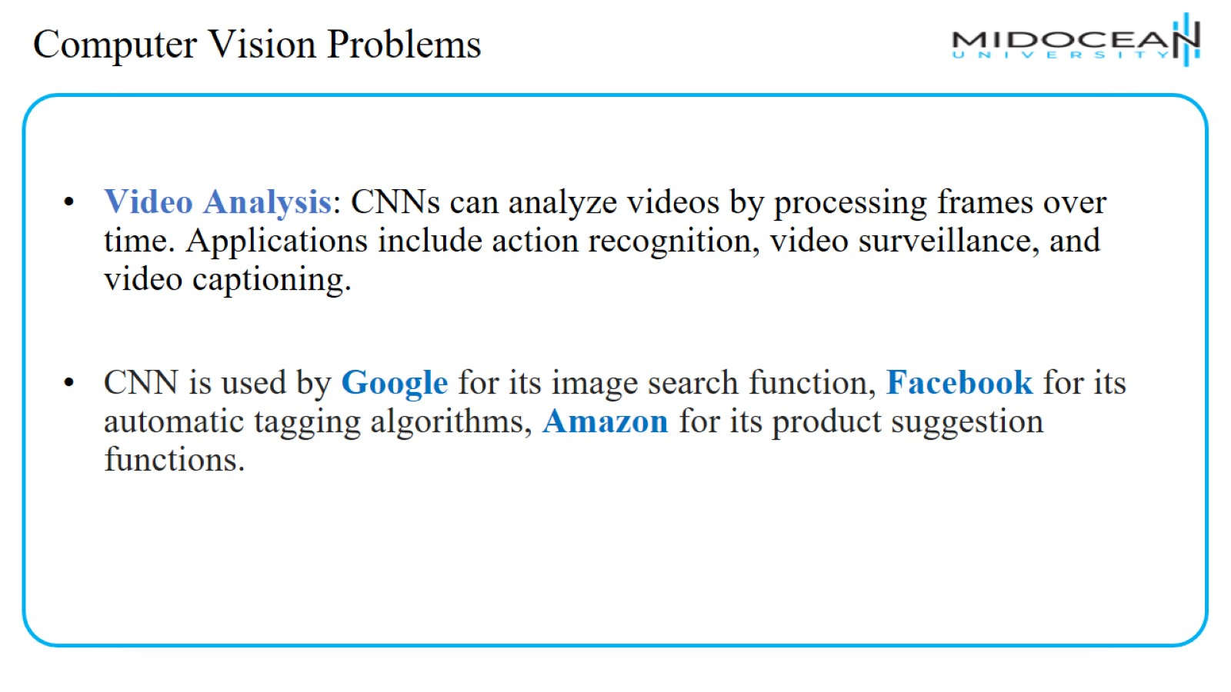
Computer Vision Problems

Slide 12
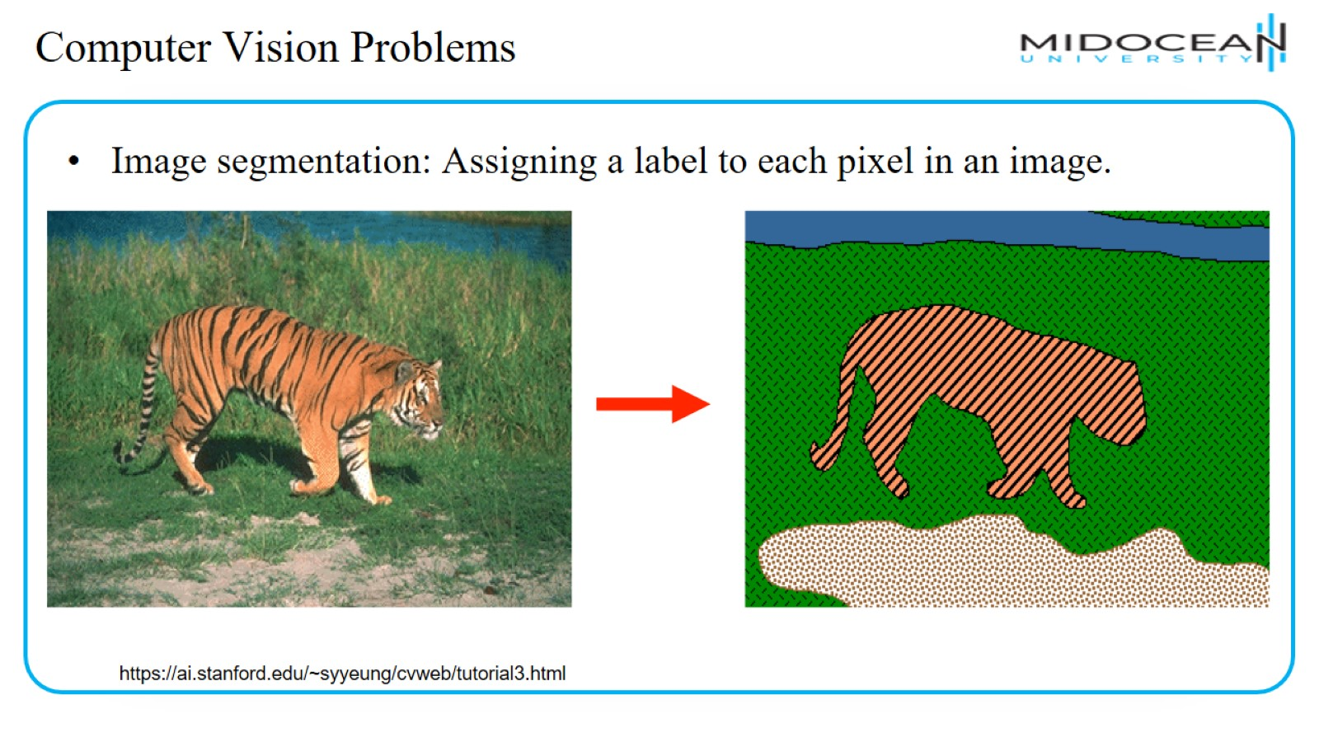
Computer Vision Problems

Slide 13
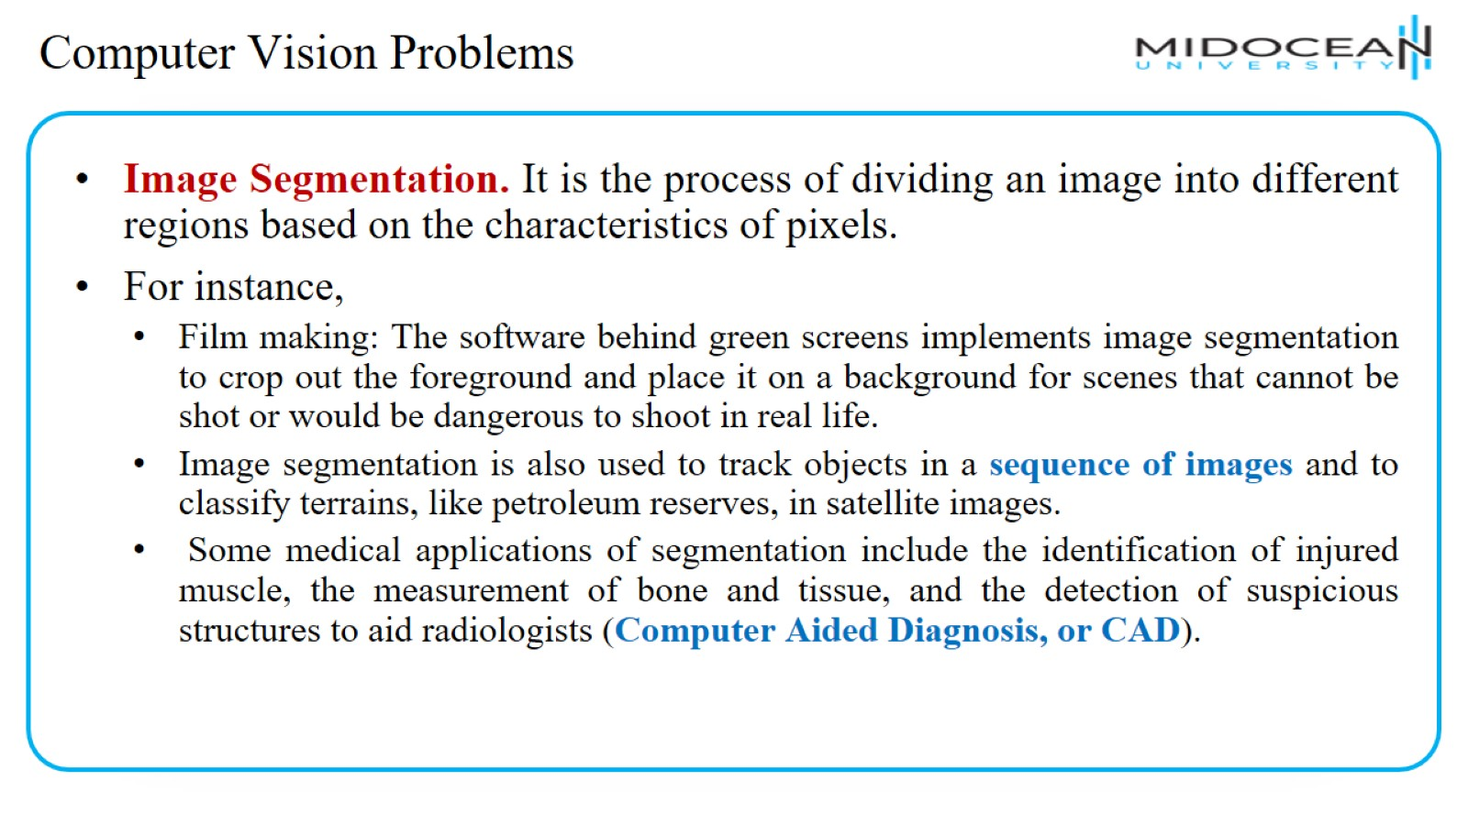
Computer Vision Problems

Slide 14
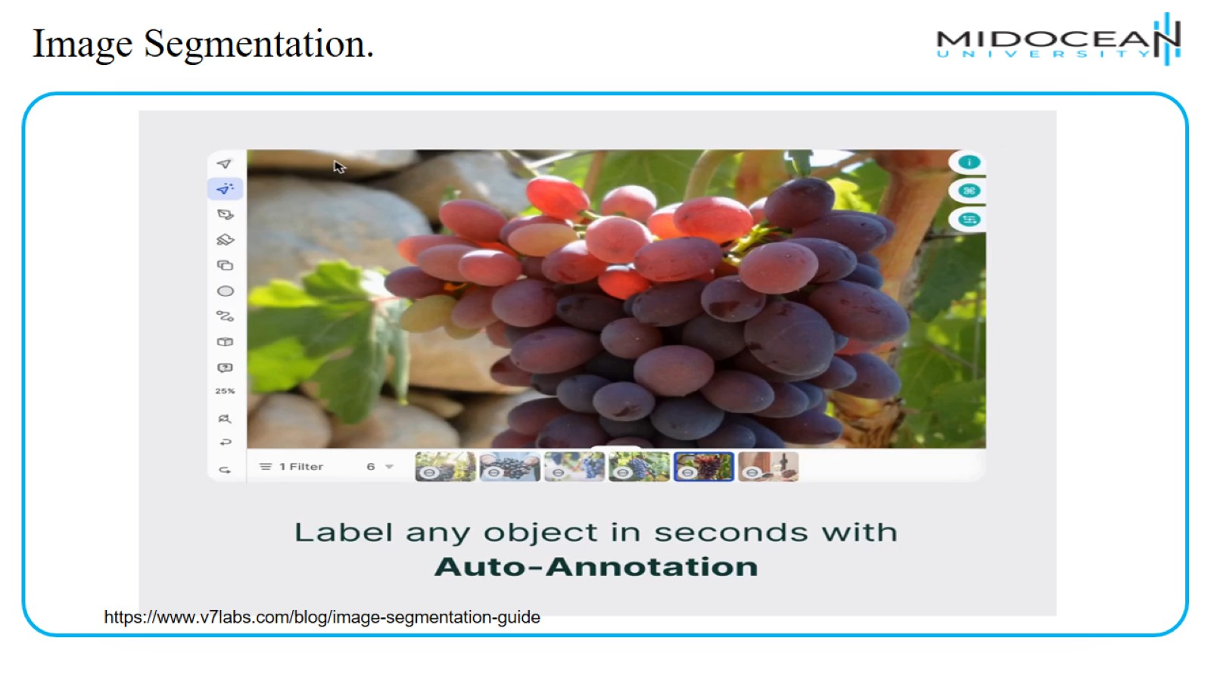
Image Segmentation.

Slide 15
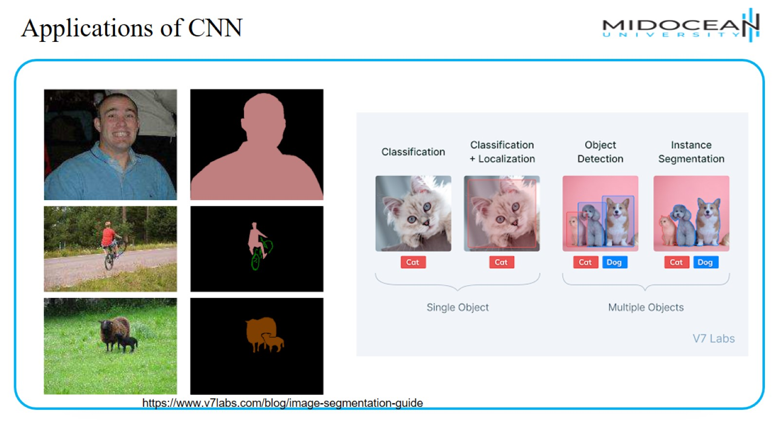
Applications of CNN

Slide 16
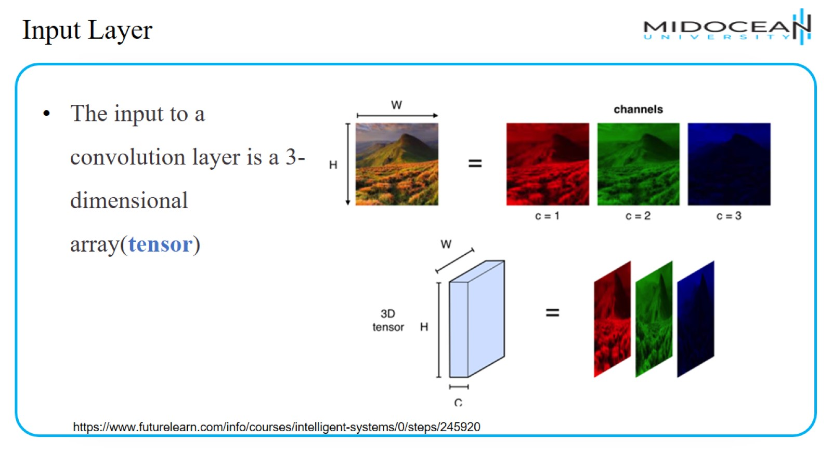
Input Layer

Slide 17
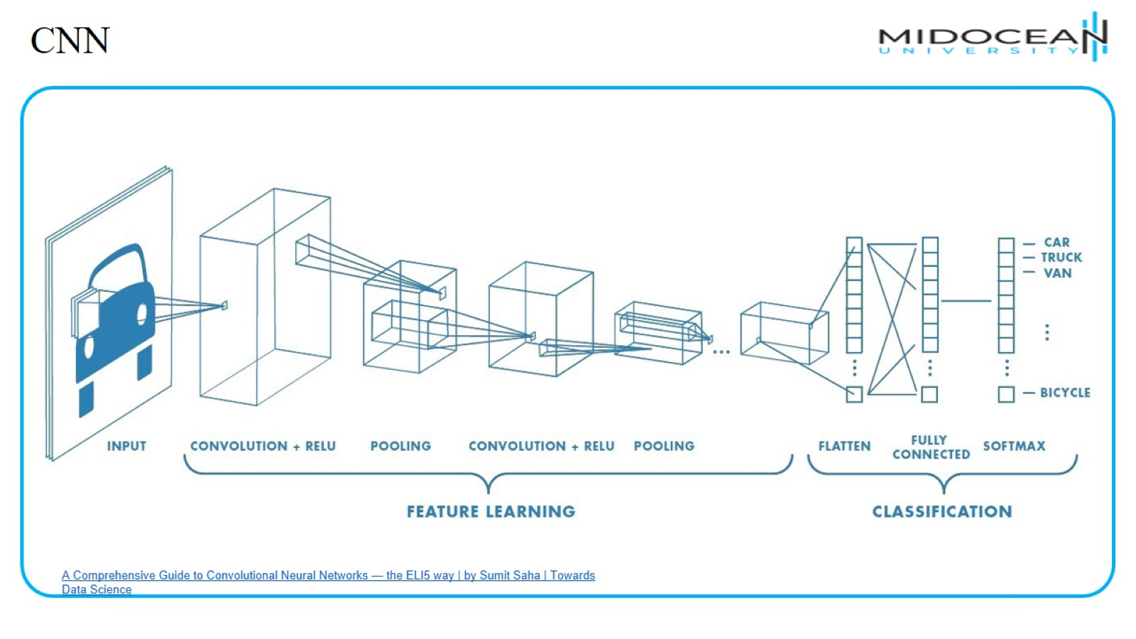
CNN

Slide 18
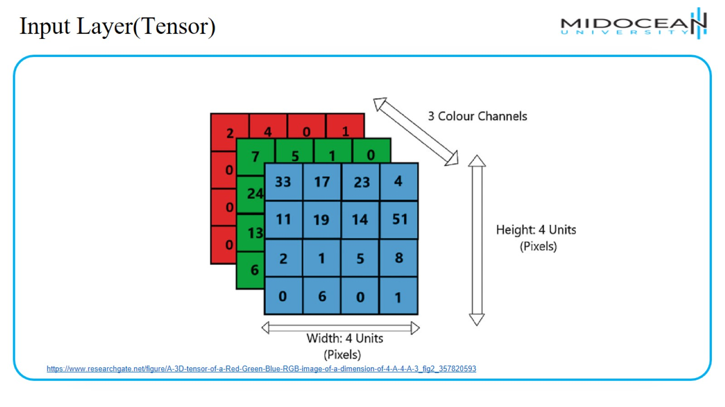
Input Layer(Tensor)

Slide 19
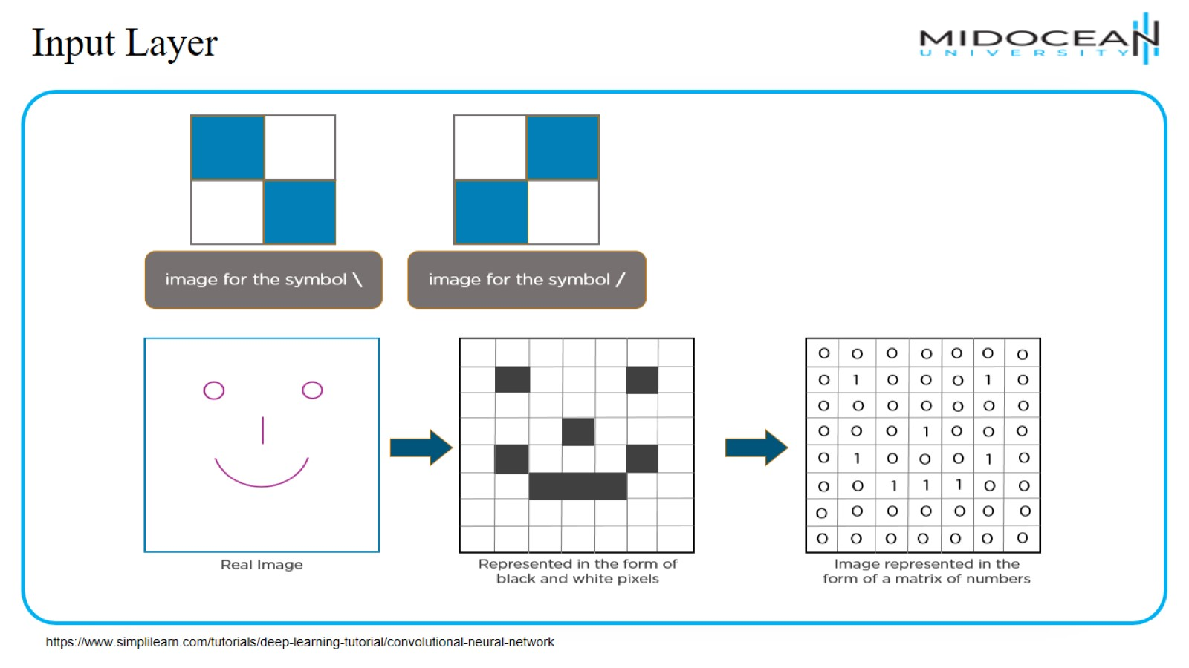
Input Layer

Slide 20
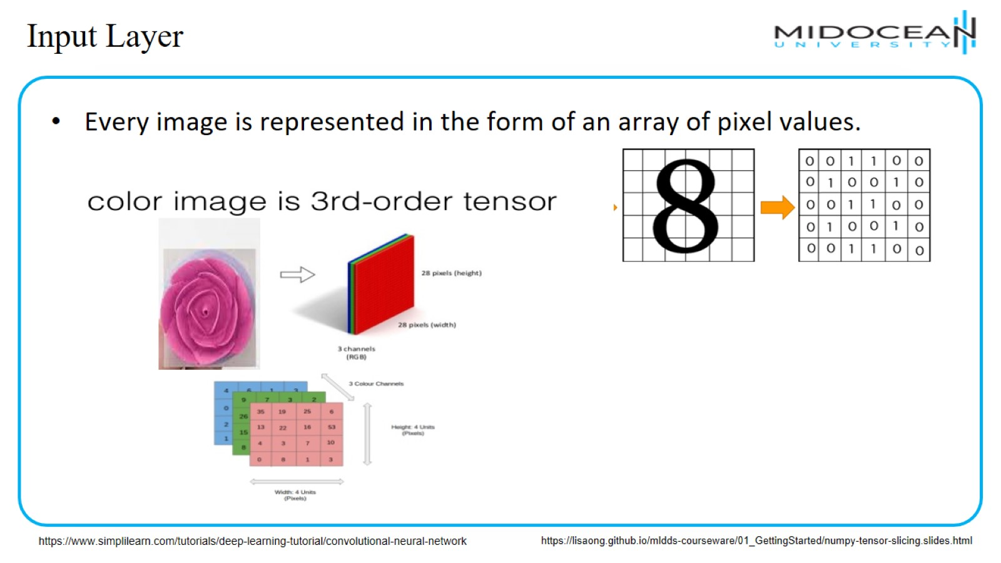
Input Layer

Slide 21
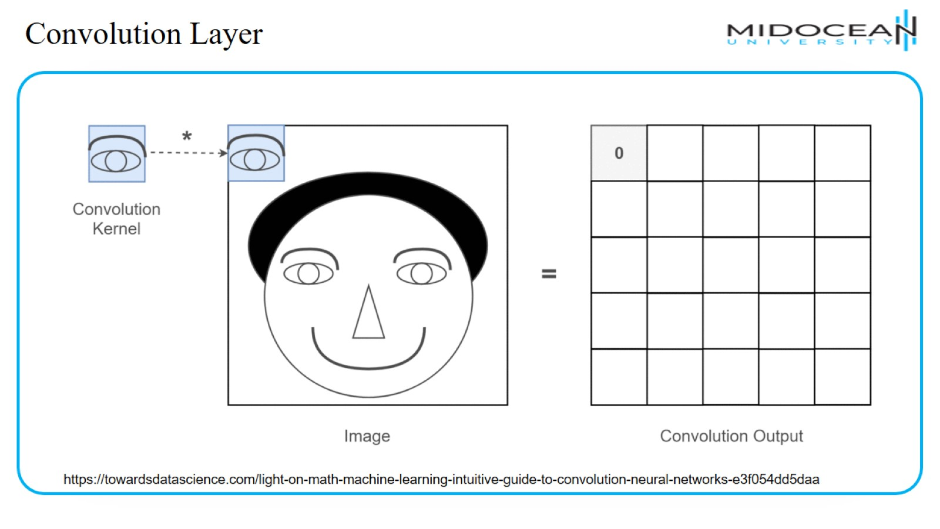
Convolution Layer

Slide 22
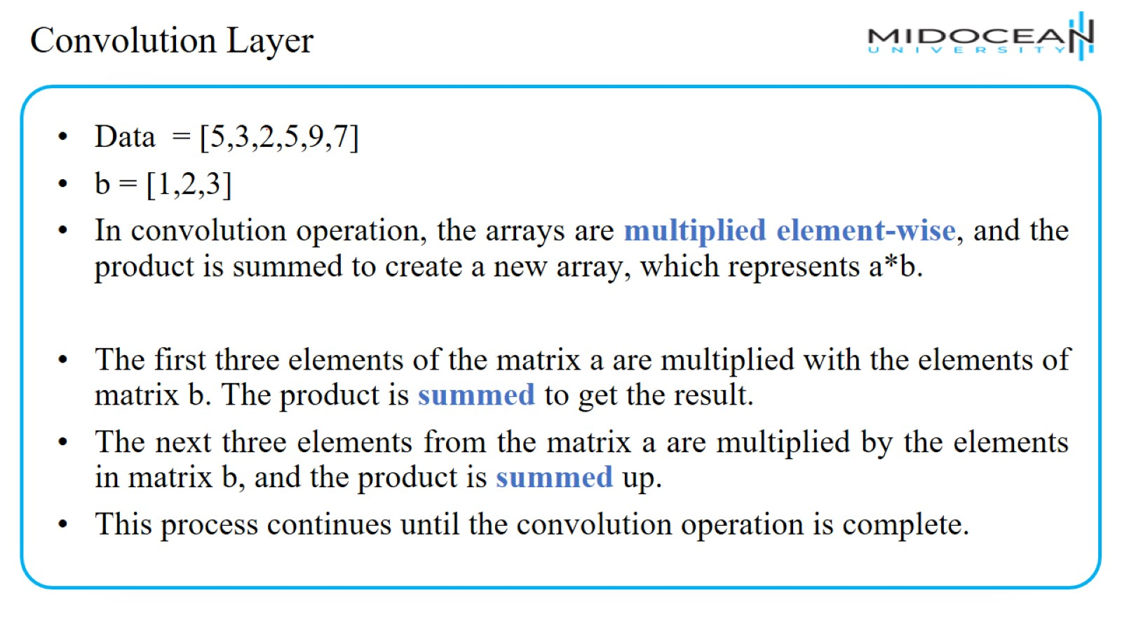
Convolution Layer

Slide 23
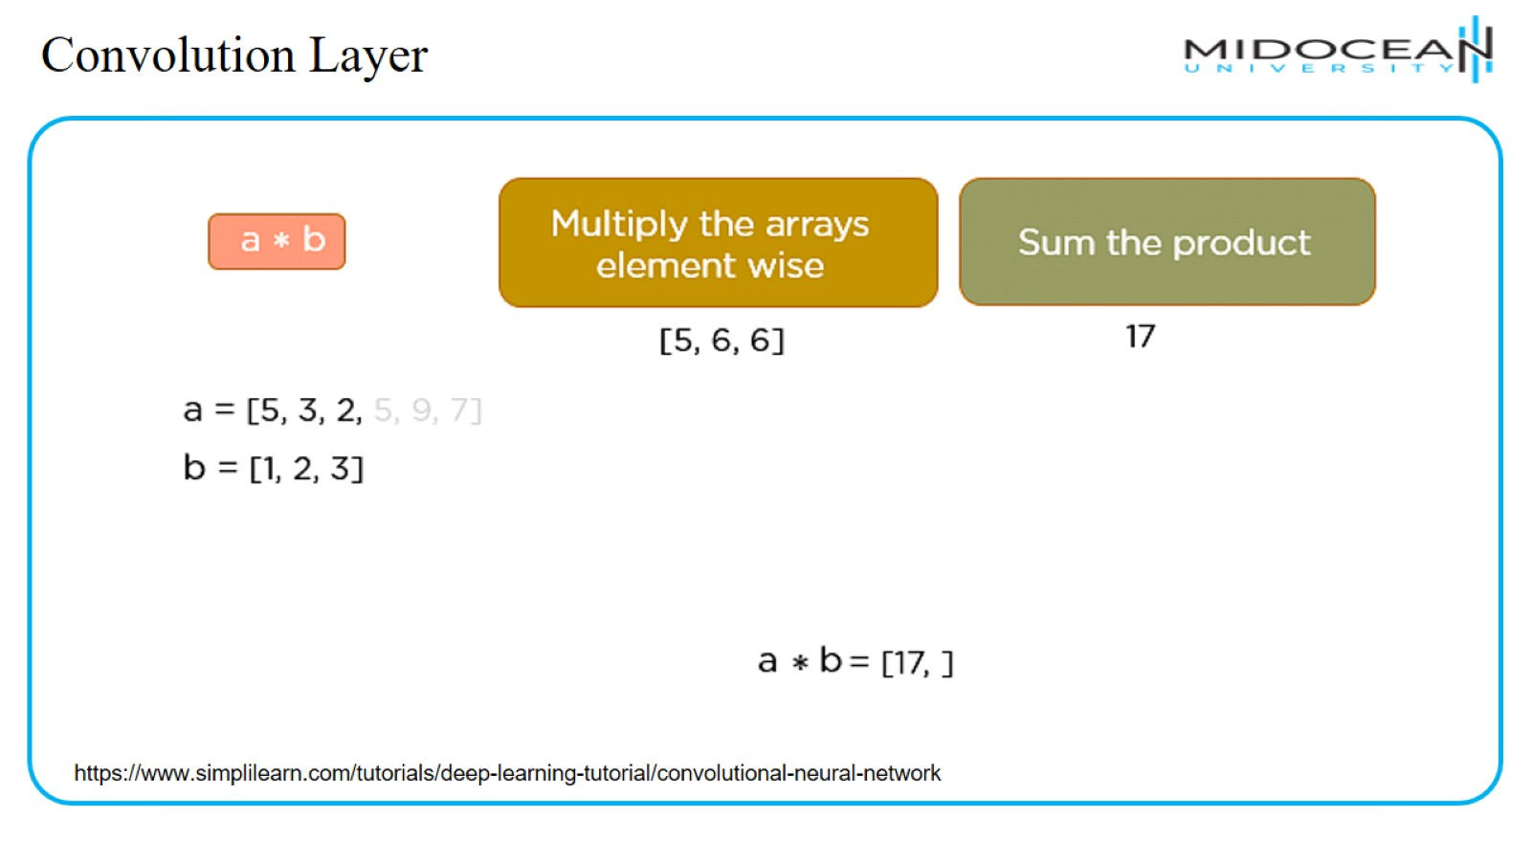
Convolution Layer

Slide 24
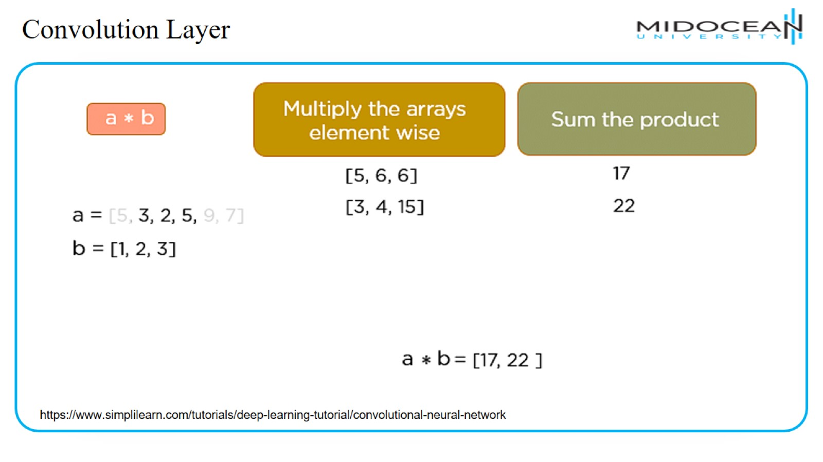
Convolution Layer

Slide 25
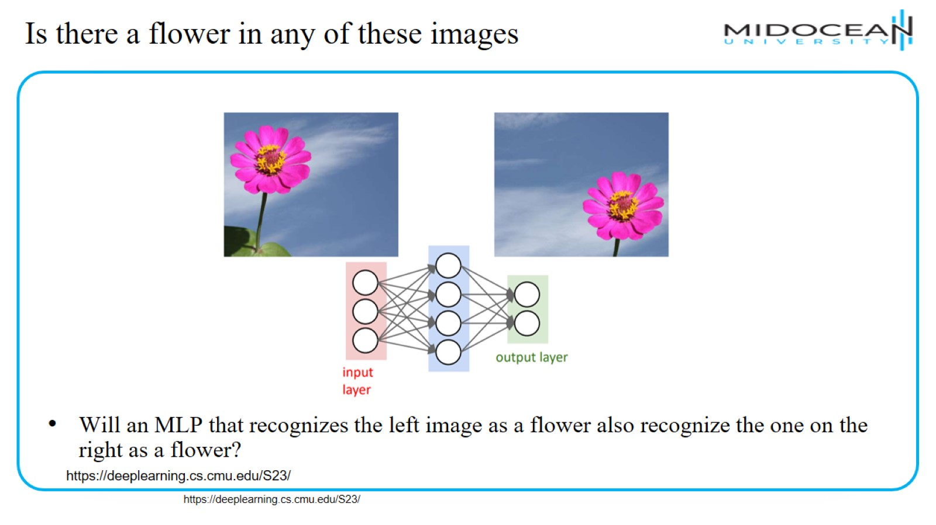
Is there a flower in any of these images

Slide 26
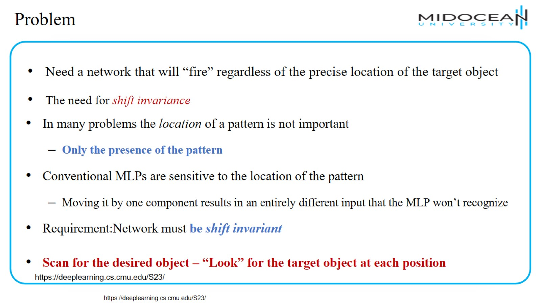
Problem

Slide 27
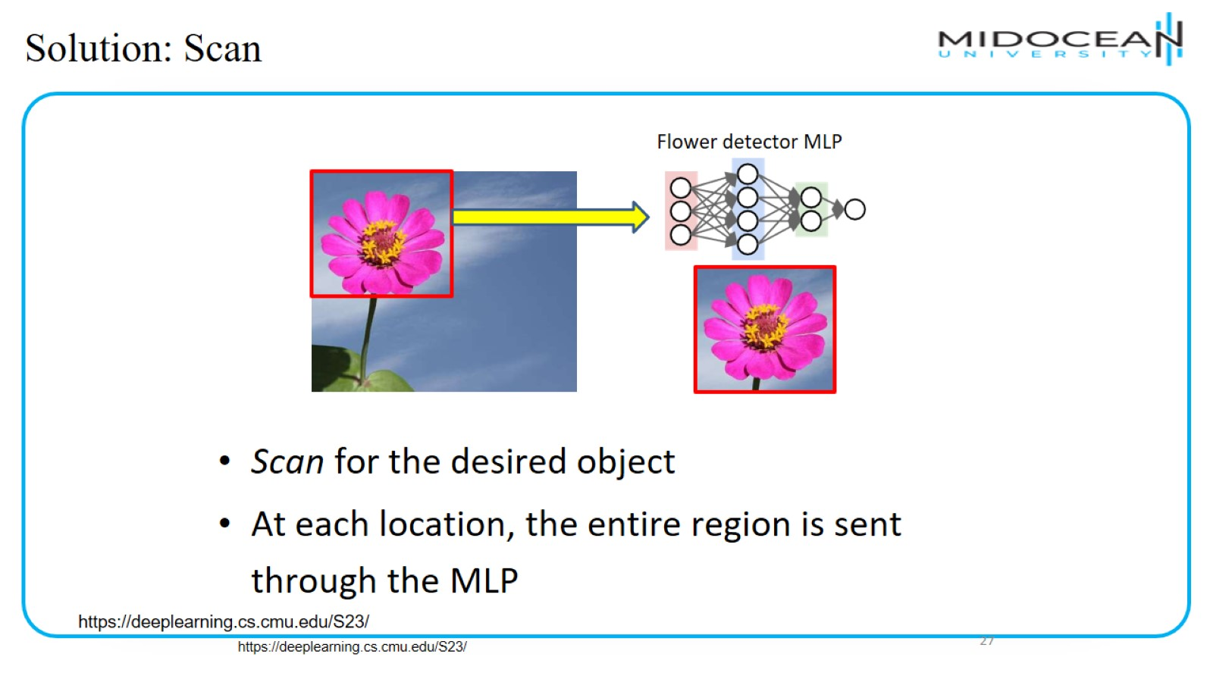
Solution: Scan

Slide 28

Solution: Scan

Slide 29

Solution: Scan

Slide 30

Solution: Scan

Slide 31
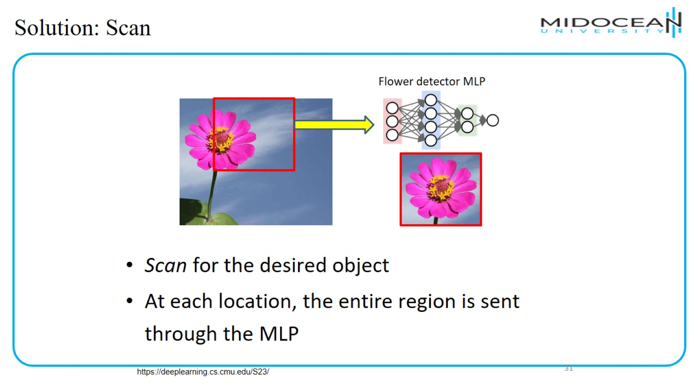
Solution: Scan

Slide 32

Solution: Scan

Slide 33
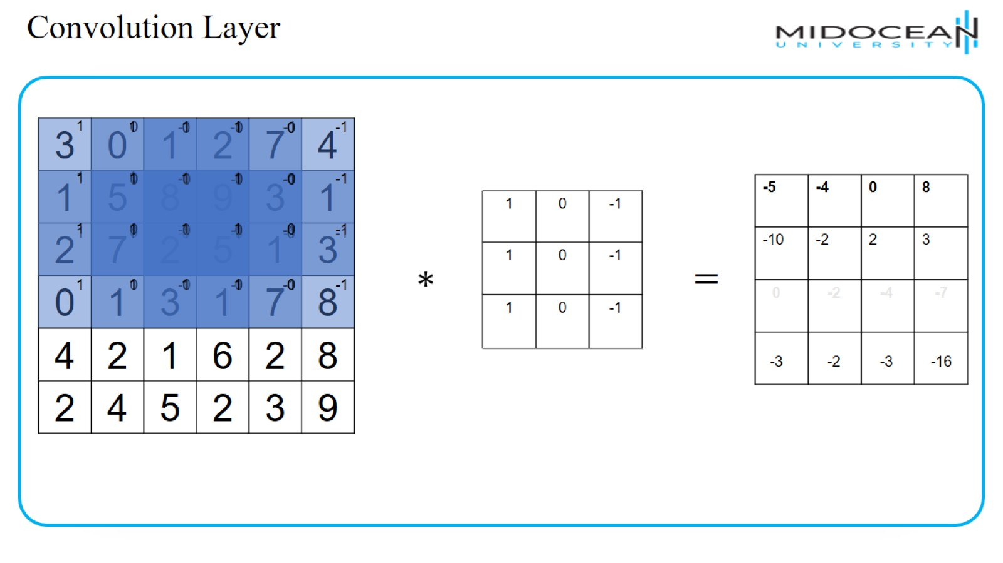
Convolution Layer

Slide 34
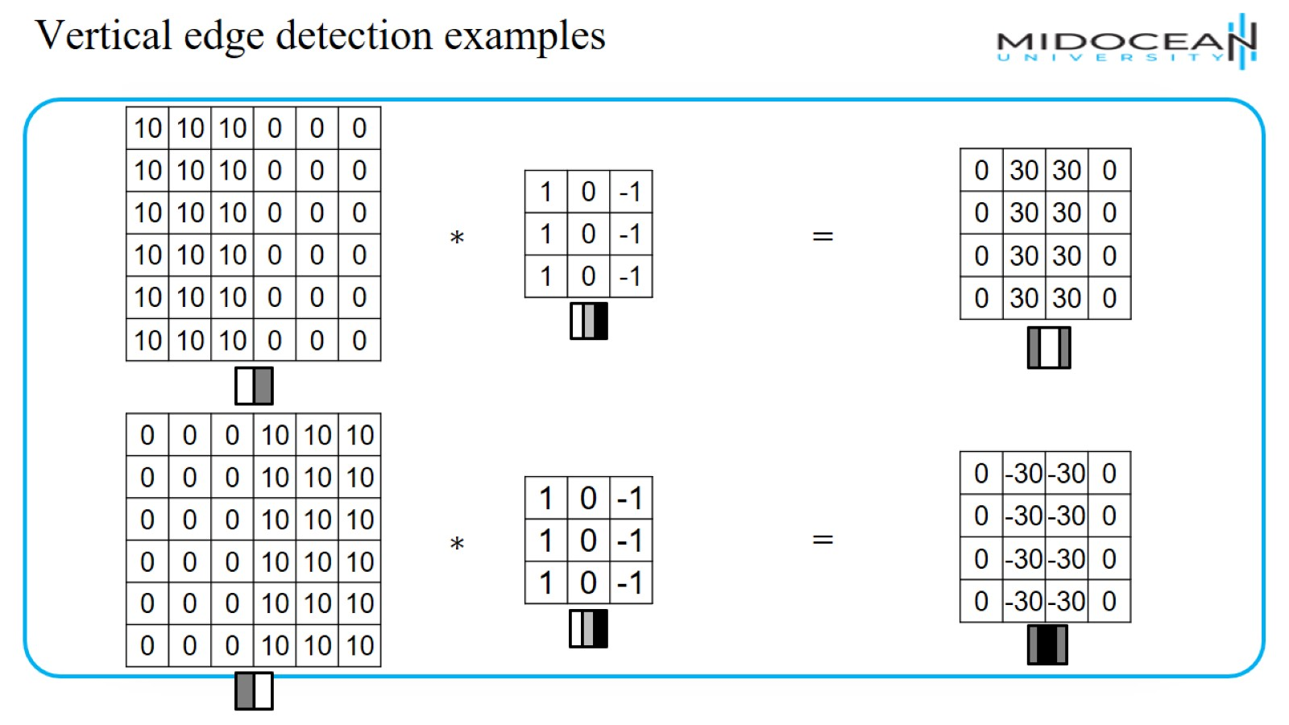
Vertical edge detection examples

Slide 35
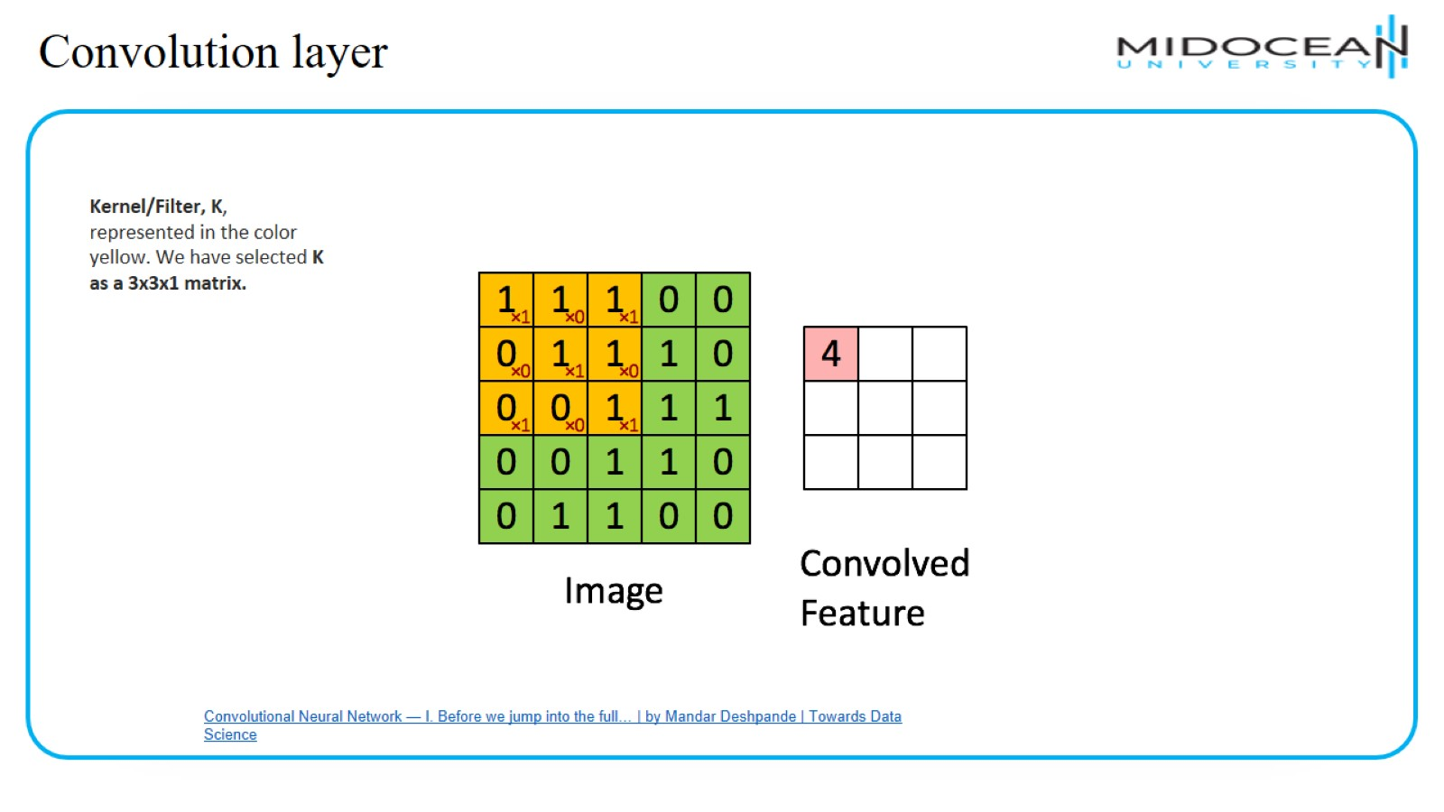
Convolution layer

Slide 36
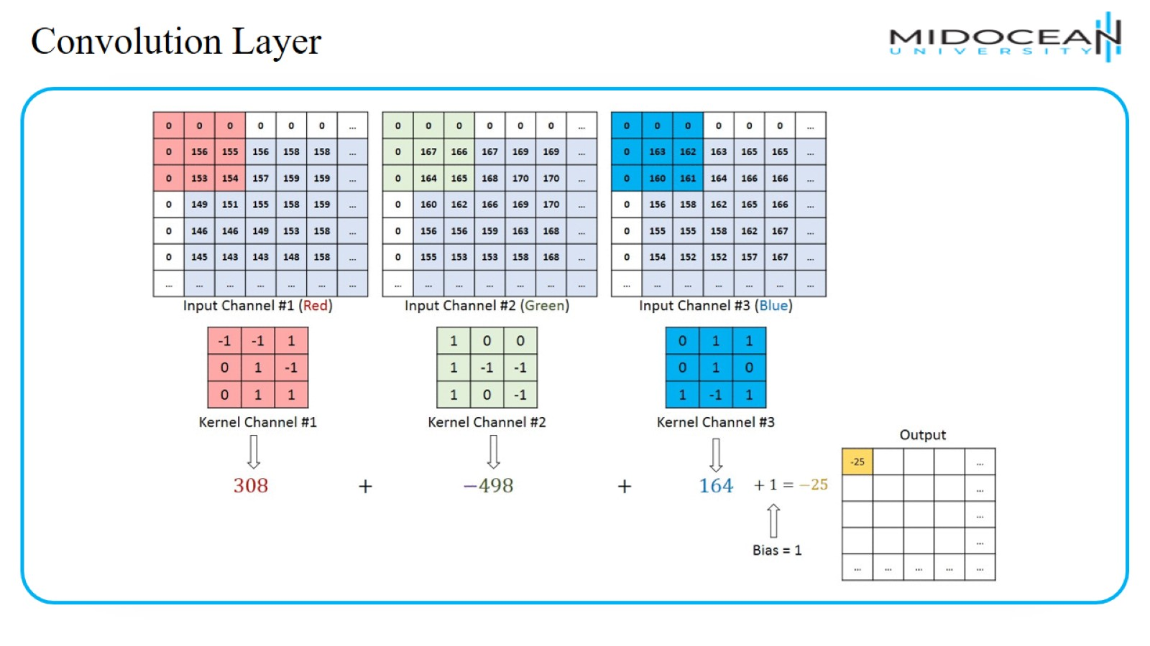
Convolution Layer

Slide 37
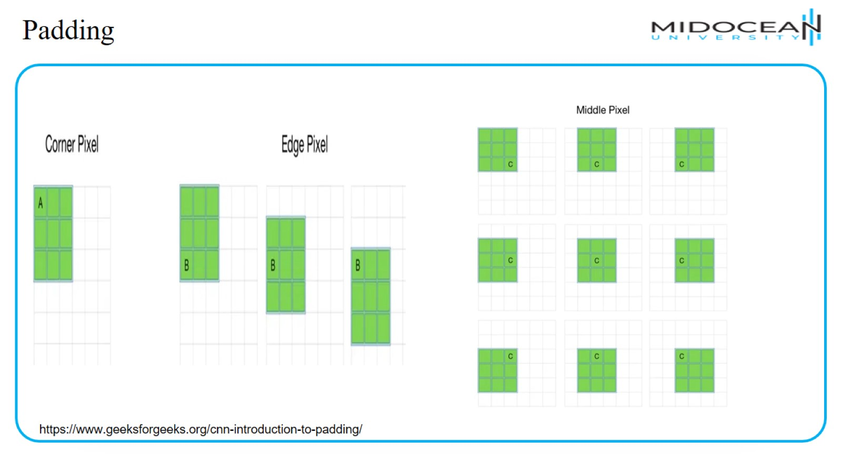
Padding

Slide 38
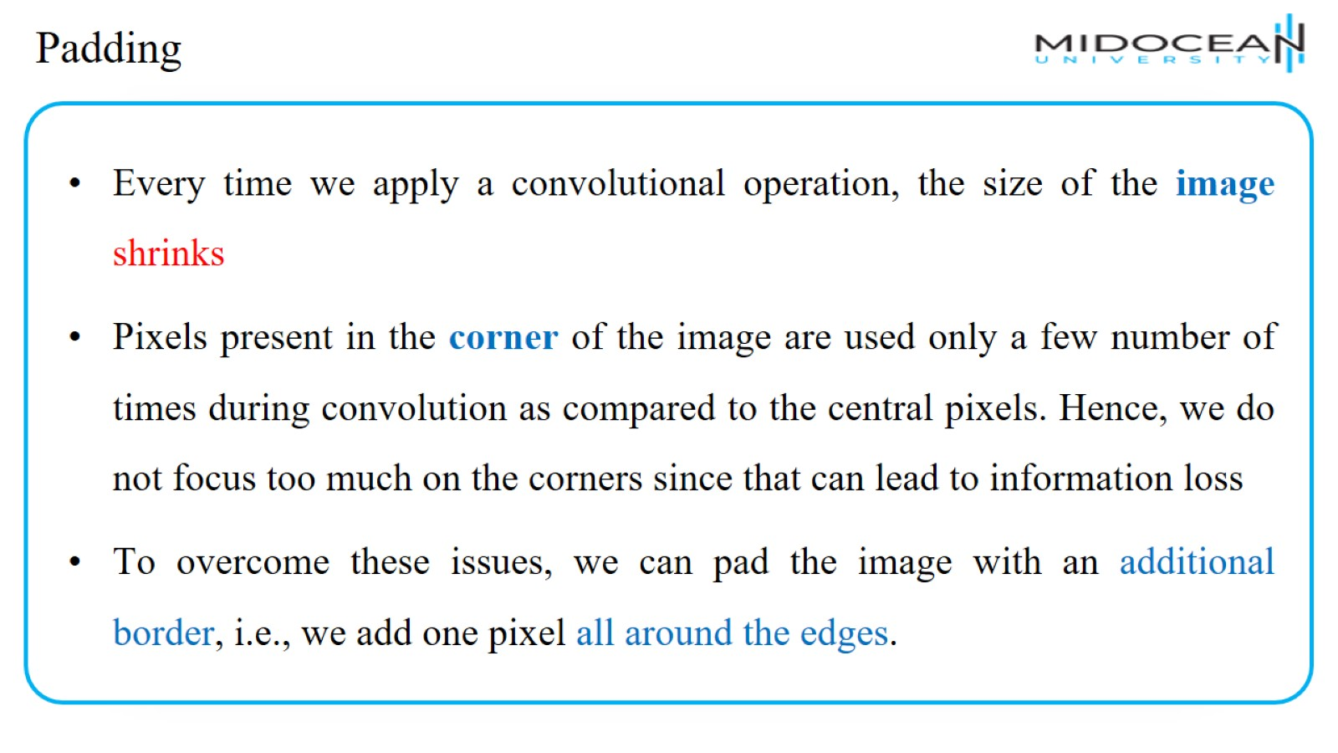
Padding

Slide 39
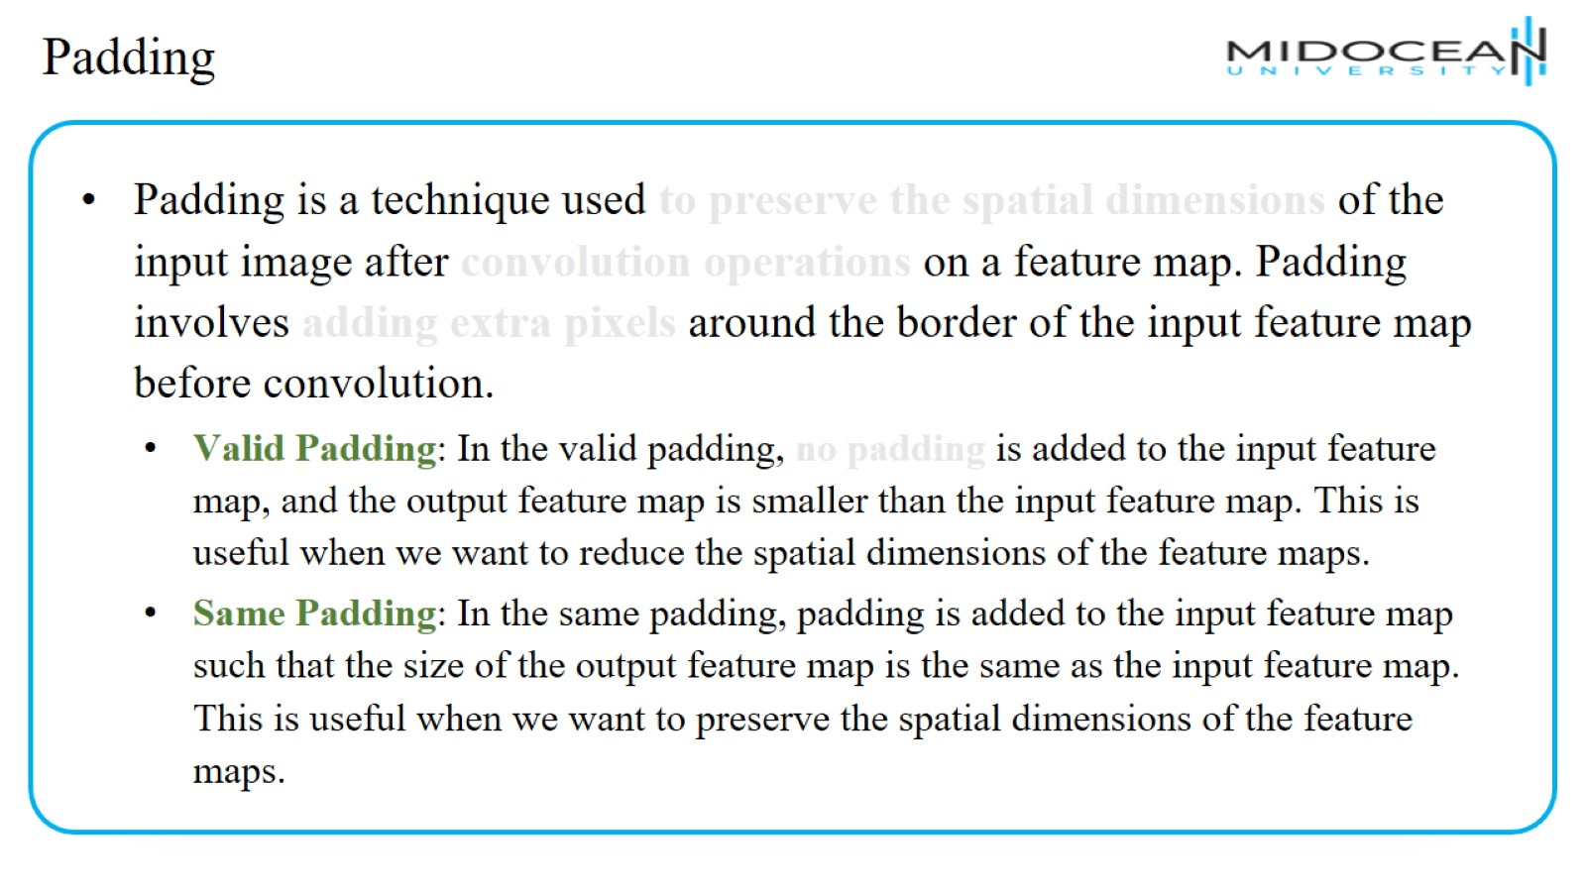
Padding

Slide 40
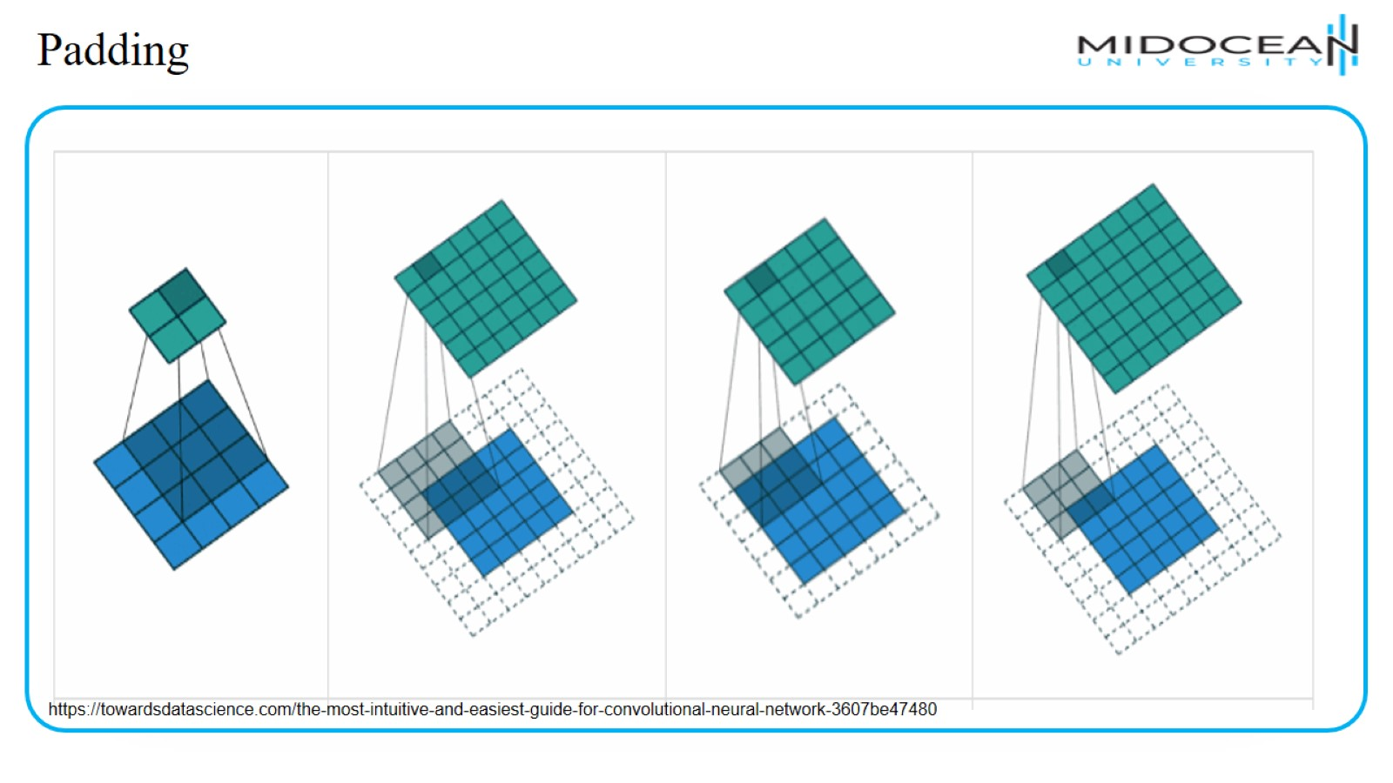
Padding

Slide 41
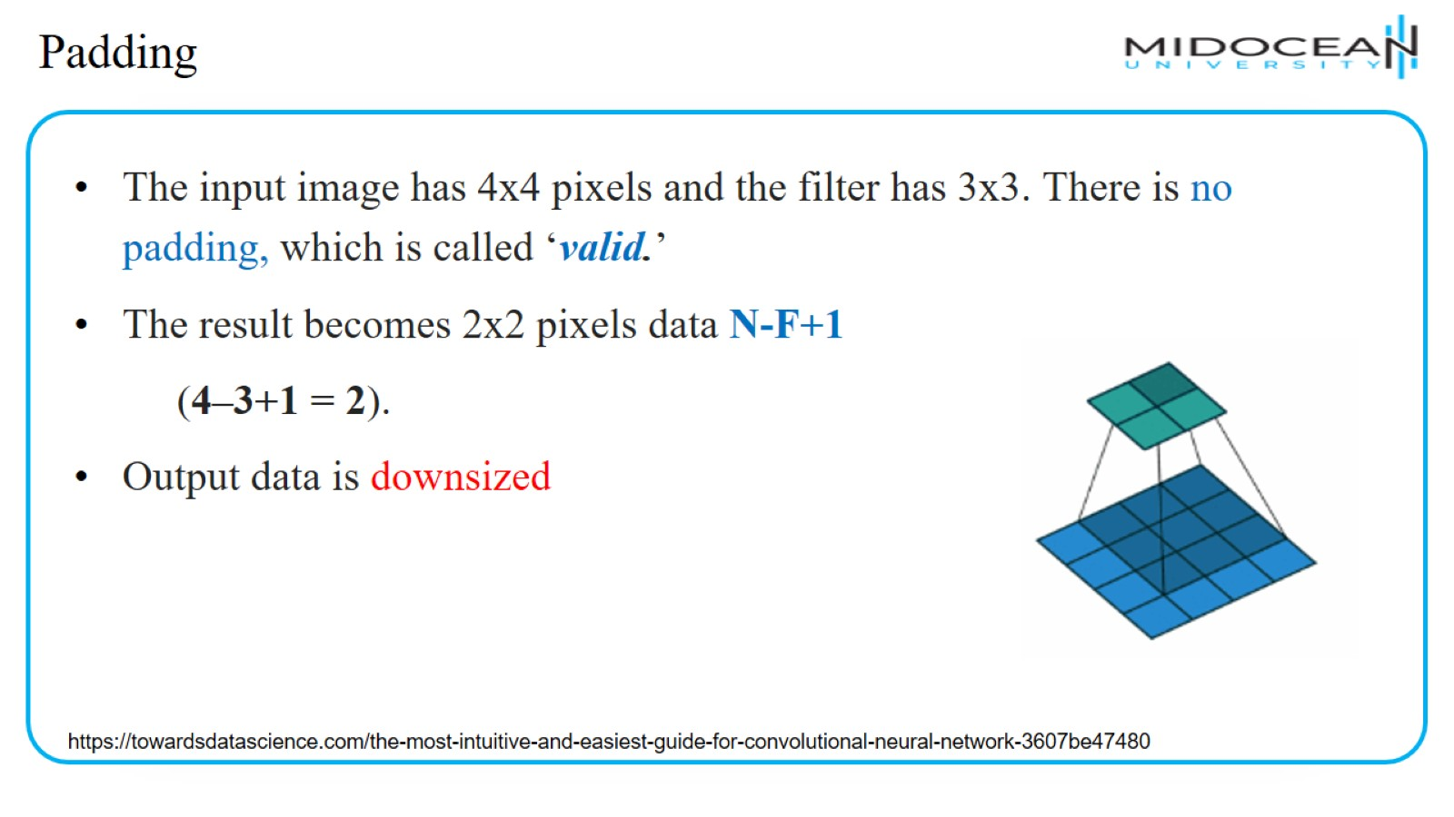
Padding

Slide 42
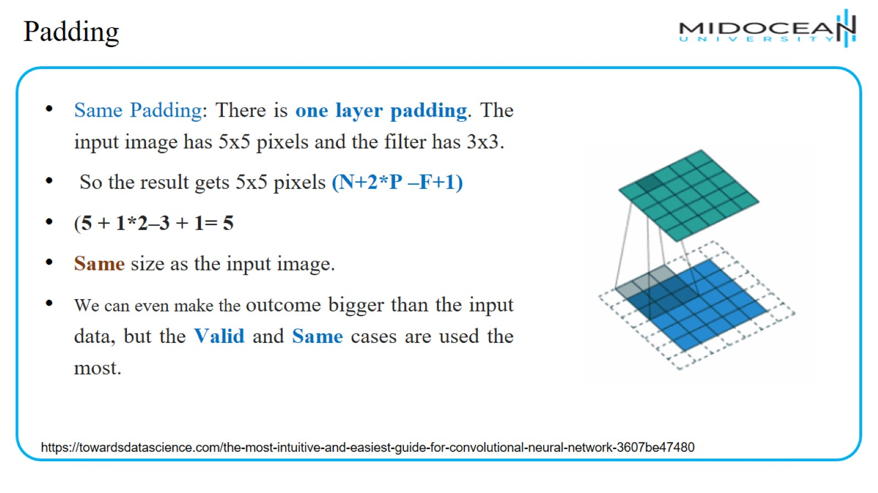
Padding

Slide 43
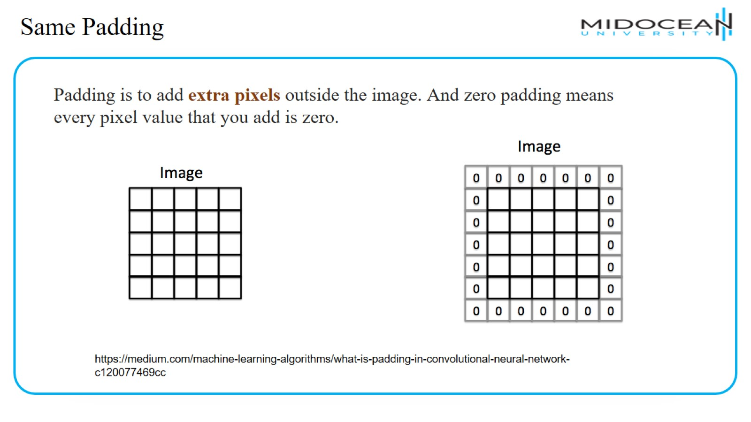
Same Padding

Slide 44
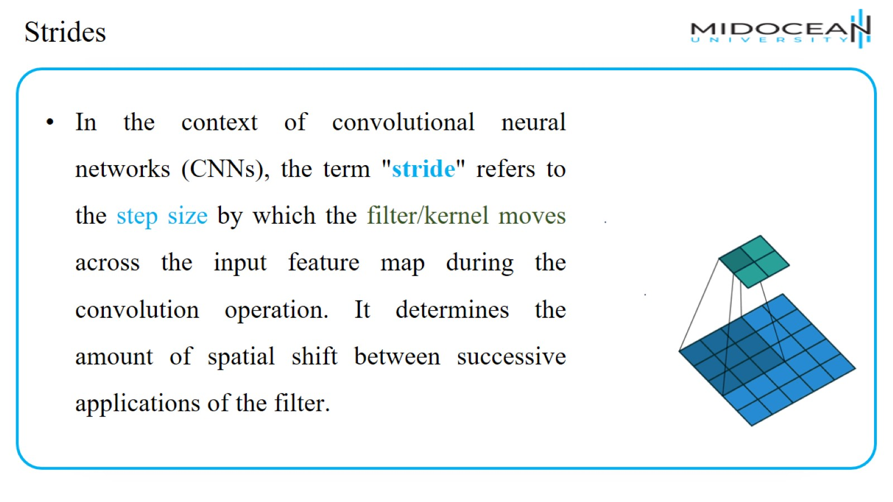
Strides

Slide 45
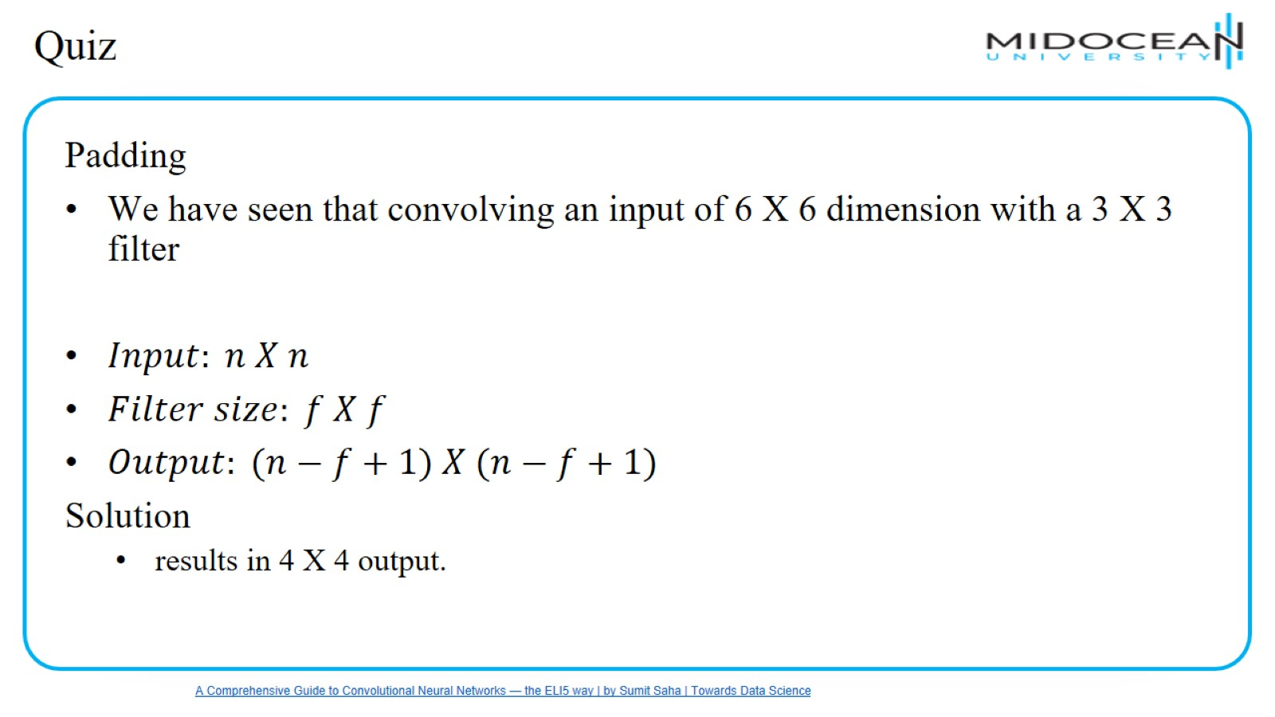
Quiz

Slide 46
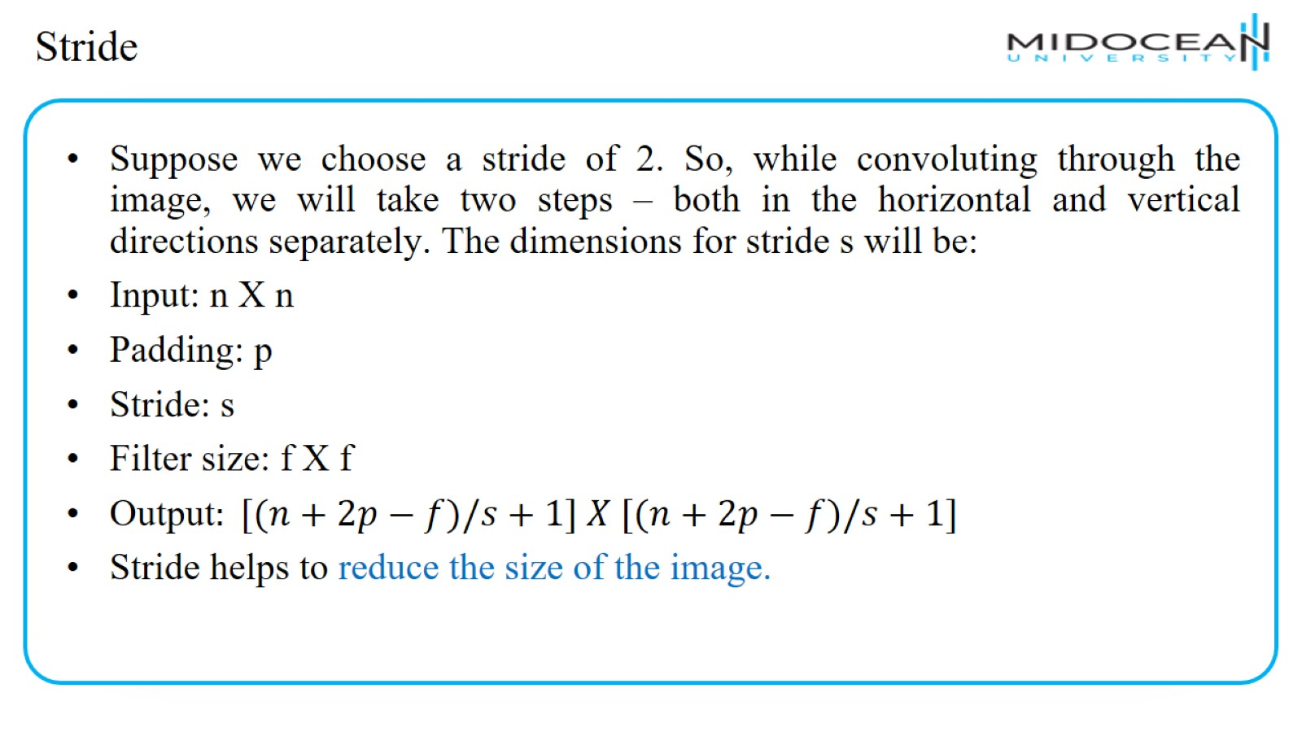
Stride

Slide 47
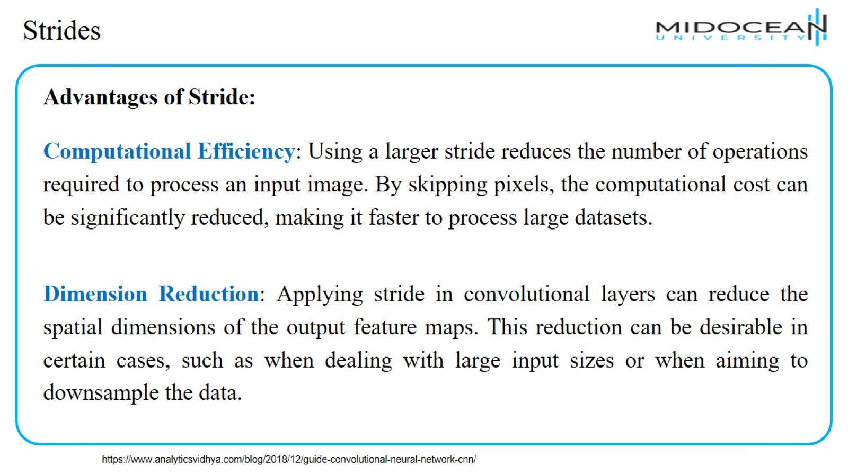
Strides

Slide 48
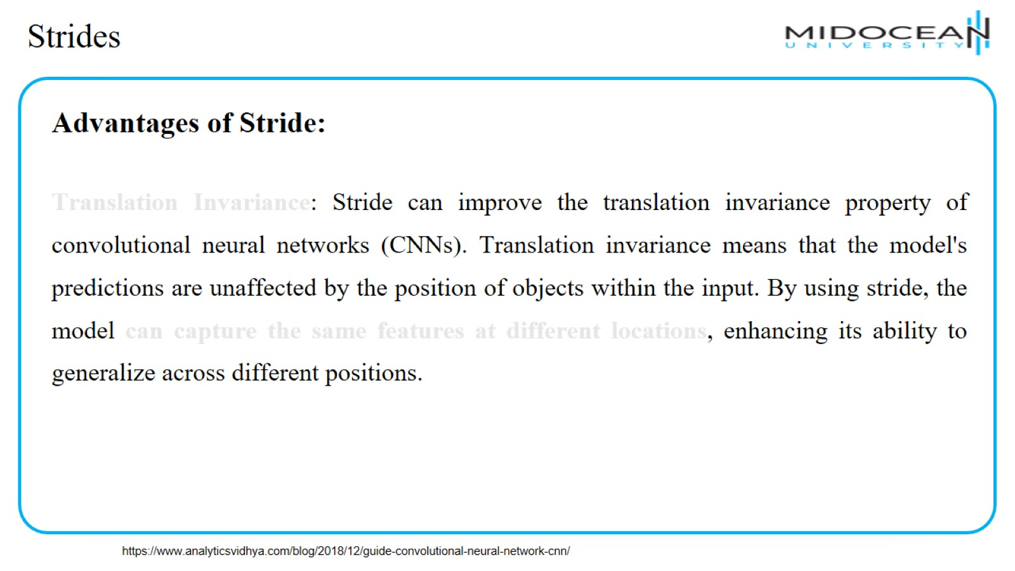
Strides

Slide 49
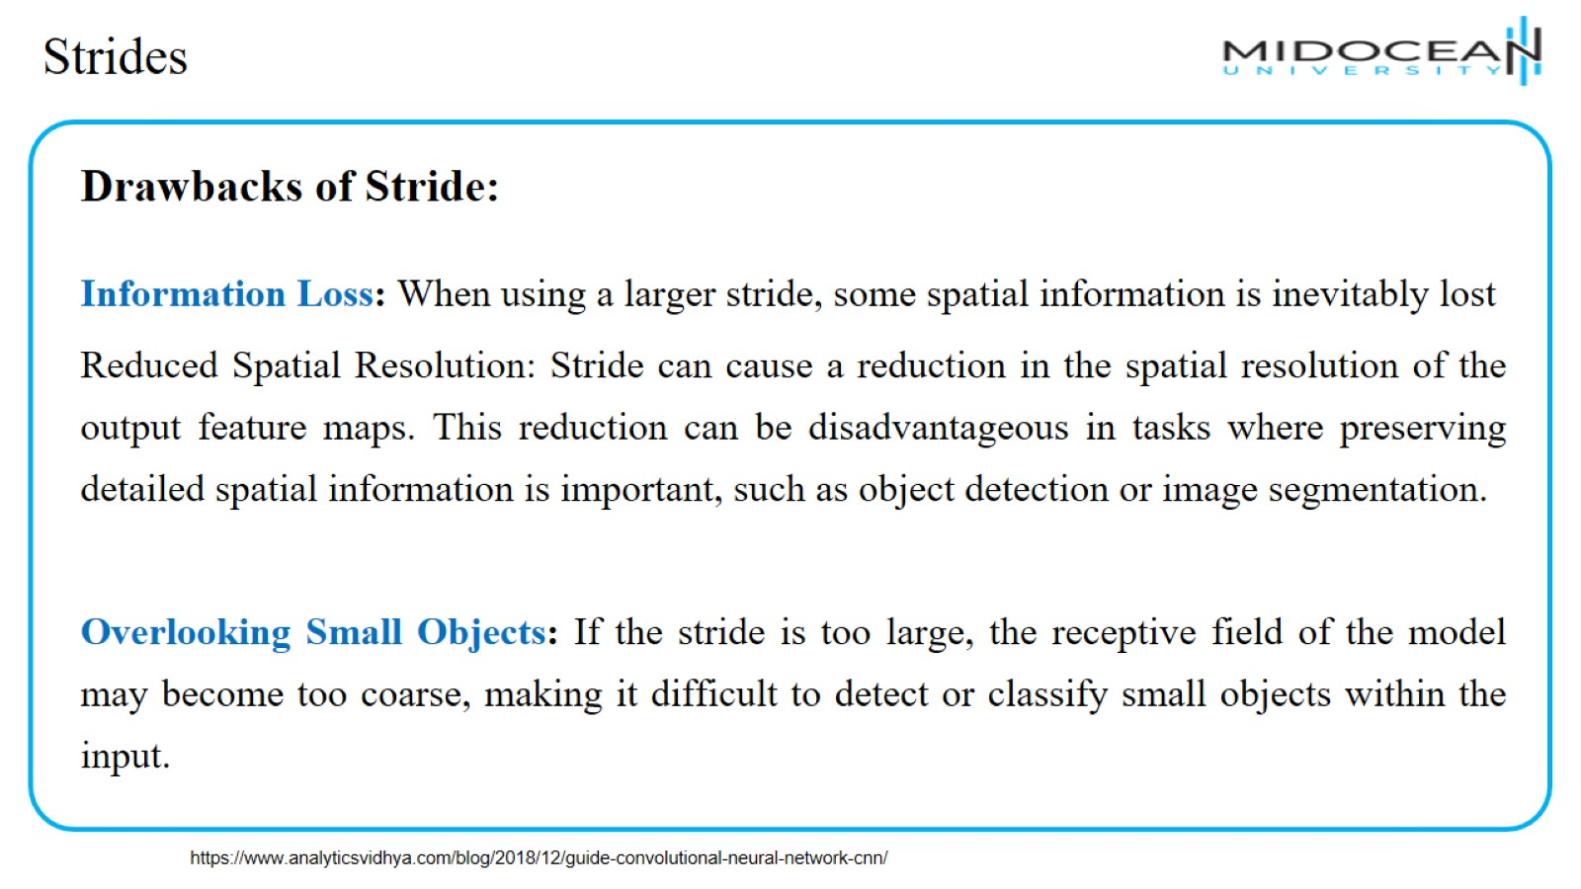
Strides

Slide 50
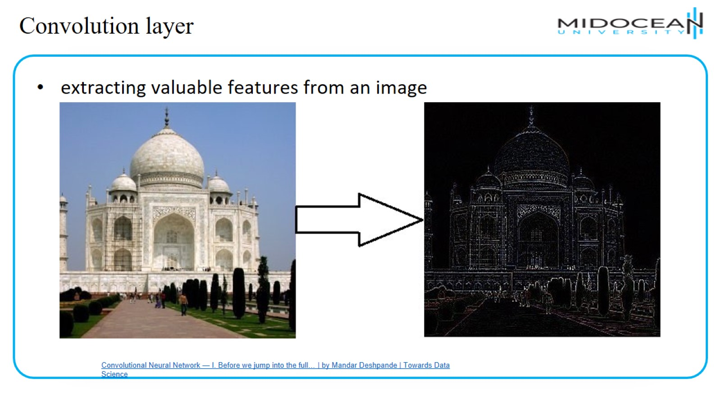
Convolution layer

Slide 51
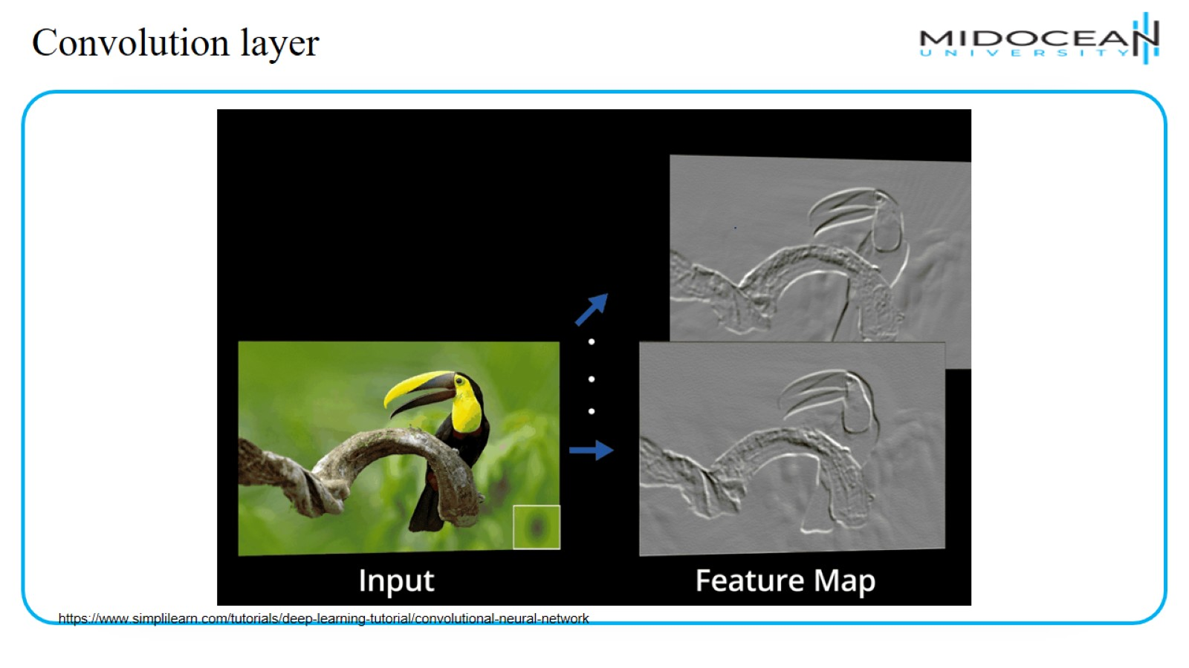
Convolution layer

Slide 52
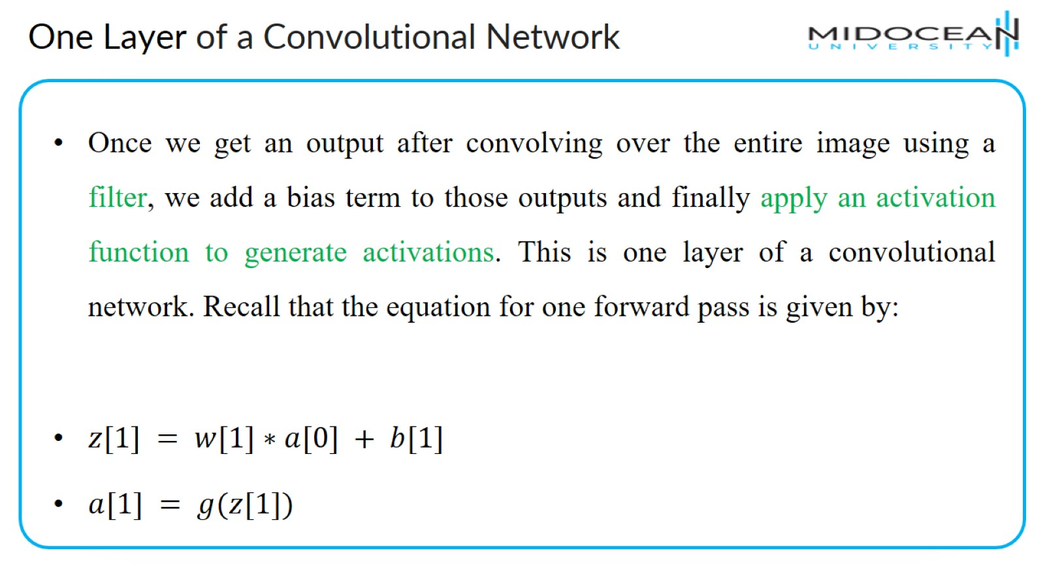
One Layer of a Convolutional Network

Slide 53
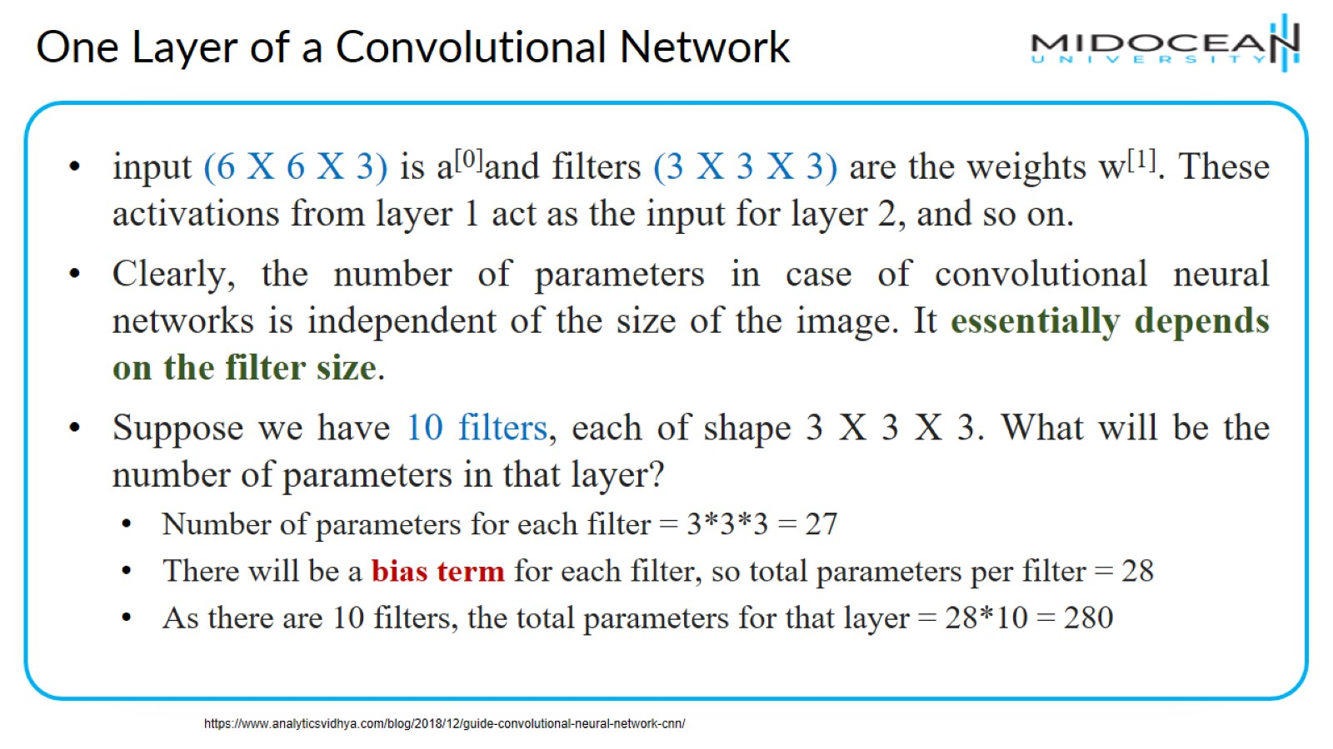
One Layer of a Convolutional Network

Slide 54
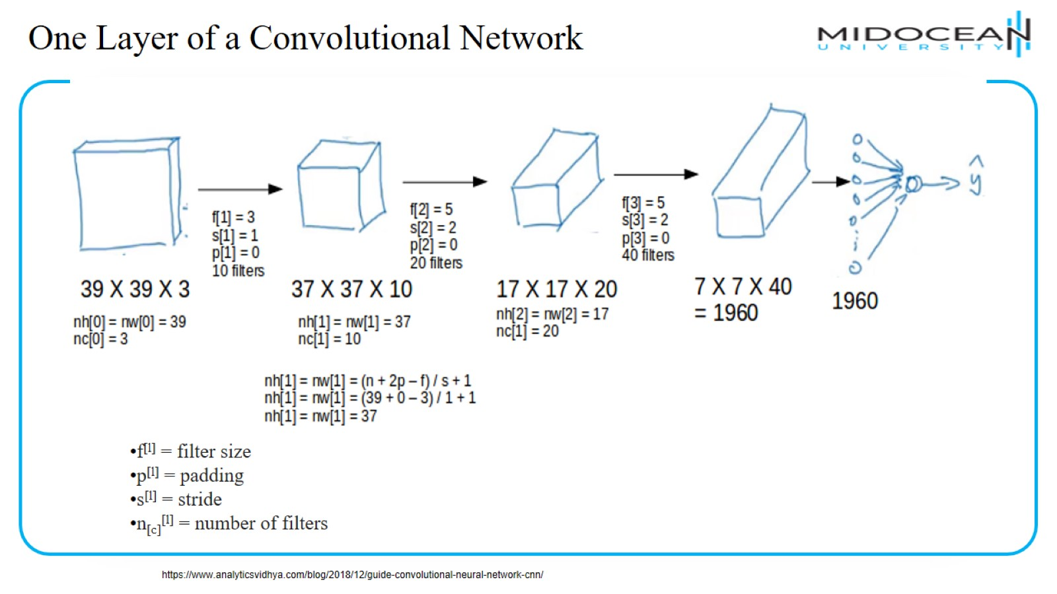
One Layer of a Convolutional Network

Slide 55
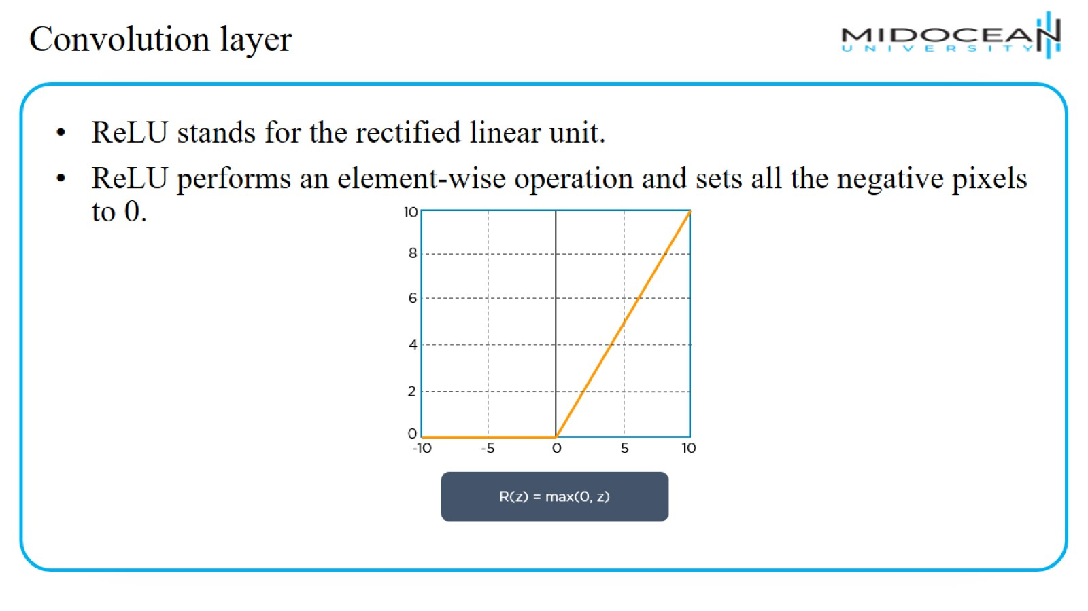
Convolution layer

Slide 56

Convolution layer

Slide 57

Pooling Layer

Slide 58

Pooling Layer

Slide 59

Pooling Layer

Slide 60

Pooling Layer

Slide 61

Flattening

Slide 62

Classification — Fully Connected Layer (FC Layer)

Slide 63

Why ConvNets over Feed-Forward Neural Nets?

Slide 64

Why Convolutions?

Slide 65

CNN Example

Slide 66

Why Convolutions?

Slide 67

CNN

Slide 68

LeNet

Slide 69

AlexNet

Slide 70

VGG

Slide 71

GoogLeNet

Slide 72

GoogLeNet

Slide 73

Kernel vs Filter

Slide 74

LAB 1

Slide 75

LAB 2

Slide 76


Slide 77


Slide 78


Slide 79


