Slide 1

Strategic and Operational Management
(part 1 Analysis)
Prepared by Dr. Adam Yagoub
Lecture 4
MGM 630
Internal Analysis: Resources,
Capabilities, and Core Competencies

Slide 2
Lecture 4
Chapter Outline
4.1 Core Competencies
4.2 The Resource-Based View
- Two Critical Assumptions
- The VRIO Framework
- Isolating Mechanisms: How to Sustain a Competitive Advantage
4.3 The Dynamic Capabilities Perspective
4.4 The Value Chain Analysis

Slide 3

Lecture 4
Learning Objectives
1. Differentiate among a firm’s core competencies, resources, capabilities, and activities.
2. Compare and contrast tangible and intangible resources.
3. Evaluate the two critical assumptions behind the resource-based view.
4. Apply the VRIO framework to assess the competitive implications of a firm’s resources.

Slide 4
Lecture 4
Learning Objectives
5. Evaluate different conditions that allow a firm to sustain a competitive advantage.
6. Outline how dynamic capabilities can enable a firm to sustain a competitive advantage.
7. Apply a value chain analysis to understand which of the firm’s activities in the process of transforming inputs into outputs generate differentiation and which drive costs.
8. Conduct a SWOT analysis to generate insights from external and internal analysis and derive strategic implications

Slide 5
Lecture 4
Internal Analysis: Resources,
Capabilities, and Core Competencies
4.1 Core Competencies
Let’s begin by taking a closer look at core competencies. These are unique strengths, embedded deep within a firm. Core competencies allow a firm to differentiate its products and services from those of its rivals, creating higher value for the customer or offering products and services of comparable value at lower cost. The important point here is that competitive advantage can be driven by core competencies.

Slide 6
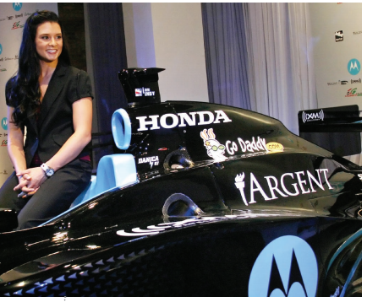
Lecture 4
Internal Analysis: Resources,
Capabilities, and Core Competencies
Take Honda as an example of a company with a clearly defined core competency. Its life began with a small two-cycle motorbike engine. Through continuous learning over several decades, and often from lessons learned from failure, Honda built the core competency to design and manufacture small but powerful and highly reliable engines for which it now is famous. This core competency results from superior engineering know-how and skills care-fully nurtured and honed over several decades. Honda’s business model is to find a place to put its engines. Today, Honda engines can be found everywhere: in cars, SUVs, vans, trucks, motorcycles, ATVs, boats, generators, snow blowers, lawn mowers and other yard equipment, and even small airplanes. Due to their superior performance, Honda engines have been the most popular in the Indy Racing League (IRL) since 2006. Not coincidentally, this was also the first year in its long history that the Indy 500 was run without a single engine problem.

Slide 7
Lecture 4
Internal Analysis: Resources,
Capabilities, and Core Competencies
therefore, compete as much in the product and service markets as they do in developing and leveraging core competencies. Although invisible by themselves, core competencies find their expression in superior products and services. Exhibit 4.2 identifies the core competencies of a number of companies, with application examples.

Slide 8
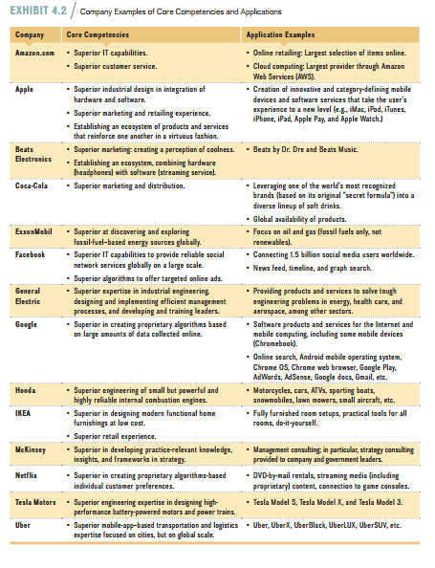

Slide 9
Lecture 4
Internal Analysis: Resources,
Capabilities, and Core Competencies
Since core competencies are critical to gaining and sustaining competitive advantage, it is important to understand how they are created. Companies develop core competencies through the interplay of resources and capabilities. Exhibit 4.3 shows this relationship. Resources are any assets such as cash, buildings, machinery, or intellectual property that a firm can draw on when crafting and executing a strategy. Resources can be either tangible or intangible.

Slide 10
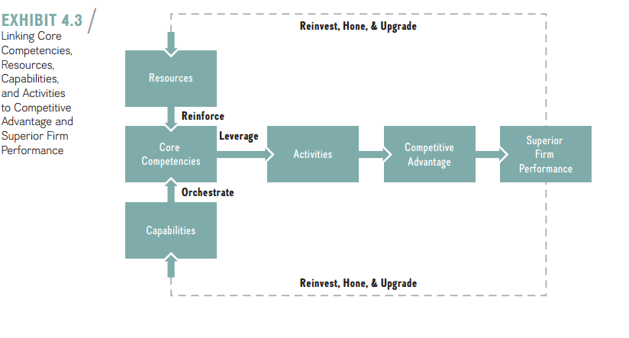

Slide 11
Lecture 4
Internal Analysis: Resources,
Capabilities, and Core Competencies
Capabilities are the organizational and managerial skills necessary to orchestrate a diverse set of resources and to deploy them strategically. Capabilities are by nature intangible. They find their expression in a company’s structure, routines, and culture. As shown in Exhibit 4.3, such competencies are demonstrated in the company’s activities, which can lead to competitive advantage, resulting in superior firm performance.
Activities are distinct and fine-grained business processes such as order taking, the physical delivery of products, or invoicing customers.

Slide 12
Lecture 4
Internal Analysis: Resources,
Capabilities, and Core Competencies
4.2 The Resource-Based View
To gain a deeper understanding of how the interplay between resources and capabilities creates core competencies that drive firm activities leading to competitive advantage, we turn to the resource-based view of the firm. This model systematically aids in identifying core competencies. As the name suggests, this model sees resources as key to superior firm performance. As Exhibit 4.4 illustrates, resources fall broadly into two categories: tangible and intangible. Tangible resource shave physical attributes and are visible. Examples of tangible resources are labor, capital, land, buildings, plant, equipment, and supplies. Intangible resources have no physical attributes and thus are invisible. Examples of intangible resources are a firm’s culture, its knowledge, brand equity, reputation, and intellectual property.

Slide 13
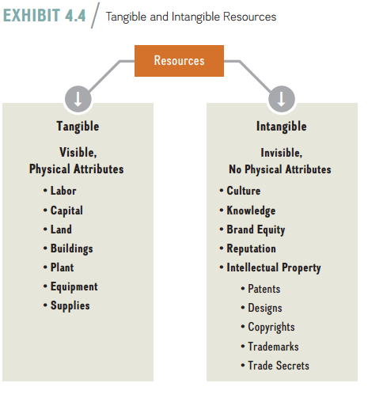
Lecture 4
Internal Analysis: Resources,
Capabilities, and Core Competencies

Slide 14
Lecture 4
Internal Analysis: Resources,
Capabilities, and Core Competencies
- Two critical assumptions
Two assumptions are critical in the resource-based model: (1) resource heterogeneity and (2) resource immobility. What does this mean? In the resource-based view, a firm is assumed to be a unique bundle of resources, capabilities, and competencies. The first critical assumption—resource heterogeneity—comes from the insight that bundles of resources, capabilities, and competencies differ across firms. This insight ensures that analysts look more critically at the resource bundles of firms competing in the same industry (or even the same strategic group), because each bundle is unique to some extent.

Slide 15
Lecture 4
Internal Analysis: Resources,
Capabilities, and Core Competencies
The second critical assumption—resource immobility—describes the insight that resources tend to be “sticky” and don’t move easily from firm to firm. Because of that stickiness, the resource differences that exist between firms are difficult to replicate and, therefore, can last for a long time.

Slide 16
Lecture 4
Internal Analysis: Resources,
Capabilities, and Core Competencies
- The VRIO Framework
Our tool for evaluating a firm’s resource endowments is a framework that answers the question of what resource attributes underpin competitive advantage. This framework is implied in the resource-based model, identifying certain types of resources as key to superior firm performance. For a resource to be the basis of a competitive advantage, it must be
- Valuable
- Rare
- I costly to Imitate.
- And finally, the firm itself must be
- Organized to capture the value of the resource.

Slide 17
Lecture 4
Internal Analysis: Resources,
Capabilities, and Core Competencies
Following the lead of Jay Barney, one of the pioneers of the resource-based view of the firm, we call this model the VRIO framework. According to this model, a firm can gain and sustain a competitive advantage only when it has resources that satisfy all of the VRIO criteria. Keep in mind that resources in the VRIO framework are broadly defined to include any assets as well as any capabilities and competencies that a firm can draw upon when formulating and implementing strategy. Exhibit 4.5 captures the VRIO framework.

Slide 18
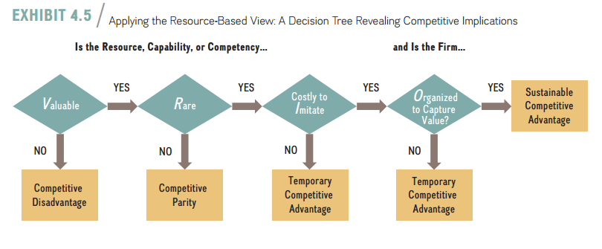
Lecture 4
Internal Analysis: Resources,
Capabilities, and Core Competencies

Slide 19
Lecture 4
Valuable. A valuable resource is one that enables the firm to exploit an external opportunity or offset an external threat. This has a positive effect on a firm’s competitive advantage. In particular, a valuable resource enables a firm to increase its economic value creation (V − C). Revenues rise if a firm is able to increase the perceived value of its product or service in the eyes of consumers by offering superior design and adding attractive features (assuming costs are not increasing).
Rare. A resource is rare if only one or a few firms possess it. If the resource is common, it will result in perfect competition where no firm is able to maintain a competitive advantage.

Slide 20
Lecture 4
Internal Analysis: Resources,
Capabilities, and Core Competencies
Costly to imitate. A resource is costly to imitate if firms that do not possess the resource are unable to develop or buy the resource at a reasonable price. If the resource in question is valuable, rare, and costly to imitate, then it is an internal strength and a core competency. If the firm’s competitors fail to duplicate the strategy based on the valuable, rare, and costly-to-imitate resource, then the firm can achieve a temporary competitive advantage.

Slide 21
Lecture 4
Internal Analysis: Resources,
Capabilities, and Core Competencies
-Organized to capture value. The final criterion of whether a rare, valuable, and costly-to-imitate resource can form the basis of a sustainable competitive advantage depends on the firm’s internal structure. To fully exploit the competitive potential of its resources, capabilities, and competencies, a firm must be organized to capture value—that is, it must have in place an effective organizational structure and coordinating systems.

Slide 22
Lecture 4
Internal Analysis: Resources,
Capabilities, and Core Competencies
- Isolating Mechanisms: how To sustain a competitive advantage
Although VRIO resources can lay the foundation of a sustainable competitive advantage, no competitive advantage can be sustained indefinitely. Several conditions, however, can offer some protection to a successful firm by making it more difficult for competitors to imitate the resources, capabilities, or competencies that underlie its competitive advantage:
■ Better expectations of future resource value.
■ Path dependence.
■ Causal ambiguity.
■ Social complexity.
■ Intellectual property (IP) protection.

Slide 23
Lecture 4
Internal Analysis: Resources,
Capabilities, and Core Competencies
Better expectations of future resource value. Sometimes firms can acquire resources at a low cost, which lays the foundation for a competitive advantage later when expectations about the future of the resource turn out to be more accurate.
Path Dependence. Path dependence describes a process in which the options one faces in a current situation are limited by decisions made in the past.27Often, early events—sometimes even random ones—have a significant effect on final outcomes.

Slide 24
Lecture 4
Internal Analysis: Resources,
Capabilities, and Core Competencies
Causal ambiguity. Causal ambiguity describes a situation in which the cause and effect of a phenomenon are not readily apparent. To formulate and implement a strategy that enhances a firm’s chances of gaining and sustaining a competitive advantage, managers need to have a hypothesis or theory of how to compete.
Social complexity. Social complexity describes situations in which different social and business systems interact. There is frequently no causal ambiguity as to how the individual systems such as supply chain management or new product development work in isolation.

Slide 25
Lecture 4
Internal Analysis: Resources,
Capabilities, and Core Competencies
Intellectual property protection. Intellectual property (IP) protection is a critical intangible resource that can also help sustain a competitive advance. Consider the five major forms of IP protection: patents, designs, copyrights, trademarks, and trade secrets.

Slide 26
Lecture 4
Internal Analysis: Resources,
Capabilities, and Core Competencies
4.3 The Dynamic Capabilities Perspective
The dynamic capabilities perspective adds, as the name suggests, a dynamic or time element. In particular, dynamic capabilities describe a firm’s ability to create, deploy, modify, reconfigure, upgrade, or leverage its resources over time in its quest for competitive advantage. Dynamic capabilities are essential to move beyond a short-lived advantage and create a sustained competitive advantage. For a firm to sustain its advantage, any fit between its internal strengths and the external environment must be dynamic.

Slide 27
Lecture 4
Internal Analysis: Resources,
Capabilities, and Core Competencies
That is, the firm must be able to change its internal resource base as the external environment changes. The goal should be to develop resources, capabilities, and competencies that create a strategic fit with the firm’s environment. Rather than creating a static fit, the firm’s internal strengths should change with its external environment in a dynamic fashion.

Slide 28
Lecture 4
Internal Analysis: Resources,
Capabilities, and Core Competencies
In the dynamic capabilities perspective, competitive advantage is the outflow of a firm’s capacity to modify and leverage its resource base in a way that enables it to gain and sustain competitive advantage in a constantly changing environment. Given the accelerated pace of technological change, in combination with deregulation, globalization, and demographic shifts, dynamic markets today are the rule rather than the exception.

Slide 29
Lecture 4
Internal Analysis: Resources,
Capabilities, and Core Competencies
As a response, a firm may create, deploy, modify, reconfigure, or upgrade resources so as to provide value to customers and/or lower costs in a dynamic environment. The essence of this perspective is that competitive advantage is not derived from static resource or market advantages, but from a dynamic reconfiguration of a firm’s resource base.

Slide 30
Lecture 4
Internal Analysis: Resources,
Capabilities, and Core Competencies
One way to think about developing dynamic capabilities and other intangible resources is to distinguish between resource stocks and resource flows. In this perspective, resource stocks are the firm’s current level of intangible resources. Resource flows are the firm’s level of investments to maintain or build a resource. A helpful metaphor to explain the differences between resource stocks and resource flows is a bathtub that is being filled with water (see Exhibit 4.7). The amount of water in the bathtub indicates a company’s level of a specific intangible resource stock—such as its dynamic capabilities, new product development, engineering expertise, innovation capability, reputation for quality, and so on.

Slide 31
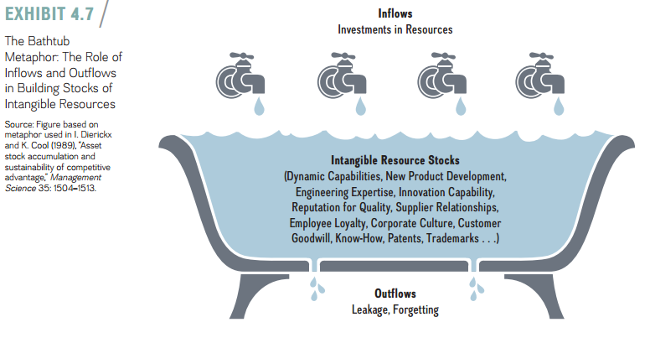

Slide 32
Lecture 4
Internal Analysis: Resources,
Capabilities, and Core Competencies
4.4 The Value Chain Analysis
The value chain describes the internal activities a firm engages in when transforming inputs into outputs. Each activity the firm performs along the horizontal chain adds incremental value—raw materials and other inputs are transformed into components that are assembled into finished products or services for the end consumer. Each activity the firm performs along the value chain also adds incremental costs.

Slide 33
Lecture 4
Internal Analysis: Resources,
Capabilities, and Core Competencies
A careful analysis of the value chain allows managers to obtain a more detailed and fine-grained understanding of how the firm’s economic value creation(V − C) breaks down into a distinct set of activities that help determine perceived value (V) and the costs (C) to create it. The value chain concept can be applied to basically any firm, from those in manufacturing industries to those in high-tech ones or service firms.

Slide 34
Lecture 4
Internal Analysis: Resources,
Capabilities, and Core Competencies
As shown in Exhibit 4.8, the value chain is divided into primary and support activities. The primary activities add value directly as the firm transforms inputs into outputs—from raw materials through production phases to sales and marketing and finally customer service, specifically
■ Supply chain management.
■ Operations.
■ Distribution.
■ Marketing and sales.
■ After-sales service.

Slide 35
Lecture 4
Internal Analysis: Resources,
Capabilities, and Core Competencies
Other activities, called support activities, add value indirectly. These activities include
■ Research and development (R&D).
■ Information systems.
■ Human resources.
■ Accounting and finance.
■ Firm infrastructure including processes, policies, and procedures.

Slide 36
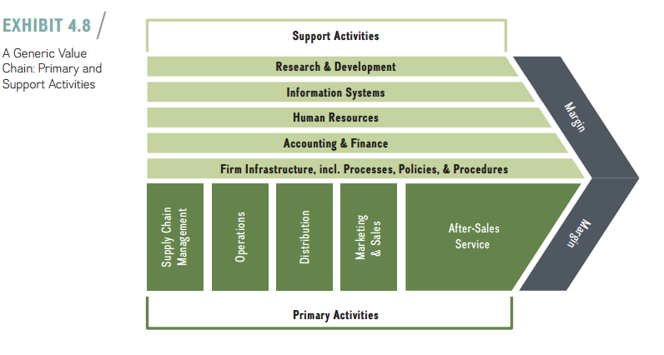

Slide 37
Lecture 4
Internal Analysis: Resources,
Capabilities, and Core Competencies
4.5 Implications for the Strategist
We’ve now reached a significant point: We can combine external analysis from Chapter 3 with the internal analysis just introduced. Together the two allow you to begin formulating a strategy that matches your firm’s internal resources and capabilities to the demands of the external industry environment. Ideally, managers want to leverage their firm’s internal strengths to exploit external opportunities, while mitigating internal weaknesses and external threats. Both types of analysis in tandem allow managers to formulate a strategy that is tailored to their company, creating a unique fit between the company’s internal resources and the external environment.

Slide 38
Lecture 4
Internal Analysis: Resources,
Capabilities, and Core Competencies
Using SWOT analysis to generate Insights From external and internal analysis
We synthesize insights from an internal analysis of the company’s strengths and weaknesses with those from an analysis of external opportunities and threats using the SWOT analysis. Internal strengths (S) and weaknesses (W) concern resources, capabilities, and competencies. Whether they are strengths or weaknesses can be determined by applying the VRIO framework. A resource is a weakness if it is not valuable. In this case, the resource does not allow the firm to exploit an external opportunity or offset an external threat. A resource, however, is a strength and a core competency if it is valuable, rare, costly to imitate, and the firm is organized to capture at least part of the economic value created.

Slide 39
Lecture 4
Internal Analysis: Resources,
Capabilities, and Core Competencies
External opportunities (O) and threats (T) are in the firm’s general environment and can be captured by PESTEL and Porter’s five forces analyses (discussed in the previous chapter). An attractive industry as determined by Porter’s five forces, for example, presents an external opportunity for firms not yet active in this industry. On the other hand, stricter regulation for financial institutions, for example, might represent an external threat to banks.

Slide 40
Lecture 4
Internal Analysis: Resources,
Capabilities, and Core Competencies
In a first step, managers gather information for a SWOT analysis in order to link internal factors (Strengths and Weaknesses)to external factors (Opportunities and Threats).Next, managers use the SWOT matrix shown in Exhibit 4.9 to develop strategic alternatives for the firm using a four-step process:
1. Focus on the Strengths–Opportunities quadrant (top left) to derive “offensive” alternatives by using an internal strength in order to exploit an external opportunity.
2. Focus on the Weaknesses–Threats quadrant (bottom right) to derive “defensive” alter-natives by eliminating or minimizing an internal weakness in order to mitigate an external threat.

Slide 41
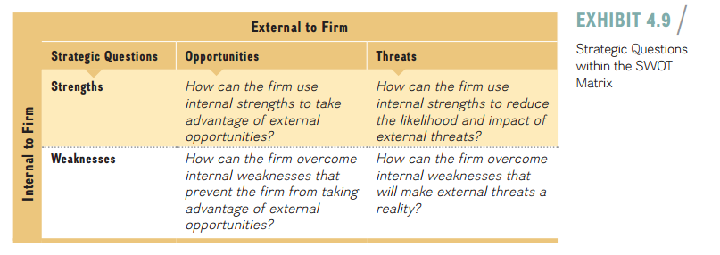

Slide 42
Lecture 4
Internal Analysis: Resources,
Capabilities, and Core Competencies
3. Focus on the Strengths–Threats quadrant (top right) to use an internal strength to minimize the effect of an external threat.
4. Focus on the Weaknesses–Opportunities quadrant (bottom left) to shore up an internal weakness to improve its ability to take advantage of an external opportunity.
In a final step, the strategist needs to carefully evaluate the pros and cons of each strategic alternative to select one or more alternatives to implement. Managers need to carefully explain their decision rationale, including why other strategic alternatives were rejected.

Slide 43
Lecture 4
Internal Analysis: Resources,
Capabilities, and Core Competencies
References:
Strategic management, third edition, 2017
By Frank t. Rothaermel
Georgia Institute of Technology
Chapter 4

