Slide 1

Risk Management
Prepared by Dr. Nael Zabel
Lecture 6
MGM 510
Risk Management

Slide 2

Lecture 6
Topics to Cover in Week 6
Risk management standards
Scope of risk management standards
IRM Standard
COSO ERM Framework
ISO 31000 Standard
Risk management context

Slide 3
Lecture 6
Risk management standards
There are a number of established risk management standards and frameworks.
The first was developed by the standards body in Australia in 1995, and has been followed by those being developed in Canada, Japan, the UK and the United States.
Standards have also been developed by other national standards bodies, as well as by government departments across the world.

Slide 4
Lecture 6
Scope of risk management standards
The international standard ISO 31000 (2009), ‘Risk Management: Principles and Guidelines’, was published in the latter part of 2009.
Although some standards are better recognized than others, organizations should select the approach that is most
relevant to their particular circumstances.

Slide 5
Lecture 6
scope of risk management standards
It is important to distinguish between a risk management standard and a risk management framework.
A risk management standard sets out the overall approach
to the successful management of risk, including a description of the risk management process, together with the suggested framework that supports that process.

Slide 6
Lecture 6
scope of risk management standards
In simple terms, a risk management standard is the combination of a description of the risk management process, together with the recommended framework.

Slide 7
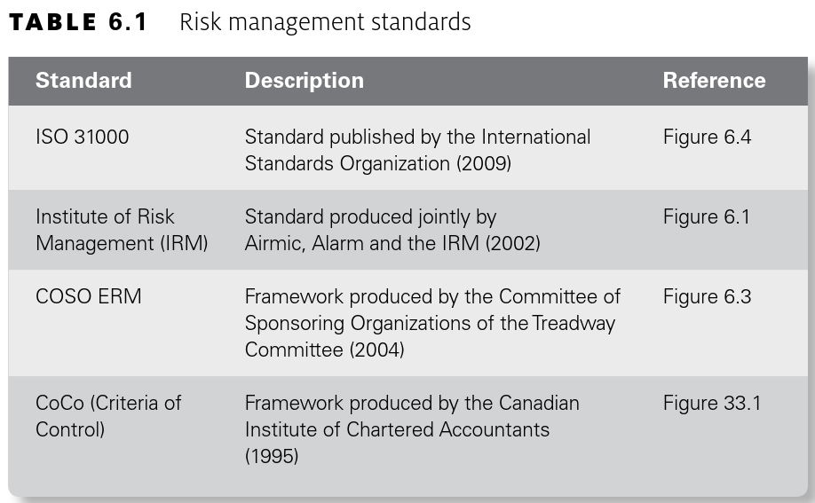
Lecture 6
Risk management standards

Slide 8
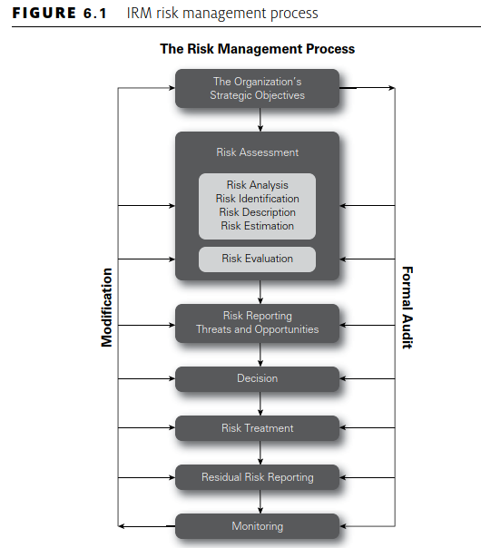
Lecture 6
IRM Standard
One of the best-established and most widely used risk management standards was produced by the IRM in 2002 in co-operation with Airmic and Alarm. The IRM Standard is a high-level approach aimed at non-risk-management specialists

Slide 9
Lecture 6
Risk management process
Although there are many ways of representing the risk management process, the basic steps are all similar. There can be difficulties with the terminology that is used to describe the various steps

Slide 10
Lecture 6
Risk management context
In order for the context to be described and defined, a framework is required to implement and support the risk
management process.
ISO 31000 places particular emphasis on context and states
that consideration should be given to the internal context, external context and risk management context when undertaking risk management activities.

Slide 11
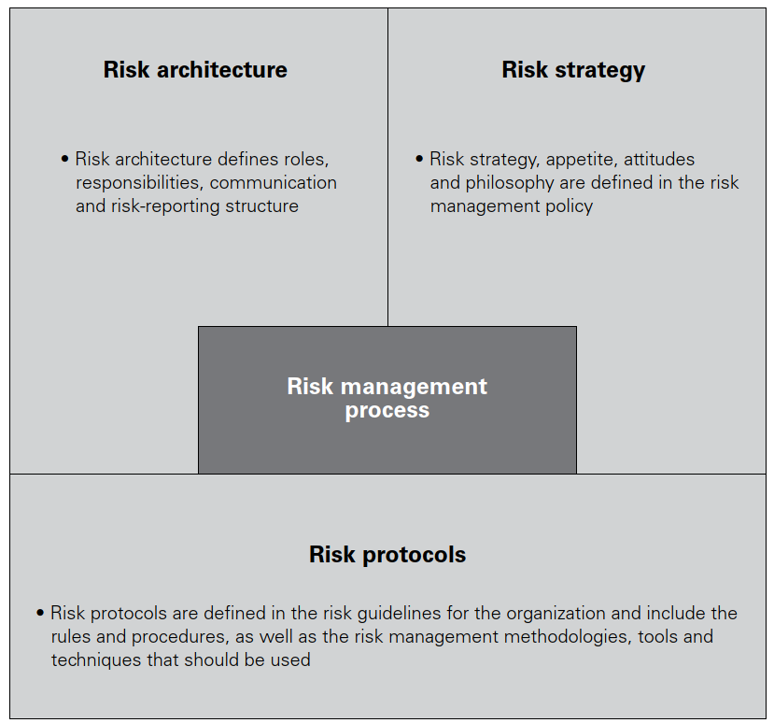
Lecture 6
Components of the RM context

Slide 12
Lecture 6
Risk management context
These three components of risk architecture, strategy
and protocols are required for successful risk management activities.
There needs to be a clear understanding of the risk management process, followed by a clear definition of the framework that supports the process.

Slide 13
Lecture 6
Risk management framework
In implementing and supporting the risk management process, the risk management framework needs to facilitate communication and the flow of risk information.
The risk management framework has two separate considerations.

Slide 14
Lecture 6
Risk management framework
Firstly, it must be supportive of the risk management process and, secondly, it must ensure that the outputs from the process are communicated into the organization and achieve the anticipated benefits for the organization. If an organization decides to follow the structure of the IRM Risk Management Standard, it would then have to set up a framework that includes the structure, responsibilities, administration, reporting
and communication components of risk management.

Slide 15
Lecture 6
Coso ERM cube
In the COSO ERM framework, there is a direct relationship between objectives, which are what an entity strives to achieve, and enterprise risk management components, which represent what is needed to achieve them. The relationship is depicted in a three-dimensional matrix, in the form of a cube, and this is reproduced as Figure 6.3.

Slide 16
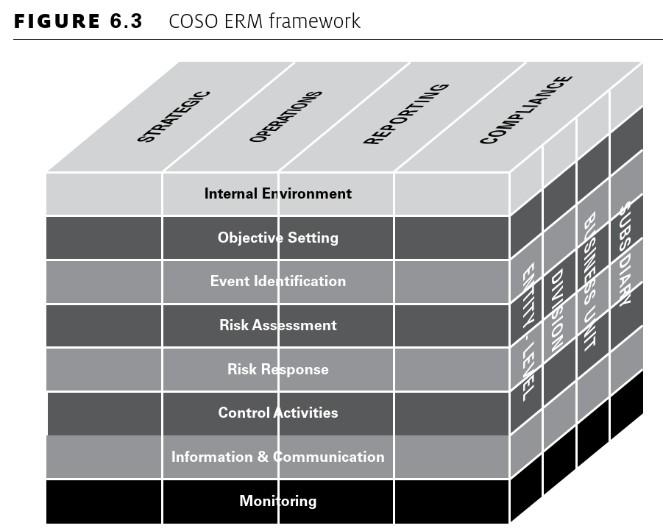
Lecture 6
Coso ERM Framework

Slide 17
Lecture 6
Coso ERM cube
The COSO ERM cube is a very influential risk management framework and it consists of eight interrelated components. These are derived from the way management runs an enterprise and are integrated with the management process. A brief
description of the COSO ERM components is set out in Table 6.2.

Slide 18
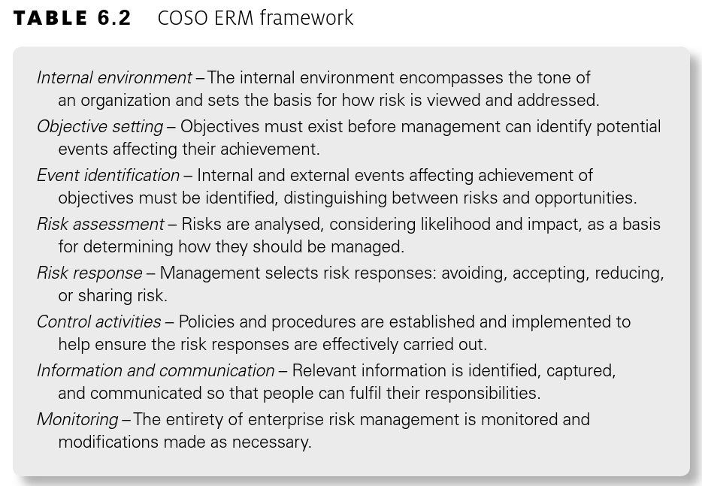
Lecture 6
Coso ERM cube

Slide 19
Lecture 6
Coso ERM cube
This enterprise risk management framework is geared toموجهة نحو achieving corporate objectives, set out in four risk categories:
  ●● strategic: high-level goals, aligned with and supporting its mission;
  ●● operations: effective and efficient use of its resources;
  ●● reporting: reliability of reporting;
  ●● compliance: compliance with applicable laws and regulations.

Slide 20
Lecture 6
ISO 31000
The International Standards Organization (ISO) published ISO 31000 entitled ‘Risk Management: Principles and Guidelines’ in the latter part of 2009. The diagram used to illustrate the risk management process in ISO 31000 is reproduced in
Figure 6.4.

Slide 21
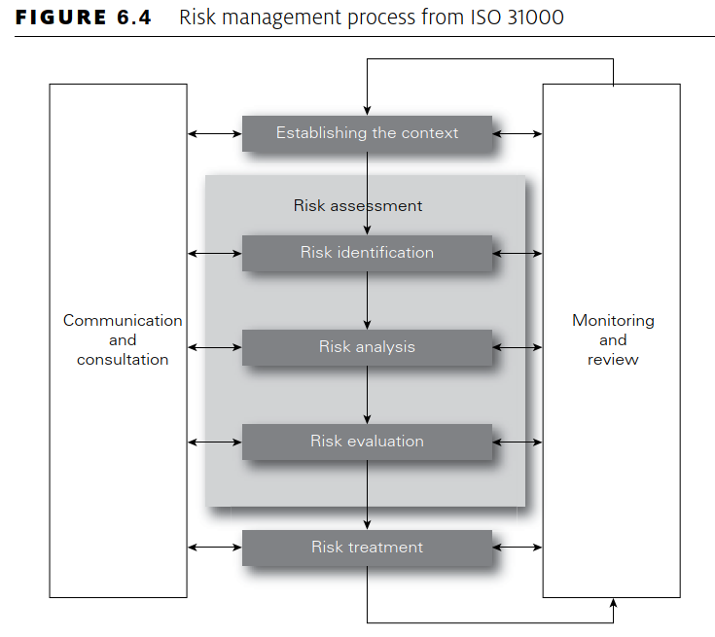
Lecture 6
ISO 31000

Slide 22
Lecture 6
risk management standards selecting
The challenge for standards organizations is to ensure that the risk management standards they publish are relevant to the future success of the organization.
COSO has taken the approach, in updating the COSO ERM framework, that greater consideration should be paid to stakeholder expectations and the relationship between risk and strategy.

Slide 23
Lecture 6
COSO
In particular, the COSO consultation document suggests that organizations that integrate enterprise risk management into strategic planning can obtain a range of benefits including:
  ●● increasing range of opportunities by considering both positive and negative aspects of risk;
  ●● improving performance by identifying and managing risk on an entity-wide basis;

Slide 24
Lecture 6
COSO
  ●● reducing negative surprises, increasing gain and profiting from advantageous developments;
  ●● reducing performance variability تقلبby taking actions to minimize disruption;
  ●● improving resource deployment and achieving enhanced resource allocation.

Slide 25
Lecture 6
scope of the context
  The three components of context may be considered as follows:
  ●● Risk management context has already been described as the risk architecture, strategy and protocols or the risk management framework within the organization. This framework must fulfil two functions:
  provide support for the risk management process within the organization; and
  ensure that the outputs from the risk management process are communicated to internal and external stakeholders.

Slide 26
Lecture 6
scope of the context
  ●● Internal context refers to the organization itself, the activities it undertakes, the range of skills and capabilities available within the organization, and how it is structured. Internal stakeholders and their expectations are part of the internal context. This may be considered to be the strengths and weaknesses within the organization.

Slide 27
Lecture 6
scope of the context
  ●● External context is the environment within which the organization exists.
  This environment will include consideration of the business sector within which the organization operates, external stakeholders and their expectations and the external financial environment. This may be considered to be the opportunities and threats facing the organization.

Slide 28
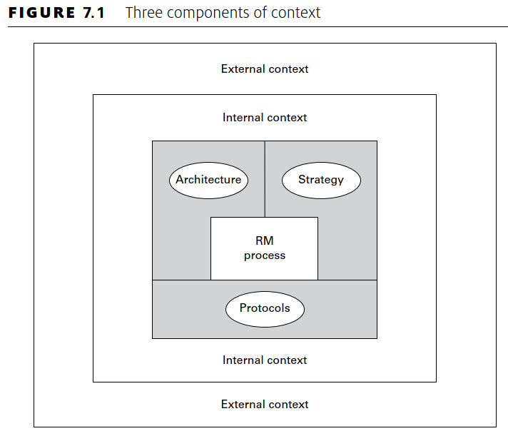
Lecture 6
scope of the context

Slide 29
Lecture 6
External context
  In summary, the reputational component of the external context for an organization defines the external perception إدراكof the organization and the desire الرغبه of customers to trade with the
  organization and the level of customer retention

Slide 30
Lecture 6
External context
  In particular, when evaluating the reputational component of the external context, the following issues should be addressed:
  ●● public perception of the industry sector in which the organization operates;
  ●● corporate social responsibility standards achieved by the organization;
  ●● governance standards and whether the sector is highly regulated;
  ●● quality of products or services and/or after-sales service standards.

Slide 31
Lecture 6
External context
  In particular, when evaluating the marketplace component of the external environment, the following issues should be addressed:
  ●● level of revenue generation in the marketplace and return on investment;
  ●● presence of aggressive competitors and/or high customer expectations;

Slide 32
Lecture 6
External context
  ●● level of economic stability, including exposure to interest rates and foreign exchange rates;
  ●● complexity of the supply chain and volatility of raw material costs;
  ●● exposure to international disruption because of political risks, war and terrorism.

Slide 33
Lecture 6
Internal context
  In summary, the financial component of the internal context of an organization defines the financial procedures and the means by which money is managed and profitability is achieved.
  In particular, when evaluating the financial component of the internal context, the following issues should be addressed:
  ●● availability of adequate funds to fulfil strategic plans;

Slide 34
Lecture 6
Internal context
  ●● existence of robust procedures for correct allocation of funds for investment;
  ●● nature of internal financial control environment to prevent fraud;
  ●● availability of funds to meet historical and anticipated مرتقبfuture liabilities.

Slide 35
Lecture 6
Internal context
  In particular, when evaluating the infrastructure component of the internal context, the following issues should be addressed:
  ●● senior management structure and the nature of the risk culture;
  ●● availability of adequate people resources and people skills, including intellectual propertyالملكية الفكرية;
  ●● availability of adequate physical assets to support operational activities;

Slide 36
Lecture 6
Internal context
  ●● information technology infrastructure sufficient to achieve resilience and protect data;
  ●● business continuity plans in place to ensure continuity of activities following major disruption;
  ●● arrangements for service delivery and/or transportation and reliable communication infrastructure.

Slide 37
Lecture 6
Thank You

