Slide 1
Introduction to economics
Chapter 1
Chapter 1:
The challenge of economics
Prepared by
Dr Myriam ZORGUI

Slide 2


Slide 3

Course objectives
On completion of the course, you will have the ability to:
Define the concepts of Economics and Economics Education
Discuss the importance of teaching Economics
Analyze the challenges of teaching Economics

Slide 4
Syllabus :
The challenge of economics
Definition & Scope of Economics
The Economic Agents
Summary
The Foundation of Economics

Slide 5
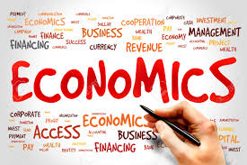
I- Definition & Scope of Economics
I-1- Some definitions of Economics
I-2- Nature of Economics
I-3- The top 4 definitions
I-4- The scope of Economics
I-4-1- The fields of Economics
I-4-2- The branches of Economics
I-4-3- Problem-Solving Approaches towards Economy

Slide 6
I-1. Definitions of Economics
Economics is essentially a study of the usage of resources under specific constraints, all bound with an audacious hope that the subject under scrutiny is a rational entity which seeks to improve its overall well-being.
Economics is the study of how individuals and societies choose to allocate scarce resources, why they choose to allocate them that way, and the consequences of those decisions.

Slide 7
I-2- Nature of Economics -1-
The nature of economics refers to whether economics is a science or art or both, and if it is a science, whether it is positive science or normative science or both.
Science: any system of knowledge that is concerned with the physical world and its phenomena and that entails unbiased observations and systematic experimentation.
Art: expression or application of human creative skill and imagination

Slide 8

I-2- Nature of Economics -2-
Economics as an Art of teaching
Economics is an art that teaches us how to practically implement the laws of nature for the economic well-being of humans and its dependents. Economics tells us how to get out of the problem by implementing the science of Economics. Economics is purely a problem-based subject, be it personal or collective problems.
Economics as a base to Identify Problems
Economics is based on identifying the problem and means to solve it; it can be positive or normative science of business
Economics is both science as well as an art

Slide 9
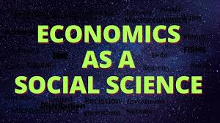

I-2- Nature of Economics -3-
Economics as Science
Economics as Social Sciences
Samuelson says that Economics is
“the queen of the social sciences”.

Slide 10
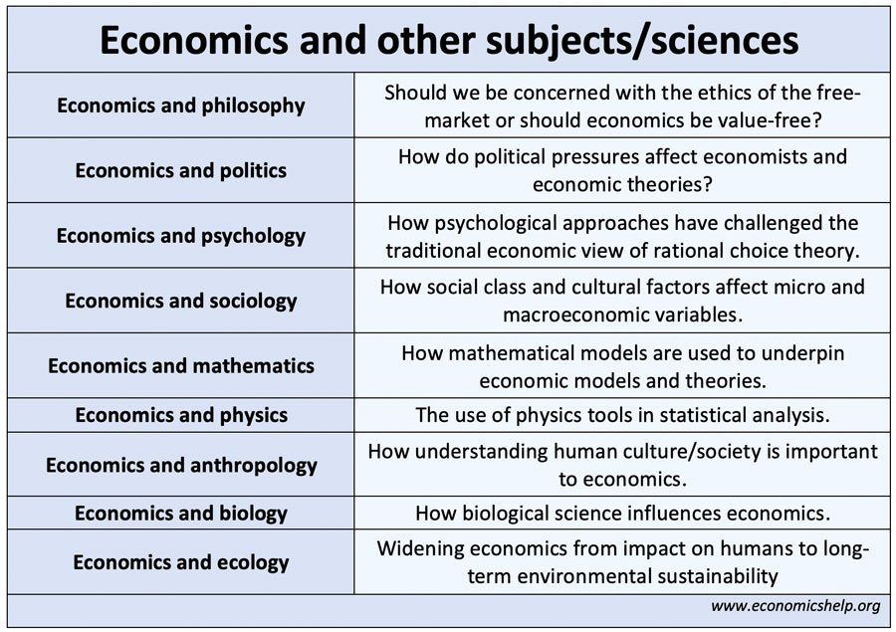

Slide 11
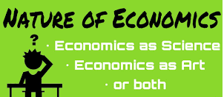
I-2- Nature of Economics -4-
« Economics is not an exact science. It's a combination of an art and elements of science. And that's almost the first and last lesson to be learned about economics: that in my judgment, we are not converging toward exactitude, but we're improving our data bases and our ways of reasoning about them. »
Paul SAMUELSON

Slide 12
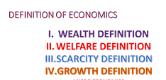
I-3- The Top 4 Definitions -1-
Four definitions, each referring to particular stage of the
growth of the subject of Economics, are presented here.
They are:
a- Smith’s Wealth Definition
b- Marshall’s Welfare Definition
c- Robbins’ Scarcity Definition
d- Samuelson’s Growth Definition

Slide 13
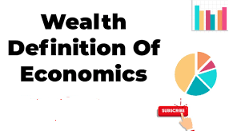

I-3- The Top 4 Definitions -2-
a- Wealth Definition of Adam Smith, the father of Economics (the Classical era)
“Economics as a science which inquired into the nature and cause of wealth of Nations”.
b- Welfare definition of Alfred Marshall (the Neo-Classical era):
“Economics is the study of man in the ordinary business of life”.

Slide 14

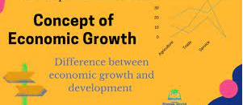
I-3- The Top 4 Definitions -3-
C- Scarcity Definition of Lionel Robbins (the New Age):
« Economics is a science which studies human behaviour as a relationship between ends and scarce means which have alternative uses ».
d- Growth Definition of Samuelson (the Modern Age):
Economics is « the study of how men and society choose,with or without the use of money, to employ scarce productive resources which could have alternative uses,to produce various commodities over time, and distribute them for consumption, now and in the future among various people and groups of society ».

Slide 15
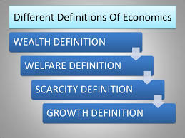

Slide 16

I-4- The Scope of Economics
The scope of economics: It’s the boundary in which the field of study is contained.
It is a science of human activities in day-to-day businesses
It is considered an art of persuasion and dealings to buy or sell anything
Economy is the only subject that’s considered a science and art together

Slide 17
I-4-1- - The Fields of Economics
Behavioural Economics
Ecological Economics
Environmental Economics
Health Economics
Information Economics
International Economics
Labour Economics
Monetary Economics
Population Economics
Public Finance
Urban Economics

Slide 18
I-4-2- The Branches of Economics
Economics is divided into two different branches: Microeconomics and Macroeconomics.
Microeconomics is the study of individuals and business decisions
Macroeconomics looks at the decisions of countries and governments.

Slide 19
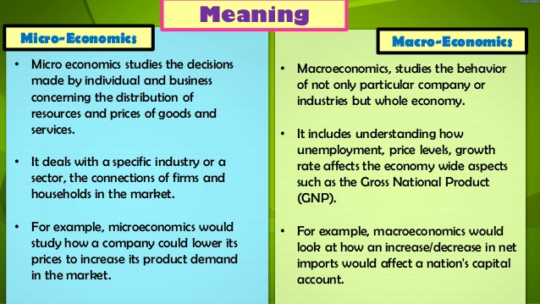

Slide 20
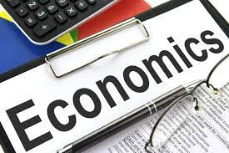
I-4-3- Problem-Solving Approaches towards Economy
Economics is studied by two problem-solving approaches:
The traditional approach is carried through the five basic principles of Consumption, production, exchange, distribution and public finance.
The modern approach is sub-divided into microeconomics and macroeconomics.

Slide 21
II-The Foundation of Economics
II-1- General problems of Economics
II-2- The Scarcity
II-3- 10 principles of Economics
II-4- The factors of Production
II-4-1-The Inputs
II-4-2- Goods & Services

Slide 22
II-The Foundation of Economics
Society has virtually unlimited wants...but limited or scarce resources!!!
There will always be a demand for NEEDS and WANTS.
Needs = required for survival
Wants = make life more comfortable and enjoyable

Slide 23
II-1- Central Problem of all Economies
In case of any economy, whatever the economy required cannot be satisfied fully.
• Economic resources or means of production are limited and they can be put to alternative uses.
• Every economy faces some common problems.

Slide 24
II-2- The Scarcity
Scarcity is one of the key concepts of economics.
It means that the demand for a good or service is greater than the availability of the good or service.
Scarcity can limit the choices available to the consumers who ultimately make up the economy.

Slide 25
II-3 - 10 Principles of Economics -1-
Gregory Mankiw in his Principles of Economics outlines
10 Principles of Economics that we will replicate here,
they are:
1- People face trade-offs
2- The cost of something is what you give up to get it
3- Rational people think at the margin
4- People respond to incentives
5- Trade can make everyone better off
Notes:
Nicholas Gregory Mankiw ( born February 3, 1958) is an American macroeconomist who is currently the Robert M. Beren Professor of Economics at Harvard University. Mankiw is best known in academia for his work on New Keynesian economics.

Slide 26
II-3 - 10 Principles of Economics -2-
6- Markets are usually a good way to organize economic activity
7- Governments can sometimes improve market outcomes
8- A country's standard of living depends on its ability to produce goods and services
9- Prices rise when the government prints too much money
10- Society faces a short-run tradeoff between Inflation and unemployment.

Slide 27
II-4- The Factors of Production
The factors of production are resources that are the building blocks of the economy.
They are what people use to produce goods and services.
The factors of production or resources are the Inputs.
The products are the Outputs.

Slide 28
II-4-1- The Inputs
Economists divide the factors of production into four categories:
  land
  Labor
  capital
  entrepreneurship

Slide 29
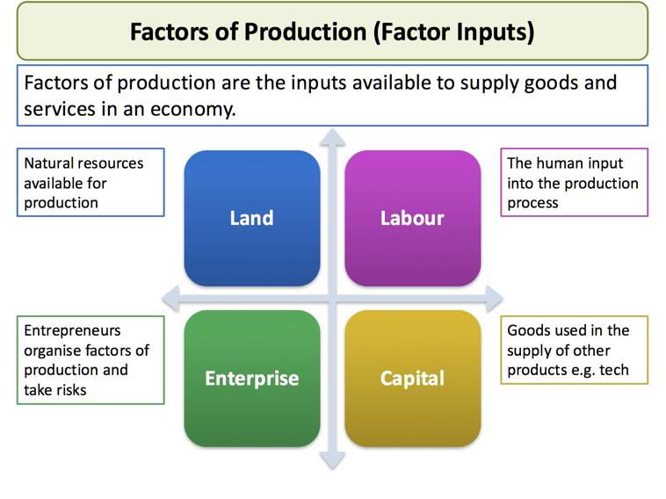

Slide 30
II-4-2- GOODS & SERVICES
In each Economy, we find GOODS and SERVICES.
They are called PRODUCTS.
The prices of products are largely determined by the supply and demand of an economy.
    What’s the difference between them?
    What do they provide?

Slide 31
II-3-2- A- Services
Services are the non-physical, intangible parts of our economy, as opposed to goods.
A Service is a transaction in which no physical goods are transferred from the seller to the buyer.

Slide 32
II-3-2- B- GOODS-1
Goods are material, physical, tangible items that you can purchase.
They are items that we can touch or handle
There are 4 types of goods: private goods, common goods, club goods, and public goods.
They vary in their level of exclusivity; that is, how many people can enjoy them.

Slide 33
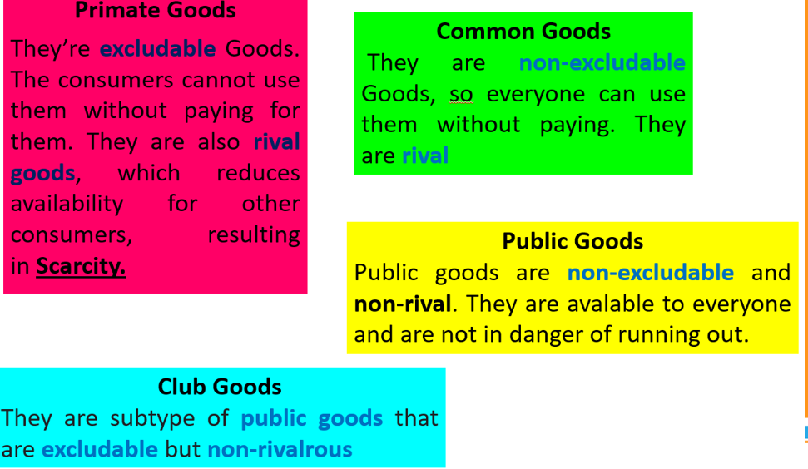

II-4-2- B- GOODS - 2

Slide 34
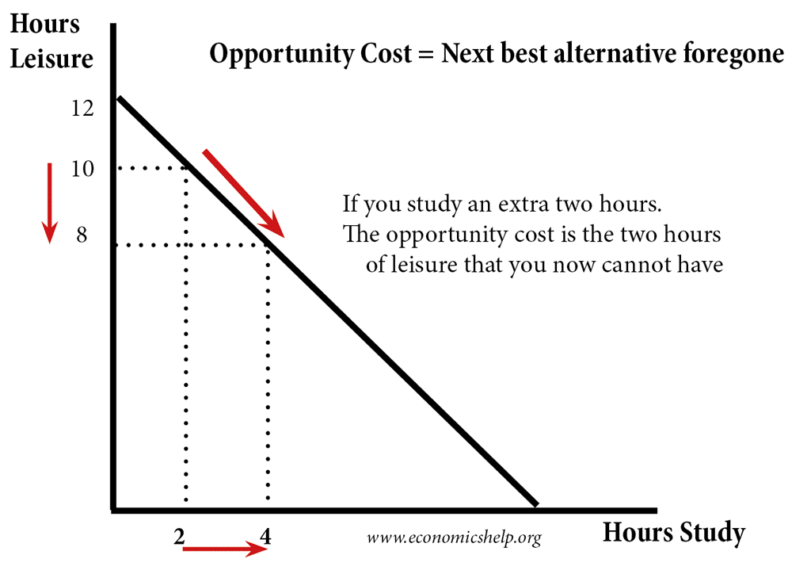
Opportunity cost
Opportunity cost is the next best alternative
foregone.
If you decide to spend two hours studying
on a Friday night, The opportunity cost is that
you cannot have those two hours for leisure.

Slide 35

II-3-2- B-GOODS -3
We can also classify them according to if they’re free or economic Goods.
Free Goods | Economic Goods
A free good is a good with zero opportunity cost. This means it can be consumed in as much quantity as needed without reducing its availability to others. | An economic good is a good that has a benefit (utility) to society. Also, economic goods have a degree of scarcity and therefore an opportunity cost

Slide 36
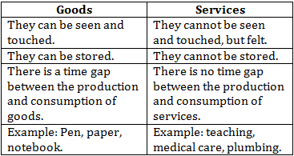

Goods / Services

Slide 37
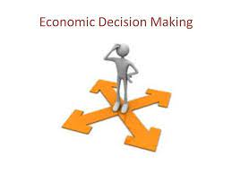
III- Economic Agents
III-1- The economic decison-makers
III-1-1- The Households
III-1-2- The Firms
III-1-3- The Governments
III-1-4- The « Rest of the World »
III-2- Consumers Vs Producers

Slide 38

III- The Economic actors
Who makes decisions in the economy ?
4 (broadly defined) economic actors exist in each economy. They’re its actors.
Each one of these actors has a specific role.
They are interdependent

Slide 39
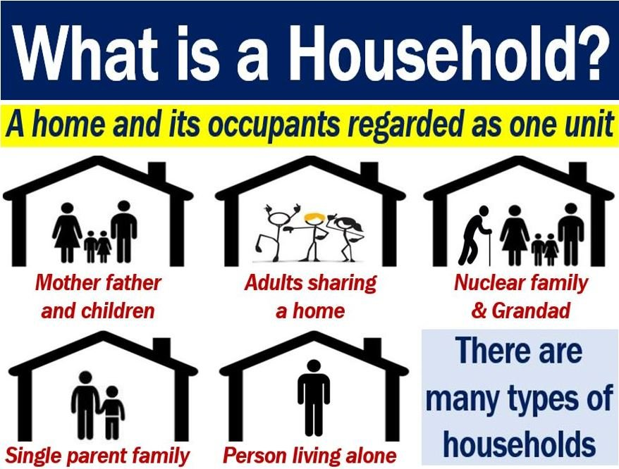
IV-1- Economic Decision Makers -1-
1. Households: All those people living under one roof are considered a household.
Households do two fundamental things vital to the economy:
Demand goods and services from product markets
Supply labor, capital, land, and entrepreneurial ability to resource markets.

Slide 40
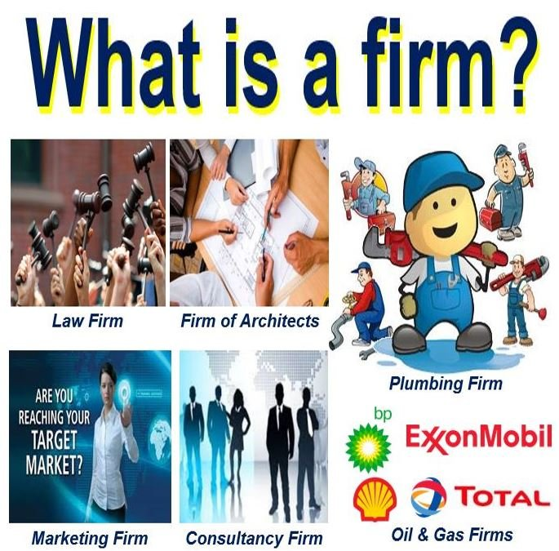
III-1- Economic Decision Makers -2-
2. Firms:
They’re Economic units, formed by profit-seeking entrepreneurs who employ resources to produce goods and services for sale.

Slide 41

IV-1- Economic Decision Makers -3-
3. Governments
a. Establish and Enforcing the Rules of the Game.
b. Promote Competition
c. Regulate Natural Monopolies
d. Produce public goods (goods that, once produced, are available for everyone to consume, regardless of who pays and who doesn't)

Slide 42

III-1- Economic Decision Makers -4-
4. "The Rest of the World"
Rest of World means all countries of the world outside the Territory.

Slide 43
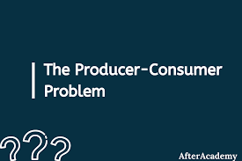
III- 2- Consumers / Producers -1-
A- The Households will be what we call Consumers.
A consumer is a person who buys and uses goods and services
Households are rational utility maximizers.
Economists assume that individuals, and thus households, attempt to maximize their utility.

Slide 44
III- 2- Consumers / Producers -2-
B- The firms are the producers
Producers make the goods and services that are sold in the economy.
They also provide jobs for people who make the products or who provide the services.
Producers include businesses, the government, and individuals.

Slide 45
III- 2- Consumers / Producers -3-
One of the hypotheses of Economics is that each Consumer and Producer is rational. They would not make choices that would make them worse off: they are rational.
Rationality
The decion-makers (customers and firms especially) act in their own best interest
Customer’s own goal
Producer’s own goal

Slide 46
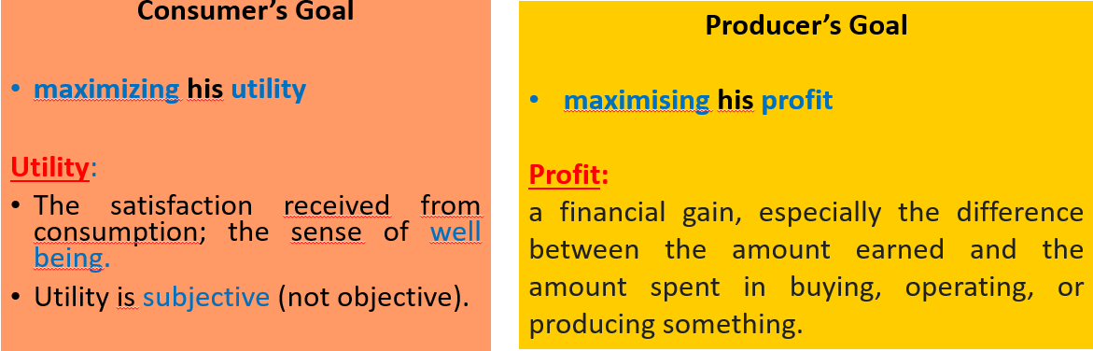
III- 2- Consumers / Producers -4-

Slide 47


Slide 48
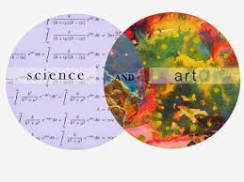
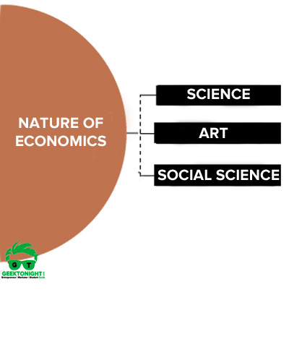
The nature of Economics -1-

Slide 49
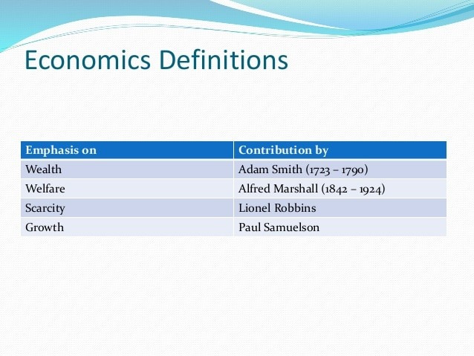
The top 4 definitions of Economics -2-

Slide 50
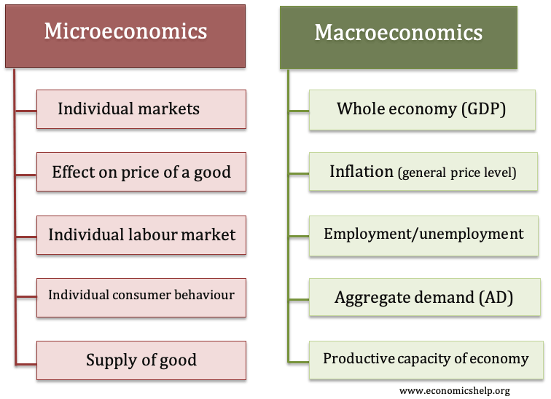
The 2 branches of Economics -3-

Slide 51
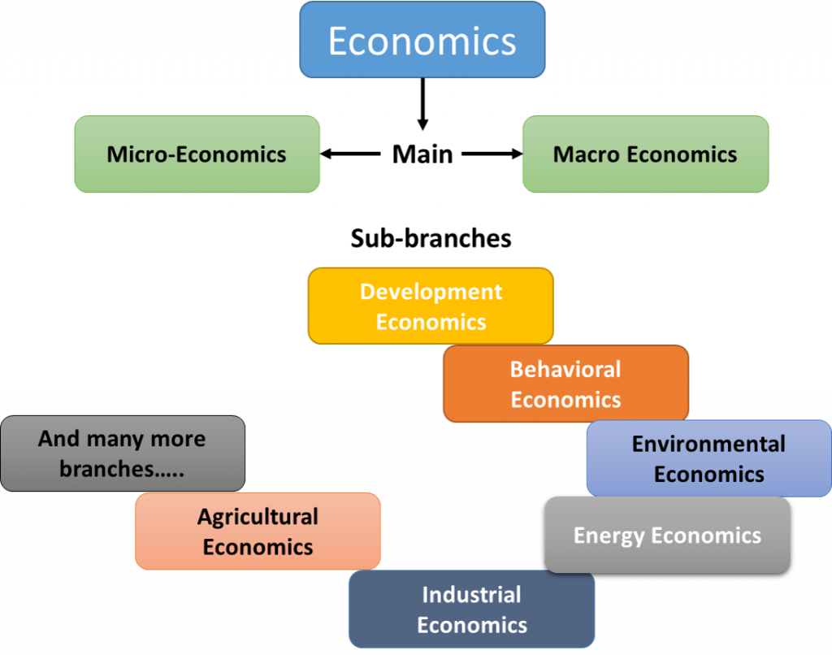
The fields of Economics -4-

Slide 52
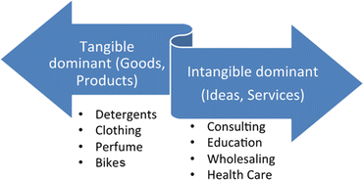
Goods & Services -5-

Slide 53
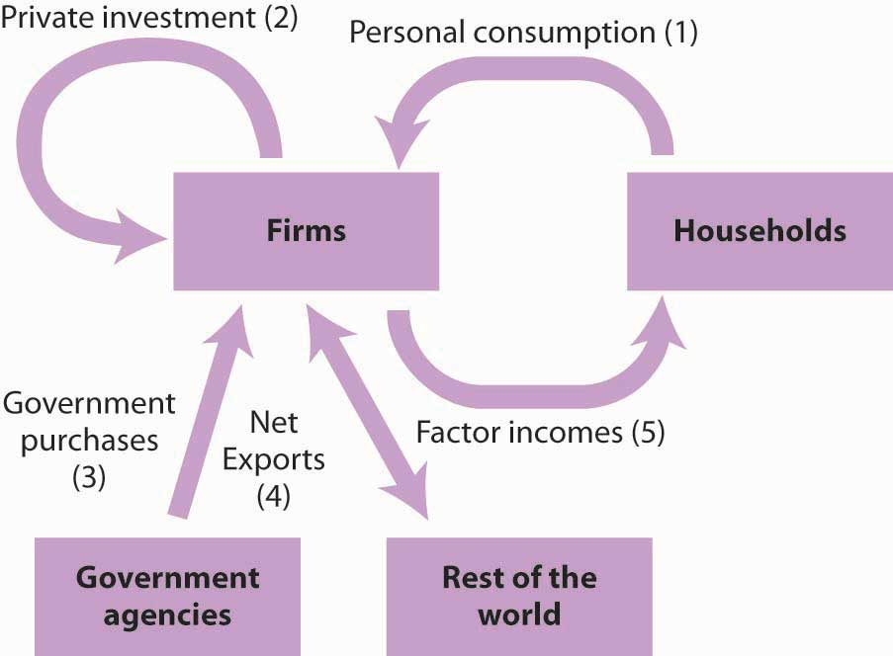
Economic Agents -6-

Slide 54
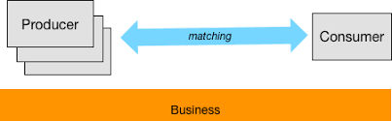
Consumer Vs Producer -7-

Slide 55
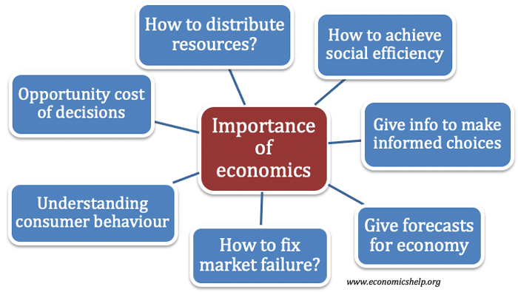
Importance of Economics -8-

Slide 56


