Slide 1



Orientation show
عرض توجيهي
IT Forensics
Master of Science in
cy Cybersecurity
Dr. Nermin Hamza Ewais

Slide 2

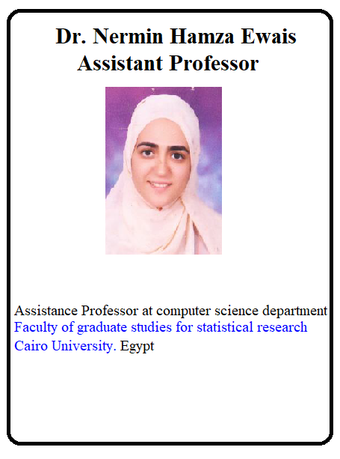

Who Am I?
Dr. Nermin Hamza Ewais
  Assistant Professor in computer science
    Ph.D from Cairo University 2010
    PHD Thesis: “A novel security system for computer networks”
    M.Sc from Cairo University, 2005
    B.Sc from Cairo University , 2000

Slide 3
Who Am I?
  Work.
    Cairo University – King Abdulaziz University
  Training.
    CEH – CHFI- Academic Courses
  Office hours
  Discussion Time (Tuesday at 9:00 PM) every day
  How to reach me
    By email at hamza@midocean.ae
    ( please include “IT Forensic” in subject line)

Slide 4

The course that will be taught
IT forensics

Slide 5
IT forensics
This course is designed to provide a basic foundation in the field of digital forensic for students in the science of crime scene investigation.
The student will gain experience in the use of various analytical methods that are used to analyze digital evidence during criminal investigations.

Slide 6
Primary Goal of This Course
Learning Outcomes:
  • Understand what is digital forensic and its important
  • Explain the process of digital forensics analysis
  • Gain an understanding of the tradeoffs and differences between various digital forensic tools
  • Understand the workings of file systems and operating system
  • Create disk images, recover deleted files, and extract hidden information
  • Write the final report.

Slide 7
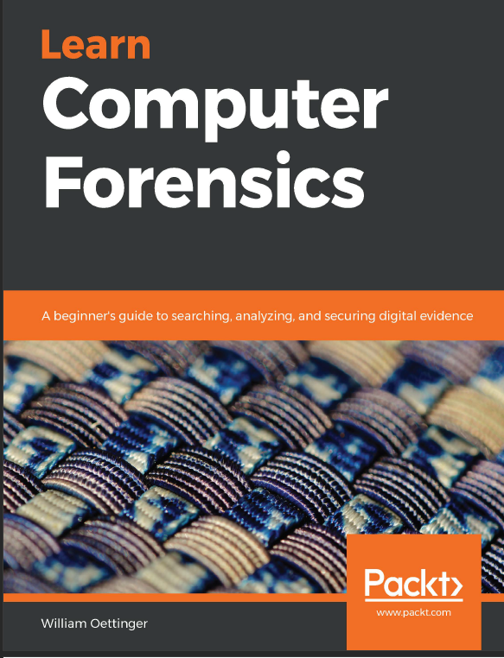

Learning Resources:
Credit Hours:
3 credit hours.
  Required Textbook:
  Learn Computer Forensics , William Oettinger ,2020 Packt Publishing
  Guide to Computer Forensics and Investigations: Processing Digital Evidence 6th Edition Bill Nelson , Amelia Phillips and Christopher Steuart Cengage Learning, Inc 2019

Slide 8
Units of Course Contents
  Lecture Structure:
Module | Course Unit | No.of. Weeks | Contact Hours
1 | Lecture1 Introduction to IT Forensics | 1st | 3
2 | Lecture2 The Forensic Analysis Process | 2nd | 3
3 | Lecture3 Acquisition of Evidence | 3 | 3
4 | Lecture4 Computer System | 4 | 3
5 | Lecture5 Operating systems | 5 | 3
6 | Lecture6 Memory | 6 | 3
7 | Lecture7 Network and E-mail | 7 | 3
8 | Lecture8 Database | 8 | 3
9 | Lecture9 Cloud ,Web and Mobile | 9 | 3
10 | Lecture10 Reporting | 10 | 3

Slide 9

Course Information
  Assessment Method:
Short Exam
  80% marks
    Count of short Exam 10 (Weekly)
    8 Marks for each of short Exam.
  20% Final Examination

Slide 10
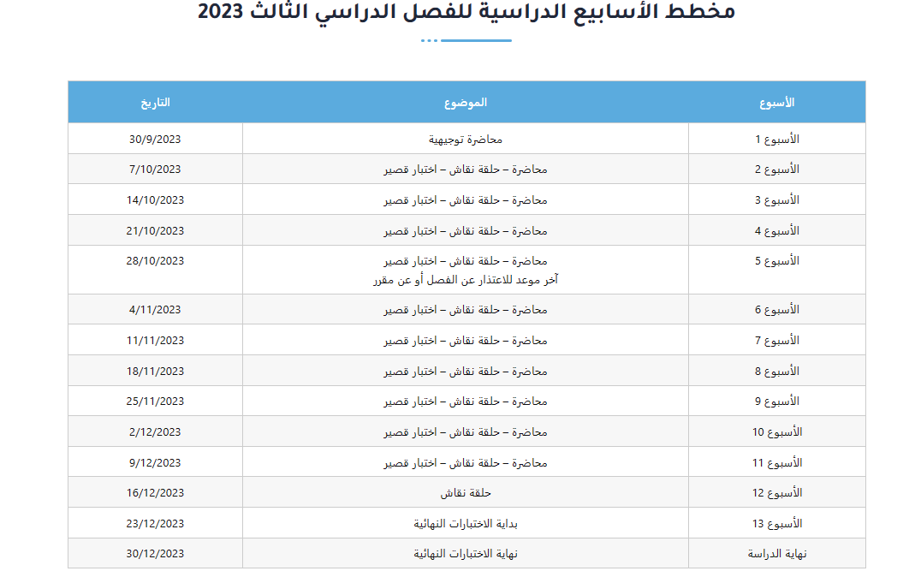
Academic Calendar
-- اللغة الأساسية في المحاضرات هي:
اللغة الإنجليزية
-- الاختبارات باللغة الإنجليزية مع وجود
ترجمة للسؤال.

Slide 11


