Slide 1


Prepared by Dr. Wesam Ahmed
IT402
Internet of Things
Lecture 5

Slide 2



IoT Networking Protocols
Lecture 5
IT402‎
Internet of Things
Prepared by
Dr. Wesam Ahmed

Slide 3

04
Learning Objectives:
1.1 Big data analytics
1.2 Explain the Iot and Big Data use cases
1.3 IoT networking

Slide 4
05
Iot and Big Data use cases
Understand the Importance of Business Intelligence
There are many use cases of IoT and Big Data such as smart home automation, Industrial IoT (IIoT), smart cities, healthcare monitoring, supply chain optimization, precision agriculture, energy management, transportation and fleet management, retail analytics, environmental monitoring, and so on.
IoT devices such as smart thermostats, smart lighting systems, and connected appliances collect data on energy usage, occupancy patterns, and user preferences. This data, when combined with Big Data analytics, enables homeowners to optimize energy consumption, automate routine tasks, and enhance home security.
Big Data analytics applied to this data can enable predictive maintenance, optimize production processes, and improve overall operational efficiency.

Slide 5
05
Iot and Big Data use cases
Smart Home Automation :
Deployment: IoT devices such as smart thermostats, smart lighting systems, and connected appliances (like smart refrigerators, washing machines, and ovens) are installed in homes. These devices are connected to a central hub or a cloud-based platform that collects data from the devices.
Data Collection: The IoT devices collect data on energy consumption, occupancy patterns (motion sensors or cameras detect when people are home or in a specific room), and user preferences (temperature settings, lighting brightness). This data is transmitted to the central hub (such as Amazon Echo) or cloud platform for analysis.
Data Analytics: Big Data analytics algorithms analyze the collected data to identify patterns, trends, and anomalies. This analysis helps in optimizing energy usage, automating routine tasks, and providing personalized experiences
Understand the Importance of Business Intelligence

Slide 6
05
Iot and Big Data use cases
Understand the Importance of Business Intelligence
Smart Home Automation :
Control and Automation: Based on the analysis results, commands are sent back to the IoT devices to control actions such as adjusting the temperature, turning lights on or off, and activating appliances.
Example - Temperature adjustment: The thermostat automatically reduces heating or cooling when rooms are unoccupied.
Benefits: These include increased energy efficiency (Optimized usage of heating, cooling, and lighting reduces energy waste), cost savings on utilities (Energy efficiency directly lowers electricity and gas bills), enhanced home security, and personalized home experiences (The system learns user routines (e.g., preferred lighting levels, room temperature, or music playlists).

Slide 7
05
Iot and Big Data use cases
Understand the Importance of Business Intelligence
Industrial Internet of Things (IIoT):
Deployment: IoT sensors are embedded in machines, equipment, and production lines within manufacturing environments. These sensors are connected to a network or a central data aggregation system.
Data Collection: IoT sensors continuously collect real-time data on various parameters such as temperature, pressure, vibration, and machine performance. The data is transmitted to the central system for further processing.
Data Analytics: Big Data analytics algorithms process the collected data to identify patterns, deviations, and potential issues. This analysis helps in predicting maintenance needs, optimizing production processes, and improving overall operational efficiency.

Slide 8
05
Iot and Big Data use cases
Understand the Importance of Business Intelligence
Industrial Internet of Things (IIoT):
Decision Support: Based on the analysis results, actionable insights and alerts are generated to inform operators and maintenance teams about potential failures, required maintenance actions (Suggest when and how to service equipment before breakdowns occur), and process optimizations (Highlight inefficiencies in workflow, resource usage, or energy consumption).
Benefits: These include reduced downtime (Predictive maintenance prevents unexpected machine failures), improved equipment reliability, optimized production processes (Real-time analytics help balance workloads and optimize process parameters), and cost savings through efficient resource allocation.

Slide 9
05
Iot and Big Data use cases
Understand the Importance of Business Intelligence
Smart Cities :
Deployment: IoT sensors and devices are deployed across urban areas and integrated into infrastructure (Roads, bridges, water systems), buildings, and public spaces. These devices are connected to a network or a central data platform.
Data Collection: IoT sensors capture data on various aspects such as traffic flow, air quality, waste management, energy consumption, and public services. The collected data is transmitted to the central platform.

Slide 10
05
Iot and Big Data use cases
Understand the Importance of Business Intelligence
Smart Cities :
Data Analytics: Big Data analytics algorithms process the data in real time or in batches to extract insights and patterns. This analysis helps in optimizing traffic management (Adjust traffic lights dynamically to reduce congestion), resource allocation, environmental sustainability (Identify pollution sources), and urban planning (Use long-term data to design efficient transport routes and green spaces).
Decision-Making and Automation: The analyzed data is used to inform decision-making processes for traffic control, resource management, emergency response, and infrastructure planning. Automation systems can be triggered based on the analysis results to optimize services and operations.
Benefits: These include reduced traffic congestion, improved air quality, optimized waste management, enhanced citizen safety, and efficient use of resources.

Slide 11
05
Data Handling
Understand the Importance of Business Intelligence
Data handling technologies encompass a wide range of tools, techniques, and practices used to manage data throughout their lifecycles. These technologies facilitate data collection, storage, processing, analysis, and presentation.
These data handling technologies collectively enable organizations to effectively manage and leverage data for decision-making, insights, and innovation. The choice of specific technologies depends on the nature of data, scale, requirements, and organizational goals .
The term “Big Data Analytics” describes the process of analyzing large amounts of different datasets using the latest analytical methods. Big Data analytics enables analysts, researchers, and business users to harness Big Data that was previously inaccessible and unusable for faster and more effective decision-making .

Slide 12
05
Data Handling
Companies use this analytics tool to glean valuable insights from a mountain of unstructured and raw data, e.g., hidden patterns, undiscovered correlations, market trends and customer preferences. Using statistical methods (such as measures of central tendencies, graphs, etc.), information systems software (such as data mining and sorting routines), and operations research methods (such as linear programming), analysis aims to explore, visualize, identify, and find patterns or trends in communicating data . For example, weather data collected by meteorology agencies can be analyzed and used to predict weather conditions.
There are four major types of Big Data analytics: namely descriptive analytics, diagnostic analytics, predictive analytics, and prescriptive analytics.
Understand the Importance of Business Intelligence

Slide 13
05
Data Handling
Companies use this analytics tool to glean valuable insights from a mountain of unstructured and raw data, e.g., hidden patterns, undiscovered correlations, market trends and customer preferences. Using statistical methods (such as measures of central tendencies, graphs, etc.), information systems software (such as data mining and sorting routines), and operations research methods (such as linear programming), analysis aims to explore, visualize, identify, and find patterns or trends in communicating data . For example, weather data collected by meteorology agencies can be analyzed and used to predict weather conditions.
There are four major types of Big Data analytics: namely descriptive analytics, diagnostic analytics, predictive analytics, and prescriptive analytics.
Understand the Importance of Business Intelligence

Slide 14
05
Challenges in IoT with Big Data Analytics
The rapid growth of various applications in IoT also leads to various challenges that need to be addressed [43, 87]. While the combination of IoT systems and Big Data analytics offers significant benefits, there are also several challenges that need to be addressed for successful implementation. The main challenges of IoT using Big Data analytics are as follows.
1.
The rapid growth of various applications in IoT also leads to various challenges that need to be addressed . While the combination of IoT systems and Big Data analytics offers significant benefits, there are also several challenges that need to be addressed for successful implementation. The main challenges of IoT using Big Data analytics are as follows:
Data Storage and Management: The data generated by internet-enabled devices is constantly increasing, and the storage capacity of Big Data systems is limited, so storing and managing such a large amount of data becomes one of the biggest challenges. There is a need to design mechanisms and frameworks to collect, store, and process this data .
Data Visualization: We are already aware that data generated is heterogeneous, i.e., it becomes challenging to directly visualize this data because it is structured, unstructured, and semi-structured in a variety of formats. Data preparation is necessary for better understanding and visualization, which will lead to more timely and accurate industrial decision-making and increased industry productivity .

Slide 15
05
Challenges in IoT with Big Data Analytics
Understand the Importance of Business Intelligence
Confidentiality and Privacy: Every intelligent object integrated into a network with a global reach constitutes an IoT system, whether it is used by people or machines. This raises concerns about information leakage and privacy. Since the produced data contains the personal information of users, it is important that privacy and confidentiality are maintained.
Integrity: Connected devices can collect information, communicate, share information, and perform analytics for a variety of applications. These tools ensure that users will not share their data indefinitely. In order to successfully meet scalability and integrity requirements, data collection methods must follow a set of procedures and rules. Integrity ensures that the data collected, processed, and transmitted by IoT devices is accurate, consistent, and unaltered.

Slide 16
05
Challenges in IoT with Big Data Analytics
Understand the Importance of Business Intelligence
Power Captivity: For the smooth and continuous operation of IoT operations, internet-enabled devices should be connected to an endless power supply. In the Internet of Things (IoT), millions of interconnected devices operate continuously — collecting data, transmitting information, and performing computations.
For these devices to function smoothly and reliably, they must have uninterrupted power. These devices must be deployed with lightweight mechanisms because they have memory, processing, and energy limitations.
Analytics Complexity: Extracting valuable insights from IoT data requires advanced analytics techniques, including machine learning, predictive modeling, and real-time analytics. Developing and deploying complex analytics models, algorithms, and infrastructure require specialized skills and expertise.

Slide 17
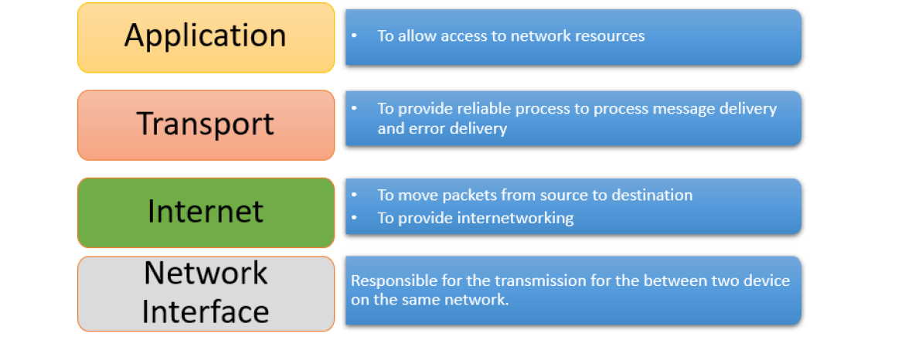
IoT Networking
05
Understand the Importance of Business Intelligence
The classic TCP/IP protocol stack is not suitable for sensor-based networks such as IoT because its requirements in each layer are sufficiently different.
So, there is a need for an evolution of TCP/IP protocol stack to address the IoT requirements and the shortcomings of TCP/IP technologies.

Slide 18
IoT Networking
05
Understand the Importance of Business Intelligence
Network Interface (Link) Layer: Purpose: Manages physical data transmission between devices on the same network.
Internet Layer: Purpose: Handles logical addressing and routing of packets.
Transport Layer: Purpose: Ensures reliable communication between devices.
Application Layer: Purpose: Allows users and applications to access network services like email (SMTP), web browsing (HTTP), file transfer (FTP).

Slide 19
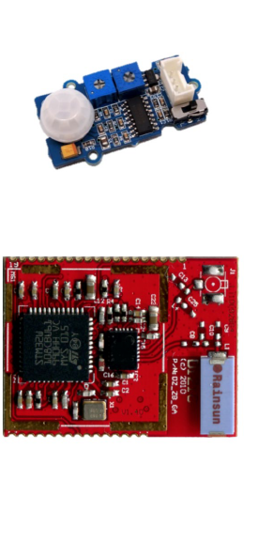
Support for Constrained Devices
05
Understand the Importance of Business Intelligence
IoT devices span a wide range of capabilities and characteristics Computational power, mobility, size, complexity, dispersion (timing out), power resource , placement and connectivity patterns.
These characteristics impose new requirements and restrictions for the underlying network infrastructure In particular, the devices computational capabilities and their power resources introduce challenging requirements for IP networking technologies.

Slide 20
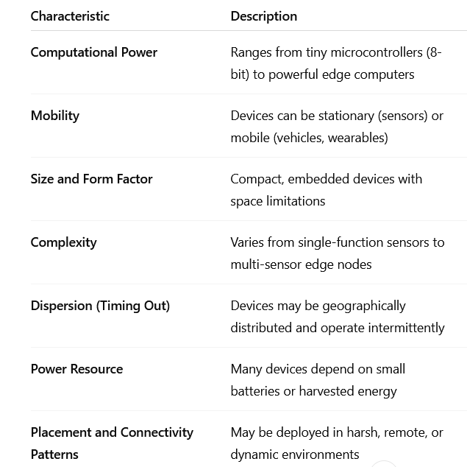
Support for Constrained Devices
05
Understand the Importance of Business Intelligence
Table 5.1 Key Characteristics of IoT Devices

Slide 21
Support for Constrained Devices
05
Understand the Importance of Business Intelligence
Traditional devices connected to the internet are homogeneous Fully capable computers (e.g. servers, desktops and laptops) have an endless source of power.
In this environment: TCP/IP worked perfectly, since devices could handle heavy protocol overhead, constant connections, and retransmissions.
IoT devices with limited processing, memory and power resources are referred to as constrained devices. They are typically small embedded systems — such as sensors, actuators, and simple controllers — designed to perform specific, limited tasks . The limitations:
Maximum code complexity (ROM/Flash)
Size of run-time state and buffers (RAM)
Amount of computation feasible in a specific period of time ("processing power")
Available power resources
Management UI and accessibility in deployment (ability to set security keys, update software, etc.).

Slide 22
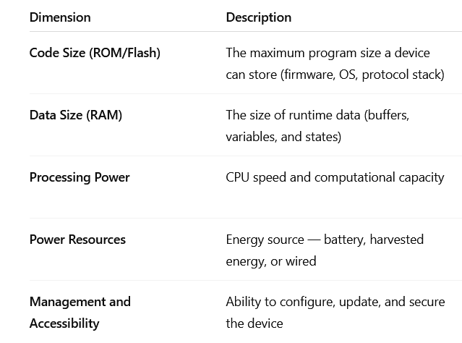
Support for Constrained Devices
05
Understand the Importance of Business Intelligence
IETF RFC 7228 defines a taxonomy of constrained devices based on the first two dimensions above. These limitations mean that traditional Internet protocols (like TCP/IP) are often too heavy to run on such devices.

Slide 23
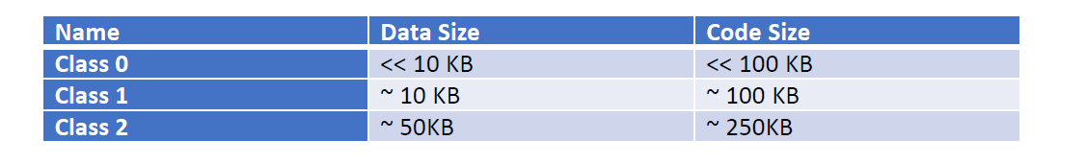
Support for Constrained Devices
05
Understand the Importance of Business Intelligence
IETF RFC 7228 defines a taxonomy of constrained devices based on the first two dimensions above, which recognizes three classes of devices:
Code size refers to the amount of non-volatile memory (typically Flash or ROM) available on a device to store program code. It’s how much “space” the device has to hold its software permanently.
Data size refers to the volatile memory (RAM). It’s how much “working memory” the device has while it’s running.

Slide 24
Support for Constrained Devices
05
Understand the Importance of Business Intelligence
Class 0 devices are the most constrained in memory and processing power.
They do not have resources to connect to an IP network directly, and will leverage the services of gateways for connectivity. E.g., sensors typically fall under this class.
Characteristics:
Memory: Very limited (<10 KB RAM, <100 KB Flash/ROM)
Processing Power: Very low — simple microcontrollers.
Power Supply: Often battery-operated or energy-harvested.
Connectivity: Cannot run a full IP stack; rely on gateways.

Slide 25
Support for Constrained Devices
05
Understand the Importance of Business Intelligence
Class 1 devices are highly constrained in terms of code space and processing capacity.
However they can connect to an IP network directly.
These devices face challenges in running certain demanding IP protocols such as BGP, OSPF, HTTP.
Characteristics:
Memory: Around 10 KB RAM, ~100 KB Flash/ROM.
Processing Power: Moderate — can handle lightweight IP protocols.
Power Supply: Usually low-power (battery).
Connectivity: Capable of direct IP communication, but with limitations.

Slide 26
Support for Constrained Devices
05
Understand the Importance of Business Intelligence
Class 1 devices are highly constrained in terms of code space and processing capacity.
Examples:
Smart light bulbs
Smart door locks

Slide 27
Support for Constrained Devices
05
Understand the Importance of Business Intelligence
Class 2 devices are capable of running the same IP stack that runs on general compute nodes today. They can communicate using standard Internet protocols (e.g., TCP, UDP, HTTP, MQTT). They don’t always need an intermediary gateway to translate data — they can connect directly to cloud servers.
Characteristics:
Memory: Around 50 KB RAM, up to 250 KB Flash/ROM.
Processing Power: High compared to other constrained devices — can run multitasking OSs.
Power Supply: Often mains-powered or equipped with sufficient battery.
Connectivity: Can support full IP networking stacks (IPv4/IPv6, TCP/UDP).
Examples: Smart cameras

Slide 28
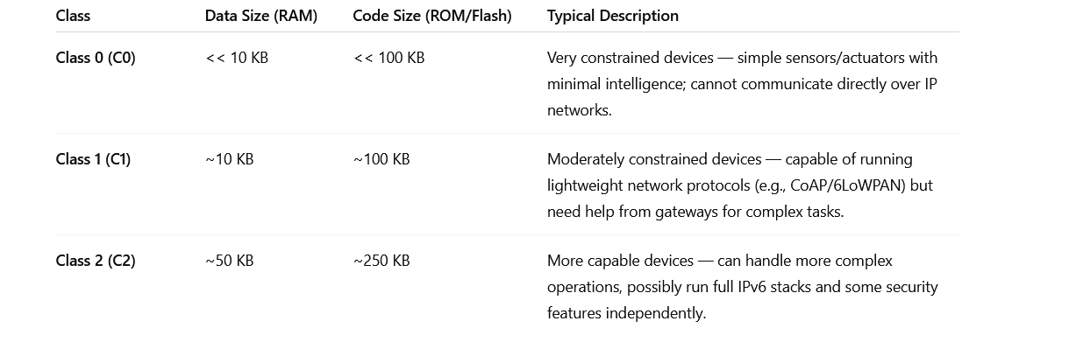
Support for Constrained Devices
05
Understand the Importance of Business Intelligence

Slide 29

Support for Constrained Devices
05
Understand the Importance of Business Intelligence
Another dimension that characterizes constrained devices is power/energy resource constraints.
They may:
Run on small batteries
Have non-replaceable or non-rechargeable power sources
Unlike traditional computers or routers (which are always plugged in).
many IoT nodes must function for months or even years without human intervention.
So, energy efficiency becomes one of the most critical design requirements for IoT systems.

Slide 30
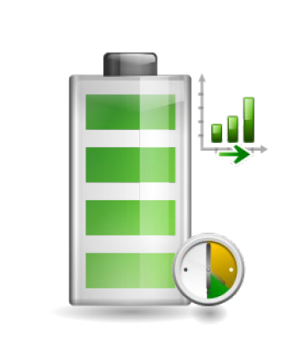
Support for Constrained Devices
05
Understand the Importance of Business Intelligence
To address the requirements of constrained devices, lightweight, energy-efficient and bandwidth-conscious communication protocols are required across all the Layers of the protocol stack. These protocols help minimize communication frequency, data size, and energy waste — enabling IoT devices to operate for long periods even on limited power.

Slide 31
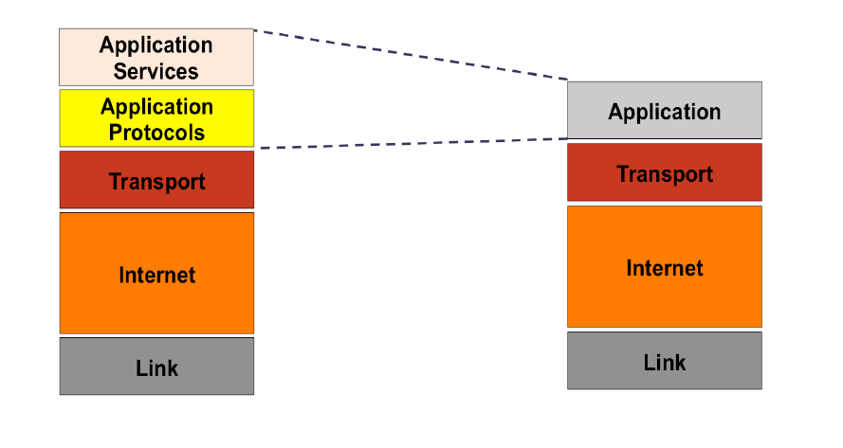
IoT Protocol Stack: A Layered View
05
Understand the Importance of Business Intelligence
The Application Layer of the TCP/IP protocol stack is expanded into two layers in the IoT protocol stack:
Application Protocols
Application Services

Slide 32
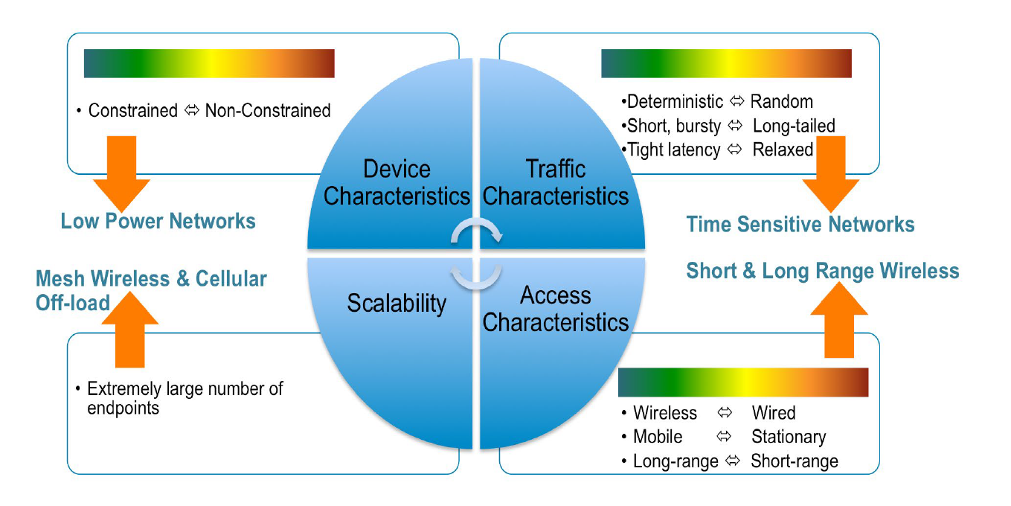
IoT Protocol Stack: A Layered View
05
Link Layer Challenges
Understand the Importance of Business Intelligence
The Link Layer in IoT networks is the foundation that connects billions of devices — from tiny sensors to large machines across diverse environments.
To meet IoT’s unique needs, it must be flexible, power-efficient, low-latency, scalable, and adaptive.

Slide 33
IoT Protocol Stack: A Layered View
05
Link Layer:
Device characteristics: IoT covers a wide spectrum of “things” that span from fully capable computing nodes to highly constrained devices. The link layer must be flexible to accommodate both simple and advanced hardware.
Traffic characteristics: In networking, traffic refers to the flow of data between devices over a network. Different IoT applications have very different traffic behaviors — and the Link Layer must handle all efficiently. Every IoT device — from a smart sensor to an industrial robot — generates network traffic when it sends data (for example, sensor readings, commands, alerts) or receives instructions from the cloud or other devices. Not all IoT devices are the same. They differ greatly in capabilities, communication needs, energy usage, and reliability requirements — depending on what task they perform.
Understand the Importance of Business Intelligence

Slide 34
IoT Protocol Stack: A Layered View
05
Understand the Importance of Business Intelligence
Link Layer:
Access characteristics: IoT endpoints are increasingly diverse -the footprint of the network grows beyond traditional LAN and WAN technologies into industrial plant floor, oil fields, marine platforms, mines, wells, power grids, vehicles, locomotives, and even the human body. IoT devices are deployed in vastly different environments, which determines how they access the network at the Link Layer.
IoT scalability demands, especially for wireless technologies. IoT networks can consist of thousands to millions of devices, often all communicating wirelessly. This introduces serious scalability challenges at the Link Layer.

Slide 35
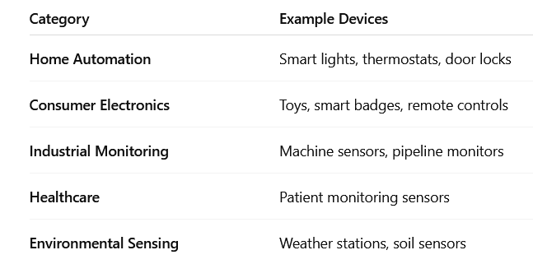
IoT Protocol Stack: A Layered View
05
Link Layer Protocols :
IEEE 802.15.4 is a Link Layer standard designed specifically for:
Low-power,
Low-data-rate, and Short-range wireless communication.
Understand the Importance of Business Intelligence

Slide 36
IoT Protocol Stack: A Layered View
05
Link Layer Protocols :
The 802.11ah group was chartered to develop a wireless connectivity solution that operates in the license-exempt sub-1GHz bands addressing IoT requirements:
large number of constrained devices: IoT environments often have hundreds or even thousands of small, low-power devices.
long transmission range: Because it uses sub-1 GHz frequencies, 802.11ah can transmit over much longer distances.
small and infrequent data messages: Many IoT sensors don’t need to send huge amounts of data — just small updates.
low data rates : IoT devices usually send small bits of data, they don’t need high-speed internet.
Understand the Importance of Business Intelligence

Slide 37
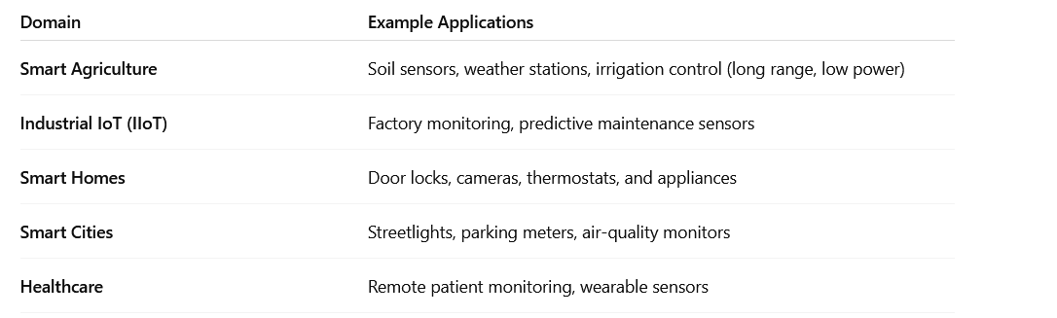
IoT Protocol Stack: A Layered View
05
Link Layer Protocols :
IoT Use Cases for 802.11ah
Understand the Importance of Business Intelligence

Slide 38
IoT Protocol Stack: A Layered View
05
Internet Layer:
In networking, the Internet Layer is responsible for addressing, routing, and delivering packets between devices across different networks — most commonly using the Internet Protocol (IP) . However, IoT networks are not like normal IP networks. In IoT systems, the Internet Layer allows tiny sensors and actuators to communicate globally — sending their data to cloud servers or other devices over the Internet.
Many IoT deployments constitute Low power & Lossy Networks (LLNs).
LLNs are IoT networks made up of a large number of constrained devices that:
Have limited power (battery).
Have small memory and CPU.
Are connected using wireless links that can be unreliable (fail) .
Understand the Importance of Business Intelligence

Slide 39
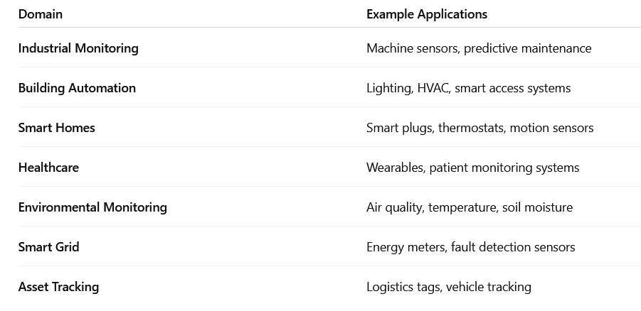
IoT Protocol Stack: A Layered View
05
Understand the Importance of Business Intelligence
Internet Layer:
Common Use Cases for LLNs:

Slide 40
Summary
05
Gorry and Scott-Morton (1971) proposed a framework that is a 3-by-3 matrix
Big data analytics
Explain the Iot and big data use cases
IoT networking layers

Slide 41


Thank You

