Slide 1

Operating Systems
Prepared by Dr. Alaa Mohamed
Lecture 1
Operating System Introduction

Slide 2

Chapter
01
OPERATING SYSTEM INTRODUCTION
Objectives:
  To provide a grand tour of the major operating systems components
  To provide coverage of basic computer system organization

Slide 3
Chapter
01
OPERATING SYSTEM INTRODUCTION
Topics:
  What is an Operating Systems
  Computer-System Organization
  Computer-System Architecture
  Operating-System Structure
  Operating-System Operations

Slide 4


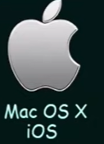

Chapter
01
What is an Operating System?
  A program that acts as an intermediary between a user of a computer and the computer hardware
  Operating system goals:
    Execute user programs and make solving user problems easier
    Make the computer system convenient to use
    Use the computer hardware in an efficient manner

Slide 5
Chapter
01
Computer System Structure
Computer system can be divided into four components
  Hardware – provides basic computing resources
    CPU, memory, I/O devices
  Operating system
    Controls and coordinates use of hardware among various applications and users

Slide 6
Chapter
01
Computer System Structure
  Application programs – define the ways in which the system resources are used to solve the computing problems of the users
    Word processors, compilers, web browsers, database systems, video games
  Users
    People, machines, other computers

Slide 7
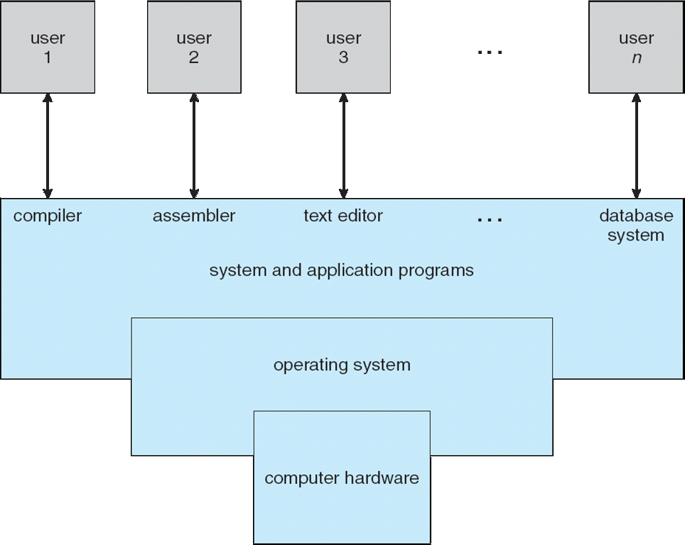
Chapter
01
Four Components of a Computer System

Slide 8
Chapter
01
Operating System Definition
OS is a resource allocator
  Manages all resources
  Decides between conflicting requests for efficient and fair resource use
OS is a control program
  Controls execution of programs to prevent errors and improper use of the computer

Slide 9
Chapter
01
Operating System Definition (cont)
“The one program running at all times on the computer” is the kernel. Everything else is either a system program (ships with the operating system) or an application program

Slide 10
Chapter
01
Computer Startup
Bootstrap Program:-
  The Initial program that runs when the Computer is powered up or rebooted
  It is stored in the ROM.
  It must know how to load the OS and start executing the System
  It must locate and Load into memory the OS kernel.

Slide 11
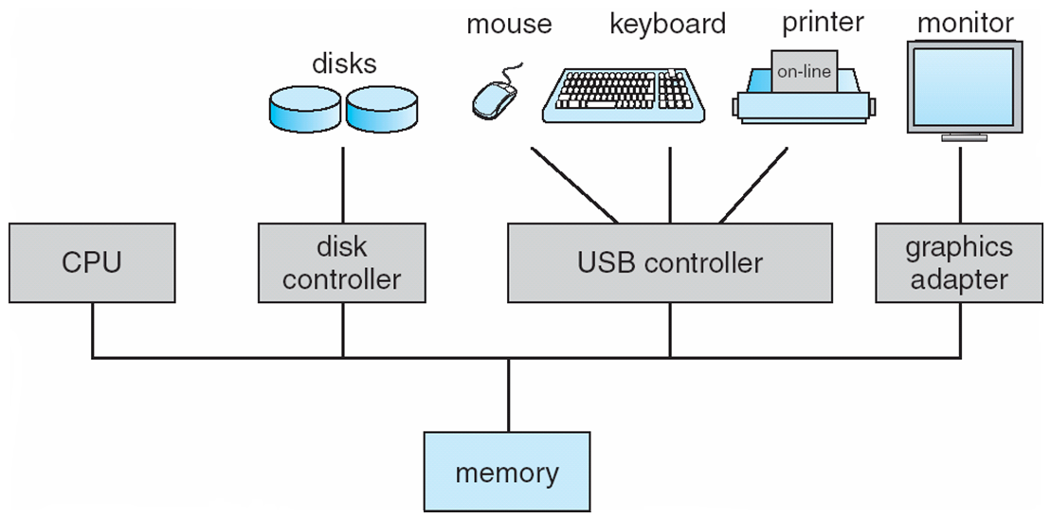
Chapter
01
Computer System Organization
Computer-system operation
  One or more CPUs, device controllers connect through common bus providing access to shared memory
  Concurrent execution of CPUs and devices competing for memory cycles

Slide 12
Chapter
01
Computer-System Operation
I/O devices and the CPU can execute concurrently
Each device controller is in charge of a particular device type
Each device controller has a local buffer
CPU moves data from/to main memory to/from local buffers
I/O is from the device to local buffer of controller
Device controller informs CPU that it has finished its operation by causing an interrupt

Slide 13
Chapter
01
Some Important Terms
Interrupt:-
  The occurrence of event is usually signaled by Interrupt from hardware or software.
  Hardware may trigger an interrupt at any time by sending a signal to the CPU, usually by the way of system bus.

Slide 14
Chapter
01
Some Important Terms
System Call:
  Software may trigger an interrupt by executing a special operation called System Call.
  System call is the programmatic way
  in which a computer program request
  a service from the kernel of the operating system

Slide 15
Chapter
01
Some Important Terms
When the CPU is interrupted, it stops what it is doing and immediately transfers execution to fixed location.
  The fixed location usually contains the starting address where the service Routines of the interrupt is located.
The Interrupt service Routines executes.
On completion, the CPU resumes the interrupted computation.

Slide 16
Chapter
01
Storage Structure
Main memory: is the only large storage media that the CPU can access directly
Secondary storage: is an extension of main memory that provides large nonvolatile storage capacity

Slide 17
Chapter
01
Storage Structure
A magnetic disk is a storage device that uses a magnetization process to write, rewrite and access data.
Electronic Disks: is data storage device functionally similar to a hard disk drive but using flash memory
Cache memory: is a small-sized type of volatile computer memory that provides high-speed data access to a processor and stores frequently used computer programs, applications and data.

Slide 18
Chapter
01
Storage Hierarchy
Storage systems organized in hierarchy
  Speed
  Cost
  Volatility
    (Volatile: Looses its contents when power is removed)
    (Non Volatile: Retains its contents even when power is removed)

Slide 19
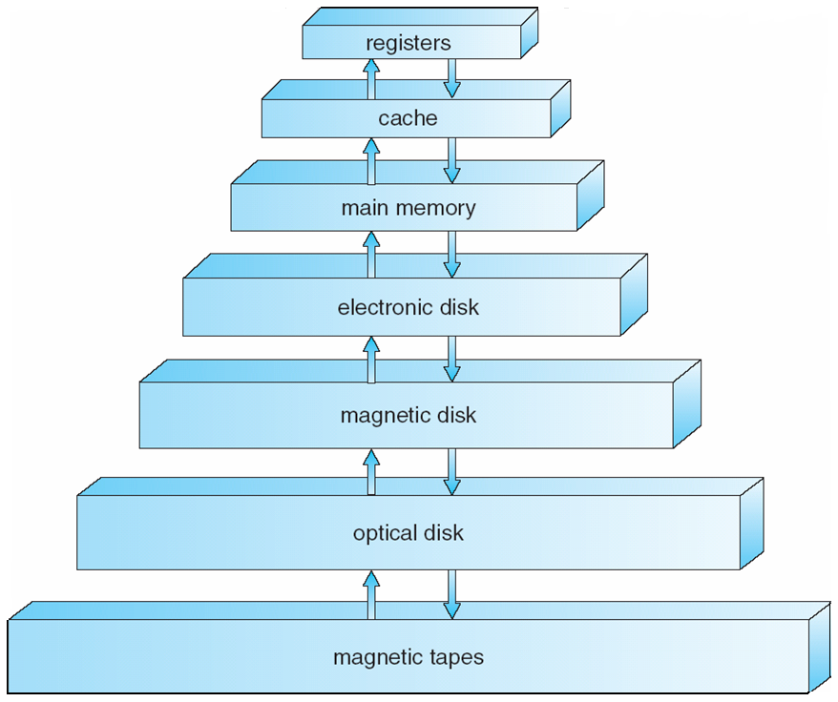
Chapter
01
Storage Device Hierarchy

Slide 20
Chapter
01
Basic of Operating Systems (I/O Structure)
Storage is only one of many types of I/O devices within a computer.
A large portion of operating system code is dedicated to managing I/O, both because of its importance to the reliability and performance of system and because of the varying nature pf the devices.
A general-purpose computer system consists of CPUs and multiple device controllers that are connected through a common bus.

Slide 21
Chapter
01
Basic of Operating Systems (I/O Structure)
Typically, Operating systems have a device driver for each device controller.
This device driver understands the device controller and presents a uniform interface to the device to the rest of the operating system.

Slide 22
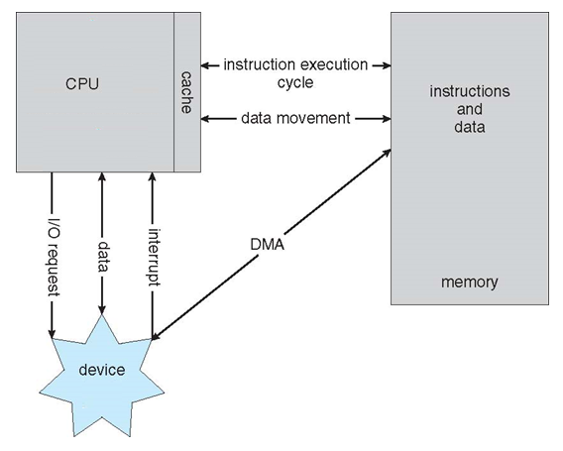
Chapter
01
Working of an I/O operation
To start in I/O operation, the device driver loads the appropriate registers within the device controller which in turn determine what action to take.
The controller starts the transfer of data from the device to the local buffer.

Slide 23
Chapter
01
Working of an I/O operation
Once data transfer is completed, the device controller informs device driver via interrupt that it has finished its operation and the control is returned to the operating system

Slide 24
Chapter
01
Basic of Operating Systems (I/O Structure)
The form presented in the last slide is called interrupt-driven I/O. it is suitable when moving small amounts of data but can produce high overhead when used for bulk of data.
To solve this problem, Direct Memory Access (DMA) is used.
Device controller with DMA capability, transfers blocks of data from buffer storage directly to main memory without CPU intervention
Only one interrupt is generated per block, rather than the one interrupt per byte

Slide 25
Chapter
01
Computer-System Architecture
Types of Computer Systems are based on the number of General-Purpose Processors:
    Single Processor Systems
    Multi Processor Systems
    Clustered Systems
Single Processor Systems: one main CPU capable of executing a general-purpose instruction set.
Other special purpose processors (device controllers) are also present to perform specific task.

Slide 26
Chapter
01
Computer-System Architecture
Multiprocessors systems growing in use and importance
  Also known as parallel systems, tightly-coupled systems
  Advantages include
    Increased throughput
    Economy of scale
    Increased reliability – graceful degradation or fault tolerance
  Two types
    Asymmetric Multiprocessing
    Symmetric Multiprocessing

Slide 27
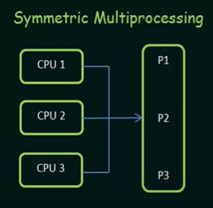
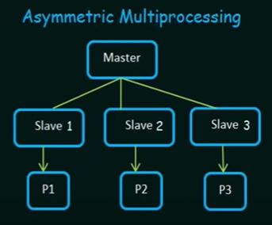
Chapter
01
Computer-System Architecture

Slide 28
Chapter
01
Computer-System Architecture
Clustered Systems:
Like multiprocessor systems, but multiple systems working together
  Usually sharing storage via a storage-area network (SAN)
  Provides a high-availability service which survives failures
    Asymmetric clustering has one machine in hot-standby mode
    Symmetric clustering has multiple nodes running applications, monitoring each other

Slide 29
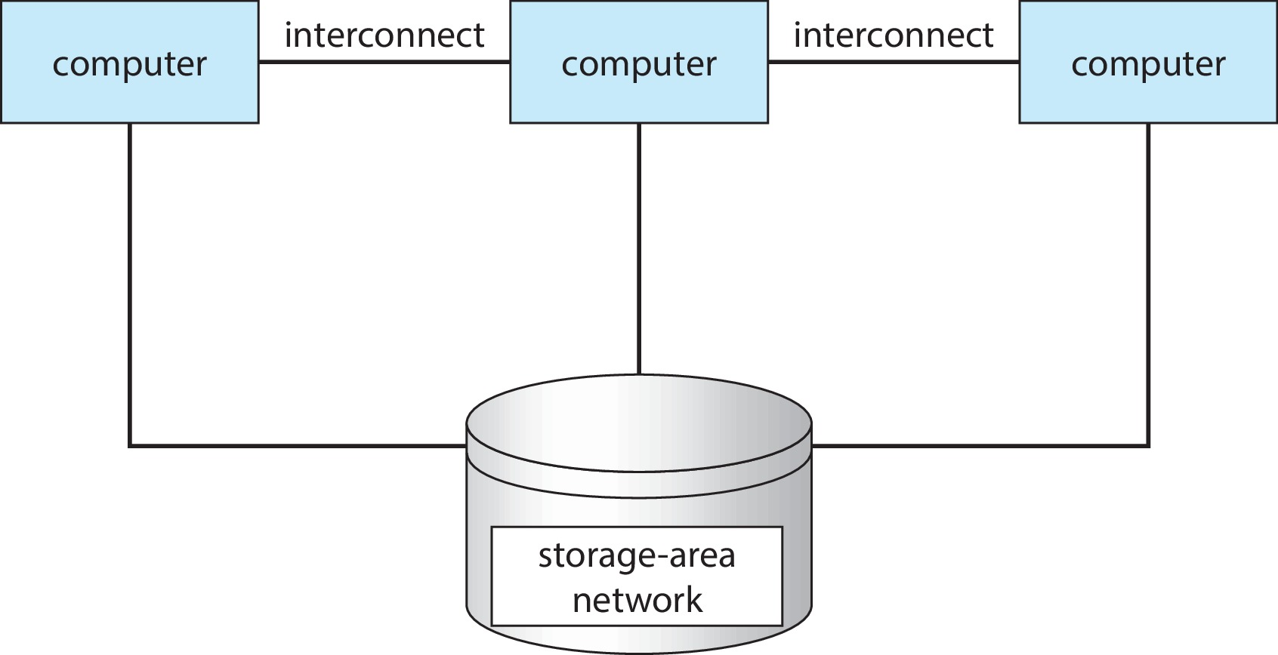
Chapter
01
Computer-System Architecture

Slide 30
Chapter
01
Operating Systems Structure
Operating Systems vary greatly in their makeup internally:
Multiprogramming
Time Sharing (Multitasking)

Slide 31
Chapter
01
Operating Systems Structure
Multiprogramming needed for efficiency
  Single user cannot keep CPU and I/O devices busy at all times
  Multiprogramming organizes jobs (code and data) so CPU always has one to execute
  A subset of total jobs in system is kept in memory
  One job selected and run via job scheduling
  When it has to wait (for I/O for example), OS switches to another job

Slide 32
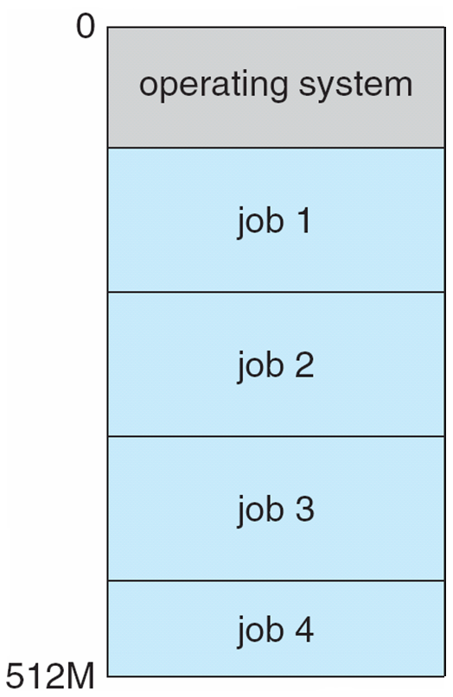
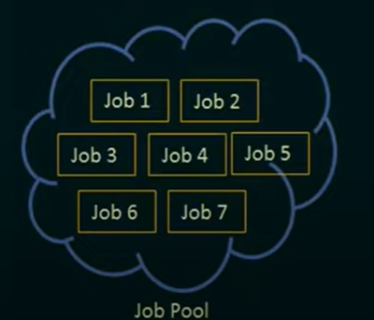
Chapter
01
Operating Systems Structure
Memory layout of multiprogramming systems

Slide 33
Chapter
01
Operating Systems Structure
Timesharing (multitasking) is a logical extension of multiprogramming in which CPU switches jobs so frequently that users can interact with each job while it is running, creating interactive computing
Response time should be < 1 second
Each user has at least one program executing in memory process

Slide 34
Chapter
01
Operating Systems Structure
If several jobs ready to run at the same time  CPU scheduling
If processes don’t fit in memory, swapping moves them in and out to run
Virtual memory allows execution of processes not completely in memory

Slide 35
Chapter
01
Operating Systems Operations
Operating systems are considered as an Interrupt driven mostly by hardware
A trap is a software-generated interrupt caused either by an error or a user request
Software error or request creates exception or trap
  Division by zero, request for operating system service

Slide 36
Chapter
01
Operating Systems Operations
Dual-mode operation allows OS to protect itself and other system components
  User mode and kernel mode
  Mode bit provided by hardware
    Provides ability to distinguish when system is running user code or kernel code
    Some instructions designated as privileged, only executable in kernel mode
    System call changes mode to kernel, return from call resets it to user

Slide 37
Chapter
01
Transition from User to Kernel Mode
Timer to prevent infinite loop / process hogging resources
  Set interrupt after specific period
  Operating system decrements counter
  When counter zero generate an interrupt
  Set up before scheduling process to regain control or terminate program that exceeds allotted time

Slide 38
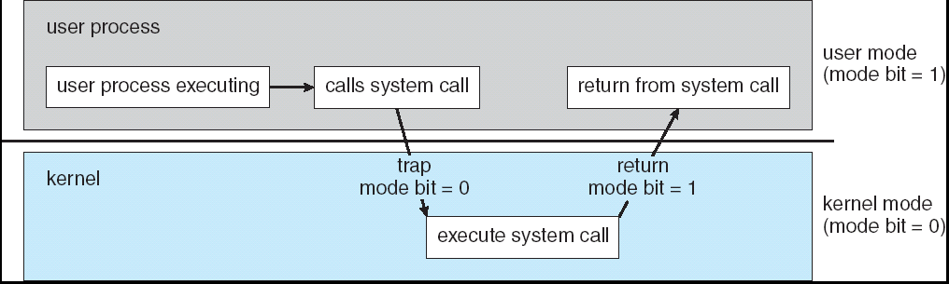
Chapter
01
Transition from User to Kernel Mode

Slide 39
Chapter
01
Transition from User to Kernel Mode
User’s code issues a system call
Mode is changed to kernel mode
OS first checks that everything (e.g., parameter values) is in order and legal
Then, OS executes system call which may contain multiple privileged instructions
mode is set again to user mode

Slide 40
Chapter
01
End of Chapter 1
End of Chapter 1

