Slide 1


Business Mathematics
Prepared by Dr. Alfaisal Hasan
MTH 112
Business Mathematics
Lecture NO 8

Slide 2



Business Mathematics
Lecture NO 8
MTH 112
Business Mathematics
Prepared by
Dr. Alfaisal Hasan
www.midocean.ae

Slide 3

Chapter
Topics
Chapter 1: Mathematical preliminaries
Chapter 2: The straight line and applications
Chapter 3: Functions and Graphs
Chapter 4: Limits and Continuity
Chapter 5: Financial Mathematics
Chapter 6: Differentiation
Chapter 7: Methods of Differentiation
Chapter 8: Function of several variables
Chapter 9: Integration and applications
Chapter 10: Linear algebra and applications
www.midocean.ae

Slide 4
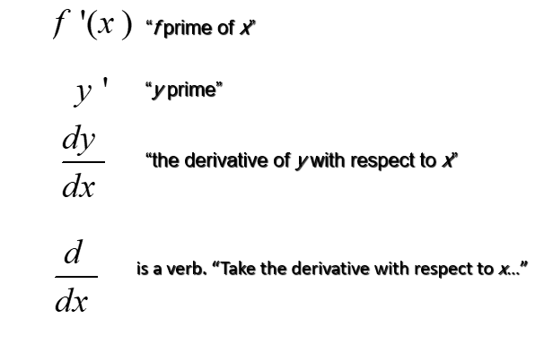
Differentiation
Remember that
www.midocean.ae

Slide 5
Differentiation
Remember that
Differentiation is the process of computing the derivative of a function.
You may be asked to:
Differentiate.
Derive.
Find the derivative of…
www.midocean.ae

Slide 6
Differentiation
Remember that
The derivative of a constant function is zero.
www.midocean.ae

Slide 7
Differentiation
Remember that
www.midocean.ae

Slide 8
Differentiation
Remember that
The derivative of a constant times a function is equal to the constant times the derivative of the function.
www.midocean.ae

Slide 9
Differentiation
Remember that
The derivative of a sum is the sum of the derivatives.
The derivative of a difference is the difference of the derivatives.
www.midocean.ae

Slide 10
Differentiation
Remember that
The derivative of the product of two differentiable
functions is given by
www.midocean.ae

Slide 11
Differentiation
Remember that
The derivative of the quotient of two differentiable functions is given by
www.midocean.ae

Slide 12
Methods of Differentiation
Remember that
The Rate of change of the total Cost Function
is the derivative of the total Cost Function
www.midocean.ae

Slide 13
Methods of Differentiation
Remember that
The Profit Function
is difference between of Revenue Function and Cost Function
www.midocean.ae

Slide 14
Methods of Differentiation
Remember that
Now we will discuss the marginal analysis of various functions related to:
  Cost
  Revenue
  Profit
www.midocean.ae

Slide 15
Methods of Differentiation
Remember that
The marginal Cost Function
is the derivative of the Cost Function
www.midocean.ae

Slide 16
Methods of Differentiation
Remember that
The marginal Revenue Function
is the derivative of the Revenue Function
www.midocean.ae

Slide 17
Methods of Differentiation
Remember that
The marginal Revenue Function
is the derivative of the Revenue Function
www.midocean.ae

Slide 18
Methods of Differentiation
Remember that
The marginal Profit Function
is the derivative of the Profit Function
www.midocean.ae

Slide 19
Functions of Several Variables
The Chain Rule
www.midocean.ae

Slide 20
Functions of Several Variables
Consider the function
To compute h′(x), we can first expand h(x)
and then derive the resulting polynomial
But how should we derive a function like H(x)?
www.midocean.ae

Slide 21
Functions of Several Variables
Note that is a composite function:
H(x) is composed of two simpler functions
So that
We can use this to find the derivative of H(x).
www.midocean.ae

Slide 22
Functions of Several Variables
If h(x) = g[f(x)], then
Equivalently, if we write y = h(x) = g(u),
where u = f(x), then
www.midocean.ae

Slide 23
Functions of Several Variables
If the function f is differentiable and
h(x) = [f(x)]^{n} (n, a real number),
then
www.midocean.ae

Slide 24
Functions of Several Variables
Find the derivative of
www.midocean.ae

Slide 25
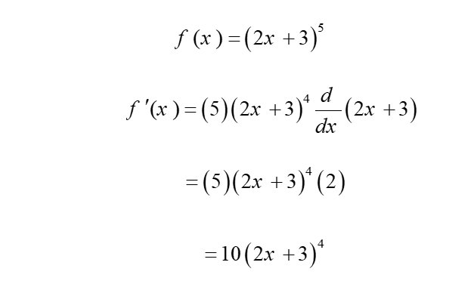
Functions of Several Variables
www.midocean.ae

Slide 26
Functions of Several Variables
Find the derivative of
www.midocean.ae

Slide 27
Functions of Several Variables
Rewrite as a power function:
Apply the general power rule:
www.midocean.ae

Slide 28
Functions of Several Variables
Find the derivative of
Rewrite as a power function:
Apply the general power rule:
www.midocean.ae

Slide 29
Functions of Several Variables
Differentiate:
www.midocean.ae

Slide 30
Functions of Several Variables
Differentiate:
www.midocean.ae

Slide 31
Functions of Several Variables
Differentiate:
www.midocean.ae

Slide 32
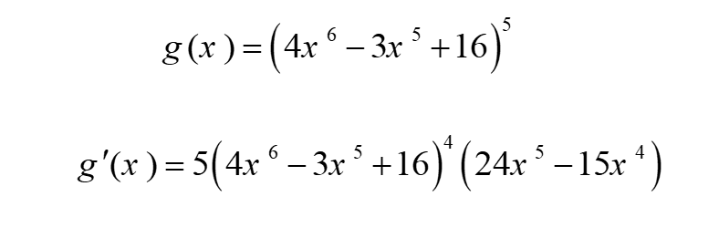
Functions of Several Variables
www.midocean.ae

Slide 33
Functions of Several Variables
Given that ,
then find the value of
www.midocean.ae

Slide 34
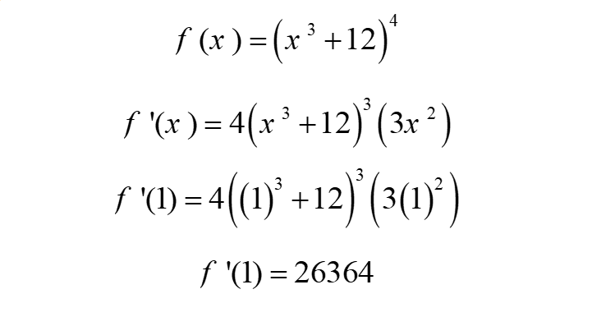
Functions of Several Variables
www.midocean.ae

Slide 35
Functions of Several Variables
Given that
then find the value of
www.midocean.ae

Slide 36
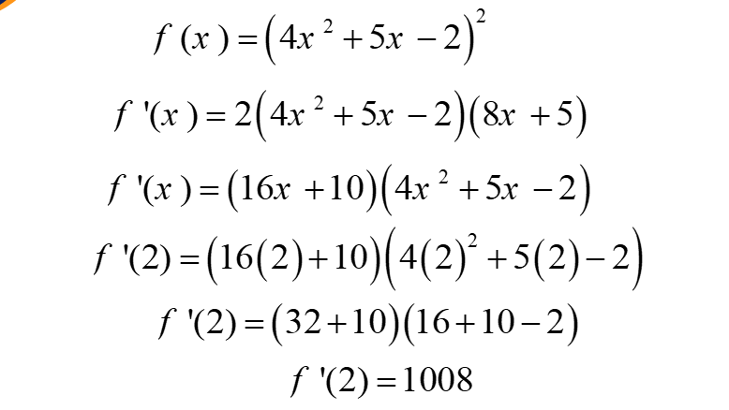
Functions of Several Variables
www.midocean.ae

Slide 37
Functions of Several Variables
Differentiate:
www.midocean.ae

Slide 38
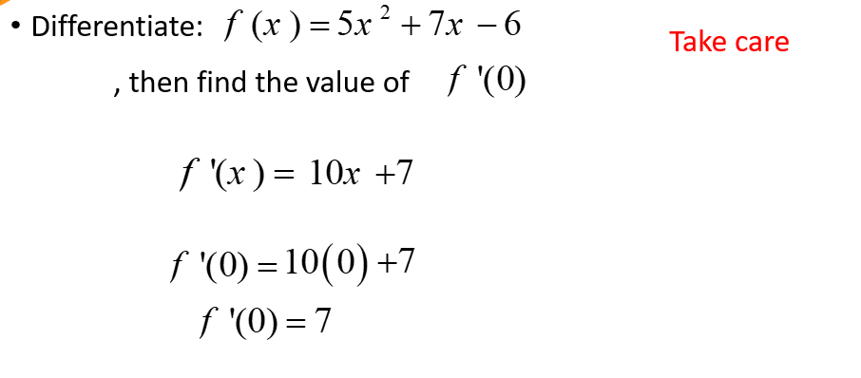
Functions of Several Variables
www.midocean.ae

Slide 39
Functions of Several Variables
Find the second derivative of
www.midocean.ae

Slide 40
Functions of Several Variables
www.midocean.ae

Slide 41
Functions of Several Variables
Find the third derivative of
www.midocean.ae

Slide 42
Functions of Several Variables
www.midocean.ae

Slide 43
Functions of Several Variables
Find the derivative of
www.midocean.ae

Slide 44
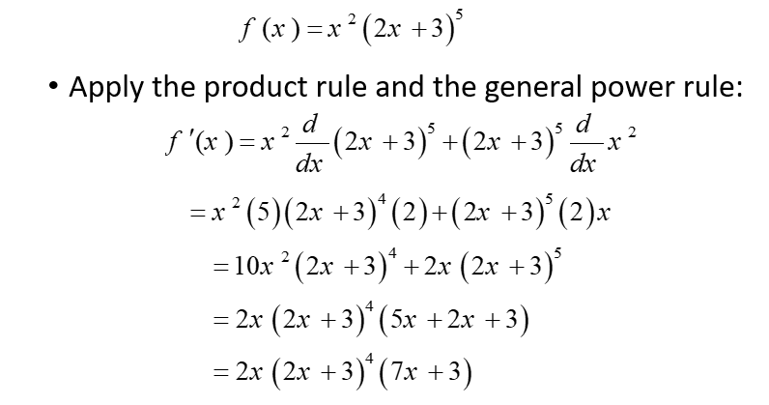
Functions of Several Variables
www.midocean.ae

Slide 45
Functions of Several Variables
Find the derivative of
www.midocean.ae

Slide 46
Functions of Several Variables
www.midocean.ae

Slide 47
Functions of Several Variables
Find the derivative of
www.midocean.ae

Slide 48
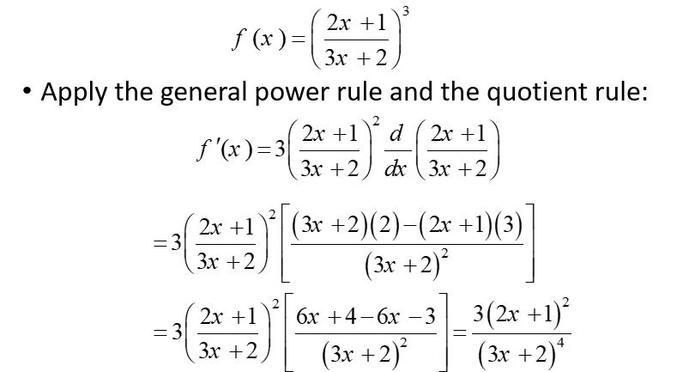
Functions of Several Variables
www.midocean.ae

Slide 49
Functions of Several Variables
Find the derivative of
www.midocean.ae

Slide 50
www.midocean.ae

Slide 51
Functions of Several Variables
Given that
then find the second value of
www.midocean.ae

Slide 52
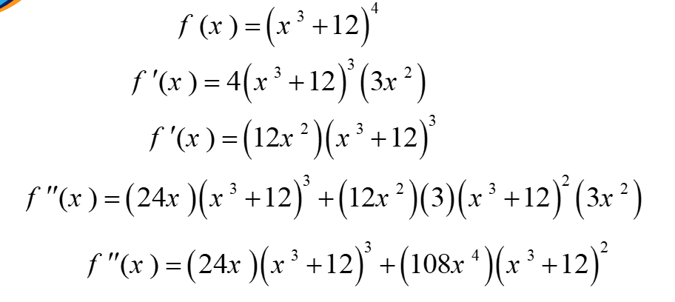
Functions of Several Variables
www.midocean.ae

Slide 53
Functions of Several Variables
Given that
then find the second value of
www.midocean.ae

Slide 54
Functions of Several Variables
www.midocean.ae

Slide 55
Functions of Several Variables
Given that
then find the first derivative of
www.midocean.ae

Slide 56
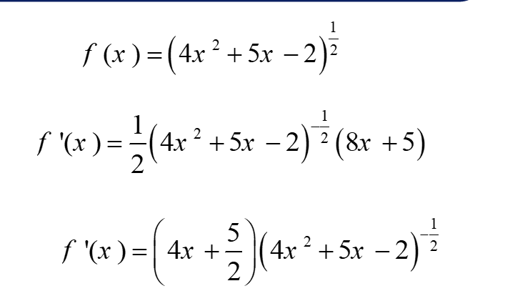
Functions of Several Variables
www.midocean.ae

Slide 57
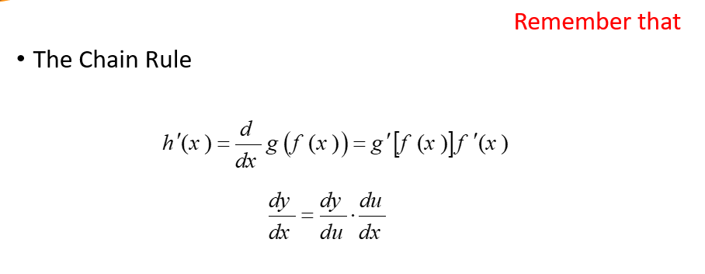
Functions of Several Variables
www.midocean.ae

Slide 58
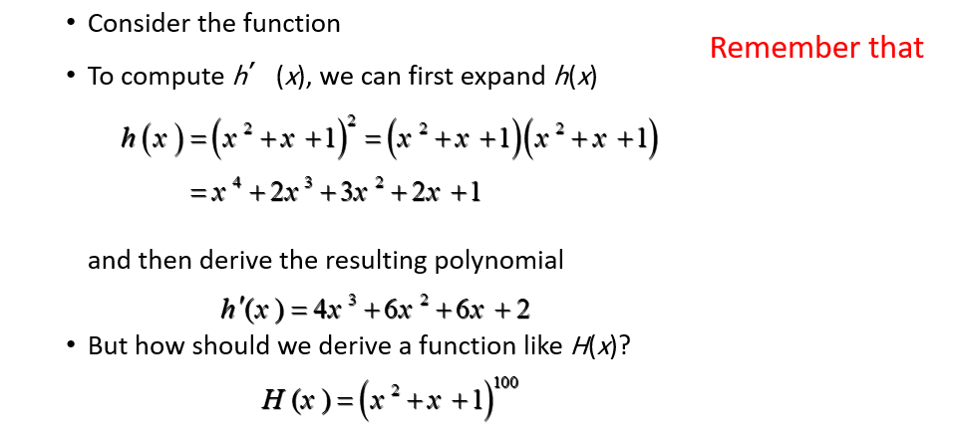
Functions of Several Variables
www.midocean.ae

Slide 59
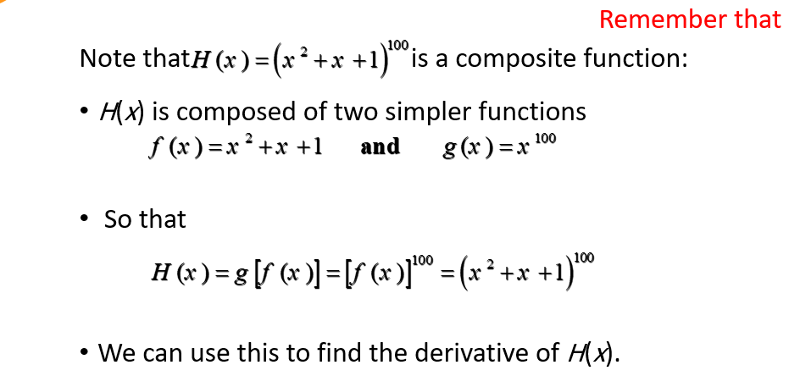
Functions of Several Variables
www.midocean.ae

Slide 60
Un Solved Examples
Find the derivative of
www.midocean.ae

Slide 61
Un Solved Examples
Find the derivative of
www.midocean.ae

Slide 62
Un Solved Examples
Find the derivative of
www.midocean.ae

Slide 63
Un Solved Examples
Find the derivative of
www.midocean.ae

Slide 64
Un Solved Examples
Given the function
Find the value of
www.midocean.ae

Slide 65
Un Solved Examples
Find the derivative of
www.midocean.ae

Slide 66
Un Solved Examples
Find the derivative of
www.midocean.ae

Slide 67



Thank You

