Slide 1




Organizational Behavior and Projects
PMG421
Prepared by Mrs. Deena Ibrahim
Lecture 9
Solving Project Problems

Slide 2


1- Tools for Solving Problems
1.1 Force Field Analysis. 2.1 Brainstorming. 3.1 Affinity Diagrams. 4.1 Nominal Group Technique and Multivoting.
2. Summary.

Slide 3
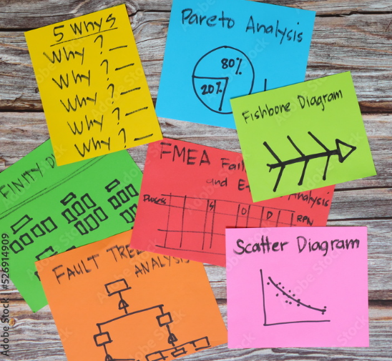
Introduction
Collecting data, understanding and analyzing data, and processes are important. They are important as preparatory steps for taking action. These steps alone do not guarantee quality. Eventually, a project manager must do something. Much guidance exists regarding action.

Slide 4
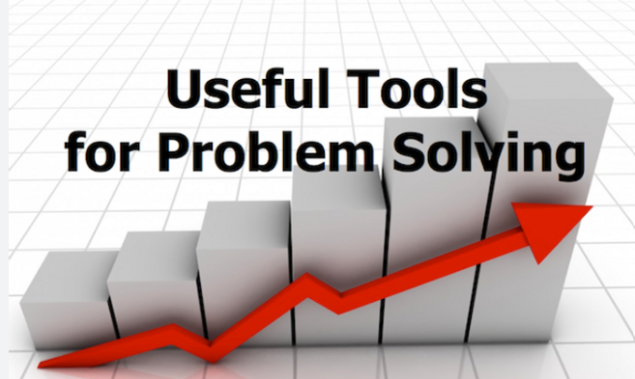
Tools for Solving Problems
Four quality tools help a project manager determine the right action. Taken together, these tools constitute a progressive set that supports understanding of the organizational environment and supports generating, organizing, and prioritizing actions.

Slide 5
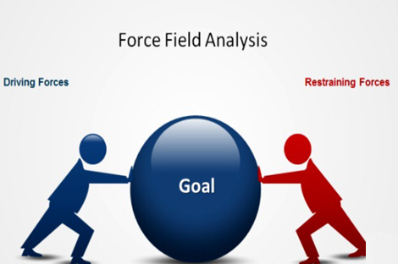
Force Field Analysis
Kurt Lewin (pronounced la-veen) was a social psychologist who was active and highly influential in the United States during the 1940s. He developed T-groups (the foundation for contemporary team building) and the “unfreezemovement-refreeze” model of organizational change. He also developed force field analysis, a disciplined way of identifying forces and factors that help or hinder problem solving.

Slide 6

In Lewin’s view, powerful forces that influence change are at play within any organization. These forces are of two types: those that help or enable change and those that hinder or restrain change. If you want to effect some kind of change within an organization, you must first identify and understand the forces at play and then use them in some advantageous way.

Slide 7

Force field analysis includes five steps:
Define the challenge. Establish the scope of the analysis. The challenge may be very broad or it may be specific.
Identify helping and hindering forces. Consider the organization’s operating environment. Determine what aspects of the environment might push the organization toward change and what aspects might stand as barriers to change.

Slide 8
Force field analysis includes five steps:
3- Assume the forces are in balance. The opposing forces that may help or hinder change are probably in a state of balanced. That is why the organization is where it is at the current time; the forces that influence change are balanced.
4- Develop action plans to change the balance of forces. Changing the balance of opposing forces will break the balance and allow change to occur.
5- Change the balance. Take the actions planned and pursue the desired change.

Slide 9
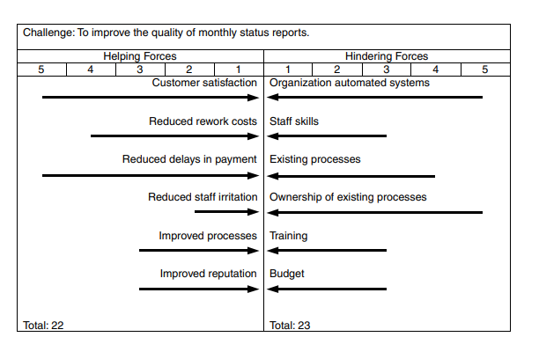
Force field analysis employs a simple graphic tool to organize the steps and capture the information for use.
The example shown in the following Figure addresses an organizational change, improving the quality of monthly status reports.
The challenge is entered at the top of the chart.
Helping and hindering forces are entered in two columns below.

Slide 10
Forces are entered in no particular order and there is no relationship between forces that may be listed across from each other on the chart.
When forces are entered on the chart, they are assigned a value from one to five, with one meaning “not too influential” and five meaning “very influential.”
The values are determined by the project team, either by consensus or simply by the judgment of the individual who suggested the force.

Slide 11
When all forces have been identified and added to the chart, the values are added together to create a total.
Totals for helping and hindering forces need not be equal or close to equal.
Those applying force field analysis should not balance the values to create an artificial equivalence.
The totals are just a guide. In fact, the values are just guides; their relevance will be apparent shortly.

Slide 12
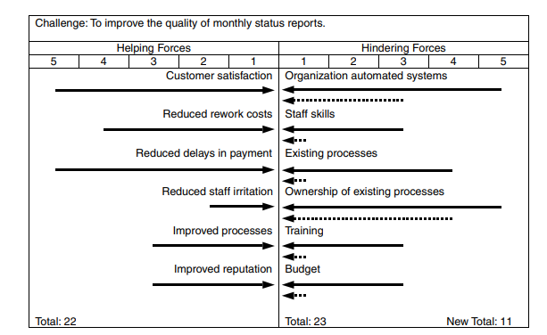
To make change possible, the influence of the forces must be altered in some way to either increase the influence of the helping forces or decrease the influence of the hindering forces.
Often, the most effective approach is to reduce the influence of the hindering forces, which naturally allows the helping forces to be more influential even though they have not changed. On the other hand, decreasing the influence of hindering forces (decreasing negatives) usually does not encounter much resistance from organizational elements or members.

Slide 13

Brainstorming

Slide 14

Brainstorming
Brainstorming is a common quality tool that is much applied in the breach. That is, people think they are doing brainstorming, but they are really just having a discussion. True brainstorming is a formal process that may be applied in a structured or unstructured approach, as described below.
The goal of either method is to generate a high volume of ideas creatively and efficiently, free of criticism and other chilling or disruptive influences.

Slide 15

Structured Approach
◆ Step 1. The team meets in a location that provides some privacy, free from interruption. The location should have comfortable seating and either writing boards on the wall or flip charts on stands. The team decides on a scribe who will write down the ideas as they are generated during the brainstorming session.
◆ Step 2. The project team identifies and defines the issue to be addressed. The scribe enters this on the board or flip chart.

Slide 16
◆ Step 3. Team members present ideas, going around the team in roundrobin fashion. Each team member presents only one idea. Then it is the next member’s turn. The scribe writes the idea on the board or flip chart.
Note: No criticism, clarification, prioritization, or discussion of any kind is allowed. Any of these may disrupt the flow and possibly bog down the team in fruitless, wandering discussion.
◆ Step 4. Team members may “pass” if they do not have an idea when their turn comes around. This does not exclude them from further participation. Intervening ideas presented by others may stimulate thought that may generate an idea on the next go-round.

Slide 17
◆ Step 5. When all team members pass in succession, the idea generation is over. The team may now review the ideas generated and clarify any fine points or perhaps remove duplicates. Teams should exercise great care in removing any ideas from the list as duplicates. What may seem like duplication may, in fact, be a different idea based on a nuance of meaning of the suggestor.
◆ Step 6. After tidying up the list, the brainstorming session is finished, with the result being a list of ideas that address the subject issue.

Slide 18
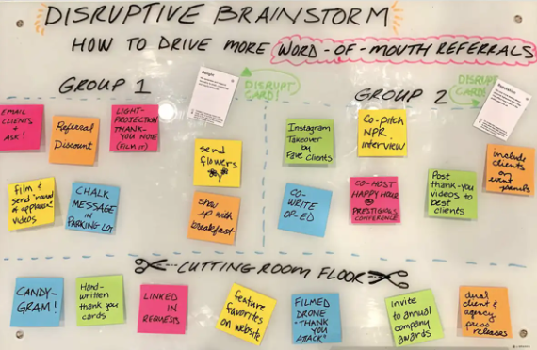
Unstructured Approach
◆ Step 1. The team meets in a location that provides some privacy, free from interruption. The location should have comfortable seating and either writing boards on the wall or flip charts on stands. The team decides on a scribe who will write down the ideas as they are generated during the brainstorming session.
◆ Step 2. The project team identifies and defines the issue to be addressed. The scribe enters this on the board or flip chart.

Slide 19
Step 3. Team members call out ideas as the ideas occur to them. There is no need to wait their turn. Members are not limited in the number of ideas they may present at one time. If someone has twenty ideas and can get them all out without taking a breath, so be it. The scribe writes the ideas on the board or flip chart, trying to keep up with the flow of ideas. Note. No criticism, clarification, prioritization, or discussion of any kind is allowed. Any of these may disrupt the flow and possibly bog down the team in fruitless, wandering discussion. This constraint may be harder to observe in the unstructured approach because of the free-for-all aspect of participation.

Slide 20
Step 4. Eventually, everyone will run out of ideas. When the participation is clearly finished, the idea generation is over.
This point should be determined by team consensus, not by direction of one particular participant.
◆ Step 5. The team may now review the ideas generated and clarify any fine points or perhaps remove duplicates. Teams should exercise great care in removing any ideas from the list as duplicates.
◆ Step 6. After tidying up the list, the brainstorming session is finished, with the result being a list of ideas that address the subject issue.

Slide 21

Structured approach
Disadvantages | Advantages
This very deliberate approach may not release creative energy. It may give people a chance to “think twice” and offer more cautious ideas or even withhold ideas that, in a more spontaneous approach, they would throw out for consideration. | Allows everyone to take a turn and prevents one person from monopolizing the session. It allows time for individual thought and reflection as participants await their next turn. It may produce better-formed ideas. May also make people participate who otherwise might sit silently by as others generate all the ideas.

Slide 22
Unstructured approach
Disadvantages | Advantages
The session might degenerate into a meandering discussion People who are free to jump in any time with new ideas may feel free to criticize or comment on ideas suggested by others. | Allows an element of spontaneity and may result in more creative ideas. People are not restricted to waiting their turn . It may be just what is needed to break the bonds of conventional thinking and open the doors to new ideas.

Slide 23
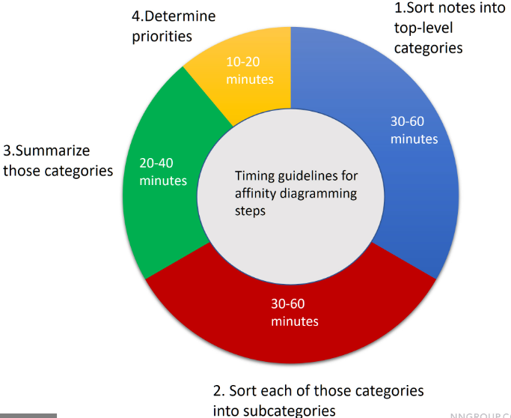
Affinity Diagrams

Slide 24
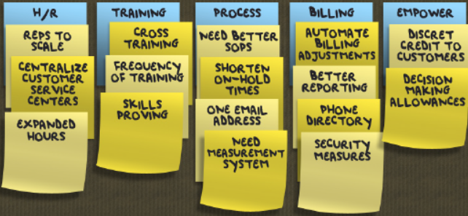
Affinity Diagrams
A list is just a list. Having generated a list of ideas through brainstorming, the project team must now make some sense out of it. Ideas are probably listed helter-skelter on the board or flip chart in the order that they were generated. An affinity diagram is a quality tool that is used to organize and summarize unstructured issues or ideas.

Slide 25
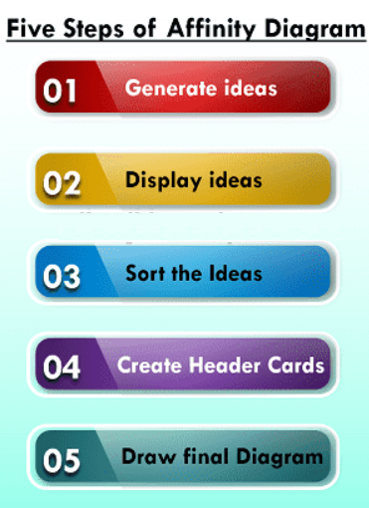
Five steps of the affinity diagramming process:
1. Write each idea on a “sticky note” and stick all the notes on the wall or a flip chart.
2. Move notes into groups with some kind of association. Team members do this in incremental steps, one at a time. Team members do this silently, without discussion.
3. Make duplicate notes in cases of conflict among team members.
4. Discuss and resolve conflicts when all ideas have been grouped together in some way.
5. Create headers or titles for the groups that reflect the content of the ideas.

Slide 26
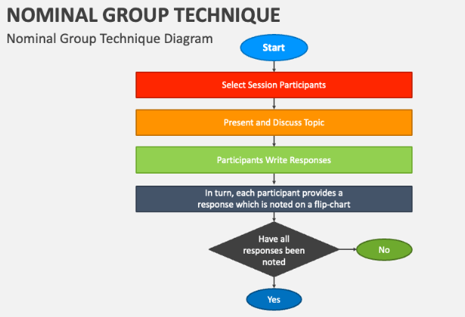
Nominal Group Technique and Multivoting
Nominal group technique was developed at the University of Wisconsin in 1971 as a means of developing team consensus on priority rankings free of bias or influence. It is called “nominal” group technique because the teams that apply it are usually ad hoc groups that are temporary in nature and do not go through the building processes necessary to become a formal group in a sociological sense. It is a disciplined process, not a haphazard approach, which allows the collection of input in a way that overcomes group bias.

Slide 27
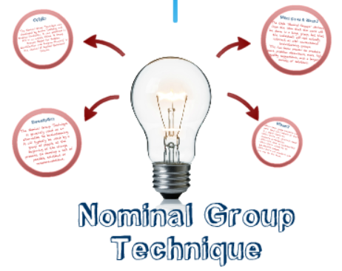
Nominal group technique consists of five general steps, with some variation within the steps in practice:
Generate ideas. Team members may write all ideas on a single sheet of paper or, they may write each idea on a separate note card, such as an index card.
Collect and record ideas. Each team member discloses one idea at a time, going around the team in round-robin fashion until all ideas have been disclosed.
Review and discuss the ideas. Remove any obvious duplicates, discuss each idea briefly to make sure everyone has the same understanding.

Slide 28
4. Vote on the ideas. Each team member, individually, selects and prioritizes a small number of ideas from the total list.
5. Record results. The team leader collects the cards, shuffles them to avoid disclosing a writer’s identity, and enters the priority values from the cards on the general list. Adding all the priority numbers for each idea yields a prioritized list.

Slide 29

◆ To solve problems, project managers must take action. Quality tools help determine the right action to take.
◆ Problem solving and quality improvement involve change. Before you can make a change of some kind, you must understand the forces at play within the organization that influence change.
◆ Force field analysis identifies forces and factors that help or hinder problem solving. Helping forces must be made more influential or hindering forces must be made less influential. It is often easier to reduce the influence of hindering forces than it is to increase the influence of helping forces.
◆ Brainstorming is a tool for creatively and efficiently generating a high volume of ideas free of criticism. During brainstorming, creativity is the rule; no idea is too unconventional for consideration. No criticism, clarification, prioritization, or discussion of ideas is permitted as ideas are presented.

Slide 30
◆ Brainstorming may be employed in an unstructured approach in which team members present their ideas in a free-for-all fashion with no limit on the number of ideas presented at one time and no sequence of presentation among team members.
◆ An affinity diagram may be used to organize and summarize unstructured ideas or issues. Team members associate individual ideas with other ideas that have something in common one at a time until all ideas are grouped together in associated categories. Groups are then given titles that reflect the nature of the association.
◆ Nominal group technique is a method for developing team consensus on priority ranking of ideas or issues free of bias or influence. Ideas may be generated by anonymous input from team members or by a public disclosure method such as brainstorming.
◆ In applying nominal group technique, team members anonymously assign priorities to a small number of ideas. Adding priorities for each idea produces a prioritized list that was reached by team consensus.

Slide 31


