Slide 1
Lecture 1

Slide 2
What is digital forensics?
It is a division of forensics involving the recovery and analysis of data that has been recovered from digital devices.
At one time, the term digital forensics was as a synonym for computer forensics, but now involves all devices capable of storing digital data. No matter what term is used, the goal is to identify, collect, and examine/analyze digital data while preserving its integrity.
Digital forensics is not only about finding the artifact, it is a formal examination/analysis of the digital evidence to prove or to disapprove whether the accused committed the violation

Slide 3
A Brief History of Digital Forensics
By the early 1990s, the International Association of Computer Investigative Specialists (IACIS) introduced training on software for digital forensics
IRS created search-warrant programs
ASR Data created Expert Witness for Macintosh
ILook is currently maintained by the IRS Criminal Investigation Division
AccessData Forensic Toolkit (FTK) is a popular commercial product

Slide 4
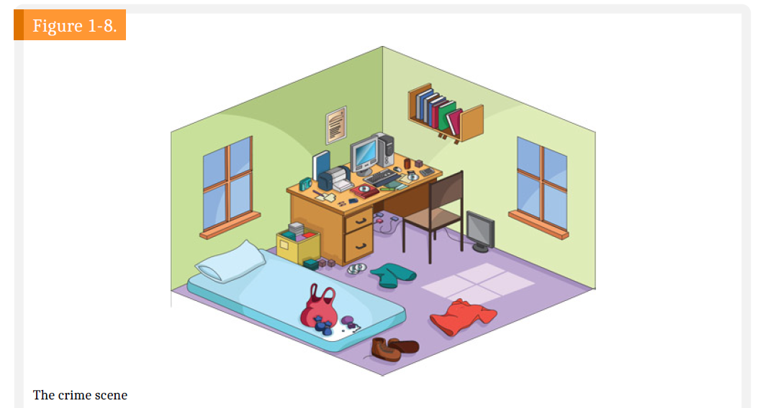
Crime scene مسرح الجريمة

Slide 5

An Overview of a Computer Crime
Computers can contain information that helps law enforcement determine:
  Chain of events leading to a crime
  Evidence that can lead to a conviction

Slide 6
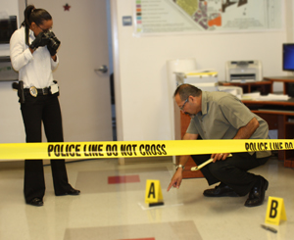
Criminal investigations
The first responder
The investigator
Crime scene technician

Slide 7

First responders
The first responders are the first ones on the scene.
They will do this until the investigator arrives.
The first responder's primary mission is to make the scene safe and secure and ensure that no one can contaminate the evidence.

Slide 8
First responders
The first responder must have basic knowledge of what items could contain digital evidence when they secure the scene.
Potential victims ضحية
Witnesses شاهد
Subjects
Maintain control

Slide 9

Investigators
Upon arriving at the scene, the first responder and the investigator will coordinate, and information sharing will now start
The first responder will provide the basic information
The investigator will want to know whether the first responder(s) touched anything, moved anything, or changed anything within the crime scene.

Slide 10
Investigators
The investigator takes charge of the scene and directs all activity
A chain of custody must be completed and maintained showing who found the item and who maintained control until the completion of the judicial or administrative proceeding.

Slide 11

Crime scene technician
Finally, we come to the crime scene technician.
This can be a sworn محلف or unsworn position within the law enforcement agency.
They have specialized training in the collection of evidence

Slide 12

Planning Your Investigation
A basic investigation plan should include the following activities:
  Acquire the evidence
  Complete an evidence form and establish a chain of custody
  Transport the evidence to a computer forensics lab
  Secure evidence in an approved secure container

Slide 13

Planning Your Investigation
A basic investigation plan (cont’d):
  Prepare your forensics workstation
  Retrieve the evidence from the secure container
  Make a forensic copy of the evidence
  Return the evidence to the secure container
  Process the copied evidence with computer forensics tools

Slide 14

Planning Your Investigation
An evidence custody form helps you document what has been done with the original evidence and its forensics copies
  Also called a chain-of-evidence form
Two types
  Single-evidence form
    Lists each piece of evidence on a separate page
  Multi-evidence form

Slide 15
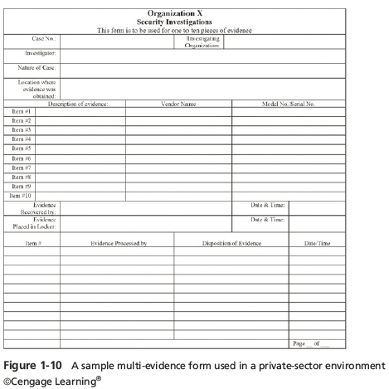
Planning Your Investigation
Notes:
Planning Your Investigation
Figure 1-10 A sample multi-evidence from used on a private-sector environment

Slide 16
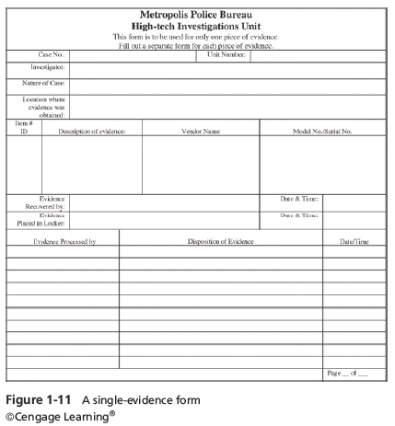
Planning Your Investigation
Notes:
Planning Your Investigation
Figure 1-11 A single-evidence form

Slide 17
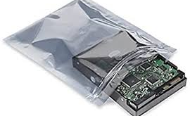
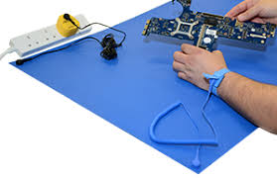
Securing Your Evidence
Use evidence bags to secure and catalog the evidence
Use computer safe products when collecting computer evidence
  Antistatic bags
  Antistatic pads
Use well padded containers
Use evidence tape to seal all openings
  CD drive bays
  Insertion slots for power supply electrical cords and USB cables
Notes:
Securing Your Evidence
Use evidence bags to secure and catalog the evidence
Use computer safe products when collecting computer evidence
Antistatic bags
Antistatic pads
Use well padded containers
Use evidence tape to seal all openings
CD drive bays
Insertion slots for power supply electrical cords and USB cables

Slide 18
Securing Your Evidence
Write your initials on tape to prove that evidence has not been tampered with
Consider computer specific temperature and humidity ranges
Make sure you have a safe environment for transporting and storing it until a secure evidence container is available
Notes:
Securing Your Evidence
Write your initials on tape to prove that evidence has not been tampered with
Consider computer specific temperature and humidity ranges
Make sure you have a safe environment for transporting and storing it until a secure evidence container is available

Slide 19
Portable Devices and Data Storage
Power
  The first rule of securing portables for forensic examination is that if the device is off, leave it off (but keep the battery charged);
  if the device is on, do everything feasible to keep the device powered on until a full examination can be performed

Slide 20

Digital Forensic Process

Slide 21
The forensic analysis process is made up of five subsets
Pre-investigation considerations
Understanding case information and legal issues
Understanding data acquisition
Understanding the analysis process
Reporting your findings

Slide 22

1. Pre-investigation considerations
Determine your budget for hardware, personnel, and training
Before you are ready to begin the investigation, you have to prepare yourself
Some equipment will be reusable, and some will not
The forensic workstation
The response kit
Forensic software
Forensic investigator training

Slide 23
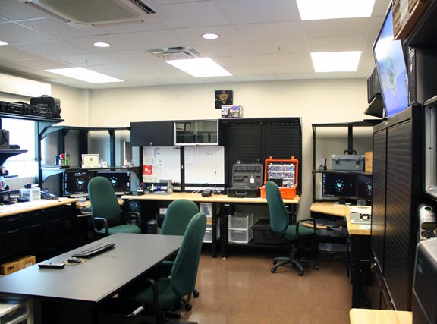
Setting Up Your Workstation for Digital Forensics
Basic requirements
  A workstation running Windows XP or later
  A write-blocker device
  Digital forensics acquisition tool
  Digital forensics analysis tool
  Target drive to receive the source or suspect disk data
  Spare PATA or SATA ports
  USB ports
Notes:
Setting Up Your Workstation for Digital Forensics
Basic requirements
A workstation running Windows XP or later
A write-blocker device
Digital forensics acquisition tool
Digital forensics analysis tool
Target drive to receive the source or suspect disk data
Spare PATA or SATA ports
USB ports

Slide 24
Setting Up your Workstation for Digital Forensics( cont..)
Additional useful items
  Network interface card (NIC)
  Extra USB ports
  FireWire 400/800 ports
  SCSI card
  Disk editor tool
  Text editor tool
  Graphics viewer program
  Other specialized viewing tools
Notes:
Setting Up your Workstation for Digital Forensics
Additional useful items
Network interface card (NIC)
Extra USB ports
FireWire 400/800 ports
SCSI card
Disk editor tool
Text editor tool
Graphics viewer program
Other specialized viewing tools

Slide 25
2. Understanding case information and legal issues
What is the nature of the investigation?
What digital evidence do you expect to find at the scene?
As a government and corporate digital forensic investigator, I have had limits on what I can search for or view on digital devices many times
Civil and Criminal

Slide 26

3. Understanding data acquisition
To collect volatile evidence, we should start from the most to the least volatile
chain of custody

Slide 27
chain of custody
Maintaining the chain of custody is an integral part of preserving and authenticating evidence, both physical and digital, for an
administrative or judicial proceeding. The chain of custody documents all access to the evidence, who accessed it, when it was accessed,
and for what purpose it was accessed

Slide 28
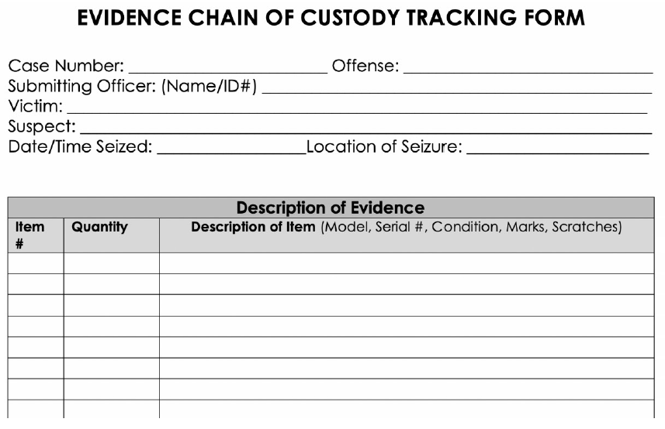

Slide 29
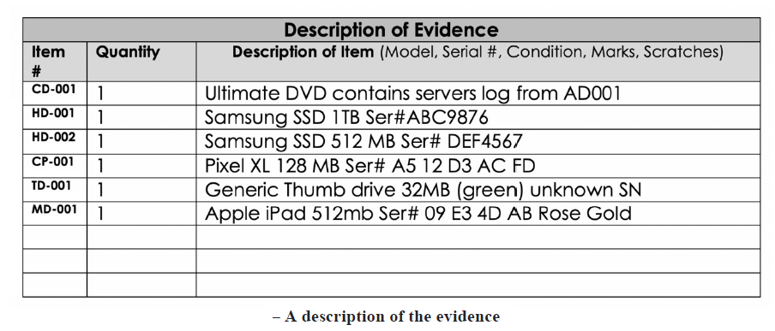

Slide 30
4. Understanding the analysis process
Dates and time zones
Setting the forensic machine and tools to use universal time (UTC)
Hash analysis
File signature analysis
Antivirus

Slide 31
5. Reporting your findings
Communication between the primary investigator and prosecutor
The condition of the evidence containers
The specifics of the storage device (the make, model, serial number, and condition)
Personal identifiers of the suspect, victim, and witness
The forensic hardware used
The forensic software used
What you examined (even if the examination turned up nothing of evidentiary value)
Your findings

Slide 32
References
1.Guide to Computer Forensics and Investigations: Processing Digital Evidence 6th Edition Bill Nelson , Amelia Phillips and Christopher Steuart
Cengage Learning, Inc 2019
2. Learn Computer Forensics, William ottinger, Packt Publishing, 2020
3. The Official CHFI Study Guide (Exam 312-49) for Computer Hacking Forensic Investigators , Dave Kleiman, and etc. Syngress Publishing, Inc. Elsevier, Inc

