Slide 1

Mathematics 2
Dr. Israa Lewaa
Orientation show
MAT122
First Trimaster 2023

Slide 2



Welcome
Welcome Back!
First Trimaster 2023
Mathematics, Dr. Israa Lewaa

Slide 3
Who Am I?
Dr. Israa Lewaa
  Lecturer in Statistics and Mathematics
    Ph.D from Faculty of Economics and Political Science, Cairo University, Statistics Department.
    Thesis: “Statistical data integration Using A latent Class Model”.
    M.Sc from Faculty of Economics and Political Science, Cairo University, Statistics Department.
    B.Sc from Faculty of Economics and Political Science, Cairo University, Statistics Department.
Mathematics, Dr. Israa Lewaa

Slide 4



Who Am I?
  How to reach me
    By email at israa@esu.ac.ae
    ( please include “Mathematics 2” in subject line)
  Office hours
  Discussion Time (Tuesday at 8:00 PM to 9:00 PM) every week
https://scholar.google.com.my/citations?user=3rS1w7UAAAAJ&hl=en
https://www.scopus.com/authid/detail.uri?authorId=57222739185
https://orcid.org/0000-0002-3471-9609
Mathematics, Dr. Israa Lewaa

Slide 5
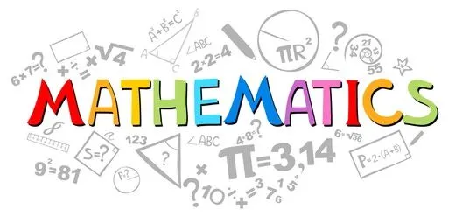
The course that will be taught
Mathematics 2
Mathematics, Dr. Israa Lewaa

Slide 6
Primary Goal of This Course
This course aims to:
  Provide students with concepts of
Linear Algebra,
Matrices,
System of linear Equations,
Vector Space,
Linear Algebra by Spreadsheet,
  and other Mathematical topics.
Mathematics, Dr. Israa Lewaa

Slide 7
Learning Resources:
Credit Hours:
3 credit hours.
  Required Textbook:
  Strang, G. (2006). Linear algebra and its applications. Belmont, CA: Thomson, Brooks/Cole.‏
Mathematics, Dr. Israa Lewaa

Slide 8
What This Course is About
  The course will help students to
Compute with and recognize properties of particular matrices
Formulate, solve, apply, and interpret properties of linear systems
Perform row operations on a matrix
Find the transpose of a matrix
Perform Gaussian elimination
Solve systems of linear equations using the inverse of the coefficient matrix when possible
Perform common matrix operations such as addition, scalar multiplication, multiplication, and transposition
Recognize and use equivalent forms to identify matrices and solve linear systems
Mathematics, Dr. Israa Lewaa

Slide 9
Units of Course Contents
  Lecture Structure:
Module | Course Unit | No.of. Weeks | Contact Hours
1 | Lecture_1_Introduction to linear algebra | 1st | 3
2 | Lecture_2_Scalar and vector | 2nd | 3
3 | Lecture_3_Introduction to matrix algebra | 3 | 3
4 | Lecture_4_Operations on matrices | 4 | 3
5 | Lecture_5_Advanced Topics in matrix algebra | 5 | 3
6 | Lecture_6_Determinants | 6 | 3
7 | Lecture_7_System of linear equations | 7 | 3
8 | Lecture_8_Vector Space | 8 | 3
9 | Lecture_9_Diagonalization | 9 | 3
10 | Lecture_10_Linear Algebra by Spreadsheet | 10 | 3
Mathematics, Dr. Israa Lewaa

Slide 10
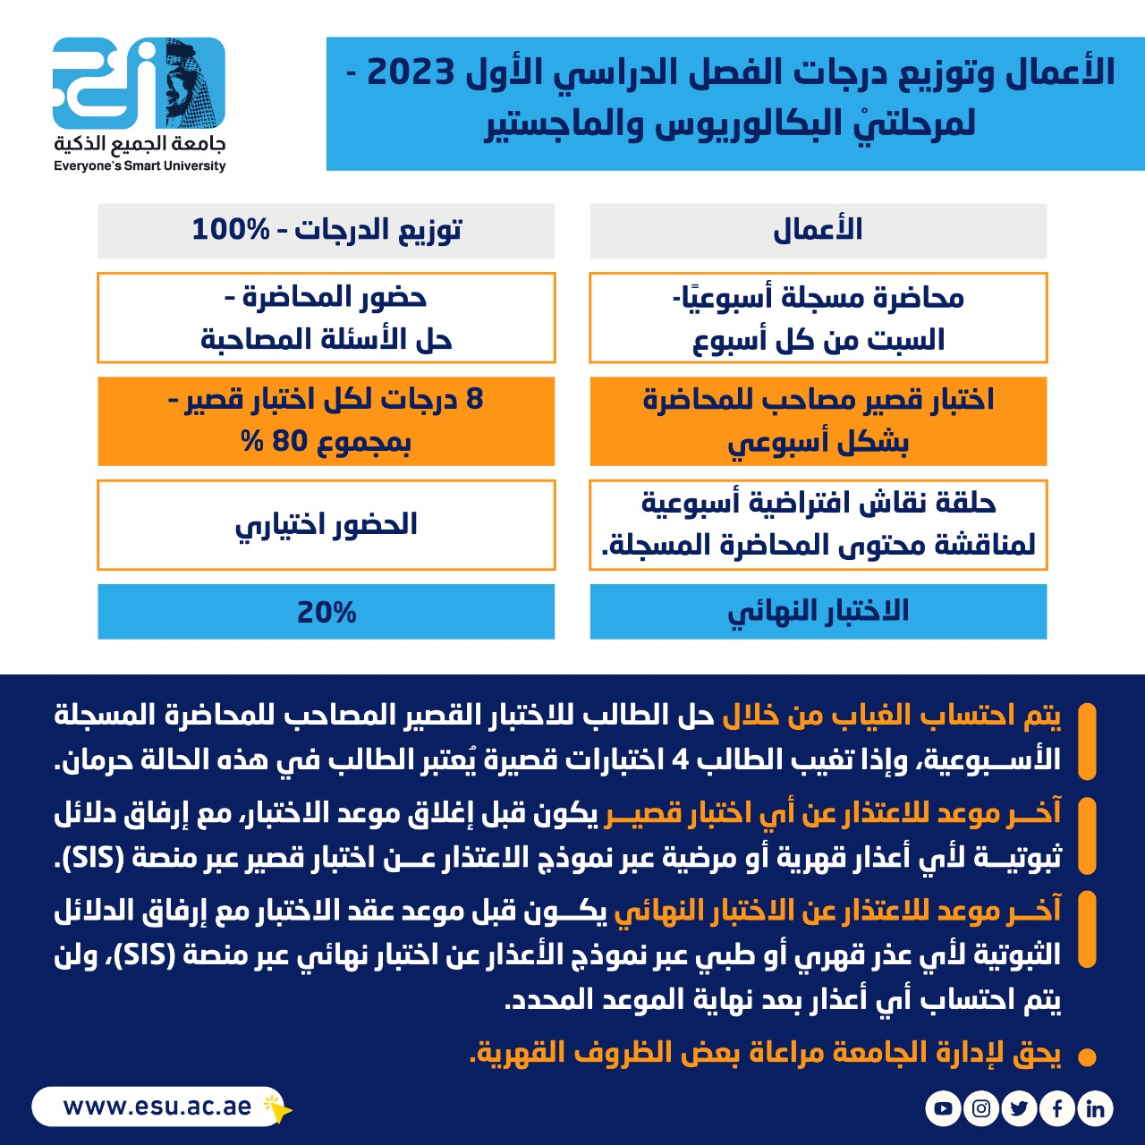
Course Information
  Assessment Method:
اعمال الفصل الدراسي
الأول 2023
Mathematics, Dr. Israa Lewaa

Slide 11
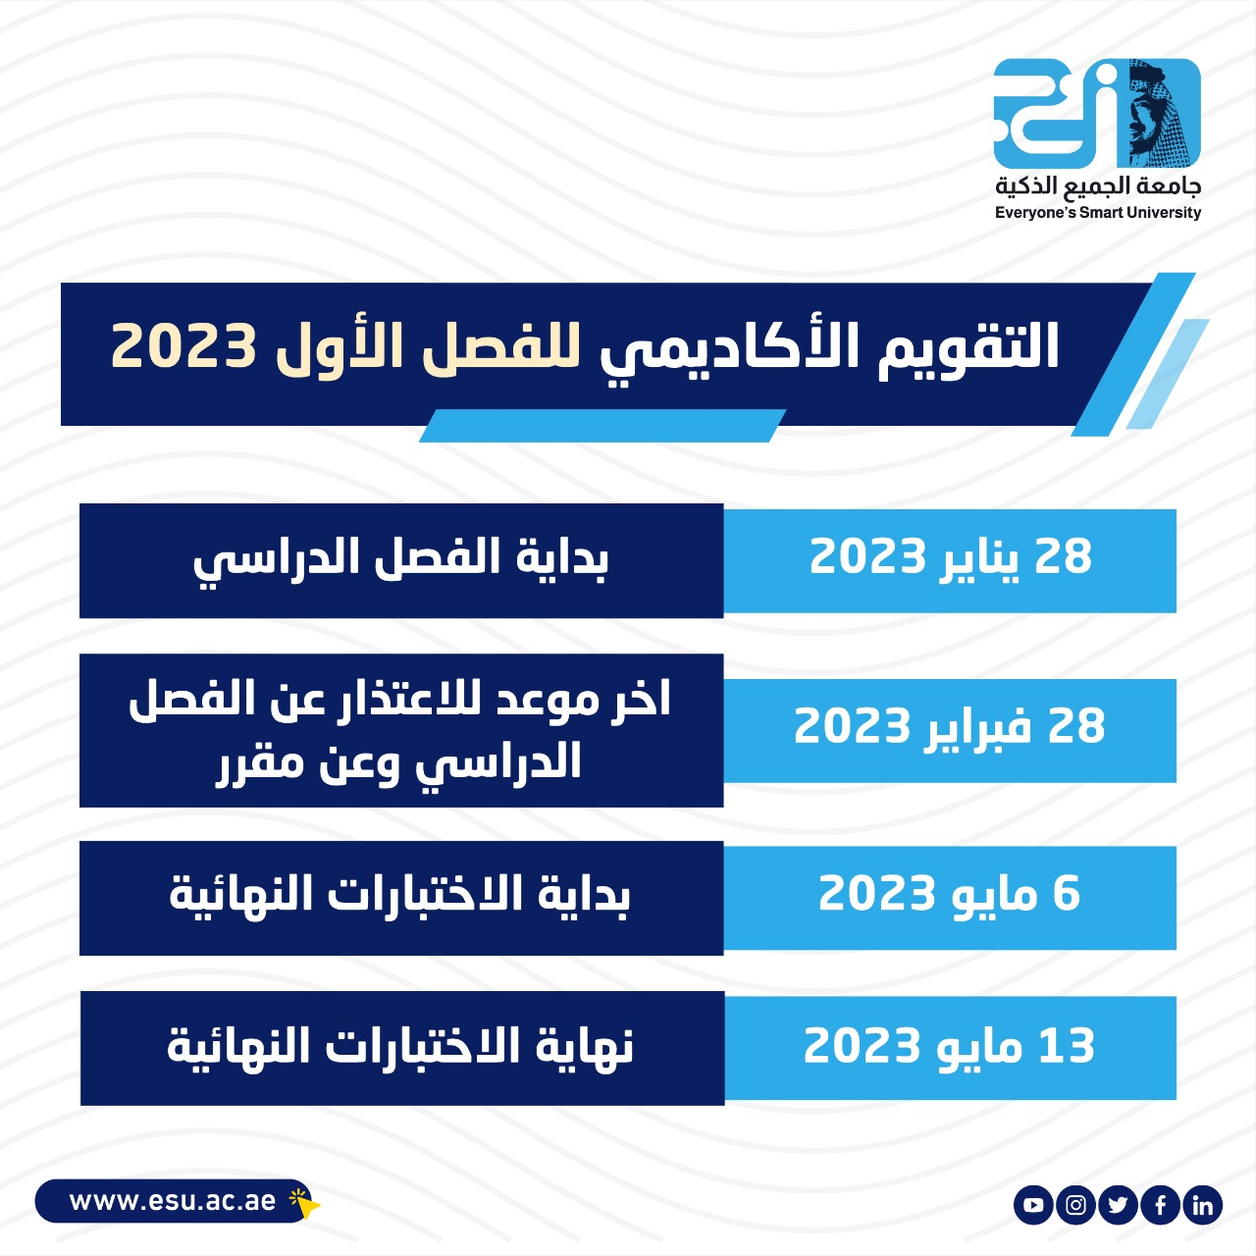
Academic Calendar
First Trimaster 2023 Academic
Calendar
Everyone's smart university
Mathematics, Dr. Israa Lewaa

Slide 12
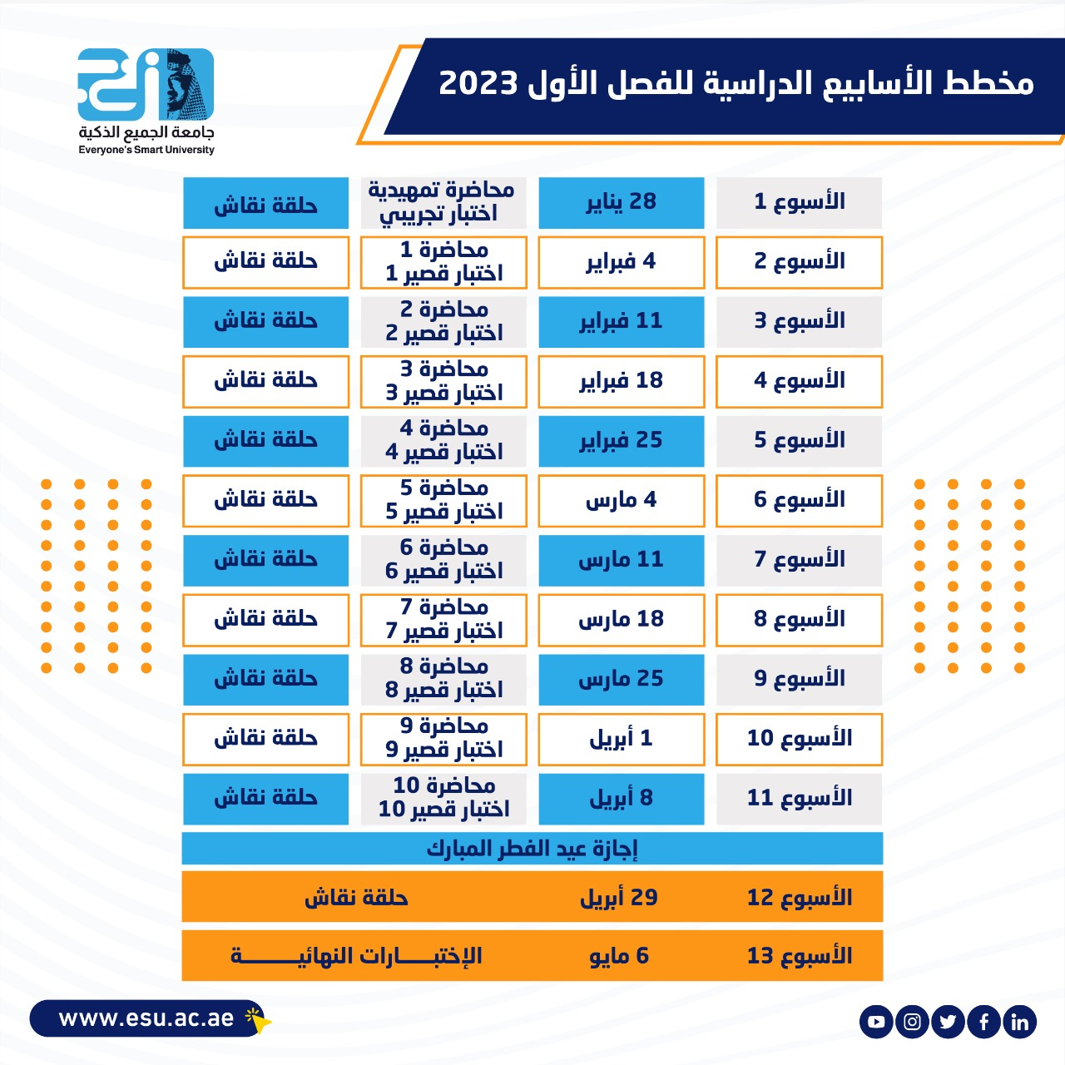
Academic Calendar
مخطط الأسابيع الدراسية
Mathematics, Dr. Israa Lewaa

Slide 13
Academic Calendar
عبر برنامج ZOOM
سيتم تثبيت رابط حلقة النقاش على صفحة المقرر
حلقة النقاش يوم الثلاثاء من كل أسبوع من الساعة 8 إلى الساعة 9
Mathematics, Dr. Israa Lewaa

Slide 14
Academic Calendar
-- اللغة الأساسية في المحاضرات هي:
اللغة الإنجليزية
-- الاختبارات باللغة الإنجليزية مع وجود
ترجمة للسؤال.
Mathematics, Dr. Israa Lewaa

Slide 15


