Slide 1


Using communication tools
Chapter 6
Everyone’s Smart University
PMG112
Project communication

Slide 2
Section 2
Communication tools
Lecture
Putting it into practice
Section 1
Choosing the right tools

Slide 3
Section one
Choosing the right tools

Slide 4
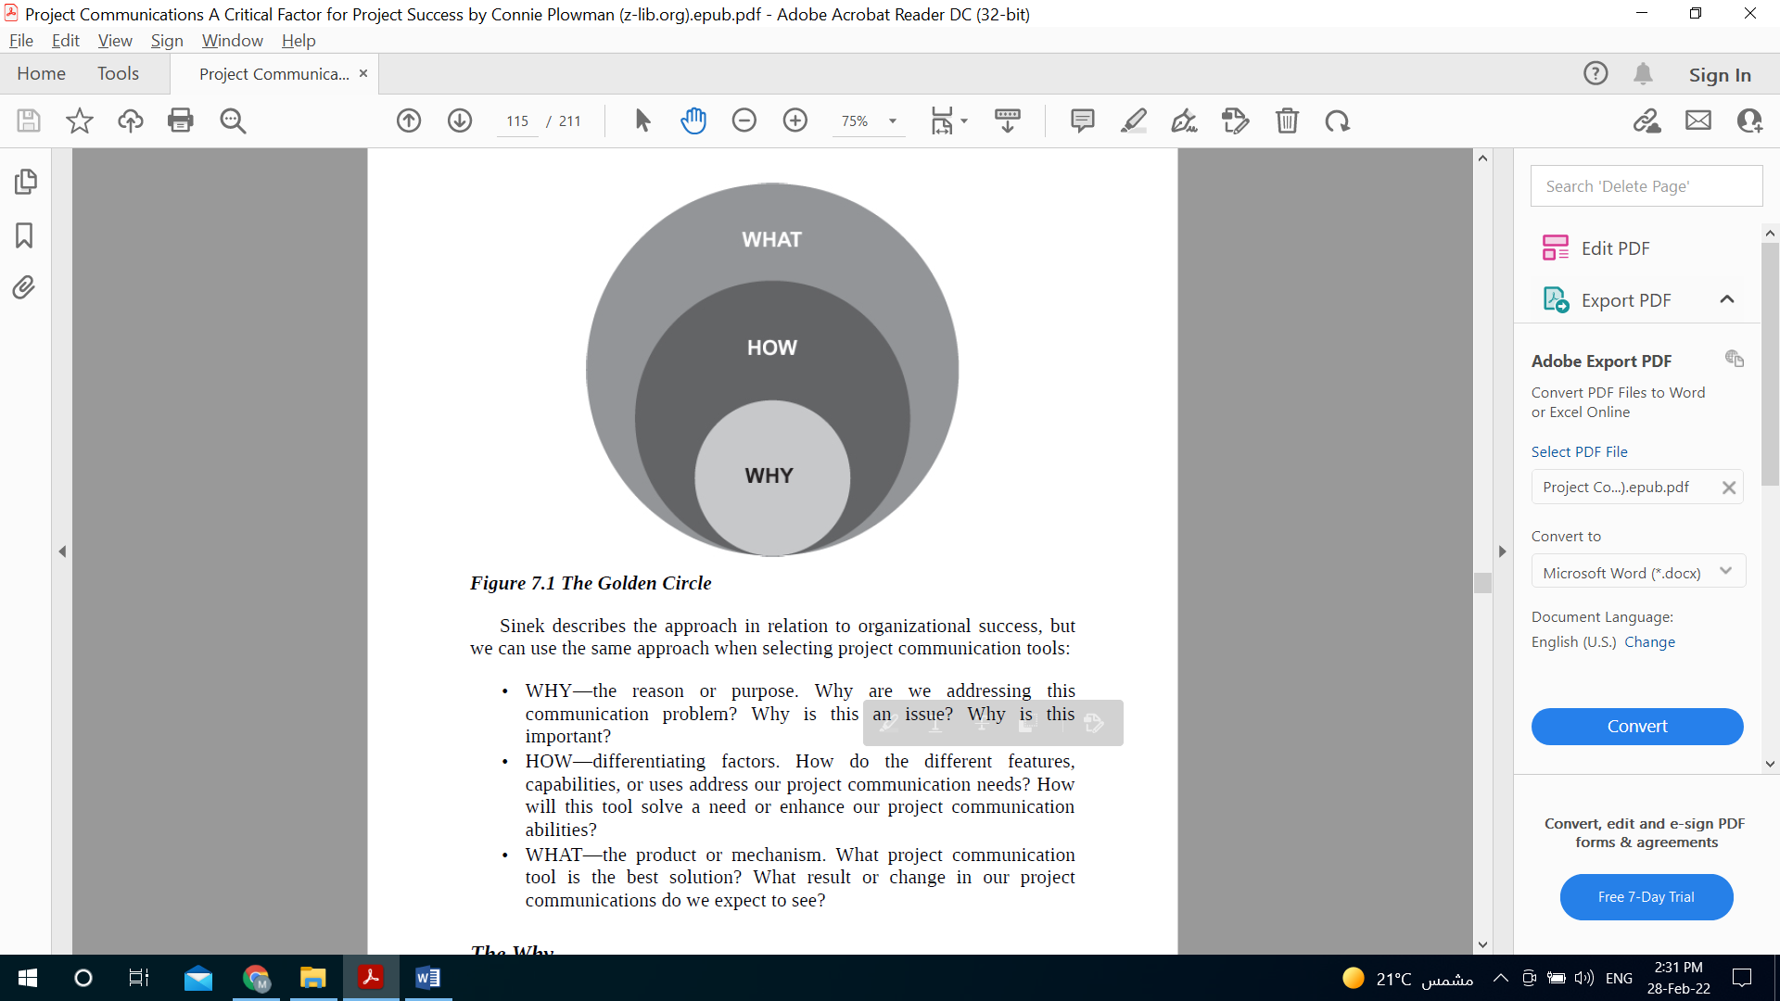
Choosing the right tools
Our emphasis in this section is on the process and importance of choosing the right tool, rather than focusing on specific, brand-name products or services. The concept is to start with WHY, then look at HOW, then answer WHAT

Slide 5
Choosing the right tools
WHY—the reason or purpose. Why are we addressing this communication problem? Why is this an issue? Why is this important?
HOW—differentiating factors. How do the different features, capabilities, or uses address our project communication needs? How will this tool solve a need or enhance our project communication abilities?
WHAT—the product or mechanism. What project communication tool is the best solution? What result or change in our project communications do we expect to see?

Slide 6
Choosing the right tools
The way
Many times, we don’t stop to consider the why. Usually, we start with the tool (the what) and even look at the features (the how), before we address the need (the why).
Let’s say you see a demonstration of a new carpet cleaner (the what). You love the features, accessories and the high-quality cleaning it does (the how), and you buy it—except you don’t have any carpets to clean (missing the why)! The same is true in projects.

Slide 7
Choosing the right tools
The way
We get a new communications tool. We start using it. We then discover it does not meet our communication needs. This creates even greater communication problems on the project: more misunderstandings, more frustration, more waste of time and resources, and more uncertainty.

Slide 8
Choosing the right tools
The way
How can we avoid this?
By starting with the why! Why are we addressing this communication need? Why is this an issue? Why is this important to the project, team, and stakeholders?
Focus first on the why— the reason or the purpose. Once these questions are answered, the next steps of how and what will logically follow.

Slide 9
Choosing the right tools
The How
Next, establish a list of criteria based on your project needs, organization, team, budget, and other influencing factors. You should be focusing “on the criteria that matter” when selecting the right product or tool.
These criteria are the how—how the tool can accomplish the why. This is an excellent place to begin. Take a look at the list and modify it to build your own set of selection criteria.

Slide 10
Choosing the right tools
The How
criteria to consider when selecting a project tool
Task management: How is managing tasks handled? Is it a simple tool or do we need complex features?
Tracking: How does the tool track time, tasks, budgets, resources, and progress?
Visibility: How are dashboards and project reports shown?
Accessibility: How is the online access?

Slide 11
Choosing the right tools
The How
criteria to consider when selecting a project tool
Mobility: How does a mobile app help our project team manage their work?
Features: How are collaboration features handled, like discussions or online chats?
Security: How is security addressed so that we know our data is safe?
Integration: How easy is it to integrate with our current environment including compatibility with other products we use?

Slide 12
Choosing the right tools
The How
criteria to consider when selecting a project tool
Usability: How is the usability? Is it simple to use so that the team can start using it immediately?
Cost: How does it fit within our budget?

Slide 13
Choosing the right tools
The How
The importance of these criteria
A criteria list provides you with a focused roadmap for your selection process so that you don’t get off track with criteria that do not matter.
In evaluating tools, you also need to consider how the communication takes place—is it synchronous (meaning real-time or contemporaneous) or asynchronous (not interactive or not at the same time)? A combination of both synchronous and asynchronous communication tools is required for all types of project teams and stakeholders.

Slide 14
Choosing the right tools
The How
Criteria’s groups
Once you have established your criteria list and have considered the need for synchronous and asynchronous communications, the next step is to prioritize the criteria in order of importance. Categorize the features into three groups:
Group 1: Criteria you must have
Group 2: Criteria you would like to have
Group 3: Criteria you don’t need

Slide 15
Choosing the right tools
The How
Why is putting Criteria in groups important?
Putting together a criteria list and establishing priorities before looking at the actual communication tools—regardless of the type of tool—will help you throughout the selection process and increase the probability of choosing and using the most effective tools that fit your project needs.

Slide 16
Choosing the right tools
The What
Now that we have looked at the why and the how, it is time to look at the what—the actual project communication tools that you might consider.
The goal here is to find and select tools that can accomplish the why while meeting all of the criteria you have established in the how.

Slide 17
Section two
Communication tools

Slide 18
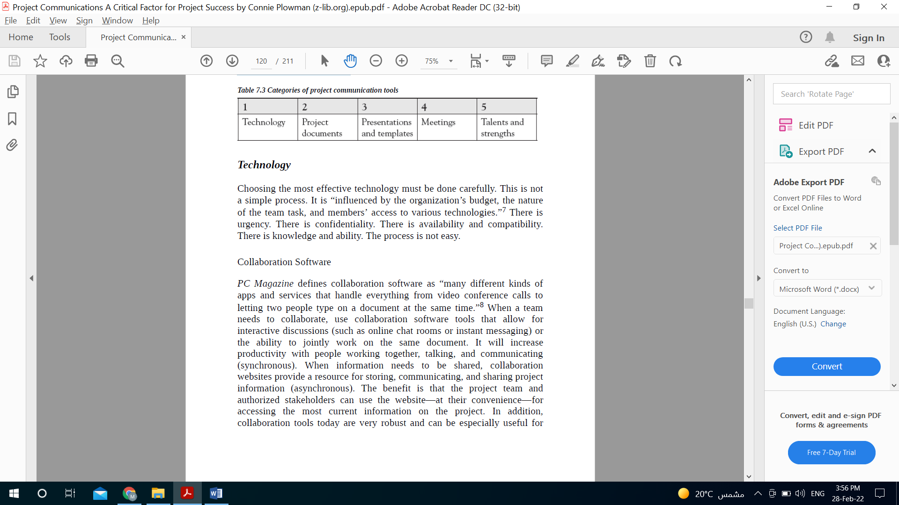
Communication tools
In managing projects and working with project teams and stakeholders, you should be using a collection of project communication tools. Each tool in your collection has its own purpose and benefits. When it comes to project communications, there is no “one size fits all!”
To get started, we will look at five general categories of project communication tools. There may be other classifications, but let’s start with these.

Slide 19
Communication tools
Technology
collaboration tools
Teleconferencing
Social Media
Video Conferencing
E-mail
Choosing the most effective technology must be done carefully. This is not a simple process. It is “influenced by the organization’s budget, the nature of the team task, and members’ access to various technologies.”
There is urgency. There is confidentiality. There is availability and compatibility. There is knowledge and ability. The process is not easy.

Slide 20

Communication tools
Technology
Collaboration tools
Collaboration Software PC Magazine defines collaboration software as “many different kinds of apps and services that handle everything from video conference calls to letting two people type on a document at the same time.”

Slide 21
Communication tools
Technology
When should we use Collaboration tools?
When a team needs to collaborate, use collaboration software tools that allow for interactive discussions (such as online chat rooms or instant messaging).
when you need the ability to jointly work on the same document. It will increase productivity with people working together, talking, and communicating (synchronous).
When information needs to be shared, collaboration websites provide a resource for storing, communicating, and sharing project information (asynchronous).

Slide 22
Communication tools
Technology
Benefits of Collaboration tools?
The benefit is that the project team and authorized stakeholders can use the website—at their convenience—for accessing the most current information on the project.
In addition, collaboration tools today are very robust and can be especially useful for teams who are not colocated. They also cut down significantly on e-mail clutter.

Slide 23

Communication tools
Technology
Video Conferencing
The value in using a video conferencing tool as a communication method is that you can see everyone. Consider it another form of face-to-face meeting.
You benefit from the verbal communication, as well as seeing the nonverbal communication of gestures, body language, reactions, or level of participation.
Furthermore, you can share a screen to show participants documents, presentations, videos, and other information which can facilitate even greater understanding and collaboration.

Slide 24
Communication tools
Technology
Benefits of Video Conferencing
The chat feature within many video conferencing tools provides an added mechanism for asking questions, getting clarification, and engaging online with other participants.
The downside of video conferencing is that not everyone has the required bandwidth, or some may have difficulty accessing it or may not know how to use it effectively.

Slide 25
Communication tools
Technology
Benefits of Video Conferencing
The benefit is that it is easier to schedule as it involves less complicated technology than a video conference call.
Many teleconferencing and video conferencing tools also allow the meeting to be recorded so that team members who are absent can listen to it at a later time.

Slide 26
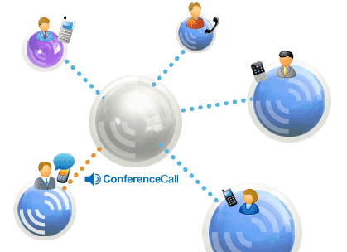
Communication tools
Technology
Teleconferencing
Teleconferencing requires an excellent facilitator to manage the conversation so that participants are not talking all at the same time and the conversation (and agenda topics) keeps moving forward.
A downside of these tools is that you can only hear the participants; you cannot see them.

Slide 27

Communication tools
Technology
E-mail
While e-mail is part of our daily routine, it is considered one-way communication (asynchronous). You send a message. Then you wait. And wait. And wait until you get a response, if any. E-mail should be used for documenting conversations, not conducting conversations.

Slide 28
Communication tools
Technology
Benefits of E-mail
The benefit of email is that it provides you with project documentation. The downside of email is urgency (others may not respond as quickly as you need) and understanding (the tone of your written message may be different from the tone of how your message is read).

Slide 29
Communication tools
Technology
E-mail
In working on projects, look for tools that enable a two-way dialogue, not one-way. Remember: Just because you hit the “send” button on an e-mail does not mean that you have actually communicated. Just because you hit the “send” button on an e-mail does not mean that you have actually communicated.

Slide 30

Communication tools
Technology
Social Media
Using social media tools to communicate in a project is becoming more prevalent. Social media provides an avenue for sharing project information with stakeholders in a public, low-cost, and easily accessible way.

Slide 31
Communication tools
Technology
Benefits of Social Media
This can be beneficial in large projects that affect members of the broader external community as a means to provide them with current information about the project status and how it affects them as it progresses.
It also provides stakeholders with a means of providing feedback, and can be measured through engagement metrics available in many social platforms.

Slide 32
Communication tools
Technology
Social Media
However, social media is not the right tool for every project and every stakeholder group. Carefully consider the why, how, and what of using social media as a tool, and ensure it satisfies your tool selection criteria before moving forward.

Slide 34

Communication tools
Project documents
Project repots
Project Schedule
Milestone Schedule
Status Reports
Kanban Board

Slide 35

Communication tools
Project documents
Project repots
the report is simply for documentation purposes. If you know there is information in the report that certain stakeholders need to know, communicate it separately. At minimum, when you send the report, add an introductory note that uses bullet points to highlight specific aspects of the report you want to ensure they see.

Slide 36
Communication tools
Project documents
Project repots
The benefit of project reports is that critical project information has been documented.
The challenge: making sure that project reports, decision logs, issue logs, and other reports have a purpose and are being used (and read)!

Slide 37

Communication tools
Project documents
Project Schedule
One of the most powerful tools we have for communicating about the project is the project schedule. The project schedule is highly detailed and communicates the tasks, milestones, planned and actual start/end dates, durations, dependencies, resources, and other detailed information.

Slide 38
Communication tools
Project documents
Project Schedule
One of the most powerful tools we have for communicating about the project is the project schedule. The project schedule is highly detailed and communicates the tasks, milestones, planned and actual start/end dates, durations, dependencies, resources, and other detailed information.
It brings the pieces (information) from other sections of the project plan into one place—the schedule.

Slide 39
Communication tools
Project documents
How to use Project Schedule
To improve your project communications, consider printing the project schedule as a large wall chart, or post it on a virtual team wall. As you start doing the work on the project, mark your project schedule in different colors.
When a task is late, communicate this by highlighting the task in a bright color with a large arrow or circle.
When a task is completed early, communicate this by highlighting the task on the schedule in a different bright color and add an icon (star, exclamation point, etc.).

Slide 40
Communication tools
Project documents
Benefits of Project Schedule
The benefit of having a marked-up project schedule that is visible to everyone is communicating progress, problems, and commitment. Visibility is an excellent communication tool.
For example, if you are assigned a task and it is late, it is circled for everyone to see! And for those tasks that are completed early or for other achievements, it is important to communicate and celebrate successes (large and small) throughout the life of the project.

Slide 41
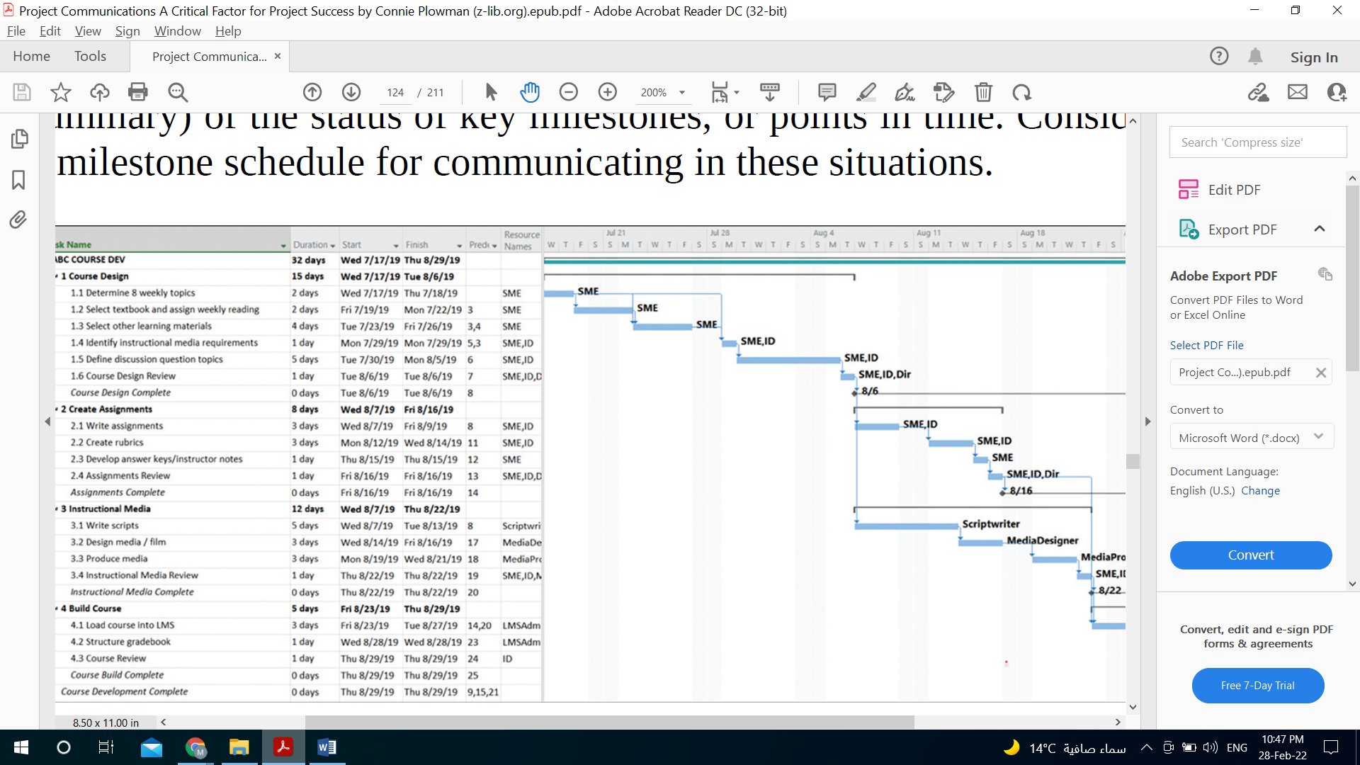
Communication tools
Project documents
Project Schedule

Slide 42
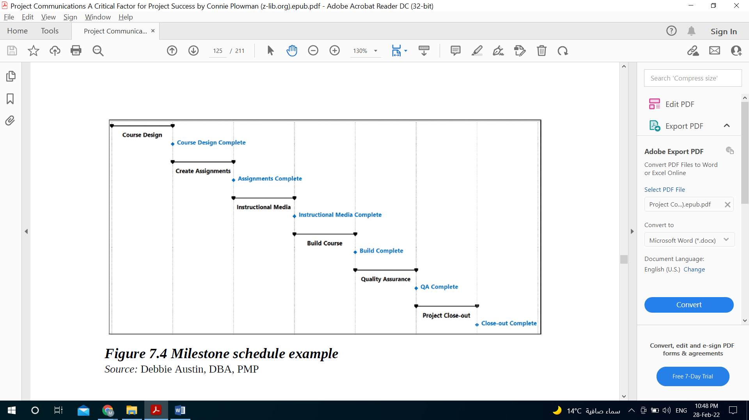
Communication tools
Project documents
Milestone Schedule
By definition, a milestone schedule is “a type of schedule that presents milestones with planned dates.

Slide 43
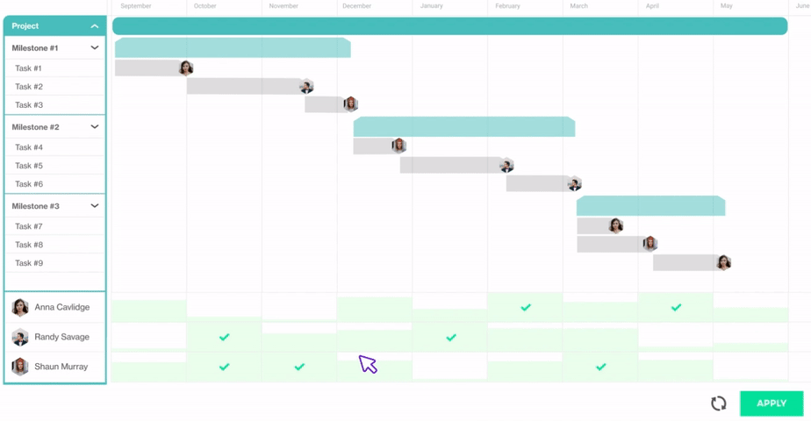
Communication tools
Project documents
Milestone Schedule

Slide 44
Communication tools
Project documents
Benefits of Milestone Schedule
The benefit of using a milestone schedule as a communication tool is that sometimes key stakeholders, project sponsors, or management may only want a high-level view (or summary) of the status of key milestones, or points in time. Consider using a milestone schedule for communicating in these situations.

Slide 45
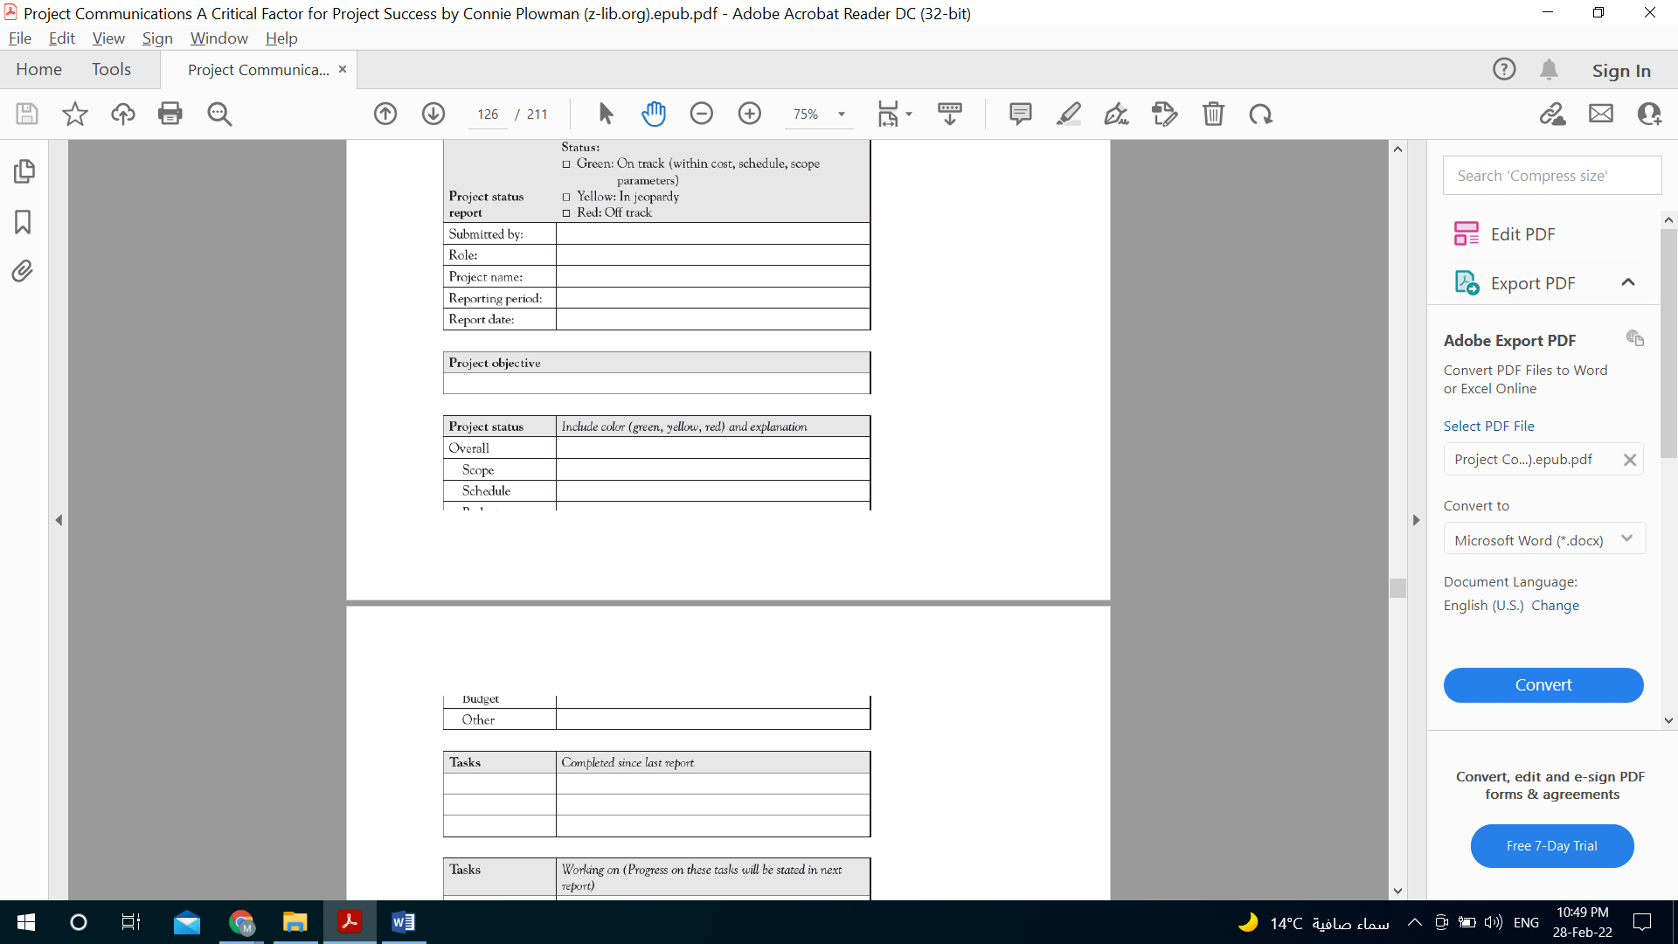
Communication tools
Project documents
Status Reports
Status reports allow us to communicate project progress at regular intervals.

Slide 46
Communication tools
Project documents
How to use Status Reports
The frequency and formality of communicating project status will depend on your project.
Status reports do not need to be complicated. They should be easy to read and preferably a maximum of one page (depending on the size and complexity of the project).
Using a template ensures that a constant format and consistent information is being communicated.

Slide 47
Communication tools
Project documents
How to use Status Reports
Don’t forget to add a section to your status report on recent lessons learned! Post your status reports on the collaboration website or in a shared folder for easy access by the project sponsor, project team, management, and other key stakeholders.
Make sure that your stakeholders are receiving current information in the status reports, and not getting status reports with outdated details.
The timing of your status report distribution should be outlined in your project communications management plan.

Slide 48
Communication tools
Project documents
Benefits of Status Reports
The benefit in consistently using status reports is that they help answer the question, “Where are we on the project?” for everyone involved.

Slide 49
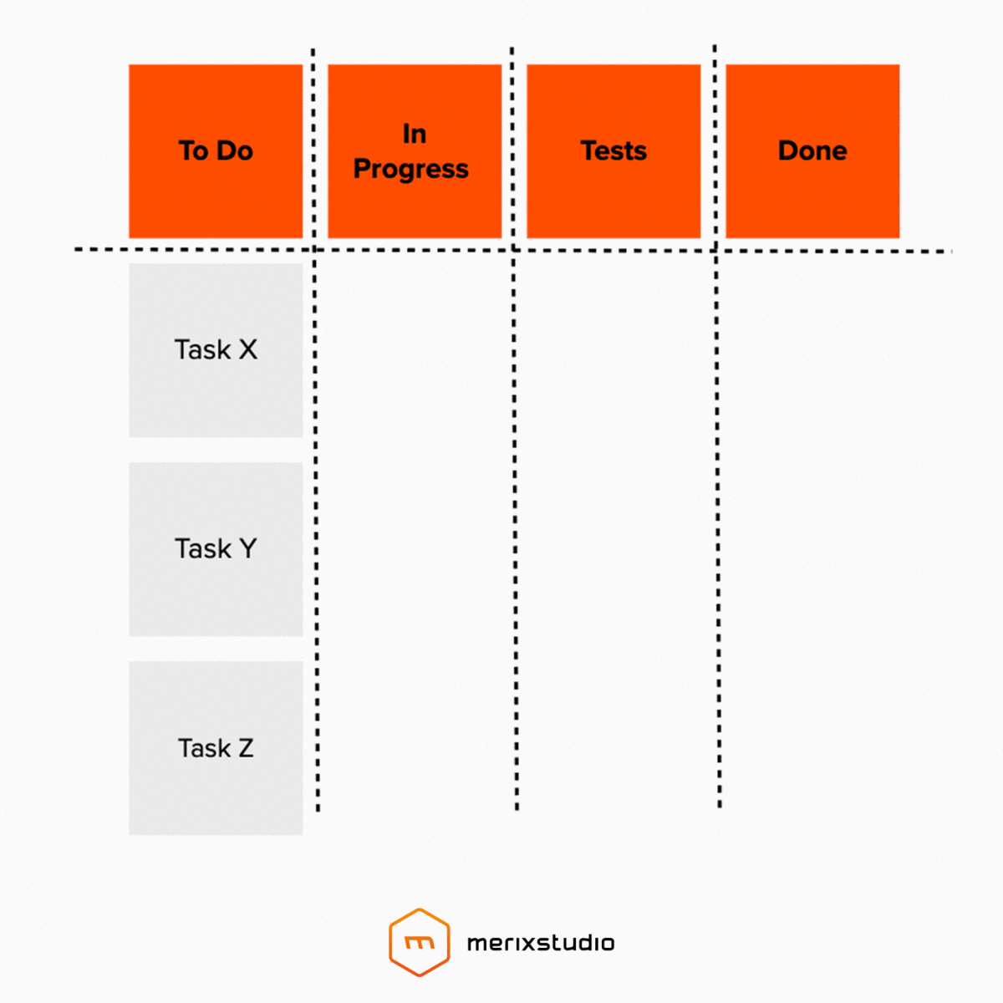
Communication tools
Project documents
Kanban Board
The Kanban board is becoming a more common tool, particularly for agile project teams. Basically, it communicates what tasks need to be done (to do), what is being worked on (in progress), and what has been done (completed).

Slide 50
Communication tools
Project documents
Kanban Board
There may be other elements you include on your Kanban board to fit your needs.
Each task is represented by a “card” and the card moves across the board as the work progresses.
Consider it a visible status report or a different, more visual way to communicate workload on the project.

Slide 51
Communication tools
Project documents
Benefits of Kanban Board
The benefit is that it is a great visual to show to do, doing, and done. It also helps in showing how much work is waiting to be done, the need to establish priorities, and visibility on problems (or work that is stalled or blocked).

Slide 52
Communication tools
In managing projects and working with project teams and stakeholders, you should be using a collection of project communication tools. Each tool in your collection has its own purpose and benefits. When it comes to project communications, there is no “one size fits all!”
To get started, we will look at five general categories of project communication tools. There may be other classifications, but let’s start with these.

Slide 53


