Slide 1


Human Resource
Management
HRM 611
Lecture 4: Workforce Planning & Recruitment
Prepared by Dr. Sahar Ahmed

Slide 2

Ch.
04
Main Topics
List the steps in the recruitment and selection process.
Explain the main techniques used in employment planning and forecasting.
Explain and give examples for the need for effective recruiting.
Name and describe the main internal sources of candidates.
List and discuss the main outside sources of candidates.
Develop a help wanted ad.
Explain how to recruit a more diverse workforce.
www.midocean.ae

Slide 3
Chapter
The Recruitment and Selection Process
04
Decide what positions to fill through personnel planning and forecasting.
Build a candidate pool by recruiting internal or external candidates.
Have candidates' complete application forms and undergo initial screening interviews.
Use selection tools to identify viable candidates.
Decide who to make an offer to, by having the supervisor and others interview the candidates.
www.midocean.ae
Notes:
Job analysis identifies the duties and human requirements for each of the company’s jobs. The next step is to decide how many of these jobs you need to fill, and to recruit and select employees for them.

Slide 4
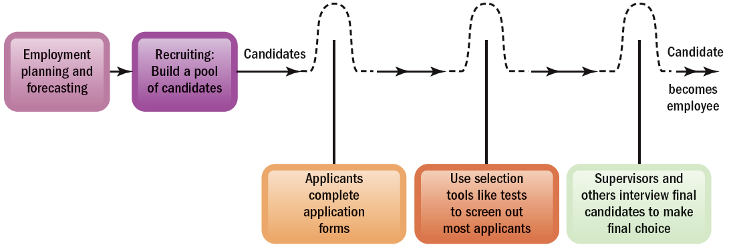
Chapter
04
Steps in Recruitment and Selection Process
The recruitment and selection process is a series of hurdles aimed
at selecting the best candidate for the job.
www.midocean.ae
Notes:
The best way to envision recruitment and selection is as a series of hurdles as shown in Figure 5-1.

Slide 5
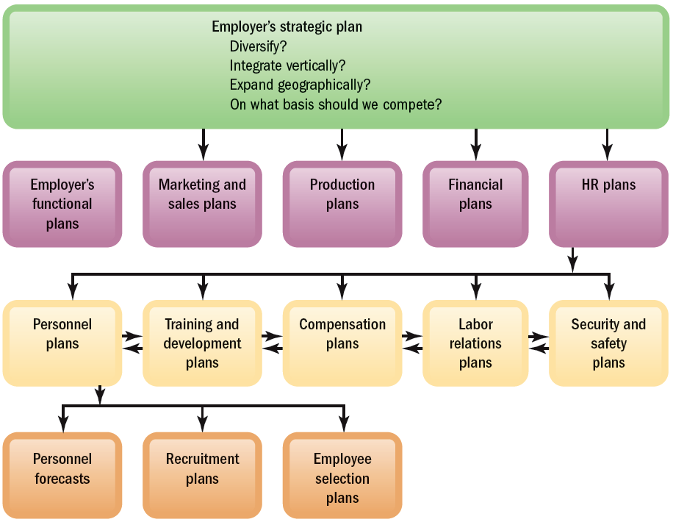
Chapter
04
FIGURE 5–2 Linking Employer’s Strategy to Plans
www.midocean.ae
Notes:
Employment planning should flow from the firm’s strategic plans. Figure 5-2 summarizes the link between strategic and personnel planning.

Slide 6
Chapter
04
Workforce Planning and Forecasting
Employment or Personnel Planning
  The process of deciding what positions the firm will have to fill, and how to fill them.
Strategic Alignment: Effective workforce planning should be closely aligned with the organization's overall strategy. Changes in business direction, such as entering new markets or reducing costs, will directly impact the types of positions required.
For example, a company expanding internationally will need
to hire personnel for its overseas operations.
www.midocean.ae
Notes:
Employment (or personnel) planning is the process of deciding what positions the firm will have to fill, and how to fill them. It embraces all future positions, from maintenance clerk to CEO. However, most firms call the process of deciding how to fill executive jobs succession planning.
Like all good plans, personnel plans require some forecasts or estimates, in this case, of three things: personnel needs, the supply of inside candidates, and the likely supply of outside candidates.

Slide 7
Chapter
04
Workforce Planning and Forecasting
Forecasting Needs: Workforce planning requires forecasting three key areas:
Personnel Needs: Estimating the number and types of employees needed to achieve organizational objectives.
Internal Supply: Assessing the availability of qualified candidates within the organization.
External Supply: Evaluating the potential pool of candidates available in the external labor market.
Gap Analysis: Once these forecasts are made, the next step is to identify any gaps between the projected demand for labor and the available supply. This analysis helps determine the actions necessary to fill the anticipated staffing needs.
www.midocean.ae
Notes:
Employment (or personnel) planning is the process of deciding what positions the firm will have to fill, and how to fill them. It embraces all future positions, from maintenance clerk to CEO. However, most firms call the process of deciding how to fill executive jobs succession planning.
Like all good plans, personnel plans require some forecasts or estimates, in this case, of three things: personnel needs, the supply of inside candidates, and the likely supply of outside candidates.

Slide 8
Chapter
04
Forecasting Personnel Needs
Labor demand forecasting estimates the number of employees needed to meet product/service demand.
Influencing factors: Strategic goals, turnover rates, productivity levels.
Short-term forecasting: Focuses on daily, weekly, and seasonal forecasts.
Long-term forecasting: Analyzes industry trends, economic indicators, and potential business changes.
Importance: Helps organizations anticipate changes and adjust workforce plans accordingly.
www.midocean.ae
Notes:
Employment (or personnel) planning is the process of deciding what positions the firm will have to fill, and how to fill them. It embraces all future positions, from maintenance clerk to CEO. However, most firms call the process of deciding how to fill executive jobs succession planning.
Like all good plans, personnel plans require some forecasts or estimates, in this case, of three things: personnel needs, the supply of inside candidates, and the likely supply of outside candidates.

Slide 9
Chapter
04
Forecasting Personnel Needs Tools
Trend Analysis
Trend analysis involves examining changes in employment levels over time to identify patterns and trends. By analyzing historical data, organizations can gain insights into future staffing requirements. However, it's important to consider other factors that may influence employment levels, such as productivity, demographics, and voluntary turnover.
Ratio Analysis
Ratio analysis is another simple forecasting method that involves comparing historical relationships between a causal factor (like sales volume) and the number of employees required. By analyzing these ratios, organizations can estimate future staffing needs based on projected changes in the causal factor. However, it's important to note that productivity changes can affect these ratios.
www.midocean.ae
Notes:
Employment (or personnel) planning is the process of deciding what positions the firm will have to fill, and how to fill them. It embraces all future positions, from maintenance clerk to CEO. However, most firms call the process of deciding how to fill executive jobs succession planning.
Like all good plans, personnel plans require some forecasts or estimates, in this case, of three things: personnel needs, the supply of inside candidates, and the likely supply of outside candidates.

Slide 10
Chapter
04
Forecasting Personnel Needs Tools
Scatter Plots
Scatter plots are visual representations of the relationship between two variables, such as sales and staffing levels. By analyzing scatter plots, organizations can identify patterns and estimate future staffing needs based on projected changes in business activity.
Managerial Judgment
While forecasting tools provide valuable insights, managerial judgment is essential for interpreting the results and making informed decisions. Historical trends, ratios, and relationships may not continue indefinitely, and subjective factors should be considered when making adjustments to forecasts.
www.midocean.ae
Notes:
Employment (or personnel) planning is the process of deciding what positions the firm will have to fill, and how to fill them. It embraces all future positions, from maintenance clerk to CEO. However, most firms call the process of deciding how to fill executive jobs succession planning.
Like all good plans, personnel plans require some forecasts or estimates, in this case, of three things: personnel needs, the supply of inside candidates, and the likely supply of outside candidates.

Slide 11
Forecasting Personnel Needs
Chapter
04
Forecasting Tools
Trend analysis
Ratio analysis
Scatter plotting
www.midocean.ae
Notes:
Trend analysis can provide an initial estimate of future staffing needs, but employment levels rarely depend just on the passage of time. Other factors (like changes in sales volume and productivity) also affect staffing needs.
Ratio analysis provides forecasts based on the historical ratio between (1) some causal factor (like sales volume) and (2) the number of employees required (such as number of salespeople).
A scatter plot shows graphically how two variables—such as sales and your firm’s staffing levels—are related. If they are, and then if you can forecast the business activity (like sales), you should also be able to estimate your personnel needs.

Slide 12
Chapter
Drawbacks to Traditional Forecasting Techniques
04
They focus on projections and historical relationships.
They do not consider the impact of strategic initiatives on future staffing levels.
They validate and institutionalize present planning processes and the usual ways of doing things.
www.midocean.ae
Notes:
Managers obviously need to consider other factors too. These include projected turnover, decisions to upgrade (or downgrade) products or services, productivity changes, and financial resources.

Slide 13
Chapter
Using Computers to Forecast Personnel Requirements
04
Computerized Forecasts
Software that estimates future staffing needs by:
Projecting sales, volume of production, and personnel required to maintain different volumes of output.
Forecasting staffing levels for direct labor, indirect staff, and exempt staff.
Creating metrics for direct labor hours and three sales projection scenarios minimum, maximum, and probable.
www.midocean.ae
Notes:
Computerized forecasts enable the manager to build more variables into his or her personnel projections. Newer systems particularly rely on mathematically setting clear goals.
Whichever forecasting tool you use, managerial judgment should play a big role. It’s rare that any historical trend, ratio, or relationship will simply continue. You will therefore have to modify the forecast based on subjective factors—such as the feeling that more employees will be quitting—you believe will be important.

Slide 14
Forecasting Internal Supply of Candidates
Chapter
04
Qualification Inventories
Manual systems and replacement charts
Computerized skills inventories
www.midocean.ae
Notes:
Knowing your staffing needs satisfies only half the staffing equation. Next, you have to estimate the likely supply of both inside and outside candidates. Most firms start with the inside candidates.
Department managers or owners of smaller firms often use manual devices to track employee qualifications. Thus a personnel inventory and development record form compiles qualifications information on each employee.
Computerized skills inventory data typically include items like work experience codes, product knowledge, the employee’s level of familiarity with the employer’s product lines or services, the person’s industry experience, and formal education.

Slide 15
Chapter
04
Forecasting Internal Supply of Candidates
  Assess internal candidates: Evaluate skills, experience, and qualifications.
  Prioritize internal hires: Cost-effective, boosts morale.
  Understand employee skills: Conduct reviews, gather information.
  Use qualifications inventories: Centralized database for candidate identification.
  Utilize replacement charts: Track potential successors for key positions.
  Consider position replacement cards: Detailed information on potential replacements.
www.midocean.ae
Notes:
Computerized forecasts enable the manager to build more variables into his or her personnel projections. Newer systems particularly rely on mathematically setting clear goals.
Whichever forecasting tool you use, managerial judgment should play a big role. It’s rare that any historical trend, ratio, or relationship will simply continue. You will therefore have to modify the forecast based on subjective factors—such as the feeling that more employees will be quitting—you believe will be important.

Slide 16
Chapter
04
Computerized skills inventories
Benefits:
Improved efficiency for tracking qualifications of many employees.
Enhanced planning for anticipating shortages and facilitating recruitment and training.
How it works:
Data entry: Employees, supervisors, and HR managers input employee information.
Search functionality: Managers search for qualified candidates based on specific job requirements.
www.midocean.ae
Notes:
Computerized forecasts enable the manager to build more variables into his or her personnel projections. Newer systems particularly rely on mathematically setting clear goals.
Whichever forecasting tool you use, managerial judgment should play a big role. It’s rare that any historical trend, ratio, or relationship will simply continue. You will therefore have to modify the forecast based on subjective factors—such as the feeling that more employees will be quitting—you believe will be important.

Slide 17

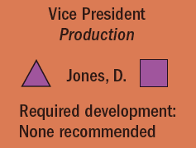
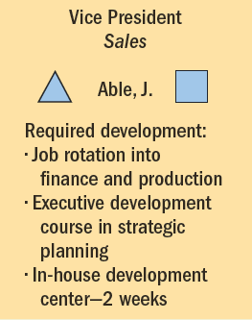
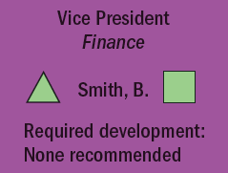
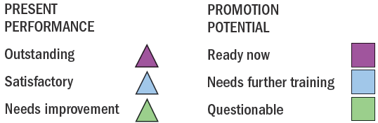
Chapter
Management Replacement Chart
04
www.midocean.ae
Notes:
Figure 5-4 is a personnel replacement chart for some of a firm’s top positions. It shows the present performance and promotability for each position’s potential replacement.

Slide 18
Forecasting Outside Candidate Supply
Chapter
04
The availability of qualified external candidates depends on several factors:
Manager's Judgment: Managers rely on their understanding of the economic climate, industry trends, and local job market conditions, like economic conditions and unemployment rate.
Formal Labor Market Analyses: Information from organizations like the U.S. Bureau of Labor Statistics (BLS) and O*NET can provide valuable insights.
www.midocean.ae
Notes:
If there won’t be enough inside candidates to fill the anticipated openings (or you want to go outside for another reason), you will turn to outside candidates.

Slide 19
Predictive Workforce Monitoring
Chapter
04
Talent management approach: Emphasizes continuous monitoring of workforce planning issues. This involve Proactive identification and addressing of challenges.
Key benefits:
  Proactive problem-solving
  Improved efficiency
  Enhanced talent acquisition
  Strategic alignment
www.midocean.ae
Notes:
If there won’t be enough inside candidates to fill the anticipated openings (or you want to go outside for another reason), you will turn to outside candidates.

Slide 20
Developing an Action Plan to Match Projected Labor Supply and Labor Demand
Chapter
04
Workforce Action Plan: Outlines specific steps to address labor supply-demand gaps.
Position Identification: Specifies positions to be filled.
Internal and External Sources: Identifies potential candidates within and outside the organization.
Training and Development: Outlines necessary training and development activities.
Promotional Activities: Details promotions or transfers required.
Resource Allocation: Estimates costs associated with implementing the staffing plan.
www.midocean.ae
Notes:
If there won’t be enough inside candidates to fill the anticipated openings (or you want to go outside for another reason), you will turn to outside candidates.

Slide 21
Effective Recruiting
Chapter
04
External Factors Affecting Recruiting
  Supply of workers
  Fewer “qualified” candidates
Other Factors Affecting Recruiting Success
  Consistency of recruitment with strategic goals
  Types of jobs recruited and recruiting methods
  Non recruitment HR issues and policies
  Successful prescreening of applicants
  Public image of the firm
  Employment laws
www.midocean.ae
Notes:
Assuming the company authorizes you to fill a position, the next step is to build up, through recruiting, an applicant pool. Employee recruiting means finding and/or attracting applicants for the employer’s open positions.

Slide 22
Organizing How You Recruit
Chapter
04
Advantages of Centralizing Recruiting Efforts
Facilitates strategic priorities
Reduces duplication of HR activities
Ensures compliance with EEO laws
Fosters effective use of online recruiting
www.midocean.ae
Notes:
Should you centralize your firm’s recruitment efforts, or let each plant or office do their own recruiting? Reasons for doing so appear on this slide.

Slide 23
Measuring Recruiting Effectiveness
Chapter
04
Evaluating Recruiting Effectiveness
What to measure
How to
measure
www.midocean.ae
Notes:
Measuring recruiting effectiveness requires deciding what recruiting outcomes to measure and how to measure them.

Slide 24
Measuring Recruiting Effectiveness
Chapter
04
Points:
Importance of Measurement: Evaluating recruiting effectiveness is crucial for optimizing hiring efforts.
Quantitative Analysis: Using metrics like applicant generation, new-hire performance, turnover, and time to fill can assess recruiting source effectiveness.
www.midocean.ae
Notes:
Assuming the company authorizes you to fill a position, the next step is to build up, through recruiting, an applicant pool. Employee recruiting means finding and/or attracting applicants for the employer’s open positions.

Slide 25
Internal Sources of Candidates
Chapter
04
Advantages
Disadvantages
Foreknowledge of candidates’ strengths
and weaknesses
More accurate view of candidate’s skills
Candidates have a stronger commitment
to the company
Increases employee morale
Less training and orientation required
Failed applicants become discontented
Time wasted interviewing inside candidates who will not be considered
Inbreeding strengthens tendency to maintain the status quo
www.midocean.ae
Notes:
Recruiting of current employees, or “hiring from within,” is often the best source of candidates. However, there are advantages and disadvantages to using internal candidates.

Slide 26
Finding Internal Candidates
Chapter
04
Hiring-from-Within Tasks
Posting open
job positions
Rehiring former employees
Succession
planning (HRIS)
www.midocean.ae
Notes:
Hiring from within ideally relies on job posting and the firm’s skills inventories. Job posting means publicizing the open job to employees (usually by literally posting it on company intranets or bulletin boards). These postings list the job’s attributes, like qualifications, supervisor, work schedule, and pay rate.
Qualifications skills banks also play a role. For example, the database may reveal persons who have potential for further training or who have the right background for the open job.

Slide 27
Finding Internal Candidates
Chapter
04
Job Posting:
Clear and concise job postings.
Wide distribution within the organization.
Encourage applications, even if requirements aren't fully met.
Skills Inventories:
Comprehensive data on education, certifications, work experience, and performance.
Easy accessibility for managers and HR professionals.
www.midocean.ae
Notes:
Assuming the company authorizes you to fill a position, the next step is to build up, through recruiting, an applicant pool. Employee recruiting means finding and/or attracting applicants for the employer’s open positions.

Slide 28
Finding Internal Candidates
Chapter
04
Rehiring Former Employees:
  Consider reason for departure and time lapse.
  Conduct thorough reference checks.
  Example: Rehiring a laid-off employee who performed well and is eager to return.
Succession Planning
  Identification of key positions.
  Development of candidates through targeted opportunities.
  Assessment and selection of most suitable individuals.
  Example: Succession plan for CEO position, including development, assessment, and selection.
www.midocean.ae
Notes:
Assuming the company authorizes you to fill a position, the next step is to build up, through recruiting, an applicant pool. Employee recruiting means finding and/or attracting applicants for the employer’s open positions.

Slide 29
Outside Sources of Candidates
Chapter
04
Locating Outside Candidates
1
Recruiting via the Internet
6
Executive Recruiters
2
Advertising
7
On Demand Recruiting Services (ODRS)
3
Employment Agencies
8
College Recruiting
4
Temp Agencies and Alternative Staffing
9
Referrals and Walk-ins
5
Offshoring/Outsourcing
www.midocean.ae
Notes:
Firms can’t always get all the employees they need from their current staff, and sometimes they just don’t want to. This slide lists some of the sources that firms use to find outside candidates.

Slide 30
Recruiting via the Internet
Chapter
04
Advantages
    Cost-effective way to publicize job openings
    More applicants attracted over a longer period
    Immediate applicant responses
    Online prescreening of applicants
    Links to other job search sites
    Automation of applicant tracking and evaluation
Disadvantages
    Exclusion of older and minority workers
    Unqualified applicants overload the system
    Personal information privacy concerns of applicants
www.midocean.ae
Notes:
Internet recruiting is a cost-effective way to publicize openings; it generates more responses quicker and for a longer time at less cost than just about any other method. However, Internet recruiting can present problems such as discrimination, application overload, and privacy.

Slide 31
Advertising for Outside Candidates
Chapter
04
The Media Choice
  Selection of the best medium depends on the positions for which the firm is recruiting.
    Newspapers: local and specific labor markets
    Trade and professional journals: specialized employees
    Internet job sites: global labor markets
Constructing (Writing) Effective Ads
  Create attention, interest, desire, and action.
  Create a positive impression (image) of the firm.
www.midocean.ae
Notes:
While Web-based recruiting is rapidly replacing help wanted ads, a glance at almost any paper or business or professional magazine will confirm that print ads are still popular. To use help wanted ads successfully, employers have to address two issues: the advertising medium and the ad’s construction.

Slide 32

Adv. that Draws Attention
www.midocean.ae
Notes:
Figure 5-9 shows an ad from one classified section. Why does this ad attract attention? The phrase “next key player” certainly helps. Employers usually advertise key positions in display ads like this.

Slide 33
Employment Agencies
Chapter
04
Types of Employment Agencies
Public
agencies
Nonprofit
agencies
Private
agencies
www.midocean.ae
Notes:
There are three main types of employment agencies: (1) public agencies operated by federal, state, or local governments; (2) agencies associated with nonprofit organizations; and (3) privately owned agencies.

Slide 34
Why Use a Private Employment Agency?
Chapter
04
No HR department: firm lacks recruiting and screening capabilities to attract a pool of qualified applicants.
To fill a particular opening quickly.
To attract more minority or female applicants.
To reach currently employed individuals who are more comfortable dealing with agencies than competing companies.
To reduce internal time devoted to recruiting.
www.midocean.ae
Notes:
Private employment agencies are important sources of clerical, white-collar, and managerial personnel. They charge fees (set by state law and posted in their offices) for each applicant they place. Most are “fee-paid” jobs, in which the employer pays the fee.

Slide 35
Avoiding Problems with Employment Agencies
Chapter
04
Give agency an accurate and complete job description.
Make sure tests, application blanks, and interviews are part of the agency’s selection process.
Review candidates accepted or rejected by your firm or the agency for effectiveness and fairness of agency’s screening process.
Screen agency for effectiveness in filling positions.
Supplement the agency’s reference checking by checking the final candidate’s references yourself.
www.midocean.ae
Notes:
Using employment agencies requires avoiding potential pitfalls. For example, the employment agency’s screening may let poor applicants go directly to the supervisors responsible for hiring, who may in turn naively hire them. Conversely, improper screening at the agency could block potentially successful applicants.

Slide 36
Specialized Staffing and Recruiting
Chapter
04
On-Demand Recruiting Services (ODRS)
  Provide short-term specialized recruiting to support specific projects without the expense of retaining traditional search firms.
www.midocean.ae
www.midocean.ae
Notes:
Employers increasingly supplement their permanent workforces by hiring contingent or temporary workers, often through temporary help employment agencies. Also known as part-time or just-in-time workers, the contingent workforce is big and growing.
The contingent workforce isn’t limited to clerical or maintenance staff. It includes thousands of engineering, science, or management support occupations, such as temporary chief financial officers, human resource managers, and CEOs.

Slide 37
Temp Agencies
Chapter
04
Benefits of Temps
  Increased productivity—paid only when working
  Allows “trial run” for prospective employees
  No recruitment, screening, and payroll administration costs
Costs of Temps
  Increased labor costs due to fees paid to temp agencies
  Temp employees’ lack of commitment to the firm
www.midocean.ae
Notes:
Employers have long used “temps” to fill in for permanent employees who were out sick or on vacation. But the desire for ever-higher productivity also contributes to temp workers’ growing popularity. Productivity is measured in terms of output per hour paid. Many firms also use temporary hiring to give prospective employees a trial run before hiring them as regular employees.

Slide 38
Offshoring and Outsourcing Jobs
Chapter
04
Political and military instability
Resentment and anxiety of employees/unions
Cultural misunderstandings
Outsourcing/ Offshoring Issues
Costs of foreign workers
Customers’ securing and privacy concerns
Special training of foreign employees
Foreign contracts, liability, and legal concerns
www.midocean.ae
Notes:
Outsourcing and offshoring are perhaps the most extreme examples of alternative staffing. Rather than bringing people in to do the firm’s jobs, outsourcing and offshoring send the jobs out.
Outsourcing means having outside vendors supply services (such as benefits management, market research, or manufacturing) that the firm’s own employees previously did in-house.
Offshoring is a narrower term. It means having outside vendors abroad supply services that the firm’s own employees previously did in-house.

Slide 39
Executive Recruitment
Chapter
04
Executive Recruiters (Headhunters)
  Contingent-based recruiters
  Retained executive searchers
  Internet technology and specialization trends
www.midocean.ae
Notes:
Executive recruiters (also known as headhunters) are special employment agencies retained by employers to seek out top-management talent for their clients. For executive positions, headhunters may be your only source of candidates. The employer always pays the fees.

Slide 40
College Recruiting
Chapter
04
On-campus recruiting goals
  To determine if the candidate is worthy of further consideration
  To attract good candidates
On-site visits
  Invitation letters
  Assigned hosts
  Information packages
  Planned interviews
  Timely employment offer
  Follow-up
Internships
www.midocean.ae
Notes:
College recruiting—sending an employer’s representatives to college campuses to prescreen applicants and create an applicant pool from the graduating class—is an important source of management trainees and professional and technical employees.

Slide 41
Sources of Outside Applicants
Chapter
04
Other Sources of Outside Applicants
Employee referrals
Walk-ins
Telecommuters
Military personnel
www.midocean.ae
Notes:
Employee referral campaigns are an important recruiting option. A firm may post announcements of openings and requests for referrals on its Web site, bulletin, and/or wallboards.

Slide 42
Employee Referrals and Walk-ins
Chapter
04
Employee Referrals
Pros:
Stakeholders: Employees feel invested
Cost-effective: Reduced recruitment costs
Diversity: Can speed up diversity efforts
Cons:
Bias: May perpetuate existing biases, and limit the pool of potential candidates.
Walk-ins
  Seek employment through a personal direct approach to the employer.
  Courteous treatment of any applicant is a good business practice.
www.midocean.ae
Notes:
Employee referrals and walk-ins are both viable sources of applicants.

Slide 43
Improving Productivity Through HRIS:
Chapter
04
Elements of an HRIS
Requisition management system
Recruiting solution
Screening services
Hiring management
www.midocean.ae
Notes:
Some employers have separate tools or systems for each element. However, several ATS providers integrate these elements into one comprehensive employee recruitment system.

Slide 44
Chapter Summary
The recruitment and selection process entails five main steps: decide what positions to fill; build a pool of candidates for these jobs; have candidates complete application forms; use selection tools; and decide to whom to make an offer, in part by having the supervisor and others interview the candidates.
Recruitment and selection starts with workforce planning and forecasting. Workforce planning is the process of deciding what positions the firm will have to fill, and how to fill them. This often starts by forecasting personnel needs.
www.midocean.ae

Slide 45
Chapter Summary
All managers need to understand why effective recruiting is important. Without enough candidates, employers cannot effectively screen the candidates or hire the best.
Filling open positions with internal sources of candidates has several advantages. For example, you re probably already more familiar with their strengths and weaknesses, and they require less orientation. Finding internal candidates often utilizes job posting.
www.midocean.ae

Slide 46
Week
01
References
Main Reference
Dessler, G. (2011). Human resource management. Thirteenth edition. Pearson International Edition.
Additional Resources for extra reading.
Armstrong, M. (2023). Armstrong's Handbook of Human Resource Management Practice (16th Ed.). Kogan Page.
Noe, R. A., Hollenbeck, J. R., Gerhart, B., & Wright, P. M. (2023). Human Resource Management in Canada (10th Ed.). McGraw-Hill Ryerson.
www.midocean.ae

Slide 47




Thank You

